Slide 1

Developing a Strength and Conditioning Program
Mike Wilson, MS, CSCS, SCCC

Slide 2
www.coachmikewilson.com
Instagram - @coachmikewilson (link in the bio)
Access Presentation Online

Slide 3
Head Strength Coach - Trevecca Nazarene University
Coach Mike Wilson, LLC
Director of Fitness and Strength - Father Ryan High School
Assistant Strength Coach - Middle Tennessee State University
Graduate Assistant Strength Coach - Georgia Southern University
Background

Slide 4
Who are you training? (training age, sport)
2. Where are you training? (environment, space)
3. When are you training? (before practice, after, before school)
4. What are your goals? (individual, team, needs analysis)
5. Why are you doing what you are doing? (does it work)
5 W’s

Slide 5
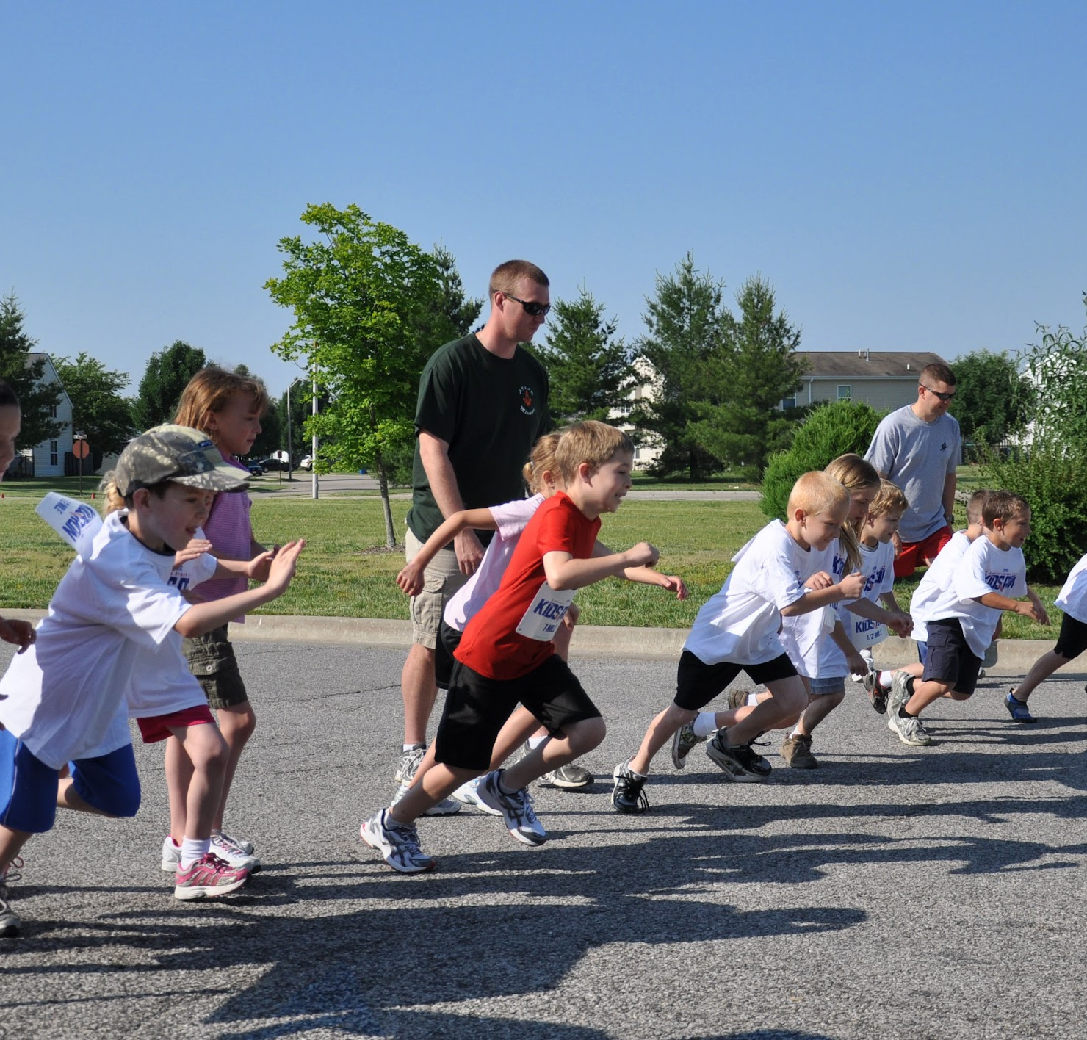
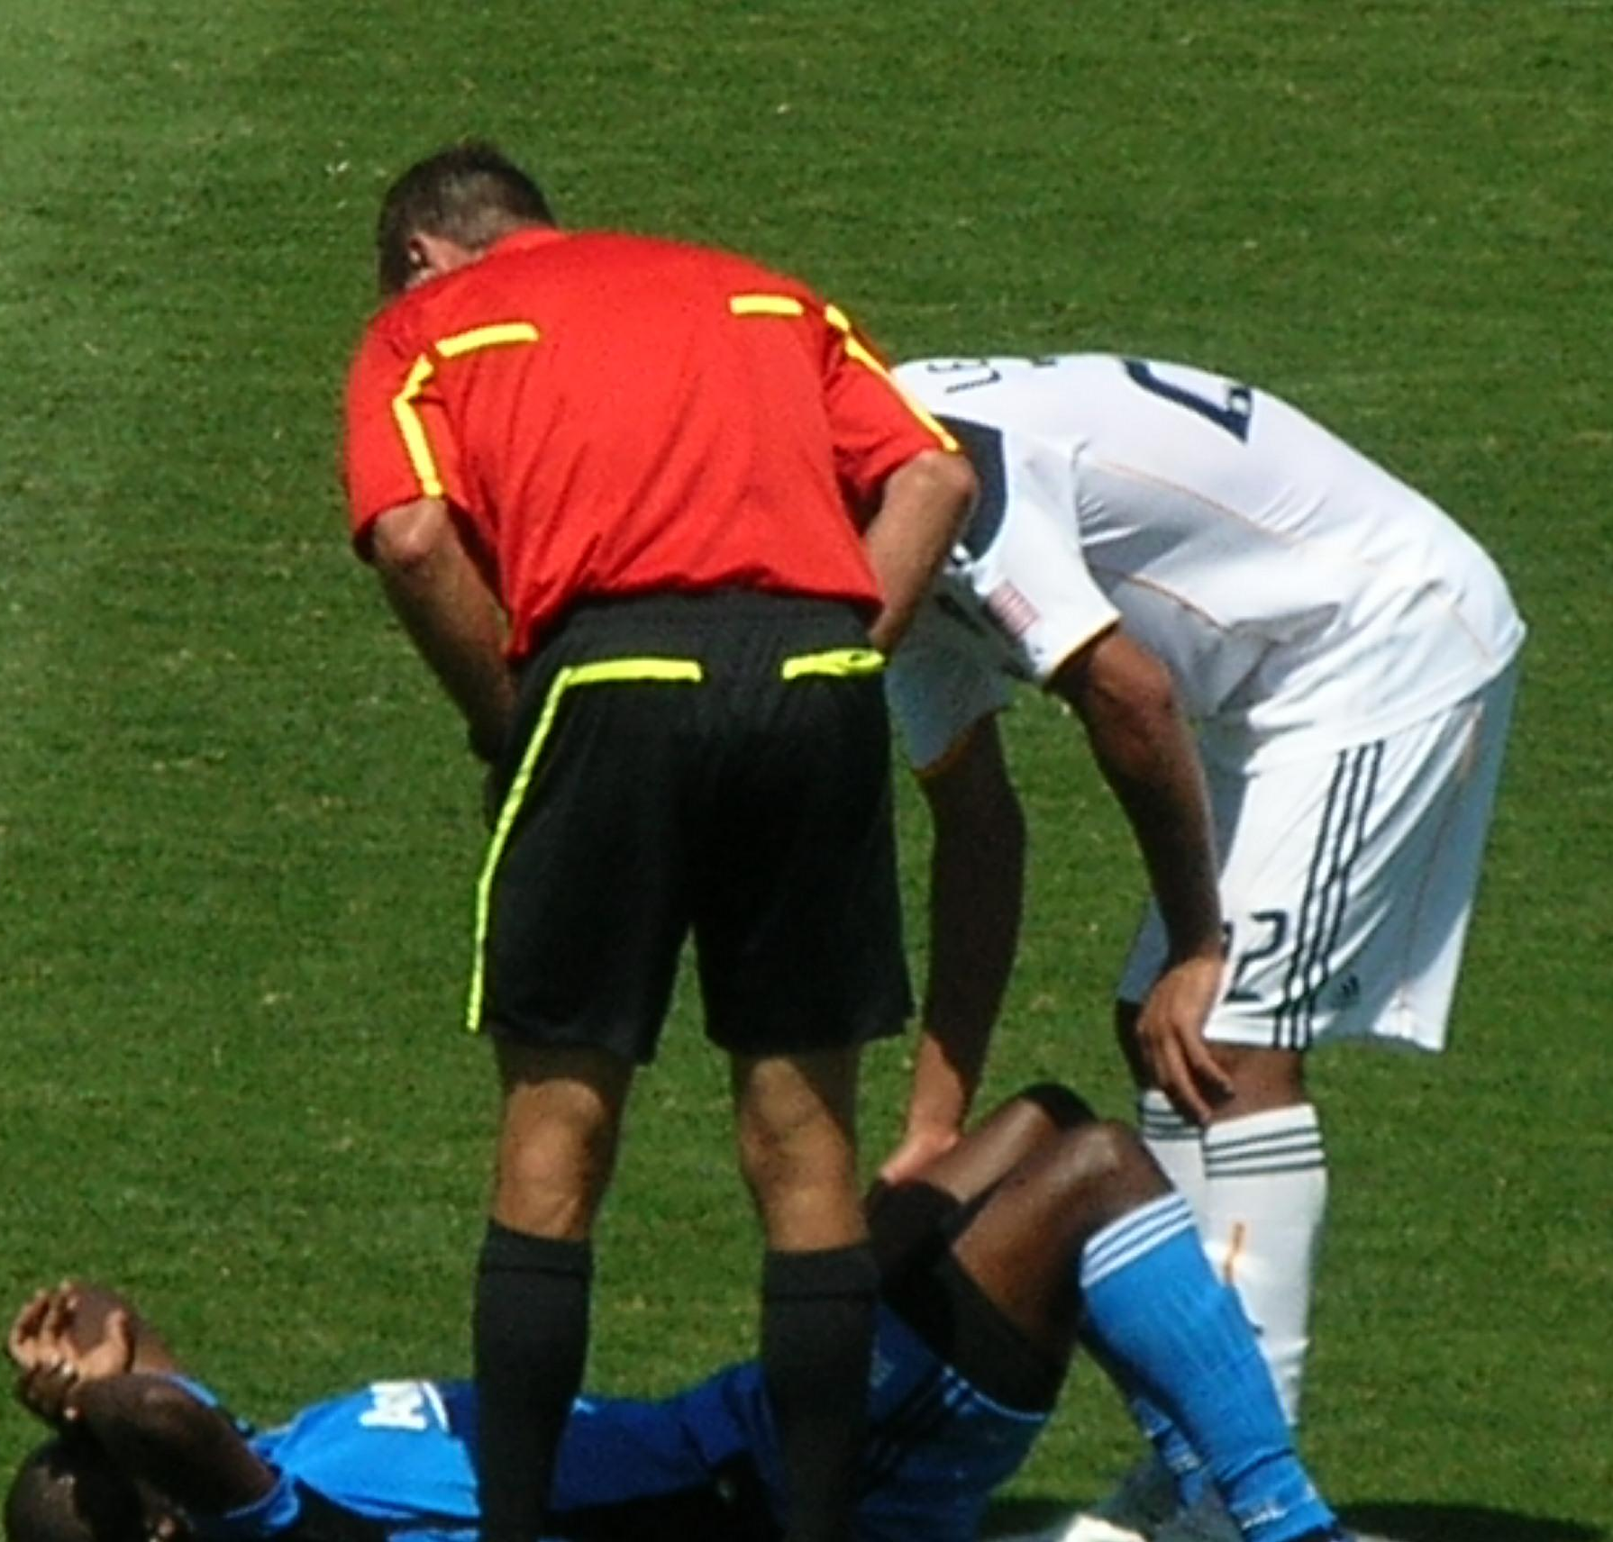
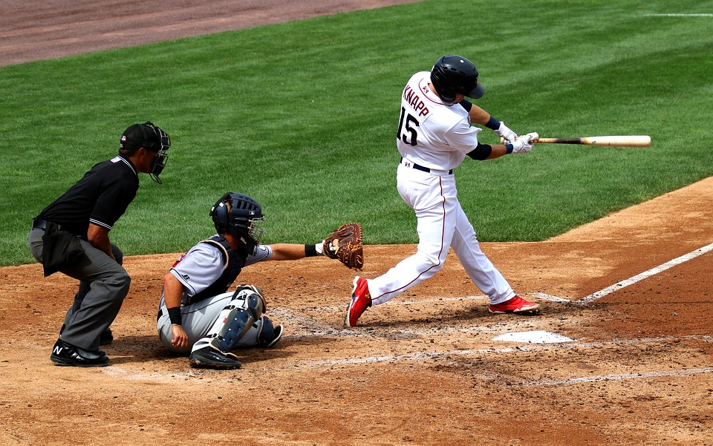
Who are you training?
Training Age
Sport
Injury History

Slide 6
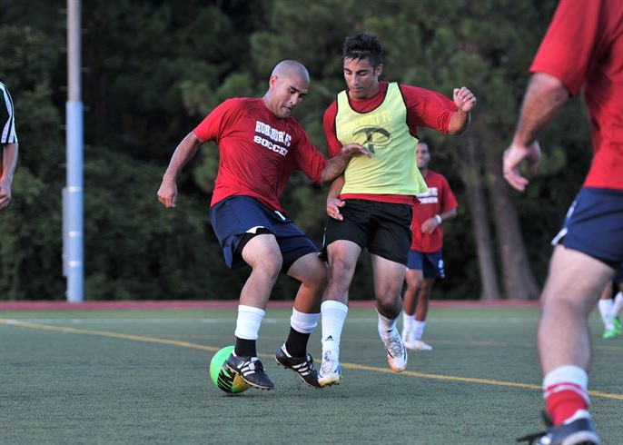
When are you training?
Before Practice
After Practice
Before School
In Season / Off Season
How many week?

Slide 7
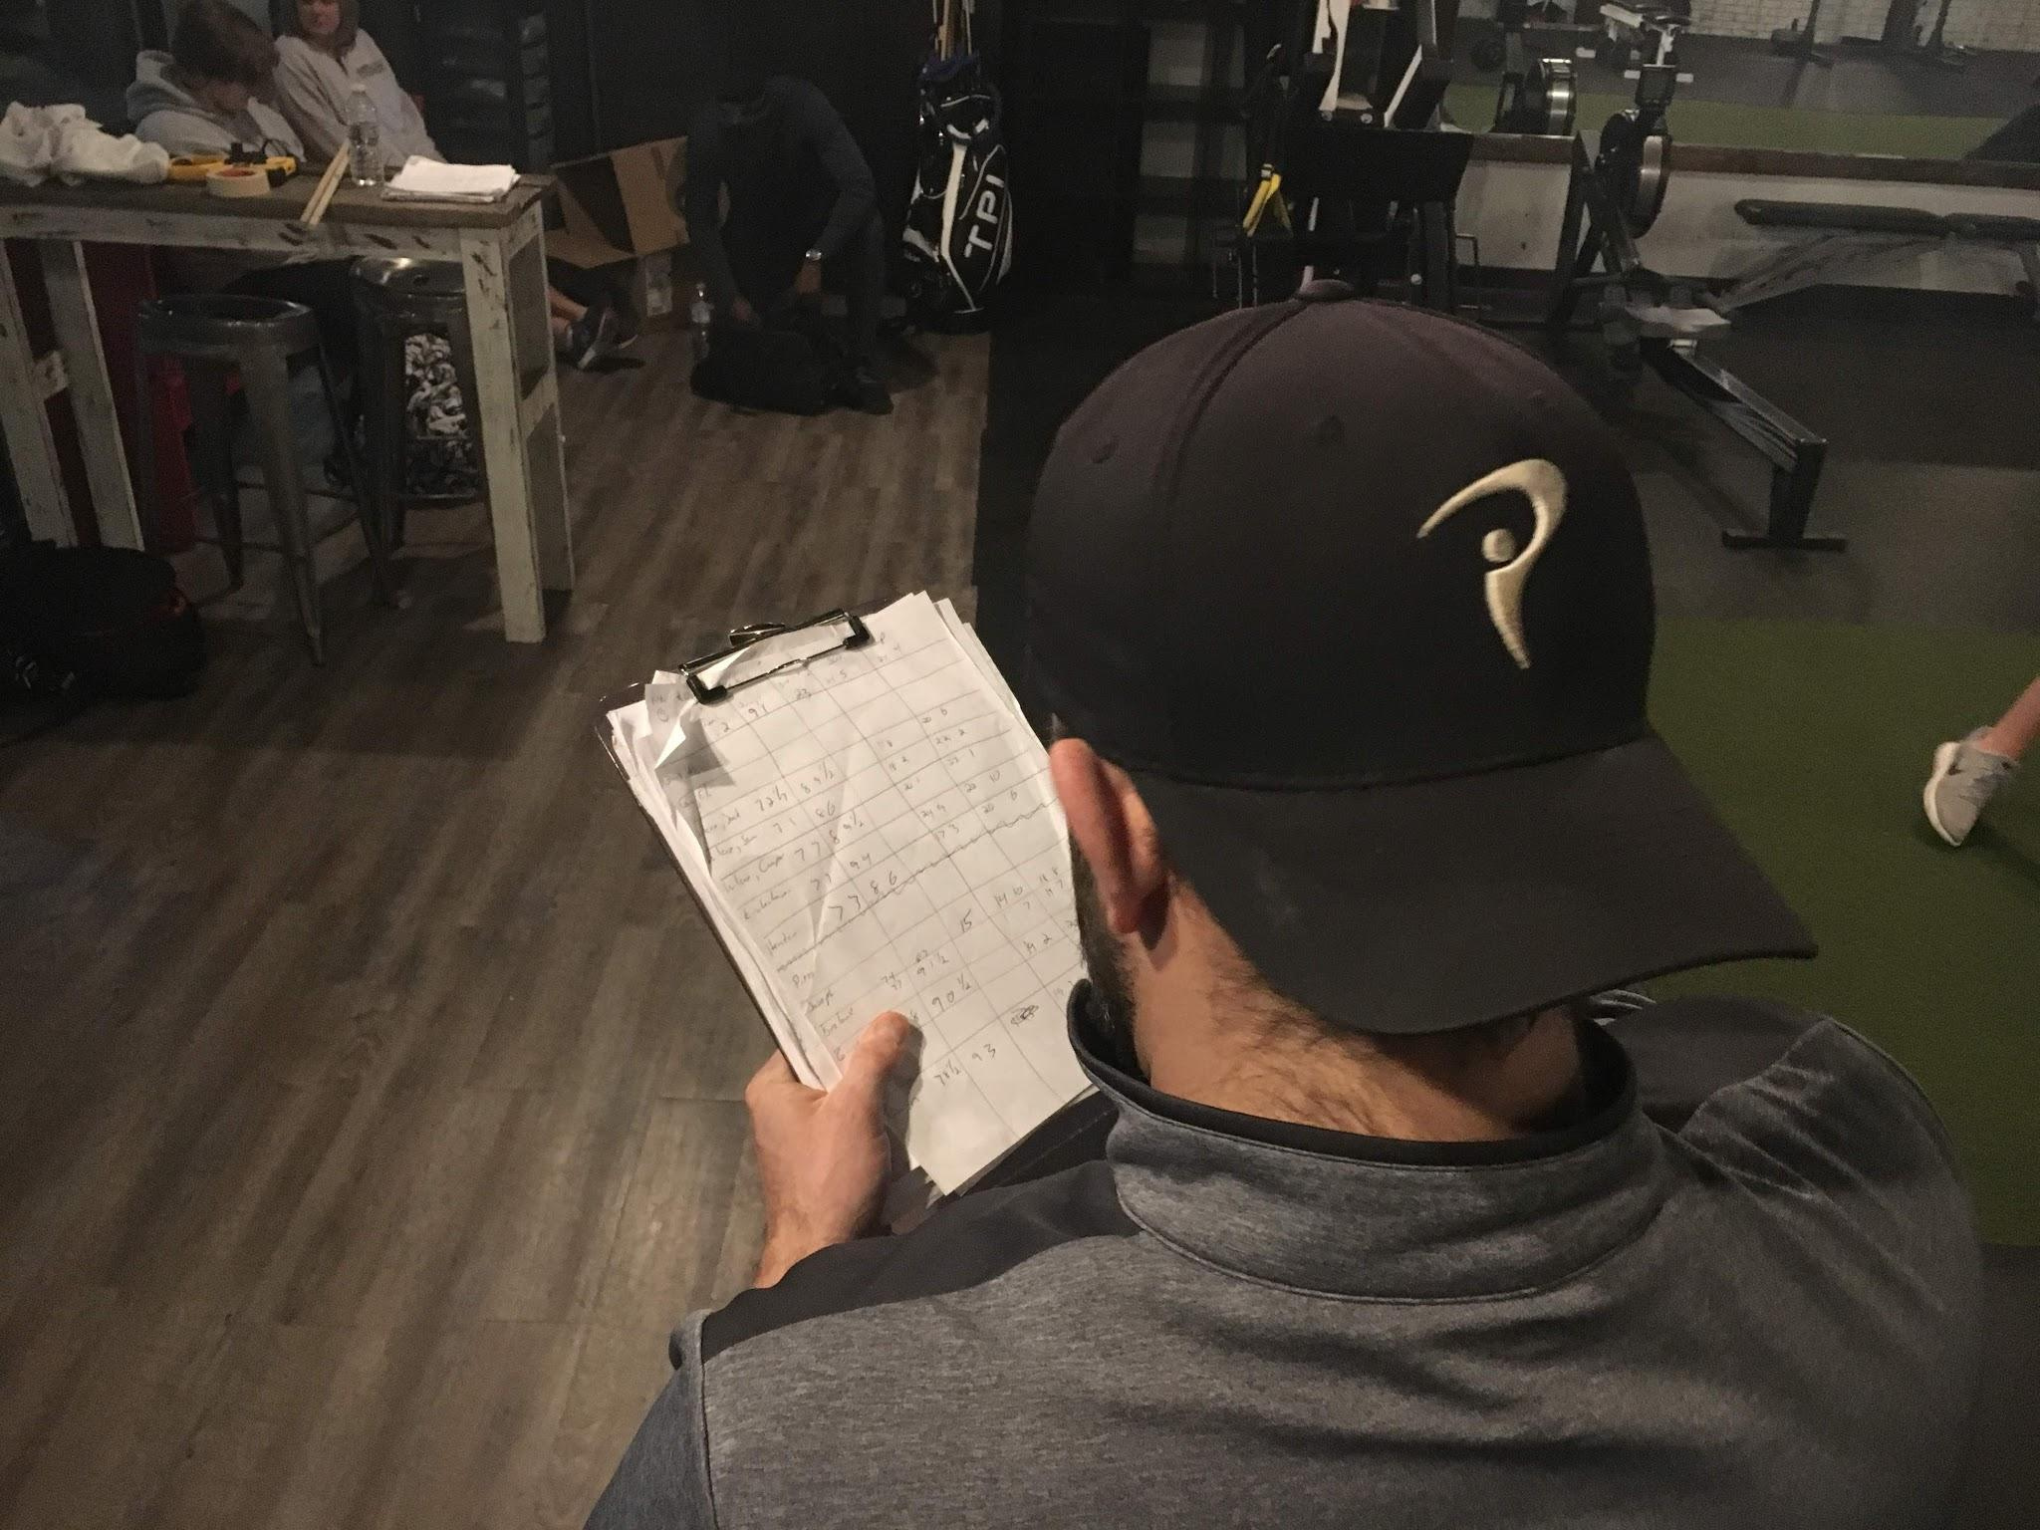
What are your goals?
Individual
Team
Needs Analysis
Speed
Strength

Slide 8

Why are you doing it?
Does it achieve goal
Does it work
Risk/Reward

Slide 9
In order for performance enhancements to occur, the body must be forced to adapt to a greater stress than it has previously experienced.
Progressive Overload

Slide 10
The daily, weekly, monthly and yearly design of a weight training program. Linear refers to the fact that the program follows a normal trajectory without fluctuating up and down.
Linear Periodization

Slide 11
Week 1 - 3x12
Week 2 - 3x10
Week 3 - 3x8
Week 4 - 3x6
Linear Periodization

Slide 12
Short Term (8 Weeks) due to Neural Adaptations
Neural Adaptations Include:
-Improved Motor Unit Firing
-Improved Ability to Recruit Motor Units
The exercises you choose aren’t that important if you don’t do them consistently over time
Strength Adaptations

Slide 13
2- 3 Days Week
Year Round -1 Day Week can maintain strength gains for over 8 Weeks
Weight Room for Strength and Power
Sprint for Speed
Recommendations

Slide 14
Supersets
Circuits
Maximize Time and Efficiency
Recommendations

Slide 15
Technique First
Don’t Chase Numbers
Train Movement not muscle
Sports Performance not Weightlifters
Build Foundation
Consistency
Reccomendations

Slide 16
Strength and Conditioning 101
Power
Push
Pull
Squat
Hinge
Carry
Rotate
Anti Rotate
KISS

Slide 17
Strength and Conditioning 101
Power - Squat Jump
Push - Pushup
Pull - Pullup
Squat - Lunge
Hinge - Single Leg RDL
Carry - Farmers Carries
Rotate - Seated Twist
Anti Rotate - Plank
Basic

Slide 18
Strength and Conditioning 101
Power - Power Clean
Push - Bench Press
Pull - Bent Over Row
Squat - Back Squat
Hinge - Barbell RDL
Carry - Farmers Carries
Rotate - MB Toss
Anti Rotate - Around the World
Advanced

Slide 19
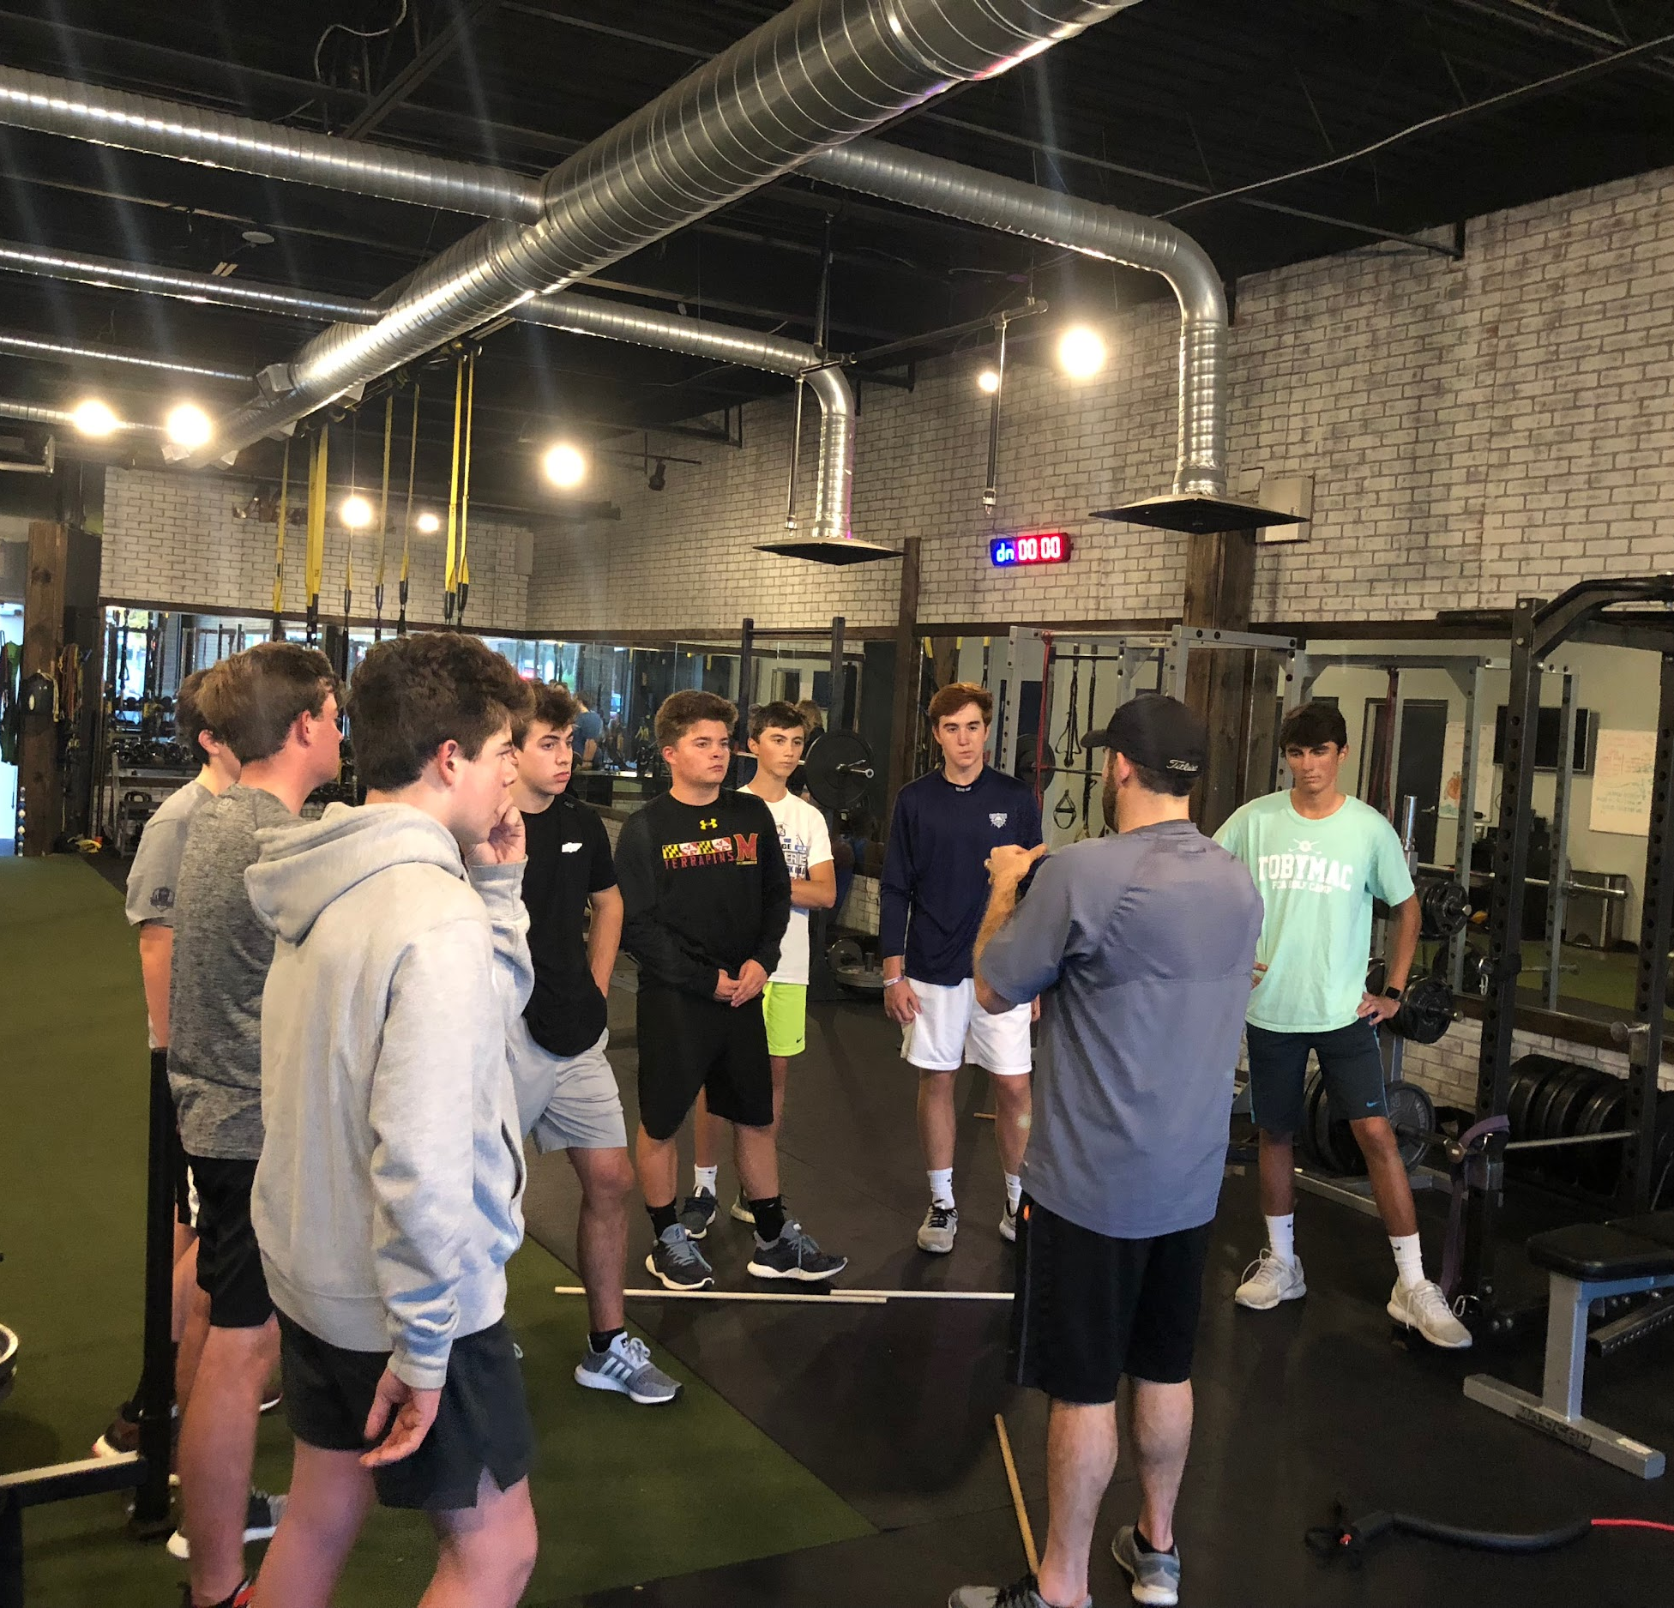
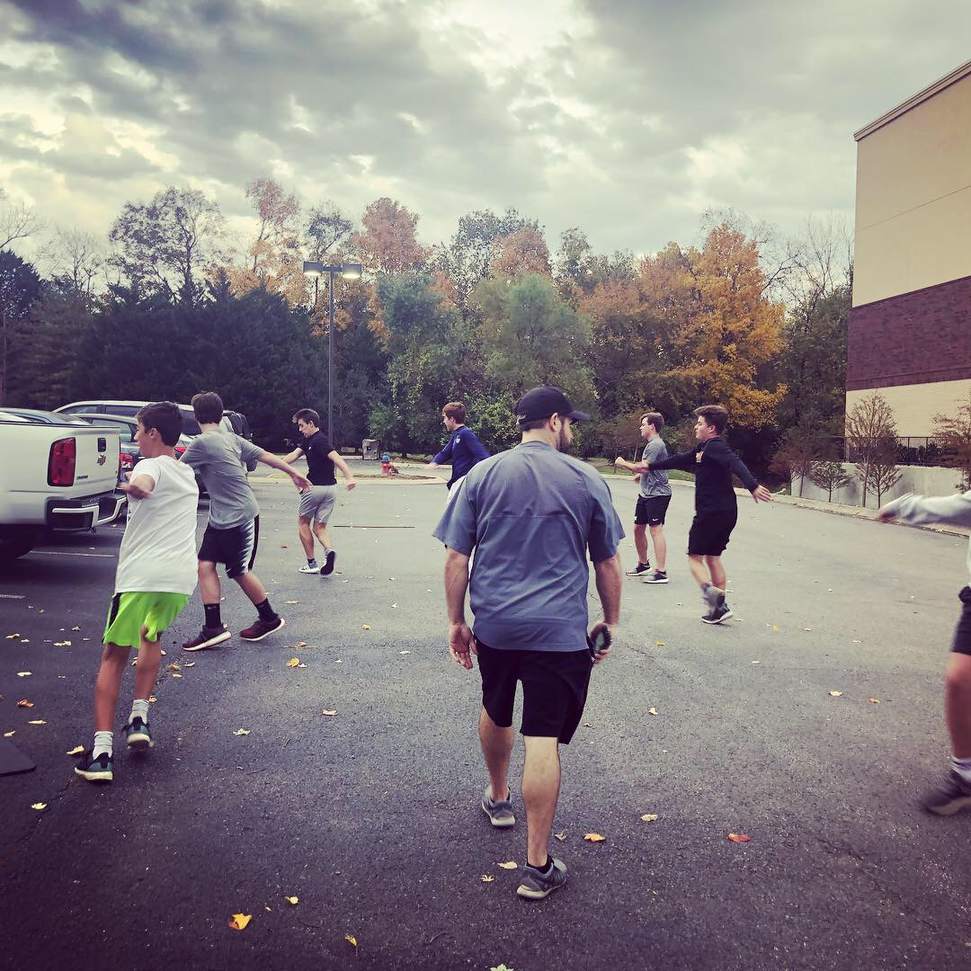
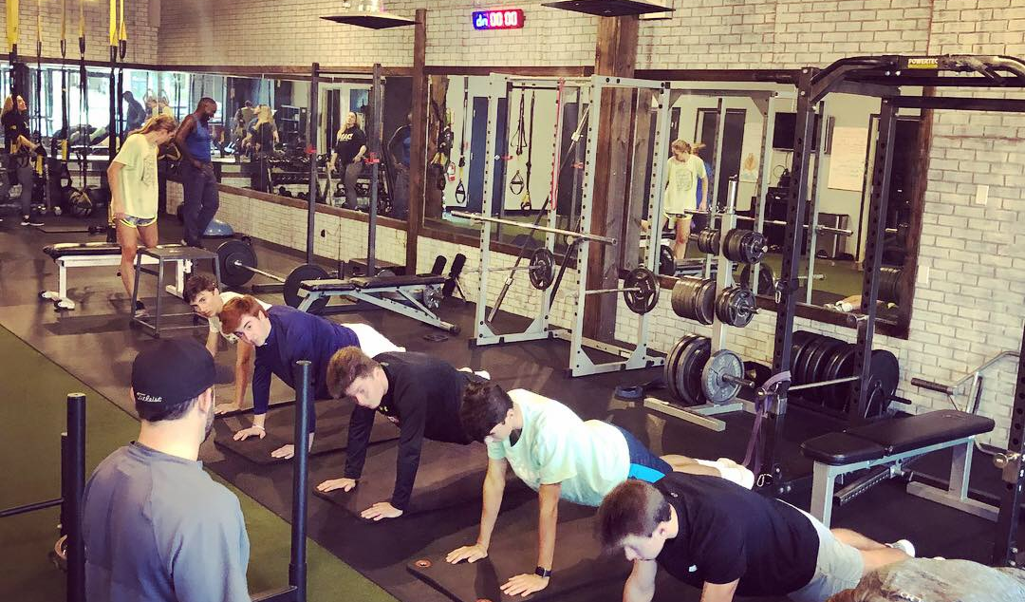
Workout Organization
Warmup
Core/Mobility/Movement Prep
Power Exercises (also speed)
Core (Major Multi-Joint) Exercises
Accessory Exercises
Conditioning

Slide 20
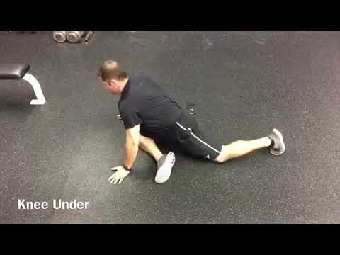
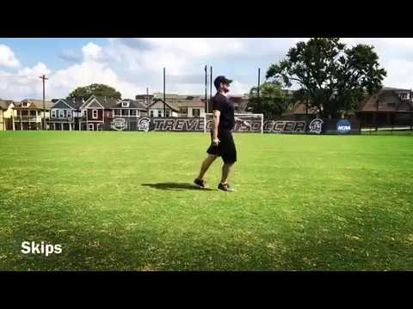
Workout
Organization
Dynamic Warmup
Straight Leg Kicks
Bent Knee Kicks
Roll and Reach
Spiderman - Elbow Down - Rotate
Knee Under
Arm Across - Front
Arm Across - Side
Reachbacks
Flex Warmup
Skips
Toe Sweep - 3rd
Knee Hug / RDL - 3rd
Lunge and Reach - 3rd
Straight Leg Kick - 3rd
Lateral Lunge Front/Back - 3rd
Straight Leg Skip
Skips for Height
Dynamic Warmup

Slide 21
Workout
Organization
Core
Plank
Side Plank
Pallof Holds
Chop/Lift
Seated Twist
Bicycles
Glute Work
Dead Bugs
Mobility
Inchworms
Hip Mobility
Foam Roller
Shoulder Rotations
Segmentations
Reverse Toe Touch
Goblet Squats
2. Core/Mobility/Movement
Movement
Crawls - Rolls - Three Way Lunge
Hops - Quick Ladder - Plyos

Slide 22
Workout
Organization
Power Exercises
Olympic Lifts
Jumps
Sprinting
Cleans
Snatch
Squat Jumps
3. Power Exercises

Slide 23
Workout
Organization
Core Multi-Joint Exercises
Bench Press
Squat
RDL
Deadlift
Front Squat
Pullups
4. Core Multi-Joint Exercises

Slide 24
Workout
Organization
Accessory Exercises
Shoulder Raises
Lunges
DB Work
Curls
Band Work
Triceps Pressdown
Machines
5. Accessory Exercises

Slide 25
Workout
Organization
Conditioning
110’s
Gassers
Shuttle Runs
Poles
Intervals
HIIT
6. Conditioning

Slide 26
Program Design

Slide 27
Splits
2 day/week --- Full Body
3 Day/week --- Full Body
3 Day/week --- Upper/Lower/Full
4 Day/week --- Upper/Lower Split
3 or 4 Day - Upper Push/Lower Pull Split
Program Design

Slide 28
2 Day Split
Day 1
Warmup
Squat Jumps 3x5
Pushups 3x10
Pullups 3x10
Squats 3x10
RDL 3x10
Curls 3x10
Tri Pressdown 3x10
Day 2
Warmup
Squat Jumps 3x5
Bench Press 3x10
One Arm Row 3x10
Lunges 3x10
SLRDL 3x10
3 Way Shoulder 3x10
Tri Extension 3x10
Full Body

Slide 29
3 Day Split
Day 1
Warmup
Squat Jumps 3x5
Pushups 3x10
Pullups 3x10
Squats 3x10
RDL 3x10
Curls 3x10
Tri Pressdown 3x10
Day 2
Warmup
Squat Jumps 3x5
Bench Press 3x10
One Arm Row 3x10
Lunges 3x10
SLRDL 3x10
3 Way Shoulder 3x10
Tri Extension 3x10
Day 3
Warmup
Squat Jumps 3x5
Bench Press 3x10
One Arm Row 3x10
Lunges 3x10
SLRDL 3x10
3 Way Shoulder 3x10
Tri Extension 3x10
Full Body

Slide 30
3 Day Split
Day 1
Warmup
Pushups 3x10
Pullups 3x10
Sh Press 3x10
Facepull 3x10
Curls 3x10
Tri Pressdown 3x10
Day 2
Warmup
Squat Jumps 3x5
Squat 3x10
Lunges 3x10
SLRDL 3x10
Lateral Lunge 3x10
DB Glute Bridge 3x10
Day 3
Warmup
Squat Jumps 3x5
Bench Press 3x10
One Arm Row 3x10
Lunges 3x10
SLRDL 3x10
3 Way Shoulder 3x10
Tri Extension 3x10
Upper/Lower/Full

Slide 31
4 Day Split
Day 1/3
Warmup
Pushups 3x10
Pullups 3x10
Sh Press 3x10
Facepull 3x10
Curls 3x10
Tri Pressdown 3x10
Day 2/4
Warmup
Squat Jumps 3x5
Squat 3x10
Lunges 3x10
SLRDL 3x10
Lateral Lunge 3x10
DB Glute Bridge 3x10
Upper/Lower

Slide 32
4 Day Split
Day 1/3
Warmup
Pushups 3x10
RDL 3x10
Sh Press 3x10
SLRDL 3x10
Tri Pressdown 3x10
DB Glute Bridge 3x10
Day 2/4
Warmup
Squat Jumps 3x5
Squat 3x10
Pullups 3x10
Lunges 3x10
One Arm Row 3x10
Facepull 3x10
Curls 3x10
Upper Anterior / Lower Posterior
Upper Posterior / Lower Anterior

Slide 33
Program Design
Post Season
Off Season
Pre Season
In Season
Cycles

Slide 34
Program Design
Post Season - Active Recovery(endurance/technique)
Off Season - Hypertrophy/Strength
Pre Season - Strength/Power
In Season - Strength
Maintenance
Cycles

Slide 35
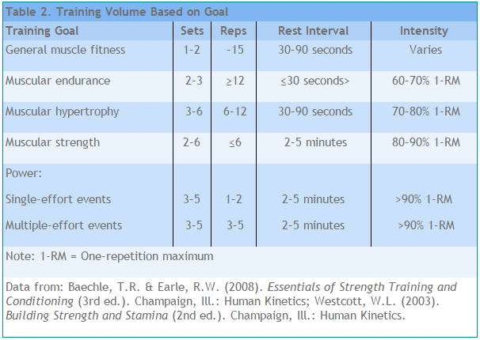
Prosign
Load Chart

Slide 36
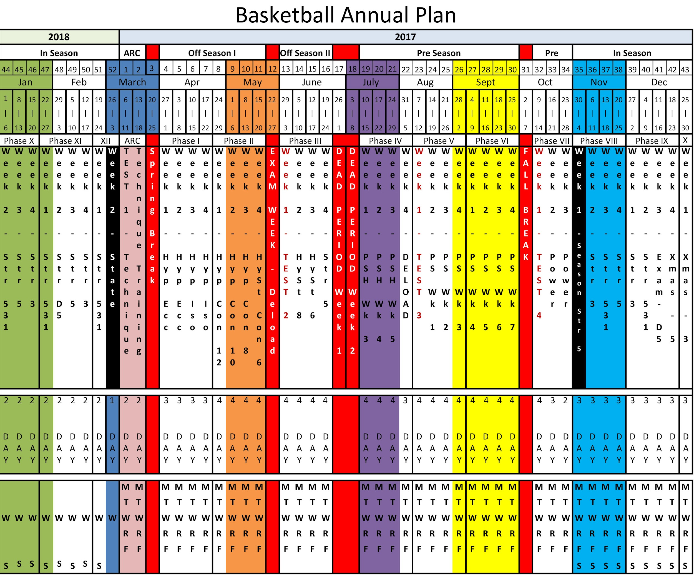
Program Design
Annual Plan

Slide 38
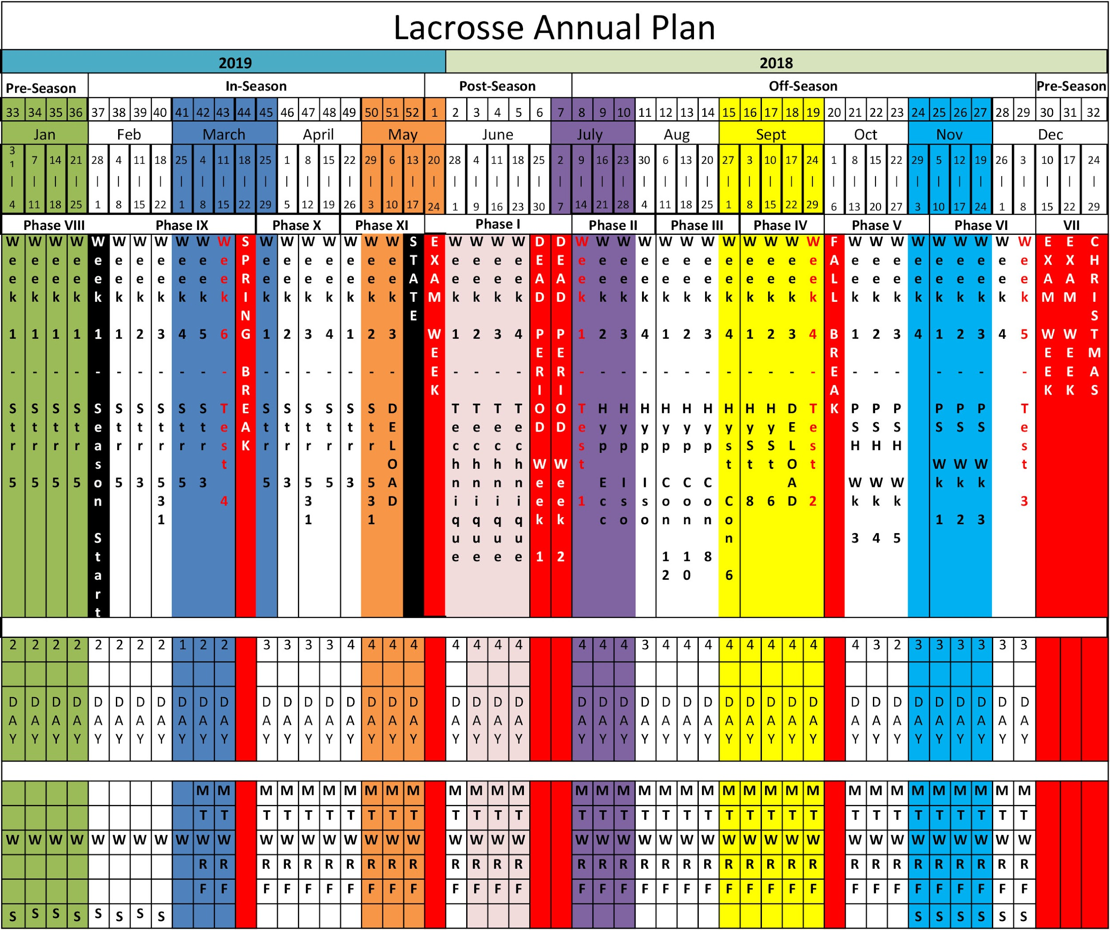

Slide 39
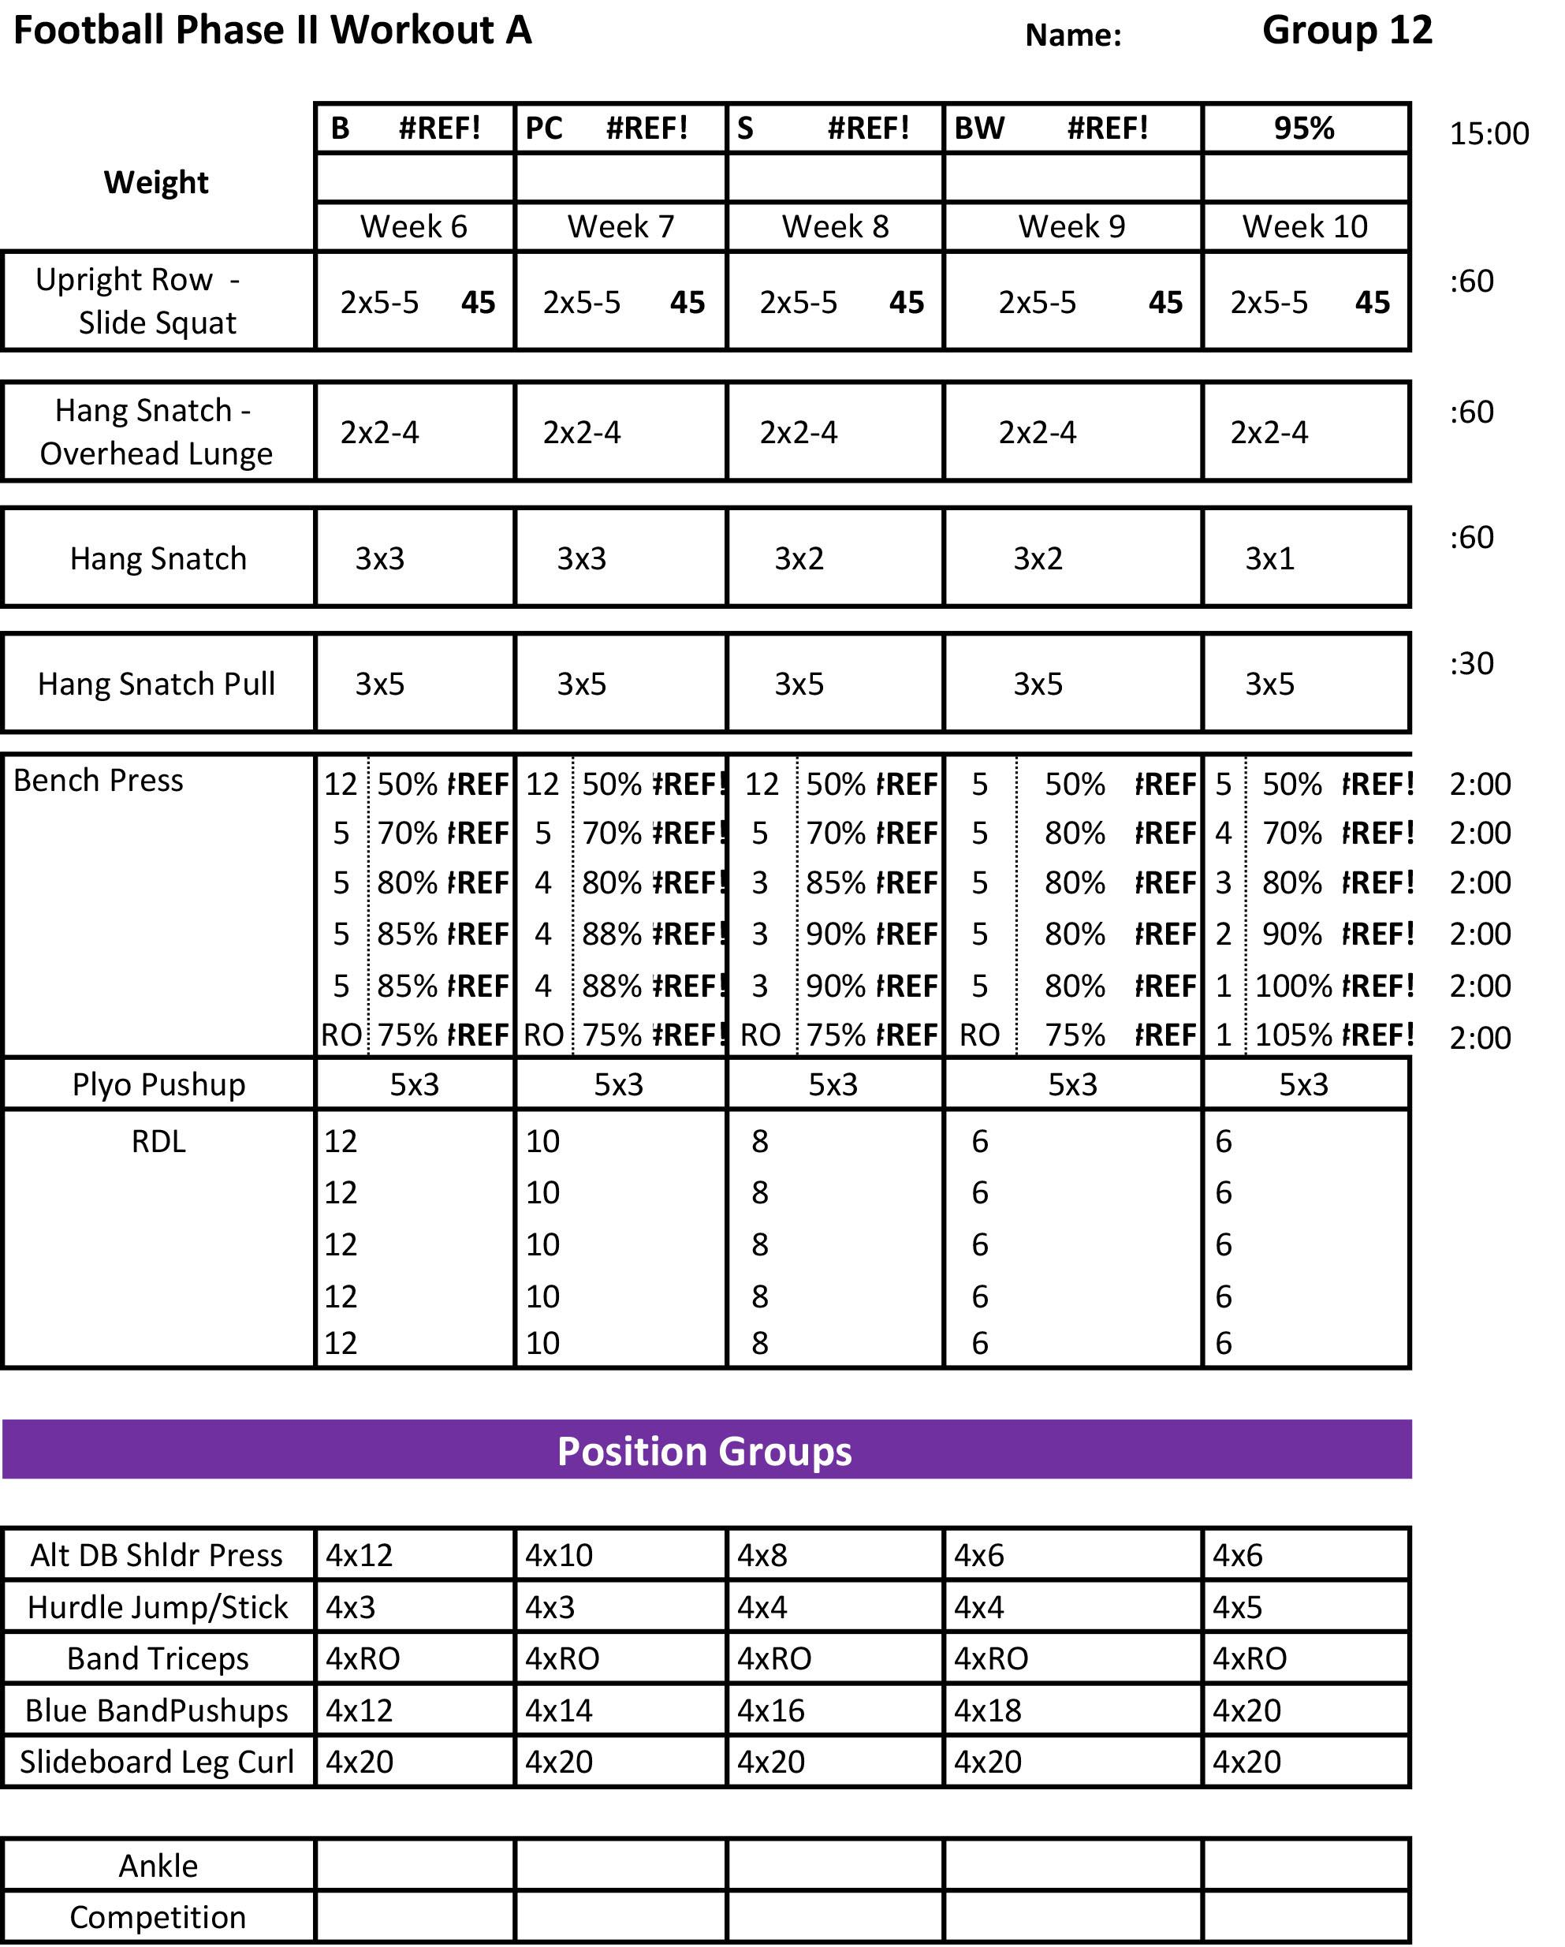

Slide 40
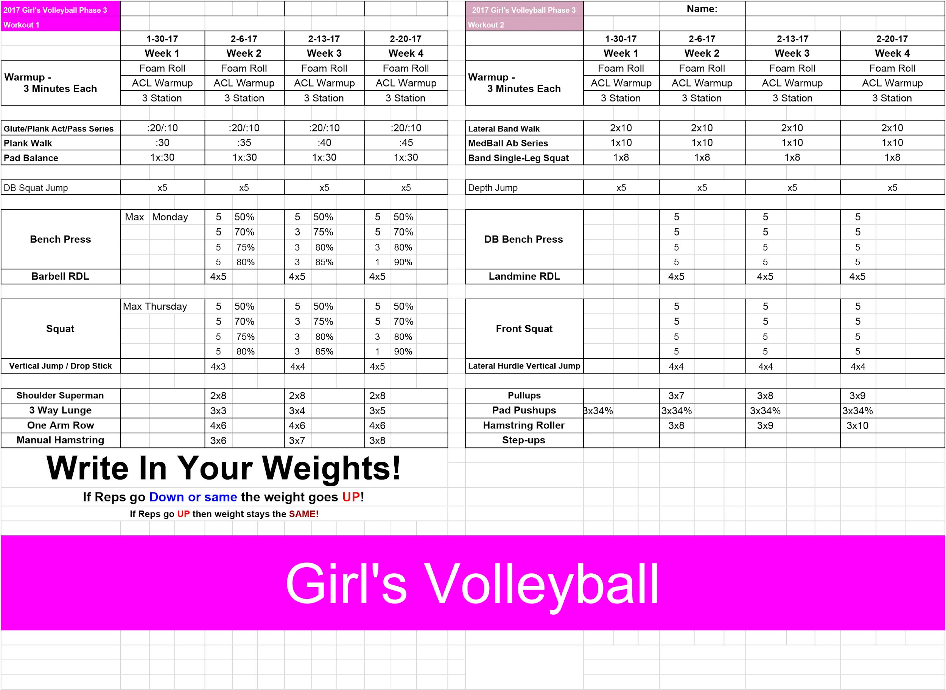

Slide 41
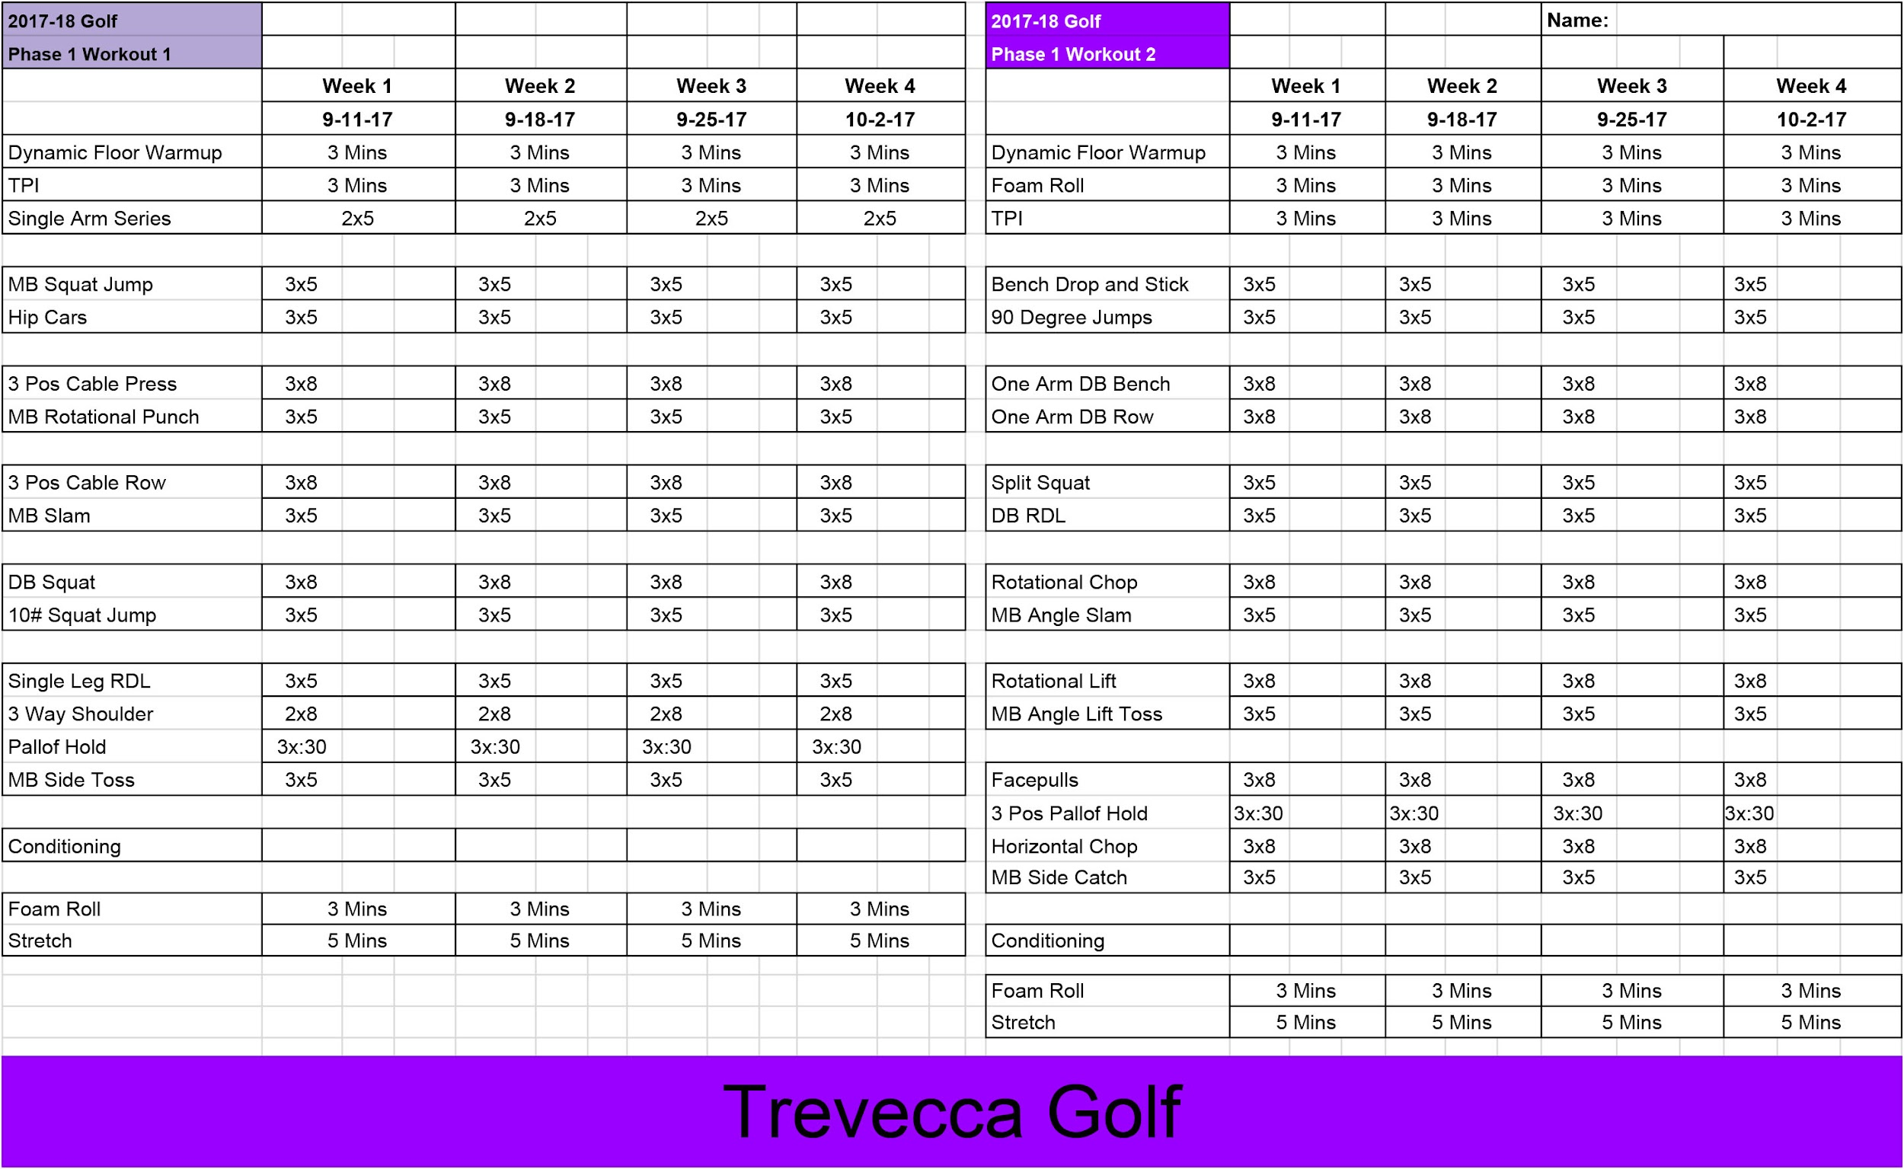

Slide 42
Coach Mike Wilson
615-293-4726
coachwilson@bellsouth.net
www.coachmikewilson.com
Thank You

