Slide 1
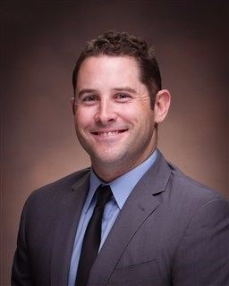

Training the Individuality of Golf in a Team Setting
Mike Wilson, MS, CSCS, TPI
615-293-4726
Coachwilson@bellsouth.net
@coachmikewilson

Slide 2
LEARNING OBJECTIVES
Understanding the movement needs for the golf athlete
Mastery of testing and evaluation procedures for the five areas of influence
Exercise prescription for immediate improvement
Implementation of individualized movements during a team workout
Combining mobility and stability needs with a strength and power workout

Slide 3
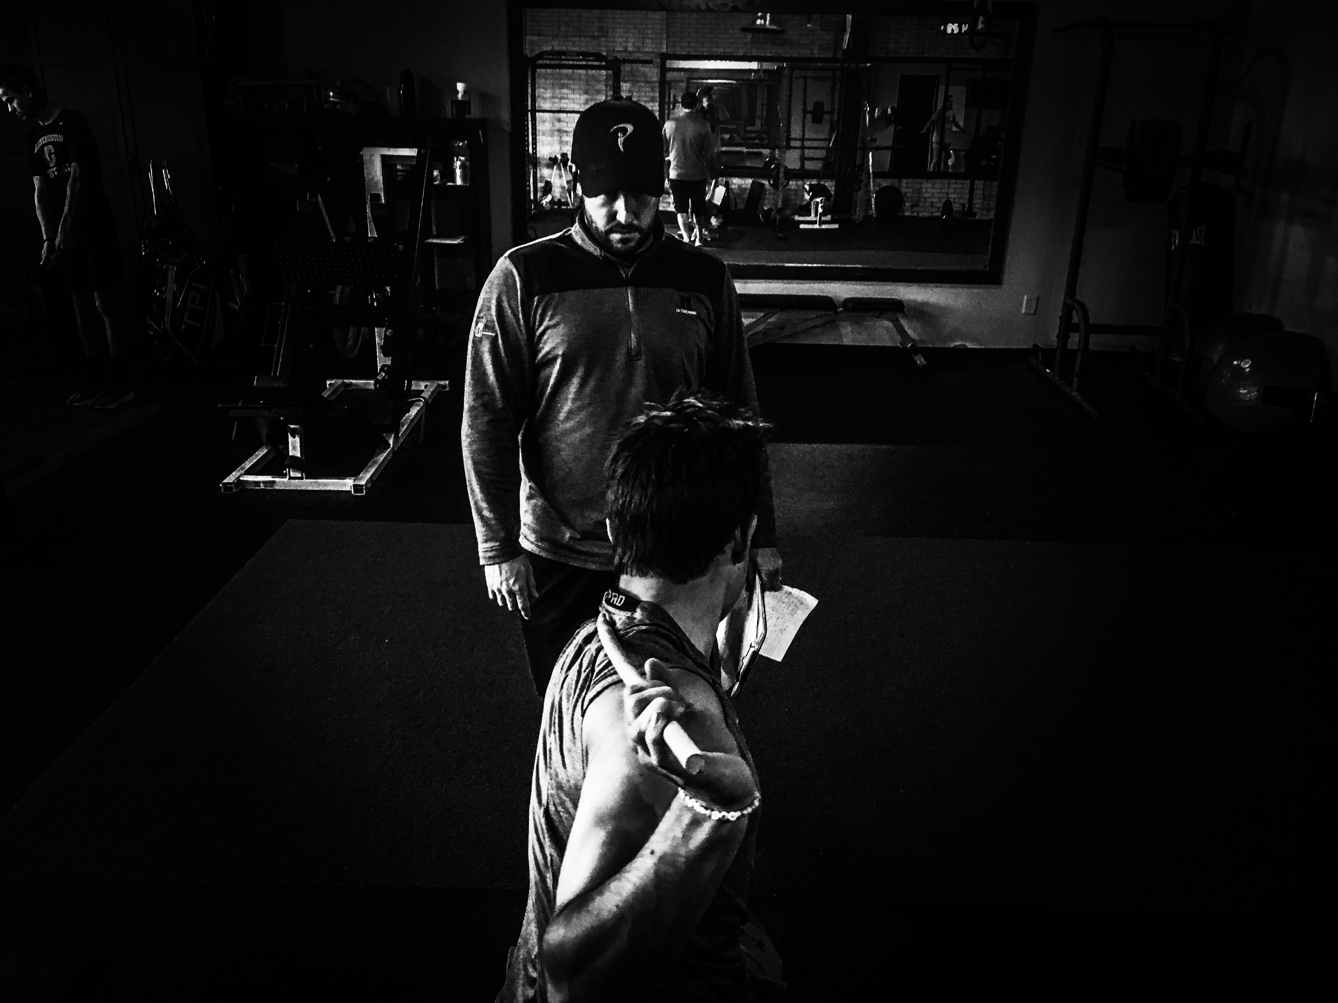
5 PRIMARY AREAS OF EVALUATION
1. Upper Lower Separation
2. Internal Hip Mobility
3. Thoracic Mobility
4. Hip Hinge (Toe Touch)
5. External Shoulder Rotation

Slide 4
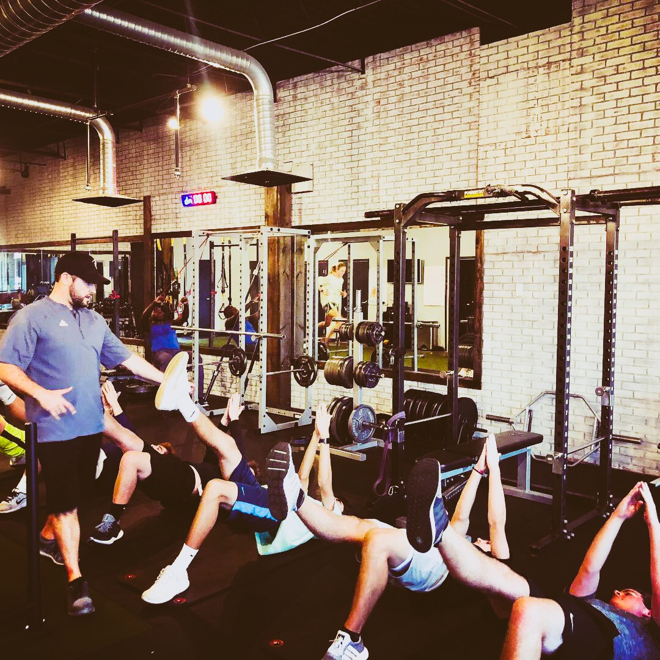
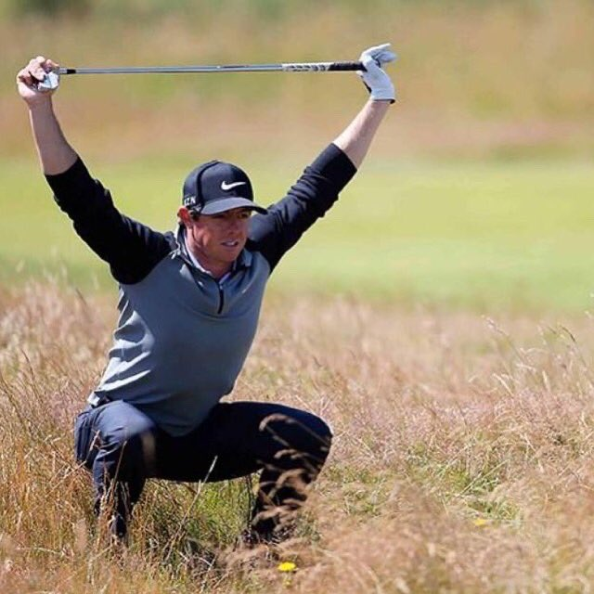
Program Design
1. Warmup
2. Extended Warmup (TPI Mobility)
3. Glute
4. Power
5. Push
6. Pull
7. Squat
8. Hinge
9. Core (Rotation & Anti-Rotation)
10. Conditioning

Slide 5
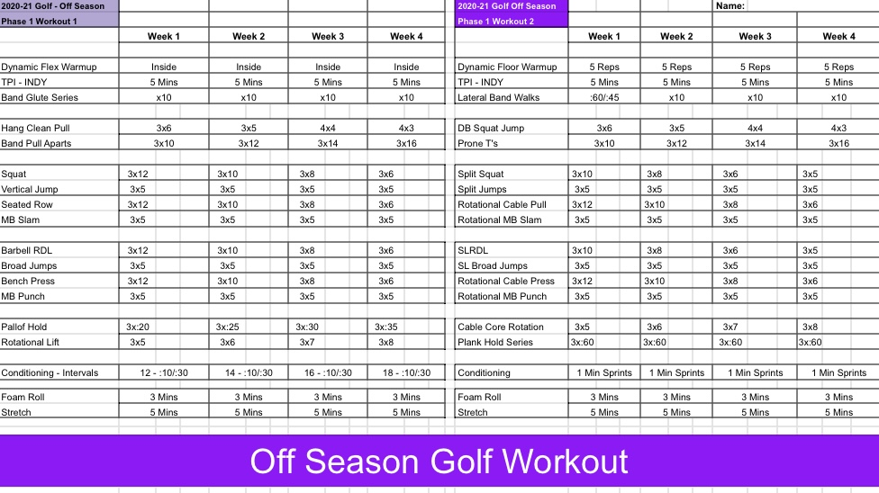
Program Design

Slide 6
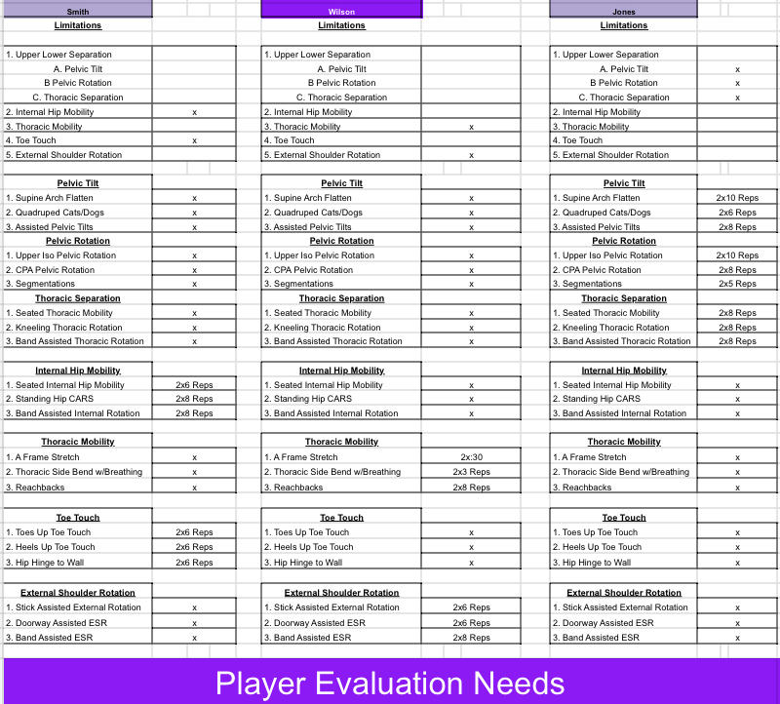
Program Design

Slide 7
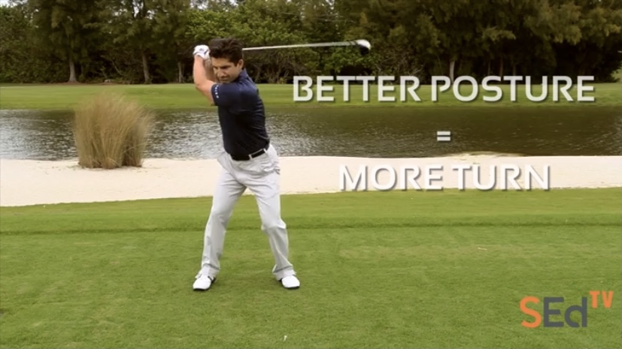
Full Swing
SportsEd TV Full Swing Video
SportsEd TV

Slide 8
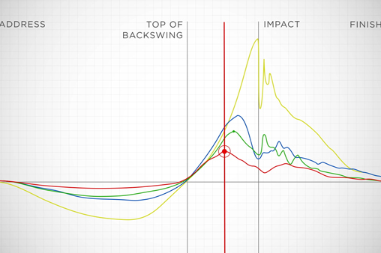
Upper Lower Separation
3 Areas of Separation
Pelvic Tilt
Pelvic Rotation
Thoracic Rotation
Occurs on Acceleration/Deceleration
Kinematic Sequence

Slide 9
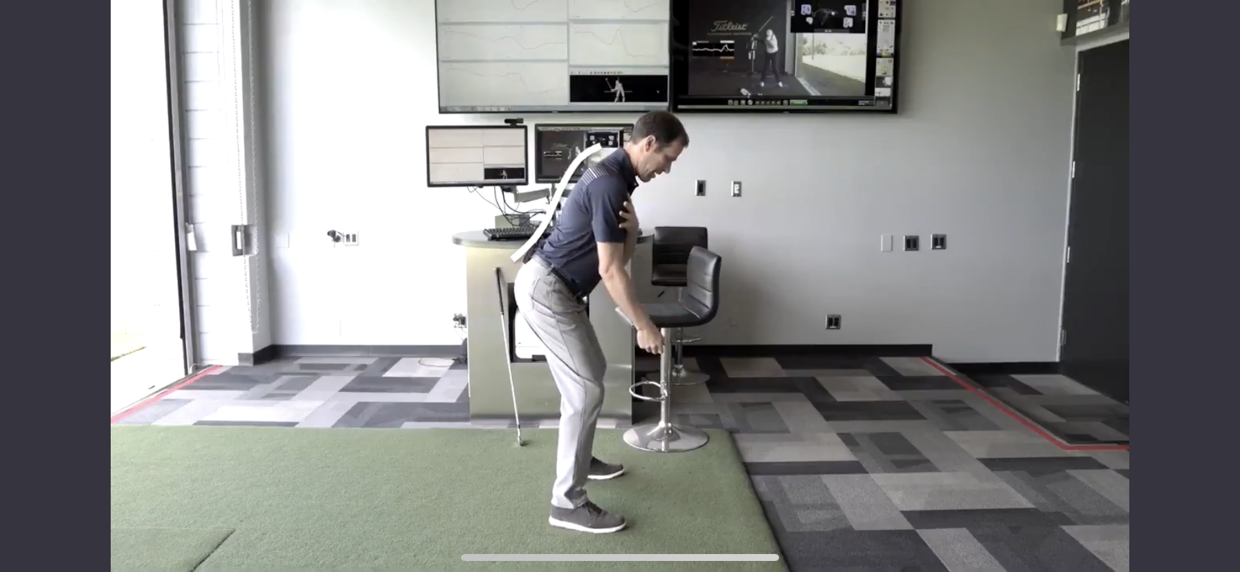

UPPER LOWER SEPARATION
Pelvic Tilt

Slide 10
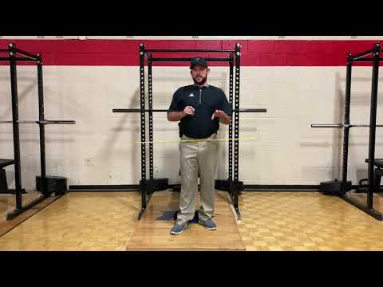
Pelvic Tilt
Assessment

Slide 11
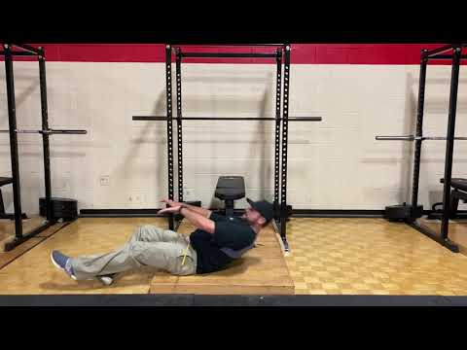
Pelvic Tilt
Supine Arch/Flatten

Slide 12
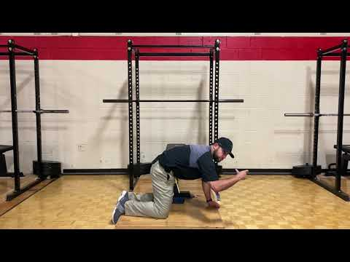
Pelvic Tilt
Quadruped Cats and Dogs

Slide 13
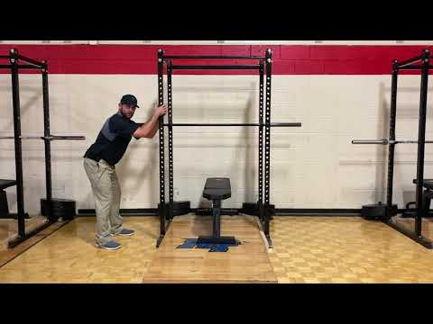
Pelvic Tilt
Assisted Pelvic Tilts

Slide 14
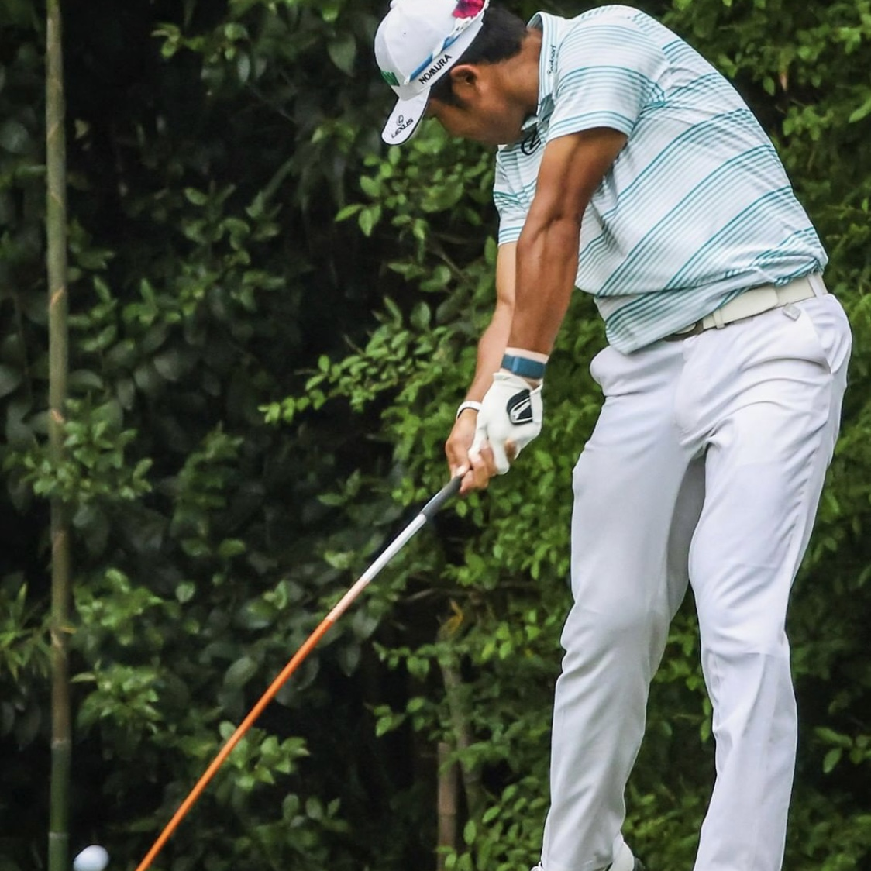
UPPER LOWER SEPARATION
Pelvic Rotation

Slide 15
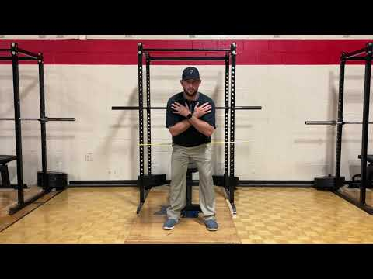
Pelvic Rotation
Assessment

Slide 16
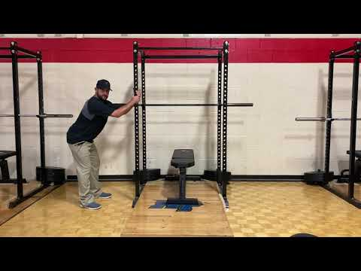
Pelvic Rotation
Upper Iso Pelvic Rotation

Slide 17
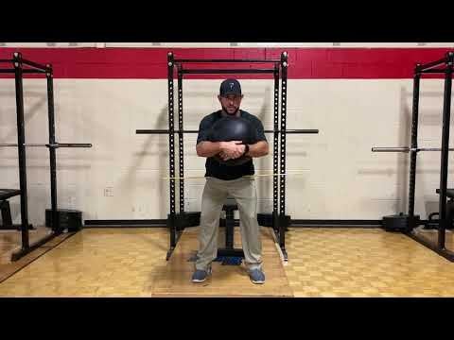
Pelvic Rotation
CPA Pelvic Rotation

Slide 18
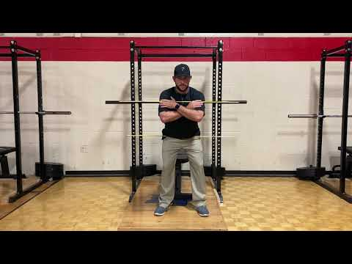
Pelvic Rotation
Segmentations

Slide 19
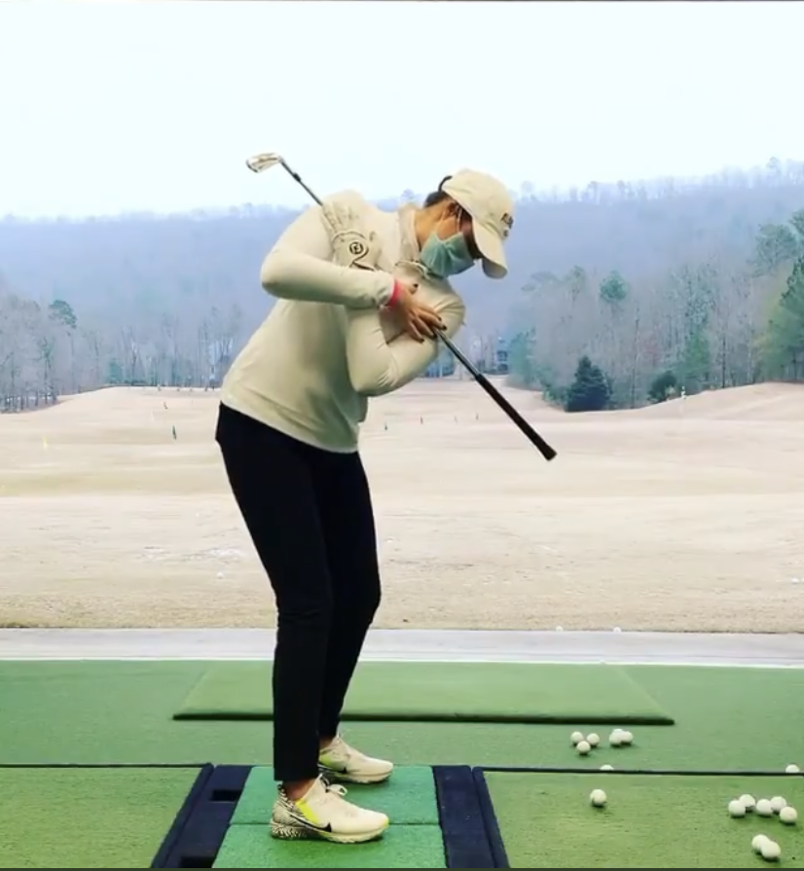
UPPER LOWER SEPARATION
Thoracic Separation

Slide 20
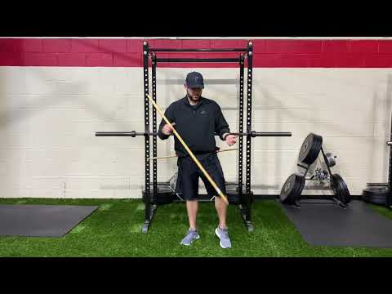
Thoracic Separation
Assessment

Slide 21
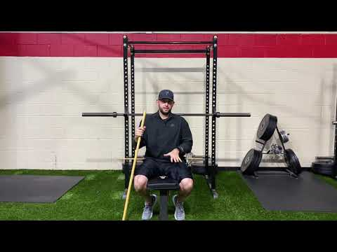
Thoracic Separation
Seated Thoracic Mobility

Slide 22
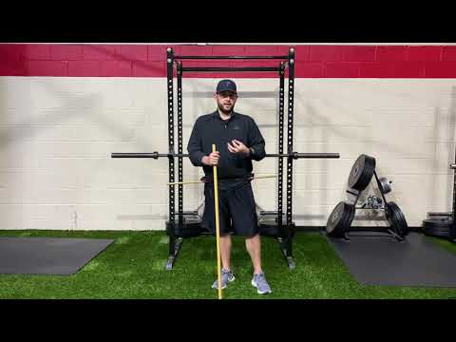
Thoracic Separation
Kneeling Thoracic Rotation

Slide 23
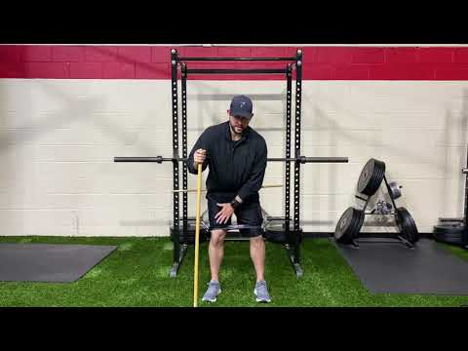
Thoracic Separation
Band Assisted Thoracic Rotation

Slide 24
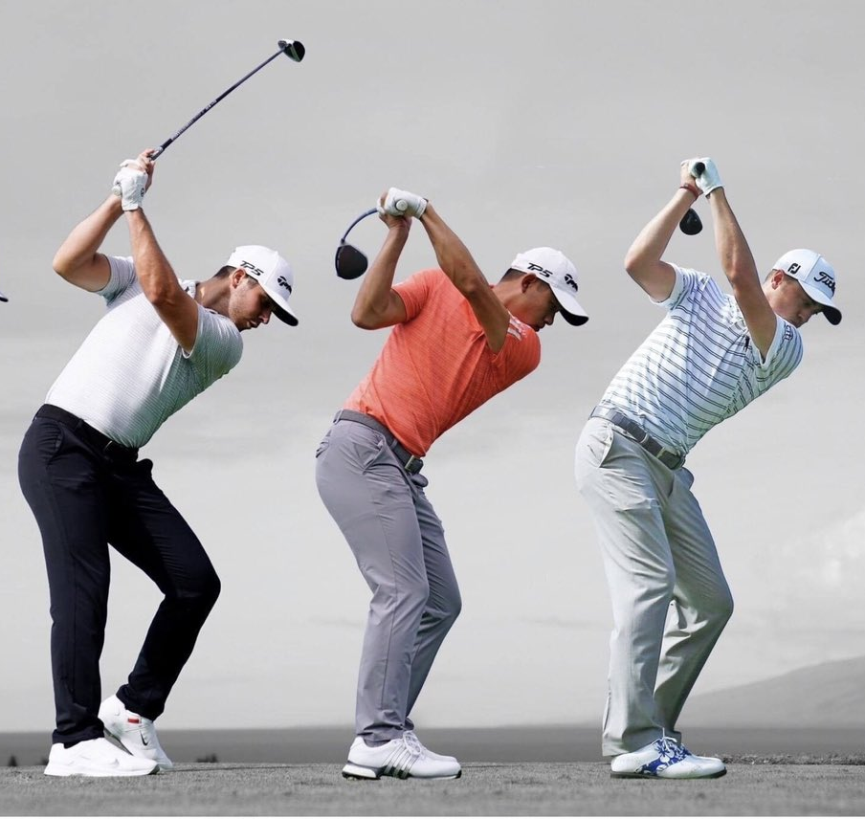
Internal Hip Rotation
Looking for >60 Degrees

Slide 25
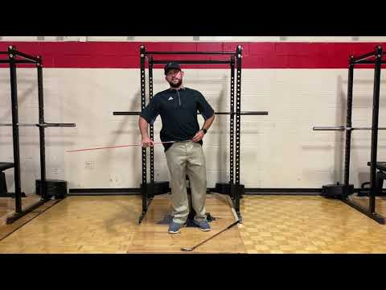
Internal Hip Rotation
Assessment

Slide 26
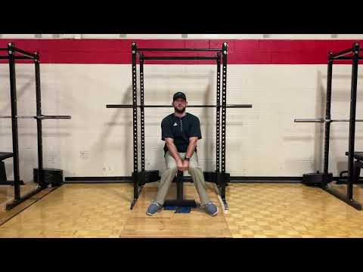
Internal Hip Rotation
Seated Internal Hip Mobility

Slide 27
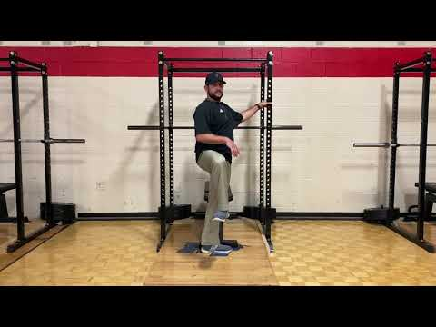
Internal Hip Rotation
Standing Hip CARS

Slide 28
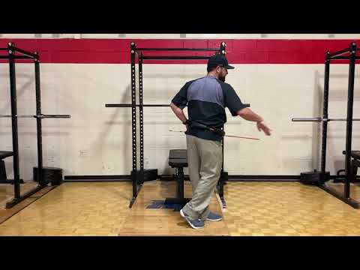
Internal Hip Rotation
Band Assisted Internal Rotation

Slide 29
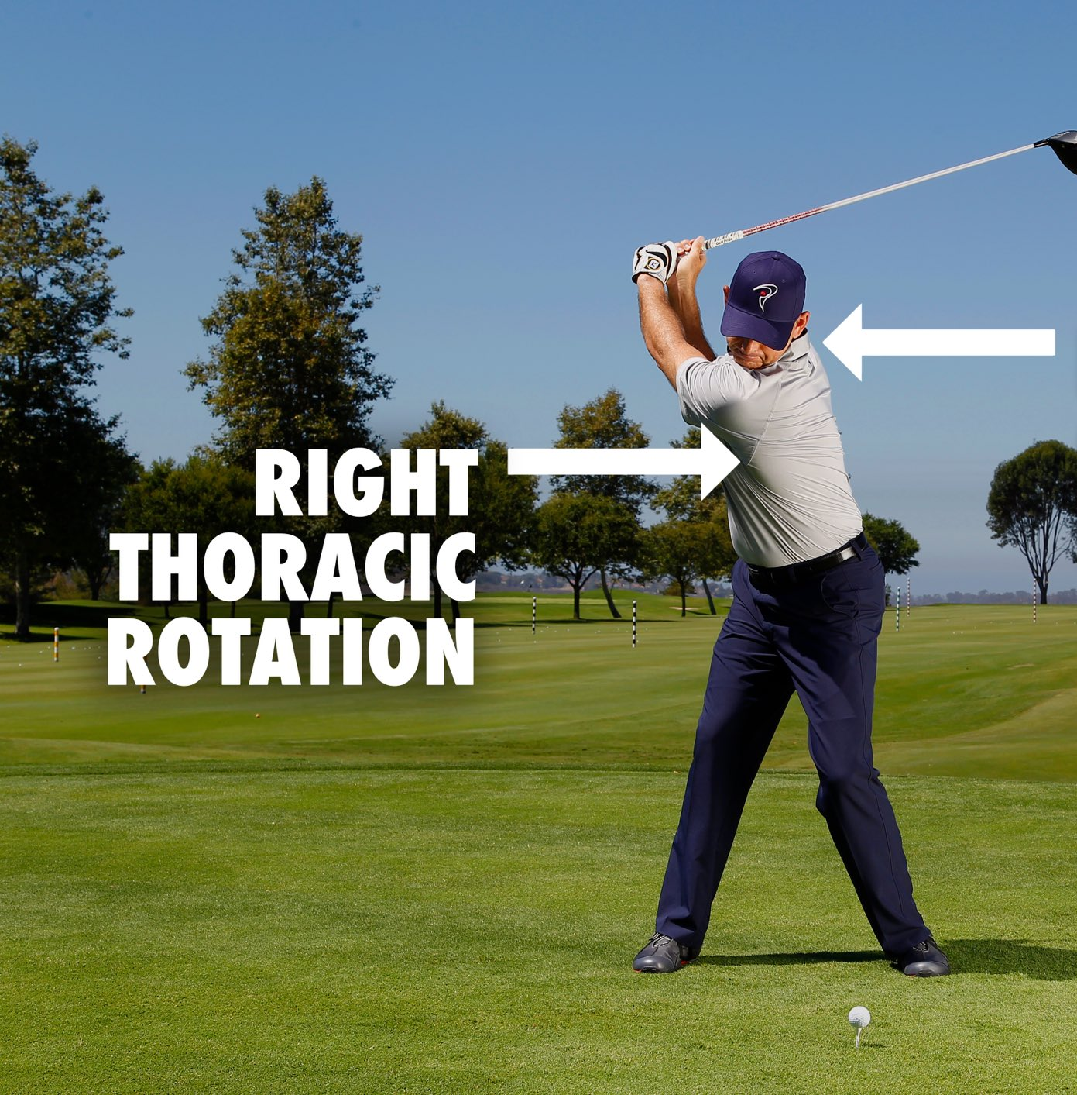
Thoracic Mobility
Looking for >45 Degrees

Slide 30
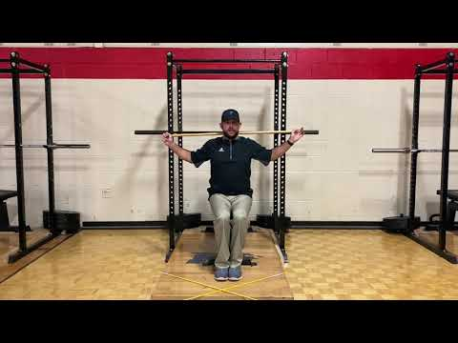
Thoracic Mobility
Assessment

Slide 31
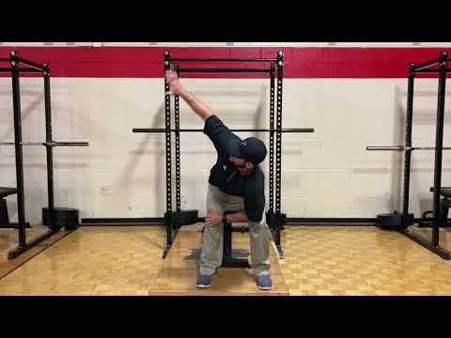
Thoracic Mobility
A Frame Stretch

Slide 32

Thoracic Mobility
Thoracic Side Bend w/Breathing

Slide 33
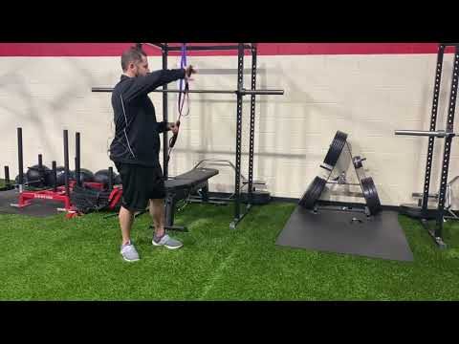
Thoracic Mobility
Reachbacks

Slide 34
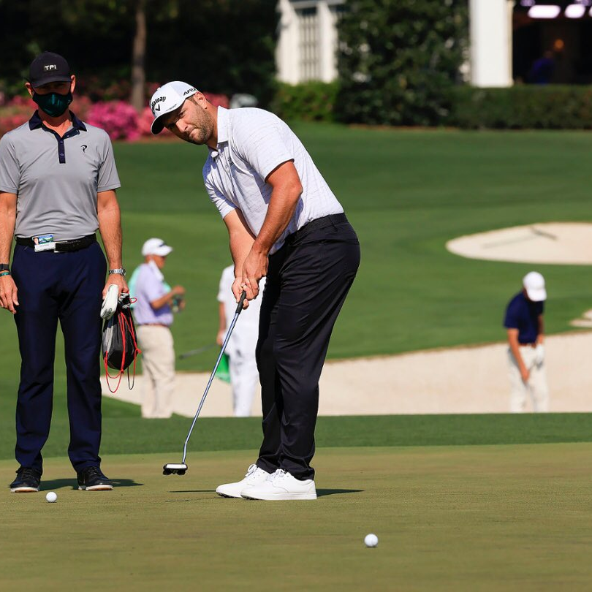
Hip Hinge
Looking for Toe Touch
w/Straight Legs

Slide 35
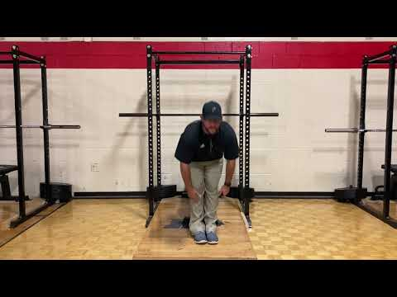
Hip Hinge
Assessment

Slide 36
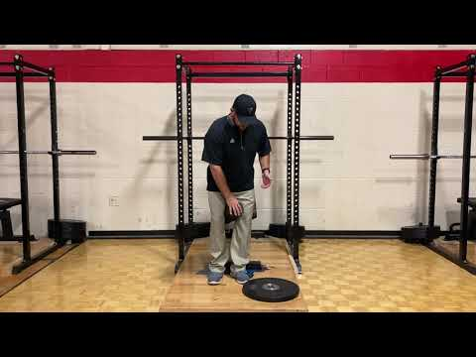
Hip Hinge
Toes Up Toe Touch

Slide 37
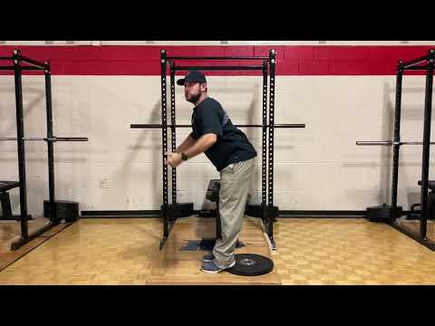
Hip Hinge
Heels Up Toe Touch

Slide 38
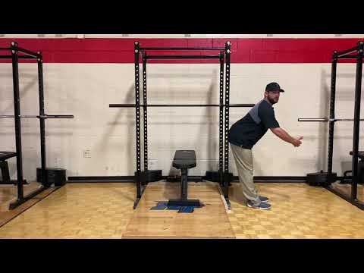
Hip Hinge
Hip Hinge to Wall

Slide 39
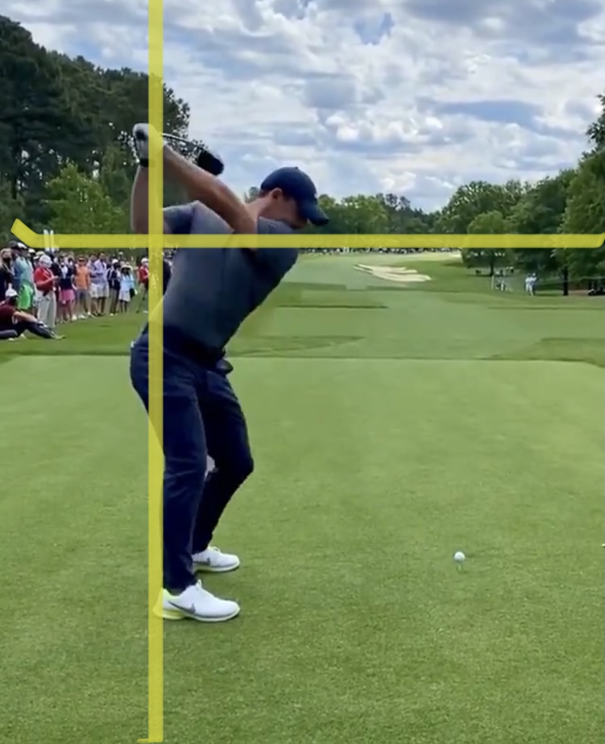
External Shoulder Rotation
Looking for >90 Degrees

Slide 40
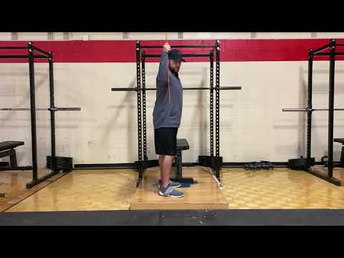
Assessment
External Shoulder Rotation

Slide 41
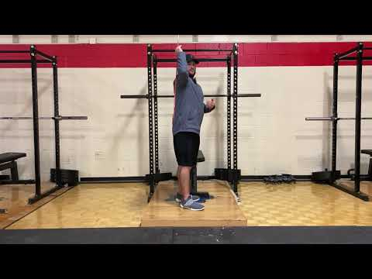
External Shoulder Rotation
Stick Assisted External Rotation

Slide 42
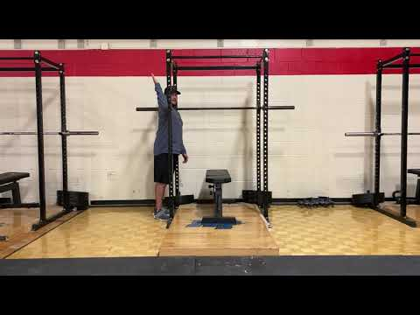
External Shoulder Rotation
Doorway Assisted ESR

Slide 43
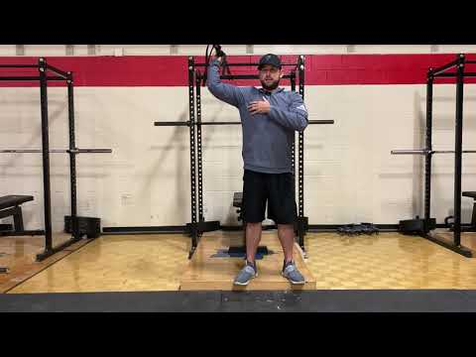
External Shoulder Rotation
Band Assisted ESR

Slide 44
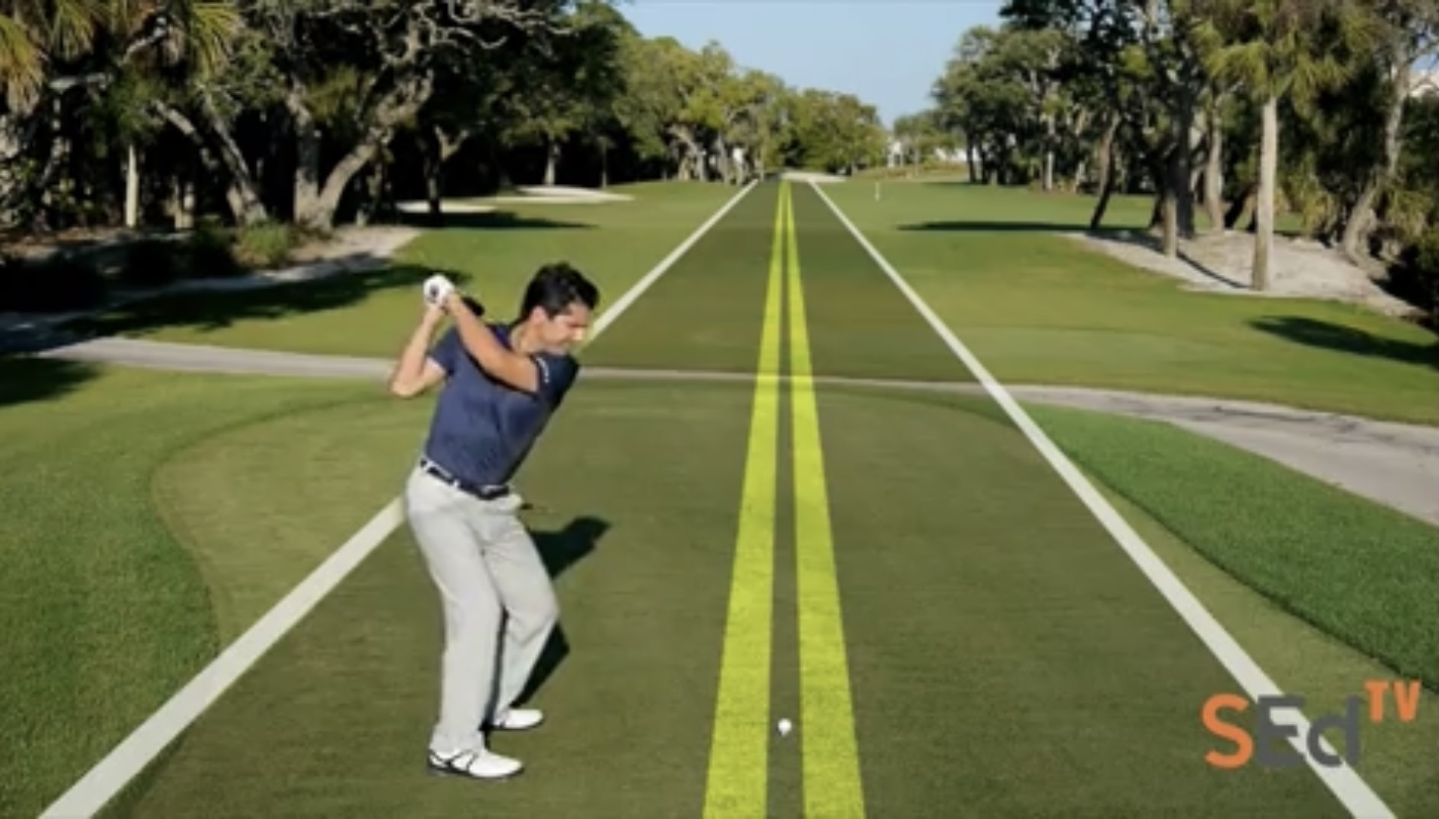
Full Swing Review
SportsEd TV Down the Line Swing Video
SportsEd TV

Slide 45
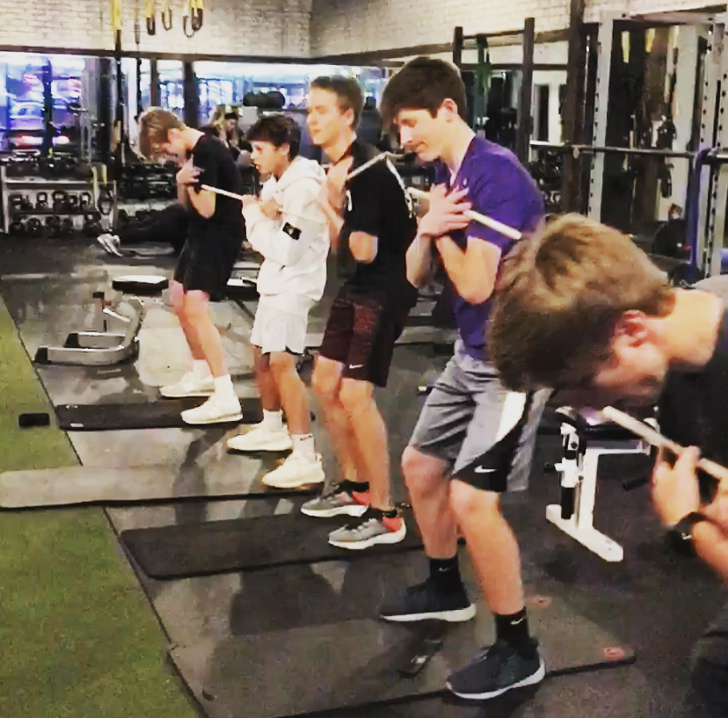
Implementation
2 Bucket System
1. Good
2. Needs work
Warmup Evaluation

Slide 46
Implementation

Slide 47
Implementation
Re-Evaluation
Weekly/Bi-Weekly
Open Conversation

Slide 48
Contact Information
Mike Wilson, MS, CSCS, TPI
615-293-4726
Coachwilson@bellsouth.net
@coachmikewilson

