Slide 1
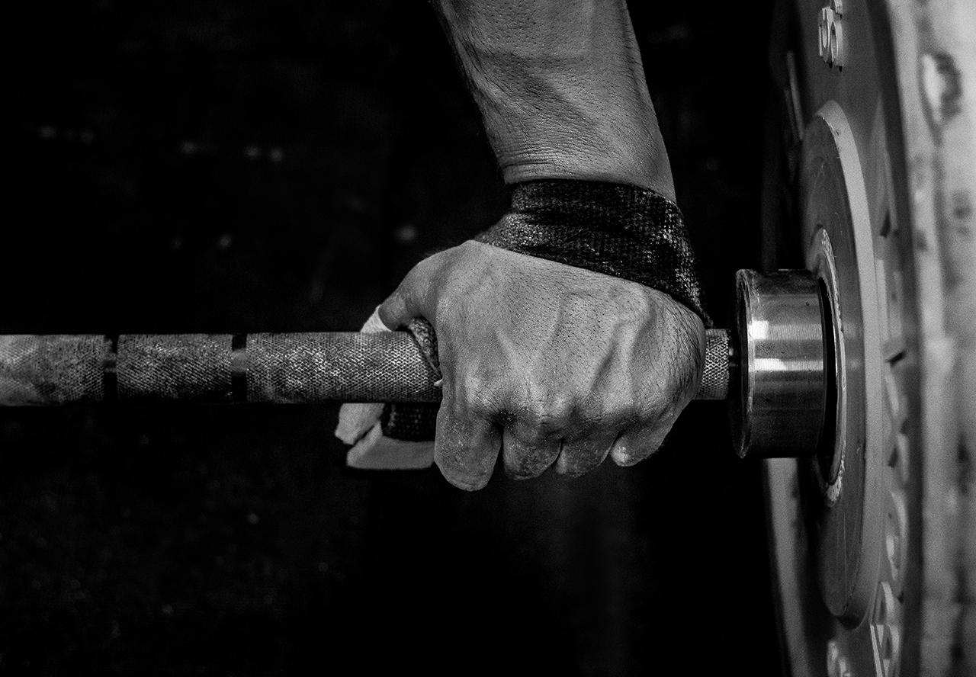
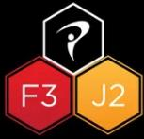


"Strength and Power Development for Juniors"
Coach Mike Wilson, MS, CSCS, TPI
www.tourperformancetraining.com

Slide 2

Yes! It is safe for your juniors to strength train!
Research shows that weight training with qualified supervision is safer than other sports in relation to growth plate injuries.
Several even suggest it could reduce the risk due to strengthening of the bones.

Slide 3
7 Exercises Your Juniors Should Be Doing
Core - Dead Bugs
Rotational Band Push/Pulls
Rotational Lunge Series
MB Punches / Slams
Jumps
Split Squat
Single Leg RDL

Slide 4
6 Phases of Youth Training
Active Start 0-6
FUNdamentals 6-8 (K-2nd)
Learn to Train 8-10 (3rd-4th)
Train to Train 11-14 (5th-8th)
Train to Compete 15-18 (HS)
Train to Win 18+ (College)

Slide 5
Active Start 0-6
Functional Movement Patterns - Crawling, Walking, Running, Jumping, Throwing, Kicking, Hitting, Squatting, Lunging, Pushups
ABCs - Agility, Balance, Coordination, Speed
Obstacle Courses!
2 Main Points
Play with your juniors
Let them see you working out

Slide 6
FUNdamentals - 6-8 (K-2nd)
FUN
Focusing on Sport Skills
Throwing - External Shoulder Rotation
Hitting/Kicking - Internal Hip Rotation
All = Sequencing and Thoracic Rotation
Play Games
Sprints Contests Bodyweight Exercises
Training through going harder, farther or faster

Slide 7
Learn to Train 8-10 (3rd-4th)
FUN
Start repping Push, Pull, Squat, Hinge
Work with Instructor on what the athlete needs
Use Medballs for progressions and overload (increase reps then weight)
Combine competitions with exercises
30-60 Min Sessions

Slide 8
Learn to Train 8-10 (3rd-4th)
15 Mins - Warmup and Plank Competitions
15 Mins - Movement Limitations and Instructor Wants with Jump Rope Competition
15 Mins - “Strength Training” Push, Pull, Squat, Hinge with Balance Competition
15 Mins - Rotations, Separations, Throws and Jumps with Last Competion
Include Water Breaks where we talk about things they like and what is going on in their lives.
Mostly Neural Adaptations but we are creating movement patterns that will prepare us for future training.

Slide 9
Train to Train 11-14 (5th-8th)
Here we really start building the foundation of future training. In the first couple years we are creating light versions of regular workouts that we will start loading heavy after PHV and Puberty.
On the back end of this phase we are loading our exercises to induce actual muscle adapatations.
Now we are starting to create consistency with 2 workouts/week 52 Weeks/year. If we can do 104 Workouts/Year we can hit 400 by HS and 800 by College.
Loading is slow and progressive without maxxing out but constantly trying to increase levels of stress.

Slide 10
Train to Train 11-14 (5th-8th)
Warmup
Movement/Mobility - General
Glute/Core
Light Weighted Functional Movements
Strength Training with explosive training - DB’s and Cables
Core Finisher
Stretch

Slide 11
Train to Train 11-14 (5th-8th)
Power (CHS) Coorelations Flexibility Needs
Vertical Jump Rotary Centers
Upper Body Power Cervical
Thoracic
Internal Hip
Shoulder External Rotation
Need to have the ability to create power with the flexibility to withstand the forces.

Slide 12
Train to Compete 15-18 (HS)
Strength and Speed
If we have been hitting all of our phases to this point, we can go hard with our training. Focusing on Strength and Speed in season and Hypertrophy during the off season.
If we haven’t done much, then we need to start with the Train to Train phase and work ourselves up.
Consistency is key! The more consistent we are, the farther ahead we will be!

Slide 13
Train to Compete 15-18 (HS)
Warmup
Movement/Mobility - Based on Need
Glute/Core - More Advanced
Light Weighted Functional Movements - Pre Prep
Strength Training with explosive training - Barbells and Dumbells
Core Finisher
Stretch

Slide 14
Train to Win 18+ (College)
Working on any deficiencies
Create challenging team environment
Always chasing speed and power - explosive exercises and plyo’s
Consistent workouts throughout the year
Hypertrophy training in the off season

Slide 15
EXTRAS
Training Age When to start Growth Plate Myths PHV = Onset of Puberty Increases in Strength without large increases in Muscle Size Lack of Hormones Increased CNS Activation Increased CNS Efficiency *Promotes Stronger Bones | Training Adaptations Short Term (8 Weeks) due to Neural Adaptations Neural Adaptations Include: -Improved Motor Unit Firing -Improved Ability to Recruit Motor Units *The exercises you choose aren’t that important if you don’t do them consistently over time | Mobility Needs (TPI Assesment) Cervical Spine Thoracic Spine >45 Shoulder External Rotation >90 Hip Internal Rotation >60 (40) Strength Needs Push Pull Squat Hinge CHS Needs Vertical Jump Upper Body Power

Slide 16
Updated App and Website
I’m excited to announce I will be launching phase 1 of my new app and website on February 1st. It’s the first of its kind guiding juniors through daily, weekly and annual workouts from beginner to advanced levels. Check back for updates.

Slide 17
Training Transitions Pre Middle School - Foundational Fitness Middle School - Beginner Resistance High School - Strength and Power Pre College - Movement Mastery - SPEED | Contact Information Coach Mike Wilson 615-293-4726 mike@coachmikewilson.com www.tourperformancetraining.com

