Slide 1
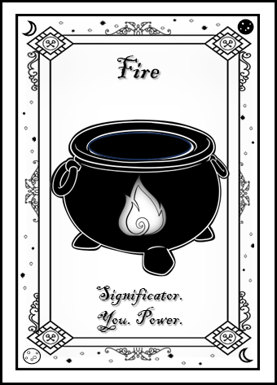
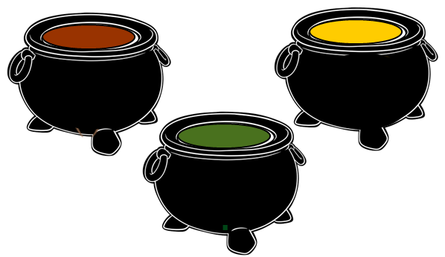
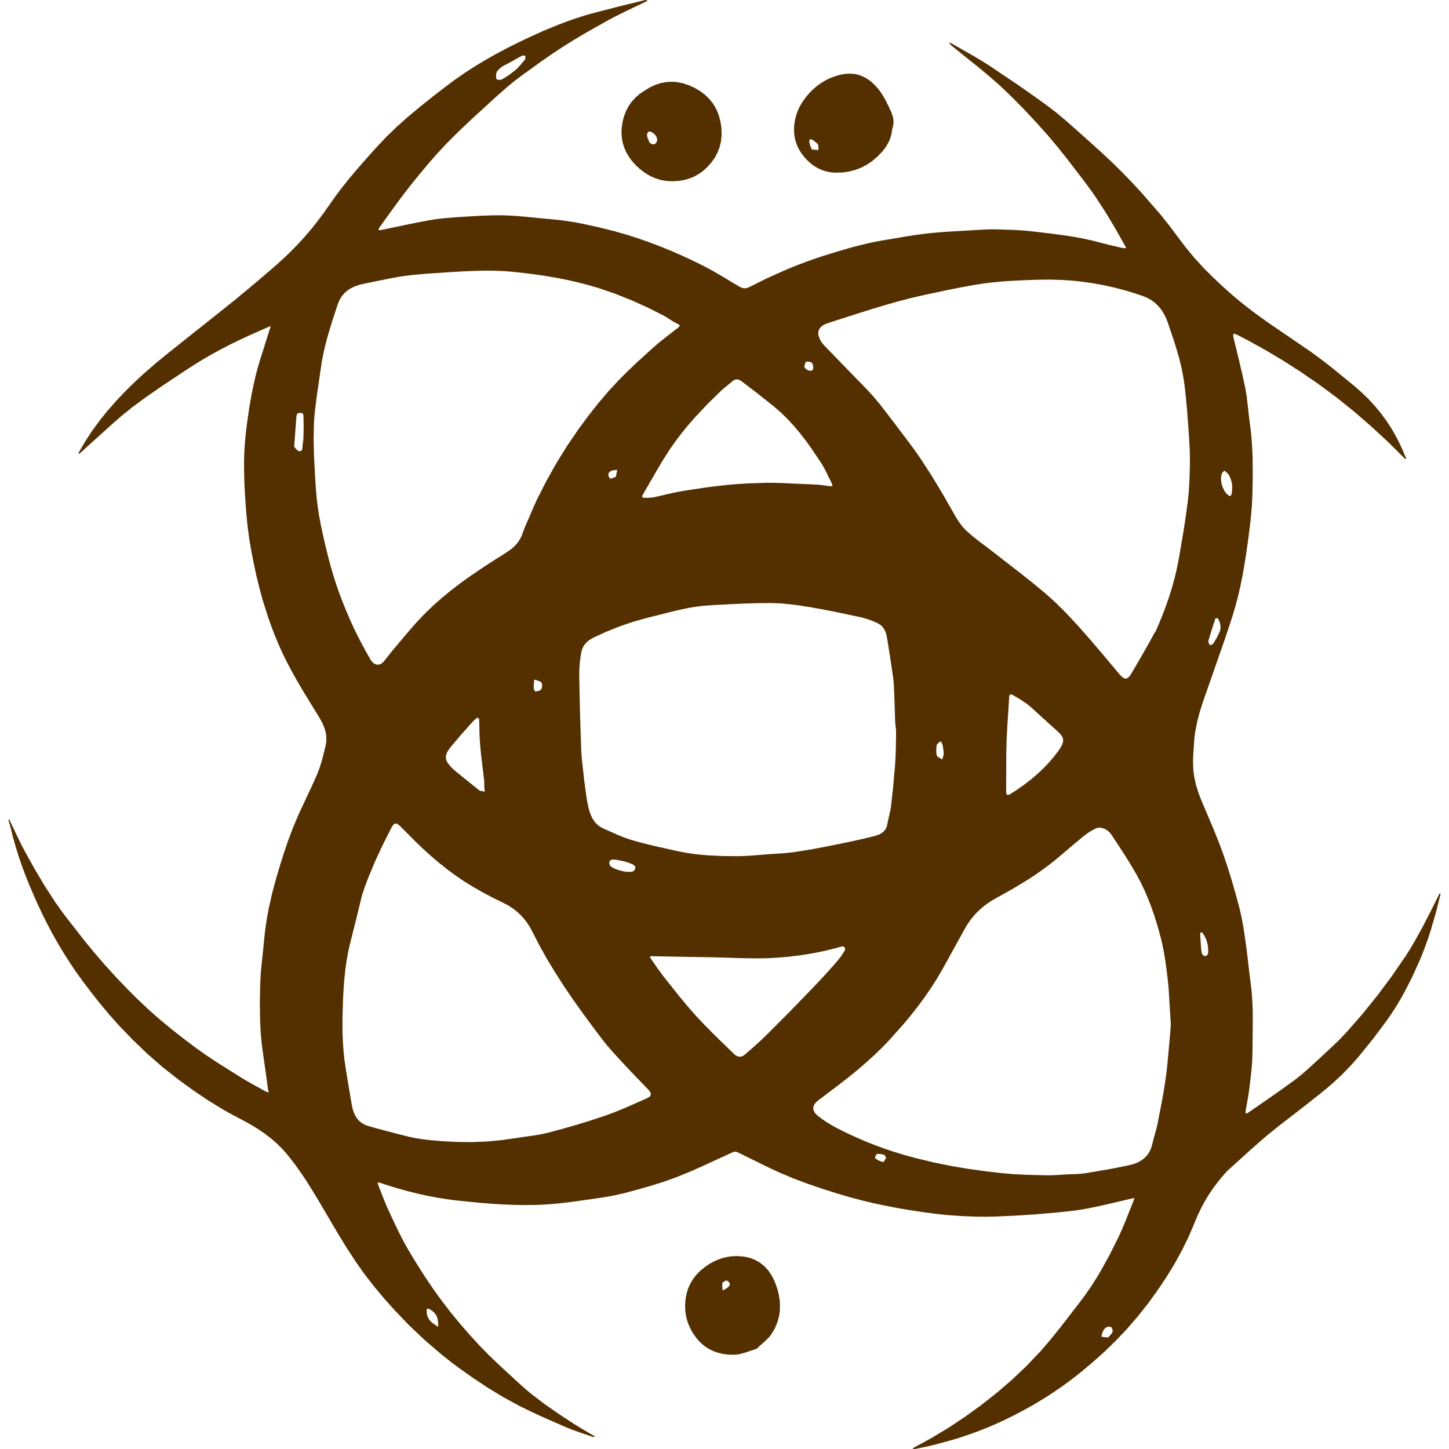
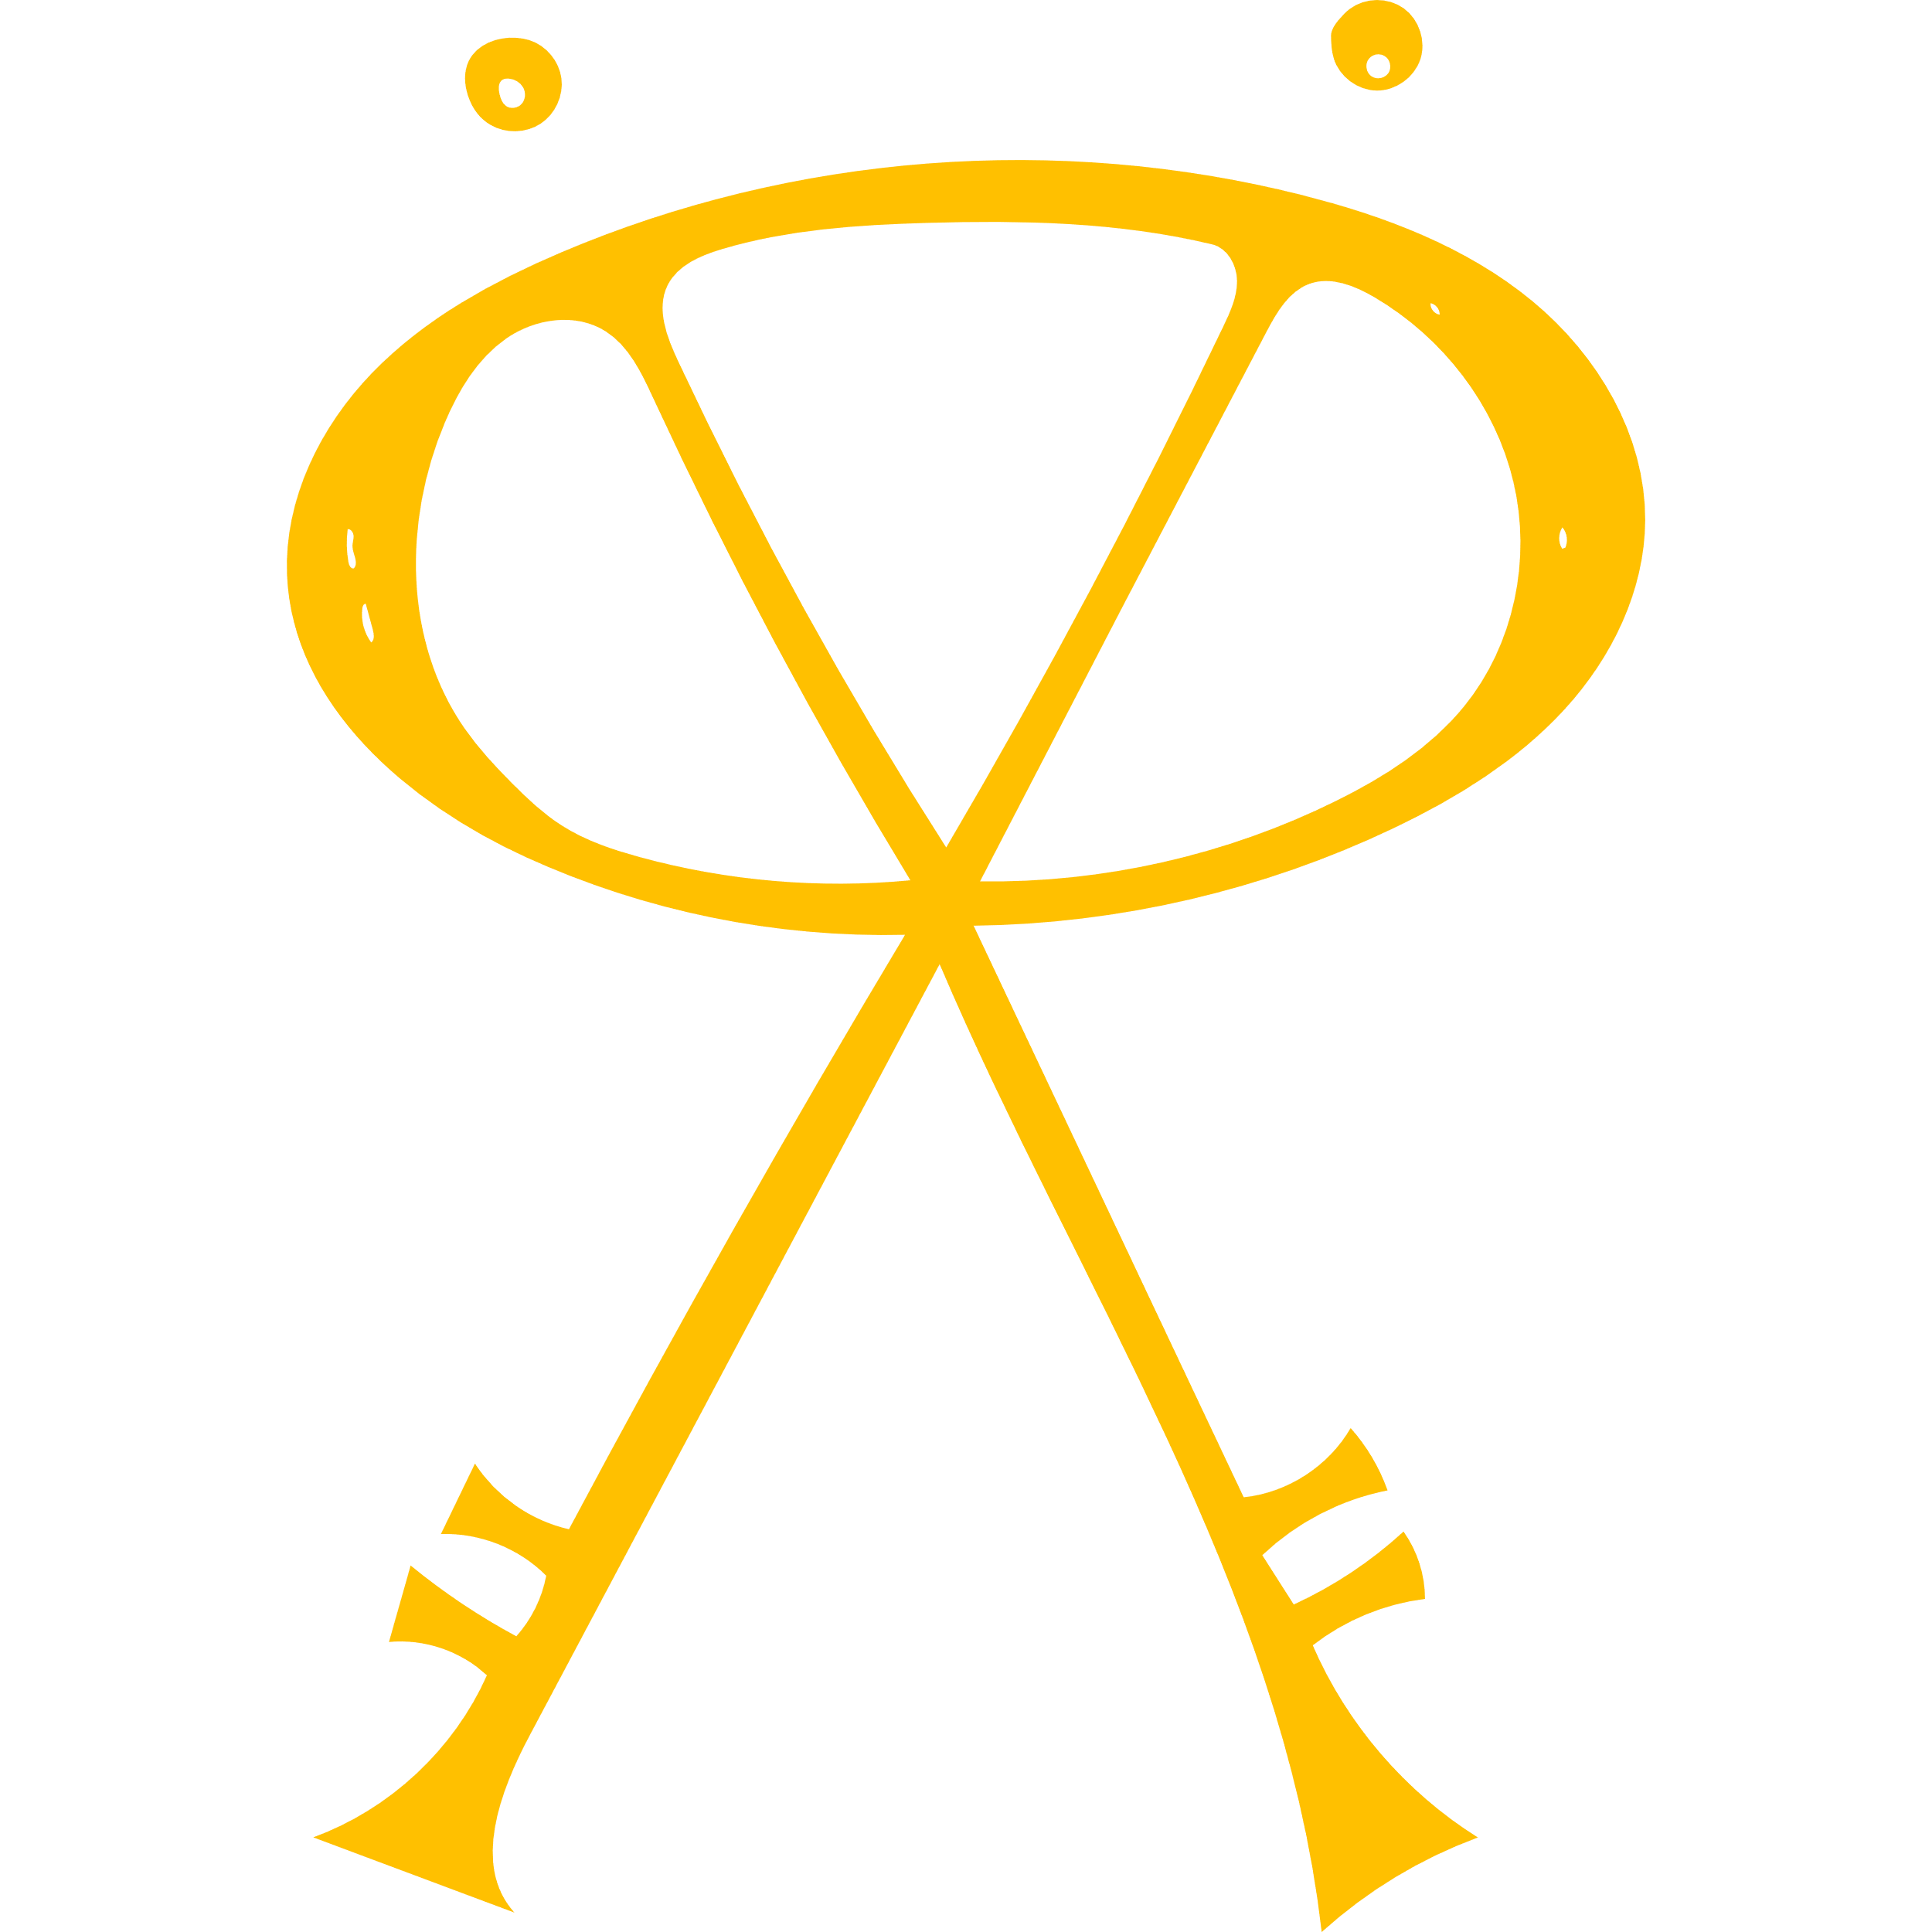
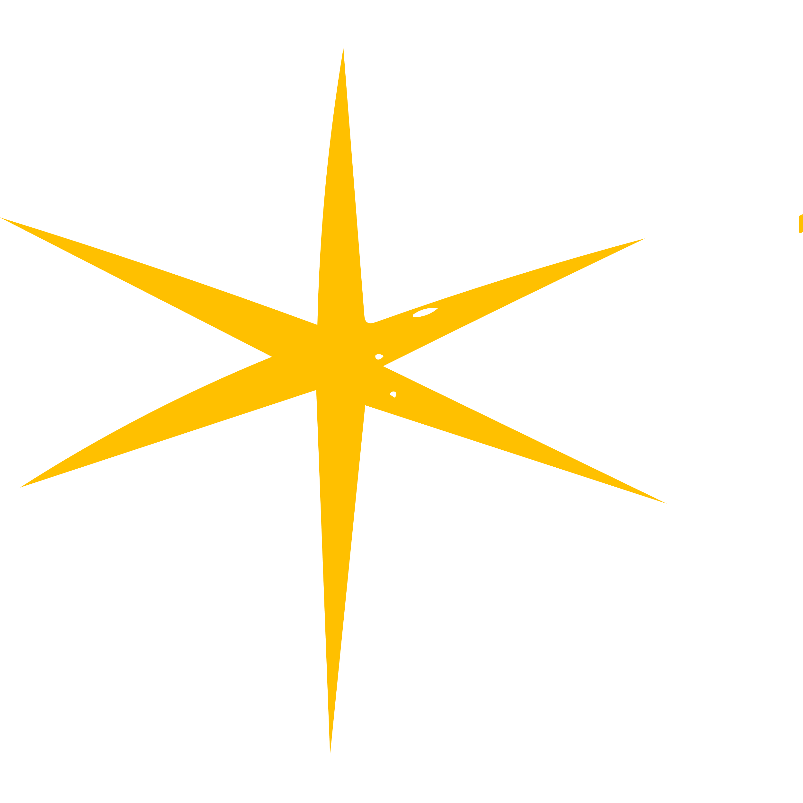
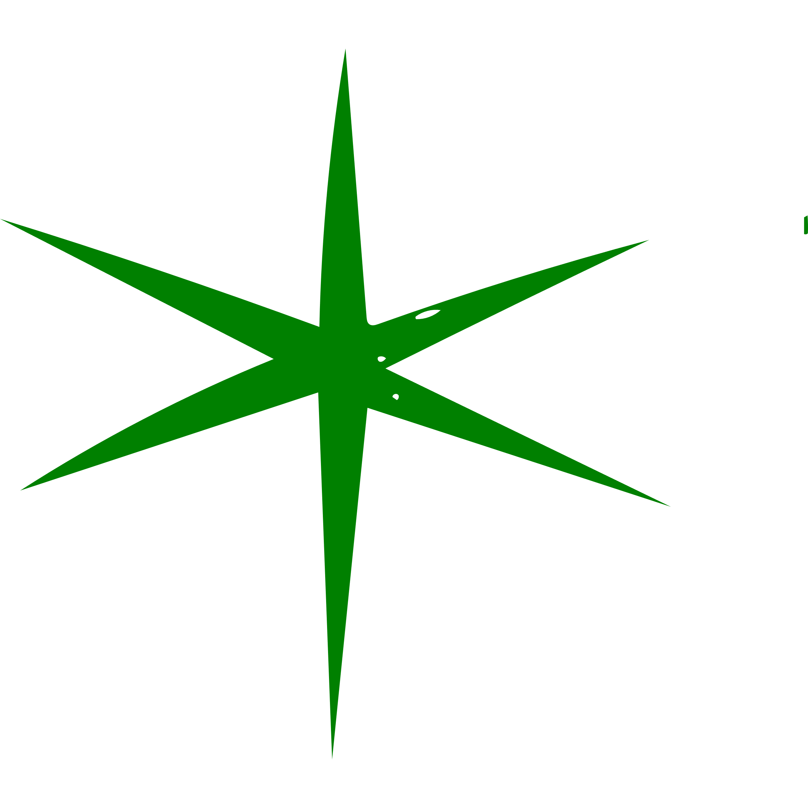
Hekate’s Cauldrons of Renewal Reading series
Reading developed by Cyndi Brannen, PhD.
Not to be shared outside of Covina. Subject to copyright and intellectual property laws. For information purposes.

Slide 2
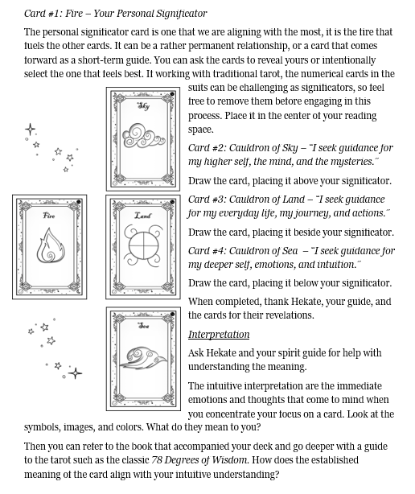
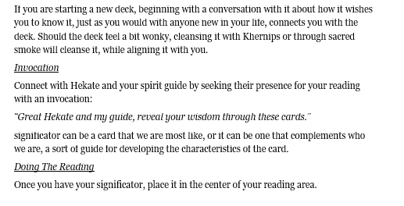

Slide 3
Triformis: Hekate’s Cauldrons of Transformation
Significator: Who I am or am becoming
Sea: What is the root of change?
land: What is the heart of change?
sky: What is the crown of change?
What transformation I am ready for:

Slide 4
Drakaina: Hekate’s Cauldrons of power
Significator: Who I am or am becoming
Sea: What is the root of my power?
land: What is the heart of my power?
sky: What is the crown of my power?
How I stand in my power:

Slide 5
ENODIA: Hekate’s Cauldrons of crossroads reading
Significator: Who I am or am becoming
Sea: What is the root of the crossroads?
land: What is the heart of the crossroads?
sky: What is the crown of the crown of the crossroads?
What crossroads I am at:

Slide 6
propylaia: Hekate’s Cauldrons of thresholds reading
Significator: Who I am or am becoming
Sea: What is the root of the threshold?
land: What is the heart of the threshold?
sky: What is the crown of the threshold?
What threshold I am at:

