Slide 2
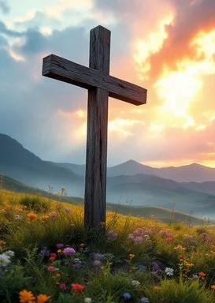
Prelude
Pastor Eduardo Carrillo
Eighth Sunday after Pentecost
July 19th, 2026
CCLI License:
3430384-01-1829
Livestream Notice: Our worship service is live-streamed and recorded. By attending, you consent to being included in the broadcast. Thank you for joining us!

Slide 3
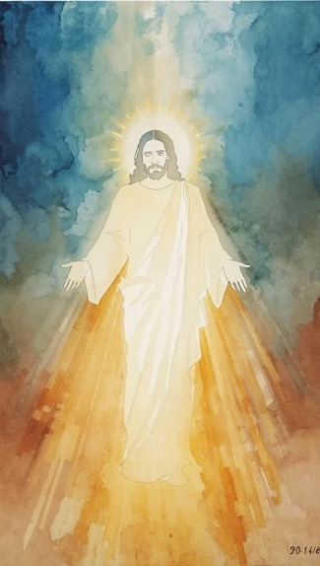
WELCOME,
ANNOUNCEMENTS,
and
CELEBRATIONS
Livestream Notice: Our worship service is live-streamed and recorded. By attending, you consent to being included in the broadcast. Thank you for joining us!

Slide 4
Lord, You have searched us and known us. You know when we sit down and when we rise up; You discern our thoughts from far away.
There is nowhere we can flee from Your presence.

Slide 5
We gather today as a field planted by Your hand, yet we look around and see that the field of our lives is a messy mix of wheat and weeds growing tightly together.

Slide 6
We confess our urge to judge quickly, to pull up what we think doesn't belong, and to act as the master of the harvest.

Slide 7
But the God who knitted us together in our mother's womb looks at our tangled fields with absolute clarity and infinite patience.

Slide 8
We come to worship the One who knows us completely, handles us gently, and promises that love will have the final word. Let us praise God together!

Slide 9
Almighty God, Before a word is even on our tongues, You know it completely. You see
the hidden corners of our hearts, the parts of us that are bearing good fruit,

Slide 10
and the tangled, wild weeds of anxiety, doubt, and judgment that grow right alongside them.
Give us the courage today to stand in Your presence without hiding.

Slide 11
Forgive our impatience with ourselves, with our neighbors, and with the state of Your world. May Your Holy Spirit tend the good seed within us this hour,

Slide 12
so that we might grow strong, secure in the knowledge that we are completely known and deeply loved. Amen.

Slide 13
“I Want to Walk as a Child of the Light” UMH 206
WORDS and MUSIC: Kathleen Thomerson, 1966
Please stand as you are able and comfortable.
I want to walk as a child of the light.
I want to follow Jesus.
God set the stars to give light to the world.
The star of my life is Jesus.
In him there is no darkness at all.
The night and the day are both alike.
The Lamb is the light of the city of God.
Shine in my heart, Lord Jesus.

Slide 14
“I Want to Walk as a Child of the Light” UMH 206
WORDS and MUSIC: Kathleen Thomerson, 1966
Please stand as you are able and comfortable.
I want to see the brightness of God.
I want to look at Jesus.
Clear Sun of Righteousness, shine on my path,
and show me the way to the Father.
In him there is no darkness at all.
The night and the day are both alike.
The Lamb is the light of the city of God.
Shine in my heart, Lord Jesus.

Slide 15
“I Want to Walk as a Child of the Light” UMH 206
WORDS and MUSIC: Kathleen Thomerson, 1966
Please stand as you are able and comfortable.
I’m looking for the coming of Christ.
I want to be with Jesus.
When we have run with patience the race,
we shall know the joy of Jesus.
In him there is no darkness at all.
The night and the day are both alike.
The Lamb is the light of the city of God.
Shine in my heart, Lord Jesus.

Slide 18
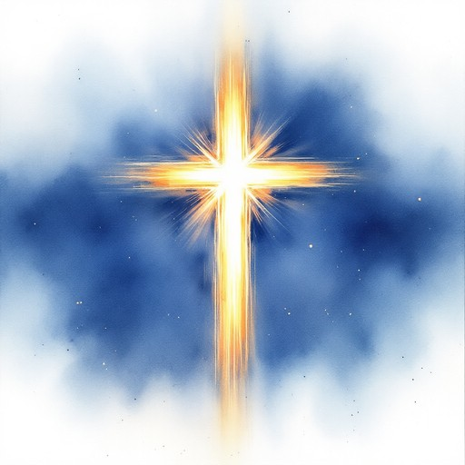
Psalm 139:
1 – 12,
23 – 24
NRSVUE

Slide 19
¹ O Lord, you have searched me and known me.
² You know when I sit down and when I rise up; you discern my thoughts from far away.
³ You search out my path and my lying down and are acquainted with all my ways.

Slide 20
⁴ Even before a word is on my tongue, Lord, you know it completely.
⁵ You hem me in, behind and before, and lay your hand upon me.
⁶ Such knowledge is too wonderful for me; it is so high that I cannot attain it.

Slide 21
⁷ Where can I go from your spirit? Or where can I flee from your presence?
⁸ If I ascend to heaven, you are there; if I make my bed in Sheol, you are there.
⁹ If I take the wings of the morning and settle at the farthest limits of the sea,

Slide 22
¹⁰ even there your hand shall lead me, and your right hand shall hold me fast.
¹¹ If I say, “Surely the darkness shall cover me, and night wraps itself around me,”
¹² even the darkness is not dark to you; the night is as bright as the day, for darkness is as light to you.

Slide 23
²³ Search me, O God, and know my heart; test me and know my thoughts.
²⁴ See if there is any wicked way in me, and lead me in the way everlasting.

Slide 24

Matthew 13: 24 – 30,
36 – 43
NRSVUE

Slide 25
²⁴ He put before them another parable: “The kingdom of heaven may be compared to someone who sowed good seed in his field,
²⁵ but while everybody was asleep an enemy came and sowed weeds among the wheat and then went away.

Slide 26
²⁶ So when the plants came up and bore grain, then the weeds appeared as well.
²⁷ And the slaves of the householder came and said to him, ‘Master, did you not sow good seed in your field? Where, then, did these weeds come from?’

Slide 27
²⁸ He answered, ‘An enemy has done this.’ The slaves said to him, ‘Then do you want us to go and gather them?’
²⁹ But he replied, ‘No, for in gathering the weeds you would uproot the wheat along with them.

Slide 28
³⁰ Let both of them grow together until the harvest, and at harvest time I will tell the reapers, Collect the weeds first and bind them in bundles to be burned, but gather the wheat into my barn.’ ”
³⁶ Then he left the crowds and went into the house. And his disciples approached him, saying, “Explain to us the parable of the weeds of the field.”

Slide 29
³⁷ He answered, “The one who sows the good seed is the Son of Man;
³⁸ the field is the world, and the good seed are the children of the kingdom; the weeds are the children of the evil one,
³⁹ and the enemy who sowed them is the devil; the harvest is the end of the age, and the reapers are angels

Slide 30
⁴⁰ Just as the weeds are collected and burned up with fire, so will it be at the end of the age.
⁴¹ The Son of Man will send his angels, and they will collect out of his kingdom all causes of sin^{[h]} and all evildoers,

Slide 31
⁴² and they will throw them into the furnace of fire, where there will be weeping and gnashing of teeth.
⁴³ Then the righteous will shine like the sun in the kingdom of their Father. Let anyone with ears listen!

Slide 32
The Word of God for the people of God
Thanks be to God

Slide 33
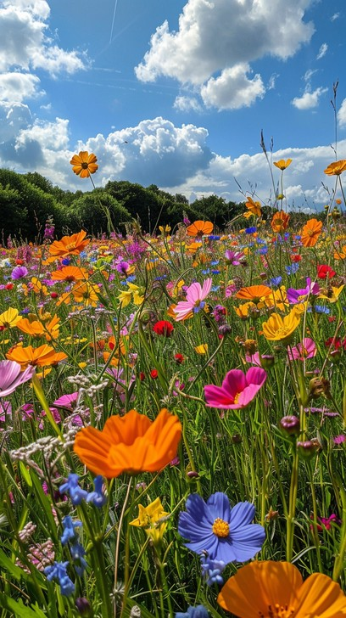
Sermon
“Finding Grace in Our Imperfect Fields ”

Slide 34
“Great is Thy Faithfulness” UMH 140
WORDS: Thomas O. Chisholm, 1923 MUSIC: William M. Runyan, 1923
Please stand as you are able and comfortable.
Great is thy faithfulness,
O God my Father;
there is no shadow
of turning with thee;
thou changest not,
thy compassions, they fail not;
as thou hast been,
thou forever wilt be.

Slide 35
“Great is Thy Faithfulness” UMH 140
WORDS: Thomas O. Chisholm, 1923 MUSIC: William M. Runyan, 1923
Please stand as you are able and comfortable.
Great is thy faithfulness!
Great is thy faithfulness!
Morning by morning
new mercies I see;
all I have needed
thy hand hath provided;
great is thy faithfulness,
Lord, unto me!

Slide 36
“Great is Thy Faithfulness” UMH 140
WORDS: Thomas O. Chisholm, 1923 MUSIC: William M. Runyan, 1923
Please stand as you are able and comfortable.
Summer and winter
and springtime and harvest,
sun, moon, and stars
in their courses above
join with all nature
in manifold witness
to thy great faithfulness,
mercy, and love.

Slide 37
“Great is Thy Faithfulness” UMH 140
WORDS: Thomas O. Chisholm, 1923 MUSIC: William M. Runyan, 1923
Please stand as you are able and comfortable.
Great is thy faithfulness!
Great is thy faithfulness!
Morning by morning
new mercies I see;
all I have needed
thy hand hath provided;
great is thy faithfulness,
Lord, unto me!

Slide 38
“Great is Thy Faithfulness” UMH 140
WORDS: Thomas O. Chisholm, 1923 MUSIC: William M. Runyan, 1923
Please stand as you are able and comfortable.
Pardon for sin and
a peace that endureth,
thine own dear presence
to cheer and to guide;
strength for today and
bright hope for tomorrow,
blessings all mine, with ten
thousand beside!

Slide 39
“Great is Thy Faithfulness” UMH 140
WORDS: Thomas O. Chisholm, 1923 MUSIC: William M. Runyan, 1923
Please stand as you are able and comfortable.
Great is thy faithfulness!
Great is thy faithfulness!
Morning by morning
new mercies I see;
all I have needed
thy hand hath provided;
great is thy faithfulness,
Lord, unto me!

Slide 44
Tithes and Offerings
Worship through giving
Notes:
https://www.goodfon.com/flowers/wallpaper-blue-wood-blossom-spring-flowers-vesna-iablonia-tsvety.html

Slide 45

“Praise God, from Whom All Blessings Flow” UMH 94
WORDS: Thomas Ken, 1674; adapted by Gilbert H. Viera, 1978
MUSIC: Geistliche Kirchengesange, 1623; harmonized by Ralph Vaughn Williams, 1906
Please stand as you are able and comfortable.
Praise God from whom all blessings flow;
Praise God, all creatures here below:
Alleluia! Alleluia!
Praise God, the source of all our gifts!
Praise Jesus Christ, whose power uplifts!
Praise the Spirit, Holy Spirit!
Alleluia! Alleluia! Alleluia!

Slide 46
Offertory Prayer

Slide 47
“We’ve a Story to Tell to the Nations” UMH 569
WORDS and MUSIC: H. Ernest Nichol, 1896
Please stand as you are able and comfortable.
We’ve a story to tell to the nations,
that shall turn their hearts to the right,
a story of truth and mercy,
a story of peace and light,
a story of peace and light.

Slide 48
“We’ve a Story to Tell to the Nations” UMH 569
WORDS and MUSIC: H. Ernest Nichol, 1896
Please stand as you are able and comfortable.
For the darkness shall turn to dawning,
and the dawning to noonday bright;
and Christ’s great kingdom
shall come on earth,
the kingdom of love and light.

Slide 49
“We’ve a Story to Tell to the Nations” UMH 569
WORDS and MUSIC: H. Ernest Nichol, 1896
Please stand as you are able and comfortable.
We’ve a song to be sung to the nations,
that shall lift their hearts to the Lord,
a song that shall conquer evil
and shatter the spear and sword,
and shatter the spear and sword.

Slide 50
“We’ve a Story to Tell to the Nations” UMH 569
WORDS and MUSIC: H. Ernest Nichol, 1896
Please stand as you are able and comfortable.
For the darkness shall turn to dawning,
and the dawning to noonday bright;
and Christ’s great kingdom
shall come on earth,
the kingdom of love and light.

Slide 51
“We’ve a Story to Tell to the Nations” UMH 569
WORDS and MUSIC: H. Ernest Nichol, 1896
Please stand as you are able and comfortable.
We’ve a message to give to the nations,
that the Lord who reigneth above
hath sent us his Son to save us,
and show us that God is love,
and show us that God is love.

Slide 52
“We’ve a Story to Tell to the Nations” UMH 569
WORDS and MUSIC: H. Ernest Nichol, 1896
Please stand as you are able and comfortable.
For the darkness shall turn to dawning,
and the dawning to noonday bright;
and Christ’s great kingdom
shall come on earth,
the kingdom of love and light.

Slide 53
“We’ve a Story to Tell to the Nations” UMH 569
WORDS and MUSIC: H. Ernest Nichol, 1896
Please stand as you are able and comfortable.
We’ve a Savior to show to the nations,
who the path of sorrow hath trod,
that all of the world’s great peoples
might come to the truth of God,
might come to the truth of God.

Slide 54
“We’ve a Story to Tell to the Nations” UMH 569
WORDS and MUSIC: H. Ernest Nichol, 1896
Please stand as you are able and comfortable.
For the darkness shall turn to dawning,
and the dawning to noonday bright;
and Christ’s great kingdom
shall come on earth,
the kingdom of love and light.

Slide 61
Postlude
This service has ended, and now
your service in the world begins!

Slide 62
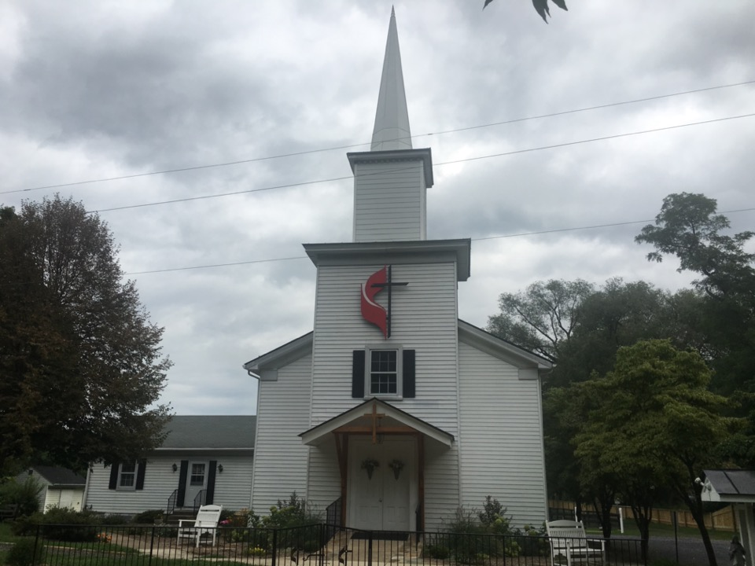
Rectortown United Methodist Church
serving God with
Prayer, Action, and Love
through Service.

