Slide 2
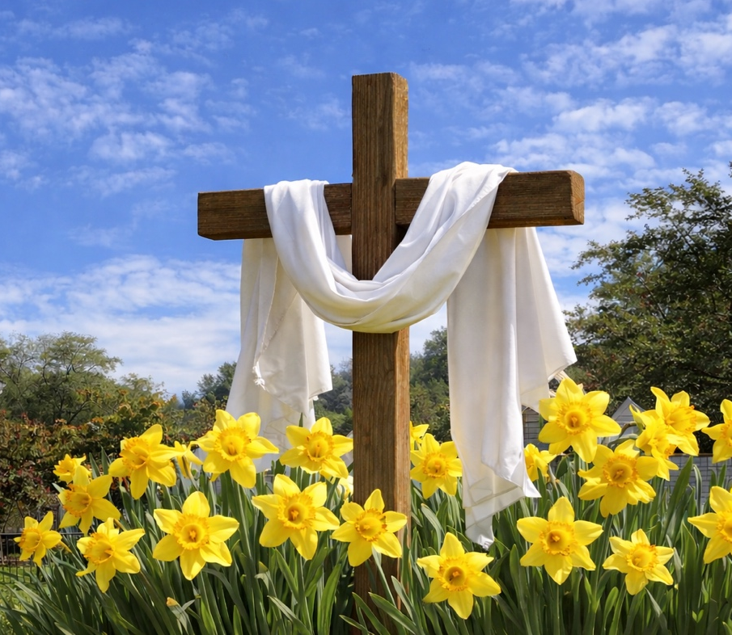
Prelude
Pastor Eduardo Carrillo
Easter Sunday
April 5th, 2026
CCLI License:
3430384-01-1829
Livestream Notice: Our worship service is live-streamed and recorded. By attending, you consent to being included in the broadcast. Thank you for joining us!

Slide 3
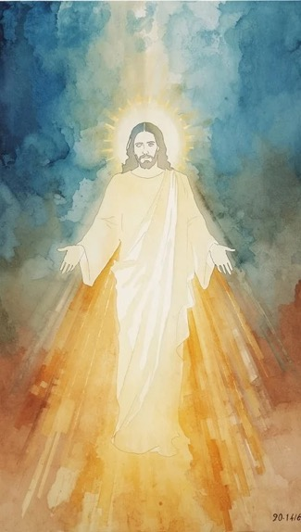
WELCOME,
ANNOUNCEMENTS,
and
CELEBRATIONS
Livestream Notice: Our worship service is live-streamed and recorded. By attending, you consent to being included in the broadcast. Thank you for joining us!

Slide 4
Christ is risen!
Christ is risen indeed!

Slide 5
The tomb is empty—death has not won.
It’s not too late for us.

Slide 6
It’s not too late for God.
It’s not too late for change.
Let us turn and follow the Risen One! Alleluia! Amen.

Slide 7
Risen Lord, we praise you that it is never too late for us because you have already made your choice. You choose to love us, to break through the walls of sin and death, and call us back to you.

Slide 8
We confess there are times when we get stuck—in our fear, in our doubt, in our sin, in hopelessness. We confess there are times we try to get unstuck on our own. Forgive us.

Slide 9
We turn to you now, knowing that you are the one who brings new life.
You are the one who resurrects. We step forward with faith that with you, in you, and through you, it’s not too late. Amen.

Slide 10

“Christ the Lord Is Risen Today” UMH 302
WORDS: Charles Wesley, 1739 MUSIC: Lyra Davidica, 1708
Please stand as you are able and comfortable.
Christ the Lord is risen today,
Alleluia!
Earth and heaven in chorus say,
Alleluia!
Raise your joys and triumphs high,
Alleluia!
Sing, ye heavens, and earth reply,
Alleluia!

Slide 11
“Christ the Lord Is Risen Today” UMH 302
WORDS: Charles Wesley, 1739 MUSIC: Lyra Davidica, 1708
Please stand as you are able and comfortable.
Love’s redeeming work is done,
Alleluia!
Fought the fight, the battle won,
Alleluia!
Death in vain forbids him rise,
Alleluia!
Christ has opened paradise,
Alleluia!

Slide 12
“Christ the Lord Is Risen Today” UMH 302
WORDS: Charles Wesley, 1739 MUSIC: Lyra Davidica, 1708
Please stand as you are able and comfortable.
Lives again, our glorious King,
Alleluia!
Where, o death, is now thy sting?
Alleluia!
Once he died our souls to save,
Alleluia!
Where’s thy victory, boasting grave?
Alleluia!

Slide 13
“Christ the Lord Is Risen Today” UMH 302
WORDS: Charles Wesley, 1739 MUSIC: Lyra Davidica, 1708
Please stand as you are able and comfortable.
Soar we now where Christ has led,
Alleluia!
Following our exalted Head,
Alleluia!
Made like him, like him we rise,
Alleluia!
Ours the cross, the grave, the skies,
Alleluia!

Slide 14
“Christ the Lord Is Risen Today” UMH 302
WORDS: Charles Wesley, 1739 MUSIC: Lyra Davidica, 1708
Please stand as you are able and comfortable.
Hail the Lord of earth and heaven,
Alleluia!
Praise to thee by both be given,
Alleluia!
Thee we greet triumphant now,
Alleluia!
Hail the resurrection, thou,
Alleluia!

Slide 15
“Christ the Lord Is Risen Today” UMH 302
WORDS: Charles Wesley, 1739 MUSIC: Lyra Davidica, 1708
Please stand as you are able and comfortable.
King of glory, soul of bliss,
Alleluia!
Everlasting life is this,
Alleluia!
Thee to know, thy power to prove,
Alleluia!
Thus to sing, and thus to love,
Alleluia!

Slide 17
Prayer For Illumination
Spirit of the living God, fall afresh on me.
Spirit of the living God, fall afresh on me.
Melt me, mold me, fill me, use me.
Spirit of the living God, fall afresh on me.
UMH 393

Slide 18

Lamentations 3: 22 – 23
NRSVUE

Slide 19
²² The steadfast love of the Lord never ceases, his mercies never come to an end;
²³ they are new every morning; great is your faithfulness.

Slide 20

Matthew 28: 1 – 10
NRSVUE

Slide 21
After the Sabbath, as the first day of the week was dawning, Mary Magdalene and the other Mary went to see the tomb.
² And suddenly there was a great earthquake, for an angel of the Lord, descending from heaven, came and rolled back the stone and sat on it.

Slide 22
³ His appearance was like lightning and his clothing white as snow.
⁴ For fear of him the guards shook and became like dead men.
⁵ But the angel said to the women, “Do not be afraid, for I know that you are looking for Jesus who was crucified.

Slide 23
⁶ He is not here, for he has been raised, as he said. Come, see the place where he lay.
⁷ Then go quickly and tell his disciples, ‘He has been raised from the dead, and indeed he is going ahead of you to Galilee; there you will see him.’ This is my message for you.”

Slide 24
⁸ So they left the tomb quickly with fear and great joy and ran to tell his disciples.
⁹ Suddenly Jesus met them and said, “Greetings!” And they came to him, took hold of his feet, and worshiped him.
¹⁰ Then Jesus said to them, “Do not be afraid; go and tell my brothers and sisters to go to Galilee; there they will see me.”

Slide 25
The Word of God for the people of God
Thanks be to God

Slide 26

Sermon
“It’s Not Too Late for Us Because It’s Not Too Late for God ”

Slide 27
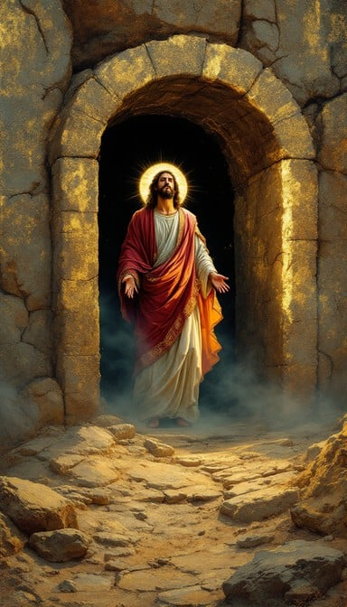
“He Lives” UMH 310
WORDS and MUSIC: Alfred H. Ackley, 1933
Please stand as you are able and comfortable.
I serve a risen Savior,
he’s in the world today;
I know that he is living,
whatever foes may say.
I see his hand of mercy,
I hear his voice of cheer,
and just the time I need him,
he’s always near.

Slide 28
“He Lives” UMH 310
WORDS and MUSIC: Alfred H. Ackley, 1933
Please stand as you are able and comfortable.
He lives, he lives,
Christ Jesus lives today!
He walks with me and talks with me along life’s narrow way.
He lives, he lives,
salvation to impart!
You ask me how I know he lives?
He lives within my heart.

Slide 29
“He Lives” UMH 310
WORDS and MUSIC: Alfred H. Ackley, 1933
Please stand as you are able and comfortable.
In all the world around me
I see his loving care,
and though my heart grows weary,
I never will despair.
I know that he is leading
through all the stormy blast;
the day of his appearing
will come at last.

Slide 30
“He Lives” UMH 310
WORDS and MUSIC: Alfred H. Ackley, 1933
Please stand as you are able and comfortable.
He lives, he lives,
Christ Jesus lives today!
He walks with me and talks with me along life’s narrow way.
He lives, he lives,
salvation to impart!
You ask me how I know he lives?
He lives within my heart.

Slide 31
“He Lives” UMH 310
WORDS and MUSIC: Alfred H. Ackley, 1933
Please stand as you are able and comfortable.
Rejoice, rejoice, O Christian,
lift up your voice and sing
eternal hallelujahs
to Jesus Christ the King!
The hope of all who seek him,
the help of all who find;
none other is so loving,
so good and kind.

Slide 32
“He Lives” UMH 310
WORDS and MUSIC: Alfred H. Ackley, 1933
Please stand as you are able and comfortable.
He lives, he lives,
Christ Jesus lives today!
He walks with me and talks with me along life’s narrow way.
He lives, he lives,
salvation to impart!
You ask me how I know he lives?
He lives within my heart.

Slide 33
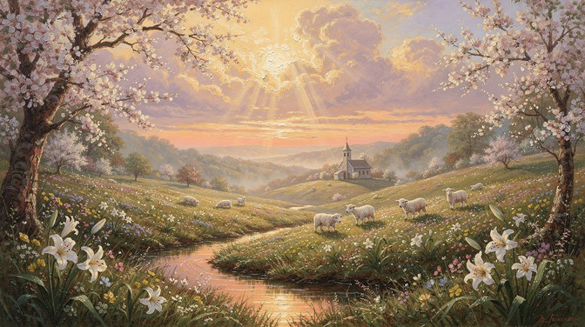
Communion

Slide 42
Tithes and Offerings
Worship through giving
Notes:
https://www.goodfon.com/flowers/wallpaper-blue-wood-blossom-spring-flowers-vesna-iablonia-tsvety.html

Slide 43

“Praise God, from Whom All Blessings Flow” UMH 94
WORDS: Thomas Ken, 1674; adapted by Gilbert H. Viera, 1978
MUSIC: Geistliche Kirchengesange, 1623; harmonized by Ralph Vaughn Williams, 1906
Please stand as you are able and comfortable.
Praise God from whom all blessings flow;
Praise God, all creatures here below:
Alleluia! Alleluia!
Praise God, the source of all our gifts!
Praise Jesus Christ, whose power uplifts!
Praise the Spirit, Holy Spirit!
Alleluia! Alleluia! Alleluia!

Slide 44
Offertory Prayer

Slide 45
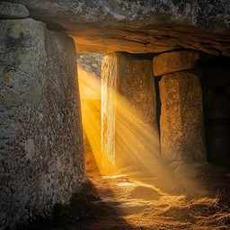
“Up From the Grave He Arose” UMH 322
WORDS and MUSIC: Robert Lowry, 1874
Please stand as you are able and comfortable.
Low in the grave he lay,
Jesus my Savior,
waiting the coming day,
Jesus my Lord!

Slide 46
“Up From the Grave He Arose” UMH 322
WORDS and MUSIC: Robert Lowry, 1874
Please stand as you are able and comfortable.
Up from the grave he arose,
with a mighty triumph o’er his foes;
he arose a victor from the dark domain,
and he lives forever, with his saints to reign.
He arose! He arose!
Hallelujah! Christ arose!

Slide 47
“Up From the Grave He Arose” UMH 322
WORDS and MUSIC: Robert Lowry, 1874
Please stand as you are able and comfortable.
Vainly they watch his bed,
Jesus my Savior;
vainly they seal the dead,
Jesus my Lord!

Slide 48
“Up From the Grave He Arose” UMH 322
WORDS and MUSIC: Robert Lowry, 1874
Please stand as you are able and comfortable.
Up from the grave he arose,
with a mighty triumph o’er his foes;
he arose a victor from the dark domain,
and he lives forever, with his saints to reign.
He arose! He arose!
Hallelujah! Christ arose!

Slide 49
“Up From the Grave He Arose” UMH 322
WORDS and MUSIC: Robert Lowry, 1874
Please stand as you are able and comfortable.
Death cannot keep its prey,
Jesus my Savior;
he tore the bars away,
Jesus my Lord!

Slide 50
“Up From the Grave He Arose” UMH 322
WORDS and MUSIC: Robert Lowry, 1874
Please stand as you are able and comfortable.
Up from the grave he arose,
with a mighty triumph o’er his foes;
he arose a victor from the dark domain,
and he lives forever, with his saints to reign.
He arose! He arose!
Hallelujah! Christ arose!

Slide 52
BLESSING AND BENEDICTION
This service has ended, and now
your service in the world begins!

Slide 53
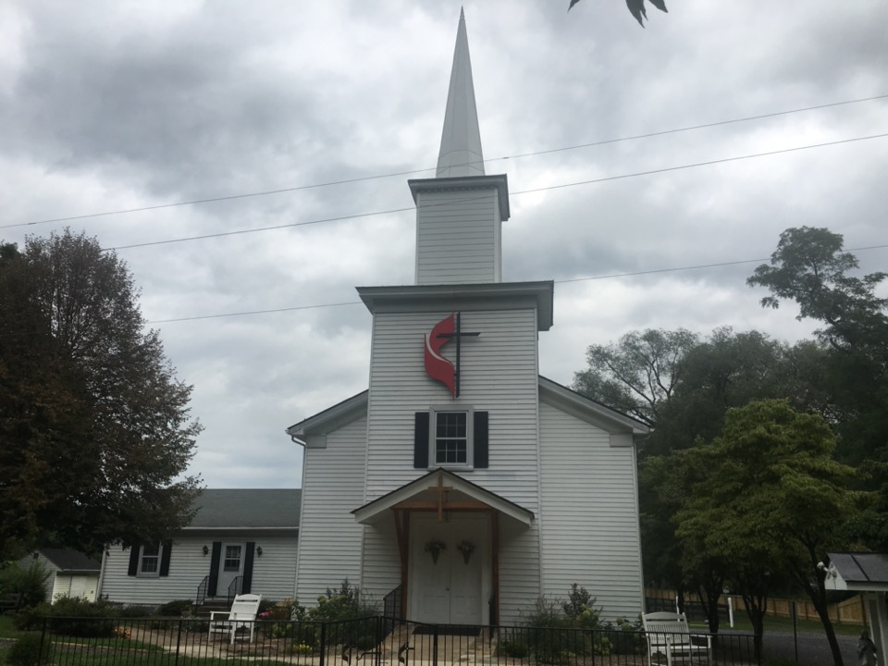
Rectortown United Methodist Church
serving God with
Prayer, Action, and Love
through Service.

