Slide 2
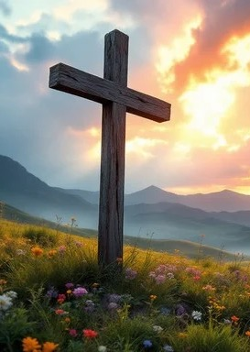
Prelude
Pastor Eduardo Carrillo
Twelfth Sunday after Pentecost
August 16th, 2026
CCLI License:
3430384-01-1829
Livestream Notice: Our worship service is live-streamed and recorded. By attending, you consent to being included in the broadcast. Thank you for joining us!

Slide 3
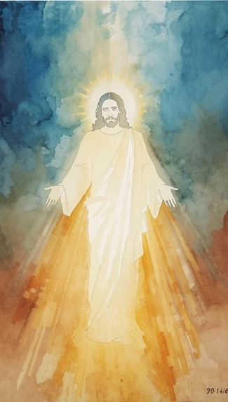
WELCOME,
ANNOUNCEMENTS,
and
CELEBRATIONS
Livestream Notice: Our worship service is live-streamed and recorded. By attending, you consent to being included in the broadcast. Thank you for joining us!

Slide 4
If the Lord had not been on our side when the world rose up against us,
The floods would have swept us away, and the torrent would have overwhelmed us.

Slide 5
But our help is in the name of the Lord, the maker of heaven and earth!
He is the Christ, the Son of the Living God!

Slide 6
Empires rise and fall, and the powers of fear try to silence our hope.
But the Lord is building a house that cannot be shaken.
All: Come, let us stand upon the Rock and praise our Deliverer!

Slide 7
God of Shiphrah and Puah, God of Peter and Paul, you are the architect of a kingdom that outlasts every empire.

Slide 8
We confess that we often freeze when we face the intimidating structures of this world. We let fear tell us that our faith is too small to matter.

Slide 9
Remind us today that you use the ordinary to confound the mighty. Give us the courage of the midwives to protect life, and the clarity of Peter to speak truth to power.

Slide 10
Present yourself to us anew today, so that we may confidently confess that you alone are Lord. Amen.

Slide 11
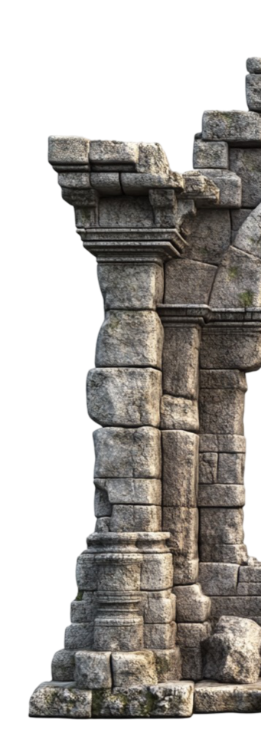
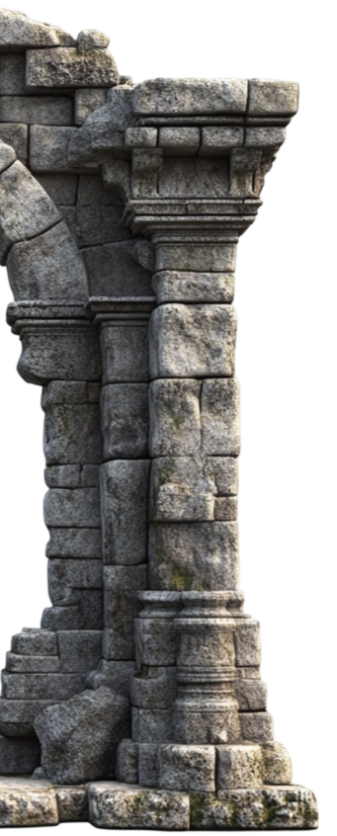
A Mighty Fortress Is Our God
110
WORDS: Martin Luther, ca. 1529; trans. by Frederick H. Hedge, 1853 (Ps. 46)
1. A mighty fortress
is our God,
a bulwark never failing;
our helper he amid the flood
of mortal ills prevailing.

Slide 12
A Mighty Fortress Is Our God
110
WORDS: Martin Luther, ca. 1529; trans. by Frederick H. Hedge, 1853 (Ps. 46)
For still our ancient foe
doth seek to work us woe;
his craft and
power are great,
and armed with cruel hate,
on earth is not his equal.

Slide 13
A Mighty Fortress Is Our God
110
WORDS: Martin Luther, ca. 1529; trans. by Frederick H. Hedge, 1853 (Ps. 46)
2. Did we in our own
strength confide,
our striving would be losing,
were not the right man
on our side,
the man of God’s
own choosing.

Slide 14
A Mighty Fortress Is Our God
110
WORDS: Martin Luther, ca. 1529; trans. by Frederick H. Hedge, 1853 (Ps. 46)
Dost ask who
that may be?
Christ Jesus, it is he;
Lord Sabaoth, his name,
from age to age the same,
and he must
win the battle.

Slide 15
A Mighty Fortress Is Our God
110
WORDS: Martin Luther, ca. 1529; trans. by Frederick H. Hedge, 1853 (Ps. 46)
3. And though this world,
with devils filled,
should threaten to undo us,
we will not fear,
for God hath willed
his truth to triumph
through us.

Slide 16
A Mighty Fortress Is Our God
110
WORDS: Martin Luther, ca. 1529; trans. by Frederick H. Hedge, 1853 (Ps. 46)
The Prince of
Darkness grim,
we tremble not for him;
his rage we can endure,
for lo, his doom is sure;
one little word
shall fell him.

Slide 17
A Mighty Fortress Is Our God
110
WORDS: Martin Luther, ca. 1529; trans. by Frederick H. Hedge, 1853 (Ps. 46)
4. That word above
all earthly powers,
no thanks to them, abideth;
the Spirit and
the gifts are ours,
through him who
with us sideth.

Slide 18
A Mighty Fortress Is Our God
110
WORDS: Martin Luther, ca. 1529; trans. by Frederick H. Hedge, 1853 (Ps. 46)
Let goods and kindred go,
this mortal life also;
the body they may kill;
God’s truth abideth still;
his kingdom is forever.

Slide 21
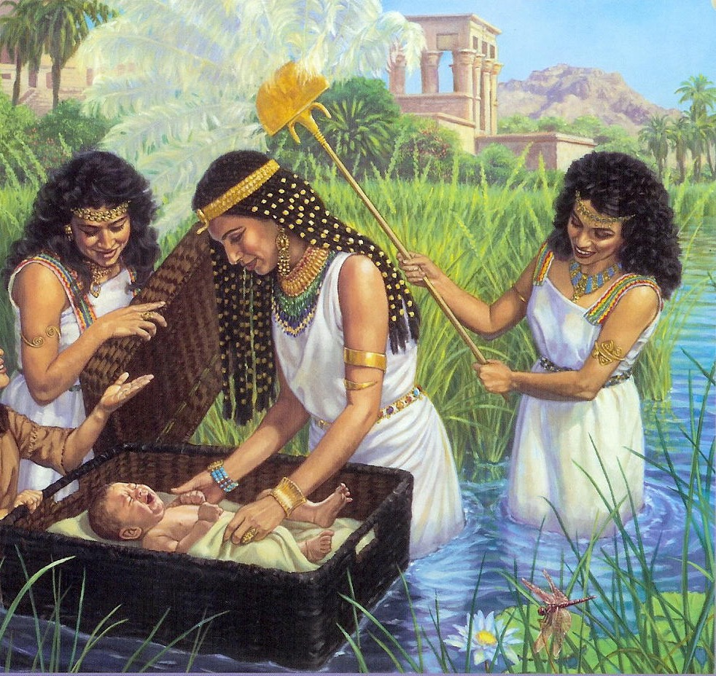
Exodus 1:8 – 2:10
NRSVUE

Slide 22
8 Now a new king arose over Egypt who did not know Joseph.
9 He said to his people, “Look, the Israelite people are more numerous and more powerful than we.

Slide 23
10 Come, let us deal shrewdly with them, or they will increase and, in the event of war, join our enemies and fight against us and escape from the land.”
¹¹ Therefore they set taskmasters over them to oppress them with forced labor. They built supply cities, Pithom and Rameses, for Pharaoh.

Slide 24
¹² But the more they were oppressed, the more they multiplied and spread, so that the Egyptians came to dread the Israelites.
¹³ The Egyptians subjected the Israelites to hard servitude

Slide 25
¹⁴ and made their lives bitter with hard servitude in mortar and bricks and in every kind of field labor. They were ruthless in all the tasks that they imposed on them.
¹⁵ The king of Egypt said to the Hebrew midwives, one of whom was named Shiphrah and the other Puah,

Slide 26
¹⁶ “When you act as midwives to the Hebrew women and see them on the birthstool, if it is a son, kill him, but if it is a daughter, she shall live.”
¹⁷ But the midwives feared God; they did not do as the king of Egypt commanded them, but they let the boys live.

Slide 27
¹⁸ So the king of Egypt summoned the midwives and said to them, “Why have you done this and allowed the boys to live?”
¹⁹ The midwives said to Pharaoh, “Because the Hebrew women are not like the Egyptian women, for they are vigorous and give birth before the midwife comes to them.”

Slide 28
²⁰ So God dealt well with the midwives, and the people multiplied and became very strong.
²¹ And because the midwives feared God, he gave them families.

Slide 29
²² Then Pharaoh commanded all his people, “Every son that is born to the Hebrews you shall throw into the Nile, but you shall let every daughter live.”
Now a man from the house of Levi went and married a Levite woman.
² The woman conceived and bore a son, and when she saw that he was a fine baby, she hid him three months.

Slide 30
³ When she could hide him no longer she got a papyrus basket for him and plastered it with bitumen and pitch; she put the child in it and placed it among the reeds on the bank of the river.
⁴ His sister stood at a distance, to see what would happen to him.

Slide 31
⁵ The daughter of Pharaoh came down to bathe at the river, while her attendants walked beside the river. She saw the basket among the reeds and sent her maid to bring it.
⁶ When she opened it, she saw the child. He was crying, and she took pity on him. “This must be one of the Hebrews’ children,” she said.

Slide 32
⁷ Then his sister said to Pharaoh’s daughter, “Shall I go and get you a nurse from the Hebrew women to nurse the child for you?”
⁸ Pharaoh’s daughter said to her, “Yes.” So the girl went and called the child’s mother.

Slide 33
⁹ Pharaoh’s daughter said to her, “Take this child and nurse it for me, and I will give you your wages.” So the woman took the child and nursed it.
¹⁰ When the child grew up, she brought him to Pharaoh’s daughter, and he became her son. She named him Moses, “because,” she said, “I drew him out of the water.”

Slide 34
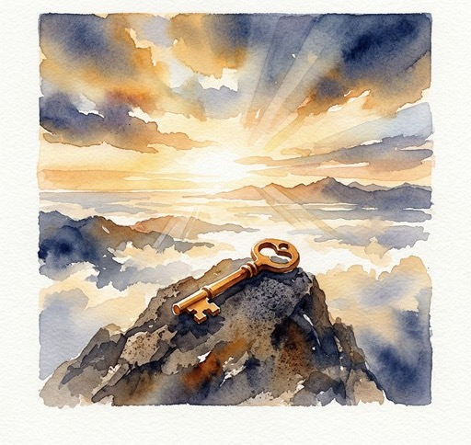
Matthew 16: 13 – 20
NRSVUE

Slide 35
¹³ Now when Jesus came into the district of Caesarea Philippi, he asked his disciples, “Who do people say that the Son of Man is?”
¹⁴ And they said, “Some say John the Baptist but others Elijah and still others Jeremiah or one of the prophets.”

Slide 36
¹⁵ He said to them, “But who do you say that I am?”
¹⁶ Simon Peter answered, “You are the Messiah, the Son of the living God.”
¹⁷ And Jesus answered him, “Blessed are you, Simon son of Jonah! For flesh and blood has not revealed this to you but my Father in heaven.

Slide 37
¹⁸ And I tell you, you are Peter, and on this rock I will build my church, and the gates of Hades will not prevail against it.

Slide 38
¹⁹ I will give you the keys of the kingdom of heaven, and whatever you bind on earth will be bound in heaven, and whatever you loose on earth will be loosed in heaven.”
²⁰ Then he sternly ordered the disciples not to tell anyone that he was the Messiah.

Slide 39
The Word of God for the people of God
Thanks be to God

Slide 40
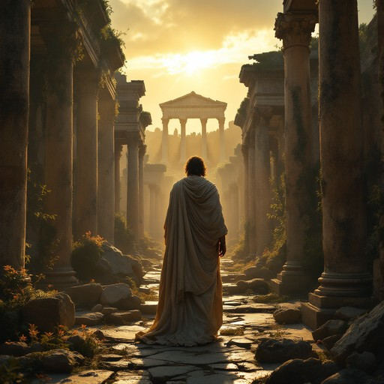
Sermon
“Cracks in the Empire”

Slide 41
“Take My Life, and Let it Be” UMH 399
WORDS: Frances R. Havergal, 1873 MUSIC: Louis J. F. Herold, argd George Kingsley 1839
Please stand as you are able and comfortable.
Take my life, and let it be
consecrated, Lord, to thee.
Take my moments and my days;
let them flow in ceaseless praise.
Take my hands, and let them move
at the impulse of thy love.
Take my feet, and let them be
swift and beautiful for thee.

Slide 42
“Take My Life, and Let it Be” UMH 399
WORDS: Frances R. Havergal, 1873 MUSIC: Louis J. F. Herold, argd George Kingsley 1839
Please stand as you are able and comfortable.
Take my voice, and let me sing
always, only, for my King.
Take my lips, and let them be
filled with messages from thee.
Take my silver and my gold;
not a mite would I withhold.
Take my intellect, and use
every power as thou shalt choose.

Slide 43
“Take My Life, and Let it Be” UMH 399
WORDS: Frances R. Havergal, 1873 MUSIC: Louis J. F. Herold, argd George Kingsley 1839
Please stand as you are able and comfortable.
Take my will, and make it thine;
it shall be no longer mine.
Take my heart, it is thine own;
it shall be thy royal throne.
Take my love, my Lord, I pour
at thy feet its treasure store.
Take myself, and I will be
ever, only, all for thee.

Slide 48
Tithes and Offerings
Worship through giving
Notes:
https://www.goodfon.com/flowers/wallpaper-blue-wood-blossom-spring-flowers-vesna-iablonia-tsvety.html

Slide 49

“Praise God, from Whom All Blessings Flow” UMH 94
WORDS: Thomas Ken, 1674; adapted by Gilbert H. Viera, 1978
MUSIC: Geistliche Kirchengesange, 1623; harmonized by Ralph Vaughn Williams, 1906
Please stand as you are able and comfortable.
Praise God from whom all blessings flow;
Praise God, all creatures here below:
Alleluia! Alleluia!
Praise God, the source of all our gifts!
Praise Jesus Christ, whose power uplifts!
Praise the Spirit, Holy Spirit!
Alleluia! Alleluia! Alleluia!

Slide 50
Offertory Prayer

Slide 51
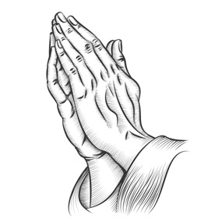
“Sanctuary” TFWS 2164
WORDS and MUSIC: John Thompson and Randy Scruggs, 1982
Please stand as you are able and comfortable.
Lord, prepare me to be a sanctuary,
pure and holy, tried and true.
With thanksgiving, I’ll be a living
sanctuary for you.

Slide 52
“Sanctuary” TFWS 2164
WORDS and MUSIC: John Thompson and Randy Scruggs, 1982
Please stand as you are able and comfortable.
Lord, prepare me to be a sanctuary,
pure and holy, tried and true.
With thanksgiving, I’ll be a living
sanctuary for you.

Slide 59
Postlude
This service has ended, and now
your service in the world begins!

Slide 60
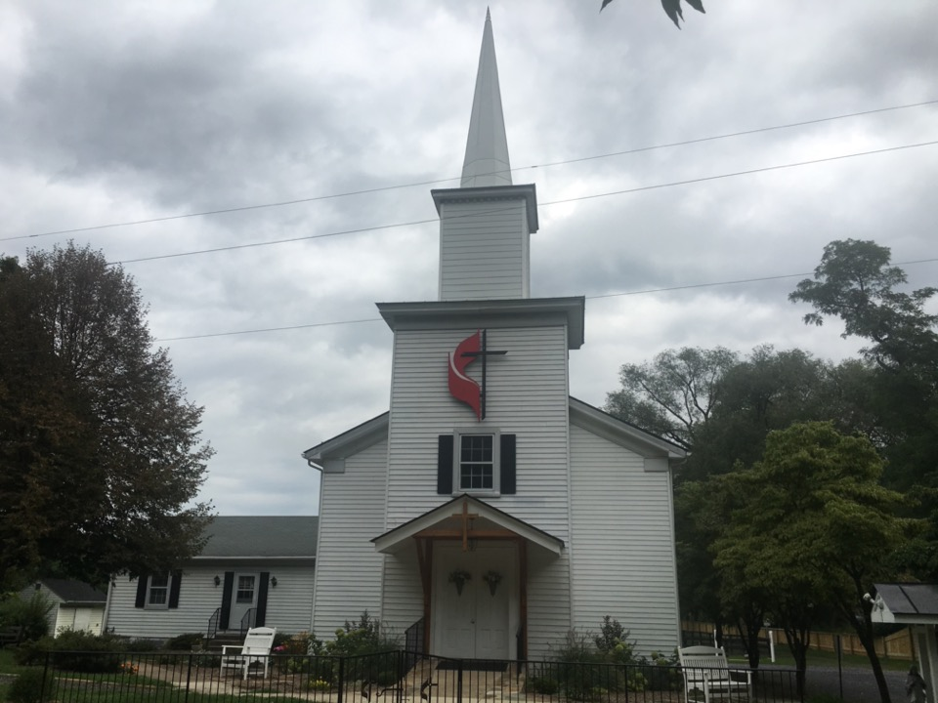
Rectortown United Methodist Church
serving God with
Prayer, Action, and Love
through Service.

