Slide 2
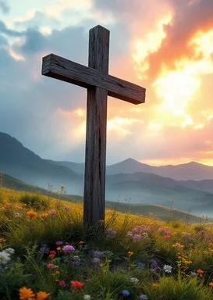
Prelude
Pastor Eduardo Carrillo
Third Sunday after Pentecost
June 14th, 2026
CCLI License:
3430384-01-1829
Livestream Notice: Our worship service is live-streamed and recorded. By attending, you consent to being included in the broadcast. Thank you for joining us!

Slide 3
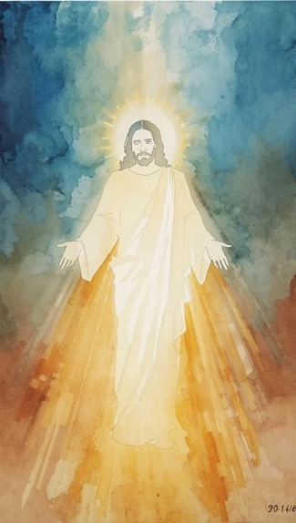
WELCOME,
ANNOUNCEMENTS,
and
CELEBRATIONS
Livestream Notice: Our worship service is live-streamed and recorded. By attending, you consent to being included in the broadcast. Thank you for joining us!

Slide 4
Is anything too hard for the Lord?
Nothing is impossible for our God!

Slide 5
The harvest is plentiful, but the laborers are few
Lord, heal our cynicism and send us out!

Slide 6
You have received without paying; now give without taking.
We come to be filled so we can be poured out! Let us worship the God of the Promise and the God of the Harvest!

Slide 7
God of the Impossible, You turned Sarah’s doubt into a nursery and her laughter into a legacy. We confess that we often stand in the harvest field feeling overwhelmed and underprepared.

Slide 8
Break our hearts for what breaks Yours. Forgive us when we laugh at Your promises instead of living into them. Equip us today with the authority to heal,

Slide 9
the grace to give, and the courage to labor in Your name. We are here, Lord. Send us. Amen.

Slide 10
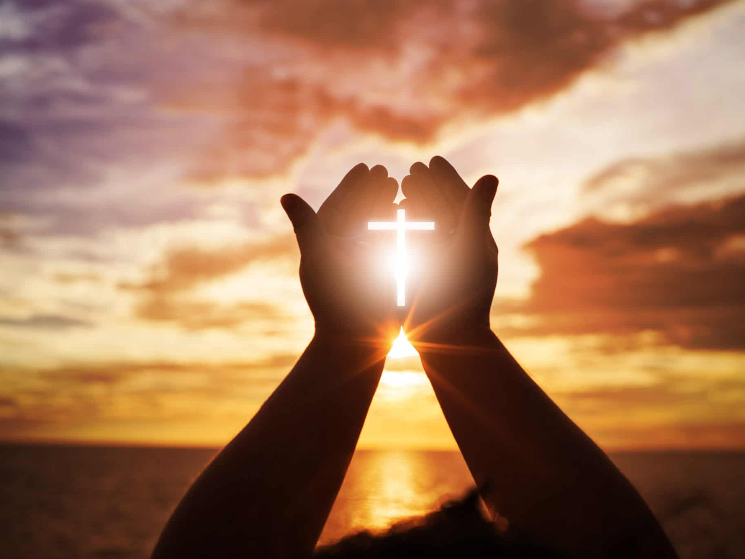
“To God Be The Glory” UMH 98
Words: Fanny J. Crosty, 1875; Music: William H. Doane, 1875
To God be the glory great things He has done
So loved He the world that He gave us His Son
Who yielded His life an atonement for sin
And opened the life gate that all may go in

Slide 11
“To God Be The Glory” UMH 98
Words: Fanny J. Crosty, 1875; Music: William H. Doane, 1875
Praise the Lord praise the Lord
Let the earth hear His voice
Praise the Lord praise the Lord
Let the people rejoice
O come to the Father through Jesus the Son
And give Him the glory great things He has done

Slide 12
“To God Be The Glory” UMH 98
Words: Fanny J. Crosty, 1875; Music: William H. Doane, 1875
O perfect redemption the purchase of blood
To every believer the promise of God
The vilest offender who truly believes
That moment from Jesus a pardon receives

Slide 13
“To God Be The Glory” UMH 98
Words: Fanny J. Crosty, 1875; Music: William H. Doane, 1875
Praise the Lord praise the Lord
Let the earth hear His voice
Praise the Lord praise the Lord
Let the people rejoice
O come to the Father through Jesus the Son
And give Him the glory great things He has done

Slide 14
“To God Be The Glory” UMH 98
Words: Fanny J. Crosty, 1875; Music: William H. Doane, 1875
Great things He has taught us
Great things He has done
And great our rejoicing through Jesus the Son
But purer and higher and greater will be
Our wonder our transport when Jesus we see

Slide 15
“To God Be The Glory” UMH 98
Words: Fanny J. Crosty, 1875; Music: William H. Doane, 1875
Praise the Lord praise the Lord
Let the earth hear His voice
Praise the Lord praise the Lord
Let the people rejoice
O come to the Father through Jesus the Son
And give Him the glory great things He has done

Slide 17
Prayer For Illumination
Spirit of the living God, fall afresh on me.
Spirit of the living God, fall afresh on me.
Melt me, mold me, fill me, use me.
Spirit of the living God, fall afresh on me.
UMH 393

Slide 18

Genesis 18: 1 – 15
NRSVUE

Slide 19
The Lord appeared to Abraham by the oaks of Mamre, as he sat at the entrance of his tent in the heat of the day.
² He looked up and saw three men standing near him. When he saw them, he ran from the tent entrance to meet them and bowed down to the ground.

Slide 20
³ He said, “My lord, if I find favor with you, do not pass by your servant.
⁴ Let a little water be brought, and wash your feet, and rest yourselves under the tree.

Slide 21
⁵ Let me bring a little bread, that you may refresh yourselves, and after that you may pass on—since you have come to your servant.” So they said, “Do as you have said.”
⁶ And Abraham hastened into the tent to Sarah and said, “Make ready quickly three measures of choice flour, knead it, and make cakes.”

Slide 22
⁷ Abraham ran to the herd and took a calf, tender and good, and gave it to the servant, who hastened to prepare it.
⁸ Then he took curds and milk and the calf that he had prepared and set it before them, and he stood by them under the tree while they ate.

Slide 23
⁹ They said to him, “Where is your wife Sarah?” And he said, “There, in the tent.”
¹⁰ Then one said, “I will surely return to you in due season, and your wife Sarah shall have a son.” And Sarah was listening at the tent entrance behind him.

Slide 24
¹¹ Now Abraham and Sarah were old, advanced in age; it had ceased to be with Sarah after the manner of women.
¹² So Sarah laughed to herself, saying, “After I have grown old, and my husband is old, shall I be fruitful?”

Slide 25
¹³ The Lord said to Abraham, “Why did Sarah laugh and say, ‘Shall I indeed bear a child, now that I am old?’
¹⁴ Is anything too wonderful for the Lord? At the set time I will return to you, in due season, and Sarah shall have a son.”

Slide 26
¹⁵ But Sarah denied, saying, “I did not laugh,” for she was afraid. He said, “Yes, you did laugh.”

Slide 27

Romans 5: 1 - 8
NRSVUE

Slide 28
Therefore, since we are justified by faith, we have peace with God through our Lord Jesus Christ,
² through whom we have obtained access to this grace in which we stand, and we boast in our hope of sharing the glory of God.

Slide 29
³ And not only that, but we also boast in our afflictions, knowing that affliction produces endurance,
⁴ and endurance produces character, and character produces hope,

Slide 30
⁵ and hope does not put us to shame, because God’s love has been poured into our hearts through the Holy Spirit that has been given to us.
⁶ For while we were still weak, at the right time Christ died for the ungodly.

Slide 31
⁷ Indeed, rarely will anyone die for a righteous person—though perhaps for a good person someone might actually dare to die.
⁸ But God proves his love for us in that while we still were sinners Christ died for us.

Slide 32
The Word of God for the people of God
Thanks be to God

Slide 33
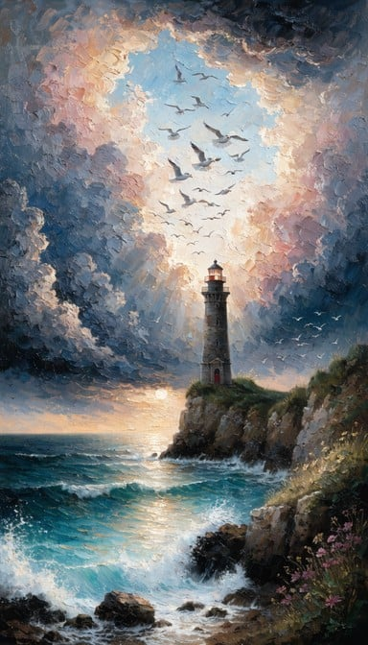
Sermon
“The Audacity of Hope”

Slide 34
“Open My Eyes, That I May See” UMH 454
WORDS and MUSIC: Clara H. Scott, 1895
Please stand as you are able and comfortable.
Open my eyes
that I may see
glimpses of truth
thou hast for me;
place in my hands
the wonderful key
that shall unclasp
and set me free.

Slide 35
“Open My Eyes, That I May See” UMH 454
WORDS and MUSIC: Clara H. Scott, 1895
Please stand as you are able and comfortable.
Silently now
I wait for thee,
ready, my God,
thy will to see.
Open my eyes,
illumine me,
Spirit Divine!

Slide 36
“Open My Eyes, That I May See” UMH 454
WORDS and MUSIC: Clara H. Scott, 1895
Please stand as you are able and comfortable.
Open my ears,
that I may hear
voices of truth
thou sendest clear;
and while the wavenotes
fall on my ear,
everything false
will disappear.

Slide 37
“Open My Eyes, That I May See” UMH 454
WORDS and MUSIC: Clara H. Scott, 1895
Please stand as you are able and comfortable.
Silently now
I wait for thee,
ready, my God,
thy will to see.
Open my ears,
illumine me,
Spirit Divine!

Slide 38
“Open My Eyes, That I May See” UMH 454
WORDS and MUSIC: Clara H. Scott, 1895
Please stand as you are able and comfortable.
Open my mouth,
and let me bear
gladly the warm
truth everywhere;
open my heart
and let me prepare
love with thy children
thus to share.

Slide 39
“Open My Eyes, That I May See” UMH 454
WORDS and MUSIC: Clara H. Scott, 1895
Please stand as you are able and comfortable.
Silently now
I wait for thee,
ready, my God,
thy will to see.
Open my heart,
illumine me,
Spirit Divine!

Slide 49
Tithes and Offerings
Worship through giving
Notes:
https://www.goodfon.com/flowers/wallpaper-blue-wood-blossom-spring-flowers-vesna-iablonia-tsvety.html

Slide 50

“Praise God, from Whom All Blessings Flow” UMH 94
WORDS: Thomas Ken, 1674; adapted by Gilbert H. Viera, 1978
MUSIC: Geistliche Kirchengesange, 1623; harmonized by Ralph Vaughn Williams, 1906
Please stand as you are able and comfortable.
Praise God from whom all blessings flow;
Praise God, all creatures here below:
Alleluia! Alleluia!
Praise God, the source of all our gifts!
Praise Jesus Christ, whose power uplifts!
Praise the Spirit, Holy Spirit!
Alleluia! Alleluia! Alleluia!

Slide 51
Offertory Prayer

Slide 52
“The Summons” TFWS 2130
WORDS: John Bell, 1987 MUSIC: traditional Scottish, arranged by John Bell, 1987
Please stand as you are able and comfortable.
Will you come and follow me
if I but call your name?
Will you go where you don’t know
and never be the same?
Will you let my love be shown,
will you let my name be known,
will you let my life be grown
in you and you in me?

Slide 53
“The Summons” TFWS 2130
WORDS: John Bell, 1987 MUSIC: traditional Scottish, arranged by John Bell, 1987
Please stand as you are able and comfortable.
Will you leave yourself behind
if I but call your name?
Will you care for cruel and kind
and never be the same?
Will you risk the hostile stare
should your life attract or scare?
Will you let me answer prayer
in you and you in me?

Slide 54
“The Summons” TFWS 2130
WORDS: John Bell, 1987 MUSIC: traditional Scottish, arranged by John Bell, 1987
Please stand as you are able and comfortable.
Will you let the blinded see
if I but call your name?
Will you set the prisoners free
and never be the same?
Will you kiss the leper clean,
and do such as this unseen,
and admit to what I mean
in you and you in me?

Slide 55
“The Summons” TFWS 2130
WORDS: John Bell, 1987 MUSIC: traditional Scottish, arranged by John Bell, 1987
Please stand as you are able and comfortable.
Will you love the “you” you hide
if I but call your name?
Will you quell the fear inside
and never be the same?
Will you use the faith you’ve found
to reshape the world around,
through my sight and touch and sound
in you and you in me?

Slide 56
“The Summons” TFWS 2130
WORDS: John Bell, 1987 MUSIC: traditional Scottish, arranged by John Bell, 1987
Please stand as you are able and comfortable.
Lord, your summons echoes true
when you but call my name.
Let me turn and follow you
and never be the same.
In your company I’ll go
where your love and footsteps show.
Thus I’ll move and live and grow
in you and you in me.

Slide 58
BLESSING AND BENEDICTION
This service has ended, and now
your service in the world begins!

Slide 59
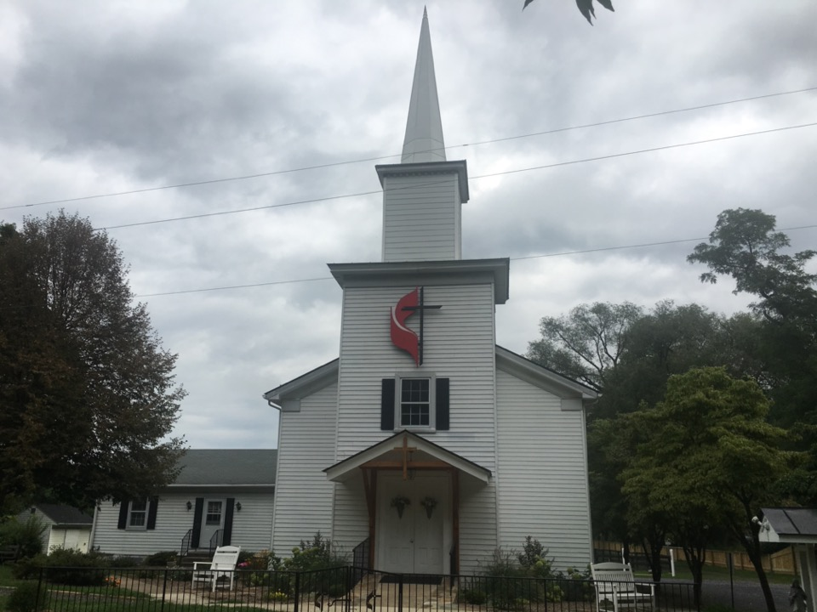
Rectortown United Methodist Church
serving God with
Prayer, Action, and Love
through Service.

