Slide 2
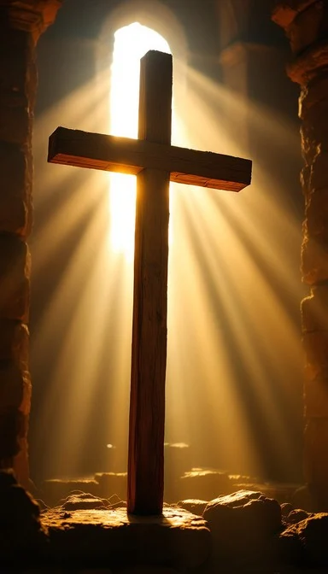
Prelude
Pastor Eduardo Carrillo
3rd Sunday after Easter
April 19th, 2026
CCLI License:
3430384-01-1829
Livestream Notice: Our worship service is live-streamed and recorded. By attending, you consent to being included in the broadcast. Thank you for joining us!

Slide 3
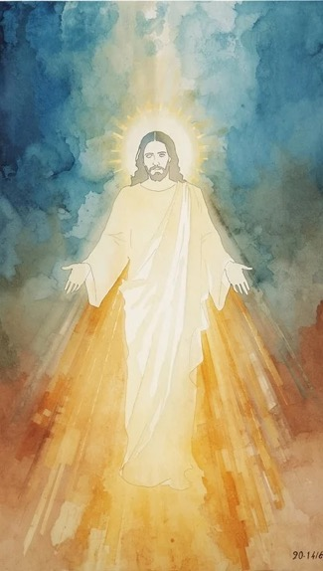
WELCOME,
ANNOUNCEMENTS,
and
CELEBRATIONS
Livestream Notice: Our worship service is live-streamed and recorded. By attending, you consent to being included in the broadcast. Thank you for joining us!

Slide 4
Come, let us celebrate! Our God has
heard our cry and answered!
We love the Lord, for He has
heard our voice!

Slide 5
On the road of life, when hope
seemed lost, Christ walked beside us!
Our hearts burn within us, Jesus
is alive and near!

Slide 6
He has lifted us from despair and set our feet to dancing
We come with joy to worship our risen, living King!
All: Let us worship the One who walks with us!

Slide 7
Lord of hope and joy, we gather with grateful hearts. Like the disciples on the road to Emmaus, You have walked with us through confusion and grief and revealed Yourself in ways that set our hearts ablaze

Slide 8
Like the Psalmist, we cry out, You have heard us! You have saved us! Open our eyes afresh today. Open Your Word to us, break bread among us,

Slide 9
and let us leave this place transformed. We come expectant, we come hopeful, we come full of faith. In Jesus' name, Amen.

Slide 10
“Amazing Grace” UMH 378
WORDS: John Newton, 1779
MUSIC: 19th Century USA melody, harmonization by Edwin O. Excell, 1900
Please stand as you are able and comfortable.
Amazing grace!
How sweet the sound
that saved a wretch like me!
I once was lost
but now am found;
was blind, but now I see.

Slide 11
“Amazing Grace” UMH 378
WORDS: John Newton, 1779
MUSIC: 19th Century USA melody, harmonization by Edwin O. Excell, 1900
Please stand as you are able and comfortable.
’Twas grace that taught
my heart to fear,
and grace my fears relieved;
how precious did
that grace appear
the hour I first believed.

Slide 12
“Amazing Grace” UMH 378
WORDS: John Newton, 1779
MUSIC: 19th Century USA melody, harmonization by Edwin O. Excell, 1900
Please stand as you are able and comfortable.
Through many dangers,
toils, and snares,
I have already come;
‘tis grace hath brought
me safe thus far,
and grace will lead me home.

Slide 13
“Amazing Grace” UMH 378
WORDS: John Newton, 1779
MUSIC: 19th Century USA melody, harmonization by Edwin O. Excell, 1900
Please stand as you are able and comfortable.
The Lord has promised
good to me,
his word my hope secures;
he will my shield
and portion be,
as long as life endures.

Slide 14
“Amazing Grace” UMH 378
WORDS: John Newton, 1779
MUSIC: 19th Century USA melody, harmonization by Edwin O. Excell, 1900
Please stand as you are able and comfortable.
Yea, when this flesh
and heart shall fail,
and mortal life shall cease,
I shall possess,
within the veil,
a life of joy and peace.

Slide 15
“Amazing Grace” UMH 378
WORDS: John Newton, 1779
MUSIC: 19th Century USA melody, harmonization by Edwin O. Excell, 1900
Please stand as you are able and comfortable.
When we’ve been
there ten thousand years,
bright shining as the sun,
we’ve no less days
to sing God’s praise
than when we’d first begun.

Slide 17
Prayer For Illumination
Spirit of the living God, fall afresh on me.
Spirit of the living God, fall afresh on me.
Melt me, mold me, fill me, use me.
Spirit of the living God, fall afresh on me.
UMH 393

Slide 18

Psalm 116: 1 – 4, 12 – 19
NRSVUE

Slide 19
¹ I love the Lord because he has heard my voice and my supplications.
² Because he inclined his ear to me, therefore I will call on him as long as I live.
³ The snares of death encompassed me; the pangs of Sheol laid hold on me; I suffered distress and anguish.

Slide 20
⁴ Then I called on the name of the Lord, “O Lord, I pray, save my life!”
¹² What shall I return to the Lord for all his bounty to me?
¹³ I will lift up the cup of salvation and call on the name of the Lord;

Slide 21
¹⁴ I will pay my vows to the Lord in the presence of all his people.
¹⁵ Precious in the sight of the Lord is the death of his faithful ones.
¹⁶ O Lord, I am your servant; I am your servant, the child of your serving girl. You have loosed my bonds.

Slide 22
¹⁷ I will offer to you a thanksgiving sacrifice and call on the name of the Lord.
¹⁸ I will pay my vows to the Lord in the presence of all his people,
¹⁹ in the courts of the house of the Lord, in your midst, O Jerusalem. Praise the Lord!

Slide 23
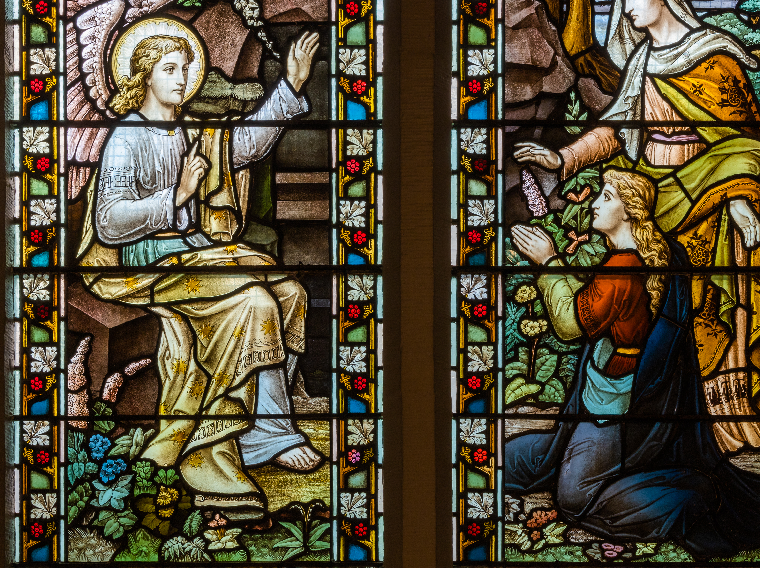
Luke 24: 13 – 35
NRSVUE

Slide 24
¹³ Now on that same day two of them were going to a village called Emmaus, about seven miles from Jerusalem,
¹⁴ and talking with each other about all these things that had happened.
¹⁵ While they were talking and discussing, Jesus himself came near and went with them,

Slide 25
¹⁶ but their eyes were kept from recognizing him.
¹⁷ And he said to them, “What are you discussing with each other while you walk along?” They stood still, looking sad.

Slide 26
¹⁸ Then one of them, whose name was Cleopas, answered him, “Are you the only stranger in Jerusalem who does not know the things that have taken place there in these days?”
¹⁹ He asked them, “What things?” They replied, “The things about Jesus of Nazareth, who was a prophet mighty in deed and word before God and all the people,

Slide 27
²⁰ and how our chief priests and leaders handed him over to be condemned to death and crucified him.
²¹ But we had hoped that he was the one to redeem Israel. Yes, and besides all this, it is now the third day since these things took place.

Slide 28
²² Moreover, some women of our group astounded us. They were at the tomb early this morning,
²³ and when they did not find his body there they came back and told us that they had indeed seen a vision of angels who said that he was alive.

Slide 29
²⁴ Some of those who were with us went to the tomb and found it just as the women had said, but they did not see him.”
²⁵ Then he said to them, “Oh, how foolish you are and how slow of heart to believe all that the prophets have declared!

Slide 30
²⁶ Was it not necessary that the Messiah should suffer these things and then enter into his glory?”
²⁷ Then beginning with Moses and all the prophets, he interpreted to them the things about himself in all the scriptures.

Slide 31
²⁸ As they came near the village to which they were going, he walked ahead as if he were going on.
²⁹ But they urged him strongly, saying, “Stay with us, because it is almost evening and the day is now nearly over.” So he went in to stay with them.

Slide 32
³⁰ When he was at the table with them, he took bread, blessed and broke it, and gave it to them.
³¹ Then their eyes were opened, and they recognized him, and he vanished from their sight.

Slide 33
³² They said to each other, “Were not our hearts burning within us while he was talking to us on the road, while he was opening the scriptures to us?”
³³ That same hour they got up and returned to Jerusalem, and they found the eleven and their companions gathered together.

Slide 34
³⁴ They were saying, “The Lord has risen indeed, and he has appeared to Simon!”
³⁵ Then they told what had happened on the road and how he had been made known to them in the breaking of the bread.

Slide 35
The Word of God for the people of God
Thanks be to God

Slide 36
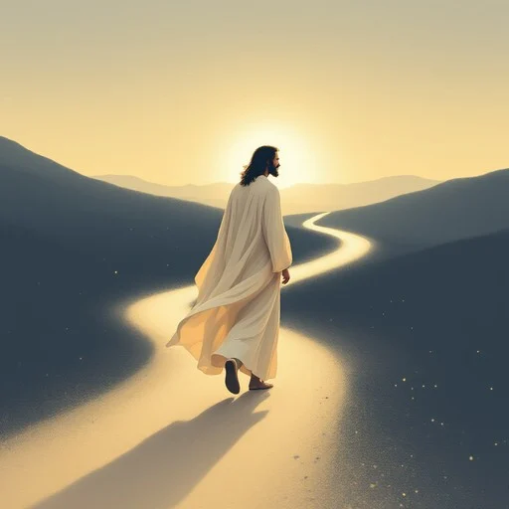
Sermon
“Company for the Road”

Slide 37
“Nothing but the Blood” UMH 362
WORDS and MUSIC: Robert Lowry, 1876
Please stand as you are able and comfortable.
What can wash away my sin?
Nothing but the blood of Jesus.
What can make me whole again?
Nothing but the blood of Jesus.
O precious is the flow
that makes me bright as snow;
no other fount I know;
nothing but the blood of Jesus.

Slide 38
“Nothing but the Blood” UMH 362
WORDS and MUSIC: Robert Lowry, 1876
Please stand as you are able and comfortable.
For my pardon this I see:
nothing but the blood of Jesus.
For my cleansing this my plea:
nothing but the blood of Jesus.
O precious is the flow
that makes me bright as snow;
no other fount I know;
nothing but the blood of Jesus.

Slide 39
“Nothing but the Blood” UMH 362
WORDS and MUSIC: Robert Lowry, 1876
Please stand as you are able and comfortable.
Nothing can for sin atone:
nothing but the blood of Jesus.
Naught of good that I have done:
nothing but the blood of Jesus.
O precious is the flow
that makes me bright as snow;
no other fount I know;
nothing but the blood of Jesus.

Slide 40
“Nothing but the Blood” UMH 362
WORDS and MUSIC: Robert Lowry, 1876
Please stand as you are able and comfortable.
This is all my hope and peace:
nothing but the blood of Jesus.
This is all my righteousness:
nothing but the blood of Jesus.
O precious is the flow
that makes me bright as snow;
no other fount I know;
nothing but the blood of Jesus.

Slide 50
Tithes and Offerings
Worship through giving
Notes:
https://www.goodfon.com/flowers/wallpaper-blue-wood-blossom-spring-flowers-vesna-iablonia-tsvety.html

Slide 51

“Praise God, from Whom All Blessings Flow” UMH 94
WORDS: Thomas Ken, 1674; adapted by Gilbert H. Viera, 1978
MUSIC: Geistliche Kirchengesange, 1623; harmonized by Ralph Vaughn Williams, 1906
Please stand as you are able and comfortable.
Praise God from whom all blessings flow;
Praise God, all creatures here below:
Alleluia! Alleluia!
Praise God, the source of all our gifts!
Praise Jesus Christ, whose power uplifts!
Praise the Spirit, Holy Spirit!
Alleluia! Alleluia! Alleluia!

Slide 52
Offertory Prayer

Slide 53
“Victory in Jesus” UMH 370
WORDS and MUSIC: Eugene M. Bartlett, 1939
Please stand as you are able and comfortable.
I heard and old, old story,
how a Savior came from glory,
how he gave his life on Calvary
to save a wretch like me;
I heard about his groaning,
of his precious blood’s atoning,
then I repented of my sins
and won the victory.

Slide 54
“Victory in Jesus” UMH 370
WORDS and MUSIC: Eugene M. Bartlett, 1939
Please stand as you are able and comfortable.
O victory in Jesus, my Savior forever!
He sought me and bought me
with his redeeming blood;
he loved me ere I knew him,
and all my love is due him;
he plunged me to victory
beneath the cleansing flood.

Slide 55
“Victory in Jesus” UMH 370
WORDS and MUSIC: Eugene M. Bartlett, 1939
Please stand as you are able and comfortable.
I heard about his healing,
of his cleansing power revealing,
how he made the lame to walk again
and caused the blind to see;
and then I cried, “Dear Jesus,
come and heal my broken spirit,”
and somehow Jesus came and brought
to me the victory.

Slide 56
“Victory in Jesus” UMH 370
WORDS and MUSIC: Eugene M. Bartlett, 1939
Please stand as you are able and comfortable.
O victory in Jesus, my Savior forever!
He sought me and bought me
with his redeeming blood;
he loved me ere I knew him,
and all my love is due him;
he plunged me to victory
beneath the cleansing flood.

Slide 57
“Victory in Jesus” UMH 370
WORDS and MUSIC: Eugene M. Bartlett, 1939
Please stand as you are able and comfortable.
I heard about a mansion
he has built for me in glory,
and I heard about the streets of gold
beyond the crystal sea;
about the angels singing
and the old redemption story,
and some sweet day I’ll sing up there
the song of victory.

Slide 58
“Victory in Jesus” UMH 370
WORDS and MUSIC: Eugene M. Bartlett, 1939
Please stand as you are able and comfortable.
O victory in Jesus, my Savior forever!
He sought me and bought me
with his redeeming blood;
he loved me ere I knew him,
and all my love is due him;
he plunged me to victory
beneath the cleansing flood.

Slide 60
BLESSING AND BENEDICTION
This service has ended, and now
your service in the world begins!

Slide 61
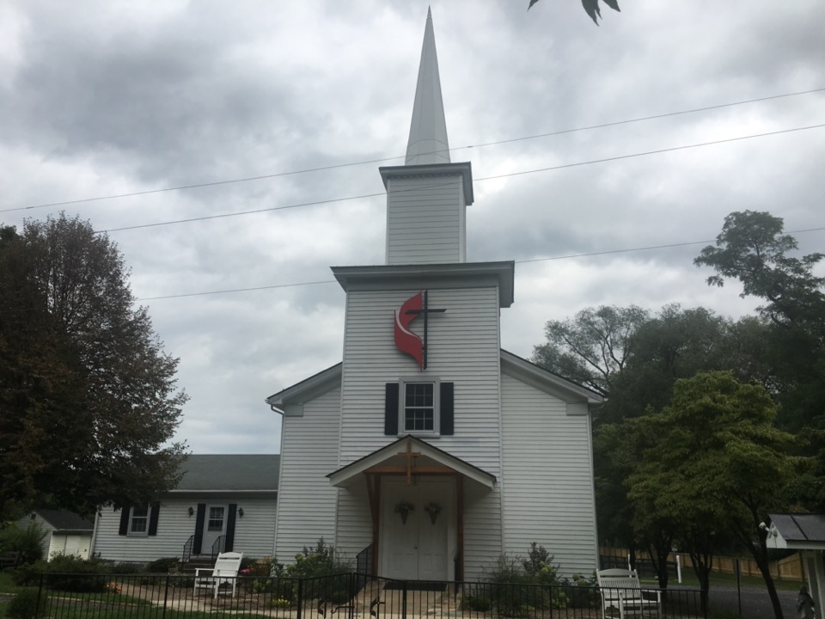
Rectortown United Methodist Church
serving God with
Prayer, Action, and Love
through Service.

