Slide 2
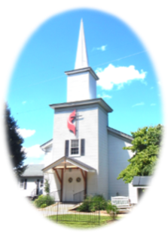
Prelude
Pastor Eduardo Carrillo
Fifth Sunday after Pentecost
June 28th, 2026
CCLI License:
3430384-01-1829
Livestream Notice: Our worship service is live-streamed and recorded. By attending, you consent to being included in the broadcast. Thank you for joining us!

Slide 3
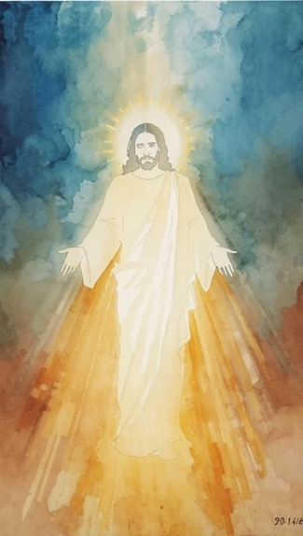
WELCOME,
ANNOUNCEMENTS,
and
CELEBRATIONS
Livestream Notice: Our worship service is live-streamed and recorded. By attending, you consent to being included in the broadcast. Thank you for joining us!

Slide 4
To everything there is a season, and a time for every purpose under heaven.
A time to weep, and a time to laugh; a time to mourn, and a time to dance.

Slide 5
We bring the fullness of our seasons into this space today.
For weeping may endure for a night, but joy comes in the morning.

Slide 6
God has turned our mourning into
dancing; He has clothed us with gladness.
Therefore our hearts will sing praise to You and not be silent.

Slide 7
Let us worship the Lord of all our
seasons!
Let us praise our God for his perfect timing.

Slide 8
Eternal God, Creator of time and Architect of our lives, we gather today acknowledging that our days are held safely in Your hands. We thank You that You do not change,

Slide 9
even when the world around us shifts like the wind. Lord, we confess that some of us enter this room in seasons of heavy weeping, carrying grief, exhaustion, or uncertainty.

Slide 10
Others enter in seasons of dancing, filled with laughter, gratitude, and light. We thank You that You are the God of both the night and the day, in time and out of time. Amen.

Slide 11
“Come, Thou Fount of Every Blessing” UMH 400
WORDS: Robert Robinson, 1758 MUSIC: Wyeth’s Repository of Sacred Music, Part Second, 1813
Please stand as you are able and comfortable.
Come, thou Fount of every blessing,
tune my heart to sing thy grace;
streams of mercy, never ceasing,
call for song of loudest praise.
Teach me some melodious sonnet,
sung by flaming tongues above.
Praise the mount! I’m fixed upon it,
mount of thy redeeming love.

Slide 12
“Come, Thou Fount of Every Blessing” UMH 400
WORDS: Robert Robinson, 1758 MUSIC: Wyeth’s Repository of Sacred Music, Part Second, 1813
Please stand as you are able and comfortable.
Here I raise mine Ebenezer;
hither by thy help I’m come;
and I hope, by thy good pleasure,
safely to arrive at home.
Jesus sought me when a stranger, wandering from the fold of God;
he, to rescue me from danger,
interposed his precious blood.

Slide 13
“Come, Thou Fount of Every Blessing” UMH 400
WORDS: Robert Robinson, 1758 MUSIC: Wyeth’s Repository of Sacred Music, Part Second, 1813
Please stand as you are able and comfortable.
O to grace how great a deptor
daily I’m constrained to be!
Let thy goodness, like a fetter
bind my wandering heart to thee.
Prone to wander, Lord, I feel it,
prone to leave the God I love;
here’s my heart, O take and seal it,
seal it for thy courts above.

Slide 15
Prayer For Illumination
Spirit of the living God, fall afresh on me.
Spirit of the living God, fall afresh on me.
Melt me, mold me, fill me, use me.
Spirit of the living God, fall afresh on me.
UMH 393

Slide 16

Psalm 30
NRSVUE

Slide 17
¹ I will extol you, O Lord, for you have drawn me up and did not let my foes rejoice over me.
² O Lord my God, I cried to you for help, and you have healed me.
³ O Lord, you brought up my soul from Sheol, restored me to life from among those gone down to the Pit.

Slide 18
⁴ Sing praises to the Lord, O you his faithful ones, and give thanks to his holy name.
⁵ For his anger is but for a moment; his favor is for a lifetime. Weeping may linger for the night, but joy comes with the morning.
⁶ As for me, I said in my prosperity, “I shall never be moved.”

Slide 19
⁷ By your favor, O Lord, you had established me as a strong mountain; you hid your face; I was dismayed.
⁸ To you, O Lord, I cried, and to the Lord I made supplication:
⁹ “What profit is there in my death, if I go down to the Pit? Will the dust praise you? Will it tell of your faithfulness?

Slide 20
¹⁰ Hear, O Lord, and be gracious to me! O Lord, be my helper!”
¹¹ You have turned my mourning into dancing; you have taken off my sackcloth and clothed me with joy,
¹² so that my soul may praise you and not be silent. O Lord my God, I will give thanks to you forever.

Slide 21
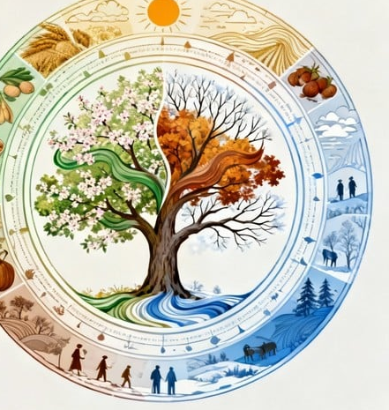
Ecclesiastes 3: 1 – 8
NRSVUE

Slide 22
For everything there is a season and a time for every matter under heaven:
² a time to be born and a time to die; a time to plant and a time to pluck up what is planted;
³ a time to kill and a time to heal; a time to break down and a time to build up;

Slide 23
⁴ a time to weep and a time to laugh; a time to mourn and a time to dance;
⁵ a time to throw away stones and a time to gather stones together; a time to embrace and a time to refrain from embracing;
⁶ a time to seek and a time to lose; a time to keep and a time to throw away;

Slide 24
⁷ a time to tear and a time to sew; a time to keep silent and a time to speak;
⁸ a time to love and a time to hate; a time for war and a time for peace.

Slide 25
The Word of God for the people of God
Thanks be to God

Slide 26
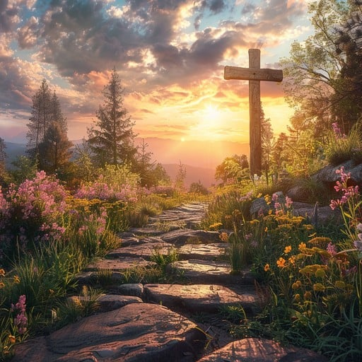
Sermon
Wayne Frick
Guest Speaker

Slide 27
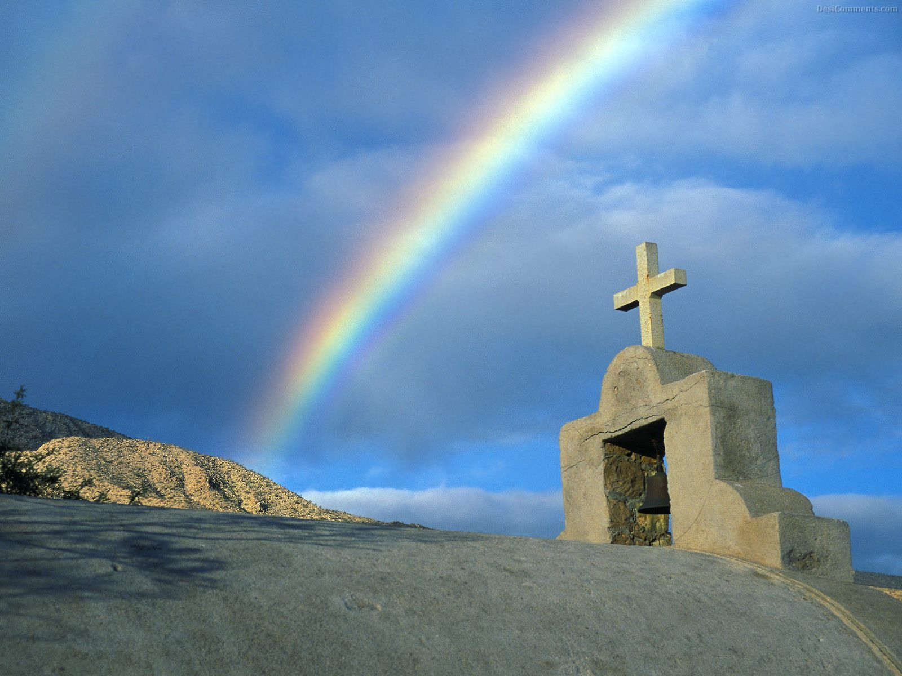
“Hymn of Promise” UMH 707
WORDS and MUSIC: Natalie Sleeth, 1986
Please stand as you are able and comfortable.
In the bulb there is a flower;
in the seed, an apple tree;
in cocoons, a hidden promise:
butterflies will soon be free!
In the cold and snow of winter
there’s a spring that waits to be,
unrevealed until its season,
something God alone can see.

Slide 28
“Hymn of Promise” UMH 707
WORDS and MUSIC: Natalie Sleeth, 1986
Please stand as you are able and comfortable.
There’s a song in every silence,
seeking word and melody;
there’s a dawn in every darkness,
bringing hope to you and me.
From the past will come the future;
what it holds, a mystery,
unrevealed until its season,
something God alone can see.

Slide 29
“Hymn of Promise” UMH 707
WORDS and MUSIC: Natalie Sleeth, 1986
Please stand as you are able and comfortable.
In our end is our beginning;
in our time, infinity;
in our doubt there is believing;
in our life, eternity.
In our death, a resurrection;
at the last, a victory,
unrevealed until its season,
something God alone can see.

Slide 39
Tithes and Offerings
Worship through giving
Notes:
https://www.goodfon.com/flowers/wallpaper-blue-wood-blossom-spring-flowers-vesna-iablonia-tsvety.html

Slide 40

“Praise God, from Whom All Blessings Flow” UMH 94
WORDS: Thomas Ken, 1674; adapted by Gilbert H. Viera, 1978
MUSIC: Geistliche Kirchengesange, 1623; harmonized by Ralph Vaughn Williams, 1906
Please stand as you are able and comfortable.
Praise God from whom all blessings flow;
Praise God, all creatures here below:
Alleluia! Alleluia!
Praise God, the source of all our gifts!
Praise Jesus Christ, whose power uplifts!
Praise the Spirit, Holy Spirit!
Alleluia! Alleluia! Alleluia!

Slide 41
Offertory Prayer

Slide 42
“Great is Thy Faithfulness” UMH 140
WORDS: Thomas O. Chisholm, 1923 MUSIC: William M. Runyan, 1923
Please stand as you are able and comfortable.
Great is thy faithfulness,
O God my Father;
there is no shadow
of turning with thee;
thou changest not,
thy compassions, they fail not;
as thou hast been,
thou forever wilt be.

Slide 43
“Great is Thy Faithfulness” UMH 140
WORDS: Thomas O. Chisholm, 1923 MUSIC: William M. Runyan, 1923
Please stand as you are able and comfortable.
Great is thy faithfulness!
Great is thy faithfulness!
Morning by morning
new mercies I see;
all I have needed
thy hand hath provided;
great is thy faithfulness,
Lord, unto me!

Slide 44
“Great is Thy Faithfulness” UMH 140
WORDS: Thomas O. Chisholm, 1923 MUSIC: William M. Runyan, 1923
Please stand as you are able and comfortable.
Summer and winter
and springtime and harvest,
sun, moon, and stars
in their courses above
join with all nature
in manifold witness
to thy great faithfulness,
mercy, and love.

Slide 45
“Great is Thy Faithfulness” UMH 140
WORDS: Thomas O. Chisholm, 1923 MUSIC: William M. Runyan, 1923
Please stand as you are able and comfortable.
Great is thy faithfulness!
Great is thy faithfulness!
Morning by morning
new mercies I see;
all I have needed
thy hand hath provided;
great is thy faithfulness,
Lord, unto me!

Slide 46
“Great is Thy Faithfulness” UMH 140
WORDS: Thomas O. Chisholm, 1923 MUSIC: William M. Runyan, 1923
Please stand as you are able and comfortable.
Pardon for sin and
a peace that endureth,
thine own dear presence
to cheer and to guide;
strength for today and
bright hope for tomorrow,
blessings all mine, with ten
thousand beside!

Slide 47
“Great is Thy Faithfulness” UMH 140
WORDS: Thomas O. Chisholm, 1923 MUSIC: William M. Runyan, 1923
Please stand as you are able and comfortable.
Great is thy faithfulness!
Great is thy faithfulness!
Morning by morning
new mercies I see;
all I have needed
thy hand hath provided;
great is thy faithfulness,
Lord, unto me!

Slide 49
BLESSING AND BENEDICTION
This service has ended, and now
your service in the world begins!

Slide 50
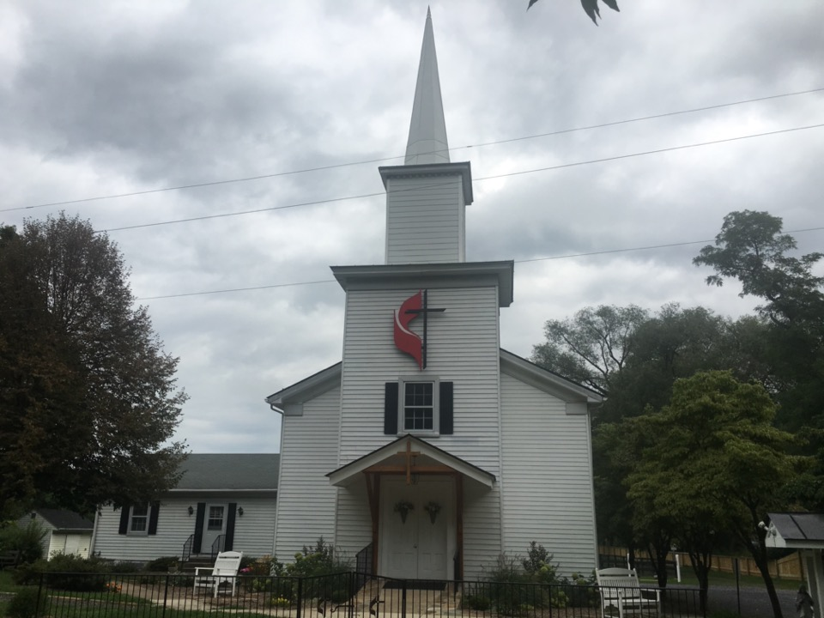
Rectortown United Methodist Church
serving God with
Prayer, Action, and Love
through Service.

