Slide 2
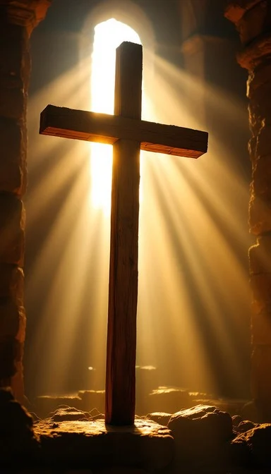
Prelude
Pastor Eduardo Carrillo
4th Sunday after Easter
April 26th, 2026
CCLI License:
3430384-01-1829
Livestream Notice: Our worship service is live-streamed and recorded. By attending, you consent to being included in the broadcast. Thank you for joining us!

Slide 3
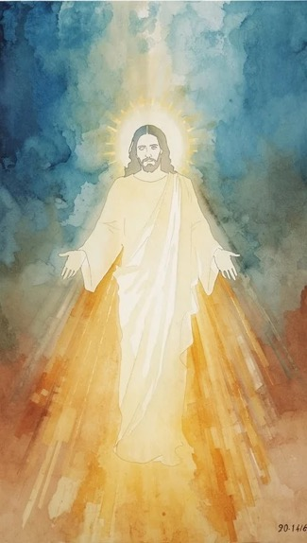
WELCOME,
ANNOUNCEMENTS,
and
CELEBRATIONS
Livestream Notice: Our worship service is live-streamed and recorded. By attending, you consent to being included in the broadcast. Thank you for joining us!

Slide 4
In the noise and rush of life, we pause and remember — we are not alone.
The Lord is our Shepherd; we shall not want.

Slide 5
He knows our name. He calls us. He leads us beside still waters.
We are His sheep, and His voice we know and trust.

Slide 6
Come, let us still our hearts and enter His presence with reverence
We come to worship the One who provides all we need.

Slide 7
Gracious Shepherd, we quiet ourselves before You now. You know our needs before we speak them. You have led us through valleys we feared and restored us in ways we did not expect.

Slide 8
Teach us today to trust You fully, not just for what You give, but for who You are. As we open Your Word, guide us through the gate of Your truth

Slide 9
into the pasture of Your presence. Still our anxious hearts. Feed our hungry souls. You are enough. You have always been enough. Amen.

Slide 10
“Rock of Ages, Cleft for Me” UMH 361
WORDS: Augustus M. Toplady, 1776 MUSIC: Thomas Hastings, 1830
Please stand as you are able and comfortable.
Rock of Ages, cleft for me,
let me hide myself in thee;
let the water and the blood,
from thy wounded side which flowed, be of sin the double cure;
save from wrath and make me pure.

Slide 11
“Rock of Ages, Cleft for Me” UMH 361
WORDS: Augustus M. Toplady, 1776 MUSIC: Thomas Hastings, 1830
Please stand as you are able and comfortable.
Not the labors of my hands
can fulfill thy law's demands;
could my zeal no respite know,
could my tears forever flow,
all for sin could not atone;
thou must save, and thou alone.

Slide 12
“Rock of Ages, Cleft for Me” UMH 361
WORDS: Augustus M. Toplady, 1776 MUSIC: Thomas Hastings, 1830
Please stand as you are able and comfortable.
Nothing in my hand I bring,
simply to the cross I cling;
naked, come to thee for dress;
helpless, look to thee for grace;
foul, I to the fountain fly;
wash me, Savior, or I die.

Slide 13
“Rock of Ages, Cleft for Me” UMH 361
WORDS: Augustus M. Toplady, 1776 MUSIC: Thomas Hastings, 1830
Please stand as you are able and comfortable.
While I draw this fleeting breath,
when mine eyes shall close in death, when I soar to world unknown,
see thee on thy judgment throne,
Rock of Ages, cleft for me,
let me hide myself in thee.

Slide 15
Prayer For Illumination
Spirit of the living God, fall afresh on me.
Spirit of the living God, fall afresh on me.
Melt me, mold me, fill me, use me.
Spirit of the living God, fall afresh on me.
UMH 393

Slide 16
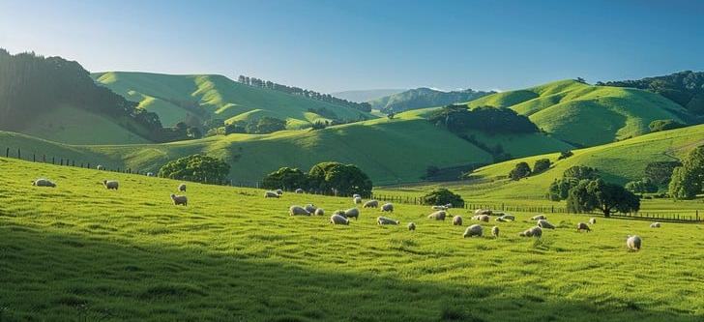
Psalm 23
NRSVUE

Slide 17
¹ The Lord is my shepherd; I shall not want.
² He makes me lie down in green pastures; he leads me beside still waters;
³he restores my soul. He leads me in right paths for his name’s sake.

Slide 18
⁴Even though I walk through the darkest valley, I fear no evil, for you are with me; your rod and your staff, they comfort me.
⁵ You prepare a table before me in the presence of my enemies; you anoint my head with oil; my cup overflows.

Slide 19
⁶Surely goodness and mercy shall follow me all the days of my life, and I shall dwell in the house of the Lord my whole life long.

Slide 20
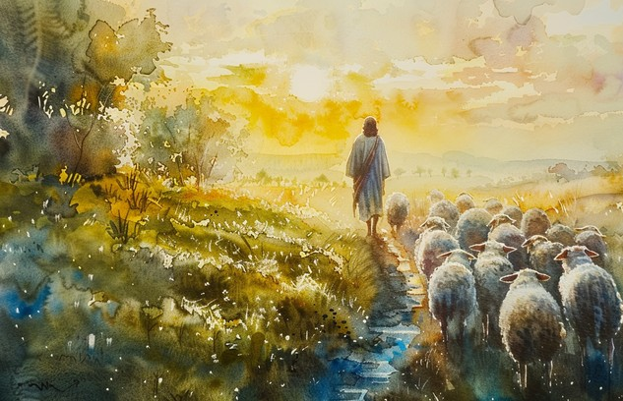
John 10: 1 – 10
NRSVUE

Slide 21
¹“Very truly, I tell you, anyone who does not enter the sheepfold by the gate but climbs in by another way is a thief and a bandit.
² The one who enters by the gate is the shepherd of the sheep.
³ The gatekeeper opens the gate for him, and the sheep hear his voice. He calls his own sheep by name and leads them out.

Slide 22
⁴ When he has brought out all his own, he goes ahead of them, and the sheep follow him because they know his voice.
⁵ They will not follow a stranger, but they will run from him because they do not know the voice of strangers.”

Slide 23
⁶ Jesus used this figure of speech with them, but they did not understand what he was saying to them.
⁷ So again Jesus said to them, “Very truly, I tell you, I am the gate for the sheep.
⁸ All who came before me are thieves and bandits, but the sheep did not listen to them.

Slide 24
⁹ I am the gate. Whoever enters by me will be saved and will come in and go out and find pasture.
¹⁰ The thief comes only to steal and kill and destroy. I came that they may have life and have it abundantly.

Slide 25
The Word of God for the people of God
Thanks be to God

Slide 26
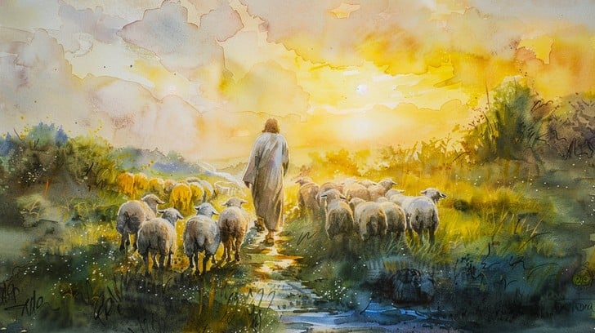
Sermon
“The Shepherd’s Flock”

Slide 27

“Take Time to Be Holy” UMH 395
WORDS: William D. Longstaff, ca. 1882 MUSIC: George C. Stebbins, 1890
Please stand as you are able and comfortable.

Slide 28
“Take Time to Be Holy” UMH 395
WORDS: William D. Longstaff, ca. 1882 MUSIC: George C. Stebbins, 1890
Please stand as you are able and comfortable.
Take time to be holy,
speak oft with thy Lord;
abide in him always,
and feed on his word.
Make friends of God’s children,
help those who are weak,
forgetting in nothing
his blessing to seek.

Slide 29
“Take Time to Be Holy” UMH 395
WORDS: William D. Longstaff, ca. 1882 MUSIC: George C. Stebbins, 1890
Please stand as you are able and comfortable.
Take time to be holy,
the world rushes on;
spend much time in secret
with Jesus alone.
By looking to Jesus,
like him thou shalt be;
thy friends in thy conduct
his likeness shall see.

Slide 30
“Take Time to Be Holy” UMH 395
WORDS: William D. Longstaff, ca. 1882 MUSIC: George C. Stebbins, 1890
Please stand as you are able and comfortable.
Take time to be holy,
let him be thy guide,
and run not before him,
whatever betide.
In joy or in sorrow,
still follow the Lord,
and, looking to Jesus,
still trust in his word.

Slide 31
“Take Time to Be Holy” UMH 395
WORDS: William D. Longstaff, ca. 1882 MUSIC: George C. Stebbins, 1890
Please stand as you are able and comfortable.
Take time to be holy,
be calm in thy soul,
each thought and each motive
beneath his control.
Thus led by his spirit
to fountains of love,
thou soon shalt be fitted
for service above.

Slide 41
Tithes and Offerings
Worship through giving
Notes:
https://www.goodfon.com/flowers/wallpaper-blue-wood-blossom-spring-flowers-vesna-iablonia-tsvety.html

Slide 42

“Praise God, from Whom All Blessings Flow” UMH 94
WORDS: Thomas Ken, 1674; adapted by Gilbert H. Viera, 1978
MUSIC: Geistliche Kirchengesange, 1623; harmonized by Ralph Vaughn Williams, 1906
Please stand as you are able and comfortable.
Praise God from whom all blessings flow;
Praise God, all creatures here below:
Alleluia! Alleluia!
Praise God, the source of all our gifts!
Praise Jesus Christ, whose power uplifts!
Praise the Spirit, Holy Spirit!
Alleluia! Alleluia! Alleluia!

Slide 43
Offertory Prayer

Slide 44
“Together We Serve” TFWS 2175
WORDS and MUSIC: Daniel Charles Damon, 1998
Please stand as you are able and comfortable.
Together we serve,
united by love,
inviting God’s world
to the glorious feast.
We work and we pray
through sorrow and joy,
extending your love to
the last and the least.

Slide 45
“Together We Serve” TFWS 2175
WORDS and MUSIC: Daniel Charles Damon, 1998
Please stand as you are able and comfortable.
We seek to become
a beacon of hope,
a lamp for the heart
and a light for the feet.
We learn, year by year,
to let love shine through
until we see Christ in
each person we meet.

Slide 46
“Together We Serve” TFWS 2175
WORDS and MUSIC: Daniel Charles Damon, 1998
Please stand as you are able and comfortable.
We welcome the scarred,
the wealthy, the poor,
the busy, the lonely,
and all who need care.
We offer a home
to those who will come,
our hands quick to help, our
hearts ready to dare.

Slide 47
“Together We Serve” TFWS 2175
WORDS and MUSIC: Daniel Charles Damon, 1998
Please stand as you are able and comfortable.
Together, by grace,
we witness and work,
remembering Jesus,
in whom we grow strong.
Together we serve
in Spirit and truth,
remembering love is
the strength of our song.

Slide 49
BLESSING AND BENEDICTION
This service has ended, and now
your service in the world begins!

Slide 50
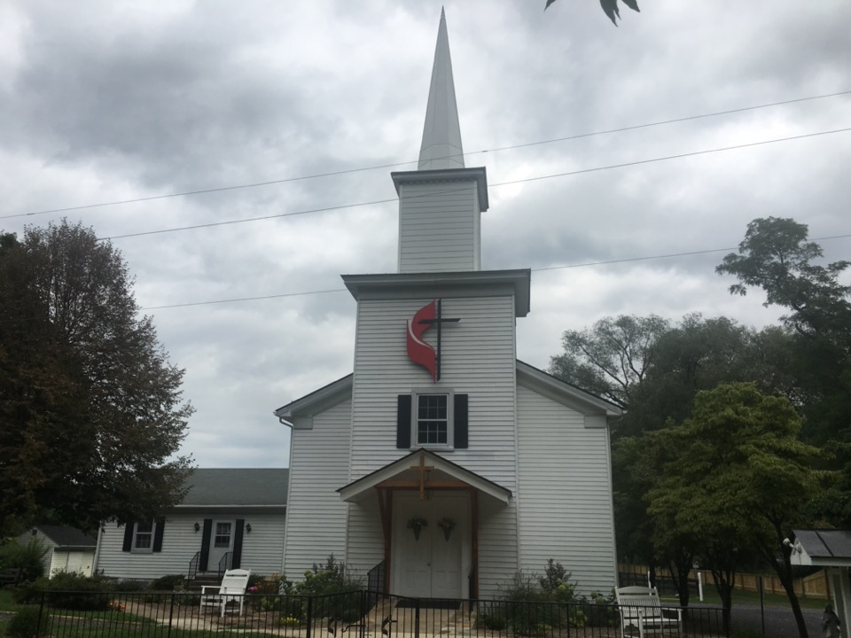
Rectortown United Methodist Church
serving God with
Prayer, Action, and Love
through Service.

