Slide 2
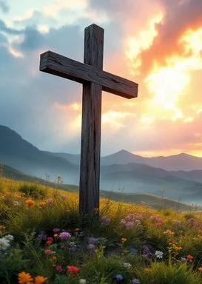
Prelude
Pastor Eduardo Carrillo
Eleventh Sunday after Pentecost
August 9th, 2026
CCLI License:
3430384-01-1829
Livestream Notice: Our worship service is live-streamed and recorded. By attending, you consent to being included in the broadcast. Thank you for joining us!

Slide 3
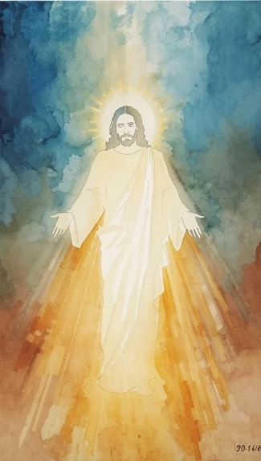
WELCOME,
ANNOUNCEMENTS,
and
CELEBRATIONS
Livestream Notice: Our worship service is live-streamed and recorded. By attending, you consent to being included in the broadcast. Thank you for joining us!

Slide 4
When we are thrown into the pits of despair by the world around us,
The Lord hears our cries from the depths.

Slide 5
When we step out in faith and the waves threaten to pull us under,
The Lord stretches out His hand to catch us.

Slide 6
Do not fear the depth of the pit or the height of the storm.
For the God who delivered Joseph is the God who walks on water.
All: Come, let us worship the God of our rescue!

Slide 7
Almighty God, your word reminds us today that no pit is too deep for your reach, and no storm is too wild for your command. We confess that when our circumstances get dark,

Slide 8
we often feel abandoned, like Joseph in the cistern or the disciples tossed on the sea. Forgive our small faith. Quiet our frantic minds this morning.

Slide 9
Stretch out your saving hand over our lives, lift us out of our anxieties, and place our feet on solid ground. We confess with our mouths and believe in our hearts that you are Lord over every storm. Amen.

Slide 10
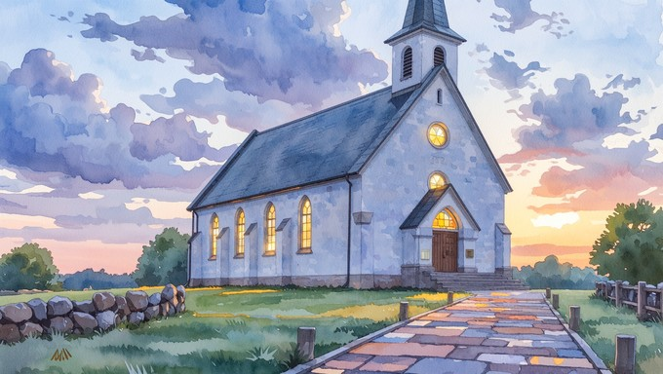
How Firm a Foundation
529
WORDS: “K” in Rippon’s Selection of Hymns, 1787
(2 Tim. 2:19; Heb. 13:5; Is. 43:1-2)
1. How firm a foundation, ye saints of the Lord, is laid for your faith in his excellent word! What more can he say than to you he hath said, to you who for refuge to Jesus have fled?

Slide 11
How Firm a Foundation
529
WORDS: “K” in Rippon’s Selection of Hymns, 1787
(2 Tim. 2:19; Heb. 13:5; Is. 43:1-2)
2. Fear not, I am with thee, O be not dismayed,
for I am thy God and will still give thee aid; I’ll strengthen and help thee, and cause thee to stand
upheld by my righteous, omnipotent hand.

Slide 12
How Firm a Foundation
529
WORDS: “K” in Rippon’s Selection of Hymns, 1787
(2 Tim. 2:19; Heb. 13:5; Is. 43:1-2)
3. When through the deep waters I call thee to go, the rivers of woe shall not thee overflow; for I will be with thee, thy troubles to bless, and sanctify to thee thy deepest distress.

Slide 13
How Firm a Foundation
529
WORDS: “K” in Rippon’s Selection of Hymns, 1787
(2 Tim. 2:19; Heb. 13:5; Is. 43:1-2)
4. When through fiery trials thy pathways shall lie, my grace, all-sufficient, shall be thy supply; the flame shall not hurt thee; I only design
thy dross to consume, and thy gold to refine.

Slide 14
How Firm a Foundation
529
WORDS: “K” in Rippon’s Selection of Hymns, 1787
(2 Tim. 2:19; Heb. 13:5; Is. 43:1-2)
5. The soul that on Jesus still leans for repose,
I will not, I will not desert to its foes; that soul, though all hell should endeavor to shake, I’ll never, no, never, no, never forsake.

Slide 17
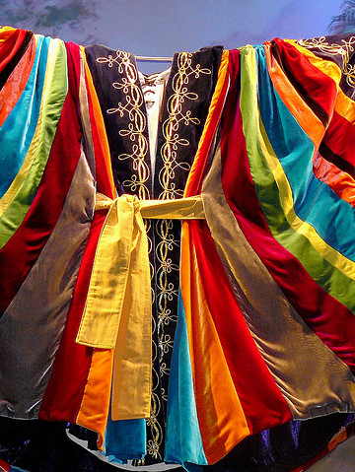
Genesis 37: 1 – 4 , 12 – 28
NRSVUE

Slide 18
Jacob settled in the land where his father had lived as an alien, the land of Canaan.
² These are the descendants of Jacob.
Joseph, being seventeen years old, was shepherding the flock with his brothers; he was a helper to the sons of Bilhah and Zilpah, his father’s wives, and Joseph brought a bad report of them to their father.

Slide 19
³ Now Israel loved Joseph more than any other of his children because he was the son of his old age, and he made him an ornamented robe.
⁴ But when his brothers saw that their father loved him more than all his brothers, they hated him and could not speak peaceably to him.

Slide 20
¹² Now his brothers went to pasture their father’s flock near Shechem.
¹³ And Israel said to Joseph, “Are not your brothers pasturing the flock at Shechem? Come, I will send you to them.” He answered, “Here I am.”

Slide 21
¹⁴ So he said to him, “Go now, see if it is well with your brothers and with the flock, and bring word back to me.” So he sent him from the valley of Hebron.
He came to Shechem,
¹⁵ and a man found him wandering in the fields; the man asked him, “What are you seeking?”

Slide 22
¹⁶ “I am seeking my brothers,” he said; “tell me, please, where they are pasturing the flock.”
¹⁷ The man said, “They have gone away, for I heard them say, ‘Let us go to Dothan.’ ” So Joseph went after his brothers and found them at Dothan.

Slide 23
¹⁸ They saw him from a distance, and before he came near to them they conspired to kill him.
¹⁹ They said to one another, “Here comes this dreamer.

Slide 24
²⁰ Come now, let us kill him and throw him into one of the pits; then we shall say that a wild animal has devoured him, and we shall see what will become of his dreams.”
²¹ But when Reuben heard it, he delivered him out of their hands, saying, “Let us not take his life.”

Slide 25
²² Reuben said to them, “Shed no blood; throw him into this pit here in the wilderness, but lay no hand on him”—that he might rescue him out of their hand and restore him to his father.
²³ So when Joseph came to his brothers, they stripped him of his robe, the ornamented robe that he wore,

Slide 26
²⁴ and they took him and threw him into a pit. The pit was empty; there was no water in it.
²⁵ Then they sat down to eat, and looking up they saw a caravan of Ishmaelites coming from Gilead, with their camels carrying gum, balm, and resin, on their way to carry it down to Egypt.

Slide 27
²⁶ Then Judah said to his brothers, “What profit is it if we kill our brother and conceal his blood?
²⁷ Come, let us sell him to the Ishmaelites and not lay our hands on him, for he is our brother, our own flesh.” And his brothers agreed.

Slide 28
²⁸ When some Midianite traders passed by, they drew Joseph up, lifting him out of the pit, and sold him to the Ishmaelites for twenty pieces of silver. And they took Joseph to Egypt.

Slide 29
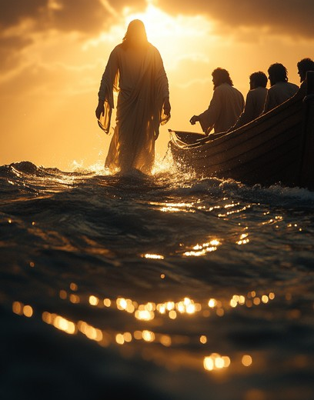
Matthew 14:22 – 33
NRSVUE

Slide 30
²² Immediately he made the disciples get into a boat and go on ahead to the other side, while he dismissed the crowds.
²³ And after he had dismissed the crowds, he went up the mountain by himself to pray. When evening came, he was there alone,

Slide 31
²⁴ but by this time the boat, battered by the waves, was far from the land, for the wind was against them.
²⁵ And early in the morning he came walking toward them on the sea.

Slide 32
²⁶ But when the disciples saw him walking on the sea, they were terrified, saying, “It is a ghost!” And they cried out in fear.
²⁷ But immediately Jesus spoke to them and said, “Take heart, it is I; do not be afraid.”

Slide 33
²⁸ Peter answered him, “Lord, if it is you, command me to come to you on the water.”
²⁹ He said, “Come.” So Peter got out of the boat, started walking on the water, and came toward Jesus.
³⁰ But when he noticed the strong wind, he became frightened, and, beginning to sink, he cried out, “Lord, save me!”

Slide 34
³¹ Jesus immediately reached out his hand and caught him, saying to him, “You of little faith, why did you doubt?”
³² When they got into the boat, the wind ceased.
³³ And those in the boat worshiped him, saying, “Truly you are the Son of God.”

Slide 35
The Word of God for the people of God
Thanks be to God

Slide 36
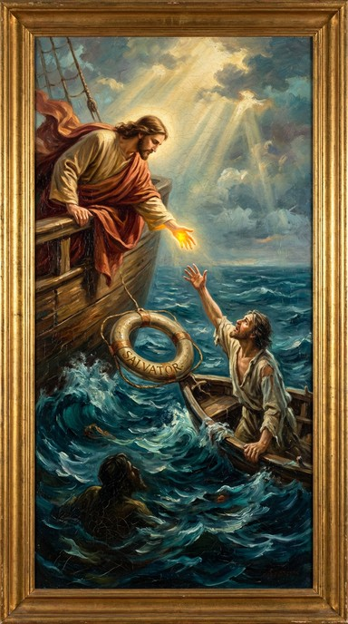
Sermon
“Anatomy of a Rescue”

Slide 37
“O For a Thousand Tongues to Sing” UMH #57
WORDS: Charles Wesley, 1739 MUSIC: Carl G. Glaser, 1839
Please stand as you are able and comfortable.
O for a thousand
tongues to sing my
great Redeemer’s praise,
the glories of my God and King,
the triumphs of his grace!

Slide 38
“O For a Thousand Tongues to Sing” UMH #57
WORDS: Charles Wesley, 1739 MUSIC: Carl G. Glaser, 1839
Please stand as you are able and comfortable.
My gracious Master
and my God,
assist me to proclaim,
to spread through all the earth abroad the honors of thy name.

Slide 39
“O For a Thousand Tongues to Sing” UMH #57
WORDS: Charles Wesley, 1739 MUSIC: Carl G. Glaser, 1839
Please stand as you are able and comfortable.
Jesus! the name that
charms our fears,
that bids our sorrows cease;
‘tis music in the sinner’s ears,
‘tis life, and health, and peace.

Slide 40
“O For a Thousand Tongues to Sing” UMH #57
WORDS: Charles Wesley, 1739 MUSIC: Carl G. Glaser, 1839
Please stand as you are able and comfortable.
He breaks the power of
canceled sin, he
sets the prisoner free;
his blood can make the foulest clean; his blood availed for me.

Slide 41
“O For a Thousand Tongues to Sing” UMH #57
WORDS: Charles Wesley, 1739 MUSIC: Carl G. Glaser, 1839
Please stand as you are able and comfortable.
He speaks, and listening
to his voice, new
life the dead receive;
the mournful, broken hearts rejoice,
the humble poor believe.

Slide 42
“O For a Thousand Tongues to Sing” UMH #57
WORDS: Charles Wesley, 1739 MUSIC: Carl G. Glaser, 1839
Please stand as you are able and comfortable.
Hear him, ye deaf; his
praise, ye dumb,
your loosened tongues employ;
ye blind, behold your Savior come,
and leap, ye lame, for joy.

Slide 43
“O For a Thousand Tongues to Sing” UMH #57
WORDS: Charles Wesley, 1739 MUSIC: Carl G. Glaser, 1839
Please stand as you are able and comfortable.
In Christ, your head, you
then shall know,
shall feel your sins forgiven;
anticipate your heaven below,
and own that love is heaven.

Slide 48
Tithes and Offerings
Worship through giving
Notes:
https://www.goodfon.com/flowers/wallpaper-blue-wood-blossom-spring-flowers-vesna-iablonia-tsvety.html

Slide 49

“Praise God, from Whom All Blessings Flow” UMH 94
WORDS: Thomas Ken, 1674; adapted by Gilbert H. Viera, 1978
MUSIC: Geistliche Kirchengesange, 1623; harmonized by Ralph Vaughn Williams, 1906
Please stand as you are able and comfortable.
Praise God from whom all blessings flow;
Praise God, all creatures here below:
Alleluia! Alleluia!
Praise God, the source of all our gifts!
Praise Jesus Christ, whose power uplifts!
Praise the Spirit, Holy Spirit!
Alleluia! Alleluia! Alleluia!

Slide 50
Offertory Prayer

Slide 51
“Precious Lord, Take My Hand” UMH 474
WORDS and MUSIC: Thomas A. Dorsey, 1932
Please stand as you are able and comfortable.
Precious Lord, take my hand,
lead me on, let me stand,
I am tired, I am weak, I am worn;
through the storm, through the night,
lead me on to the light:
Take my hand, precious Lord,
lead me home.

Slide 52
“Precious Lord, Take My Hand” UMH 474
WORDS and MUSIC: Thomas A. Dorsey, 1932
Please stand as you are able and comfortable.
When the way grows drear,
precious Lord, linger near,
when my life is almost gone,
hear my cry, hear my call,
hold my hand lest I fall:
Take my hand, precious Lord,
lead me home.

Slide 53
“Precious Lord, Take My Hand” UMH 474
WORDS and MUSIC: Thomas A. Dorsey, 1932
Please stand as you are able and comfortable.
When the darkness appears
and the night draws near,
and the day is past and gone,
at the river I stand,
guide my feet, hold my hand:
Take my hand, precious Lord,
lead me home.

Slide 60
Postlude
This service has ended, and now
your service in the world begins!

Slide 61
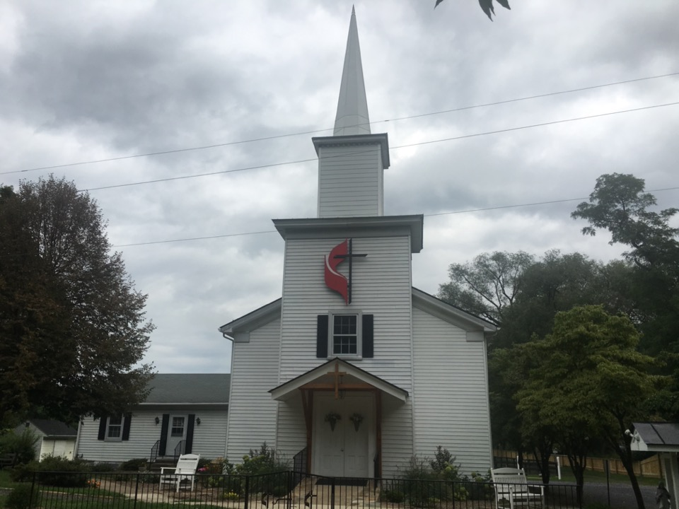
Rectortown United Methodist Church
serving God with
Prayer, Action, and Love
through Service.

