Slide 2
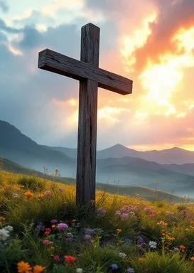
Prelude
Pastor Eduardo Carrillo
Sixth Sunday after Pentecost
July 5th, 2026
CCLI License:
3430384-01-1829
Livestream Notice: Our worship service is live-streamed and recorded. By attending, you consent to being included in the broadcast. Thank you for joining us!

Slide 3
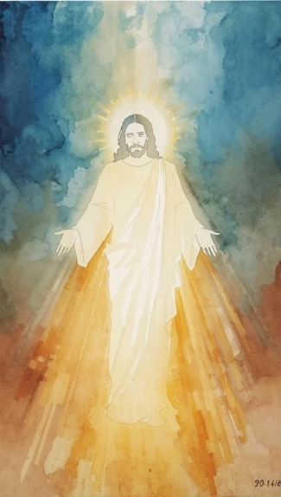
WELCOME,
ANNOUNCEMENTS,
and
CELEBRATIONS
Livestream Notice: Our worship service is live-streamed and recorded. By attending, you consent to being included in the broadcast. Thank you for joining us!

Slide 4
We gather to worship God with our full, imperfect selves.
We come to delight in the law of God, who is Love.

Slide 5
We gather as people who don’t always know what to do in the face of difficult and complex circumstances.
We come to delight in the law of God, who is Love.

Slide 6
We gather as people who desire to follow God with our actions but struggle to connect what we want to do with what we actually do.
We come to delight in the law of God, who is Love.

Slide 7
Whether you come to worship today wondering if there is anything good left in the world or rejoicing in the small moments of goodness that remind you grace is still at work among us, you are welcome here.

Slide 8
We come to delight in the law of God, whose grace shows us how to live, work, play, and rest as a community of faith woven together by Love.

Slide 9
Holy and Loving God, We thank You for bringing us together into this sacred space today. We come just as we are carrying the joys, the burdens, the distractions,

Slide 10
and the quiet hopes of the past week. Calm our anxious minds, still our restless hearts, and help us to set aside the noise of the world so that we may hear Your still, small voice.

Slide 11
Open our eyes to see Your goodness among us, and open our hearts to receive the grace You so freely offer.

Slide 12
May our worship today be pleasing to You, and may Your presence renew our spirits and bind us together as Your people. Amen.

Slide 13

America the Beautiful
696
WORDS: Katharine Lee Bates, 1904
O beautiful for spacious skies,
for amber waves of grain;
for purple mountain majesties
above the fruited plain!
America! America!
God shed his grace on thee,
and crown thy good
with brotherhood
from sea to shining sea.

Slide 14
America the Beautiful
696
WORDS: Katharine Lee Bates, 1904
2. O beautiful for heroes proved in liberating strife,
who more than self their country loved,
and mercy more than life!
America! America!
God shed his grace on thee,
and crown thy good
with brotherhood
from sea to shining sea.

Slide 15
America the Beautiful
696
WORDS: Katharine Lee Bates, 1904
3. O beautiful for patriot dream that sees beyond the years thine alabaster cities gleam,
undimmed by human tears!
America! America!
God shed his grace on thee,
and crown thy good
with brotherhood
from sea to shining sea.

Slide 17
Prayer For Illumination
Spirit of the living God, fall afresh on me.
Spirit of the living God, fall afresh on me.
Melt me, mold me, fill me, use me.
Spirit of the living God, fall afresh on me.
UMH 393

Slide 18
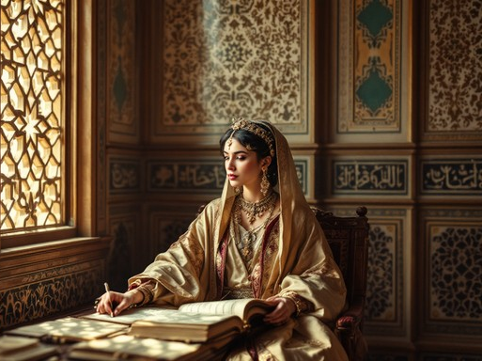
Psalm 45: 10 – 17
NRSVUE

Slide 19
¹⁰ Hear, O daughter, consider and incline your ear; forget your people and your father’s house,
¹¹ and the king will desire your beauty. Since he is your lord, bow to him;
¹² Daughter Tyre will seek your favor with gifts, the richest of the people

Slide 20
¹³ with all kinds of wealth. The princess is decked in her chamber with gold-woven robes;
¹⁴ in many-colored robes she is led to the king; behind her the virgins, her companions, follow.
¹⁵ With joy and gladness they are led along as they enter the palace of the king.

Slide 21
¹⁶ In the place of ancestors you, O king, shall have sons; you will make them princes in all the earth.
¹⁷ I will cause your name to be celebrated in all generations; therefore the peoples will praise you forever and ever.

Slide 22

Romans 7: 15 – 25
NRSVUE

Slide 23
¹⁵ I do not understand my own actions. For I do not do what I want, but I do the very thing I hate.
¹⁶ Now if I do what I do not want, I agree that the law is good.
¹⁷ But in fact it is no longer I who do it but sin that dwells within me.

Slide 24
¹⁸ For I know that the good does not dwell within me, that is, in my flesh. For the desire to do the good lies close at hand, but not the ability.
¹⁹ For I do not do the good I want, but the evil I do not want is what I do.

Slide 25
²⁰ Now if I do what I do not want, it is no longer I who do it but sin that dwells within me.
²¹ So I find it to be a law that, when I want to do what is good, evil lies close at hand.
²² For I delight in the law of God in my inmost self,

Slide 26
²³ but I see in my members another law at war with the law of my mind, making me captive to the law of sin that dwells in my members.
²⁴ Wretched person that I am! Who will rescue me from this body of death?

Slide 27
²⁵ Thanks be to God through Jesus Christ our Lord! So then, with my mind I am enslaved to the law of God, but with my flesh I am enslaved to the law of sin.

Slide 28
The Word of God for the people of God
Thanks be to God

Slide 29
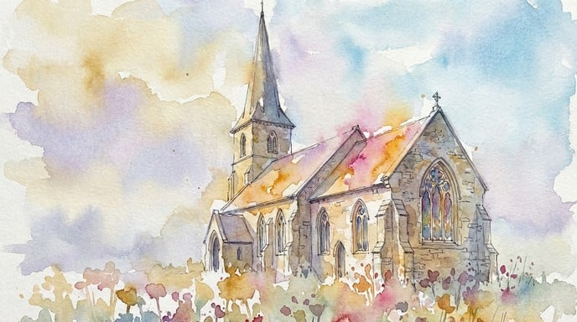
Sermon
“Sofa vs. Table”

Slide 39
Tithes and Offerings
Worship through giving
Notes:
https://www.goodfon.com/flowers/wallpaper-blue-wood-blossom-spring-flowers-vesna-iablonia-tsvety.html

Slide 40

“Praise God, from Whom All Blessings Flow” UMH 94
WORDS: Thomas Ken, 1674; adapted by Gilbert H. Viera, 1978
MUSIC: Geistliche Kirchengesange, 1623; harmonized by Ralph Vaughn Williams, 1906
Please stand as you are able and comfortable.
Praise God from whom all blessings flow;
Praise God, all creatures here below:
Alleluia! Alleluia!
Praise God, the source of all our gifts!
Praise Jesus Christ, whose power uplifts!
Praise the Spirit, Holy Spirit!
Alleluia! Alleluia! Alleluia!

Slide 41
Offertory Prayer

Slide 58
“My Hope is Built ” UMH 368
WORDS: Edward Mote, 1834 MUSIC: William B. Bradbury, 1863
Please stand as you are able and comfortable.
My hope is built on nothing less
than Jesus’ blood and righteousness.
I dare not trust the sweetest frame,
but wholly lean on Jesus’ name.
On Christ the solid rock I stand,
all other ground is sinking sand;
all other ground is sinking sand.

Slide 59
“My Hope is Built ” UMH 368
WORDS: Edward Mote, 1834 MUSIC: William B. Bradbury, 1863
Please stand as you are able and comfortable.
When darkness veils his lovely face,
I rest on his unchanging grace.
In every high and stormy gale,
my anchor holds within the veil.
On Christ the solid rock I stand,
all other ground is sinking sand;
all other ground is sinking sand.

Slide 60
“My Hope is Built ” UMH 368
WORDS: Edward Mote, 1834 MUSIC: William B. Bradbury, 1863
Please stand as you are able and comfortable.
His oath, his covenant, his blood
support me in the whelming flood.
When all around my soul gives way,
he then is all my hope and stay.
On Christ the solid rock I stand,
all other ground is sinking sand;
all other ground is sinking sand.

Slide 61
“My Hope is Built ” UMH 368
WORDS: Edward Mote, 1834 MUSIC: William B. Bradbury, 1863
Please stand as you are able and comfortable.
When he shall come with trumpet sound,
O may I then in him be found!
Dressed in his righteousness alone,
faultless to stand before the throne!
On Christ the solid rock I stand,
all other ground is sinking sand;
all other ground is sinking sand.

Slide 63
BLESSING AND BENEDICTION
This service has ended, and now
your service in the world begins!

Slide 64
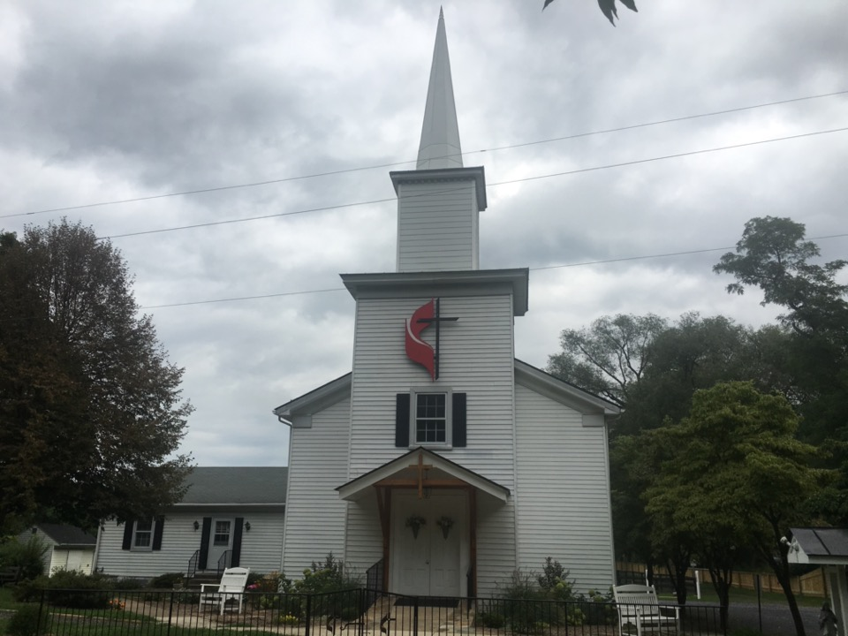
Rectortown United Methodist Church
serving God with
Prayer, Action, and Love
through Service.

