Slide 2
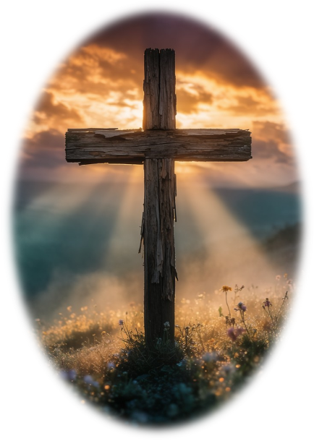
Prelude
Pastor Eduardo Carrillo
Eighteenth Sunday after Pentecost
September 27th, 2026
CCLI License:
3430384-01-1829
Livestream Notice: Our worship service is live-streamed and recorded. By attending, you consent to being included in the broadcast. Thank you for joining us!

Slide 3
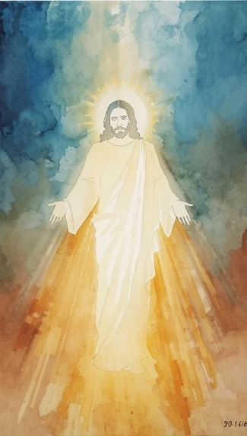
WELCOME,
ANNOUNCEMENTS,
and
CELEBRATIONS
Livestream Notice: Our worship service is live-streamed and recorded. By attending, you consent to being included in the broadcast. Thank you for joining us!

Slide 4
Is the Lord among us or not?
The Lord is here; God’s presence fills this place!

Slide 5
God brings water from the dry rock and life from unexpected places.
Let us come with humble hearts, ready not just to speak God’s will, but to do it.

Slide 6
Faith begets actions, the actions of Jesus Christ.
Let us live by faith today and always!

Slide 7
Living God, whenever our faith grows dry and our trust wavers, you pour out living water. Pour out your Spirit upon us today. Give us the mindset of Christ,

Slide 8
that our lives may be defined not merely by noble words, but by humble obedience and love. Let our actions mirror our faith. Transform us from hearers to doers. Amen.

Slide 9
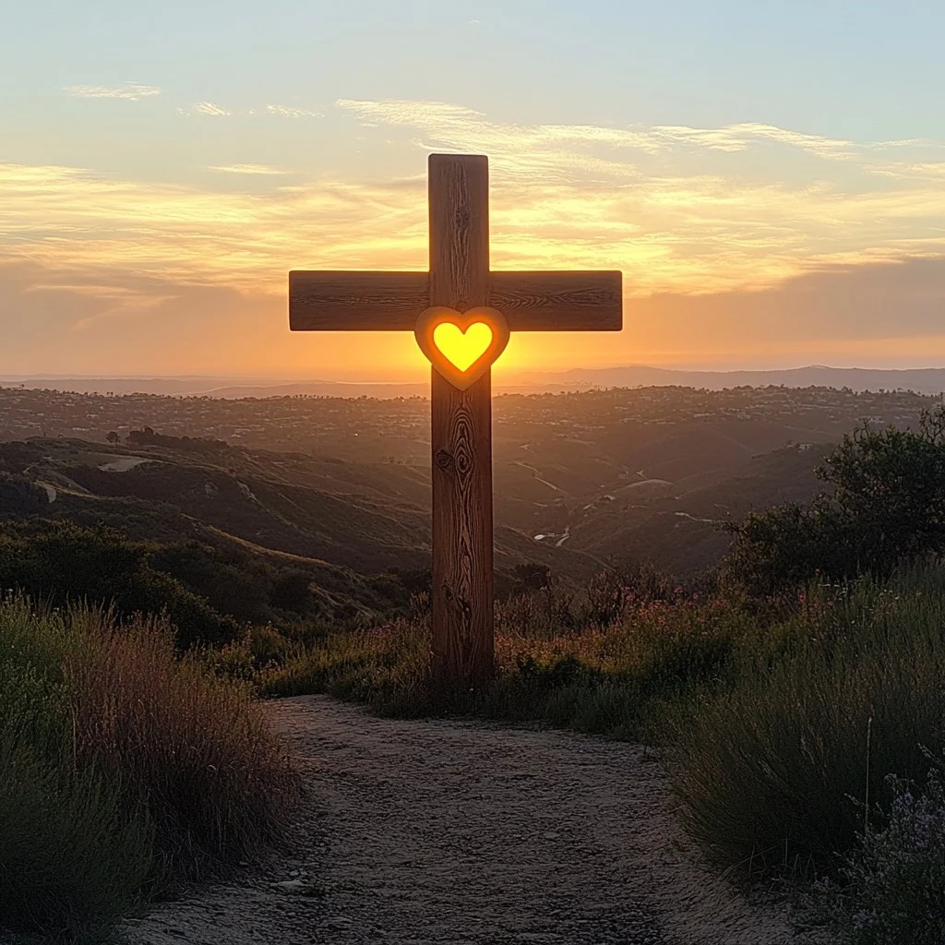
Jesu, Jesu
432
WORDS: Tom Colvin, 1969 (Jn. 13:1-17)
Refrain
Jesu, Jesu,
fill us with your love,
show us how to serve
the neighbors
we have from you.
© 1969, 1989 Hope Publishing Co.

Slide 10
Jesu, Jesu
432
WORDS: Tom Colvin, 1969 (Jn. 13:1-17)
1. Kneels at the
feet of his friends,
silently washes
their feet,
Master who acts
as a slave to them.

Slide 11
Jesu, Jesu
432
WORDS: Tom Colvin, 1969 (Jn. 13:1-17)
Refrain
Jesu, Jesu,
fill us with your love,
show us how to serve
the neighbors
we have from you.
© 1969, 1989 Hope Publishing Co.

Slide 12
Jesu, Jesu
432
WORDS: Tom Colvin, 1969 (Jn. 13:1-17)
2. Neighbors are
rich and poor,
neighbors are
black and white,
neighbors are
near and far away.

Slide 13
Jesu, Jesu
432
WORDS: Tom Colvin, 1969 (Jn. 13:1-17)
Refrain
Jesu, Jesu,
fill us with your love,
show us how to serve
the neighbors
we have from you.
© 1969, 1989 Hope Publishing Co.

Slide 14
Jesu, Jesu
432
WORDS: Tom Colvin, 1969 (Jn. 13:1-17)
3. These are the ones
we should serve,
these are the ones
we should love;
all these are neighbors
to us and you.

Slide 15
Jesu, Jesu
432
WORDS: Tom Colvin, 1969 (Jn. 13:1-17)
Refrain
Jesu, Jesu,
fill us with your love,
show us how to serve
the neighbors
we have from you.
© 1969, 1989 Hope Publishing Co.

Slide 16
Jesu, Jesu
432
WORDS: Tom Colvin, 1969 (Jn. 13:1-17)
4. Loving puts us
on our knees,
serving as though
we are slaves,
this is the way
we should live with you.

Slide 17
Jesu, Jesu
432
WORDS: Tom Colvin, 1969 (Jn. 13:1-17)
Refrain
Jesu, Jesu,
fill us with your love,
show us how to serve
the neighbors
we have from you.
© 1969, 1989 Hope Publishing Co.

Slide 18
Jesu, Jesu
432
WORDS: Tom Colvin, 1969 (Jn. 13:1-17)
5. Kneel at the
feet of our friends,
silently washing
their feet,
this is the way
we should live with you.

Slide 19
Jesu, Jesu
432
WORDS: Tom Colvin, 1969 (Jn. 13:1-17)
Refrain
Jesu, Jesu,
fill us with your love,
show us how to serve
the neighbors
we have from you.
© 1969, 1989 Hope Publishing Co.

Slide 21
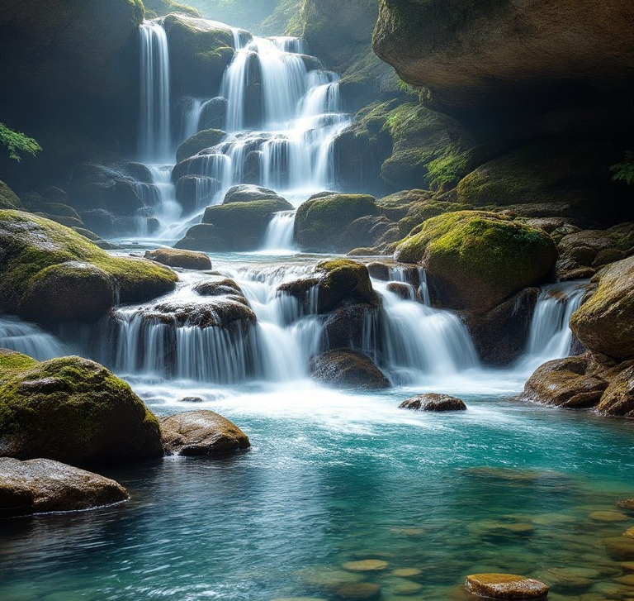
Exodus 17: 1 – 7
NRSVUE

Slide 22
From the wilderness of Sin the whole congregation of the Israelites journeyed by stages, as the Lord commanded. They camped at Rephidim, but there was no water for the people to drink.
² The people quarreled with Moses and said, “Give us water to drink.” Moses said to them, “Why do you quarrel with me? Why do you test the Lord?”

Slide 23
³ But the people thirsted there for water, and the people complained against Moses and said, “Why did you bring us out of Egypt, to kill us and our children and livestock with thirst?”
⁴ So Moses cried out to the Lord, “What shall I do for this people? They are almost ready to stone me.”

Slide 24
⁵ The Lord said to Moses, “Go on ahead of the people and take some of the elders of Israel with you; take in your hand the staff with which you struck the Nile and go.
⁶ I will be standing there in front of you on the rock at Horeb. Strike the rock, and water will come out of it, so that the people may drink.” Moses did so, in the sight of the elders of Israel.

Slide 25
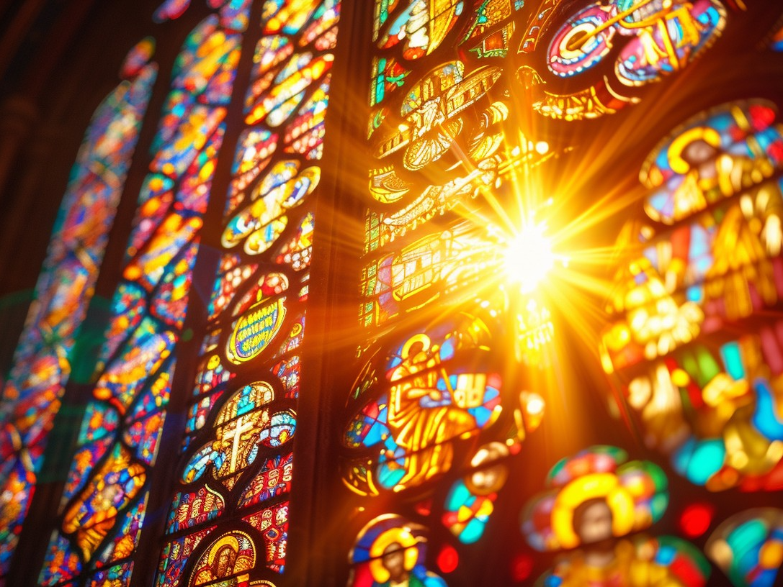
Matthew 21: 23 – 32
NRSVUE

Slide 26
²³ When he entered the temple, the chief priests and the elders of the people came to him as he was teaching and said, “By what authority are you doing these things, and who gave you this authority?”
²⁴ Jesus said to them, “I will also ask you one question; if you tell me the answer, then I will also tell you by what authority I do these things.

Slide 27
²⁵ Did the baptism of John come from heaven, or was it of human origin?” And they argued with one another, “If we say, ‘From heaven,’ he will say to us, ‘Why, then, did you not believe him?’
²⁶ But if we say, ‘Of human origin,’ we are afraid of the crowd, for all regard John as a prophet.”

Slide 28
²⁷ So they answered Jesus, “We do not know.” And he said to them, “Neither will I tell you by what authority I am doing these things.
²⁸ “What do you think? A man had two sons; he went to the first and said, ‘Son, go and work in the vineyard today.’

Slide 29
²⁹ He answered, ‘I will not,’ but later he changed his mind and went.
³⁰ The father went to the second and said the same, and he answered, ‘I go, sir,’ but he did not go.

Slide 30
³¹ Which of the two did the will of his father?” They said, “The first.” Jesus said to them, “Truly I tell you, the tax collectors and the prostitutes are going into the kingdom of God ahead of you.

Slide 31
³² For John came to you in the way of righteousness, and you did not believe him, but the tax collectors and the prostitutes believed him, and even after you saw it you did not change your minds and believe him.

Slide 32
⁷ He called the place Massah and Meribah, because the Israelites quarreled and tested the Lord, saying, “Is the Lord among us or not?”

Slide 33
The Word of God for the people of God
Thanks be to God

Slide 34

Sermon
Water from the Rock, Faith in Action

Slide 35
“Here I Am, Lord” UMH 593
WORDS and MUSIC: Dan Schutte, 1981
Please stand as you are able and comfortable.
I, the Lord of sea and sky,
I have heard my people cry.
All who dwell in dark and sin
my hand will save.
I who made the stars of night,
I will make their darkness bright.
Who will bear my light to them?
Whom shall I send?

Slide 36
“Here I Am, Lord” UMH 593
WORDS and MUSIC: Dan Schutte, 1981
Please stand as you are able and comfortable.
Here I am, Lord.
Is it I Lord?
I have heard you calling in the night.
I will go, Lord,
if you lead me.
I will hold your people in my heart.

Slide 37
“Here I Am, Lord” UMH 593
WORDS and MUSIC: Dan Schutte, 1981
Please stand as you are able and comfortable.
I, the Lord of snow and rain,
I have borne my people’s pain.
I have wept for love of them.
They turn away.
I will break their hearts of stone,
give them hearts for love alone.
I will speak my word to them.
Whom shall I send?

Slide 38
“Here I Am, Lord” UMH 593
WORDS and MUSIC: Dan Schutte, 1981
Please stand as you are able and comfortable.
Here I am, Lord.
Is it I Lord?
I have heard you calling in the night.
I will go, Lord,
if you lead me.
I will hold your people in my heart.

Slide 39
“Here I Am, Lord” UMH 593
WORDS and MUSIC: Dan Schutte, 1981
Please stand as you are able and comfortable.
I, the Lord of wind and flame,
I will tend the poor and lame,
I will set a feast for them.
My hand will save.
Finest bread I will provide
till their hearts be satisfied.
I will give my life to them.
Whom shall I send?

Slide 40
“Here I Am, Lord” UMH 593
WORDS and MUSIC: Dan Schutte, 1981
Please stand as you are able and comfortable.
Here I am, Lord.
Is it I Lord?
I have heard you calling in the night.
I will go, Lord,
if you lead me.
I will hold your people in my heart.

Slide 45
Tithes and Offerings
Worship through giving
Notes:
https://www.goodfon.com/flowers/wallpaper-blue-wood-blossom-spring-flowers-vesna-iablonia-tsvety.html

Slide 46

“Praise God, from Whom All Blessings Flow” UMH 94
WORDS: Thomas Ken, 1674; adapted by Gilbert H. Viera, 1978
MUSIC: Geistliche Kirchengesange, 1623; harmonized by Ralph Vaughn Williams, 1906
Please stand as you are able and comfortable.
Praise God from whom all blessings flow;
Praise God, all creatures here below:
Alleluia! Alleluia!
Praise God, the source of all our gifts!
Praise Jesus Christ, whose power uplifts!
Praise the Spirit, Holy Spirit!
Alleluia! Alleluia! Alleluia!

Slide 47
Offertory Prayer

Slide 54


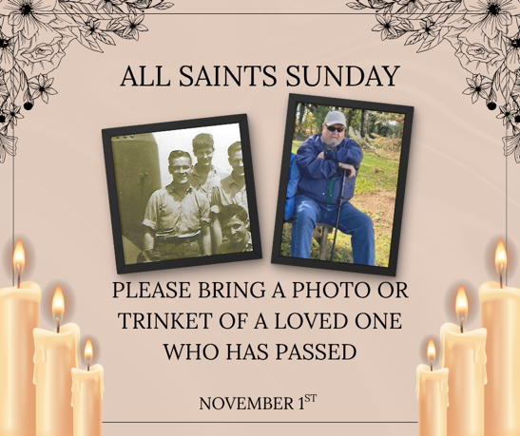
Upcoming Event Reminders

Slide 55
Postlude
This service has ended, and now
your service in the world begins!

Slide 56
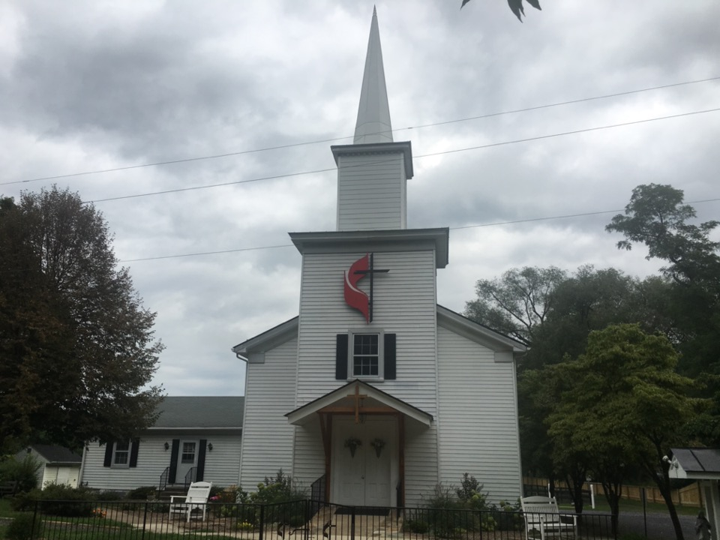
Rectortown United Methodist Church
serving God with
Prayer, Action, and Love
through Service.

