Slide 2
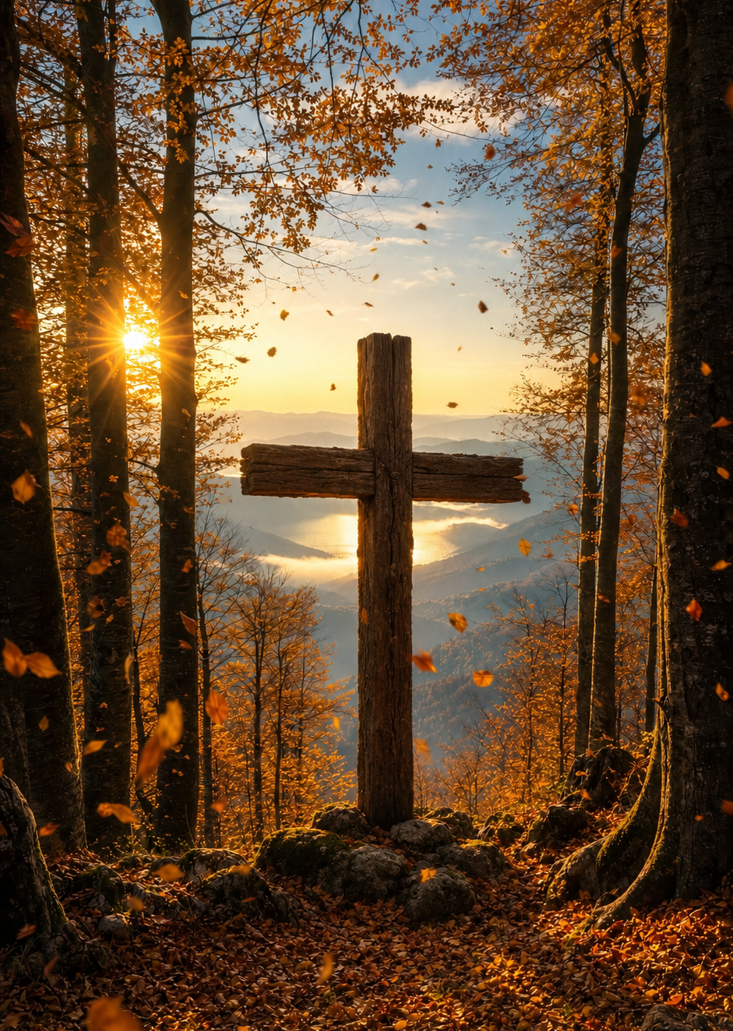
Prelude
Pastor Eduardo Carrillo
Twentieth Sunday after Pentecost
October 11th, 2026
CCLI License:
3430384-01-1829
Livestream Notice: Our worship service is live-streamed and recorded. By attending, you consent to being included in the broadcast. Thank you for joining us!

Slide 3
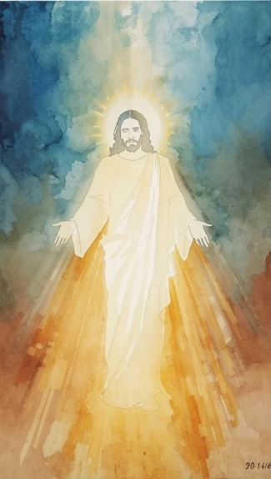
WELCOME,
ANNOUNCEMENTS,
and
CELEBRATIONS
Livestream Notice: Our worship service is live-streamed and recorded. By attending, you consent to being included in the broadcast. Thank you for joining us!

Slide 4
God invites us to a lavish banquet, a feast of joy and abundance.
Yet we fashion golden calves in the wilderness, seeking gods we can control.

Slide 5
The Lord’s anger burns against our spiritual adultery, yet His mercy turns aside destruction.
He remembers His covenant and calls us back from our self-made altars.

Slide 6
Come to the feast, but come clothed in the righteousness of Christ.
We lay down our idols to put on the garments of salvation.

Slide 7
Gracious Father, we are quick to wander and eager to replace Your living presence with cheap, manageable substitutes. We confess that like Israel, we make gods out of gold,

Slide 8
and like the ungrateful guests, we make light of Your gracious invitation.
Lord, turn away Your wrath and forgive our fickleness. Robe us in the righteous wedding garments of Christ,

Slide 9
that we may stand before Your holy presence without fear. Break our addiction to lesser things and fill us with the holy joy of Your kingdom. Amen.

Slide 10

“Come, Thou Fount of Every Blessing” UMH 400
WORDS: Robert Robinson, 1758 MUSIC: Wyeth’s Repository of Sacred Music, Part Second, 1813
Please stand as you are able and comfortable.
Come, thou Fount of every blessing,
tune my heart to sing thy grace;
streams of mercy, never ceasing,
call for song of loudest praise.

Slide 11
“Come, Thou Fount of Every Blessing” UMH 400
WORDS: Robert Robinson, 1758 MUSIC: Wyeth’s Repository of Sacred Music, Part Second, 1813
Please stand as you are able and comfortable.
Teach me some melodious sonnet,
sung by flaming tongues above.
Praise the mount! I’m fixed upon it,
mount of thy redeeming love.

Slide 12
“Come, Thou Fount of Every Blessing” UMH 400
WORDS: Robert Robinson, 1758 MUSIC: Wyeth’s Repository of Sacred Music, Part Second, 1813
Please stand as you are able and comfortable.
Here I raise mine Ebenezer;
hither by thy help I’m come;
and I hope, by thy good pleasure,
safely to arrive at home.

Slide 13
“Come, Thou Fount of Every Blessing” UMH 400
WORDS: Robert Robinson, 1758 MUSIC: Wyeth’s Repository of Sacred Music, Part Second, 1813
Please stand as you are able and comfortable.
Jesus sought me when a stranger, wandering from the fold of God;
he, to rescue me from danger,
interposed his precious blood.

Slide 14
“Come, Thou Fount of Every Blessing” UMH 400
WORDS: Robert Robinson, 1758 MUSIC: Wyeth’s Repository of Sacred Music, Part Second, 1813
Please stand as you are able and comfortable.
O to grace how great a deptor
daily I’m constrained to be!
Let thy goodness, like a fetter
bind my wandering heart to thee.

Slide 15
“Come, Thou Fount of Every Blessing” UMH 400
WORDS: Robert Robinson, 1758 MUSIC: Wyeth’s Repository of Sacred Music, Part Second, 1813
Please stand as you are able and comfortable.
Prone to wander, Lord, I feel it,
prone to leave the God I love;
here’s my heart, O take and seal it,
seal it for thy courts above.

Slide 17
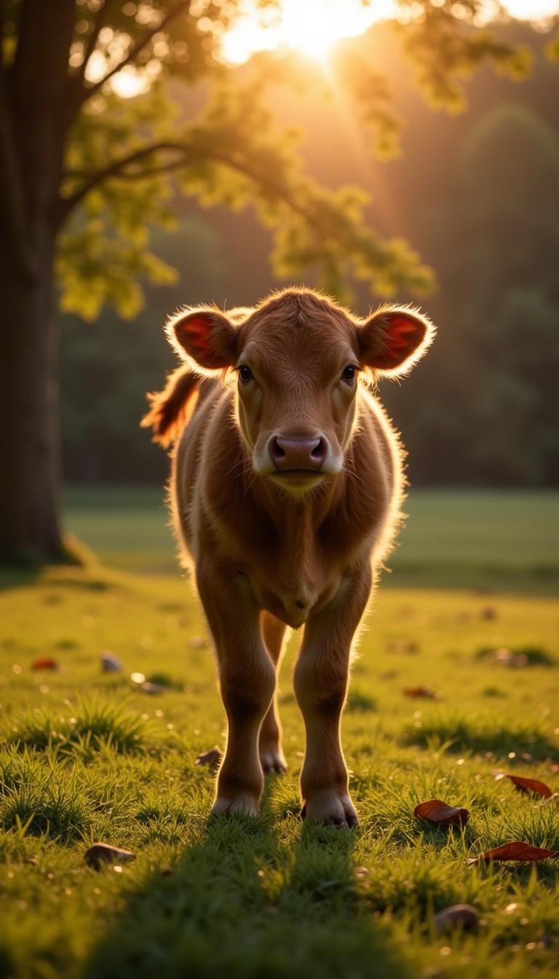
Exodus 32: 1 – 14
NRSVUE

Slide 18
When the people saw that Moses delayed to come down from the mountain, the people gathered around Aaron and said to him, “Come, make gods for us, who shall go before us; as for this Moses, the man who brought us up out of the land of Egypt, we do not know what has become of him.”

Slide 19
² Aaron said to them, “Take off the gold rings that are on the ears of your wives, your sons, and your daughters and bring them to me.”
³ So all the people took off the gold rings from their ears and brought them to Aaron.

Slide 20
⁴ He took these from them, formed them in a mold, and cast an image of a calf, and they said, “These are your gods, O Israel, who brought you up out of the land of Egypt!”
⁵ When Aaron saw this, he built an altar before it, and Aaron made a proclamation and said, “Tomorrow shall be a festival to the Lord.”

Slide 21
⁶ They rose early the next day and offered burnt offerings and brought sacrifices of well-being, and the people sat down to eat and drink and rose up to revel.
⁷ The Lord said to Moses, “Go down at once! Your people, whom you brought up out of the land of Egypt, have acted perversely;

Slide 22
⁸ they have been quick to turn aside from the way that I commanded them; they have cast for themselves an image of a calf and have worshiped it and sacrificed to it and said, ‘These are your gods, O Israel, who brought you up out of the land of Egypt!’ ”
⁹ The Lord said to Moses, “I have seen this people, how stiff-necked they are.

Slide 23
¹⁰ Now let me alone so that my wrath may burn hot against them and I may consume them, and of you I will make a great nation.”
¹¹ But Moses implored the Lord his God and said, “O Lord, why does your wrath burn hot against your people, whom you brought out of the land of Egypt with great power and with a mighty hand?

Slide 24
¹² Why should the Egyptians say, ‘It was with evil intent that he brought them out to kill them in the mountains and to consume them from the face of the earth’? Turn from your fierce wrath; change your mind and do not bring disaster on your people.

Slide 25
¹³ Remember Abraham, Isaac, and Israel, your servants, how you swore to them by your own self, saying to them, ‘I will multiply your descendants like the stars of heaven, and all this land that I have promised I will give to your descendants, and they shall inherit it forever.’ ”

Slide 26
¹⁴ And the Lord changed his mind about the disaster that he planned to bring on his people.

Slide 27
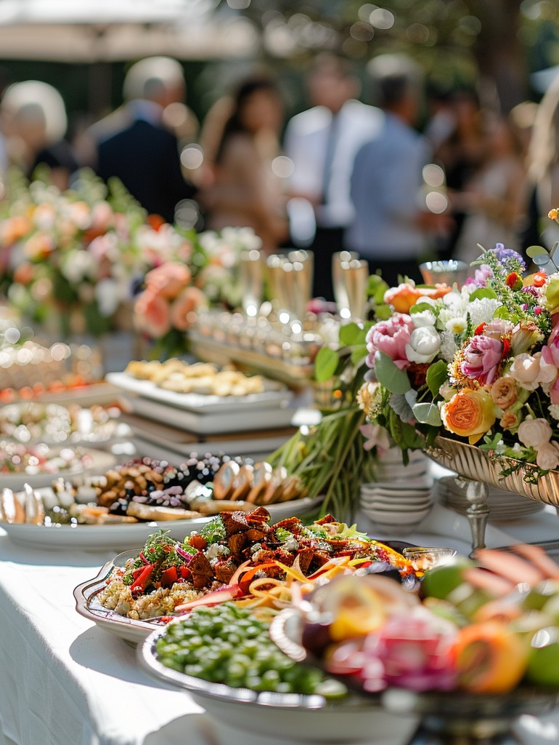
Matthew 22:1-14
NRSVUE

Slide 28
Once more Jesus spoke to them in parables, saying:
² “The kingdom of heaven may be compared to a king who gave a wedding banquet for his son.
³ He sent his slaves to call those who had been invited to the wedding banquet, but they would not come.

Slide 29
⁴ Again he sent other slaves, saying, ‘Tell those who have been invited: Look, I have prepared my dinner, my oxen and my fat calves have been slaughtered, and everything is ready; come to the wedding banquet.’
⁵ But they made light of it and went away, one to his farm, another to his business,

Slide 30
⁶ while the rest seized his slaves, mistreated them, and killed them.
⁷ The king was enraged. He sent his troops, destroyed those murderers, and burned their city.
⁸ Then he said to his slaves, ‘The wedding is ready, but those invited were not worthy.

Slide 31
⁹ Go therefore into the main streets, and invite everyone you find to the wedding banquet.’
¹⁰ Those slaves went out into the streets and gathered all whom they found, both good and bad, so the wedding hall was filled with guests.

Slide 32
¹¹ “But when the king came in to see the guests, he noticed a man there who was not wearing a wedding robe,
¹² and he said to him, ‘Friend, how did you get in here without a wedding robe?’ And he was speechless.

Slide 33
¹³ Then the king said to the attendants, ‘Bind him hand and foot, and throw him into the outer darkness, where there will be weeping and gnashing of teeth.’
¹⁴ For many are called, but few are chosen.”

Slide 34
The Word of God for the people of God
Thanks be to God

Slide 35

Sermon
Golden Calves and Wedding Garments

Slide 36

Softly and Tenderly, Jesus Is Calling
348
WORDS: Will L. Thompson, 1880
Softly and tenderly Jesus is calling,
calling for you and for me;
see, on the portals he’s waiting and watching,
watching for you and for me.

Slide 37
Softly and Tenderly, Jesus Is Calling
348
WORDS: Will L. Thompson, 1880
Refrain
Come home, (come home,) come home; (come home); you who are weary,
come home; earnestly, tenderly,
Jesus is calling, calling, O sinner,
come home!

Slide 38
Softly and Tenderly, Jesus Is Calling
348
WORDS: Will L. Thompson, 1880
Why should we tarry when Jesus is pleading,
pleading for you and for me?
Why should we linger and heed not his mercies,
mercies for you and for me?

Slide 39
Softly and Tenderly, Jesus Is Calling
348
WORDS: Will L. Thompson, 1880
Refrain
Come home, (come home,) come home; (come home); you who are weary,
come home; earnestly, tenderly,
Jesus is calling, calling, O sinner,
come home!

Slide 40
Softly and Tenderly, Jesus Is Calling
348
WORDS: Will L. Thompson, 1880
Time is now fleeting,
the moments are passing,
passing from you and from me; shadows are gathering,
deathbeds are coming,
coming for you and for me.

Slide 41
Softly and Tenderly, Jesus Is Calling
348
WORDS: Will L. Thompson, 1880
Refrain
Come home, (come home,) come home; (come home); you who are weary,
come home; earnestly, tenderly,
Jesus is calling, calling, O sinner,
come home!

Slide 42
Softly and Tenderly, Jesus Is Calling
348
WORDS: Will L. Thompson, 1880
O for the wonderful love he has promised,
promised for you and for me!
Though we have sinned,
he has mercy and pardon,
pardon for you and for me.

Slide 43
Softly and Tenderly, Jesus Is Calling
348
WORDS: Will L. Thompson, 1880
Refrain
Come home, (come home,) come home; (come home); you who are weary,
come home; earnestly, tenderly,
Jesus is calling, calling, O sinner,
come home!

Slide 48
Tithes and Offerings
Worship through giving
Notes:
https://www.goodfon.com/flowers/wallpaper-blue-wood-blossom-spring-flowers-vesna-iablonia-tsvety.html

Slide 49

“Praise God, from Whom All Blessings Flow” UMH 94
WORDS: Thomas Ken, 1674; adapted by Gilbert H. Viera, 1978
MUSIC: Geistliche Kirchengesange, 1623; harmonized by Ralph Vaughn Williams, 1906
Please stand as you are able and comfortable.
Praise God from whom all blessings flow;
Praise God, all creatures here below:
Alleluia! Alleluia!
Praise God, the source of all our gifts!
Praise Jesus Christ, whose power uplifts!
Praise the Spirit, Holy Spirit!
Alleluia! Alleluia! Alleluia!

Slide 50
Offertory Prayer

Slide 57

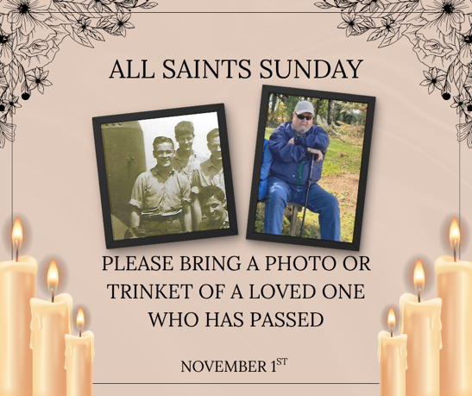
Upcoming Event Reminders

Slide 58
Postlude
This service has ended, and now
your service in the world begins!

Slide 59
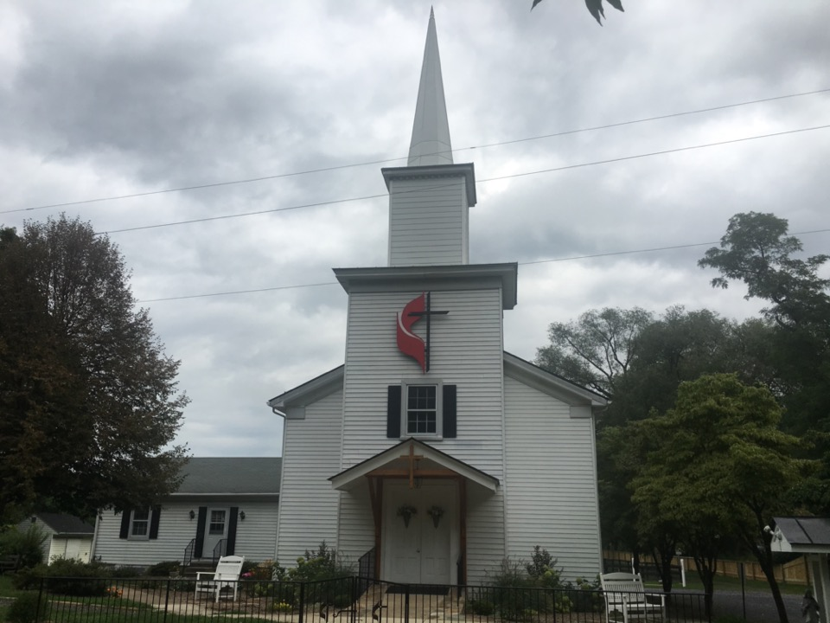
Rectortown United Methodist Church
serving God with
Prayer, Action, and Love
through Service.

