Slide 2

Prelude
Pastor Eduardo Carrillo
Maundy Thursday
April 2nd, 2026
CCLI License:
3430384-01-1829
Livestream Notice: Our worship service is live-streamed and recorded. By attending, you consent to being included in the broadcast. Thank you for joining us!

Slide 3
We gather on this holy night, remembering how God brought his people out of bondage into freedom.
We come as those still learning
what it means to be free.

Slide 4
On this night, Jesus rose from the table, took up a towel, and knelt before those he loved.
He gave us more than a meal. He gave us a commandment.

Slide 5
It is not too late to receive it. It is not too late to live it.
"Love one another as I have loved you."
All: Lead us this night, O Lord. Teach us to love as you have loved us. Amen.

Slide 6
God on bended knee, we confess that we have all too often tried to stand over one another. We have been more concerned with power or propriety than with service and love.

Slide 7
We have offered care only to those who can offer something in return. In so doing, we have betrayed and denied the fullness of life you hold out to us. Forgive us, we pray.

Slide 8
May we turn back to you by turning to one another and embracing your new commandment. May we love one another. Amen.

Slide 9

“What Wondrous Love is This” UMH 292
WORDS and MUSIC: USA folk hymn, harmonized by Paul J. Christiansen, 1955
Please stand as you are able and comfortable.
What wondrous love is this,
O my soul, O my soul,
what wondrous love is this, O my soul!
What wondrous love is this
that caused the Lord of bliss
to bear the dreadful curse
for my soul, for my soul,
to bear the dreadful curse for my soul

Slide 10
“What Wondrous Love is This” UMH 292
WORDS and MUSIC: USA folk hymn, harmonized by Paul J. Christiansen, 1955
Please stand as you are able and comfortable.
What wondrous love is this,
O my soul, O my soul,
what wondrous love is this, O my soul!
What wondrous love is this,
that caused the Lord of life
to lay aside his crown
for my soul, for my soul,
to lay aside his crown for my soul.

Slide 11
“What Wondrous Love is This” UMH 292
WORDS and MUSIC: USA folk hymn, harmonized by Paul J. Christiansen, 1955
Please stand as you are able and comfortable.
To God and to the Lamb,
I will sing, I will sing,
to God and to the Lamb, I will sing;
to God and to the Lamb
who is the great I AM,
while millions join the theme
I will sing, I will sing;
while millions join the theme I will sing.

Slide 12
“What Wondrous Love is This” UMH 292
WORDS and MUSIC: USA folk hymn, harmonized by Paul J. Christiansen, 1955
Please stand as you are able and comfortable.
And when from death I’m free,
I’ll sing on, I’ll sing on,
and when from death I’m free, I’ll sing on;
and when from death I’m free,
I’ll sing and joyful be,
and through eternity
I’ll sing on, I’ll sing on,
and through eternity I’ll sing on.

Slide 13
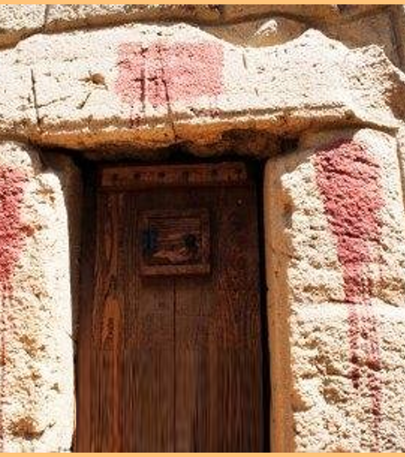
Exodus 12: 1 – 14
NRSVUE

Slide 14
The Lord said to Moses and Aaron in the land of Egypt,
² “This month shall mark for you the beginning of months; it shall be the first month of the year for you.

Slide 15
³ Tell the whole congregation of Israel that on the tenth of this month they are to take a lamb for each family, a lamb for each household.
⁴ If a household is too small for a whole lamb, it shall join its closest neighbor in obtaining one; the lamb shall be divided in proportion to the number of people who eat of it.

Slide 16
⁵ Your lamb shall be without blemish, a year-old male; you may take it from the sheep or from the goats.
⁶ You shall keep it until the fourteenth day of this month; then the whole assembled congregation of Israel shall slaughter it at twilight.

Slide 17
⁷ They shall take some of the blood and put it on the two doorposts and the lintel of the houses in which they eat it.
⁸ They shall eat the lamb that same night; they shall eat it roasted over the fire with unleavened bread and bitter herbs.

Slide 18
⁹ Do not eat any of it raw or boiled in water but roasted over the fire, with its head, legs, and inner organs.
¹⁰ You shall let none of it remain until the morning; anything that remains until the morning you shall burn with fire.

Slide 19
¹¹ This is how you shall eat it: your loins girded, your sandals on your feet, and your staff in your hand, and you shall eat it hurriedly. It is the Passover of the Lord.
¹² I will pass through the land of Egypt that night, and I will strike down every firstborn in the land of Egypt, from human to animal, and on all the gods of Egypt I will execute judgments: I am the Lord.

Slide 20
¹³ The blood shall be a sign for you on the houses where you live: when I see the blood, I will pass over you, and no plague shall destroy you when I strike the land of Egypt.
¹⁴ “This day shall be a day of remembrance for you. You shall celebrate it as a festival to the Lord; throughout your generations you shall observe it as a perpetual ordinance.

Slide 21
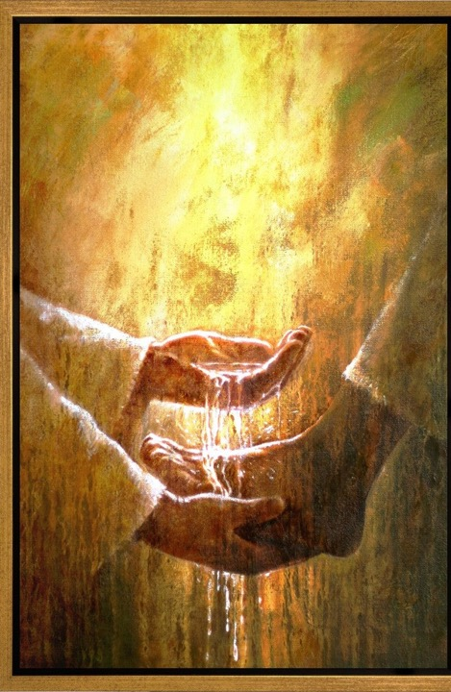
John 13: 1 – 17, 31 – 35
NRSVUE
Notes:
Foot Washing" by Yongsung Kim

Slide 22
Now before the festival of the Passover, Jesus knew that his hour had come to depart from this world and go to the Father. Having loved his own who were in the world, he loved them to the end.
² The devil had already decided that Judas son of Simon Iscariot would betray Jesus. And during supper

Slide 23
³ Jesus, knowing that the Father had given all things into his hands and that he had come from God and was going to God,
⁴ got up from supper, took off his outer robe, and tied a towel around himself.
⁵Then he poured water into a basin and began to wash the disciples’ feet and to wipe them with the towel that was tied around him.

Slide 24
⁶ He came to Simon Peter, who said to him, “Lord, are you going to wash my feet?”
⁷ Jesus answered, “You do not know now what I am doing, but later you will understand.”
⁸ Peter said to him, “You will never wash my feet.” Jesus answered, “Unless I wash you, you have no share with me.”

Slide 25
⁹ Simon Peter said to him, “Lord, not my feet only but also my hands and my head!”
¹⁰ Jesus said to him, “One who has bathed does not need to wash, except for the feet, but is entirely clean. And you are clean, though not all of you.”
¹¹ For he knew who was to betray him; for this reason he said, “Not all of you are clean.”

Slide 26
¹² After he had washed their feet, had put on his robe, and had reclined again, he said to them, “Do you know what I have done to you?
¹³ You call me Teacher and Lord, and you are right, for that is what I am.

Slide 27
¹⁴ So if I, your Lord and Teacher, have washed your feet, you also ought to wash one another’s feet.
¹⁵ For I have set you an example, that you also should do as I have done to you.

Slide 28
¹⁶ Very truly, I tell you, slaves are not greater than their master, nor are messengers greater than the one who sent them.
¹⁷ If you know these things, you are blessed if you do them.
³¹ When he had gone out, Jesus said, “Now the Son of Man has been glorified, and God has been glorified in him.

Slide 29
³² If God has been glorified in him, God will also glorify him in himself and will glorify him at once.
³³ Little children, I am with you only a little longer. You will look for me, and as I said to the Jews so now I say to you, ‘Where I am going, you cannot come.’

Slide 30
³⁴ I give you a new commandment, that you love one another. Just as I have loved you, you also should love one another.
³⁵ By this everyone will know that you are my disciples, if you have love for one another.”

Slide 31
The Word of God for the people of God
Thanks be to God

Slide 32

Sermon
“It’s Not Too Late for a New Commandment”

Slide 33

Communion with Hand or Foot Washing

Slide 35
“O Master, Let Me Walk With Thee” UMH 430
WORDS: Washington Gladden, 1879 MUSIC: H. Percy Smith, 1874
Please stand as you are able and comfortable.
O Master, let me walk with thee
in lowly paths of service free;
tell me thy secret; help me bear
the strain of toil, the fret of care.

Slide 36
“O Master, Let Me Walk With Thee” UMH 430
WORDS: Washington Gladden, 1879 MUSIC: H. Percy Smith, 1874
Please stand as you are able and comfortable.
Help me the slow of heart to move
by some clear, winning word of love; teach me the wayward feet to stay,
and guide them in the homeward way.

Slide 37
“O Master, Let Me Walk With Thee” UMH 430
WORDS: Washington Gladden, 1879 MUSIC: H. Percy Smith, 1874
Please stand as you are able and comfortable.
Teach me thy patience; still with thee
in closer, dearer company,
in work that keeps faith sweet and strong, in trust that triumphs over wrong;

Slide 38
“O Master, Let Me Walk With Thee” UMH 430
WORDS: Washington Gladden, 1879 MUSIC: H. Percy Smith, 1874
Please stand as you are able and comfortable.
In hope that sends a shining ray
far down the future’s broadening way,
in peace that only thou canst give,
with thee, O Master, let me live.

Slide 39
BLESSING AND BENEDICTION
This service has ended, and now
your service in the world begins!

Slide 40
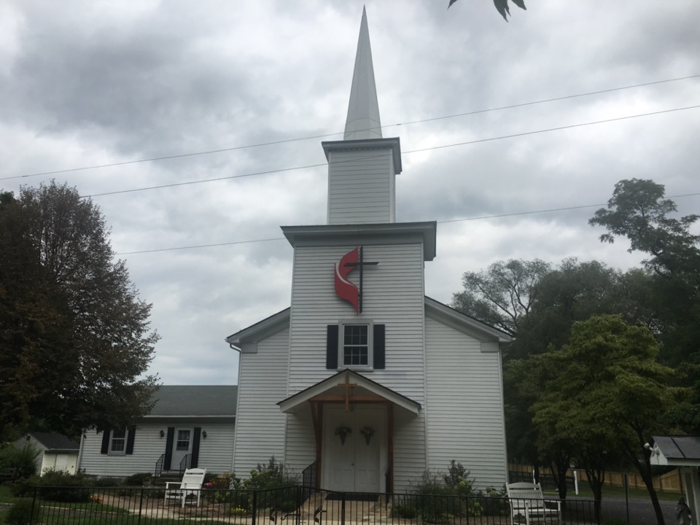
Rectortown United Methodist Church
serving God with
Prayer, Action, and Love
through Service.

