Slide 2
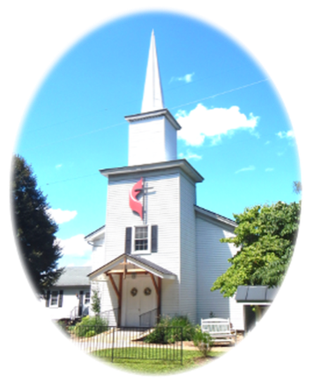
Prelude
Pastor Eduardo Carrillo
Fifth Sunday after Epiphany
February 8th , 2026
CCLI License:
3430384-01-1829
Livestream Notice: Our worship service is live-streamed and recorded. By attending, you consent to being included in the broadcast. Thank you for joining us!

Slide 3
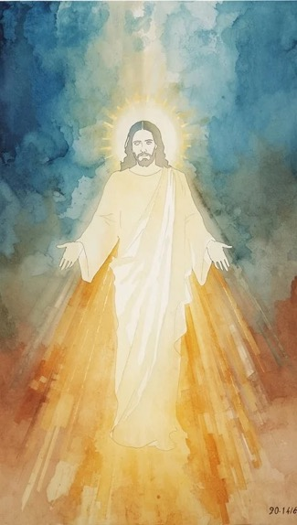
WELCOME,
ANNOUNCEMENTS,
and
CELEBRATIONS
Livestream Notice: Our worship service is live-streamed and recorded. By attending, you consent to being included in the broadcast. Thank you for joining us!

Slide 4
We don’t always get it right.
So, we learn from one another.

Slide 5
Sometimes our conversations cause pain
but we are called to speak with love.

Slide 6
Forgiveness is key to working together,
just as God forgives us.

Slide 7
We are called to do everything out of love,
because God loved us first!

Slide 8
God of us all, thank you that we do not have to do this life of faith alone. Thank you for the community both near and far that walks alongside us. When we experience division in your beloved family,

Slide 9
help us to remember our common bond in Jesus Christ. Give us your Spirit of compassion, kindness, humility, patience, and love in our relationships with one another.

Slide 10
May our life together show the world what is possible with you. All this we pray in Jesus’ name. Amen.

Slide 11
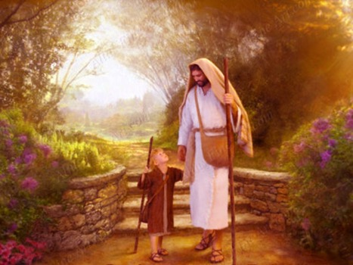
“Guide Me, O Thou Great Jehovah” UMH #127
WORDS: William Williams, 1745 MUSIC: John Hughes, 1907
Please stand as you are able and comfortable.
Guide me, O thou great Jehovah, pilgrim through this barren land.
I am weak, but thou art mighty;
hold me with thy powerful hand.
Bread of heaven, bread of heaven, feed me till I want no more;
feed me till I want no more.

Slide 12
“Guide Me, O Thou Great Jehovah” UMH #127
WORDS: William Williams, 1745 MUSIC: John Hughes, 1907
Please stand as you are able and comfortable.
Open now the crystal fountain, whence the healing stream doth flow; let the fire and cloudy pillar
lead me all my journey through. Strong deliverer, strong deliverer,
be thou still my strength and shield; be thou still my strength and shield.

Slide 13
“Guide Me, O Thou Great Jehovah” UMH #127
WORDS: William Williams, 1745 MUSIC: John Hughes, 1907
Please stand as you are able and comfortable.
When I tread the verge of Jordan,
bid my anxious fears subside;
death of death and hell’s destruction, land me safe on Canaan’s side.
Songs of praises, songs of praises,
I will ever give to thee;
I will ever give to thee.

Slide 15
Prayer For Illumination
Spirit of the living God, fall afresh on me.
Spirit of the living God, fall afresh on me.
Melt me, mold me, fill me, use me.
Spirit of the living God, fall afresh on me.
UMH 393

Slide 16

Malachi 3: 16 – 18
NRSVUE

Slide 17
¹⁶ Then those who revered the Lord spoke with one another. The Lord took note and listened, and a book of remembrance was written before him of those who revered the Lord and thought on his name.
¹⁷ They shall be mine, says the Lord of hosts, my special possession on the day when I act, and I will spare them as parents spare their children who serve them.

Slide 18
¹⁸ Then once more you shall see the difference between the righteous and the wicked, between one who serves God and one who does not serve him.

Slide 19

Colossians 3: 12 – 17
NRSVUE

Slide 20
¹² Therefore, as God’s chosen ones, holy and beloved, clothe yourselves with compassion, kindness, humility, meekness, and patience.
¹³ Bear with one another and, if anyone has a complaint against another, forgive each other; just as the Lord^{[f]} has forgiven you, so you also must forgive.

Slide 21
¹⁴ Above all, clothe yourselves with love, which binds everything together in perfect harmony.
¹⁵ And let the peace of Christ rule in your hearts, to which indeed you were called in one body. And be thankful.

Slide 22
¹⁶ Let the word of Christ dwell in you richly; teach and admonish one another in all wisdom; and with gratitude in your hearts sing psalms, hymns, and spiritual songs to God.
¹⁷ And whatever you do, in word or deed, do everything in the name of the Lord Jesus, giving thanks to God the Father through him.

Slide 23
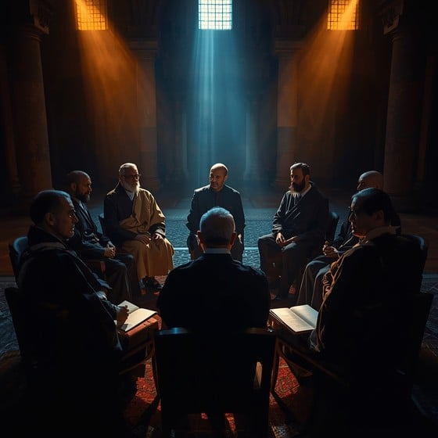
Sermon
“Holy Conferencing”

Slide 24
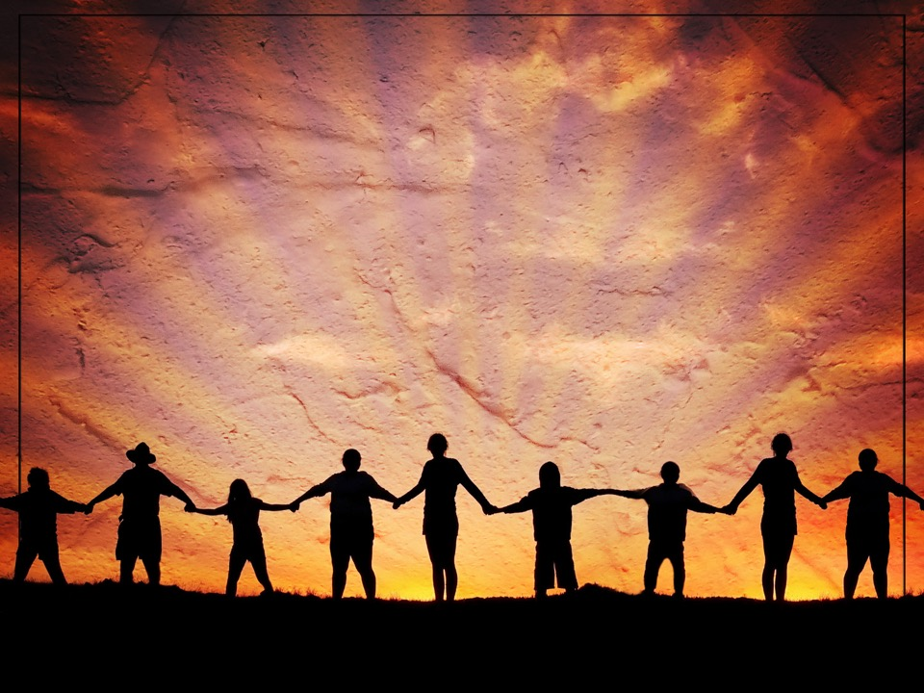
“Together We Serve” TFWS 2175
WORDS and MUSIC: Daniel Charles Damon, 1998
Please stand as you are able and comfortable.
Together we serve,
united by love,
inviting God’s world
to the glorious feast.
We work and we pray
through sorrow and joy,
extending your love to
the last and the least.

Slide 25
“Together We Serve” TFWS 2175
WORDS and MUSIC: Daniel Charles Damon, 1998
Please stand as you are able and comfortable.
We seek to become
a beacon of hope,
a lamp for the heart
and a light for the feet.
We learn, year by year,
to let love shine through
until we see Christ in
each person we meet.

Slide 26
“Together We Serve” TFWS 2175
WORDS and MUSIC: Daniel Charles Damon, 1998
Please stand as you are able and comfortable.
We welcome the scarred,
the wealthy, the poor,
the busy, the lonely,
and all who need care.
We offer a home
to those who will come,
our hands quick to help, our
hearts ready to dare.

Slide 27
“Together We Serve” TFWS 2175
WORDS and MUSIC: Daniel Charles Damon, 1998
Please stand as you are able and comfortable.
Together, by grace,
we witness and work,
remembering Jesus,
in whom we grow strong.
Together we serve
in Spirit and truth,
remembering love is
the strength of our song.

Slide 38
Tithes and Offerings
Worship through giving
Notes:
https://www.goodfon.com/flowers/wallpaper-blue-wood-blossom-spring-flowers-vesna-iablonia-tsvety.html

Slide 39

“Praise God, from Whom All Blessings Flow” UMH 94
WORDS: Thomas Ken, 1674; adapted by Gilbert H. Viera, 1978
MUSIC: Geistliche Kirchengesange, 1623; harmonized by Ralph Vaughn Williams, 1906
Please stand as you are able and comfortable.
Praise God from whom all blessings flow;
Praise God, all creatures here below:
Alleluia! Alleluia!
Praise God, the source of all our gifts!
Praise Jesus Christ, whose power uplifts!
Praise the Spirit, Holy Spirit!
Alleluia! Alleluia! Alleluia!

Slide 40
Offertory Prayer

Slide 57

“Pass It On” UMH 572
WORDS and MUSIC: Kurt Kaiser, 1969
Please stand as you are able and comfortable.
It only takes a spark
to get a fire going,
and soon all those around
can warm up in its glowing.
That’s how it is with God’s love
once you’ve experienced it;
you spread his love to everyone;
you want to pass it on.

Slide 58
“Pass It On” UMH 572
WORDS and MUSIC: Kurt Kaiser, 1969
Please stand as you are able and comfortable.
What a wondrous time is spring,
when all the trees are budding;
the birds begin to sing,
the flowers start their blooming.
That’s how it is with God’s love
once you’ve experienced it;
you want to sing, it’s fresh like spring,
you want to pass it on.

Slide 59
“Pass It On” UMH 572
WORDS and MUSIC: Kurt Kaiser, 1969
Please stand as you are able and comfortable.
I wish for you, my friend,
this happiness that I’ve found;
you can depend on him,
it matters not where you’re bound.
I’ll shout it from the mountain top;
I want my world to know;
the Lord of love has come to me,
I want to pass it on.

Slide 61
BLESSING AND BENEDICTION
This service has ended, and now
your service in the world begins!

Slide 62
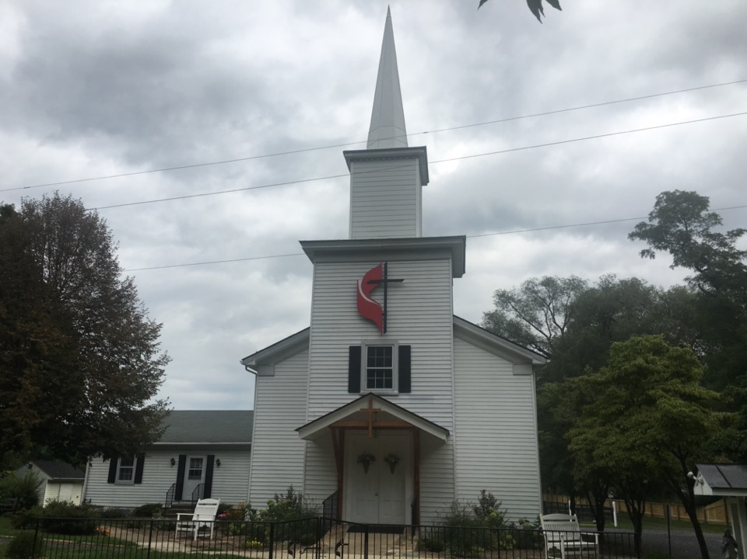
Rectortown United Methodist Church
serving God with
Prayer, Action, and Love
through Service.

