Slide 2

Prelude
Pastor Eduardo Carrillo
Twenty -Second Sunday after Pentecost/ Veteran’s Day/ Organ & Tissue Donor Sunday
November 9th, 2025
CCLI License:
3430384-01-1829
Livestream Notice: Our worship service is live-streamed and recorded. By attending, you consent to being included in the broadcast. Thank you for joining us!

Slide 3
WELCOME,
ANNOUNCEMENTS,
and
CELEBRATIONS
Livestream Notice: Our worship service is live-streamed and recorded. By attending, you consent to being included in the broadcast. Thank you for joining us!

Slide 4
Though the vision tarries, wait for it.
God’s promises do not fail.

Slide 5
God is not the God of the dead, but of the living.
In life and in death, we belong to God.

Slide 6
Let us give thanks for the gift of life.
We worship with joy and reverence.

Slide 7
God of life eternal, you hold us in love from first breath to final sigh and beyond. You see what we cannot, and you promise what we can barely imagine.

Slide 8
Fill us with trust in your power to redeem and restore. Make us generous with our lives, our hope, and our care for others. Amen.

Slide 9

The God of Abraham Praise
116
WORDS: From The Yigdal of Daniel ben Judah, ca. 1400; para. by Thomas Olivers, 1760; alt.
1. The God of Abraham praise, who reigns enthroned above; Ancient of Everlasting Days, and God of love; Jehovah, great I AM! by earth and heaven confessed; I bow and bless the sacred name forever blest.
1. The God of Abraham praise, who reigns enthroned above; Ancient of Everlasting Days, and God of love; Jehovah, great I AM! by earth and heaven confessed; I bow and bless the sacred name forever blest.

Slide 10
The God of Abraham Praise
116
WORDS: From The Yigdal of Daniel ben Judah, ca. 1400; para. by Thomas Olivers, 1760; alt.
2. The great I AM has sworn; I on this oath depend. I shall, on eagle wings upborne, to heaven ascend.
I shall behold God’s face; I shall God’s power adore, and sing the wonders of God’s grace forevermore.

Slide 11
The God of Abraham Praise
116
WORDS: From The Yigdal of Daniel ben Judah, ca. 1400; para. by Thomas Olivers, 1760; alt.
3. The heavenly land I see, with peace and plenty blest; a land of sacred liberty, and endless rest.
There milk and honey flow, and oil and wine abound, and trees of life forever grow with mercy crowned.

Slide 12
The God of Abraham Praise
116
WORDS: From The Yigdal of Daniel ben Judah, ca. 1400; para. by Thomas Olivers, 1760; alt.
4. The God who reigns on high the great archangels sing, and “Holy, holy, holy!” cry, “Almighty King! Who was, and is, the same, and evermore shall be: Jehovah, Lord, the great I AM, we worship thee!”

Slide 14
Prayer For Illumination
Spirit of the living God, fall afresh on me.
Spirit of the living God, fall afresh on me.
Melt me, mold me, fill me, use me.
Spirit of the living God, fall afresh on me.
UMH 393

Slide 15
Habbakkuk 2: 1 – 9
NRSVUE

Slide 16
¹ I will stand at my watchpost and station myself on the rampart;
I will keep watch to see what he will say to me and what he will answer concerning my complaint.
² Then the Lord answered me and said: Write the vision; make it plain on tablets, so that a runner may read it.

Slide 17
³ For there is still a vision for the appointed time; it speaks of the end and does not lie. If it seems to tarry, wait for it; it will surely come; it will not delay.
⁴ Look at the proud! Their spirit is not right in them, but the righteous live by their faithfulness.

Slide 18
⁵ Moreover, wealth is treacherous; the arrogant do not endure. They open their throats wide as Sheol; like Death they never have enough. They gather all nations for themselves and collect all peoples as their own.

Slide 19
⁶ Shall not everyone taunt such people and, with mocking riddles, say about them,
“Alas for you who heap up what is not your own!” How long will you load yourselves with goods taken in pledge?
⁷ Will not your own creditors suddenly rise and those who make you tremble wake up? Then you will be plunder for them.

Slide 20
⁸ Because you have plundered many nations, all who survive of the peoples shall plunder you – because of human bloodshed and violence to the earth, to cities and all who live in them.
⁹ ”Alas for you who get evil gain for your house, setting your nest on high to be safe from the reach of harm!”

Slide 21
Luke 20: 27 – 38
NRSVUE

Slide 22
²⁷ Some Sadducees, those who say there is no resurrection, came to him
²⁸ and asked him a question: “Teacher, Moses wrote for us that if a man’s brother dies leaving a wife but no children, the man shall marry the widow and raise up children for his brother.

Slide 23
²⁹ Now there are seven brothers; the first married a woman and died childless.
³⁰ then the second
³¹ and the third married her, and so in the same way all seven died childless.
³² Finally the woman also died.

Slide 24
³³ In the resurrection, therefore, whose wife will the woman be? For the seven had married her.”
³⁴Jesus said to them, “Those who belong to this age marry and are given in marriage,

Slide 25
³⁵ but those who are considered worthy of a place in that age and in the resurrection from the dead neither marry nor are given in marriage.
³⁶ Indeed, they cannot die anymore, because they are like angels and are children of God, being children of the resurrection.

Slide 26
³⁷ And the fact that the dead are raised Moses himself showed, in the story about the bush, where he speaks of the Lord as the God of Abraham, the God of Isaac, and the God of Jacob.
³⁸Now he is God not of the dead but of the living, for to him all of them are alive.”

Slide 27
The Word of God for the people of God
Thanks be to God

Slide 28
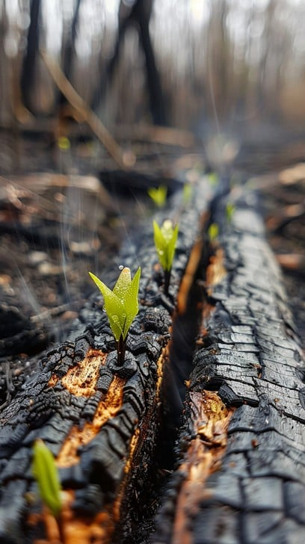
Sermon
“Living Beyond Death”

Slide 29
I Want Jesus to Walk with Me
521
WORDS: African American spiritual
1. I want Jesus to walk with me. (walk with me)
I want Jesus to walk with me. (walk with me)
All along my pilgrim journey, Lord, I want Jesus to walk with me.
(walk with me)

Slide 30
I Want Jesus to Walk with Me
521
WORDS: African American spiritual
2. In my trials, Lord, walk with me. (walk with me)
In my trials, Lord, walk with me.
(walk with me)
When my heart is almost breaking, Lord, I want Jesus to walk with me. (walk with me)

Slide 31
I Want Jesus to Walk with Me
521
WORDS: African American spiritual
3. When I’m troubled, Lord, walk with me. (walk with me)
When I’m troubled, Lord, walk with me. (walk with me)
When my head is bowed in sorrow, Lord, I want Jesus to walk with me. (walk with me)

Slide 41
Tithes and Offerings
Worship through giving
Notes:
https://www.goodfon.com/flowers/wallpaper-blue-wood-blossom-spring-flowers-vesna-iablonia-tsvety.html

Slide 42

“Praise God, from Whom All Blessings Flow” UMH 94
WORDS: Thomas Ken, 1674; adapted by Gilbert H. Viera, 1978
MUSIC: Geistliche Kirchengesange, 1623; harmonized by Ralph Vaughn Williams, 1906
Please stand as you are able and comfortable.
Praise God from whom all blessings flow;
Praise God, all creatures here below:
Alleluia! Alleluia!
Praise God, the source of all our gifts!
Praise Jesus Christ, whose power uplifts!
Praise the Spirit, Holy Spirit!
Alleluia! Alleluia! Alleluia!

Slide 43
Offertory Prayer

Slide 44
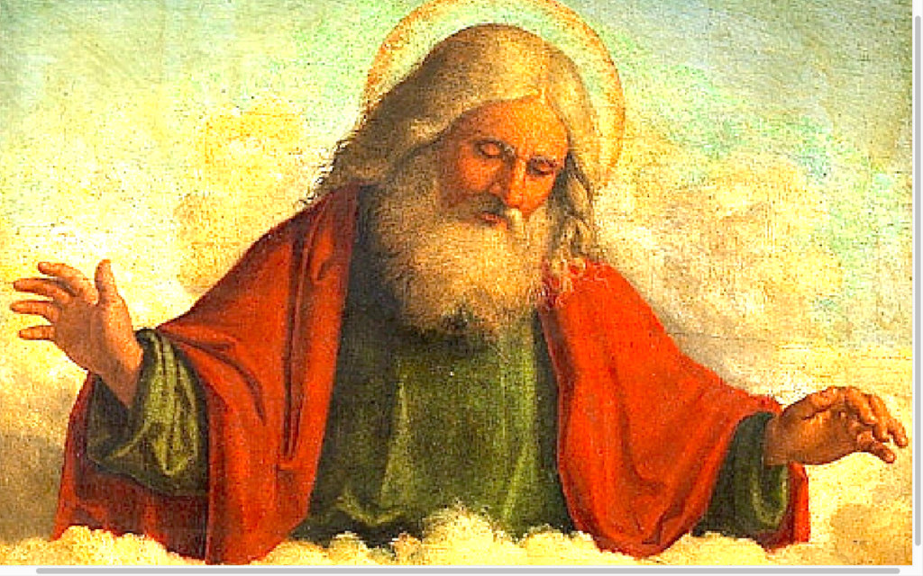
“Immortal, Invisible, God Only Wise” UMH 103
WORDS: Walter Chalmers Smith, 1867
MUSIC: Welsh melody, 1839; harmonized by John Roberts
Please stand as you are able and comfortable.
Immortal, invisible,
God only wise,
in light inaccessible
hid from our eyes,
most blessed, most glorious,
the Ancient of Days,
almighty , victorious,
thy great name we praise.

Slide 45
“Immortal, Invisible, God Only Wise” UMH 103
WORDS: Walter Chalmers Smith, 1867
MUSIC: Welsh melody, 1839; harmonized by John Roberts
Please stand as you are able and comfortable.
Unresting, unhasting,
and silent as light,
nor wanting, nor wasting,
thou rulest in might;
thy justice like mountains
high soaring above
thy clouds which are fountains
of goodness and love.

Slide 46
“Immortal, Invisible, God Only Wise” UMH 103
WORDS: Walter Chalmers Smith, 1867
MUSIC: Welsh melody, 1839; harmonized by John Roberts
Please stand as you are able and comfortable.
To all, life thou givest,
to both great and small;
in all life thou livest,
the true life of all;
we blossom and flourish
as leaves on the tree,
and wither and perish,
but naught changeth thee.

Slide 47
“Immortal, Invisible, God Only Wise” UMH 103
WORDS: Walter Chalmers Smith, 1867
MUSIC: Welsh melody, 1839; harmonized by John Roberts
Please stand as you are able and comfortable.
Thou reignest in glory;
thou dwellest in light;
thine angels adore thee,
all veiling their sight;
all laud we would render:
O help us to see
’tis only the splendor
of light hideth thee.

Slide 49
BLESSING AND BENEDICTION
This service has ended, and now
your service in the world begins!

Slide 50
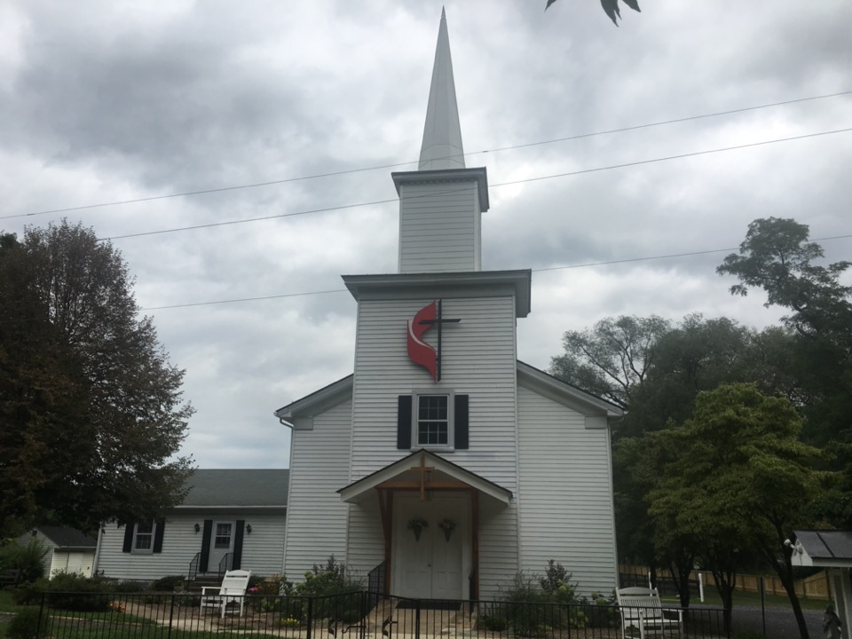
Rectortown United Methodist Church
serving God with
Prayer, Action, and Love
through Service.

