Slide 2
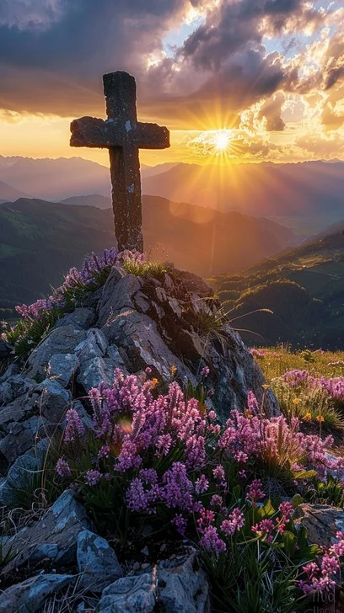
Prelude
Pastor Eduardo Carrillo
3rd Sunday of Lent
March 8th, 2026
CCLI License:
3430384-01-1829
Livestream Notice: Our worship service is live-streamed and recorded. By attending, you consent to being included in the broadcast. Thank you for joining us!

Slide 3
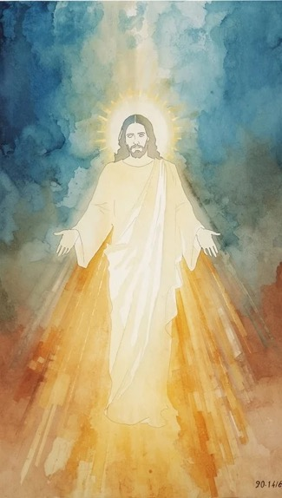
WELCOME,
ANNOUNCEMENTS,
and
CELEBRATIONS
Livestream Notice: Our worship service is live-streamed and recorded. By attending, you consent to being included in the broadcast. Thank you for joining us!

Slide 4
Wilderness-wanderers, holiness-seekers, listen for God’s voice today.
It’s never too late to come home to God.

Slide 5
Although some of us may feel guilt or shame,
It’s never too late to come home to God.

Slide 6
Although some of us may feel the weight of regret,
It’s never too late to come home to God.

Slide 7
Although some of us may feel pride or resentment,
It’s never too late to come home to God.

Slide 8
Here we gather as God’s beloved
children.
God is celebrating that we are
home!
All: Let us rejoice with one another!

Slide 9
God of grace, we confess to you today that we have not always used the gifts you have given us well. We have misplaced our priorities and squandered our blessings.

Slide 10
Moreover, we have sometimes believed ourselves too far gone to seek forgiveness, to be loved, to change. This, too, has put distance between us.

Slide 11
Today, we turn back to you, and we see you running to us with open arms. Help us receive with joy your warm embrace, take our place at your banquet table, and be led into new life. Amen.

Slide 12
“Rock of Ages, Cleft for Me” UMH 361
WORDS: Augustus M. Toplady, 1776 MUSIC: Thomas Hastings, 1830
Please stand as you are able and comfortable.
Rock of Ages, cleft for me,
let me hide myself in thee;
let the water and the blood,
from thy wounded side which flowed, be of sin the double cure;
save from wrath and make me pure.

Slide 13
“Rock of Ages, Cleft for Me” UMH 361
WORDS: Augustus M. Toplady, 1776 MUSIC: Thomas Hastings, 1830
Please stand as you are able and comfortable.
Not the labors of my hands
can fulfill thy law's demands;
could my zeal no respite know,
could my tears forever flow,
all for sin could not atone;
thou must save, and thou alone.

Slide 14
“Rock of Ages, Cleft for Me” UMH 361
WORDS: Augustus M. Toplady, 1776 MUSIC: Thomas Hastings, 1830
Please stand as you are able and comfortable.
Nothing in my hand I bring,
simply to the cross I cling;
naked, come to thee for dress;
helpless, look to thee for grace;
foul, I to the fountain fly;
wash me, Savior, or I die.

Slide 15
“Rock of Ages, Cleft for Me” UMH 361
WORDS: Augustus M. Toplady, 1776 MUSIC: Thomas Hastings, 1830
Please stand as you are able and comfortable.
While I draw this fleeting breath,
when mine eyes shall close in death, when I soar to world unknown,
see thee on thy judgment throne,
Rock of Ages, cleft for me,
let me hide myself in thee.

Slide 17
Prayer For Illumination
Spirit of the living God, fall afresh on me.
Spirit of the living God, fall afresh on me.
Melt me, mold me, fill me, use me.
Spirit of the living God, fall afresh on me.
UMH 393

Slide 18
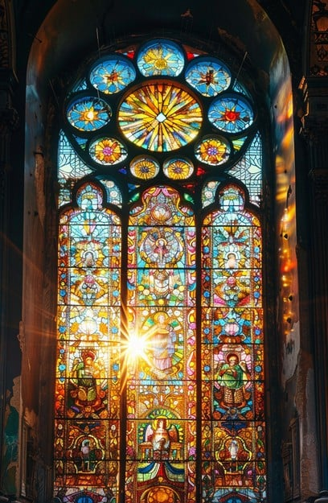
Psalm 103: 8 – 13
NRSVUE

Slide 19
⁸ The Lord is merciful and gracious, slow to anger and abounding in steadfast love.
⁹ He will not always accuse, nor will he keep his anger forever.
¹⁰ He does not deal with us according to our sins nor repay us according to our iniquities.

Slide 20
¹¹ For as the heavens are high above the earth, so great is his steadfast love toward those who fear him;
¹² as far as the east is from the west, so far he removes our transgressions from us.
¹³ As a father has compassion for his children, so the Lord has compassion for those who fear him.

Slide 21
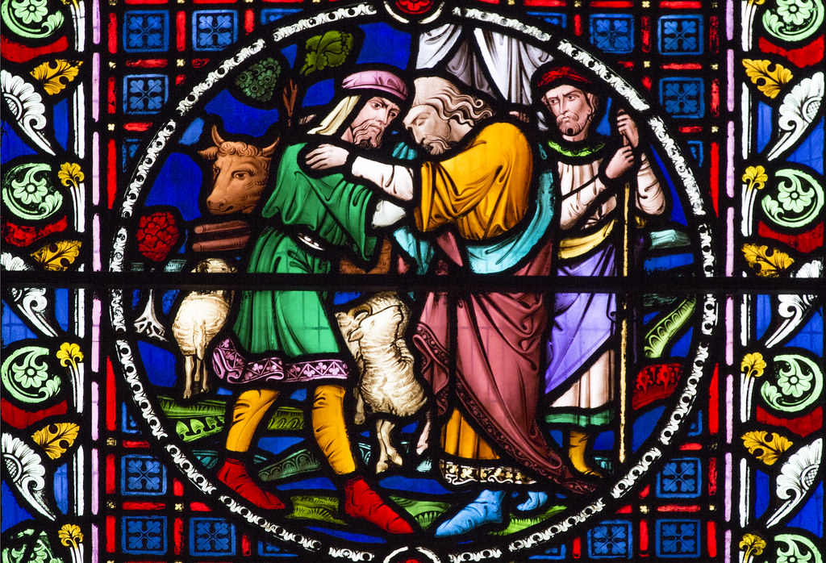
Luke 15: 11 -32
NRSVUE

Slide 22
¹¹ Then Jesus said, “There was a man who had two sons.
¹² The younger of them said to his father, ‘Father, give me the share of the wealth that will belong to me.’ So he divided his assets between them.

Slide 23
¹³ A few days later the younger son gathered all he had and traveled to a distant region, and there he squandered his wealth in dissolute living.

Slide 24
¹⁴ When he had spent everything, a severe famine took place throughout that region, and he began to be in need.
¹⁵ So he went and hired himself out to one of the citizens of that region, who sent him to his fields to feed the pigs.

Slide 25
¹⁶ He would gladly have filled his stomach with the pods that the pigs were eating, and no one gave him anything.
¹⁷ But when he came to his senses he said, ‘How many of my father’s hired hands have bread enough and to spare, but here I am dying of hunger!

Slide 26
¹⁸ I will get up and go to my father, and I will say to him, “Father, I have sinned against heaven and before you;
¹⁹ I am no longer worthy to be called your son; treat me like one of your hired hands.” ’

Slide 27
²⁰ So he set off and went to his father. But while he was still far off, his father saw him and was filled with compassion; he ran and put his arms around him and kissed him.
²¹ Then the son said to him, ‘Father, I have sinned against heaven and before you; I am no longer worthy to be called your son.’[

Slide 28
²² But the father said to his slaves, ‘Quickly, bring out a robe—the best one—and put it on him; put a ring on his finger and sandals on his feet.
²³ And get the fatted calf and kill it, and let us eat and celebrate,
²⁴ for this son of mine was dead and is alive again; he was lost and is found!’ And they began to celebrate.

Slide 29
²⁵ “Now his elder son was in the field, and as he came and approached the house, he heard music and dancing.
²⁶ He called one of the slaves and asked what was going on.
²⁷ He replied, ‘Your brother has come, and your father has killed the fatted calf because he has got him back safe and sound.’

Slide 30
²⁸ Then he became angry and refused to go in. His father came out and began to plead with him.
²⁹ But he answered his father, ‘Listen! For all these years I have been working like a slave for you, and I have never disobeyed your command, yet you have never given me even a young goat so that I might celebrate with my friends.

Slide 31
³⁰ But when this son of yours came back, who has devoured your assets with prostitutes, you killed the fatted calf for him!’
³¹ Then the father said to him, ‘Son, you are always with me, and all that is mine is yours.
³² But we had to celebrate and rejoice, because this brother of yours was dead and has come to life; he was lost and has been found.’ ”

Slide 32
The Word of God for the people of God
Thanks be to God

Slide 33

Sermon
“It’s Not Too Late to Be Forgiven”

Slide 34

“Spirit of God, Descend upon My Heart” UMH 500
WORDS: George Croly, 1867 MUSIC: Frederick C. Atkinson, 1870
Please stand as you are able and comfortable.
Spirit of God, descend
upon my heart;
wean it from earth;
through all its pulses move;
stoop to my weakness,
mighty as thou art,
and make me love thee as
I ought to love.

Slide 35
“Spirit of God, Descend upon My Heart” UMH 500
WORDS: George Croly, 1867 MUSIC: Frederick C. Atkinson, 1870
Please stand as you are able and comfortable.
I ask no dream, no
prophet ecstasies,
no sudden rending
of the veil of clay,
no angel visitant,
no opeing skies;
but take the dimness of
my soul away.

Slide 36
“Spirit of God, Descend upon My Heart” UMH 500
WORDS: George Croly, 1867 MUSIC: Frederick C. Atkinson, 1870
Please stand as you are able and comfortable.
Hast thou not bid me
love thee, God and King?
All, all thine own, soul,
heart and strength and mind.
I see thy cross; there
teach my heart to cling.
O let me seek thee, and
O let me find!

Slide 37
“Spirit of God, Descend upon My Heart” UMH 500
WORDS: George Croly, 1867 MUSIC: Frederick C. Atkinson, 1870
Please stand as you are able and comfortable.
Teach me to feel that
thou art always nigh;
teach me the struggles
of the soul to bear.
To check the rising
doubt, the rebel sigh,
teach me the patience of
unanswered prayer.

Slide 38
“Spirit of God, Descend upon My Heart” UMH 500
WORDS: George Croly, 1867 MUSIC: Frederick C. Atkinson, 1870
Please stand as you are able and comfortable.
Teach me to love thee
as tine angels love,
one holy passion
filling all my frame;
the kindling of the
heaven descended Dove,
my heart an altar, and
thy love the flame.

Slide 48
Tithes and Offerings
Worship through giving
Notes:
https://www.goodfon.com/flowers/wallpaper-blue-wood-blossom-spring-flowers-vesna-iablonia-tsvety.html

Slide 49

“Praise God, from Whom All Blessings Flow” UMH 94
WORDS: Thomas Ken, 1674; adapted by Gilbert H. Viera, 1978
MUSIC: Geistliche Kirchengesange, 1623; harmonized by Ralph Vaughn Williams, 1906
Please stand as you are able and comfortable.
Praise God from whom all blessings flow;
Praise God, all creatures here below:
Alleluia! Alleluia!
Praise God, the source of all our gifts!
Praise Jesus Christ, whose power uplifts!
Praise the Spirit, Holy Spirit!
Alleluia! Alleluia! Alleluia!

Slide 50
Offertory Prayer

Slide 51

When I Survey the Wondrous Cross
298
1. When I survey
the wondrous cross
on which the
Prince of Glory died,

Slide 52
When I Survey the Wondrous Cross
298
my richest gain
I count but loss,
and pour contempt
on all my pride.

Slide 53
When I Survey the Wondrous Cross
298
2. Forbid it, Lord,
that I should boast,
save in the death
of Christ, my God;

Slide 54
When I Survey the Wondrous Cross
298
all the vain things
that charm me most,
I sacrifice them
to his blood.

Slide 55
When I Survey the Wondrous Cross
298
3. See, from his head,
his hands, his feet,
sorrow and love
flow mingled down.

Slide 56
When I Survey the Wondrous Cross
298
Did e’er such love
and sorrow meet,
or thorns compose
so rich a crown?

Slide 57
When I Survey the Wondrous Cross
298
4. Were the whole realm
of nature mine,
that were an offering
far too small;

Slide 58
When I Survey the Wondrous Cross
298
love so amazing,
so divine,
demands my soul,
my life, my all.

Slide 60
BLESSING AND BENEDICTION
This service has ended, and now
your service in the world begins!

Slide 61
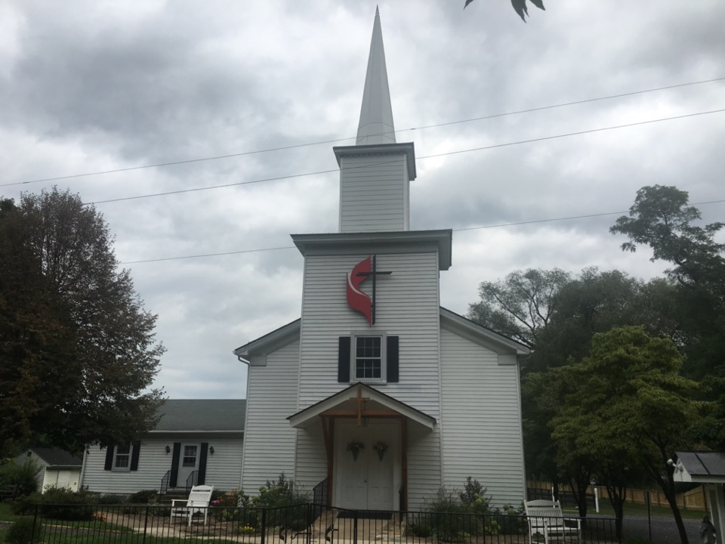
Rectortown United Methodist Church
serving God with
Prayer, Action, and Love
through Service.

