Slide 2
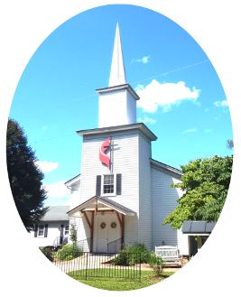
Prelude
Pastor Eduardo Carrillo
Sixth Sunday after Pentecost
July 20th , 2025
CCLI License:
3430384-01-1829
Livestream Notice: Our worship service is live-streamed and recorded. By attending, you consent to being included in the broadcast. Thank you for joining us!

Slide 3
WELCOME,
ANNOUNCEMENTS,
and
CELEBRATIONS
Livestream Notice: Our worship service is live-streamed and recorded. By attending, you consent to being included in the broadcast. Thank you for joining us!

Slide 4
Come in from the noise, the rush, the full schedules and restless nights.
We come to sit, to pause, to listen.

Slide 5
God is not absent. God's Word is not distant.
In stillness and in truth, God
speaks.

Slide 6
Let justice rise, let grace take root, Let our worship awaken us again.
We come, hungry for presence, ready to be changed.

Slide 7
Holy God, we enter this space carrying the weight of our weeks, some heavy with labor, some stretched by distraction, some dulled by routine, others bruised by injustice.

Slide 8
But here we are, your people gathered not to perform, but to be present and transformed. We don’t want to miss what you’re saying. We don’t want to outrun what you’re doing.

Slide 9
So still us. Center us. Open us to your Word. Plant something eternal in us this hour, a seed of truth, a whisper of grace, a spark of holy urgency. In Jesus’ name we pray, Amen.

Slide 10
“The Church’s One Foundation” UMH 545
WORDS: Samuel J. Stone, 1866 MUSIC: Samuel Sebastian Wesley, 1864
Please stand as you are able and comfortable.
The church’s one foundation
is Jesus Christ her Lord;
she is his new creation
by water and the Word.
From heaven he came and sought her
to be his holy bride;
with his own blood he bought her,
and for her life he died.

Slide 11
“The Church’s One Foundation” UMH 545
WORDS: Samuel J. Stone, 1866 MUSIC: Samuel Sebastian Wesley, 1864
Please stand as you are able and comfortable.
Elect from every nation,
yet one o’er all the earth;
her charter of salvation,
one Lord, one faith, one birth;
one holy name she blesses,
partakes one holy food,
and to one hope she presses,
with every grace endued.

Slide 12
“The Church’s One Foundation” UMH 545
WORDS: Samuel J. Stone, 1866 MUSIC: Samuel Sebastian Wesley, 1864
Please stand as you are able and comfortable.
Though with a scornful wonder
we see her sore oppressed,
by schisms rent asunder,
by heresies distressed,
yet saints their watch are keeping;
their cry goes up, “How long?”
And soon the night of weeping
shall be the morn of song.

Slide 13
“The Church’s One Foundation” UMH 545
WORDS: Samuel J. Stone, 1866 MUSIC: Samuel Sebastian Wesley, 1864
Please stand as you are able and comfortable.
Mid toil and tribulation,
and tumult of her war,
she waits the consummation
of peace forevermore;
till, with the vision glorious,
her longing eyes are blest,
and the greath church victorious
shall be the church at rest.

Slide 14
“The Church’s One Foundation” UMH 545
WORDS: Samuel J. Stone, 1866 MUSIC: Samuel Sebastian Wesley, 1864
Please stand as you are able and comfortable.
Yet she on earth hath union
with God the Three in One,
and mystic sweet communion
with those whose rest is won.
O happy ones and holy!
Lord, give us grace that we
like them, the meek and lowly,
on high may dwell with thee.

Slide 16
Prayer For Illumination
Lord, open our hearts and minds by the power of your Holy Spirit, that as the Scriptures are read and your Word proclaimed, we may hear with joy what you say to us today. Amen.
UM Book of Worship

Slide 17

Amos 8: 1 – 12
NRSVUE

Slide 18
¹This is what the Lord God showed me: a basket of summer fruit.
² He said, “Amos, what do you see?” And I said, “A basket of summer fruit.” Then the Lord said to me,
“The end has come upon my people Israel;
I will spare them no longer.

Slide 19
³ The songs of the temple shall become wailings on that day,” says the Lord God;
“the dead bodies shall be many, cast out in every place. Be silent!”
⁴ Hear this, you who trample on the needy,
and bring to ruin the poor of the land,

Slide 20
⁵ saying, “When will the new moon be over
so that we may sell grain, and the Sabbath,
so that we may offer wheat for sale? We will make the ephah smaller and the shekel heavier and practice deceit with false balances,

Slide 21
⁶ buying the poor for silver
and the needy for a pair of sandals
and selling the sweepings of the wheat.”
⁷ The Lord has sworn by the pride of Jacob:
Surely I will never forget any of their deeds.

Slide 22
⁸ Shall not the land tremble on this account,
and everyone mourn who lives in it, and all of it rise like the Nile, and be tossed about and sink again, like the Nile of Egypt?
⁹ On that day, says the Lord God, I will make the sun go down at noon and darken the earth in broad daylight.

Slide 23
¹⁰ I will turn your feasts into mourning and all your songs into lamentation; I will bring sackcloth on all loins and baldness on every head; I will make it like the mourning for an only son and the end of it like a bitter day.

Slide 24
¹¹ The time is surely coming, says the Lord God, when I will send a famine on the land, not a famine of bread or a thirst for water, but of hearing the words of the Lord.
¹² They shall wander from sea to sea and from north to east; they shall run to and fro, seeking the word of the Lord, but they shall not find it.

Slide 25
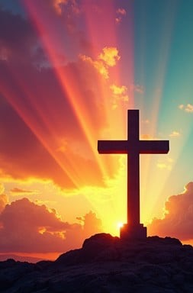
Luke 10: 38 – 42
NRSVUE

Slide 26
³⁸ Now as they went on their way, he entered a certain village where a woman named Martha welcomed him.
³⁹ She had a sister named Mary, who sat at Jesus’s feet and listened to what he was saying.

Slide 27
⁴⁰ But Martha was distracted by her many tasks, so she came to him and asked, “Lord, do you not care that my sister has left me to do all the work by myself? Tell her, then, to help me.”

Slide 28
⁴¹ But the Lord answered her, “Martha, Martha, you are worried and distracted by many things,
⁴² but few things are needed—indeed only one. Mary has chosen the better part, which will not be taken away from her.”

Slide 29
The Word of God for the people of God
Thanks be to God

Slide 30
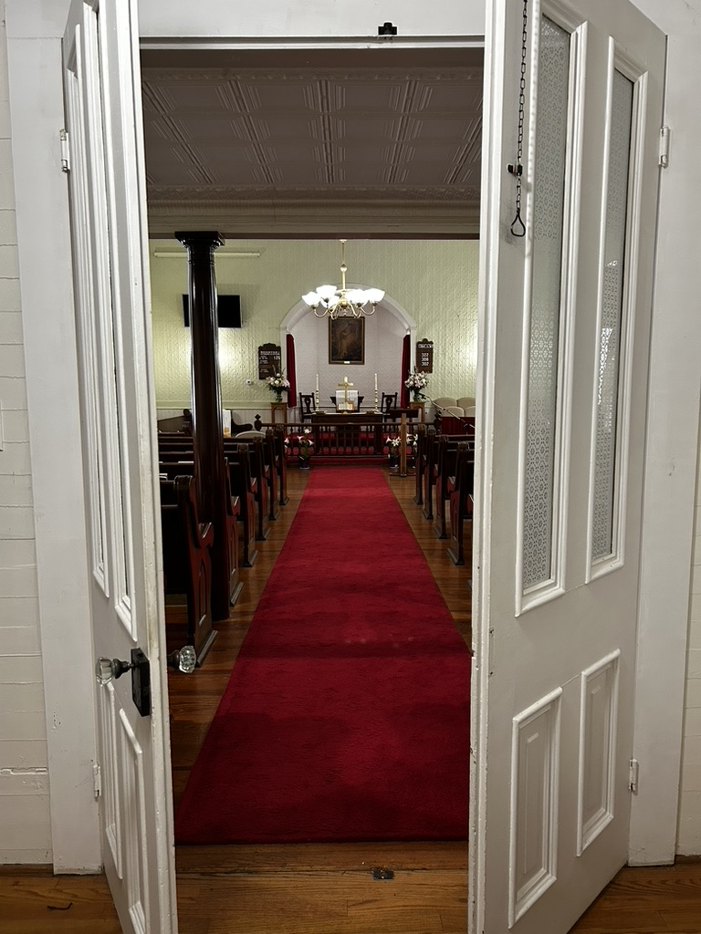
Sermon
“Occupied but Empty”

Slide 31
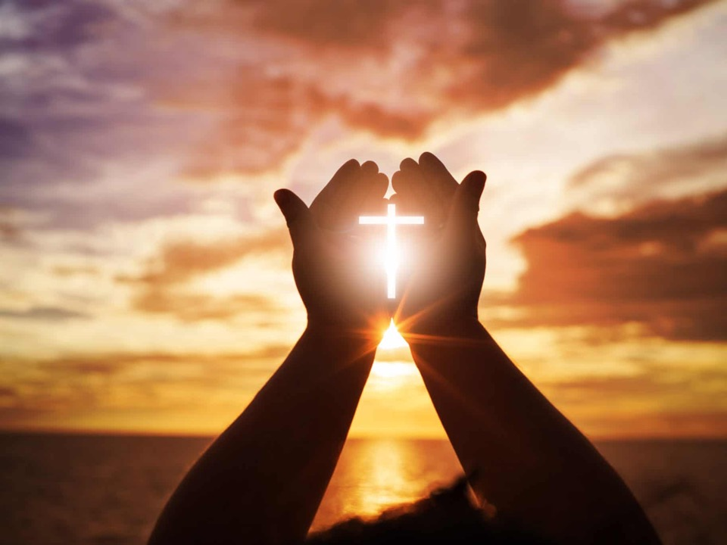
“To God Be The Glory” UMH 98
Words: Fanny J. Crosty, 1875; Music: William H. Doane, 1875
To God be the glory great things He has done
So loved He the world that He gave us His Son
Who yielded His life an atonement for sin
And opened the life gate that all may go in

Slide 32
“To God Be The Glory” UMH 98
Words: Fanny J. Crosty, 1875; Music: William H. Doane, 1875
Praise the Lord praise the Lord
Let the earth hear His voice
Praise the Lord praise the Lord
Let the people rejoice
O come to the Father through Jesus the Son
And give Him the glory great things He has done

Slide 33
“To God Be The Glory” UMH 98
Words: Fanny J. Crosty, 1875; Music: William H. Doane, 1875
O perfect redemption the purchase of blood
To every believer the promise of God
The vilest offender who truly believes
That moment from Jesus a pardon receives

Slide 34
“To God Be The Glory” UMH 98
Words: Fanny J. Crosty, 1875; Music: William H. Doane, 1875
Praise the Lord praise the Lord
Let the earth hear His voice
Praise the Lord praise the Lord
Let the people rejoice
O come to the Father through Jesus the Son
And give Him the glory great things He has done

Slide 35
“To God Be The Glory” UMH 98
Words: Fanny J. Crosty, 1875; Music: William H. Doane, 1875
Great things He has taught us
Great things He has done
And great our rejoicing through Jesus the Son
But purer and higher and greater will be
Our wonder our transport when Jesus we see

Slide 36
“To God Be The Glory” UMH 98
Words: Fanny J. Crosty, 1875; Music: William H. Doane, 1875
Praise the Lord praise the Lord
Let the earth hear His voice
Praise the Lord praise the Lord
Let the people rejoice
O come to the Father through Jesus the Son
And give Him the glory great things He has done

Slide 46
Tithes and Offerings
Worship through giving
Notes:
https://www.goodfon.com/flowers/wallpaper-blue-wood-blossom-spring-flowers-vesna-iablonia-tsvety.html

Slide 47

“Praise God, from Whom All Blessings Flow” UMH 94
WORDS: Thomas Ken, 1674; adapted by Gilbert H. Viera, 1978
MUSIC: Geistliche Kirchengesange, 1623; harmonized by Ralph Vaughn Williams, 1906
Please stand as you are able and comfortable.
Praise God from whom all blessings flow;
Praise God, all creatures here below:
Alleluia! Alleluia!
Praise God, the source of all our gifts!
Praise Jesus Christ, whose power uplifts!
Praise the Spirit, Holy Spirit!
Alleluia! Alleluia! Alleluia!

Slide 48
Offertory Prayer

Slide 49
“Victory in Jesus” UMH 370
WORDS and MUSIC: Eugene M. Bartlett, 1939
Please stand as you are able and comfortable.
I heard and old, old story,
how a Savior came from glory,
how he gave his life on Calvary
to save a wretch like me;
I heard about his groaning,
of his precious blood’s atoning,
then I repented of my sins
and won the victory.

Slide 50
“Victory in Jesus” UMH 370
WORDS and MUSIC: Eugene M. Bartlett, 1939
Please stand as you are able and comfortable.
O victory in Jesus, my Savior forever!
He sought me and bought me
with his redeeming blood;
he loved me ere I knew him,
and all my love is due him;
he plunged me to victory
beneath the cleansing flood.

Slide 51
“Victory in Jesus” UMH 370
WORDS and MUSIC: Eugene M. Bartlett, 1939
Please stand as you are able and comfortable.
I heard about his healing,
of his cleansing power revealing,
how he made the lame to walk again
and caused the blind to see;
and then I cried, “Dear Jesus,
come and heal my broken spirit,”
and somehow Jesus came and brought
to me the victory.

Slide 52
“Victory in Jesus” UMH 370
WORDS and MUSIC: Eugene M. Bartlett, 1939
Please stand as you are able and comfortable.
O victory in Jesus, my Savior forever!
He sought me and bought me
with his redeeming blood;
he loved me ere I knew him,
and all my love is due him;
he plunged me to victory
beneath the cleansing flood.

Slide 53
“Victory in Jesus” UMH 370
WORDS and MUSIC: Eugene M. Bartlett, 1939
Please stand as you are able and comfortable.
I heard about a mansion
he has built for me in glory,
and I heard about the streets of gold
beyond the crystal sea;
about the angels singing
and the old redemption story,
and some sweet day I’ll sing up there
the song of victory.

Slide 54
“Victory in Jesus” UMH 370
WORDS and MUSIC: Eugene M. Bartlett, 1939
Please stand as you are able and comfortable.
O victory in Jesus, my Savior forever!
He sought me and bought me
with his redeeming blood;
he loved me ere I knew him,
and all my love is due him;
he plunged me to victory
beneath the cleansing flood.

Slide 56
BLESSING AND BENEDICTION
This service has ended, and now
your service in the world begins!

Slide 57
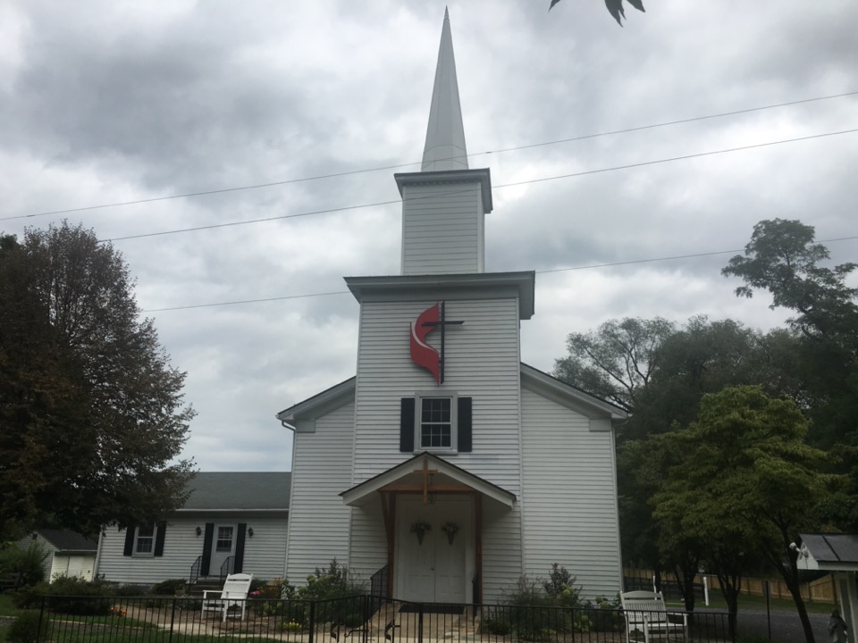
Rectortown United Methodist Church
serving God with
Prayer, Action, and Love
through Service.

