Slide 2
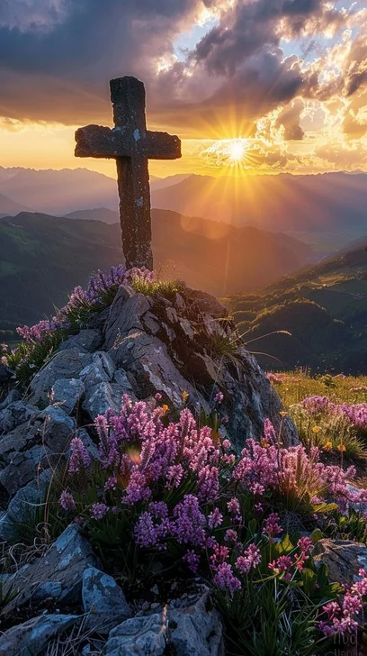
Prelude
Pastor Eduardo Carrillo
5th Sunday of Lent
March 22nd, 2026
CCLI License:
3430384-01-1829
Livestream Notice: Our worship service is live-streamed and recorded. By attending, you consent to being included in the broadcast. Thank you for joining us!

Slide 3
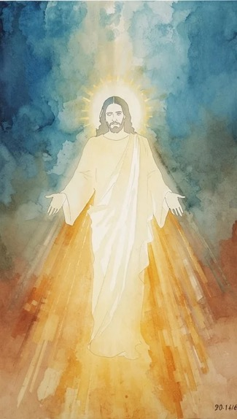
WELCOME,
ANNOUNCEMENTS,
and
CELEBRATIONS
Livestream Notice: Our worship service is live-streamed and recorded. By attending, you consent to being included in the broadcast. Thank you for joining us!

Slide 4
Wilderness-wanderers, holiness-seekers, listen for God’s voice today.
A voice that says, “I see you. I know you. I love you.”

Slide 5
Even if, in your wandering, you have
gotten lost—
God sees us. God knows us. God
loves us.

Slide 6
In the power of being seen, known, and loved, a way becomes clear—
A new way, a different way, a way of freedom.
All: Let us travel the way together in the footsteps of Jesus, our waymaker.

Slide 7
All-knowing One, sometimes we shrink from your gaze, ashamed of ourselves, our failures, our mistakes. You see it all, but you also see through it all,

Slide 8
to the beloved child that you have created. Help us to rest in your sight, that being known, we might come to know ourselves. Free us from guilt and shame,

Slide 9
so that we can stand up tall, do the work of repair and reconciliation, and step forward as the beloved children we are. In Jesus’ name we pray. Amen.

Slide 10
“Tis So Sweet to Trust in Jesus” UMH 462
WORDS: Louisa M. R. Stead, 1882 MUSIC: William J. Kirkpatrick, 1882
Please stand as you’re able and comfortable.
Tis so sweet to trust in Jesus,
and to take him at his word;
just to rest upon his promise,
and to know, “Thus saith the Lord.”

Slide 11
“Tis So Sweet to Trust in Jesus” UMH 462
WORDS: Louisa M. R. Stead, 1882 MUSIC: William J. Kirkpatrick, 1882
Please stand as you’re able and comfortable.
Jesus, Jesus, how I trust him!
How I’ve proved him o’er and o’er!
Jesus, Jesus, precious Jesus!
O for grace to trust him more!

Slide 12
“Tis So Sweet to Trust in Jesus” UMH 462
WORDS: Louisa M. R. Stead, 1882 MUSIC: William J. Kirkpatrick, 1882
Please stand as you’re able and comfortable.
O how sweet to trust in Jesus,
just to trust his cleansing blood;
and in simple faith to plunge me
neath the healing, cleansing flood!

Slide 13
“Tis So Sweet to Trust in Jesus” UMH 462
WORDS: Louisa M. R. Stead, 1882 MUSIC: William J. Kirkpatrick, 1882
Please stand as you’re able and comfortable.
Jesus, Jesus, how I trust him!
How I’ve proved him o’er and o’er!
Jesus, Jesus, precious Jesus!
O for grace to trust him more!

Slide 14
“Tis So Sweet to Trust in Jesus” UMH 462
WORDS: Louisa M. R. Stead, 1882 MUSIC: William J. Kirkpatrick, 1882
Please stand as you’re able and comfortable.
Yes, tis sweet to trust in Jesus,
just from sin and self to cease;
just from Jesus simply taking
life and rest, and joy and peace.

Slide 15
“Tis So Sweet to Trust in Jesus” UMH 462
WORDS: Louisa M. R. Stead, 1882 MUSIC: William J. Kirkpatrick, 1882
Please stand as you’re able and comfortable.
Jesus, Jesus, how I trust him!
How I’ve proved him o’er and o’er!
Jesus, Jesus, precious Jesus!
O for grace to trust him more!

Slide 16
“Tis So Sweet to Trust in Jesus” UMH 462
WORDS: Louisa M. R. Stead, 1882 MUSIC: William J. Kirkpatrick, 1882
Please stand as you’re able and comfortable.
I’m so glad I learned to trust thee, precious Jesus, Savior, friend;
and I know that thou art with me,
wilt be with me to the end.

Slide 17
“Tis So Sweet to Trust in Jesus” UMH 462
WORDS: Louisa M. R. Stead, 1882 MUSIC: William J. Kirkpatrick, 1882
Please stand as you’re able and comfortable.
Jesus, Jesus, how I trust him!
How I’ve proved him o’er and o’er!
Jesus, Jesus, precious Jesus!
O for grace to trust him more!

Slide 19
Prayer For Illumination
Spirit of the living God, fall afresh on me.
Spirit of the living God, fall afresh on me.
Melt me, mold me, fill me, use me.
Spirit of the living God, fall afresh on me.
UMH 393

Slide 20
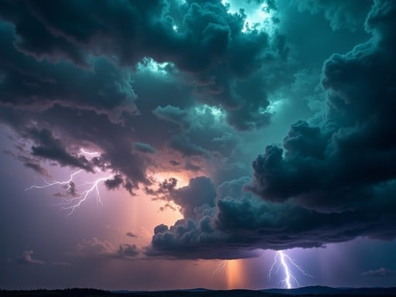
Isaiah 1: 16 – 17
NRSVUE

Slide 21
¹⁶ Wash yourselves; make yourselves clean; remove your evil deeds from before my eyes; cease to do evil;
¹⁷ learn to do good; seek justice; rescue the oppressed; defend the orphan; plead for the widow.

Slide 22

Luke 19: 1 – 10
NRSVUE

Slide 23
He entered Jericho and was passing through it.
² A man was there named Zacchaeus; he was a chief tax collector and was rich.
³ He was trying to see who Jesus was, but on account of the crowd he could not, because he was short in stature.

Slide 24
⁴ So he ran ahead and climbed a sycamore tree to see him, because he was going to pass that way.
⁵ When Jesus came to the place, he looked up and said to him, “Zacchaeus, hurry and come down, for I must stay at your house today.”
⁶ So he hurried down and was happy to welcome him.

Slide 25
⁷ All who saw it began to grumble and said, “He has gone to be the guest of one who is a sinner.”
⁸ Zacchaeus stood there and said to the Lord, “Look, half of my possessions, Lord, I will give to the poor, and if I have defrauded anyone of anything, I will pay back four times as much.”

Slide 26
⁹ Then Jesus said to him, “Today salvation has come to this house, because he, too, is a son of Abraham.
¹⁰ For the Son of Man came to seek out and to save the lost.”

Slide 27
The Word of God for the people of God
Thanks be to God

Slide 28

Sermon
“It’s Not Too Late to Live Differently”

Slide 29
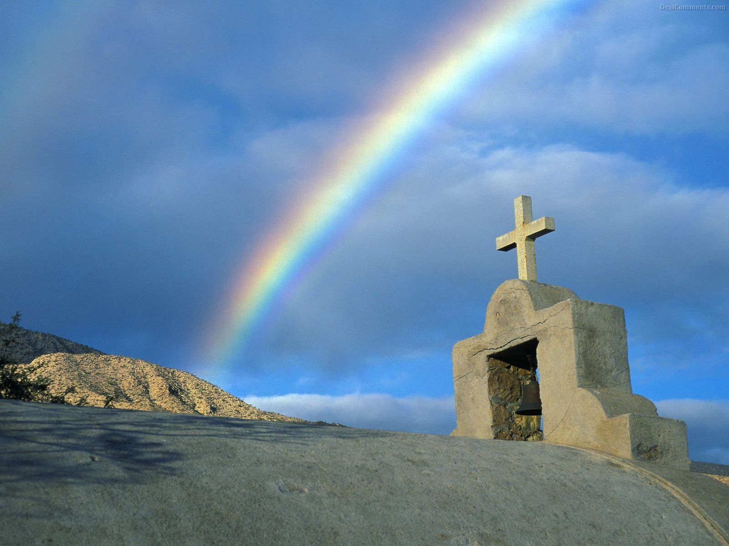
“Hymn of Promise” UMH 707
WORDS and MUSIC: Natalie Sleeth, 1986
Please stand as you are able and comfortable.
In the bulb there is a flower;
in the seed, an apple tree;
in cocoons, a hidden promise:
butterflies will soon be free!
In the cold and snow of winter
there’s a spring that waits to be,
unrevealed until its season,
something God alone can see.

Slide 30
“Hymn of Promise” UMH 707
WORDS and MUSIC: Natalie Sleeth, 1986
Please stand as you are able and comfortable.
There’s a song in every silence,
seeking word and melody;
there’s a dawn in every darkness,
bringing hope to you and me.
From the past will come the future;
what it holds, a mystery,
unrevealed until its season,
something God alone can see.

Slide 31
“Hymn of Promise” UMH 707
WORDS and MUSIC: Natalie Sleeth, 1986
Please stand as you are able and comfortable.
In our end is our beginning;
in our time, infinity;
in our doubt there is believing;
in our life, eternity.
In our death, a resurrection;
at the last, a victory,
unrevealed until its season,
something God alone can see.

Slide 41
Tithes and Offerings
Worship through giving
Notes:
https://www.goodfon.com/flowers/wallpaper-blue-wood-blossom-spring-flowers-vesna-iablonia-tsvety.html

Slide 42

“Praise God, from Whom All Blessings Flow” UMH 94
WORDS: Thomas Ken, 1674; adapted by Gilbert H. Viera, 1978
MUSIC: Geistliche Kirchengesange, 1623; harmonized by Ralph Vaughn Williams, 1906
Please stand as you are able and comfortable.
Praise God from whom all blessings flow;
Praise God, all creatures here below:
Alleluia! Alleluia!
Praise God, the source of all our gifts!
Praise Jesus Christ, whose power uplifts!
Praise the Spirit, Holy Spirit!
Alleluia! Alleluia! Alleluia!

Slide 43
Offertory Prayer

Slide 44
“Lord of the Dance” UMH 261
WORDS: Sydney Carter, 1963 MUSIC: 19th century Shaker tune;
adapted by Sydney Carter, 1963; harmony by Gary Alan Smith, 1988
Please stand as you are able and comfortable.
I danced in the morning
when the world was begun,
and I danced in the moon
and the stars and the sun,
and I came down from
heaven and I danced on the earth.
At Bethlehem I had my birth.

Slide 45
“Lord of the Dance” UMH 261
WORDS: Sydney Carter, 1963 MUSIC: 19th century Shaker tune;
adapted by Sydney Carter, 1963; harmony by Gary Alan Smith, 1988
Please stand as you are able and comfortable.
Dance, then,
wherever you may be;
I am the Lord
of the Dance, said he.
And I’ll lead you all
wherever you may be,
and I’ll lead you all
in the dance, said he.

Slide 46
“Lord of the Dance” UMH 261
WORDS: Sydney Carter, 1963 MUSIC: 19th century Shaker tune;
adapted by Sydney Carter, 1963; harmony by Gary Alan Smith, 1988
Please stand as you are able and comfortable.
I danced for the scribe
and the Pharisee,
but they would not dance
and they would not follow me;
I danced for the fishermen,
for James and John;
they came to me
and the dance went on.

Slide 47
“Lord of the Dance” UMH 261
WORDS: Sydney Carter, 1963 MUSIC: 19th century Shaker tune;
adapted by Sydney Carter, 1963; harmony by Gary Alan Smith, 1988
Please stand as you are able and comfortable.
Dance, then,
wherever you may be;
I am the Lord
of the Dance, said he.
And I’ll lead you all
wherever you may be,
and I’ll lead you all
in the dance, said he.

Slide 48
“Lord of the Dance” UMH 261
WORDS: Sydney Carter, 1963 MUSIC: 19th century Shaker tune;
adapted by Sydney Carter, 1963; harmony by Gary Alan Smith, 1988
Please stand as you are able and comfortable.
I danced on the sabbath
when I cured the lame,
the holy people
said it was a shame;
they whipped and they stripped
and they hung me high;
and they left me there
on a cross to die.

Slide 49
“Lord of the Dance” UMH 261
WORDS: Sydney Carter, 1963 MUSIC: 19th century Shaker tune;
adapted by Sydney Carter, 1963; harmony by Gary Alan Smith, 1988
Please stand as you are able and comfortable.
Dance, then,
wherever you may be;
I am the Lord
of the Dance, said he.
And I’ll lead you all
wherever you may be,
and I’ll lead you all
in the dance, said he.

Slide 50
“Lord of the Dance” UMH 261
WORDS: Sydney Carter, 1963 MUSIC: 19th century Shaker tune;
adapted by Sydney Carter, 1963; harmony by Gary Alan Smith, 1988
Please stand as you are able and comfortable.
I danced on a Friday
and the sky turned black;
it’s hard to dance
with the devil on your back;
they buried my body
and they thought I’d gone,
but I am the dance
and I still go on.

Slide 51
“Lord of the Dance” UMH 261
WORDS: Sydney Carter, 1963 MUSIC: 19th century Shaker tune;
adapted by Sydney Carter, 1963; harmony by Gary Alan Smith, 1988
Please stand as you are able and comfortable.
Dance, then,
wherever you may be;
I am the Lord
of the Dance, said he.
And I’ll lead you all
wherever you may be,
and I’ll lead you all
in the dance, said he.

Slide 52
“Lord of the Dance” UMH 261
WORDS: Sydney Carter, 1963 MUSIC: 19th century Shaker tune;
adapted by Sydney Carter, 1963; harmony by Gary Alan Smith, 1988
Please stand as you are able and comfortable.
They cut me down
and I leapt up high,
I am the life
that’ll never, never die;
I’ll live in you
if you’ll live in me;
I am the Lord
of the Dance, said he.

Slide 53
“Lord of the Dance” UMH 261
WORDS: Sydney Carter, 1963 MUSIC: 19th century Shaker tune;
adapted by Sydney Carter, 1963; harmony by Gary Alan Smith, 1988
Please stand as you are able and comfortable.
Dance, then,
wherever you may be;
I am the Lord
of the Dance, said he.
And I’ll lead you all
wherever you may be,
and I’ll lead you all
in the dance, said he.

Slide 55
BLESSING AND BENEDICTION
This service has ended, and now
your service in the world begins!

Slide 56
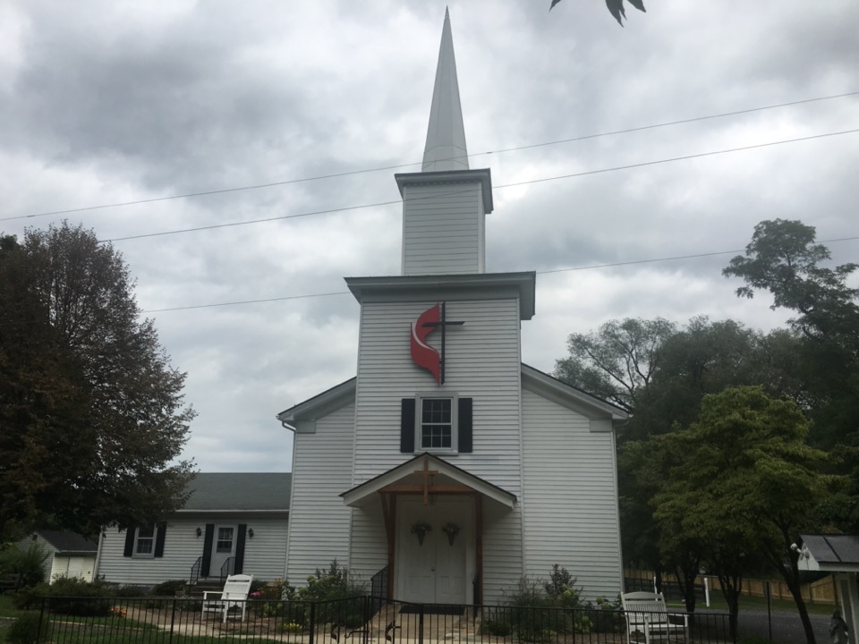
Rectortown United Methodist Church
serving God with
Prayer, Action, and Love
through Service.

