Slide 2
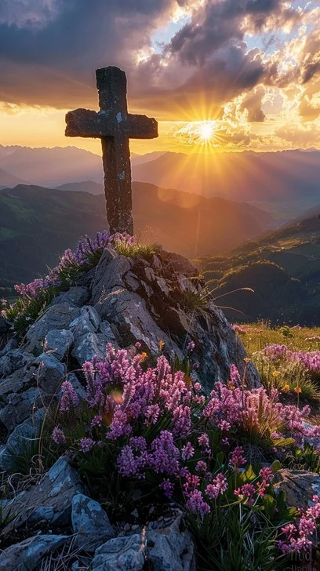
Prelude
Pastor Eduardo Carrillo
2nd Sunday of Lent
March 1st, 2026
CCLI License:
3430384-01-1829
Livestream Notice: Our worship service is live-streamed and recorded. By attending, you consent to being included in the broadcast. Thank you for joining us!

Slide 3
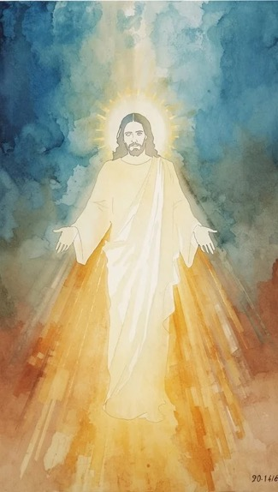
WELCOME,
ANNOUNCEMENTS,
and
CELEBRATIONS
Livestream Notice: Our worship service is live-streamed and recorded. By attending, you consent to being included in the broadcast. Thank you for joining us!

Slide 4
Wilderness-wanderers, holiness-seekers, listen for God’s voice today.
God, speak; your servants are listening.

Slide 5
God’s voice may be loud, or it may be still and small.
It may be drowned out by the noise of the world or the busyness within.

Slide 6
Today, we create space to receive your Word however it may come.
We still ourselves and trust that you are speaking even now. Word of life, direct us in your way.

Slide 7
Ever-present God, we confess that we sometimes miss your voice. We tune our hearts to messages from the world, threats from our enemies, or our own preoccupations. Forgive us.

Slide 8
We sometimes fear silence, thinking it means you are absent. Forgive us. Help us to recognize your presence in the quiet. Help us listen for you, especially on our Lenten journey.

Slide 9
Give us the courage to repent, make changes, and follow in the way of Christ, in whose name we pray. Amen.

Slide 10
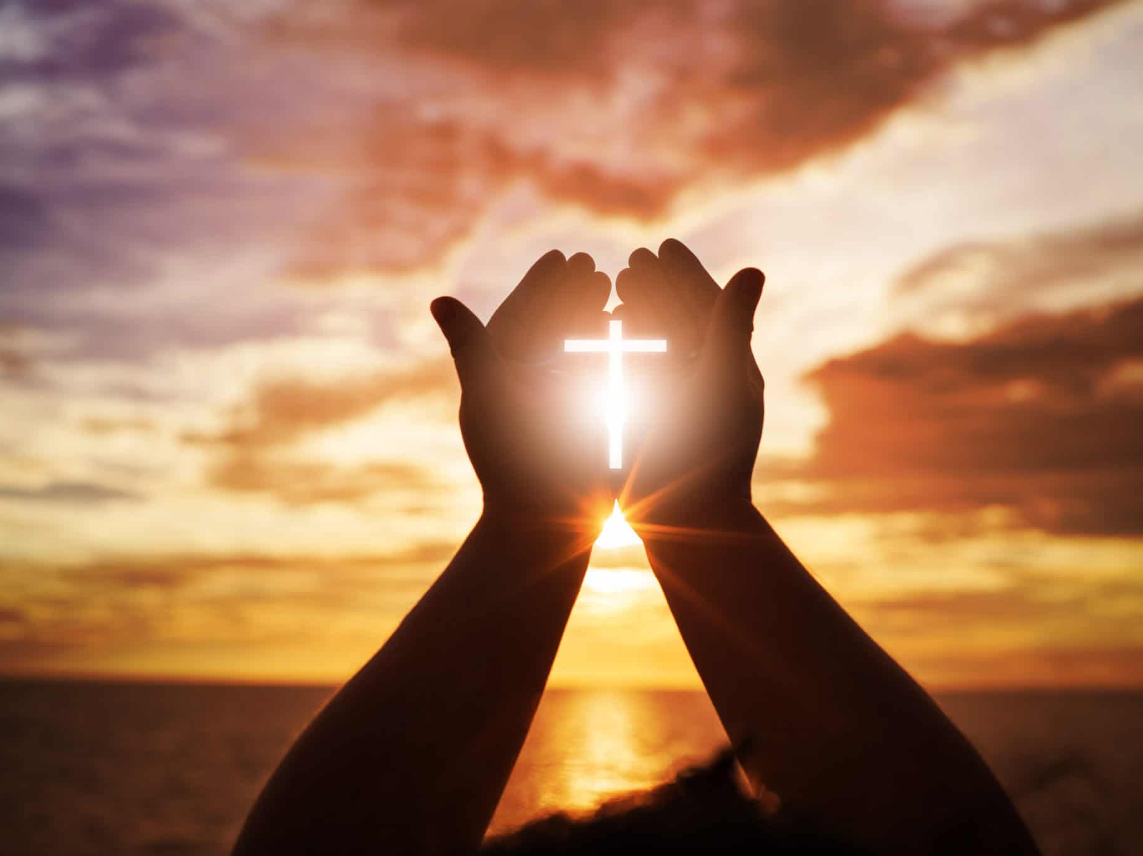
“To God Be The Glory” UMH 98
Words: Fanny J. Crosty, 1875; Music: William H. Doane, 1875
To God be the glory great things He has done
So loved He the world that He gave us His Son
Who yielded His life an atonement for sin
And opened the life gate that all may go in

Slide 11
“To God Be The Glory” UMH 98
Words: Fanny J. Crosty, 1875; Music: William H. Doane, 1875
Praise the Lord praise the Lord
Let the earth hear His voice
Praise the Lord praise the Lord
Let the people rejoice
O come to the Father through Jesus the Son
And give Him the glory great things He has done

Slide 12
“To God Be The Glory” UMH 98
Words: Fanny J. Crosty, 1875; Music: William H. Doane, 1875
O perfect redemption the purchase of blood
To every believer the promise of God
The vilest offender who truly believes
That moment from Jesus a pardon receives

Slide 13
“To God Be The Glory” UMH 98
Words: Fanny J. Crosty, 1875; Music: William H. Doane, 1875
Praise the Lord praise the Lord
Let the earth hear His voice
Praise the Lord praise the Lord
Let the people rejoice
O come to the Father through Jesus the Son
And give Him the glory great things He has done

Slide 14
“To God Be The Glory” UMH 98
Words: Fanny J. Crosty, 1875; Music: William H. Doane, 1875
Great things He has taught us
Great things He has done
And great our rejoicing through Jesus the Son
But purer and higher and greater will be
Our wonder our transport when Jesus we see

Slide 15
“To God Be The Glory” UMH 98
Words: Fanny J. Crosty, 1875; Music: William H. Doane, 1875
Praise the Lord praise the Lord
Let the earth hear His voice
Praise the Lord praise the Lord
Let the people rejoice
O come to the Father through Jesus the Son
And give Him the glory great things He has done

Slide 17
Prayer For Illumination
Spirit of the living God, fall afresh on me.
Spirit of the living God, fall afresh on me.
Melt me, mold me, fill me, use me.
Spirit of the living God, fall afresh on me.
UMH 393

Slide 18

Psalm 62: 1 – 8
NRSVUE

Slide 19
¹ For God alone my soul waits in silence; from him comes my salvation.
² He alone is my rock and my salvation, my fortress; I shall never be shaken.
³ How long will you assail a person, will you batter your victim, all of you, as you would a leaning wall, a tottering fence?

Slide 20
⁴ Their only plan is to bring down a person of prominence. They take pleasure in falsehood;
they bless with their mouths, but inwardly they curse. Selah
⁵ For God alone my soul waits in silence,
for my hope is from him.

Slide 21
⁶ He alone is my rock and my salvation,
my fortress; I shall not be shaken.
⁷ On God rests my deliverance and my honor;
my mighty rock, my refuge is in God.
⁸ Trust in him at all times, O people; pour out your heart before him; God is a refuge for us. Selah

Slide 22
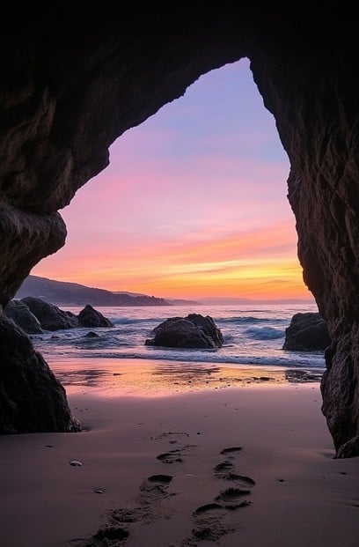
1 Kings 19: 4 – 16
NRSVUE

Slide 23
⁴ But he himself went a day’s journey into the wilderness and came and sat down under a solitary broom tree. He asked that he might die, “It is enough; now, O Lord, take away my life, for I am no better than my ancestors.”
⁵ Then he lay down under the broom tree and fell asleep. Suddenly an angel touched him and said to him, “Get up and eat.”
⁶ He looked, and there at his head was a cake baked on hot stones and a jar of water. He ate and drank and lay down again.

Slide 24
⁷ The angel of the Lord came a second time, touched him, and said, “Get up and eat, or the journey will be too much for you.”
⁸ He got up and ate and drank; then he went in the strength of that food forty days and forty nights to Horeb the mount of God.
⁹ At that place he came to a cave and spent the night there.
Then the word of the Lord came to him, saying, “What are you doing here, Elijah?”

Slide 25
¹⁰ He answered, “I have been very zealous for the Lord, the God of hosts, for the Israelites have forsaken your covenant, thrown down your altars, and killed your prophets with the sword. I alone am left, and they are seeking my life, to take it away.”

Slide 26
¹¹ He said, “Go out and stand on the mountain before the Lord, for the Lord is about to pass by.” Now there was a great wind, so strong that it was splitting mountains and breaking rocks in pieces before the Lord, but the Lord was not in the wind, and after the wind an earthquake, but the Lord was not in the earthquake,

Slide 27
¹² and after the earthquake a fire, but the Lord was not in the fire, and after the fire a sound of sheer silence.
¹³ When Elijah heard it, he wrapped his face in his mantle and went out and stood at the entrance of the cave. Then there came a voice to him that said, “What are you doing here, Elijah?”

Slide 28
¹⁴ He answered, “I have been very zealous for the Lord, the God of hosts, for the Israelites have forsaken your covenant, thrown down your altars, and killed your prophets with the sword. I alone am left, and they are seeking my life, to take it away.”
¹⁵ Then the Lord said to him, “Go, return on your way to the wilderness of Damascus; when you arrive, you shall anoint Hazael as king over Aram.

Slide 29
¹⁶ Also you shall anoint Jehu son of Nimshi as king over Israel, and you shall anoint Elisha son of Shaphat of Abel-meholah as prophet in your place.

Slide 30
The Word of God for the people of God
Thanks be to God

Slide 31

Sermon
“It’s Not Too Late to Listen to God”

Slide 32
“My Faith Looks Up to Thee” UMH #452
WORDS: Ray Palmer, 1875 MUSIC: Lowell Mason, 1831
Please stand as you are able and comfortable.
My faith looks up to thee,
thou Lamb of Calvary,
Savior divine!
Now hear me while I pray,
take all my guilt away,
O let me from this day be
wholly thine!

Slide 33
“My Faith Looks Up to Thee” UMH #452
WORDS: Ray Palmer, 1875 MUSIC: Lowell Mason, 1831
Please stand as you are able and comfortable.
May thy rich grace impart strength
to my fainting heart,
my zeal inspire!
As thou hast died for me,
O may my love to thee
pure, warm, and changeless be, a
living fire!

Slide 34
“My Faith Looks Up to Thee” UMH #452
WORDS: Ray Palmer, 1875 MUSIC: Lowell Mason, 1831
Please stand as you are able and comfortable.
While life’s dark maze I tread,
and griefs around me spread,
be thou my guide;
bid darkness turn to day,
wipe sorrow’s tears a way,
nor let me ever stray from
thee a side.

Slide 35
“My Faith Looks Up to Thee” UMH #452
WORDS: Ray Palmer, 1875 MUSIC: Lowell Mason, 1831
Please stand as you are able and comfortable.
When ends life’s transient dream,
when death’s cold, sullen stream
shall o’er me roll;
blest Savior, then in love,
fear and distrust remove;
O bear me safe above, a
ransomed soul!

Slide 46
Tithes and Offerings
Worship through giving
Notes:
https://www.goodfon.com/flowers/wallpaper-blue-wood-blossom-spring-flowers-vesna-iablonia-tsvety.html

Slide 47

“Praise God, from Whom All Blessings Flow” UMH 94
WORDS: Thomas Ken, 1674; adapted by Gilbert H. Viera, 1978
MUSIC: Geistliche Kirchengesange, 1623; harmonized by Ralph Vaughn Williams, 1906
Please stand as you are able and comfortable.
Praise God from whom all blessings flow;
Praise God, all creatures here below:
Alleluia! Alleluia!
Praise God, the source of all our gifts!
Praise Jesus Christ, whose power uplifts!
Praise the Spirit, Holy Spirit!
Alleluia! Alleluia! Alleluia!

Slide 48
Offertory Prayer

Slide 65
“Blessed Assurance” UMH 369
WORDS: Franny J. Crosby, 1873 MUSIC: Phoebe P. Knapp, 1873
Please stand as you are able and comfortable.
Blessed assurance, Jesus is mine!
O what a foretaste of glory divine!
Heir of salvation, purchase of God,
born of his Spirit, washed in his blood.

Slide 66
“Blessed Assurance” UMH 369
WORDS: Franny J. Crosby, 1873 MUSIC: Phoebe P. Knapp, 1873
Please stand as you are able and comfortable.
This is my story, this is my song,
praising my Savior all the day long;
this is my story, this is my song,
praising my Savior all the day long.

Slide 67
“Blessed Assurance” UMH 369
WORDS: Franny J. Crosby, 1873 MUSIC: Phoebe P. Knapp, 1873
Please stand as you are able and comfortable.
Perfect submission, perfect delight,
visions of rapture now burst on my sight; angels descending bring from above
echoes of mercy, whispers of love.

Slide 68
“Blessed Assurance” UMH 369
WORDS: Franny J. Crosby, 1873 MUSIC: Phoebe P. Knapp, 1873
Please stand as you are able and comfortable.
This is my story, this is my song,
praising my Savior all the day long;
this is my story, this is my song,
praising my Savior all the day long.

Slide 69
“Blessed Assurance” UMH 369
WORDS: Franny J. Crosby, 1873 MUSIC: Phoebe P. Knapp, 1873
Please stand as you are able and comfortable.
Perfect submission, all is at rest;
I in my Savior am happy and blest,
watching and waiting, looking above,
filled with his goodness, lost in his love.

Slide 70
“Blessed Assurance” UMH 369
WORDS: Franny J. Crosby, 1873 MUSIC: Phoebe P. Knapp, 1873
Please stand as you are able and comfortable.
This is my story, this is my song,
praising my Savior all the day long;
this is my story, this is my song,
praising my Savior all the day long.

Slide 72
BLESSING AND BENEDICTION
This service has ended, and now
your service in the world begins!

Slide 73
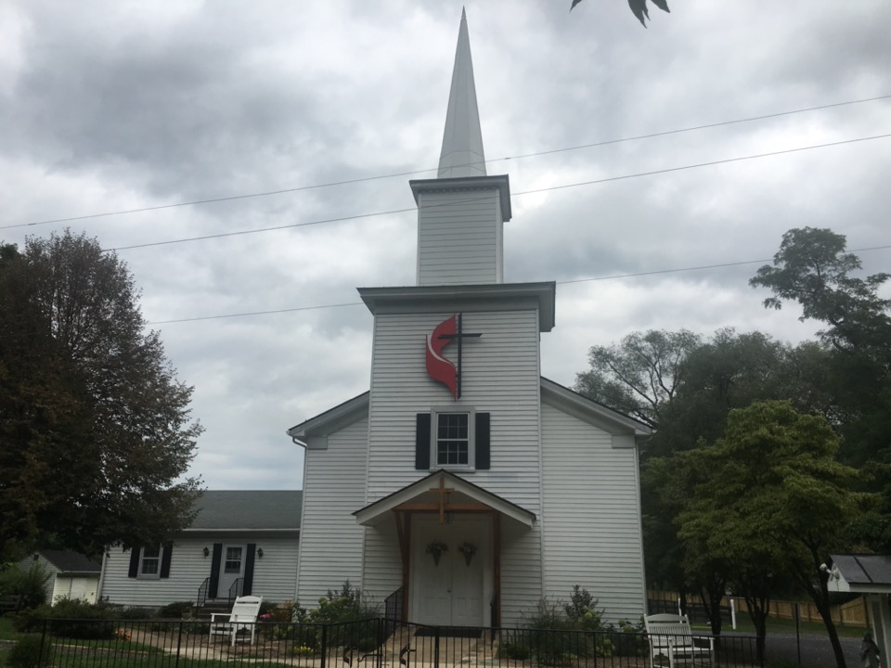
Rectortown United Methodist Church
serving God with
Prayer, Action, and Love
through Service.

