Slide 2

Prelude
Pastor Eduardo Carrillo
Fourth Sunday after Pentecost
Father’s Day
June 21st, 2026
CCLI License:
3430384-01-1829
Livestream Notice: Our worship service is live-streamed and recorded. By attending, you consent to being included in the broadcast. Thank you for joining us!

Slide 3
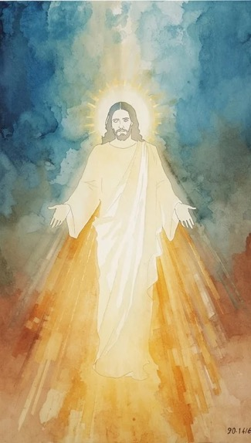
WELCOME,
ANNOUNCEMENTS,
and
CELEBRATIONS
Livestream Notice: Our worship service is live-streamed and recorded. By attending, you consent to being included in the broadcast. Thank you for joining us!

Slide 4
Hear our cry, O Lord, and give ear to our prayer
In the day of trouble, we call upon You!

Slide 5
Do not be afraid of those who kill the body but cannot kill the soul.
We trust the One who counts every hair on our heads!

Slide 6
Whoever loses their life for His sake will find it.
We lay down our pride to take up His cross! Let us worship the God who hears us in the wilderness!

Slide 7
God of Hagar and God of Matthew, You are the Protector of the forgotten and the Leader of the brave. We confess that we often fear what we might lose by following You.

Slide 8
Open our eyes to see You in our own wilderness moments. Give us the courage to choose Your Kingdom over our comfort, and Your truth over our reputation.

Slide 9
Remind us that we are worth more than many sparrows, and that in losing our old selves, we find our true life in You. Amen.

Slide 10
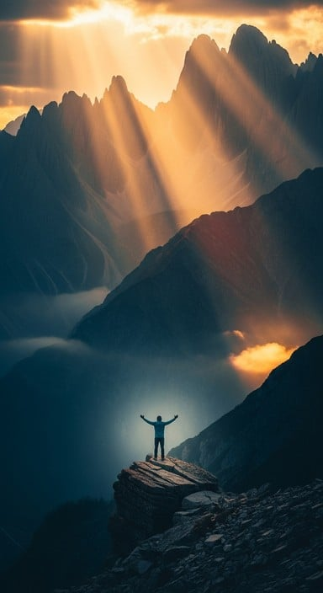
I Sing the Almighty Power of God
152
I sing the almighty power of God,
that made the mountains rise,
that spread the flowing seas abroad,
and built the lofty skies.
I sing the wisdom that ordained the sun to
rule the day;
the moon shines full at God’s command,
and all the stars obey.

Slide 11
I Sing the Almighty Power of God
152
2. I sing the goodness of the Lord,
who filled the earth with food,
who formed the creatures thru the Word,
and then pronounced them good.
Lord, how thy wonders are displayed,
where’er I turn my eye,
if I survey the ground I tread,
or gaze upon the sky.

Slide 12
I Sing the Almighty Power of God
152
3. There’s not a plant or flower below, but makes thy glories known, and clouds arise, and tempests blow, by order from thy throne;
while all that borrows life from thee is ever in thy care;
and everywhere that we can be, thou, God, art present there.

Slide 14
Prayer For Illumination
Spirit of the living God, fall afresh on me.
Spirit of the living God, fall afresh on me.
Melt me, mold me, fill me, use me.
Spirit of the living God, fall afresh on me.
UMH 393

Slide 15
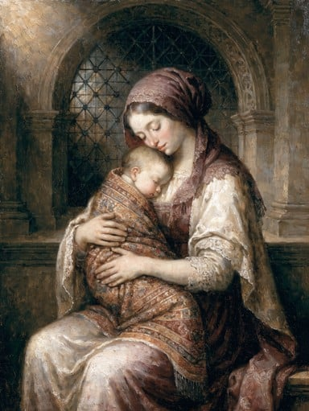
Genesis 21: 8 – 21
NRSVUE

Slide 16
⁸ The child grew and was weaned, and Abraham made a great feast on the day that Isaac was weaned.
⁹ But Sarah saw the son of Hagar the Egyptian, whom she had borne to Abraham, playing with her son Isaac.

Slide 17
¹⁰ So she said to Abraham, “Cast out this slave woman with her son, for the son of this slave woman shall not inherit along with my son Isaac.”
¹¹ The matter was very distressing to Abraham on account of his son.

Slide 18
¹² But God said to Abraham, “Do not be distressed because of the boy and because of your slave woman; whatever Sarah says to you, do as she tells you, for it is through Isaac that offspring shall be named for you.
¹³ As for the son of the slave woman, I will make a nation of him also, because he is your offspring.”

Slide 19
¹⁴ So Abraham rose early in the morning and took bread and a skin of water and gave it to Hagar, putting it on her shoulder, along with the child, and sent her away. And she departed and wandered about in the wilderness of Beer-sheba.
¹⁵ When the water in the skin was gone, she cast the child under one of the bushes.

Slide 20
¹⁶ Then she went and sat down opposite him a good way off, about the distance of a bowshot, for she said, “Do not let me look on the death of the child.” And as she sat opposite him, she lifted up her voice and wept.

Slide 21
¹⁷ And God heard the voice of the boy, and the angel of God called to Hagar from heaven and said to her, “What troubles you, Hagar? Do not be afraid, for God has heard the voice of the boy where he is.
¹⁸ Come, lift up the boy and hold him fast with your hand, for I will make a great nation of him.”

Slide 22
¹⁹ Then God opened her eyes, and she saw a well of water. She went and filled the skin with water and gave the boy a drink.
²⁰ God was with the boy, and he grew up; he lived in the wilderness and became an expert with the bow.

Slide 23
²¹ He lived in the wilderness of Paran, and his mother got a wife for him from the land of Egypt.

Slide 24
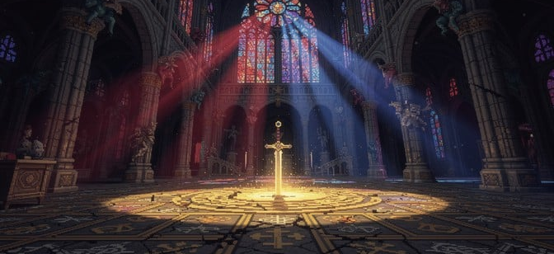
Matthew 10: 24 – 39
NRSVUE

Slide 25
²⁴ “A disciple is not above the teacher nor a slave above the master;
²⁵ it is enough for the disciple to be like the teacher and the slave like the master. If they have called the master of the house Beelzebul, how much more will they malign those of his household!

Slide 26
²⁶ “So have no fear of them, for nothing is covered up that will not be uncovered and nothing secret that will not become known.
²⁷ What I say to you in the dark, tell in the light, and what you hear whispered, proclaim from the housetops.

Slide 27
²⁸ Do not fear those who kill the body but cannot kill the soul; rather, fear the one who can destroy both soul and body in hell.
²⁹ Are not two sparrows sold for a penny? Yet not one of them will fall to the ground apart from your Father.

Slide 28
³⁰ And even the hairs of your head are all counted.
³¹ So do not be afraid; you are of more value than many sparrows.
³² “Everyone, therefore, who acknowledges me before others, I also will acknowledge before my Father in heaven,

Slide 29
³³ but whoever denies me before others, I also will deny before my Father in heaven.
³⁴ “Do not think that I have come to bring peace to the earth; I have not come to bring peace but a sword.

Slide 30
³⁵ For I have come to set a man against his father, and a daughter against her mother, and a daughter-in-law against her mother-in-law,
³⁶ and one’s foes will be members of one’s own household.

Slide 31
³⁷ “Whoever loves father or mother more than me is not worthy of me, and whoever loves son or daughter more than me is not worthy of me,
³⁸ and whoever does not take up the cross and follow me is not worthy of me.

Slide 32
³⁹ Those who find their life will lose it, and those who lose their life for my sake will find it.

Slide 33
The Word of God for the people of God
Thanks be to God

Slide 34
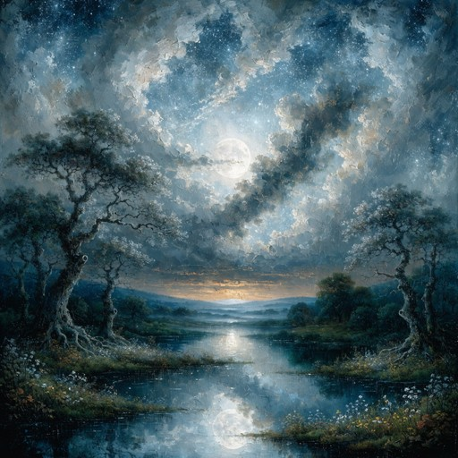
Sermon
“Worthy of the Wilderness”

Slide 35
“Just a Closer Walk with Thee” TFWS 2158
WORDS and MUSIC: anonomous
Please stand as you are able and comfortable.
I am weak, but thou art strong;
Jesus, keep me from all wrong;
I’ll be satisfied as long
as I walk, let me walk close to thee.

Slide 36
“Just a Closer Walk with Thee” TFWS 2158
WORDS and MUSIC: anonomous
Please stand as you are able and comfortable.
Just a closer walk with thee,
grant it Jesus, is my plea,
daily walking close to thee:
Let it be, dear Lord, let it be.

Slide 37
“Just a Closer Walk with Thee” TFWS 2158
WORDS and MUSIC: anonomous
Please stand as you are able and comfortable.
Through this world of toil and snares,
if I falter, Lord, who cares?
Who with me my burden shares?
None but thee, dear Lord, none but thee.

Slide 38
“Just a Closer Walk with Thee” TFWS 2158
WORDS and MUSIC: anonomous
Please stand as you are able and comfortable.
Just a closer walk with thee,
grant it Jesus, is my plea,
daily walking close to thee:
Let it be, dear Lord, let it be.

Slide 39
“Just a Closer Walk with Thee” TFWS 2158
WORDS and MUSIC: anonomous
Please stand as you are able and comfortable.
When my feeble life is o’er,
time for me will be no more;
guide me gently, safely o’er
to thy shore, dear Lord, to thy shore.

Slide 40
“Just a Closer Walk with Thee” TFWS 2158
WORDS and MUSIC: anonomous
Please stand as you are able and comfortable.
Just a closer walk with thee,
grant it Jesus, is my plea,
daily walking close to thee:
Let it be, dear Lord, let it be.

Slide 50
Tithes and Offerings
Worship through giving
Notes:
https://www.goodfon.com/flowers/wallpaper-blue-wood-blossom-spring-flowers-vesna-iablonia-tsvety.html

Slide 51

“Praise God, from Whom All Blessings Flow” UMH 94
WORDS: Thomas Ken, 1674; adapted by Gilbert H. Viera, 1978
MUSIC: Geistliche Kirchengesange, 1623; harmonized by Ralph Vaughn Williams, 1906
Please stand as you are able and comfortable.
Praise God from whom all blessings flow;
Praise God, all creatures here below:
Alleluia! Alleluia!
Praise God, the source of all our gifts!
Praise Jesus Christ, whose power uplifts!
Praise the Spirit, Holy Spirit!
Alleluia! Alleluia! Alleluia!

Slide 52
Offertory Prayer

Slide 53
“Lord of the Dance” UMH 261
WORDS: Sydney Carter, 1963 MUSIC: 19th century Shaker tune;
adapted by Sydney Carter, 1963; harmony by Gary Alan Smith, 1988
Please stand as you are able and comfortable.
I danced in the morning
when the world was begun,
and I danced in the moon
and the stars and the sun,
and I came down from
heaven and I danced on the earth.
At Bethlehem I had my birth.

Slide 54
“Lord of the Dance” UMH 261
WORDS: Sydney Carter, 1963 MUSIC: 19th century Shaker tune;
adapted by Sydney Carter, 1963; harmony by Gary Alan Smith, 1988
Please stand as you are able and comfortable.
Dance, then,
wherever you may be;
I am the Lord
of the Dance, said he.
And I’ll lead you all
wherever you may be,
and I’ll lead you all
in the dance, said he.

Slide 55
“Lord of the Dance” UMH 261
WORDS: Sydney Carter, 1963 MUSIC: 19th century Shaker tune;
adapted by Sydney Carter, 1963; harmony by Gary Alan Smith, 1988
Please stand as you are able and comfortable.
I danced for the scribe
and the Pharisee,
but they would not dance
and they would not follow me;
I danced for the fishermen,
for James and John;
they came to me
and the dance went on.

Slide 56
“Lord of the Dance” UMH 261
WORDS: Sydney Carter, 1963 MUSIC: 19th century Shaker tune;
adapted by Sydney Carter, 1963; harmony by Gary Alan Smith, 1988
Please stand as you are able and comfortable.
Dance, then,
wherever you may be;
I am the Lord
of the Dance, said he.
And I’ll lead you all
wherever you may be,
and I’ll lead you all
in the dance, said he.

Slide 57
“Lord of the Dance” UMH 261
WORDS: Sydney Carter, 1963 MUSIC: 19th century Shaker tune;
adapted by Sydney Carter, 1963; harmony by Gary Alan Smith, 1988
Please stand as you are able and comfortable.
I danced on the sabbath
when I cured the lame,
the holy people
said it was a shame;
they whipped and they stripped
and they hung me high;
and they left me there
on a cross to die.

Slide 58
“Lord of the Dance” UMH 261
WORDS: Sydney Carter, 1963 MUSIC: 19th century Shaker tune;
adapted by Sydney Carter, 1963; harmony by Gary Alan Smith, 1988
Please stand as you are able and comfortable.
Dance, then,
wherever you may be;
I am the Lord
of the Dance, said he.
And I’ll lead you all
wherever you may be,
and I’ll lead you all
in the dance, said he.

Slide 59
“Lord of the Dance” UMH 261
WORDS: Sydney Carter, 1963 MUSIC: 19th century Shaker tune;
adapted by Sydney Carter, 1963; harmony by Gary Alan Smith, 1988
Please stand as you are able and comfortable.
I danced on a Friday
and the sky turned black;
it’s hard to dance
with the devil on your back;
they buried my body
and they thought I’d gone,
but I am the dance
and I still go on.

Slide 60
“Lord of the Dance” UMH 261
WORDS: Sydney Carter, 1963 MUSIC: 19th century Shaker tune;
adapted by Sydney Carter, 1963; harmony by Gary Alan Smith, 1988
Please stand as you are able and comfortable.
Dance, then,
wherever you may be;
I am the Lord
of the Dance, said he.
And I’ll lead you all
wherever you may be,
and I’ll lead you all
in the dance, said he.

Slide 61
“Lord of the Dance” UMH 261
WORDS: Sydney Carter, 1963 MUSIC: 19th century Shaker tune;
adapted by Sydney Carter, 1963; harmony by Gary Alan Smith, 1988
Please stand as you are able and comfortable.
They cut me down
and I leapt up high,
I am the life
that’ll never, never die;
I’ll live in you
if you’ll live in me;
I am the Lord
of the Dance, said he.

Slide 62
“Lord of the Dance” UMH 261
WORDS: Sydney Carter, 1963 MUSIC: 19th century Shaker tune;
adapted by Sydney Carter, 1963; harmony by Gary Alan Smith, 1988
Please stand as you are able and comfortable.
Dance, then,
wherever you may be;
I am the Lord
of the Dance, said he.
And I’ll lead you all
wherever you may be,
and I’ll lead you all
in the dance, said he.

Slide 64
BLESSING AND BENEDICTION
This service has ended, and now
your service in the world begins!

Slide 65
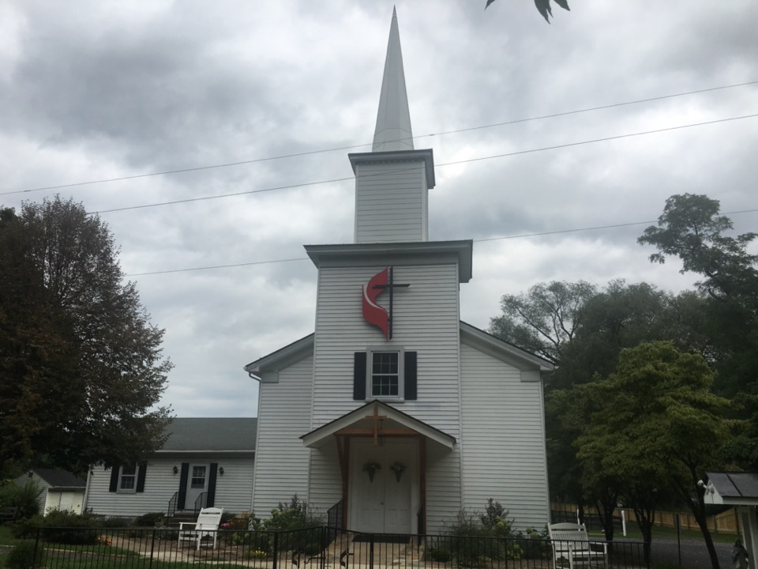
Rectortown United Methodist Church
serving God with
Prayer, Action, and Love
through Service.

