Slide 2
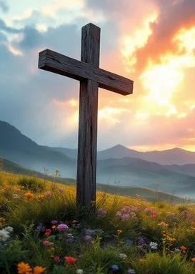
Prelude
Pastor Eduardo Carrillo
Tenth Sunday after Pentecost
August 2nd, 2026
CCLI License:
3430384-01-1829
Livestream Notice: Our worship service is live-streamed and recorded. By attending, you consent to being included in the broadcast. Thank you for joining us!

Slide 3
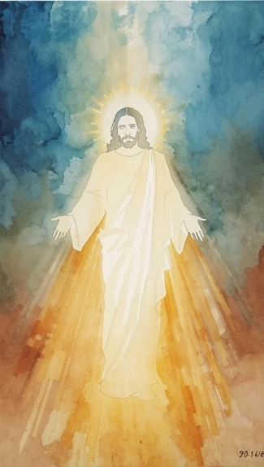
WELCOME,
ANNOUNCEMENTS,
and
CELEBRATIONS
Livestream Notice: Our worship service is live-streamed and recorded. By attending, you consent to being included in the broadcast. Thank you for joining us!

Slide 4
Come, all who wrestle in the darkness of the world,
We bring our doubts, our exhaustion, and our longings.

Slide 5
Come, all who hunger in the desolate places of life,
We bring our scarcity, wondering if there will ever be enough.

Slide 6
The Lord is here! The one who blesses us in the struggle and feeds us in the wilderness.
Let us worship the God who takes our brokenness and turns it into abundance.
All: Come, let us worship together!

Slide 7
God of the midnight struggle and the wilderness feast, we gather today just as we are. Some of us come limping from the battles of life;

Slide 8
others come hungry for a word of hope. Do not let us leave the same way we entered. Meet us in our empty places. Take our small offerings, bless them, and break them for your glory.

Slide 9
Open our hearts to receive your presence here at your table. In Jesus' name, Amen.

Slide 10

Sweet Hour of Prayer
496
WORDS: William Walford, 1845
1. Sweet hour of prayer! sweet hour of prayer! that calls me from a world of care, and bids me at my Father’s throne
make all my wants and wishes known. In seasons of distress and grief, my soul has often found relief, and oft escaped
the tempter’s snare by thy return, sweet hour of prayer!

Slide 11
Sweet Hour of Prayer
496
WORDS: William Walford, 1845
2. Sweet hour of prayer! sweet hour of prayer! the joys I feel, the bliss I share of those whose anxious spirits burn with strong desires for thy return! With such I hasten to the place where God my Savior shows his face, and gladly take my station there, and wait for thee, sweet hour of prayer!

Slide 12
Sweet Hour of Prayer
496
WORDS: William Walford, 1845
3. Sweet hour of prayer! sweet hour of prayer! thy wings shall my petition bear to him whose truth
and faithfulness engage the waiting soul to bless. And since he bids me seek his face, believe his word, and trust his grace, I’ll cast on him my every care, and wait for thee, sweet hour of prayer!

Slide 15
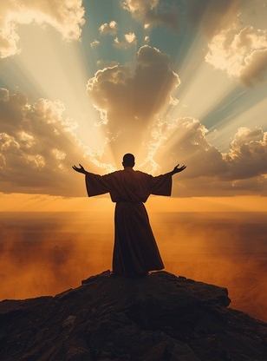
Genesis 32:
22 – 31
NRSVUE

Slide 16
²² The same night he got up and took his two wives, his two maids, and his eleven children and crossed the ford of the Jabbok.
²³ He took them and sent them across the stream, and likewise everything that he had.

Slide 17
²⁴ Jacob was left alone, and a man wrestled with him until daybreak.
²⁵ When the man saw that he did not prevail against Jacob, he struck him on the hip socket, and Jacob’s hip was put out of joint as he wrestled with him.

Slide 18
²⁶ Then he said, “Let me go, for the day is breaking.” But Jacob said, “I will not let you go, unless you bless me.”
²⁷ So he said to him, “What is your name?” And he said, “Jacob.”

Slide 19
²⁸ Then the man said, “You shall no longer be called Jacob, but Israel, for you have striven with God and with humans and have prevailed.”
²⁹ Then Jacob asked him, “Please tell me your name.” But he said, “Why is it that you ask my name?” And there he blessed him.

Slide 20
³⁰ So Jacob called the place Peniel, saying, “For I have seen God face to face, yet my life is preserved.”
³¹ The sun rose upon him as he passed Penuel, limping because of his hip.

Slide 21
³² Therefore to this day the Israelites do not eat the thigh muscle that is on the hip socket, because he struck Jacob on the hip socket at the thigh muscle.

Slide 22
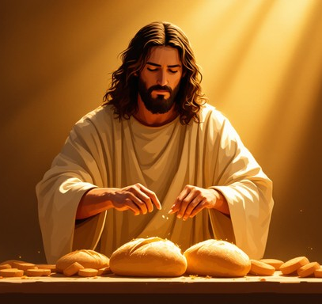
Matthew 14: 13 – 21
NRSVUE

Slide 23
¹³ Now when Jesus heard this, he withdrew from there in a boat to a deserted place by himself. But when the crowds heard it, they followed him on foot from the towns.
¹⁴ When he went ashore, he saw a great crowd, and he had compassion for them and cured their sick.

Slide 24
¹⁵ When it was evening, the disciples came to him and said, “This is a deserted place, and the hour is now late; send the crowds away so that they may go into the villages and buy food for themselves.”
¹⁶ Jesus said to them, “They need not go away; you give them something to eat.”

Slide 25
¹⁷ They replied, “We have nothing here but five loaves and two fish.”
¹⁸ And he said, “Bring them here to me.”

Slide 26
¹⁹ Then he ordered the crowds to sit down on the grass. Taking the five loaves and the two fish, he looked up to heaven and blessed and broke the loaves and gave them to the disciples, and the disciples gave them to the crowds.

Slide 27
²⁰ And all ate and were filled, and they took up what was left over of the broken pieces, twelve baskets full.
²¹ And those who ate were about five thousand men, besides women and children.

Slide 28
The Word of God for the people of God
Thanks be to God

Slide 29
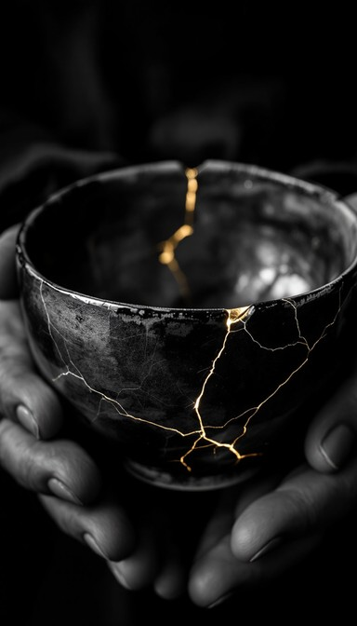
Sermon
“Broken
Blessedness”

Slide 30
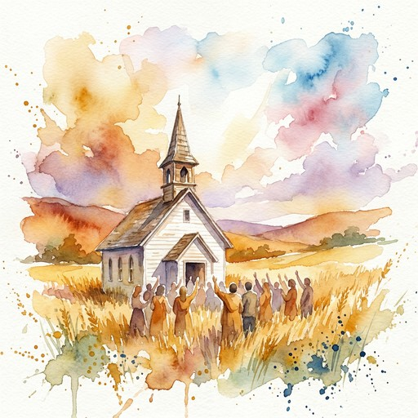
I Will Call Upon the Lord
2002
WORDS: Michael O’Shields
1. I will call upon the Lord who is worthy to be praised. So shall I be saved from my enemies. I will call upon the Lord.

Slide 31
I Will Call Upon the Lord
2002
WORDS: Michael O’Shields
Refrain
The Lord liveth, and blessed be the Rock; and let the God of my salvation be exalted. The Lord liveth, and blessed be the Rock; and let the God of my salvation be exalted.

Slide 32
I Will Call Upon the Lord
2002
WORDS: Michael O’Shields
2. I will call upon the Lord who is worthy to be praised. So shall I be saved from my enemies. I will call upon the Lord.

Slide 33
I Will Call Upon the Lord
2002
WORDS: Michael O’Shields
Refrain
The Lord liveth, and blessed be the Rock; and let the God of my salvation be exalted. The Lord liveth, and blessed be the Rock; and let the God of my salvation be exalted.

Slide 41
Tithes and Offerings
Worship through giving
Notes:
https://www.goodfon.com/flowers/wallpaper-blue-wood-blossom-spring-flowers-vesna-iablonia-tsvety.html

Slide 42

“Praise God, from Whom All Blessings Flow” UMH 94
WORDS: Thomas Ken, 1674; adapted by Gilbert H. Viera, 1978
MUSIC: Geistliche Kirchengesange, 1623; harmonized by Ralph Vaughn Williams, 1906
Please stand as you are able and comfortable.
Praise God from whom all blessings flow;
Praise God, all creatures here below:
Alleluia! Alleluia!
Praise God, the source of all our gifts!
Praise Jesus Christ, whose power uplifts!
Praise the Spirit, Holy Spirit!
Alleluia! Alleluia! Alleluia!

Slide 43
Offertory Prayer

Slide 54
“One Bread, One Body” UMH 620
WORDS and MUSIC: John B. Foley, 1978; harmony by Gary Alan Smith, 1988
Please stand as you are able and comfortable.
One bread, one body,
one Lord of all,
one cup of blessing
which we bless.
And we, though many
throughout the earth,
we are one body
in this one Lord.

Slide 55
“One Bread, One Body” UMH 620
WORDS and MUSIC: John B. Foley, 1978; harmony by Gary Alan Smith, 1988
Please stand as you are able and comfortable.
Gentile or Jew,
servant or free,
woman or man,
no more.

Slide 56
“One Bread, One Body” UMH 620
WORDS and MUSIC: John B. Foley, 1978; harmony by Gary Alan Smith, 1988
Please stand as you are able and comfortable.
One bread, one body,
one Lord of all,
one cup of blessing
which we bless.
And we, though many
throughout the earth,
we are one body
in this one Lord.

Slide 57
“One Bread, One Body” UMH 620
WORDS and MUSIC: John B. Foley, 1978; harmony by Gary Alan Smith, 1988
Please stand as you are able and comfortable.
Many the gifts,
many the works,
one in the Lord
of all.

Slide 58
“One Bread, One Body” UMH 620
WORDS and MUSIC: John B. Foley, 1978; harmony by Gary Alan Smith, 1988
Please stand as you are able and comfortable.
One bread, one body,
one Lord of all,
one cup of blessing
which we bless.
And we, though many
throughout the earth,
we are one body
in this one Lord.

Slide 59
“One Bread, One Body” UMH 620
WORDS and MUSIC: John B. Foley, 1978; harmony by Gary Alan Smith, 1988
Please stand as you are able and comfortable.
Grain for the fields,
scattered and grown,
gathered to one,
for all.

Slide 60
“One Bread, One Body” UMH 620
WORDS and MUSIC: John B. Foley, 1978; harmony by Gary Alan Smith, 1988
Please stand as you are able and comfortable.
One bread, one body,
one Lord of all,
one cup of blessing
which we bless.
And we, though many
throughout the earth,
we are one body
in this one Lord.

Slide 65
Postlude
This service has ended, and now
your service in the world begins!

Slide 66
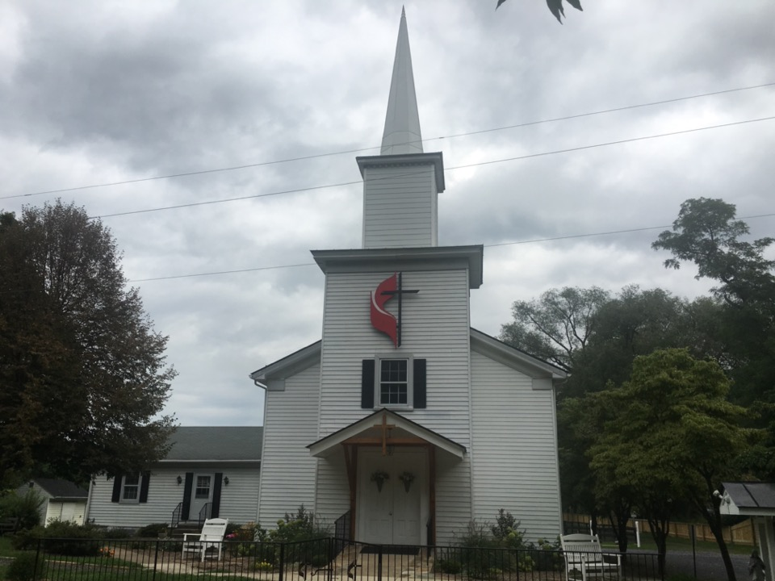
Rectortown United Methodist Church
serving God with
Prayer, Action, and Love
through Service.

