Slide 2
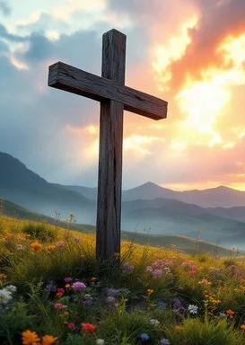
Prelude
Pastor Eduardo Carrillo
Twelfth Sunday after Pentecost
August 16th, 2026
CCLI License:
3430384-01-1829
Livestream Notice: Our worship service is live-streamed and recorded. By attending, you consent to being included in the broadcast. Thank you for joining us!

Slide 3
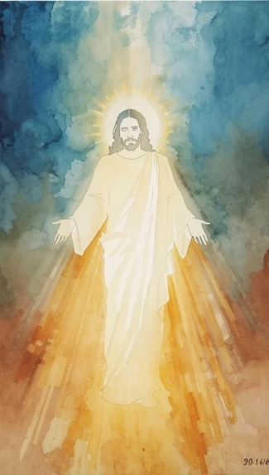
WELCOME,
ANNOUNCEMENTS,
and
CELEBRATIONS
Livestream Notice: Our worship service is live-streamed and recorded. By attending, you consent to being included in the broadcast. Thank you for joining us!

Slide 4
How pleasant it is when God's people dwell together in unity!
But our worlds are deeply divided, fractured by hurt and old walls.

Slide 5
The Lord is expanding the borders of the house, calling those who were far off to come near.
We come seeking a mercy that is wider than our minds can measure.

Slide 6
Do not be afraid, for the one who healed the outsider and forgave the brother is in this place.
Let us open our hearts to the radical, boundary-breaking grace of God.
All: Come, let us worship together!

Slide 7
God of unsearchable mercy, you refuse to be contained by the walls we build or the boundaries we draw.

Slide 8
We come before you today acknowledging our own tendency to keep people out, and our own desperate need to be let in. Like Joseph’s brothers, we need your forgiveness.

Slide 9
Like the Canaanite woman, we cry out from the margins for your healing touch. Break down the barriers in our hearts this morning. Pour out your grace upon us,

Slide 10
heal our broken relationships, and teach us to marvel at a faith that refuses to give up on you. In Jesus’ name, Amen.

Slide 11

I Want a Principle Within
410
WORDS: Charles Wesley, 1749
1. I want a principle within of watchful, godly fear, a sensibility of sin, a pain to feel it near. I want the first approach to feel of pride or wrong desire, to catch the wandering of my will, and quench the kindling fire.

Slide 12
I Want a Principle Within
410
WORDS: Charles Wesley, 1749
2. From thee that I no more may stray, no more thy goodness grieve, grant me the filial awe,
I pray, the tender conscience give. Quick as the apple of an eye, O God, my conscience make;
awake my soul when sin is nigh, and keep it still awake.

Slide 13
I Want a Principle Within
410
WORDS: Charles Wesley, 1749
3. Almighty God of truth and love, to me thy power impart; the mountain from my soul remove, the hardness from my heart. O may the least omission pain my reawakened soul,
and drive me to that blood again, which makes the wounded whole.

Slide 16
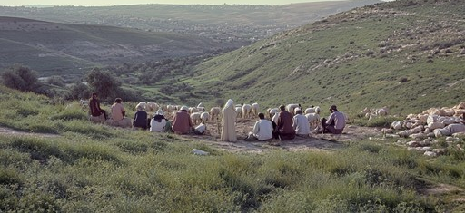
Genesis 45:1 – 15
NRSVUE

Slide 17
Then Joseph could no longer control himself before all those who stood by him, and he cried out, “Send everyone away from me.” So no one stayed with him when Joseph made himself known to his brothers.
² And he wept so loudly that the Egyptians heard it, and the household of Pharaoh heard it.

Slide 18
³ Joseph said to his brothers, “I am Joseph. Is my father still alive?” But his brothers could not answer him, so dismayed were they at his presence.
⁴ Then Joseph said to his brothers, “Come closer to me.” And they came closer. He said, “I am your brother, Joseph, whom you sold into Egypt.

Slide 19
³ Joseph said to his brothers, “I am Joseph. Is my father still alive?” But his brothers could not answer him, so dismayed were they at his presence.
⁴ Then Joseph said to his brothers, “Come closer to me.” And they came closer. He said, “I am your brother, Joseph, whom you sold into Egypt.

Slide 20
⁵ And now do not be distressed or angry with yourselves because you sold me here, for God sent me before you to preserve life.
⁶ For the famine has been in the land these two years, and there are five more years in which there will be neither plowing nor harvest.

Slide 21
⁷ God sent me before you to preserve for you a remnant on earth and to keep alive for you many survivors.
⁸ So it was not you who sent me here but God; he has made me a father to Pharaoh and lord of all his house and ruler over all the land of Egypt.

Slide 22
⁹ Hurry and go up to my father and say to him, ‘Thus says your son Joseph, God has made me lord of all Egypt; come down to me; do not delay.
¹⁰ You shall settle in the land of Goshen, and you shall be near me, you and your children and your children’s children, as well as your flocks, your herds, and all that you have.

Slide 23
¹¹ I will provide for you there, since there are five more years of famine to come, so that you and your household and all that you have will not come to poverty.’
¹² And now your eyes and the eyes of my brother Benjamin see that it is my own mouth that speaks to you.

Slide 24
¹³ You must tell my father how greatly I am honored in Egypt and all that you have seen. Hurry and bring my father down here.”
¹⁴ Then he fell upon his brother Benjamin’s neck and wept, while Benjamin wept upon his neck.

Slide 25
¹⁵ And he kissed all his brothers and wept upon them, and after that his brothers talked with him.

Slide 26
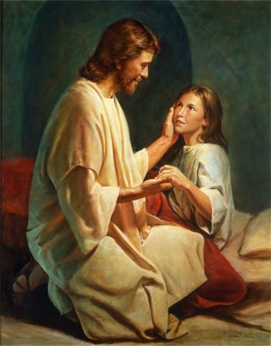
Matthew 15: 21 – 28
NRSVUE

Slide 27
²¹ Jesus left that place and went away to the district of Tyre and Sidon.
²² Just then a Canaanite woman from that region came out and started shouting, “Have mercy on me, Lord, Son of David; my daughter is tormented by a demon.”

Slide 28
²³ But he did not answer her at all. And his disciples came and urged him, saying, “Send her away, for she keeps shouting after us.”
²⁴ He answered, “I was sent only to the lost sheep of the house of Israel.”

Slide 29
²⁵ But she came and knelt before him, saying, “Lord, help me.”
²⁶ He answered, “It is not fair to take the children’s food and throw it to the dogs.”

Slide 30
²⁷ She said, “Yes, Lord, yet even the dogs eat the crumbs that fall from their masters’ table.”
²⁸ Then Jesus answered her, “Woman, great is your faith! Let it be done for you as you wish.” And her daughter was healed from that moment.

Slide 31
The Word of God for the people of God
Thanks be to God

Slide 32

“Great is Thy Faithfulness” UMH 140
WORDS: Thomas O. Chisholm, 1923 MUSIC: William M. Runyan, 1923
Please stand as you are able and comfortable.
Great is thy faithfulness,
O God my Father;
there is no shadow
of turning with thee;
thou changest not,
thy compassions, they fail not;
as thou hast been,
thou forever wilt be.

Slide 33
“Great is Thy Faithfulness” UMH 140
WORDS: Thomas O. Chisholm, 1923 MUSIC: William M. Runyan, 1923
Please stand as you are able and comfortable.
Great is thy faithfulness!
Great is thy faithfulness!
Morning by morning
new mercies I see;
all I have needed
thy hand hath provided;
great is thy faithfulness,
Lord, unto me!

Slide 34
“Great is Thy Faithfulness” UMH 140
WORDS: Thomas O. Chisholm, 1923 MUSIC: William M. Runyan, 1923
Please stand as you are able and comfortable.
Summer and winter
and springtime and harvest,
sun, moon, and stars
in their courses above
join with all nature
in manifold witness
to thy great faithfulness,
mercy, and love.

Slide 35
“Great is Thy Faithfulness” UMH 140
WORDS: Thomas O. Chisholm, 1923 MUSIC: William M. Runyan, 1923
Please stand as you are able and comfortable.
Great is thy faithfulness!
Great is thy faithfulness!
Morning by morning
new mercies I see;
all I have needed
thy hand hath provided;
great is thy faithfulness,
Lord, unto me!

Slide 36
“Great is Thy Faithfulness” UMH 140
WORDS: Thomas O. Chisholm, 1923 MUSIC: William M. Runyan, 1923
Please stand as you are able and comfortable.
Pardon for sin and
a peace that endureth,
thine own dear presence
to cheer and to guide;
strength for today and
bright hope for tomorrow,
blessings all mine, with ten
thousand beside!

Slide 37
“Great is Thy Faithfulness” UMH 140
WORDS: Thomas O. Chisholm, 1923 MUSIC: William M. Runyan, 1923
Please stand as you are able and comfortable.
Great is thy faithfulness!
Great is thy faithfulness!
Morning by morning
new mercies I see;
all I have needed
thy hand hath provided;
great is thy faithfulness,
Lord, unto me!

Slide 38
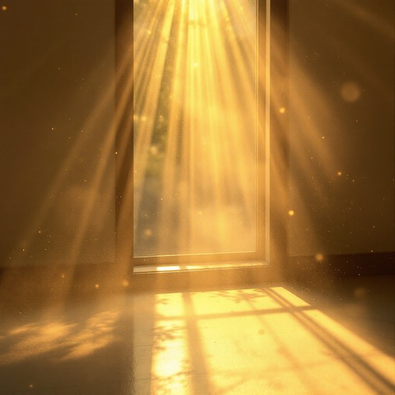
Sermon
“Mercy Makes Room”

Slide 43
Tithes and Offerings
Worship through giving
Notes:
https://www.goodfon.com/flowers/wallpaper-blue-wood-blossom-spring-flowers-vesna-iablonia-tsvety.html

Slide 44

“Praise God, from Whom All Blessings Flow” UMH 94
WORDS: Thomas Ken, 1674; adapted by Gilbert H. Viera, 1978
MUSIC: Geistliche Kirchengesange, 1623; harmonized by Ralph Vaughn Williams, 1906
Please stand as you are able and comfortable.
Praise God from whom all blessings flow;
Praise God, all creatures here below:
Alleluia! Alleluia!
Praise God, the source of all our gifts!
Praise Jesus Christ, whose power uplifts!
Praise the Spirit, Holy Spirit!
Alleluia! Alleluia! Alleluia!

Slide 45
Offertory Prayer

Slide 46

“Bind Us Together” TFWS 2226
WORDS and MUSIC: Bob Gillman, 1977
Please stand as you are able and comfortable.
Bind us together, Lord,
bind us together with cords
that cannot be broken.
Bind us together, Lord,
bind us together, Lord,
bind us together in love.

Slide 47
“Bind Us Together” TFWS 2226
WORDS and MUSIC: Bob Gillman, 1977
Please stand as you are able and comfortable.
There is only one God,
there is only one King;
There is only one body,
that is why we sing.

Slide 48
“Bind Us Together” TFWS 2226
WORDS and MUSIC: Bob Gillman, 1977
Please stand as you are able and comfortable.
Bind us together, Lord,
bind us together with cords
that cannot be broken.
Bind us together, Lord,
bind us together, Lord,
bind us together in love.

Slide 55
Postlude
This service has ended, and now
your service in the world begins!

Slide 56
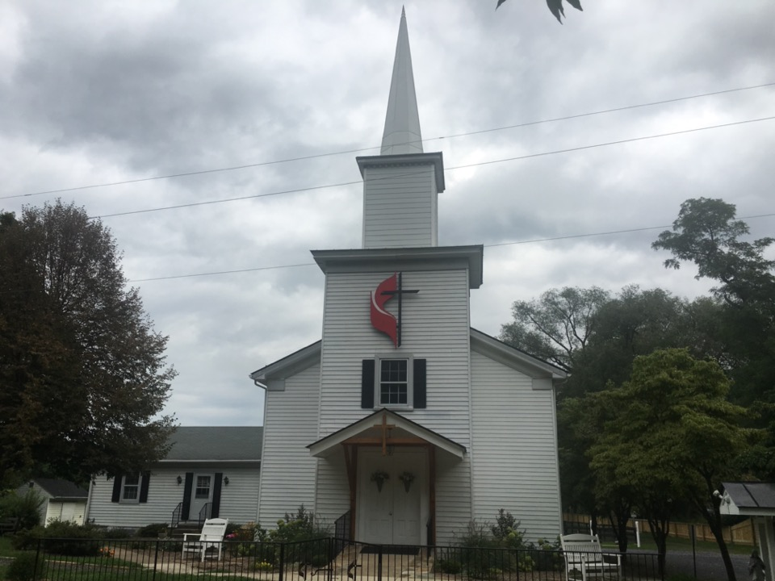
Rectortown United Methodist Church
serving God with
Prayer, Action, and Love
through Service.

