Slide 2
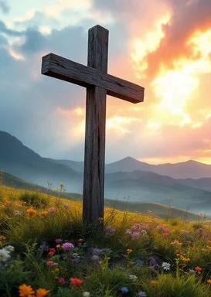
Prelude
Pastor Eduardo Carrillo
Seventh Sunday after Pentecost
July 12th, 2026
CCLI License:
3430384-01-1829
Livestream Notice: Our worship service is live-streamed and recorded. By attending, you consent to being included in the broadcast. Thank you for joining us!

Slide 3
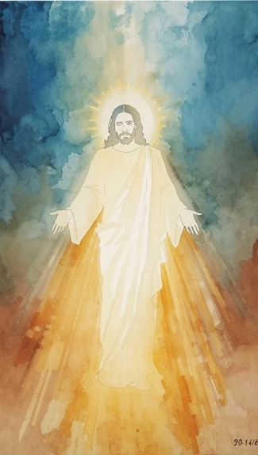
WELCOME,
ANNOUNCEMENTS,
and
CELEBRATIONS
Livestream Notice: Our worship service is live-streamed and recorded. By attending, you consent to being included in the broadcast. Thank you for joining us!

Slide 4
The Great Sower walks among us, scattering the seeds of life, love, and grace across the landscape of our lives.
Open our hearts, O God, to receive what You stand ready to plant.

Slide 5
We come here today carrying the heavy inclinations of the flesh, anxious for quick results, wondering if "we are there yet," and searching for instant comfort.

Slide 6
Speak to our spirits, O God, and reorient our minds toward Your life and peace.

Slide 7
Christ invites us to step out of the frantic race for worldly success and into the patient, holy work of daily obedience.

Slide 8
We come to pull out the rocks, weed out the thorns, and settle deeply into the rich soil of Your grace. Let us worship God together!

Slide 9
Generous and Patient God, You are the Sower of all good things, and You have brought us together today as a field of Your own making.

Slide 10
We confess that we often arrive in this space with tired souls and distracted minds, looking for quick fixes rather than lasting transformation. We thank You that You do not demand instant perfection,

Slide 11
but instead invite us into a lifelong process of growth. May the words we hear and the prayers we share cultivate deep roots in our hearts,

Slide 12
so that we may bear the fruits of peace, patience, and obedience in the week ahead. Amen.

Slide 13
“O Spirit of the Living God” UMH 539
WORDS: Henry H. Tweedy, 1935
MUSIC: Traditional English melody arranged by Ralph Vaughan Williams, 1906
Please stand as you are able and comfortable.
O Spirit of the living God,
thou light and fire divine,
descend upon thy church once more,
and make it truly thine.
Fill it with love and joy and power,
with righteousness and peace;
till Christ shall dwell in human hearts,
and sin and sorrow cease.

Slide 14
“O Spirit of the Living God” UMH 539
WORDS: Henry H. Tweedy, 1935
MUSIC: Traditional English melody arranged by Ralph Vaughan Williams, 1906
Please stand as you are able and comfortable.
Blow, wind of God! With wisdom blow until our minds are free
from mists of error, clouds of doubt,
which blind our eyes to thee.
Burn, winged fire! Inspire our lips
with flaming love and zeal,
to preach to all thy great good news,
God’s glorious common weal.

Slide 15
“O Spirit of the Living God” UMH 539
WORDS: Henry H. Tweedy, 1935
MUSIC: Traditional English melody arranged by Ralph Vaughan Williams, 1906
Please stand as you are able and comfortable.
Teach us to utter living words
of truth which all may hear,
the language all may understand
when love speaks loud and clear;
till every age and race and clime
shall blend their creeds in one,
and earth shall form one family
by whom thy will is done.

Slide 16
“O Spirit of the Living God” UMH 539
WORDS: Henry H. Tweedy, 1935
MUSIC: Traditional English melody arranged by Ralph Vaughan Williams, 1906
Please stand as you are able and comfortable.
So shall we know the power of Christ
who came this world to save;
so shall we rise with him to life
which soars beyond the grave;
and earth shall win true holiness,
which makes thy children whole;
till, perfected by thee, we reach
creation’s glorious goal!

Slide 18
Prayer For Illumination
Spirit of the living God, fall afresh on me.
Spirit of the living God, fall afresh on me.
Melt me, mold me, fill me, use me.
Spirit of the living God, fall afresh on me.
UMH 393

Slide 19
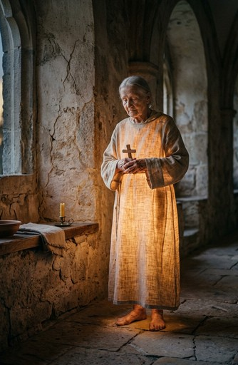
Romans 8: 1 – 11
NRSVUE

Slide 20
Therefore there is now no condemnation for those who are in Christ Jesus.
² For the law of the Spirit of life in Christ Jesus has set you free from the law of sin and of death.

Slide 21
³ For God has done what the law, weakened by the flesh, could not do: by sending his own Son in the likeness of sinful flesh and to deal with sin, he condemned sin in the flesh,
⁴ so that the just requirement of the law might be fulfilled in us, who walk not according to the flesh but according to the Spirit.

Slide 22
⁵ For those who live according to the flesh set their minds on the things of the flesh, but those who live according to the Spirit set their minds on the things of the Spirit.
⁶ To set the mind on the flesh is death, but to set the mind on the Spirit is life and peace.

Slide 23
⁷ For this reason the mind that is set on the flesh is hostile to God; it does not submit to God’s law—indeed, it cannot,
⁸ and those who are in the flesh cannot please God.

Slide 24
⁹ But you are not in the flesh; you are in the Spirit, since the Spirit of God dwells in you. Anyone who does not have the Spirit of Christ does not belong to him.

Slide 25
¹⁰ But if Christ is in you, then the body is dead because of sin, but the Spirit is life because of righteousness.
¹¹ If the Spirit of him who raised Jesus from the dead dwells in you, he who raised Christ Jesus from the dead will give life to your mortal bodies also through his Spirit that dwells in you.

Slide 26

Matthew 13: 1 – 9, 18 – 23
NRSVUE

Slide 27
That same day Jesus went out of the house and sat beside the sea.
² Such great crowds gathered around him that he got into a boat and sat there, while the whole crowd stood on the beach.
³ And he told them many things in parables, saying: “Listen! A sower went out to sow.

Slide 28
⁴ And as he sowed, some seeds fell on a path, and the birds came and ate them up.
⁵ Other seeds fell on rocky ground, where they did not have much soil, and they sprang up quickly, since they had no depth of soil.
⁶ But when the sun rose, they were scorched, and since they had no root, they withered away.

Slide 29
⁷ Other seeds fell among thorns, and the thorns grew up and choked them.
⁸ Other seeds fell on good soil and brought forth grain, some a hundredfold, some sixty, some thirty.
⁹ If you have ears, hear!”

Slide 30
¹⁸ “Hear, then, the parable of the sower.
¹⁹ When anyone hears the word of the kingdom and does not understand it, the evil one comes and snatches away what is sown in the heart; this is what was sown on the path.

Slide 31
²⁰ As for what was sown on rocky ground, this is the one who hears the word and immediately receives it with joy,
²¹ yet such a person has no root but endures only for a while, and when trouble or persecution arises on account of the word, that person immediately falls away.

Slide 32
²² As for what was sown among thorns, this is the one who hears the word, but the cares of this age and the lure of wealth choke the word, and it yields nothing.
²³ But as for what was sown on good soil, this is the one who hears the word and understands it, who indeed bears fruit and yields in one case a hundredfold, in another sixty, and in another thirty.”

Slide 33
The Word of God for the people of God
Thanks be to God

Slide 34

Sermon
“The Counter- Cultural Work of Deep Roots ”

Slide 35
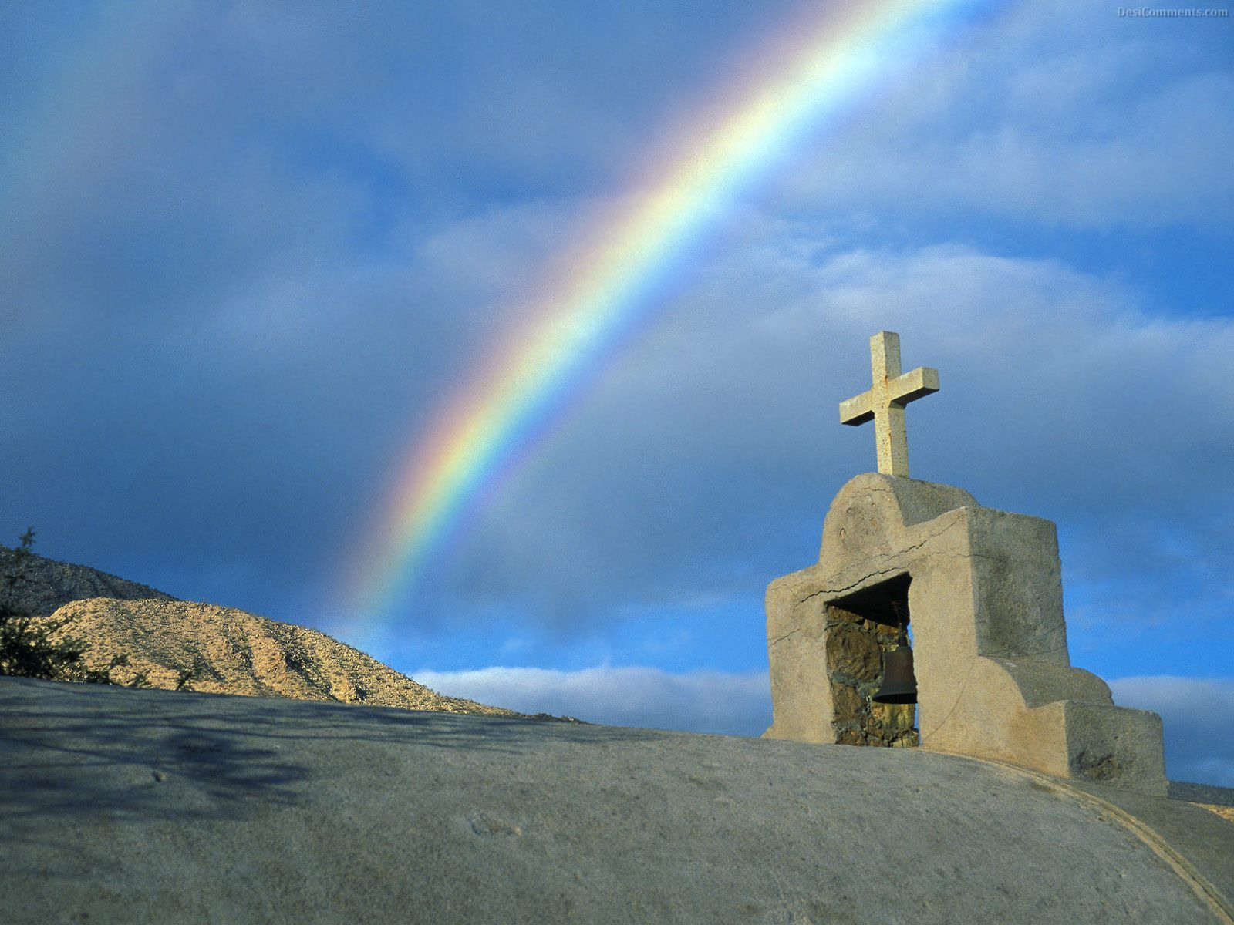
“Hymn of Promise” UMH 707
WORDS and MUSIC: Natalie Sleeth, 1986
Please stand as you are able and comfortable.
In the bulb there is a flower;
in the seed, an apple tree;
in cocoons, a hidden promise:
butterflies will soon be free!
In the cold and snow of winter
there’s a spring that waits to be,
unrevealed until its season,
something God alone can see.

Slide 36
“Hymn of Promise” UMH 707
WORDS and MUSIC: Natalie Sleeth, 1986
Please stand as you are able and comfortable.
There’s a song in every silence,
seeking word and melody;
there’s a dawn in every darkness,
bringing hope to you and me.
From the past will come the future;
what it holds, a mystery,
unrevealed until its season,
something God alone can see.

Slide 37
“Hymn of Promise” UMH 707
WORDS and MUSIC: Natalie Sleeth, 1986
Please stand as you are able and comfortable.
In our end is our beginning;
in our time, infinity;
in our doubt there is believing;
in our life, eternity.
In our death, a resurrection;
at the last, a victory,
unrevealed until its season,
something God alone can see.

Slide 49
Tithes and Offerings
Worship through giving
Notes:
https://www.goodfon.com/flowers/wallpaper-blue-wood-blossom-spring-flowers-vesna-iablonia-tsvety.html

Slide 50

“Praise God, from Whom All Blessings Flow” UMH 94
WORDS: Thomas Ken, 1674; adapted by Gilbert H. Viera, 1978
MUSIC: Geistliche Kirchengesange, 1623; harmonized by Ralph Vaughn Williams, 1906
Please stand as you are able and comfortable.
Praise God from whom all blessings flow;
Praise God, all creatures here below:
Alleluia! Alleluia!
Praise God, the source of all our gifts!
Praise Jesus Christ, whose power uplifts!
Praise the Spirit, Holy Spirit!
Alleluia! Alleluia! Alleluia!

Slide 51
Offertory Prayer

Slide 52
“Wonderful Words of Life” UMH #600
WORDS and MUSIC: Philip P. Bliss, 1874
Please stand as you are able and comfortable.
Sing them over again to me,
wonderful words of life;
let me more of their beauty see,
wonderful words of life;
words of life and beauty
teach me faith and duty.

Slide 53
“Wonderful Words of Life” UMH #600
WORDS and MUSIC: Philip P. Bliss, 1874
Please stand as you are able and comfortable.
Beautiful words,
wonderful words,
wonderful words of life.
Beautiful words,
wonderful words,
wonderful words of life.

Slide 54
“Wonderful Words of Life” UMH #600
WORDS and MUSIC: Philip P. Bliss, 1874
Please stand as you are able and comfortable.
Christ, the blessed one, gives to all wonderful words of life;
sinner, list to the loving call,
wonderful words of life;
all so freely given,
wooing us to heaven.

Slide 55
“Wonderful Words of Life” UMH #600
WORDS and MUSIC: Philip P. Bliss, 1874
Please stand as you are able and comfortable.
Beautiful words,
wonderful words,
wonderful words of life.
Beautiful words,
wonderful words,
wonderful words of life.

Slide 56
“Wonderful Words of Life” UMH #600
WORDS and MUSIC: Philip P. Bliss, 1874
Please stand as you are able and comfortable.
Sweetly echo the gospel call,
wonderful words of life;
offer pardon and peace to all,
wonderful words of life;
Jesus, only Savior,
sanctify forever.

Slide 57
“Wonderful Words of Life” UMH #600
WORDS and MUSIC: Philip P. Bliss, 1874
Please stand as you are able and comfortable.
Beautiful words,
wonderful words,
wonderful words of life.
Beautiful words,
wonderful words,
wonderful words of life.

Slide 59
BLESSING AND BENEDICTION
This service has ended, and now
your service in the world begins!

Slide 60
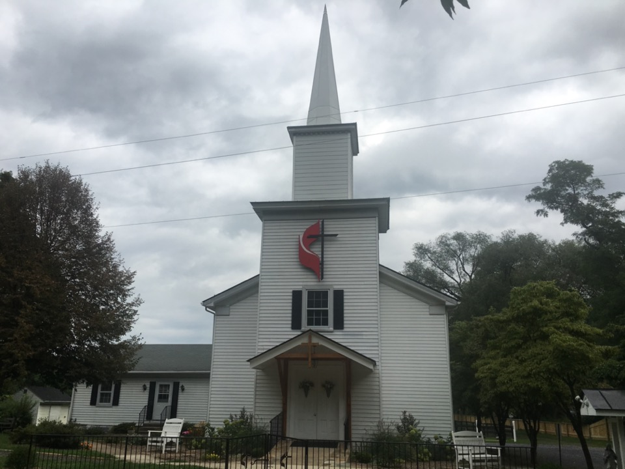
Rectortown United Methodist Church
serving God with
Prayer, Action, and Love
through Service.

