Slide 2
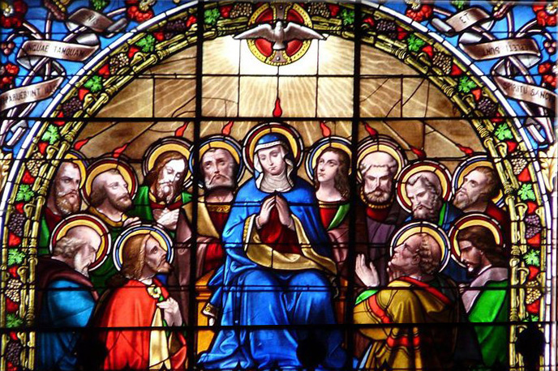
Prelude
Pastor Eduardo Carrillo
Pentecost
May 24th, 2026
CCLI License:
3430384-01-1829
Livestream Notice: Our worship service is live-streamed and recorded. By attending, you consent to being included in the broadcast. Thank you for joining us!

Slide 3
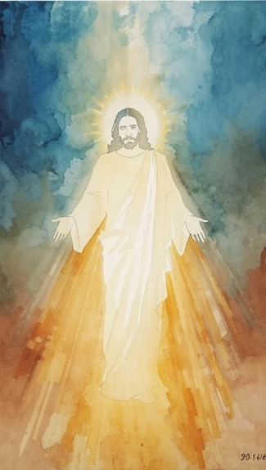
WELCOME,
ANNOUNCEMENTS,
and
CELEBRATIONS
Livestream Notice: Our worship service is live-streamed and recorded. By attending, you consent to being included in the broadcast. Thank you for joining us!

Slide 4
The Spirit of the Living God has been poured out on all flesh, this is that day!
We declare it boldly, the Holy Spirit is here and He is moving!

Slide 5
From the rushing wind of creation to the fire of Pentecost, God has never stopped breathing life!
Send Your Spirit, Lord, renew us, revive us, set us ablaze!

Slide 6
Young and old, sons and daughters, all shall prophesy, all shall be filled!
We will not be silent! The Spirit of God is upon us, let us worship with everything we have!

Slide 7
Holy Spirit, we welcome You boldly into this place today! You hovered over creation, You fell like fire at Pentecost, You breathed life into dry bones and scared disciples.

Slide 8
Do it again, Lord, right here, right now. Fill every corner of this room and every corner of our hearts. We are not here for a quiet, comfortable Sunday, we are here for an encounter.

Slide 9
Pour Yourself out upon us. Renew us like the face of the earth. Make us witnesses we were born to be. Come, Holy Spirit. We are ready. In Jesus' name, Amen!

Slide 10

“Spirit of God, Descend upon My Heart” UMH 500
WORDS: George Croly, 1867 MUSIC: Frederick C. Atkinson, 1870
Please stand as you are able and comfortable.
Spirit of God, descend
upon my heart;
wean it from earth;
through all its pulses move;
stoop to my weakness,
mighty as thou art,
and make me love thee as
I ought to love.

Slide 11
“Spirit of God, Descend upon My Heart” UMH 500
WORDS: George Croly, 1867 MUSIC: Frederick C. Atkinson, 1870
Please stand as you are able and comfortable.
I ask no dream, no
prophet ecstasies,
no sudden rending
of the veil of clay,
no angel visitant,
no opeing skies;
but take the dimness of
my soul away.

Slide 12
“Spirit of God, Descend upon My Heart” UMH 500
WORDS: George Croly, 1867 MUSIC: Frederick C. Atkinson, 1870
Please stand as you are able and comfortable.
Hast thou not bid me
love thee, God and King?
All, all thine own, soul,
heart and strength and mind.
I see thy cross; there
teach my heart to cling.
O let me seek thee, and
O let me find!

Slide 13
“Spirit of God, Descend upon My Heart” UMH 500
WORDS: George Croly, 1867 MUSIC: Frederick C. Atkinson, 1870
Please stand as you are able and comfortable.
Teach me to feel that
thou art always nigh;
teach me the struggles
of the soul to bear.
To check the rising
doubt, the rebel sigh,
teach me the patience of
unanswered prayer.

Slide 14
“Spirit of God, Descend upon My Heart” UMH 500
WORDS: George Croly, 1867 MUSIC: Frederick C. Atkinson, 1870
Please stand as you are able and comfortable.
Teach me to love thee
as tine angels love,
one holy passion
filling all my frame;
the kindling of the
heaven descended Dove,
my heart an altar, and
thy love the flame.

Slide 16
Prayer For Illumination
Spirit of the living God, fall afresh on me.
Spirit of the living God, fall afresh on me.
Melt me, mold me, fill me, use me.
Spirit of the living God, fall afresh on me.
UMH 393

Slide 17
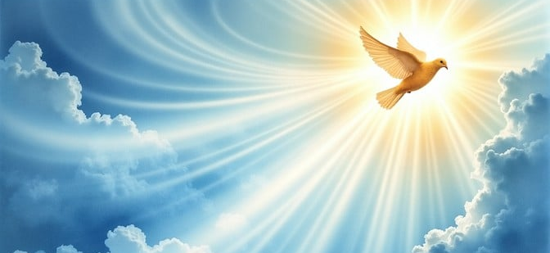
Psalm 104: 24 – 32, 35
NRSVUE

Slide 18
²⁴ O Lord, how manifold are your works! In wisdom you have made them all; the earth is full of your creatures.
²⁵ There is the sea, great and wide; creeping things innumerable are there, living things both small and great.
²⁶ There go the ships and Leviathan that you formed to sport in it.

Slide 19
²⁷ These all look to you to give them their food in due season;
²⁸ when you give to them, they gather it up; when you open your hand, they are filled with good things.

Slide 20
²⁹ When you hide your face, they are dismayed; when you take away their breath, they die and return to their dust.
³⁰ When you send forth your spirit, they are created, and you renew the face of the ground.
³¹ May the glory of the Lord endure forever; may the Lord rejoice in his works—

Slide 21
³² who looks on the earth and it trembles, who touches the mountains and they smoke.
³⁵ Let sinners be consumed from the earth, and let the wicked be no more. Bless the Lord, O my soul. Praise the Lord!

Slide 22
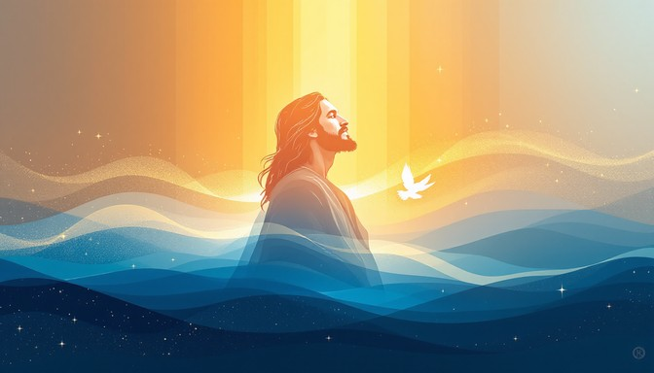
Acts 2: 1 – 21
NRSVUE

Slide 23
When the day of Pentecost had come, they were all together in one place.
² And suddenly from heaven there came a sound like the rush of a violent wind, and it filled the entire house where they were sitting.
³ Divided tongues, as of fire, appeared among them, and a tongue rested on each of them.

Slide 24
⁴ All of them were filled with the Holy Spirit and began to speak in other languages, as the Spirit gave them ability.
⁵ Now there were devout Jews from every people under heaven living in Jerusalem.

Slide 25
⁶ And at this sound the crowd gathered and was bewildered, because each one heard them speaking in the native language of each.
⁷ Amazed and astonished, they asked, “Are not all these who are speaking Galileans?
⁸ And how is it that we hear, each of us, in our own native language?

Slide 26
⁹ Parthians, Medes, Elamites, and residents of Mesopotamia, Judea and Cappadocia, Pontus and Asia,
¹⁰ Phrygia and Pamphylia, Egypt and the parts of Libya belonging to Cyrene, and visitors from Rome, both Jews and proselytes,

Slide 27
¹¹ Cretans and Arabs—in our own languages we hear them speaking about God’s deeds of power.”
¹² All were amazed and perplexed, saying to one another, “What does this mean?”
¹³ But others sneered and said, “They are filled with new wine.”

Slide 28
¹⁴ But Peter, standing with the eleven, raised his voice and addressed them, “Fellow Jews and all who live in Jerusalem, let this be known to you, and listen to what I say.
¹⁵ Indeed, these are not drunk, as you suppose, for it is only nine o’clock in the morning.

Slide 29
¹⁶ No, this is what was spoken through the prophet Joel:
¹⁷ ‘In the last days it will be, God declares, that I will pour out my Spirit upon all flesh, and your sons and your daughters shall prophesy, and your young men shall see visions, and your old men shall dream dreams.

Slide 30
¹⁸ Even upon my slaves, both men and women, in those days I will pour out my Spirit, and they shall prophesy.
¹⁹ And I will show portents in the heaven above and signs on the earth below, blood, and fire, and smoky mist.

Slide 31
²⁰ The sun shall be turned to darkness and the moon to blood, before the coming of the Lord’s great and glorious day.
²¹ Then everyone who calls on the name of the Lord shall be saved.’

Slide 32
The Word of God for the people of God
Thanks be to God

Slide 33
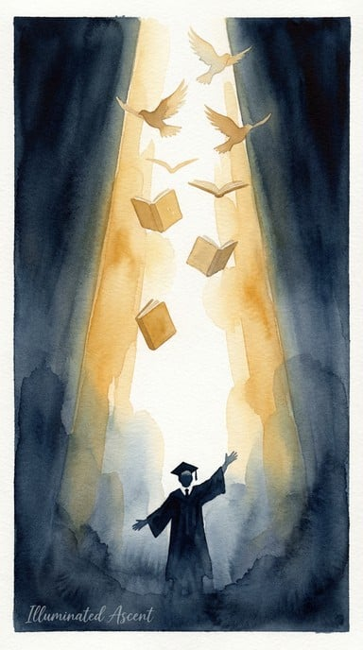
Congratulations Graduates!
Paris Wegdam
Buddy Wegdam

Slide 34
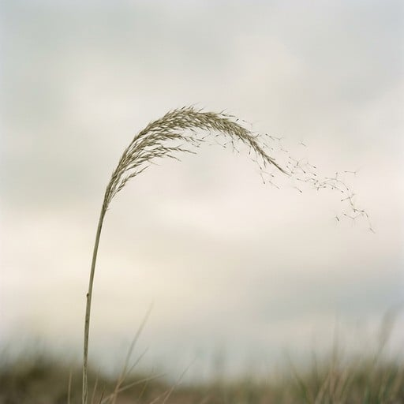
Sermon
“The Wind Still Moving”

Slide 44
Tithes and Offerings
Worship through giving
Notes:
https://www.goodfon.com/flowers/wallpaper-blue-wood-blossom-spring-flowers-vesna-iablonia-tsvety.html

Slide 45

“Praise God, from Whom All Blessings Flow” UMH 94
WORDS: Thomas Ken, 1674; adapted by Gilbert H. Viera, 1978
MUSIC: Geistliche Kirchengesange, 1623; harmonized by Ralph Vaughn Williams, 1906
Please stand as you are able and comfortable.
Praise God from whom all blessings flow;
Praise God, all creatures here below:
Alleluia! Alleluia!
Praise God, the source of all our gifts!
Praise Jesus Christ, whose power uplifts!
Praise the Spirit, Holy Spirit!
Alleluia! Alleluia! Alleluia!

Slide 46
Offertory Prayer

Slide 47
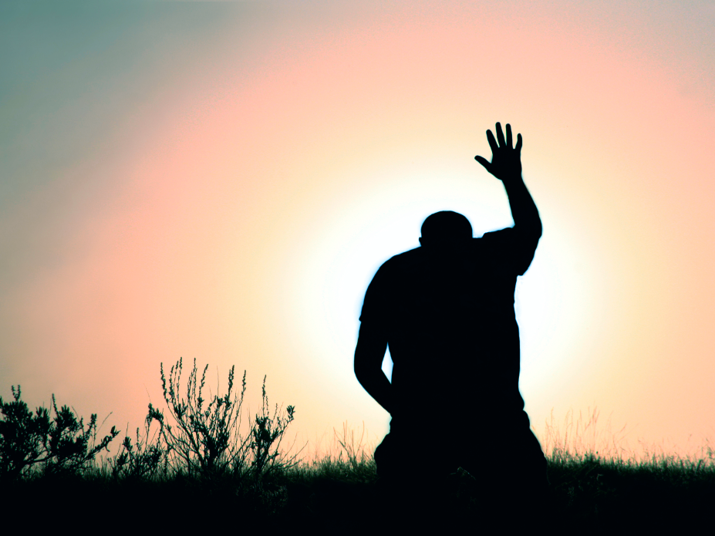
“Every Time I Feel the Spirit” UMH 404
WORDS and MUSIC: Afro-American spiritual.
Adapted and arranged by William Farley Smith, 1986
Please stand as you are able and comfortable.
Every time I feel the Spirit
moving in my heart, I will pray.
Yes, every time I feel the Spirit
moving in my heart, I will pray.

Slide 48
“Every Time I Feel the Spirit” UMH 404
WORDS and MUSIC: Afro-American spiritual.
Adapted and arranged by William Farley Smith, 1986
Please stand as you are able and comfortable.
Upon the mountain, my Lord spoke,
out his mouth came fire and smoke.
All around me looks to shine,
ask my Lord if all was mine.

Slide 49
“Every Time I Feel the Spirit” UMH 404
WORDS and MUSIC: Afro-American spiritual.
Adapted and arranged by William Farley Smith, 1986
Please stand as you are able and comfortable.
Every time I feel the Spirit
moving in my heart, I will pray.
Yes, every time I feel the Spirit
moving in my heart, I will pray.

Slide 50
“Every Time I Feel the Spirit” UMH 404
WORDS and MUSIC: Afro-American spiritual.
Adapted and arranged by William Farley Smith, 1986
Please stand as you are able and comfortable.
Jordan river runs right cold,
chills the body, not the soul.
Ain’t but one train on this track,
runs to heaven and right back.

Slide 51
“Every Time I Feel the Spirit” UMH 404
WORDS and MUSIC: Afro-American spiritual.
Adapted and arranged by William Farley Smith, 1986
Please stand as you are able and comfortable.
Every time I feel the Spirit
moving in my heart, I will pray.
Yes, every time I feel the Spirit
moving in my heart, I will pray.

Slide 53
BLESSING AND BENEDICTION
This service has ended, and now
your service in the world begins!

Slide 54
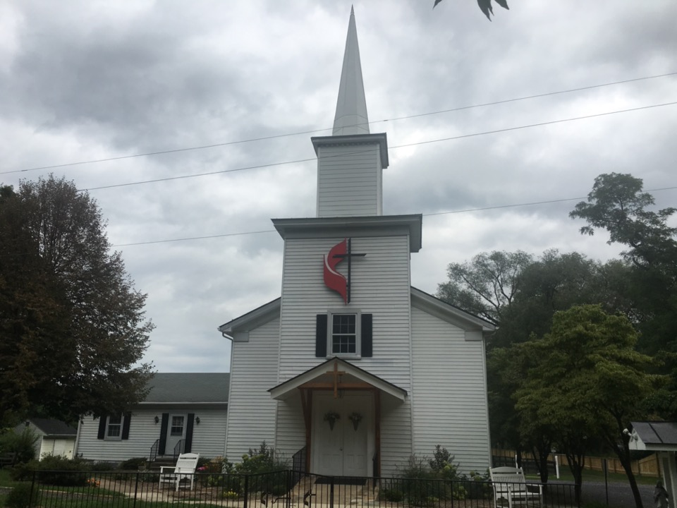
Rectortown United Methodist Church
serving God with
Prayer, Action, and Love
through Service.

