Slide 2

Prelude
Pastor Eduardo Carrillo
6th Sunday of Lent/ Palm Sunday
March 29th, 2026
CCLI License:
3430384-01-1829
Livestream Notice: Our worship service is live-streamed and recorded. By attending, you consent to being included in the broadcast. Thank you for joining us!

Slide 3
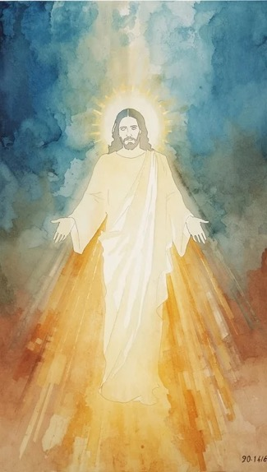
WELCOME,
ANNOUNCEMENTS,
and
CELEBRATIONS
Livestream Notice: Our worship service is live-streamed and recorded. By attending, you consent to being included in the broadcast. Thank you for joining us!

Slide 4
Wilderness-wanderers, holiness-seekers, listen for God’s voice today.
In the sounds of palm branches
rustling and shouts of hosanna, We listen for God’s voice.

Slide 5
The King of kings is here to lead with true authority.
May we raise our hosannas, even when the crowd is gone.

Slide 6
The King of kings stands for truth,
mercy, and justice.
May we stand there too.

Slide 7
The King of kings is going to the cross.
Today and every day, we follow the king of kings.

Slide 8
God of true power, we want to follow you. We need you to save us. And yet, we admit that at times, we deny you. We deny you when we do not feed the hungry,

Slide 9
when we do not welcome the stranger, when we do not visit those in prison. We deny you when fear or complacency overwhelms us, when we go along to get along,

Slide 10
when others promise a quicker, easier salvation. Forgive us. Give us the courage to stand up and stand out—under your authority and in your authority—on behalf of the marginalized, of truth, and of love. Amen.

Slide 11
“Hosanna, Loud Hosanna” UMH 278
WORDS: Jeanette Threlfall, 1873 MUSIC: Gesangbuch der J. W. k. Hofkapelle, 1784
Please stand as you are able and comfortable.
Hosanna, loud hosanna,
the little children sang;
through pillared court and temple
the lovely anthem rang.
To Jesus, who had blessed them
close folded to his breast,
the children sang their praises,
the simplest and the best.

Slide 12
“Hosanna, Loud Hosanna” UMH 278
WORDS: Jeanette Threlfall, 1873 MUSIC: Gesangbuch der J. W. k. Hofkapelle, 1784
Please stand as you are able and comfortable.
From Olivet they followed
mid an exultant crowd,
the victor palm branch waving,
and chanting clear and loud.
The Lord of earth and heaven
rode on in lowly state,
nor scorned that little children
should on his bidding wait.

Slide 13
“Hosanna, Loud Hosanna” UMH 278
WORDS: Jeanette Threlfall, 1873 MUSIC: Gesangbuch der J. W. k. Hofkapelle, 1784
Please stand as you are able and comfortable.
“Hosanna in the highest!”
that ancient song we sing,
for Christ is our Redeemer,
the Lord of Heaven our King.
O may we ever praise him
with heart and life and voice,
and in his blissful presence
eternally rejoice!

Slide 15
Prayer For Illumination
Spirit of the living God, fall afresh on me.
Spirit of the living God, fall afresh on me.
Melt me, mold me, fill me, use me.
Spirit of the living God, fall afresh on me.
UMH 393

Slide 16

Zechariah 9: 9 – 10
NRSVUE

Slide 17
⁹ Rejoice greatly, O daughter Zion! Shout aloud, O daughter Jerusalem! See, your king comes to you; triumphant and victorious is he, humble and riding on a donkey, on a colt, the foal of a donkey.

Slide 18
¹⁰ He will cut off the chariot from Ephraim and the war horse from Jerusalem; and the battle bow shall be cut off, and he shall command peace to the nations; his dominion shall be from sea to sea and from the River to the ends of the earth.

Slide 19
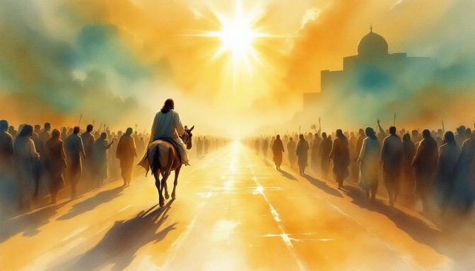
Matthew 21: 1 – 11
NRSVUE

Slide 20
When they had come near Jerusalem and had reached Bethphage, at the Mount of Olives, Jesus sent two disciples,
² saying to them, “Go into the village ahead of you, and immediately you will find a donkey tied and a colt with her; untie them and bring them to me.

Slide 21
³ If anyone says anything to you, just say this, ‘The Lord needs them.’ And he will send them immediately.”
⁴ This took place to fulfill what had been spoken through the prophet:
⁵ “Tell the daughter of Zion, Look, your king is coming to you, humble and mounted on a donkey, and on a colt, the foal of a donkey.”

Slide 22
⁶ The disciples went and did as Jesus had directed them;
⁷ they brought the donkey and the colt and put their cloaks on them, and he sat on them.
⁸ A very large crowd spread their cloaks on the road, and others cut branches from the trees and spread them on the road.

Slide 23
⁹ The crowds that went ahead of him and that followed were shouting,
“Hosanna to the Son of David!
Blessed is the one who comes in the name of the Lord!
Hosanna in the highest heaven!”

Slide 24
¹⁰ When he entered Jerusalem, the whole city was in turmoil, asking, “Who is this?”
¹¹ The crowds were saying, “This is the prophet Jesus from Nazareth in Galilee.”

Slide 25
The Word of God for the people of God
Thanks be to God

Slide 26
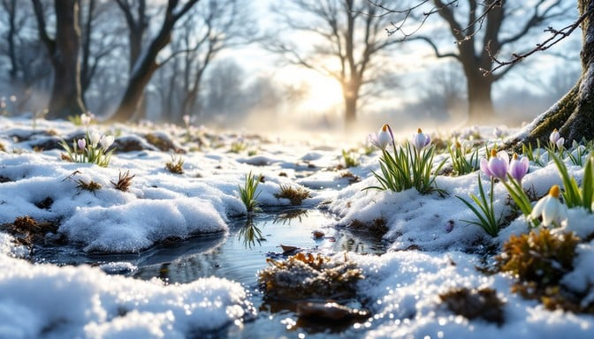
Sermon
“It’s Not Too Late to Live Differently”

Slide 27
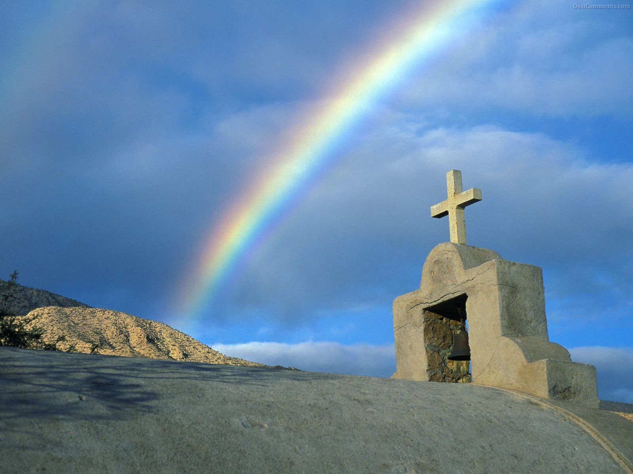
“Hymn of Promise” UMH 707
WORDS and MUSIC: Natalie Sleeth, 1986
Please stand as you are able and comfortable.
In the bulb there is a flower;
in the seed, an apple tree;
in cocoons, a hidden promise:
butterflies will soon be free!
In the cold and snow of winter
there’s a spring that waits to be,
unrevealed until its season,
something God alone can see.

Slide 28
“Hymn of Promise” UMH 707
WORDS and MUSIC: Natalie Sleeth, 1986
Please stand as you are able and comfortable.
There’s a song in every silence,
seeking word and melody;
there’s a dawn in every darkness,
bringing hope to you and me.
From the past will come the future;
what it holds, a mystery,
unrevealed until its season,
something God alone can see.

Slide 29
“Hymn of Promise” UMH 707
WORDS and MUSIC: Natalie Sleeth, 1986
Please stand as you are able and comfortable.
In our end is our beginning;
in our time, infinity;
in our doubt there is believing;
in our life, eternity.
In our death, a resurrection;
at the last, a victory,
unrevealed until its season,
something God alone can see.

Slide 39
Tithes and Offerings
Worship through giving
Notes:
https://www.goodfon.com/flowers/wallpaper-blue-wood-blossom-spring-flowers-vesna-iablonia-tsvety.html

Slide 40

“Praise God, from Whom All Blessings Flow” UMH 94
WORDS: Thomas Ken, 1674; adapted by Gilbert H. Viera, 1978
MUSIC: Geistliche Kirchengesange, 1623; harmonized by Ralph Vaughn Williams, 1906
Please stand as you are able and comfortable.
Praise God from whom all blessings flow;
Praise God, all creatures here below:
Alleluia! Alleluia!
Praise God, the source of all our gifts!
Praise Jesus Christ, whose power uplifts!
Praise the Spirit, Holy Spirit!
Alleluia! Alleluia! Alleluia!

Slide 41
Offertory Prayer

Slide 42
“Lord of the Dance” UMH 261
WORDS: Sydney Carter, 1963 MUSIC: 19th century Shaker tune;
adapted by Sydney Carter, 1963; harmony by Gary Alan Smith, 1988
Please stand as you are able and comfortable.
I danced in the morning
when the world was begun,
and I danced in the moon
and the stars and the sun,
and I came down from
heaven and I danced on the earth.
At Bethlehem I had my birth.

Slide 43
“Lord of the Dance” UMH 261
WORDS: Sydney Carter, 1963 MUSIC: 19th century Shaker tune;
adapted by Sydney Carter, 1963; harmony by Gary Alan Smith, 1988
Please stand as you are able and comfortable.
Dance, then,
wherever you may be;
I am the Lord
of the Dance, said he.
And I’ll lead you all
wherever you may be,
and I’ll lead you all
in the dance, said he.

Slide 44
“Lord of the Dance” UMH 261
WORDS: Sydney Carter, 1963 MUSIC: 19th century Shaker tune;
adapted by Sydney Carter, 1963; harmony by Gary Alan Smith, 1988
Please stand as you are able and comfortable.
I danced for the scribe
and the Pharisee,
but they would not dance
and they would not follow me;
I danced for the fishermen,
for James and John;
they came to me
and the dance went on.

Slide 45
“Lord of the Dance” UMH 261
WORDS: Sydney Carter, 1963 MUSIC: 19th century Shaker tune;
adapted by Sydney Carter, 1963; harmony by Gary Alan Smith, 1988
Please stand as you are able and comfortable.
Dance, then,
wherever you may be;
I am the Lord
of the Dance, said he.
And I’ll lead you all
wherever you may be,
and I’ll lead you all
in the dance, said he.

Slide 46
“Lord of the Dance” UMH 261
WORDS: Sydney Carter, 1963 MUSIC: 19th century Shaker tune;
adapted by Sydney Carter, 1963; harmony by Gary Alan Smith, 1988
Please stand as you are able and comfortable.
I danced on the sabbath
when I cured the lame,
the holy people
said it was a shame;
they whipped and they stripped
and they hung me high;
and they left me there
on a cross to die.

Slide 47
“Lord of the Dance” UMH 261
WORDS: Sydney Carter, 1963 MUSIC: 19th century Shaker tune;
adapted by Sydney Carter, 1963; harmony by Gary Alan Smith, 1988
Please stand as you are able and comfortable.
Dance, then,
wherever you may be;
I am the Lord
of the Dance, said he.
And I’ll lead you all
wherever you may be,
and I’ll lead you all
in the dance, said he.

Slide 48
“Lord of the Dance” UMH 261
WORDS: Sydney Carter, 1963 MUSIC: 19th century Shaker tune;
adapted by Sydney Carter, 1963; harmony by Gary Alan Smith, 1988
Please stand as you are able and comfortable.
I danced on a Friday
and the sky turned black;
it’s hard to dance
with the devil on your back;
they buried my body
and they thought I’d gone,
but I am the dance
and I still go on.

Slide 49
“Lord of the Dance” UMH 261
WORDS: Sydney Carter, 1963 MUSIC: 19th century Shaker tune;
adapted by Sydney Carter, 1963; harmony by Gary Alan Smith, 1988
Please stand as you are able and comfortable.
Dance, then,
wherever you may be;
I am the Lord
of the Dance, said he.
And I’ll lead you all
wherever you may be,
and I’ll lead you all
in the dance, said he.

Slide 50
“Lord of the Dance” UMH 261
WORDS: Sydney Carter, 1963 MUSIC: 19th century Shaker tune;
adapted by Sydney Carter, 1963; harmony by Gary Alan Smith, 1988
Please stand as you are able and comfortable.
They cut me down
and I leapt up high,
I am the life
that’ll never, never die;
I’ll live in you
if you’ll live in me;
I am the Lord
of the Dance, said he.

Slide 51
“Lord of the Dance” UMH 261
WORDS: Sydney Carter, 1963 MUSIC: 19th century Shaker tune;
adapted by Sydney Carter, 1963; harmony by Gary Alan Smith, 1988
Please stand as you are able and comfortable.
Dance, then,
wherever you may be;
I am the Lord
of the Dance, said he.
And I’ll lead you all
wherever you may be,
and I’ll lead you all
in the dance, said he.

Slide 53
BLESSING AND BENEDICTION
This service has ended, and now
your service in the world begins!

Slide 54
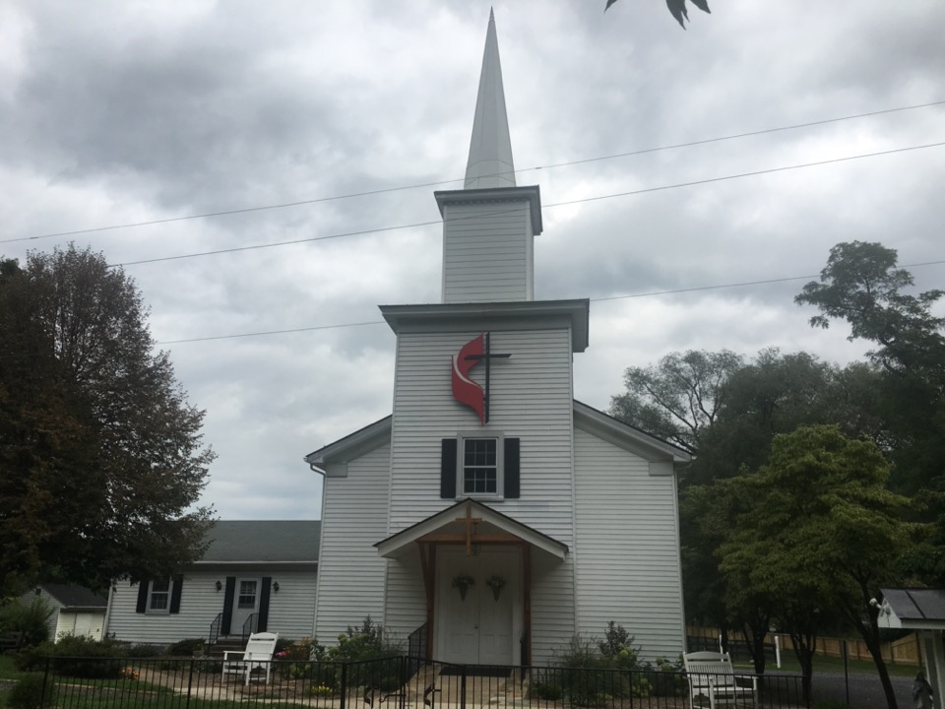
Rectortown United Methodist Church
serving God with
Prayer, Action, and Love
through Service.

