Slide 2
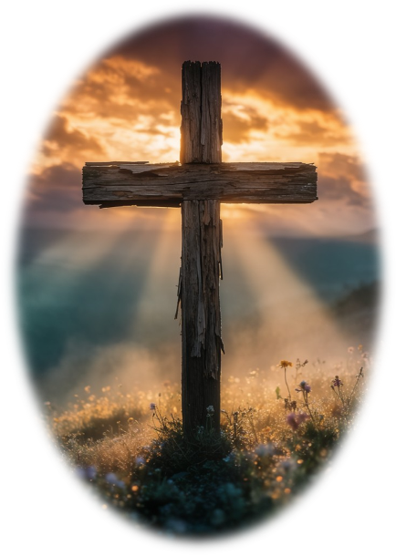
Prelude
Pastor Eduardo Carrillo
Sixteenth Sunday after Pentecost
September 13th, 2026
CCLI License:
3430384-01-1829
Livestream Notice: Our worship service is live-streamed and recorded. By attending, you consent to being included in the broadcast. Thank you for joining us!

Slide 3
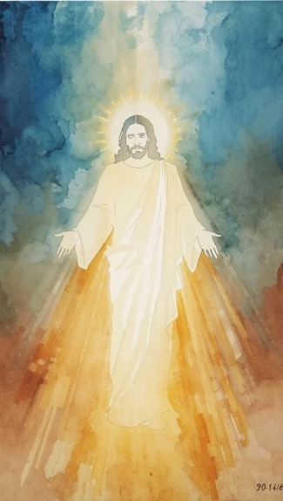
WELCOME,
ANNOUNCEMENTS,
and
CELEBRATIONS
Livestream Notice: Our worship service is live-streamed and recorded. By attending, you consent to being included in the broadcast. Thank you for joining us!

Slide 4
Sing to the Lord, for God has triumphed gloriously!
God is our strength, our song, and our salvation.

Slide 5
How many times shall we extend God’s mercy to others?
Not seven times, but seventy-seven times.

Slide 6
Just as God is merciful, we, who are God’s children, have to be merciful.
With humble hearts we receive and give.
All: Let us worship the God of endless grace!

Slide 7
O God, who parted the waters of the Red Sea and made a path through the wilderness: liberate us today from the burden of unforgiveness. Teach us to extend the same extravagant mercy

Slide 8
that you have poured out on us to our neighbors. Forgive us we pray, when we hoard your forgiveness. Equip us to part the sea that divides us, and find that all of us are worthy of your mercy.

Slide 9
This we pray through Jesus Christ our Lord. Amen.

Slide 10
“Joyful, Joyful, We Adore Thee” UMH 89
WORDS: Henry Van Dyke, 1907 MUSIC: Ludwig van Beethoven, 1824
Please stand as you are able and comfortable.
Joyful, joyful, we adore thee
God of glory, Lord of love;
hearts unfold like flowers before thee, opening to the sun above.
Melt the clouds of sin and sadness; drive the dark of doubt away.
Giver of immortal gladness,
fill us with the light of day!

Slide 11
“Joyful, Joyful, We Adore Thee” UMH 89
WORDS: Henry Van Dyke, 1907 MUSIC: Ludwig van Beethoven, 1824
Please stand as you are able and comfortable.
All thy works with joy surround thee, earth and heaven reflect thy rays,
stars and angels sing around thee,
center of unbroken praise.
Field and forest, vale and mountain, flowery meadow, flashing sea,
chanting bird and flowing fountain,
call us to rejoice in thee.

Slide 12
“Joyful, Joyful, We Adore Thee” UMH 89
WORDS: Henry Van Dyke, 1907 MUSIC: Ludwig van Beethoven, 1824
Please stand as you are able and comfortable.
Thou art giving and forgiving,
ever blessing, ever blest,
wellspring of the joy of living,
ocean depth of happy rest!
Thou our Father, Christ our brother,
all who live in love are thine;
teach us how to love each other,
lift us to the joy divine.

Slide 13
“Joyful, Joyful, We Adore Thee” UMH 89
WORDS: Henry Van Dyke, 1907 MUSIC: Ludwig van Beethoven, 1824
Please stand as you are able and comfortable.
Mortals, join the mighty chorus
which the morning stars began;
love divine is reigning o’er us,
binding all within its span.
Ever singing, march we onward,
victors in the midst of strife;
joyful music leads us sunward,
in the triumph song of life.

Slide 16
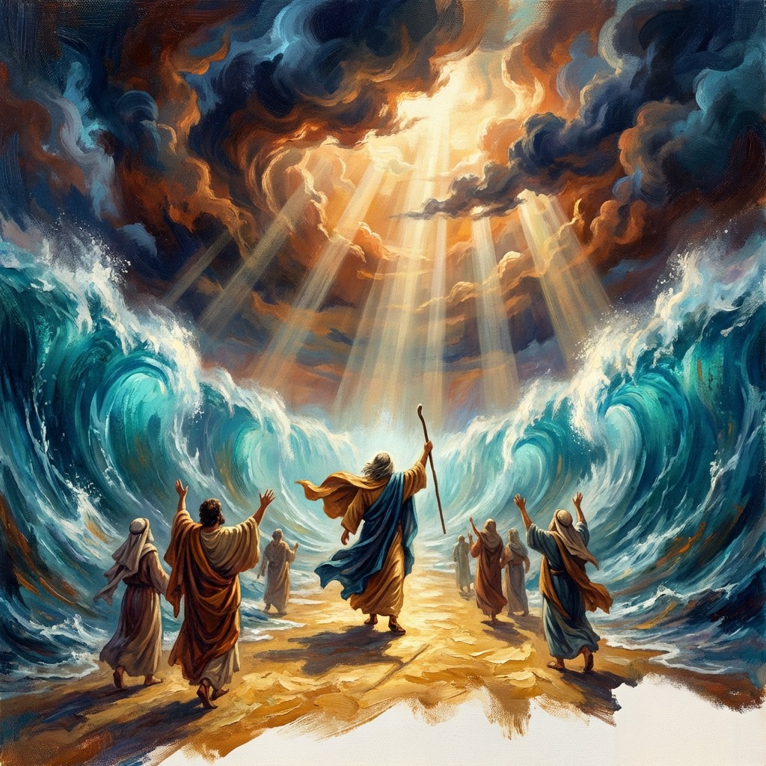
Exodus 14: 19 – 31
NRSVUE

Slide 17
¹⁹ The angel of God who was going before the Israelite army moved and went behind them, and the pillar of cloud moved from in front of them and took its place behind them.
²⁰ It came between the army of Egypt and the army of Israel. And so the cloud was there with the darkness, and it lit up the night; one did not come near the other all night.

Slide 18
²¹ Then Moses stretched out his hand over the sea. The Lord drove the sea back by a strong east wind all night and turned the sea into dry land, and the waters were divided.
²² The Israelites went into the sea on dry ground, the waters forming a wall for them on their right and on their left.

Slide 19
²³ The Egyptians pursued and went into the sea after them, all of Pharaoh’s horses, chariots, and chariot drivers.
²⁴ At the morning watch the Lord, in the pillar of fire and cloud, looked down on the Egyptian army and threw the Egyptian army into a panic.

Slide 20
²⁵ He clogged their chariot wheels so that they turned with difficulty. The Egyptians said, “Let us flee from the Israelites, for the Lord is fighting for them against Egypt.”
²⁶ Then the Lord said to Moses, “Stretch out your hand over the sea, so that the water may come back upon the Egyptians, upon their chariots and chariot drivers.”

Slide 21
²⁷ So Moses stretched out his hand over the sea, and at dawn the sea returned to its normal depth. As the Egyptians fled before it, the Lord tossed the Egyptians into the sea.
²⁸ The waters returned and covered the chariots and the chariot drivers, the entire army of Pharaoh that had followed them into the sea; not one of them remained.

Slide 22
²⁹ But the Israelites walked on dry ground through the sea, the waters forming a wall for them on their right and on their left.
³⁰ Thus the Lord saved Israel that day from the Egyptians, and Israel saw the Egyptians dead on the seashore.

Slide 23
³¹ Israel saw the great work that the Lord did against the Egyptians. So the people feared the Lord and believed in the Lord and in his servant Moses.

Slide 24
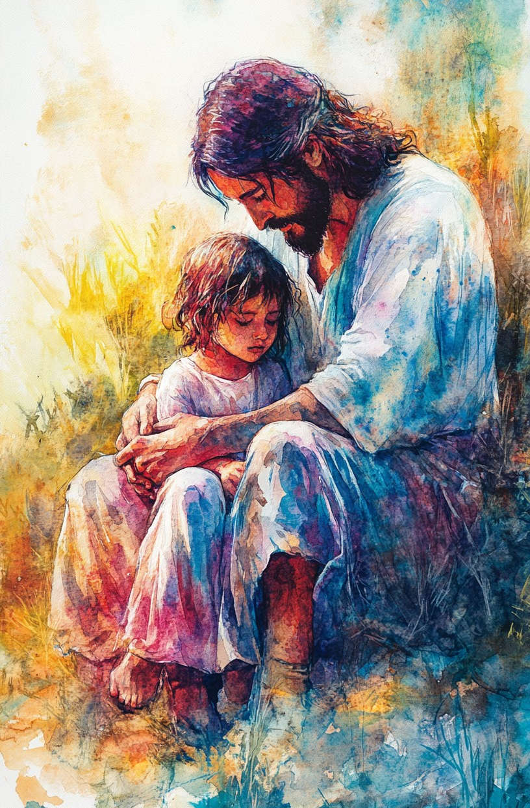
Matthew 18: 21 – 35
NRSVUE

Slide 25
²¹ Then Peter came and said to him, “Lord, if my brother or sister sins against me, how often should I forgive? As many as seven times?”
²² Jesus said to him, “Not seven times, but, I tell you, seventy-seven times.

Slide 26
²³ “For this reason the kingdom of heaven may be compared to a king who wished to settle accounts with his slaves.
²⁴ When he began the reckoning, one who owed him ten thousand talents was brought to him,

Slide 27
²⁵ and, as he could not pay, the lord ordered him to be sold, together with his wife and children and all his possessions and payment to be made.
²⁶ So the slave fell on his knees before him, saying, ‘Have patience with me, and I will pay you everything.’

Slide 28
²⁷ And out of pity for him, the lord of that slave released him and forgave him the debt.
²⁸ But that same slave, as he went out, came upon one of his fellow slaves who owed him a hundred denarii, and seizing him by the throat he said, ‘Pay what you owe.’

Slide 29
²⁹ Then his fellow slave fell down and pleaded with him, ‘Have patience with me, and I will pay you.’
³⁰ But he refused; then he went and threw him into prison until he would pay the debt.

Slide 30
³¹ When his fellow slaves saw what had happened, they were greatly distressed, and they went and reported to their lord all that had taken place.
³² Then his lord summoned him and said to him, ‘You wicked slave! I forgave you all that debt because you pleaded with me.

Slide 31
³³ Should you not have had mercy on your fellow slave, as I had mercy on you?’
³⁴ And in anger his lord handed him over to be tortured until he would pay his entire debt.
³⁵ So my heavenly Father will also do to every one of you, if you do not forgive your brother or sister from your heart.”

Slide 32
The Word of God for the people of God
Thanks be to God

Slide 33
Sermon
The Way Through
&
The Grace to Forgive

Slide 34
“Grace Greater than Our Sin” UMH 365
WORDS: Julia H. Johnston, 1911 MUSIC: Daniel B. Towner, 1910
Please stand as you are able and comfortable.
Marvelous grace of our loving Lord,
grace that exceeds
our sin and our guilt!
Yonder on Calvary’s mount outpoured, there where the blood of
the Lamb was spilt.

Slide 35
“Grace Greater than Our Sin” UMH 365
WORDS: Julia H. Johnston, 1911 MUSIC: Daniel B. Towner, 1910
Please stand as you are able and comfortable.
Grace, grace, God’s grace,
grace that will pardon and cleanse within;
grace, grace, God’s grace,
grace that is greater than all our sin!

Slide 36
“Grace Greater than Our Sin” UMH 365
WORDS: Julia H. Johnston, 1911 MUSIC: Daniel B. Towner, 1910
Please stand as you are able and comfortable.
Sin and despair, like the sea waves cold, threaten the soul
with infinite loss;
grace that is greater, yes, grace untold, points to the refuge,
the mighty cross.

Slide 37
“Grace Greater than Our Sin” UMH 365
WORDS: Julia H. Johnston, 1911 MUSIC: Daniel B. Towner, 1910
Please stand as you are able and comfortable.
Grace, grace, God’s grace,
grace that will pardon and cleanse within;
grace, grace, God’s grace,
grace that is greater than all our sin!

Slide 38
“Grace Greater than Our Sin” UMH 365
WORDS: Julia H. Johnston, 1911 MUSIC: Daniel B. Towner, 1910
Please stand as you are able and comfortable.
Dark is the stain that we cannot hide.
What can avail
to wash it away?
Look! There is flowing a crimson tide, brighter than snow you
may be today.

Slide 39
“Grace Greater than Our Sin” UMH 365
WORDS: Julia H. Johnston, 1911 MUSIC: Daniel B. Towner, 1910
Please stand as you are able and comfortable.
Grace, grace, God’s grace,
grace that will pardon and cleanse within;
grace, grace, God’s grace,
grace that is greater than all our sin!

Slide 40
“Grace Greater than Our Sin” UMH 365
WORDS: Julia H. Johnston, 1911 MUSIC: Daniel B. Towner, 1910
Please stand as you are able and comfortable.
Marvelous, infinite, matchless grace,
freely bestowed
on all who believe!
You that are longing to see his face,
will you this moment
his grace receive?

Slide 41
“Grace Greater than Our Sin” UMH 365
WORDS: Julia H. Johnston, 1911 MUSIC: Daniel B. Towner, 1910
Please stand as you are able and comfortable.
Grace, grace, God’s grace,
grace that will pardon and cleanse within;
grace, grace, God’s grace,
grace that is greater than all our sin!

Slide 46
Tithes and Offerings
Worship through giving
Notes:
https://www.goodfon.com/flowers/wallpaper-blue-wood-blossom-spring-flowers-vesna-iablonia-tsvety.html

Slide 47

“Praise God, from Whom All Blessings Flow” UMH 94
WORDS: Thomas Ken, 1674; adapted by Gilbert H. Viera, 1978
MUSIC: Geistliche Kirchengesange, 1623; harmonized by Ralph Vaughn Williams, 1906
Please stand as you are able and comfortable.
Praise God from whom all blessings flow;
Praise God, all creatures here below:
Alleluia! Alleluia!
Praise God, the source of all our gifts!
Praise Jesus Christ, whose power uplifts!
Praise the Spirit, Holy Spirit!
Alleluia! Alleluia! Alleluia!

Slide 48
Offertory Prayer

Slide 49
“Freely, Freely” UMH 389
WORDS and MUSIC: Carol Owens, 1972
Please stand as you are able and comfortable.
God forgave my sin in Jesus’ name,
I’ve been born again in Jesus’ name,
and in Jesus’ name I come to you,
to share his love as he told me to.

Slide 50
“Freely, Freely” UMH 389
WORDS and MUSIC: Carol Owens, 1972
Please stand as you are able and comfortable.
He said,
“Freely, freely you have received,
freely, freely give.
Go in my name
and because you believe,
others will know that I live.”

Slide 51
“Freely, Freely” UMH 389
WORDS and MUSIC: Carol Owens, 1972
Please stand as you are able and comfortable.
All power is given in Jesus’ name,
in earth and heaven in Jesus’ name,
and in Jesus’ name I come to you,
to share his power as he told me to.

Slide 52
“Freely, Freely” UMH 389
WORDS and MUSIC: Carol Owens, 1972
Please stand as you are able and comfortable.
He said,
“Freely, freely you have received,
freely, freely give.
Go in my name
and because you believe,
others will know that I live.”

Slide 59
Postlude
This service has ended, and now
your service in the world begins!

Slide 60
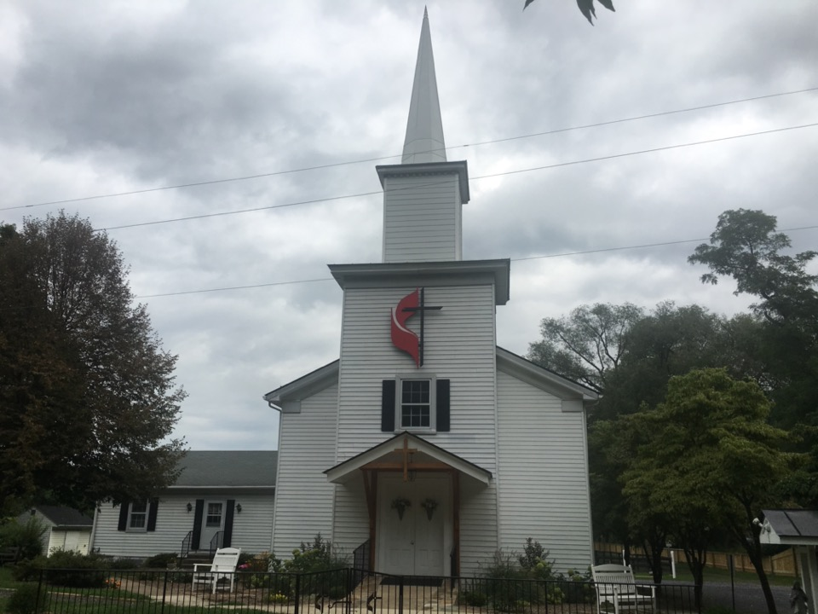
Rectortown United Methodist Church
serving God with
Prayer, Action, and Love
through Service.

