Slide 2
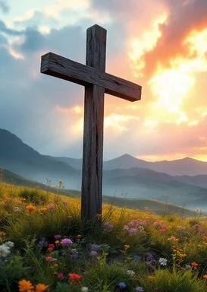
Prelude
Pastor Eduardo Carrillo
Second Sunday after Pentecost
June 7th, 2026
CCLI License:
3430384-01-1829
Livestream Notice: Our worship service is live-streamed and recorded. By attending, you consent to being included in the broadcast. Thank you for joining us!

Slide 3
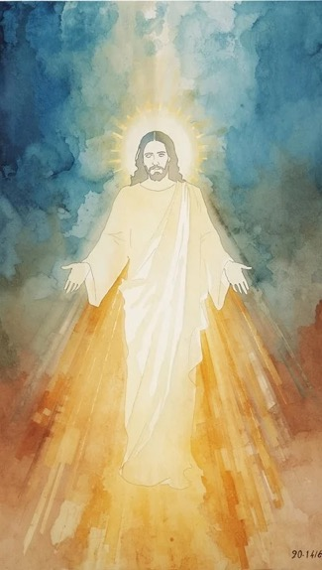
WELCOME,
ANNOUNCEMENTS,
and
CELEBRATIONS
Livestream Notice: Our worship service is live-streamed and recorded. By attending, you consent to being included in the broadcast. Thank you for joining us!

Slide 4
Come, weary and worn, you are welcome here. This is a place of refuge.
We step out in faith, trusting the promise!

Slide 5
Jesus walks to the tax booth and says, "Follow Me."
We leave the past behind to find our seat at His table!

Slide 6
Whether you are a pioneer or a seeker, the Lord is here.
We are not alone. We are a people on the move! Let us worship the God of new beginnings!

Slide 7
God of the Journey, You called Abram to travel and Matthew to rise from his desk. We admit we often prefer comfort over Your call. Shake us awake.

Slide 8
Heal us like the woman who touched Your hem. Remind us that You don’t call the perfect; You call the willing. Grant us the courage to follow You into the unknown,

Slide 9
trusting that Your mercy is enough for the road ahead. In Jesus’ name, Amen.

Slide 10
“Standing on the Promises” UMH 374
WORDS and MUSIC: R. Kelso Carter, 1886
Please stand as you are able and comfortable.
Standing on the promises of Christ my King, through eternal ages let his praises ring;
glory in the highest, I will shout and sing, standing on the promises of God.
Standing, standing,
standing on the promises of God my Savior; standing, standing,
I’m standing on the promises of God.

Slide 11
“Standing on the Promises” UMH 374
WORDS and MUSIC: R. Kelso Carter, 1886
Please stand as you are able and comfortable.
Standing on the promises that cannot fail,
when the howling storms of doubt and fear assail, by the living Word of God I shall prevail,
standing on the promises of God.
Standing, standing,
standing on the promises of God my Savior; standing, standing,
I’m standing on the promises of God.

Slide 12
“Standing on the Promises” UMH 374
WORDS and MUSIC: R. Kelso Carter, 1886
Please stand as you are able and comfortable.
Standing on the promises of Christ the Lord,
bound to him eternally by love’s strong cord, overcoming daily with the Spirit’s sword,
standing on the promises of God.
Standing, standing,
standing on the promises of God my Savior; standing, standing,
I’m standing on the promises of God.

Slide 13
“Standing on the Promises” UMH 374
WORDS and MUSIC: R. Kelso Carter, 1886
Please stand as you are able and comfortable.
Standing on the promises I cannot fall,
listening every moment to the Spirit’s call, resting in my Savior as my all in all,
standing on the promises of God.
Standing, standing,
standing on the promises of God my Savior; standing, standing,
I’m standing on the promises of God.

Slide 15
Prayer For Illumination
Spirit of the living God, fall afresh on me.
Spirit of the living God, fall afresh on me.
Melt me, mold me, fill me, use me.
Spirit of the living God, fall afresh on me.
UMH 393

Slide 16
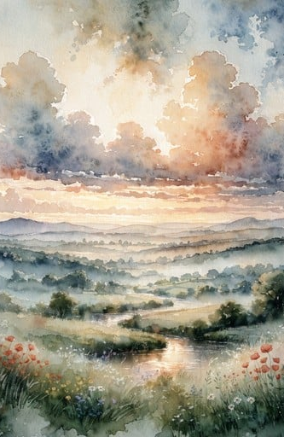
Genesis 12: 1 – 9
NRSVUE

Slide 17
Now the Lord said to Abram, “Go from your country and your kindred and your father’s house to the land that I will show you.
² I will make of you a great nation, and I will bless you and make your name great, so that you will be a blessing.

Slide 18
³ I will bless those who bless you, and the one who curses you I will curse, and in you all the families of the earth shall be blessed.”
⁴ So Abram went, as the Lord had told him, and Lot went with him. Abram was seventy-five years old when he departed from Haran.

Slide 19
⁵ Abram took his wife Sarai and his brother’s son Lot and all the possessions that they had gathered and the persons whom they had acquired in Haran, and they set forth to go to the land of Canaan. When they had come to the land of Canaan,

Slide 20
⁶ Abram passed through the land to the place at Shechem, to the oak of Moreh. At that time the Canaanites were in the land.
⁷ Then the Lord appeared to Abram and said, “To your offspring I will give this land.” So he built there an altar to the Lord, who had appeared to him.

Slide 21
⁸ From there he moved on to the hill country on the east of Bethel and pitched his tent, with Bethel on the west and Ai on the east, and there he built an altar to the Lord and invoked the name of the Lord.
⁹ And Abram journeyed on by stages toward the Negeb.

Slide 22
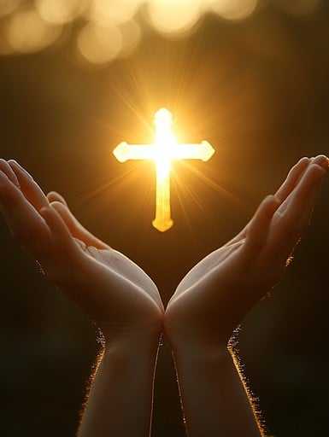
Matthew 9: 9 – 13,
18 – 26
NRSVUE

Slide 23
⁹ As Jesus was walking along, he saw a man called Matthew sitting at the tax-collection station, and he said to him, “Follow me.” And he got up and followed him.
¹⁰ And as he sat at dinner in the house, many tax collectors and sinners came and were sitting with Jesus and his disciples.

Slide 24
¹¹ When the Pharisees saw this, they said to his disciples, “Why does your teacher eat with tax collectors and sinners?”
¹² But when he heard this, he said, “Those who are well have no need of a physician, but those who are sick.

Slide 25
¹³ Go and learn what this means, ‘I desire mercy, not sacrifice.’ For I have not come to call the righteous but sinners.”
¹⁸ While he was saying these things to them, suddenly a leader came in and knelt before him, saying, “My daughter has just died, but come and lay your hand on her, and she will live.”

Slide 26
¹⁹ And Jesus got up and followed him, with his disciples.
²⁰ Then suddenly a woman who had been suffering from a flow of blood for twelve years came up behind him and touched the fringe of his cloak,

Slide 27
²¹ for she was saying to herself, “If I only touch his cloak, I will be made well.”
²² Jesus turned, and seeing her he said, “Take heart, daughter; your faith has made you well.” And the woman was made well from that moment.

Slide 28
²³ When Jesus came to the leader’s house and saw the flute players and the crowd making a commotion,
²⁴ he said, “Go away, for the girl is not dead but sleeping.” And they laughed at him.

Slide 29
²⁵ But when the crowd had been put outside, he went in and took her by the hand, and the girl got up.
²⁶ And the report of this spread through all of that district.

Slide 30
The Word of God for the people of God
Thanks be to God

Slide 31
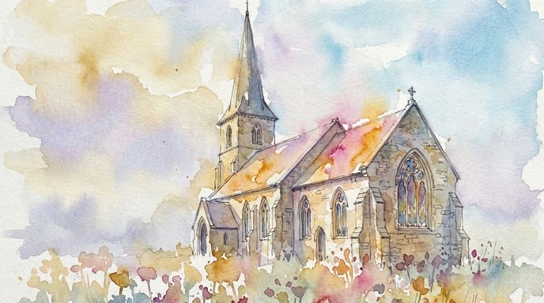
Sermon
“Unqualified & Invited”

Slide 32
“Would I Have Answered When You Called” TFWS 2137
WORDS: Herman G. Stuempfle, Jr.
MUSIC: Traditional English melody; arranged by Ralph Vaughn Williams; descant by Gary Alan Smith
Please stand as you are able and comfortable.
Would I have answered when you called, “Come, follow, follow me!”?
Would I at once have left behind
both work and family”
Or would the old, familiar round
have held me by its claim
and kept the spark within my heart
from bursting into flame?

Slide 33
“Would I Have Answered When You Called” TFWS 2137
WORDS: Herman G. Stuempfle, Jr.
MUSIC: Traditional English melody; arranged by Ralph Vaughn Williams; descant by Gary Alan Smith
Please stand as you are able and comfortable.
Would I have followed where you led
through ancient Galilee,
on roads unknown, by ways untried,
beyond security?
Or would I soon have hurried back
where home and comfort drew,
where truth you taught would not disturb
the ordered world I knew?

Slide 34
“Would I Have Answered When You Called” TFWS 2137
WORDS: Herman G. Stuempfle, Jr.
MUSIC: Traditional English melody; arranged by Ralph Vaughn Williams; descant by Gary Alan Smith
Please stand as you are able and comfortable.
Would I have matched my step with yours
when crowds cried, “Crucify!”
when on a rocky hill I saw
a cross against the sky?
Or would I too have slipped away
and left you there alone,
a dying king with crown of thorns
upon a terrible throne?

Slide 35
“Would I Have Answered When You Called” TFWS 2137
WORDS: Herman G. Stuempfle, Jr.
MUSIC: Traditional English melody; arranged by Ralph Vaughn Williams; descant by Gary Alan Smith
Please stand as you are able and comfortable.
O Christ, I cannot search my heart
through all its tangled ways,
nor can I with a certain mind
my steadfastness appraise.
I only pray that when you call,
“Come, follow, follow me!”
you’ll give me strength beyond my own
to follow faithfully.

Slide 45
Tithes and Offerings
Worship through giving
Notes:
https://www.goodfon.com/flowers/wallpaper-blue-wood-blossom-spring-flowers-vesna-iablonia-tsvety.html

Slide 46

“Praise God, from Whom All Blessings Flow” UMH 94
WORDS: Thomas Ken, 1674; adapted by Gilbert H. Viera, 1978
MUSIC: Geistliche Kirchengesange, 1623; harmonized by Ralph Vaughn Williams, 1906
Please stand as you are able and comfortable.
Praise God from whom all blessings flow;
Praise God, all creatures here below:
Alleluia! Alleluia!
Praise God, the source of all our gifts!
Praise Jesus Christ, whose power uplifts!
Praise the Spirit, Holy Spirit!
Alleluia! Alleluia! Alleluia!

Slide 47
Offertory Prayer

Slide 64
“Here I Am, Lord” UMH 593
WORDS and MUSIC: Dan Schutte, 1981
Please stand as you are able and comfortable.
I, the Lord of sea and sky,
I have heard my people cry.
All who dwell in dark and sin
my hand will save.
I who made the stars of night,
I will make their darkness bright.
Who will bear my light to them?
Whom shall I send?

Slide 65
“Here I Am, Lord” UMH 593
WORDS and MUSIC: Dan Schutte, 1981
Please stand as you are able and comfortable.
Here I am, Lord.
Is it I Lord?
I have heard you calling in the night.
I will go, Lord,
if you lead me.
I will hold your people in my heart.

Slide 66
“Here I Am, Lord” UMH 593
WORDS and MUSIC: Dan Schutte, 1981
Please stand as you are able and comfortable.
I, the Lord of snow and rain,
I have borne my people’s pain.
I have wept for love of them.
They turn away.
I will break their hearts of stone,
give them hearts for love alone.
I will speak my word to them.
Whom shall I send?

Slide 67
“Here I Am, Lord” UMH 593
WORDS and MUSIC: Dan Schutte, 1981
Please stand as you are able and comfortable.
Here I am, Lord.
Is it I Lord?
I have heard you calling in the night.
I will go, Lord,
if you lead me.
I will hold your people in my heart.

Slide 68
“Here I Am, Lord” UMH 593
WORDS and MUSIC: Dan Schutte, 1981
Please stand as you are able and comfortable.
I, the Lord of wind and flame,
I will tend the poor and lame,
I will set a feast for them.
My hand will save.
Finest bread I will provide
till their hearts be satisfied.
I will give my life to them.
Whom shall I send?

Slide 69
“Here I Am, Lord” UMH 593
WORDS and MUSIC: Dan Schutte, 1981
Please stand as you are able and comfortable.
Here I am, Lord.
Is it I Lord?
I have heard you calling in the night.
I will go, Lord,
if you lead me.
I will hold your people in my heart.

Slide 71
BLESSING AND BENEDICTION
This service has ended, and now
your service in the world begins!

Slide 72
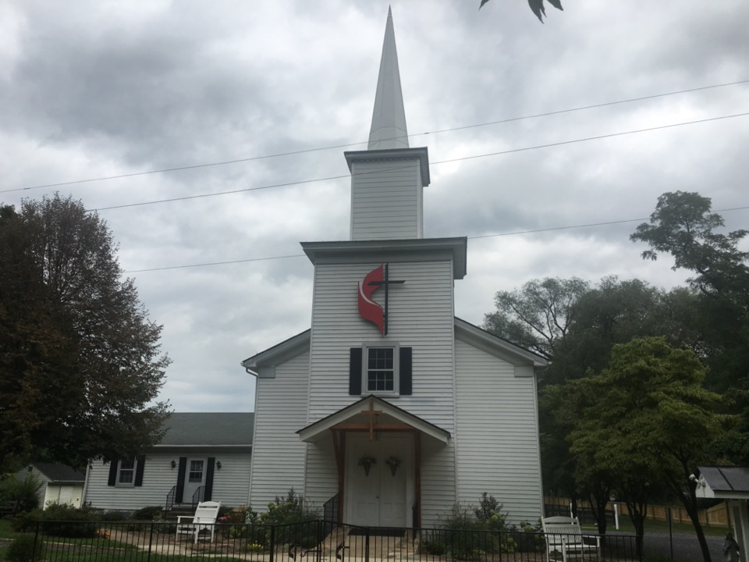
Rectortown United Methodist Church
serving God with
Prayer, Action, and Love
through Service.

