Slide 2
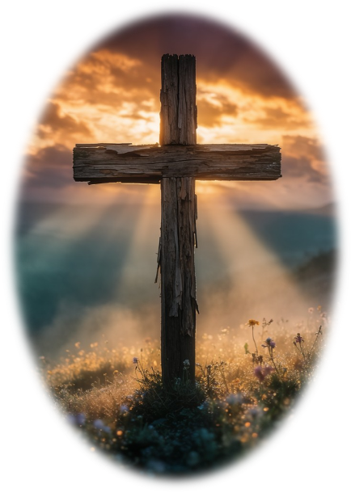
Prelude
Pastor Eduardo Carrillo
Seventeenth Sunday after Pentecost
September 20th, 2026
CCLI License:
3430384-01-1829
Livestream Notice: Our worship service is live-streamed and recorded. By attending, you consent to being included in the broadcast. Thank you for joining us!

Slide 3
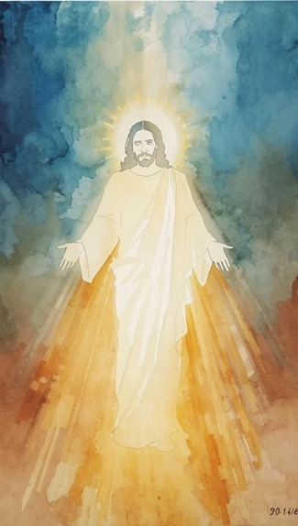
WELCOME,
ANNOUNCEMENTS,
and
CELEBRATIONS
Livestream Notice: Our worship service is live-streamed and recorded. By attending, you consent to being included in the broadcast. Thank you for joining us!

Slide 4
Praise the Lord! Give thanks to God, for God is good.
God’s steadfast love endures forever!

Slide 5
In our hunger and anxiety,
God opens the heavens and provides daily bread.

Slide 6
In our striving and score-keeping,
God offers grace beyond measure.
All: Let us worship our generous God!

Slide 7
Provider God, you hear our grumbling and meet our deepest needs with unexpected grace. Overturn our notions of fairness with your vast and equal love.

Slide 8
Feed us with the heavenly manna of your Word today, that we may learn to live with grateful and contented hearts. Continue to meet us in the wilderness, in our hunger

Slide 9
and in our time of need. We lift up these moments in worship, Amen.

Slide 10
“Guide Me, O Thou Great Jehovah” UMH 127
WORDS: William Williams, 1745 MUSIC: John Jughes, 1907
Please stand as you are able and comfortable.
Guide me, O thou great Jehovah,
pilgrim through this barren land.
I am weak, but thou are mighty;
hold me with thy powerful hand.
Bread of heaven, bread of heaven,
feed me till I want no more;
feed me till I want no more.

Slide 11
“Guide Me, O Thou Great Jehovah” UMH 127
WORDS: William Williams, 1745 MUSIC: John Jughes, 1907
Please stand as you are able and comfortable.
Open now the crystal fountain,
whence the healing stream doth flow;
let the fire and cloudy pillar
lead me all my journey through.
Strong deliverer, strong deliverer,
be thou still my strength and shield;
be thou still my strength and shield.

Slide 12
“Guide Me, O Thou Great Jehovah” UMH 127
WORDS: William Williams, 1745 MUSIC: John Jughes, 1907
Please stand as you are able and comfortable.
When I tread the verge of Jordan,
bid my anxious fears subside;
death of death and hell’s destruction,
land me safe on Canaan’s side.
Songs of praises, songs of praises,
I will ever give to thee;
I will ever give to thee.

Slide 14
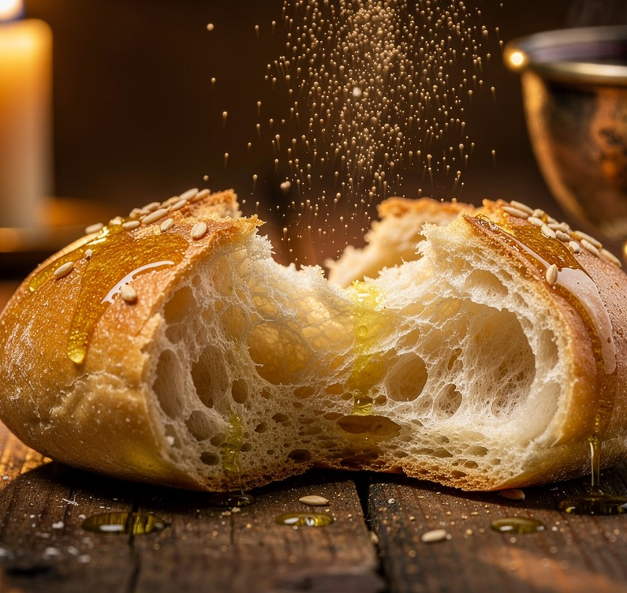
Exodus 16: 2 – 15
NRSVUE

Slide 15
² The whole congregation of the Israelites complained against Moses and Aaron in the wilderness.
³ The Israelites said to them, “If only we had died by the hand of the Lord in the land of Egypt, when we sat by the pots of meat and ate our fill of bread, for you have brought us out into this wilderness to kill this whole assembly with hunger.”

Slide 16
⁴ Then the Lord said to Moses, “I am going to rain bread from heaven for you, and each day the people shall go out and gather enough for that day. In that way I will test them, whether they will follow my instruction or not.
⁵ On the sixth day, when they prepare what they bring in, it will be twice as much as they gather on other days.”

Slide 17
⁶ So Moses and Aaron said to all the Israelites, “In the evening you shall know that it was the Lord who brought you out of the land of Egypt,
⁷ and in the morning you shall see the glory of the Lord, because he has heard your complaining against the Lord. For what are we, that you complain against us?”

Slide 18
⁸ And Moses said, “When the Lord gives you meat to eat in the evening and your fill of bread in the morning, because the Lord has heard the complaining that you utter against him—what are we? Your complaining is not against us but against the Lord.”
⁹ Then Moses said to Aaron, “Say to the whole congregation of the Israelites: ‘Draw near to the Lord, for he has heard your complaining.’

Slide 19
¹⁰ And as Aaron spoke to the whole congregation of the Israelites, they looked toward the wilderness, and the glory of the Lord appeared in the cloud.
¹¹ The Lord spoke to Moses,

Slide 20
¹² “I have heard the complaining of the Israelites; say to them, ‘At twilight you shall eat meat, and in the morning you shall have your fill of bread; then you shall know that I am the Lord your God.’ ”
¹³ In the evening quails came up and covered the camp, and in the morning there was a layer of dew around the camp.

Slide 21
¹⁴ When the layer of dew lifted, there on the surface of the wilderness was a fine flaky substance, as fine as frost on the ground.
¹⁵ When the Israelites saw it, they said to one another, “What is it?” For they did not know what it was. Moses said to them, “It is the bread that the Lord has given you to eat.

Slide 22
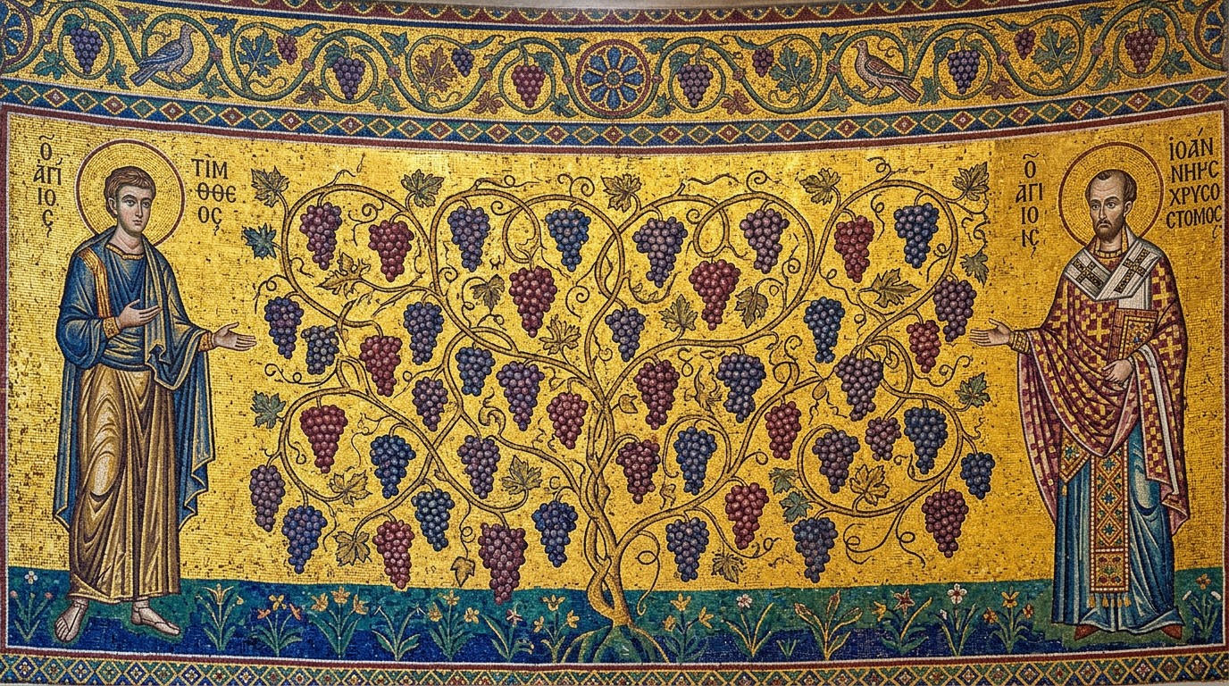
Matthew 20: 1 – 16
NRSVUE

Slide 23
“For the kingdom of heaven is like a landowner who went out early in the morning to hire laborers for his vineyard.
² After agreeing with the laborers for a denarius for the day, he sent them into his vineyard.
³ When he went out about nine o’clock, he saw others standing idle in the marketplace,

Slide 24
⁴ and he said to them, ‘You also go into the vineyard, and I will pay you whatever is right.’ So they went.
⁵ When he went out again about noon and about three o’clock, he did the same.

Slide 25
⁶ And about five o’clock he went out and found others standing around, and he said to them, ‘Why are you standing here idle all day?’
⁷ They said to him, ‘Because no one has hired us.’ He said to them, ‘You also go into the vineyard.’

Slide 26
⁸ When evening came, the owner of the vineyard said to his manager, ‘Call the laborers and give them their pay, beginning with the last and then going to the first.’
⁹ When those hired about five o’clock came, each of them received a denarius.

Slide 27
¹⁰ Now when the first came, they thought they would receive more; but each of them also received a denarius.
¹¹ And when they received it, they grumbled against the landowner,

Slide 28
¹² saying, ‘These last worked only one hour, and you have made them equal to us who have borne the burden of the day and the scorching heat.’
¹³ But he replied to one of them, ‘Friend, I am doing you no wrong; did you not agree with me for a denarius?

Slide 29
¹⁴ Take what belongs to you and go; I choose to give to this last the same as I give to you.
¹⁵ Am I not allowed to do what I choose with what belongs to me? Or are you envious because I am generous?’
¹⁶ So the last will be first, and the first will be last.”

Slide 30
The Word of God for the people of God
Thanks be to God

Slide 31

Sermon
Bread in the Wilderness, Grace Beyond Merit

Slide 32
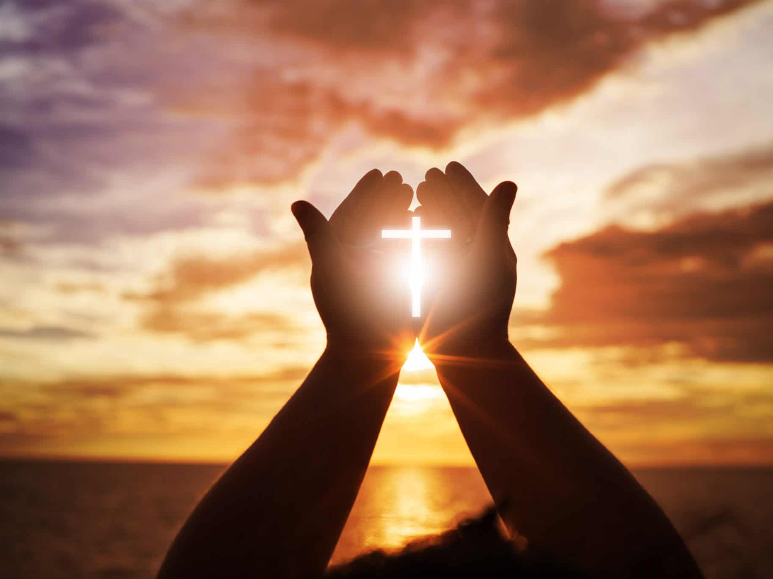
“To God Be The Glory” UMH 98
Words: Fanny J. Crosty, 1875; Music: William H. Doane, 1875
To God be the glory great things He has done
So loved He the world that He gave us His Son
Who yielded His life an atonement for sin
And opened the life gate that all may go in

Slide 33
“To God Be The Glory” UMH 98
Words: Fanny J. Crosty, 1875; Music: William H. Doane, 1875
Praise the Lord praise the Lord
Let the earth hear His voice
Praise the Lord praise the Lord
Let the people rejoice
O come to the Father through Jesus the Son
And give Him the glory great things He has done

Slide 34
“To God Be The Glory” UMH 98
Words: Fanny J. Crosty, 1875; Music: William H. Doane, 1875
O perfect redemption the purchase of blood
To every believer the promise of God
The vilest offender who truly believes
That moment from Jesus a pardon receives

Slide 35
“To God Be The Glory” UMH 98
Words: Fanny J. Crosty, 1875; Music: William H. Doane, 1875
Praise the Lord praise the Lord
Let the earth hear His voice
Praise the Lord praise the Lord
Let the people rejoice
O come to the Father through Jesus the Son
And give Him the glory great things He has done

Slide 36
“To God Be The Glory” UMH 98
Words: Fanny J. Crosty, 1875; Music: William H. Doane, 1875
Great things He has taught us
Great things He has done
And great our rejoicing through Jesus the Son
But purer and higher and greater will be
Our wonder our transport when Jesus we see

Slide 37
“To God Be The Glory” UMH 98
Words: Fanny J. Crosty, 1875; Music: William H. Doane, 1875
Praise the Lord praise the Lord
Let the earth hear His voice
Praise the Lord praise the Lord
Let the people rejoice
O come to the Father through Jesus the Son
And give Him the glory great things He has done

Slide 42
Tithes and Offerings
Worship through giving
Notes:
https://www.goodfon.com/flowers/wallpaper-blue-wood-blossom-spring-flowers-vesna-iablonia-tsvety.html

Slide 43

“Praise God, from Whom All Blessings Flow” UMH 94
WORDS: Thomas Ken, 1674; adapted by Gilbert H. Viera, 1978
MUSIC: Geistliche Kirchengesange, 1623; harmonized by Ralph Vaughn Williams, 1906
Please stand as you are able and comfortable.
Praise God from whom all blessings flow;
Praise God, all creatures here below:
Alleluia! Alleluia!
Praise God, the source of all our gifts!
Praise Jesus Christ, whose power uplifts!
Praise the Spirit, Holy Spirit!
Alleluia! Alleluia! Alleluia!

Slide 44
Offertory Prayer

Slide 45
“Amazing Grace” UMH 378
WORDS: John Newton, 1779
MUSIC: 19th Century USA melody, harmonization by Edwin O. Excell, 1900
Please stand as you are able and comfortable.
Amazing grace!
How sweet the sound
that saved a wretch like me!
I once was lost
but now am found;
was blind, but now I see.

Slide 46
“Amazing Grace” UMH 378
WORDS: John Newton, 1779
MUSIC: 19th Century USA melody, harmonization by Edwin O. Excell, 1900
Please stand as you are able and comfortable.
’Twas grace that taught
my heart to fear,
and grace my fears relieved;
how precious did
that grace appear
the hour I first believed.

Slide 47
“Amazing Grace” UMH 378
WORDS: John Newton, 1779
MUSIC: 19th Century USA melody, harmonization by Edwin O. Excell, 1900
Please stand as you are able and comfortable.
Through many dangers,
toils, and snares,
I have already come;
‘tis grace hath brought
me safe thus far,
and grace will lead me home.

Slide 48
“Amazing Grace” UMH 378
WORDS: John Newton, 1779
MUSIC: 19th Century USA melody, harmonization by Edwin O. Excell, 1900
Please stand as you are able and comfortable.
The Lord has promised
good to me,
his word my hope secures;
he will my shield
and portion be,
as long as life endures.

Slide 49
“Amazing Grace” UMH 378
WORDS: John Newton, 1779
MUSIC: 19th Century USA melody, harmonization by Edwin O. Excell, 1900
Please stand as you are able and comfortable.
Yea, when this flesh
and heart shall fail,
and mortal life shall cease,
I shall possess,
within the veil,
a life of joy and peace.

Slide 50
“Amazing Grace” UMH 378
WORDS: John Newton, 1779
MUSIC: 19th Century USA melody, harmonization by Edwin O. Excell, 1900
Please stand as you are able and comfortable.
When we’ve been
there ten thousand years,
bright shining as the sun,
we’ve no less days
to sing God’s praise
than when we’d first begun.

Slide 57
Postlude
This service has ended, and now
your service in the world begins!

Slide 58
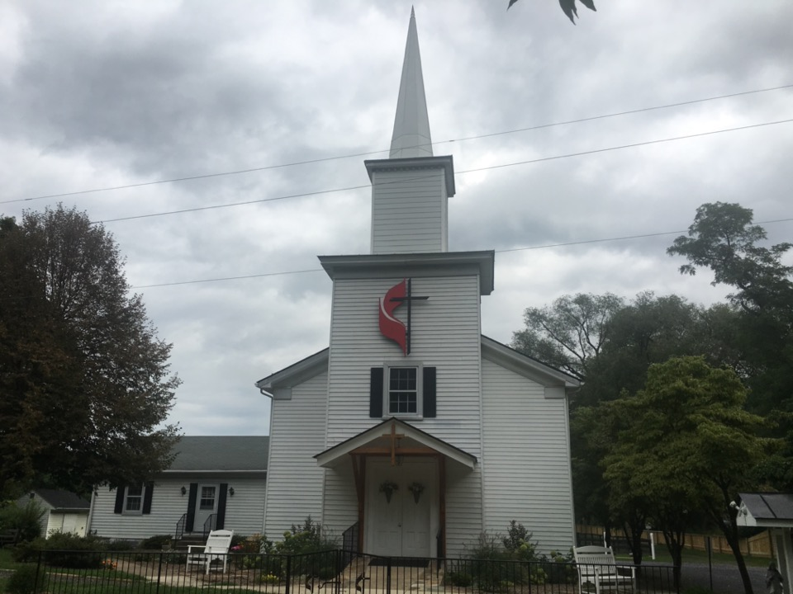
Rectortown United Methodist Church
serving God with
Prayer, Action, and Love
through Service.

