Slide 2
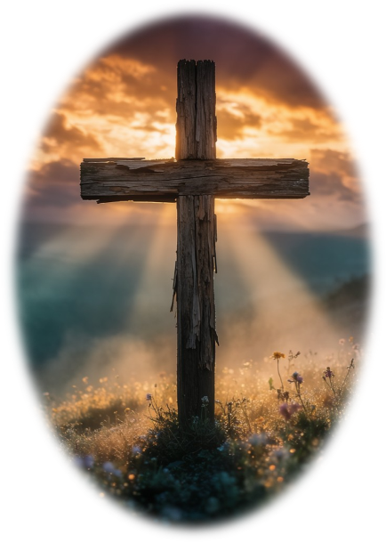
Prelude
Pastor Eduardo Carrillo
Fifteenth Sunday after Pentecost
September 6th, 2026
CCLI License:
3430384-01-1829
Livestream Notice: Our worship service is live-streamed and recorded. By attending, you consent to being included in the broadcast. Thank you for joining us!

Slide 3
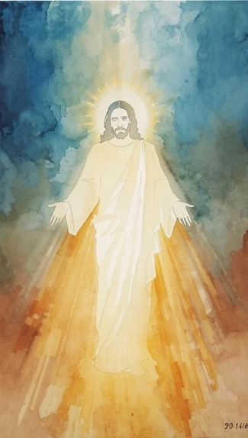
WELCOME,
ANNOUNCEMENTS,
and
CELEBRATIONS
Livestream Notice: Our worship service is live-streamed and recorded. By attending, you consent to being included in the broadcast. Thank you for joining us!

Slide 4
Come, gather in the presence of the God who claims us.
We come, bound together by the love of Christ.

Slide 5
Where two or three are gathered in God's name, Christ is here among us.
We bring our best and our worst.

Slide 6
The Lord is here! The one who blesses us in the struggle and feeds us in the wilderness.
Gather closer, vulnerable and surrounded by God’s love.
All: Let us worship with joyful hearts and reconciled spirits!

Slide 7
Gracious God, you have redeemed us out of bondage and gathered us into one body. Open our hearts this morning to hear your Word,

Slide 8
that we may lay down our grievances, clothe ourselves in the light of Christ, and reflect your reconciling love in our community. Forgive us when egos,

Slide 9
hate, misinformation, and our own understandings get on the way to reconciliation. Nudge us to walk closer to you and one another. Amen.

Slide 10
“God of Grace and God of Glory” UMH 577
WORDS: Harry Emerson Fosdick, 1930 MUSIC: John Hughes, 1907
Please stand as you are able and comfortable.
God of grace
and God of glory,
on thy people pour thy power;
crown thine ancient
church’s story;
bring her bud to glorious flower.

Slide 11
“God of Grace and God of Glory” UMH 577
WORDS: Harry Emerson Fosdick, 1930 MUSIC: John Hughes, 1907
Please stand as you are able and comfortable.
Grant us wisdom,
grant us courage,
for the facing of this hour,
for the facing of this hour.

Slide 12
“God of Grace and God of Glory” UMH 577
WORDS: Harry Emerson Fosdick, 1930 MUSIC: John Hughes, 1907
Please stand as you are able and comfortable.
Lo! the hosts
of evil round us
scorn thy Christ, assail his ways!
Fears and doubts
too long have bound us;
free our hearts to work and praise.

Slide 13
“God of Grace and God of Glory” UMH 577
WORDS: Harry Emerson Fosdick, 1930 MUSIC: John Hughes, 1907
Please stand as you are able and comfortable.
Grant us wisdom,
grant us courage,
for the living of these days,
for the living of these days.

Slide 14
“God of Grace and God of Glory” UMH 577
WORDS: Harry Emerson Fosdick, 1930 MUSIC: John Hughes, 1907
Please stand as you are able and comfortable.
Cure thy chil-dren’s
warring madness,
bend our pride to thy control;
shame our wan-ton,
selfish gladness,
rich in things and poor in soul.

Slide 15
“God of Grace and God of Glory” UMH 577
WORDS: Harry Emerson Fosdick, 1930 MUSIC: John Hughes, 1907
Please stand as you are able and comfortable.
Grant us wisdom,
grant us courage,
lest we miss thy kingdom’s goal,
lest we miss thy kingdom’s goal.

Slide 16
“God of Grace and God of Glory” UMH 577
WORDS: Harry Emerson Fosdick, 1930 MUSIC: John Hughes, 1907
Please stand as you are able and comfortable.
Save us from
weak resignation
to the evils we deplore;
let the search
for thy salvation
be our glory evermore.

Slide 17
“God of Grace and God of Glory” UMH 577
WORDS: Harry Emerson Fosdick, 1930 MUSIC: John Hughes, 1907
Please stand as you are able and comfortable.
Grant us wisdom,
grant us courage,
serving thee whom we adore,
serving thee whom we adore.

Slide 20
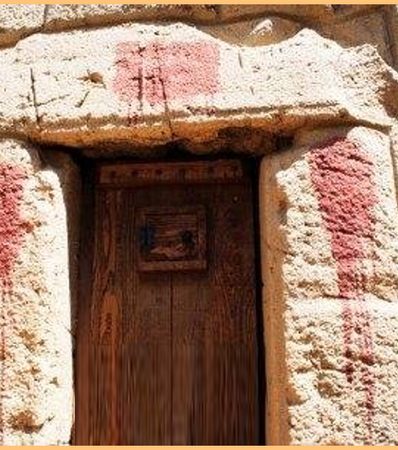
Exodus 12: 1 – 14
NRSVUE

Slide 21
The Lord said to Moses and Aaron in the land of Egypt,
² “This month shall mark for you the beginning of months; it shall be the first month of the year for you.

Slide 22
³ Tell the whole congregation of Israel that on the tenth of this month they are to take a lamb for each family, a lamb for each household.
⁴ If a household is too small for a whole lamb, it shall join its closest neighbor in obtaining one; the lamb shall be divided in proportion to the number of people who eat of it.

Slide 23
⁵ Your lamb shall be without blemish, a year-old male; you may take it from the sheep or from the goats.
⁶ You shall keep it until the fourteenth day of this month; then the whole assembled congregation of Israel shall slaughter it at twilight.

Slide 24
⁷ They shall take some of the blood and put it on the two doorposts and the lintel of the houses in which they eat it.
⁸ They shall eat the lamb that same night; they shall eat it roasted over the fire with unleavened bread and bitter herbs.

Slide 25
⁹ Do not eat any of it raw or boiled in water but roasted over the fire, with its head, legs, and inner organs.
¹⁰ You shall let none of it remain until the morning; anything that remains until the morning you shall burn with fire.

Slide 26
¹¹ This is how you shall eat it: your loins girded, your sandals on your feet, and your staff in your hand, and you shall eat it hurriedly. It is the Passover of the Lord.
¹² I will pass through the land of Egypt that night, and I will strike down every firstborn in the land of Egypt, from human to animal, and on all the gods of Egypt I will execute judgments: I am the Lord.

Slide 27
¹³ The blood shall be a sign for you on the houses where you live: when I see the blood, I will pass over you, and no plague shall destroy you when I strike the land of Egypt.
¹⁴ “This day shall be a day of remembrance for you. You shall celebrate it as a festival to the Lord; throughout your generations you shall observe it as a perpetual ordinance.

Slide 28
Matthew 18: 15 – 20
NRSVUE

Slide 29
¹⁵ “If your brother or sister sins against you, go and point out the fault when the two of you are alone. If you are listened to, you have regained that one.
¹⁶ But if you are not listened to, take one or two others along with you, so that every word may be confirmed by the evidence of two or three witnesses.

Slide 30
¹⁷ If that person refuses to listen to them, tell it to the church, and if the offender refuses to listen even to the church, let such a one be to you as a gentile and a tax collector.
¹⁸ Truly I tell you, whatever you bind on earth will be bound in heaven, and whatever you loose on earth will be loosed in heaven.

Slide 31
¹⁹ Again, truly I tell you, if two of you agree on earth about anything you ask, it will be done for you by my Father in heaven.
²⁰ For where two or three are gathered in my name, I am there among them.”

Slide 32
The Word of God for the people of God
Thanks be to God

Slide 33

Sermon
“Bound Together in Love”

Slide 34
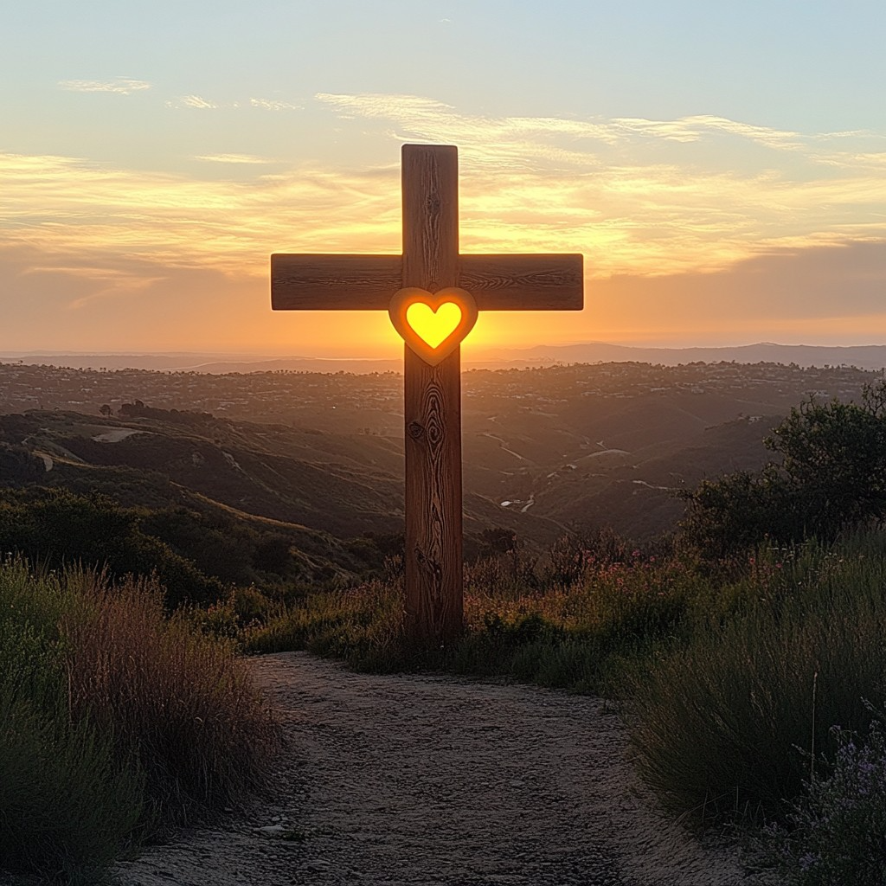
O How I Love Jesus
170
WORDS: Frederick Whitfield, 1855
1. There is a name I love to hear,
I love to sing its worth;
it sounds like music in my ear,
the sweetest name on earth.

Slide 35
O How I Love Jesus
170
WORDS: Frederick Whitfield, 1855
Refrain
O how I love Jesus,
O how I love Jesus,
O how I love Jesus,
because he first loved me!

Slide 36
O How I Love Jesus
170
WORDS: Frederick Whitfield, 1855
2. It tells me of a Savior’s love,
who died to set me free;
it tells me of his precious blood,
the sinner’s perfect plea.

Slide 37
O How I Love Jesus
170
WORDS: Frederick Whitfield, 1855
Refrain
O how I love Jesus,
O how I love Jesus,
O how I love Jesus,
because he first loved me!

Slide 38
O How I Love Jesus
170
WORDS: Frederick Whitfield, 1855
3. It tells of one whose loving heart
can feel my deepest woe;
who in each sorrow bears a part
that none can bear below.

Slide 39
O How I Love Jesus
170
WORDS: Frederick Whitfield, 1855
Refrain
O how I love Jesus,
O how I love Jesus,
O how I love Jesus,
because he first loved me!

Slide 47
Tithes and Offerings
Worship through giving
Notes:
https://www.goodfon.com/flowers/wallpaper-blue-wood-blossom-spring-flowers-vesna-iablonia-tsvety.html

Slide 48

“Praise God, from Whom All Blessings Flow” UMH 94
WORDS: Thomas Ken, 1674; adapted by Gilbert H. Viera, 1978
MUSIC: Geistliche Kirchengesange, 1623; harmonized by Ralph Vaughn Williams, 1906
Please stand as you are able and comfortable.
Praise God from whom all blessings flow;
Praise God, all creatures here below:
Alleluia! Alleluia!
Praise God, the source of all our gifts!
Praise Jesus Christ, whose power uplifts!
Praise the Spirit, Holy Spirit!
Alleluia! Alleluia! Alleluia!

Slide 49
Offertory Prayer

Slide 60
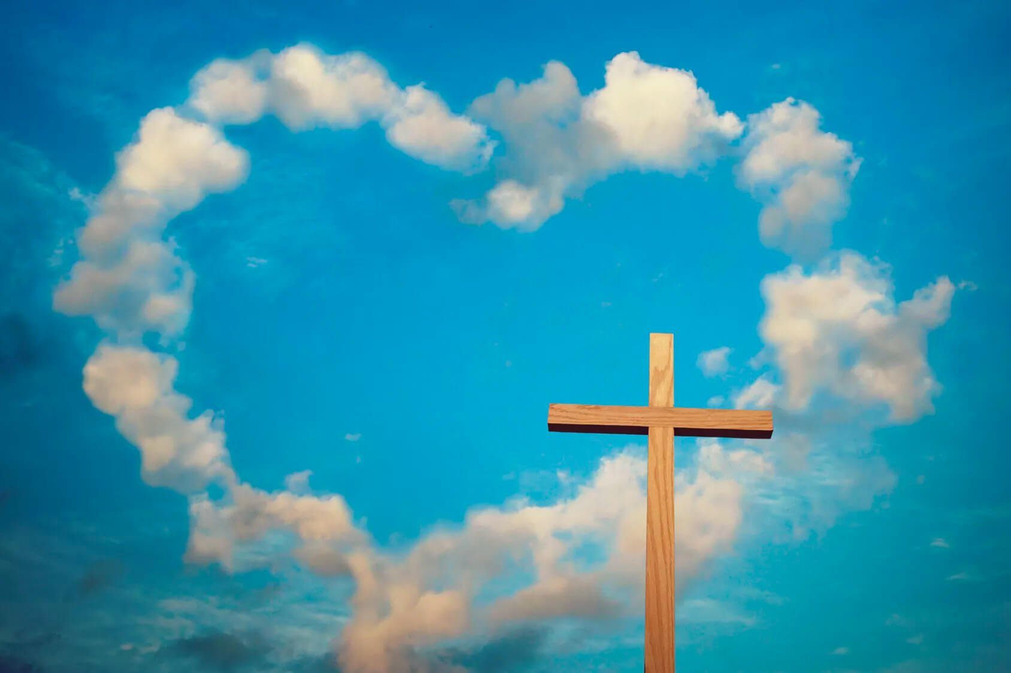
“Love Divine, All Love Excelling” UMH 384
WORDS: Charles Wesley, 1747 MUSIC: John Zundel, 1870
Please stand as you are able and comfortable.
Love divine, all loves excelling,
joy of heaven, to earth come down;
fix in us they humble dwelling;
all thy faithful mercies crown!
Jesus, thou art all compassion,
pure, unbounded love thou art;
visit us with thy salvation;
enter every trembling heart.

Slide 61
“Love Divine, All Love Excelling” UMH 384
WORDS: Charles Wesley, 1747 MUSIC: John Zundel, 1870
Please stand as you are able and comfortable.
Breathe, O breathe thy loving Spirit
into every troubled breast!
Let us all in thee inherit;
let us find that second rest.
Take a way our bent to sinning;
Alpha and Omega be;
end of faith, as its beginning,
set our hearts at liberty.

Slide 62
“Love Divine, All Love Excelling” UMH 384
WORDS: Charles Wesley, 1747 MUSIC: John Zundel, 1870
Please stand as you are able and comfortable.
Come, Almighty to deliver,
let us all thy life receive;
suddenly return and never,
never more thy temples leave.
Thee we would be always blessing,
serve thee as thy hosts above,
pray and praise thee without ceasing,
glory in thy perfect love.

Slide 63
“Love Divine, All Love Excelling” UMH 384
WORDS: Charles Wesley, 1747 MUSIC: John Zundel, 1870
Please stand as you are able and comfortable.
Finish, then, thy new creation;
pure and spotless let us be.
Let us see thy great salvation
perfectly restored in thee;
changed from glory into glory,
till in heaven we take our place,
till we cast our crown before thee,
lost in wonder, love, and praise.

Slide 68
Postlude
This service has ended, and now
your service in the world begins!

Slide 69
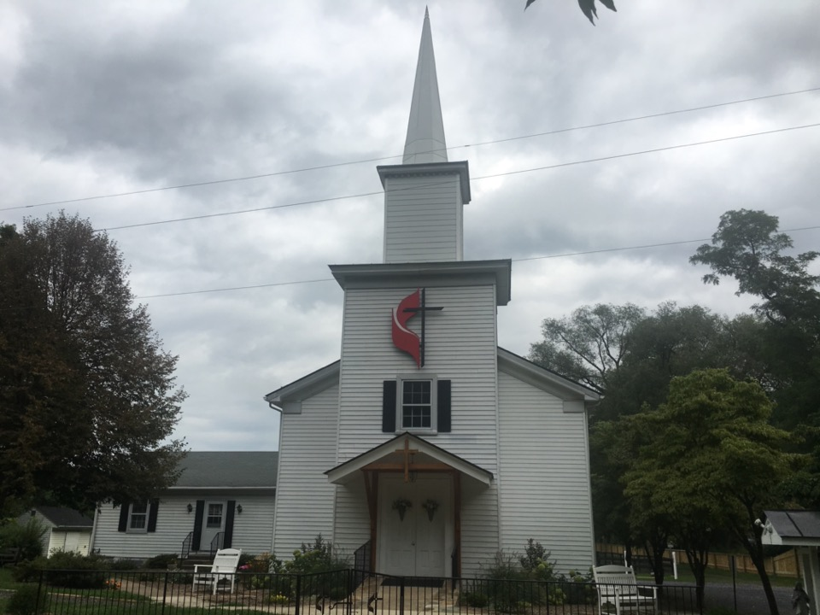
Rectortown United Methodist Church
serving God with
Prayer, Action, and Love
through Service.

