Slide 2
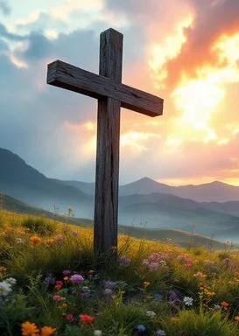
Prelude
Pastor Eduardo Carrillo
Nineth Sunday after Pentecost
July 26th, 2026
CCLI License:
3430384-01-1829
Livestream Notice: Our worship service is live-streamed and recorded. By attending, you consent to being included in the broadcast. Thank you for joining us!

Slide 3
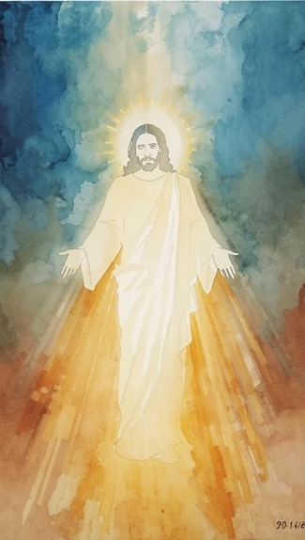
WELCOME,
ANNOUNCEMENTS,
and
CELEBRATIONS
Livestream Notice: Our worship service is live-streamed and recorded. By attending, you consent to being included in the broadcast. Thank you for joining us!

Slide 4
O give thanks to the Lord and call upon His holy name! Make known His deeds among the peoples!
We gather to sing to God, to tell of all His wonderful works, and to glory in His holy name.

Slide 5
We come seeking the Lord and His strength, remembering the covenant He made for a thousand generations.

Slide 6
Yet, we arrive knowing our own weakness. We come carrying burdens so heavy that we do not even know how to pray as we ought.

Slide 7
We worship with confidence today, resting in the promise that neither death, nor life, nor things present, nor things to come, nor anything else in all creation, will ever separate us from the love of God in Christ Jesus.

Slide 8
Let us rejoice in the God who holds us fast. Let us worship the Lord!

Slide 9
Everlasting and Faithful God, We come before You today with hearts full of gratitude, remembering the wonderful works You have done. You are mindful of Your covenant forever,

Slide 10
and You have proven Your faithfulness to us time and time again. Remind us today that we are more than conquerors through Him who loved us.

Slide 11
Bind our wandering hearts to Your eternal promises. Assure us once again that absolutely nothing in all creation can sever us from Your love.

Slide 12
We pray this in the strong and saving name of Jesus Christ, our Lord. Amen.

Slide 13
“Seek Ye First” UMH 405
WORDS and MUSIC: Karen Lafferty, 1972
Please stand as you are able and comfortable.
Seek ye first
the kingdom of God
and his righteousness,
and all these things
shall be added unto you.
Allelu, alleluia!

Slide 14
“Seek Ye First” UMH 405
WORDS and MUSIC: Karen Lafferty, 1972
Please stand as you are able and comfortable.
We shall not live
by bread alone,
but by every word
that proceeds from
the mouth of God.
Allelu, alleluia!

Slide 15
“Seek Ye First” UMH 405
WORDS and MUSIC: Karen Lafferty, 1972
Please stand as you are able and comfortable.
Ask, and it shall
be given unto you;
seek and ye shall find;
knock, and the door
shall be opened unto you.
Allelu, alleluia!

Slide 18
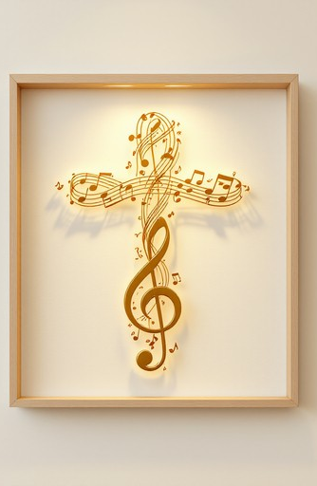
Psalm 105: 1 – 11
NRSVUE

Slide 19
¹ O give thanks to the Lord; call on his name; make known his deeds among the peoples.
² Sing to him, sing praises to him; tell of all his wonderful works.
³ Glory in his holy name; let the hearts of those who seek the Lord rejoice.

Slide 20
⁴ Seek the Lord and his strength; seek his presence continually.
⁵ Remember the wonderful works he has done, his miracles and the judgments he has uttered,
⁶ O offspring of his servant Abraham, children of Jacob, his chosen ones.

Slide 21
⁷ He is the Lord our God; his judgments are in all the earth.
⁸ He is mindful of his covenant forever, of the word that he commanded for a thousand generations,
⁹ the covenant that he made with Abraham, his sworn promise to Isaac,

Slide 22
¹⁰ which he confirmed to Jacob as a statute, to Israel as an everlasting covenant,
¹¹ saying, “To you I will give the land of Canaan as your portion for an inheritance.”

Slide 23
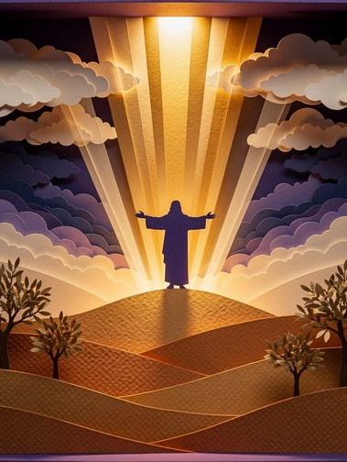
Romans 8: 26 – 39
NRSVUE

Slide 24
²⁶ Likewise the Spirit helps us in our weakness, for we do not know how to pray as we ought, but that very Spirit intercedes with groanings too deep for words.
²⁷ And God, who searches hearts, knows what is the mind of the Spirit, because the Spirit intercedes for the saints according to the will of God.

Slide 25
²⁸ We know that all things work together for good for those who love God, who are called according to his purpose.
²⁹ For those whom he foreknew he also predestined to be conformed to the image of his Son, in order that he might be the firstborn within a large family.

Slide 26
³⁰ And those whom he predestined he also called, and those whom he called he also justified, and those whom he justified he also glorified.
³¹ What then are we to say about these things? If God is for us, who is against us?

Slide 27
³² He who did not withhold his own Son but gave him up for all of us, how will he not with him also give us everything else?
³³ Who will bring any charge against God’s elect? It is God who justifies.

Slide 28
³⁴ Who is to condemn? It is Christ who died, or rather, who was raised, who is also at the right hand of God, who also intercedes for us.
³⁵ Who will separate us from the love of Christ? Will affliction or distress or persecution or famine or nakedness or peril or sword?

Slide 29
³⁶ As it is written, “For your sake we are being killed all day long; we are accounted as sheep to be slaughtered.”
³⁷ No, in all these things we are more than victorious through him who loved us.

Slide 30
³⁸ For I am convinced that neither death, nor life, nor angels, nor rulers, nor things present, nor things to come, nor powers,
³⁹ nor height, nor depth, nor anything else in all creation will be able to separate us from the love of God in Christ Jesus our Lord.

Slide 31
The Word of God for the people of God
Thanks be to God

Slide 32

Sermon
“When Words Fail, the Covenant Speaks ”

Slide 33

O Love That Wilt Not Let Me Go
480
WORDS: George Matheson, 1882
O Love that wilt not let me go, I rest my weary soul in thee; I give thee back the life I owe, that in thine ocean depths its flow
may richer, fuller be.

Slide 34
O Love That Wilt Not Let Me Go
480
WORDS: George Matheson, 1882
2. O Light that followest all my way, I yield my flickering torch to thee; my heart restores
its borrowed ray, that in thy sunshine’s blaze its day may brighter, fairer be.

Slide 35
O Love That Wilt Not Let Me Go
480
WORDS: George Matheson, 1882
3. O Joy that sleekest me through pain, I cannot close my heart to thee; I trace the rainbow through the rain, and feel the promise is not vain, that morn shall tearless be.

Slide 36
O Love That Wilt Not Let Me Go
480
WORDS: George Matheson, 1882
4. O Cross that liftest up my head, I dare not ask to fly from thee; I lay in dust life’s glory dead, and from the ground there blossoms red life that shall endless be.

Slide 41
Tithes and Offerings
Worship through giving
Notes:
https://www.goodfon.com/flowers/wallpaper-blue-wood-blossom-spring-flowers-vesna-iablonia-tsvety.html

Slide 42

“Praise God, from Whom All Blessings Flow” UMH 94
WORDS: Thomas Ken, 1674; adapted by Gilbert H. Viera, 1978
MUSIC: Geistliche Kirchengesange, 1623; harmonized by Ralph Vaughn Williams, 1906
Please stand as you are able and comfortable.
Praise God from whom all blessings flow;
Praise God, all creatures here below:
Alleluia! Alleluia!
Praise God, the source of all our gifts!
Praise Jesus Christ, whose power uplifts!
Praise the Spirit, Holy Spirit!
Alleluia! Alleluia! Alleluia!

Slide 43
Offertory Prayer

Slide 44

Since Jesus Came Into My Heart
TFWS 2140
WORDS: R. H. McDaniel
1. What a wonderful change in my has been wrought since Jesus came into my heart! I have light in my soul for which long I had sought, since Jesus came into my heart!

Slide 45
Since Jesus Came Into My Heart
TFWS 2140
WORDS: R. H. McDaniel
REFRAIN
Since Jesus came into my heart, since Jesus came into my heart, floods of joy o’er my soul like the sea billows roll, since Jesus came into my heart.

Slide 46
Since Jesus Came Into My Heart
TFWS 2140
WORDS: R. H. McDaniel
2. I have ceased from my wan-d'ring and going astray, since Jesus came into my heart! And my sins, which were many, are all washed away, since Jesus came into my heart!

Slide 47
Since Jesus Came Into My Heart
TFWS 2140
WORDS: R. H. McDaniel
REFRAIN
Since Jesus came into my heart, since Jesus came into my heart, floods of joy o’er my soul like the sea billows roll, since Jesus came into my heart.

Slide 48
Since Jesus Came Into My Heart
TFWS 2140
WORDS: R. H. McDaniel
3. I'm possessed of a hope that is steadfast and sure,
since Jesus came into my heart! And no dark clouds of doubt now my pathway obscure, since Jesus came into my heart!

Slide 49
Since Jesus Came Into My Heart
TFWS 2140
WORDS: R. H. McDaniel
REFRAIN
Since Jesus came into my heart, since Jesus came into my heart, floods of joy o’er my soul like the sea billows roll, since Jesus came into my heart.

Slide 50
Since Jesus Came Into My Heart
TFWS 2140
WORDS: R. H. McDaniel
4. There's a light in the valley of death now for me,
since Jesus came into my heart! And the gates of the City beyond I can see, since Jesus came into my heart!

Slide 51
Since Jesus Came Into My Heart
TFWS 2140
WORDS: R. H. McDaniel
REFRAIN
Since Jesus came into my heart, since Jesus came into my heart, floods of joy o’er my soul like the sea billows roll, since Jesus came into my heart.

Slide 52
Since Jesus Came Into My Heart
TFWS 2140
WORDS: R. H. McDaniel
5. I shall go there to dwell in that City, I know,
since Jesus came into my heart! And I'm happy, so happy, as onward I go,
since Jesus came into my heart!

Slide 53
Since Jesus Came Into My Heart
TFWS 2140
WORDS: R. H. McDaniel
REFRAIN
Since Jesus came into my heart, since Jesus came into my heart, floods of joy o’er my soul like the sea billows roll, since Jesus came into my heart.

Slide 60
BLESSING AND BENEDICTION
This service has ended, and now
your service in the world begins!

Slide 61
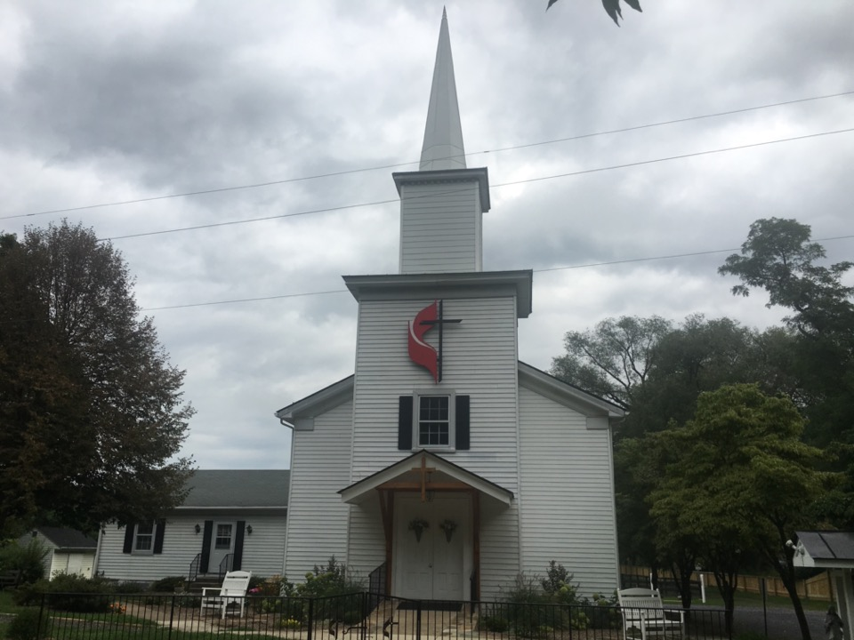
Rectortown United Methodist Church
serving God with
Prayer, Action, and Love
through Service.

