Slide 2
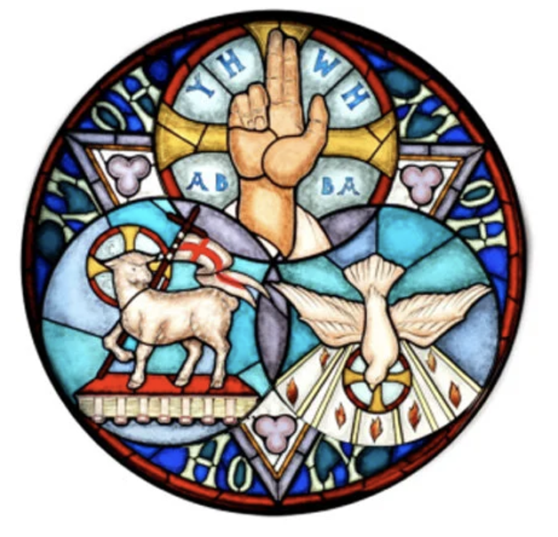
Prelude
Pastor Eduardo Carrillo
Pentecost
May 31st, 2026
CCLI License:
3430384-01-1829
Livestream Notice: Our worship service is live-streamed and recorded. By attending, you consent to being included in the broadcast. Thank you for joining us!

Slide 3
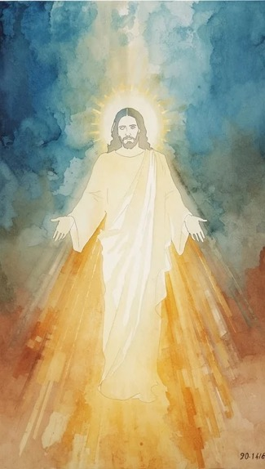
WELCOME,
ANNOUNCEMENTS,
and
CELEBRATIONS
Livestream Notice: Our worship service is live-streamed and recorded. By attending, you consent to being included in the broadcast. Thank you for joining us!

Slide 4
On this Trinity Sunday, we come to praise the Triune God—Father, Son, and Holy Spirit!
We praise God who creates, redeems, and sustains all creation!

Slide 5
We come to wade into the depths of the divine mystery of God, the One-in-Three and Three-in-One.
We seek an ever-deepening faith in God who creates, redeems, and sustains all creation!

Slide 6
We come to witness the interconnectedness of the Triune God, to marvel at the divine dance of partnership and
cooperation

Slide 7
We receive the invitation to join the divine dance of God who creates, redeems, and sustains all creation! Come, let us worship the Triune God who creates, redeems, and sustains all creation!

Slide 8
Out of our ordinary, everyday lives, you have gathered us here, Holy God, to this time of worship, to this time of praise.

Slide 9
We join with angels and archangels and all the company of the saints to bless you, to listen for your Word, to immerse
ourselves in your grace, in your love. Open our hearts and our minds to your presence with us.

Slide 10
Take our longings for your goodness to shape our lives, this community, the hurting world, speak your Word and infuse us with your courage and
your hope and your love.

Slide 11
Then, awaken us to your Holy Spirit who is making all things new, even us. Amen.

Slide 12
“Holy, Holy, Holy, Lord God Almighty” UMH 64
WORDS: Reginald Heber, 1826 MUSIC: John B. Dykes, 1861
Please stand as you are able and comfortable.
Holy, holy, holy!
Lord God Almighty!
Early in the morning
our song shall rise to thee.
Holy, holy, holy!
Merciful and mighty,
God in three persons,
blessed Trinity!

Slide 13
“Holy, Holy, Holy, Lord God Almighty” UMH 64
WORDS: Reginald Heber, 1826 MUSIC: John B. Dykes, 1861
Please stand as you are able and comfortable.
Holy, holy, holy!
All the saints adore thee,
casting down their golden crowns
around the glassy sea;
cherubim and seraphim
falling down before thee,
which wert, and art, and
evermore shalt be.

Slide 14
“Holy, Holy, Holy, Lord God Almighty” UMH 64
WORDS: Reginald Heber, 1826 MUSIC: John B. Dykes, 1861
Please stand as you are able and comfortable.
Holy, holy, holy!
Though the darkness hide thee,
though the eye of sinful man
thy glory may not see,
only thou art holy;
there is none beside thee,
perfect in power, in
love and purity.

Slide 15
“Holy, Holy, Holy, Lord God Almighty” UMH 64
WORDS: Reginald Heber, 1826 MUSIC: John B. Dykes, 1861
Please stand as you are able and comfortable.
Holy, holy, holy!
Lord God Almighty!
All thy works shall praise thy name,
in earth and sky and sea.
Holy, holy, holy!
Merciful and mighty,
God in three persons,
blessed Trinity.

Slide 17
Prayer For Illumination
Spirit of the living God, fall afresh on me.
Spirit of the living God, fall afresh on me.
Melt me, mold me, fill me, use me.
Spirit of the living God, fall afresh on me.
UMH 393

Slide 18
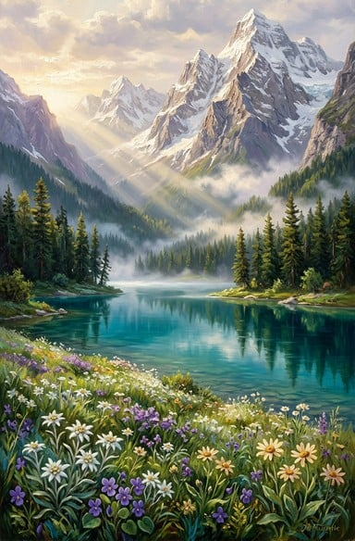
Psalm 8
NRSVUE

Slide 19
¹ O Lord, our Sovereign, how majestic is your name in all the earth! You have set your glory above the heavens.
² Out of the mouths of babes and infants you have founded a bulwark because of your foes, to silence the enemy and the avenger.

Slide 20
³ When I look at your heavens, the work of your fingers, the moon and the stars that you have established;
⁴ what are humans that you are mindful of them, mortals that you care for them?

Slide 21
⁵ Yet you have made them a little lower than God and crowned them with glory and honor.
⁶ You have given them dominion over the works of your hands; you have put all things under their feet,

Slide 22
⁷ all sheep and oxen, and also the beasts of the field,
⁸ the birds of the air, and the fish of the sea, whatever passes along the paths of the seas.
⁹ O Lord, our Sovereign, how majestic is your name in all the earth!

Slide 23
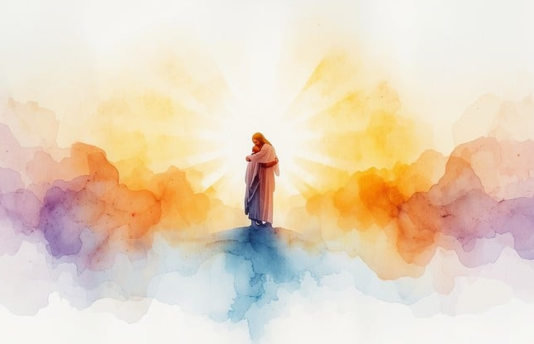
Matthew 28: 16 – 20
NRSVUE

Slide 24
¹⁶ Now the eleven disciples went to Galilee, to the mountain to which Jesus had directed them.
¹⁷ When they saw him, they worshiped him, but they doubted.

Slide 25
¹⁸ And Jesus came and said to them, “All authority in heaven and on earth has been given to me.
¹⁹ Go therefore and make disciples of all nations, baptizing them in the name of the Father and of the Son and of the Holy Spirit

Slide 26
²⁰ and teaching them to obey everything that I have commanded you. And remember, I am with you always, to the end of the age.”

Slide 27
The Word of God for the people of God
Thanks be to God

Slide 28
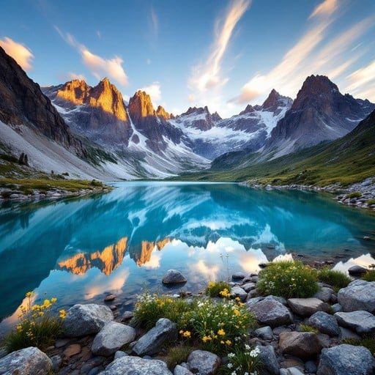
Sermon
“Majestic Charge”

Slide 29
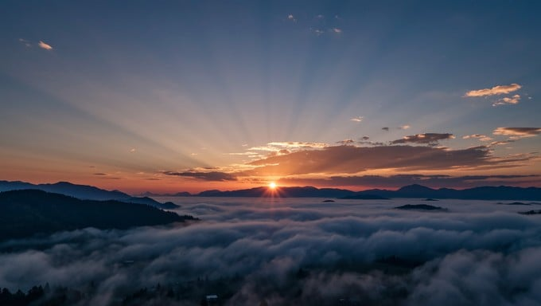
Morning Has Broken
145
WORDS: Eleanor Farjeon, 1931 (Lam. 3:22-23)
Morning has broken like the first morning;
blackbird has spoken like the first bird.
Praise for the singing! Praise for the morning!
Praise for them, springing fresh from the Word!
Words by permission of David Higham Associates, Ltd.

Slide 30
Morning Has Broken
145
WORDS: Eleanor Farjeon, 1931 (Lam. 3:22-23)
2. Sweet the rain’s new fall sunlit from heaven,
like the first dewfall on the first grass. Praise for the sweetness of the wet garden, sprung in completeness
where his feet pass.
Words by permission of David Higham Associates, Ltd.

Slide 31
Morning Has Broken
145
WORDS: Eleanor Farjeon, 1931 (Lam. 3:22-23)
3. Mine is the sunlight! Mine is the morning
born of the one light Eden saw play! Praise with elation, praise every morning, God’s re-creation
of the new day!
Words by permission of David Higham Associates, Ltd.

Slide 41
Tithes and Offerings
Worship through giving
Notes:
https://www.goodfon.com/flowers/wallpaper-blue-wood-blossom-spring-flowers-vesna-iablonia-tsvety.html

Slide 42
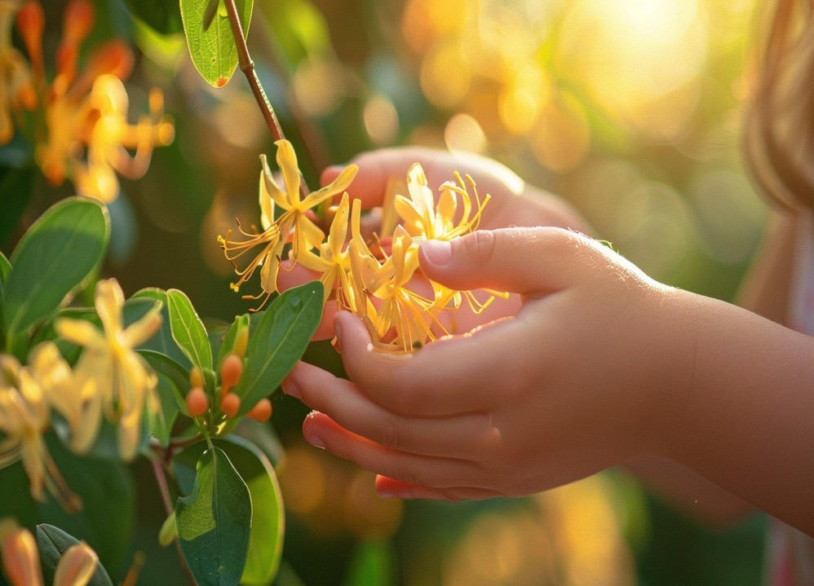
“Praise God, from Whom All Blessings Flow” UMH 94
WORDS: Thomas Ken, 1674; adapted by Gilbert H. Viera, 1978
MUSIC: Geistliche Kirchengesange, 1623; harmonized by Ralph Vaughn Williams, 1906
Please stand as you are able and comfortable.
Praise God from whom all blessings flow;
Praise God, all creatures here below:
Alleluia! Alleluia!
Praise God, the source of all our gifts!
Praise Jesus Christ, whose power uplifts!
Praise the Spirit, Holy Spirit!
Alleluia! Alleluia! Alleluia!

Slide 43
Offertory Prayer

Slide 44
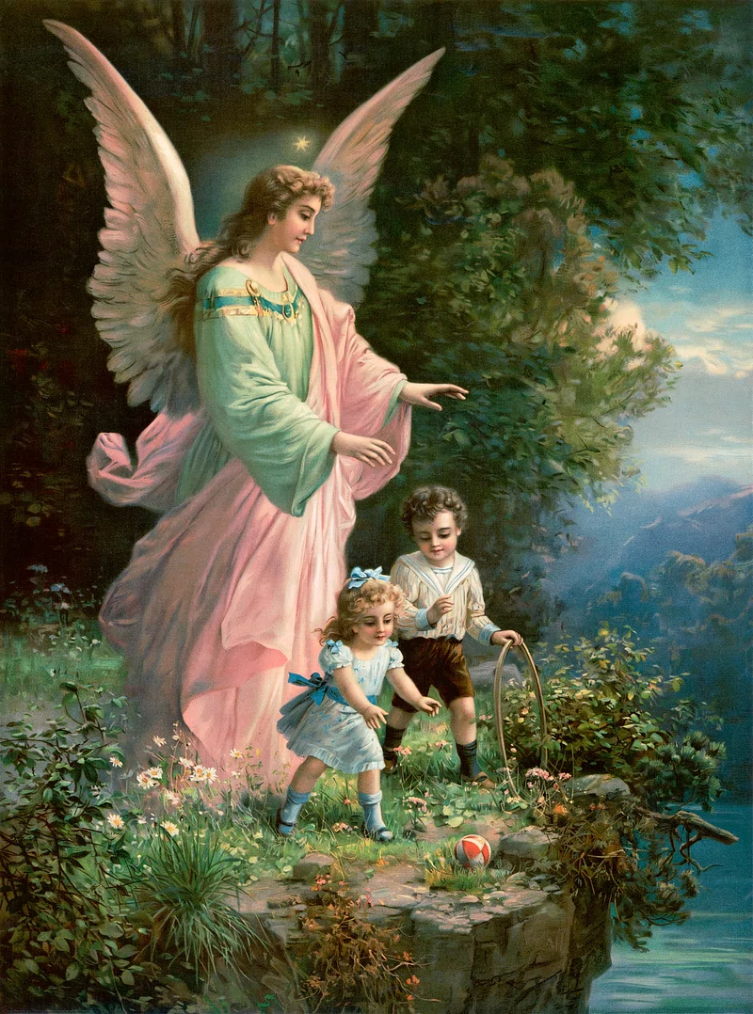
“God Be With You till We Meet Again” UMH 672
WORDS: Jeremiah E. Rankin, 1880 MUSIC: William G. Tomer, 1880
Please stand as you are able and comfortable.
God be with you till we meet again;
by his counsels guide, uphold you,
with his sheep securely fold you;
God be with you till we meet again.

Slide 45
“God Be With You till We Meet Again” UMH 672
WORDS: Jeremiah E. Rankin, 1880 MUSIC: William G. Tomer, 1880
Please stand as you are able and comfortable.
Till we meet,
till we meet,
till we meet at Jesus feet;
till we meet,
till we meet,
God be with you till we meet again.

Slide 46
“God Be With You till We Meet Again” UMH 672
WORDS: Jeremiah E. Rankin, 1880 MUSIC: William G. Tomer, 1880
Please stand as you are able and comfortable.
God be with you till we meet again;
neath his wings securely hide you,
daily manna still provide you;
God be with you till we meet again.

Slide 47
“God Be With You till We Meet Again” UMH 672
WORDS: Jeremiah E. Rankin, 1880 MUSIC: William G. Tomer, 1880
Please stand as you are able and comfortable.
Till we meet,
till we meet,
till we meet at Jesus feet;
till we meet,
till we meet,
God be with you till we meet again.

Slide 48
“God Be With You till We Meet Again” UMH 672
WORDS: Jeremiah E. Rankin, 1880 MUSIC: William G. Tomer, 1880
Please stand as you are able and comfortable.
God be with you till we meet again;
when life’s perils thick confound you,
put his arms unfailing round you;
God be with you till we meet again.

Slide 49
“God Be With You till We Meet Again” UMH 672
WORDS: Jeremiah E. Rankin, 1880 MUSIC: William G. Tomer, 1880
Please stand as you are able and comfortable.
Till we meet,
till we meet,
till we meet at Jesus feet;
till we meet,
till we meet,
God be with you till we meet again.

Slide 50
“God Be With You till We Meet Again” UMH 672
WORDS: Jeremiah E. Rankin, 1880 MUSIC: William G. Tomer, 1880
Please stand as you are able and comfortable.
God be with you till we meet again;
keep love’s banner floating o’er you,
smite death’s threatening wave before you;
God be with you till we meet again.

Slide 51
“God Be With You till We Meet Again” UMH 672
WORDS: Jeremiah E. Rankin, 1880 MUSIC: William G. Tomer, 1880
Please stand as you are able and comfortable.
Till we meet,
till we meet,
till we meet at Jesus feet;
till we meet,
till we meet,
God be with you till we meet again.

Slide 53
BLESSING AND BENEDICTION
This service has ended, and now
your service in the world begins!

Slide 54
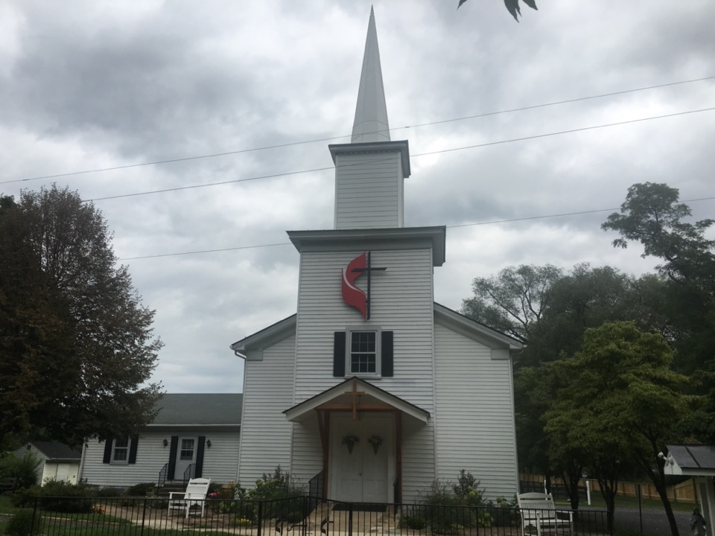
Rectortown United Methodist Church
serving God with
Prayer, Action, and Love
through Service.

