Slide 2
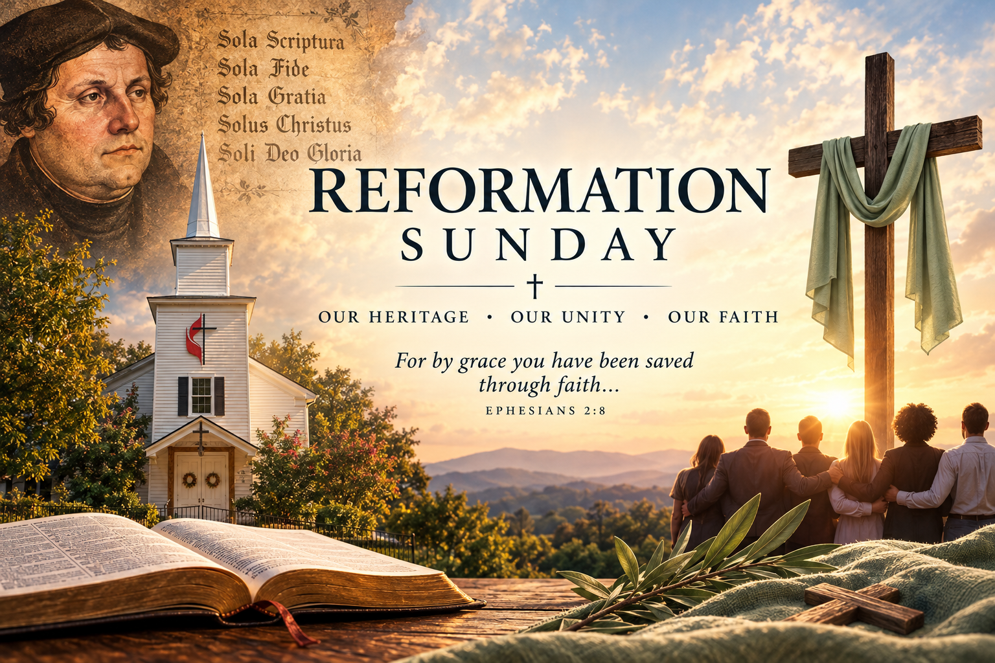
Prelude
Pastor Eduardo Carrillo
Reformation Sunday
October 25th, 2026
CCLI License:
3430384-01-1829
Livestream Notice: Our worship service is live-streamed and recorded. By attending, you consent to being included in the broadcast. Thank you for joining us!

Slide 3
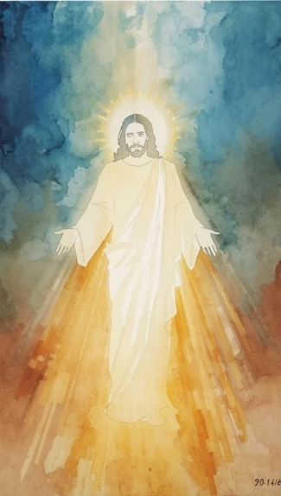
WELCOME,
ANNOUNCEMENTS,
and
CELEBRATIONS
Livestream Notice: Our worship service is live-streamed and recorded. By attending, you consent to being included in the broadcast. Thank you for joining us!

Slide 4
Moses saw the Promised Land from afar, yet died before stepping onto its soil.
Our earthly dreams may fail, but God’s covenant endures forever.

Slide 5
What is the greatest commandment in the Law?
To love the Lord our God with all our heart, soul, and mind.

Slide 6
What is the second?
To love our neighbor as ourselves.

Slide 7
Though leaders fall and seasons end, the Son of David reigns eternally.
Let us worship God!

Slide 8
Eternal God, You bring our earthly labors to a close and remind us that we are pilgrims passing through.

Slide 9
Forgive us for measuring Your faithfulness by whether we reach our personal Promised Lands. When our earthly hopes fall short, ground us in the ultimate command:

Slide 10
to love You wholeheartedly and our neighbors selflessly. Fix our eyes on David’s Lord, Jesus Christ, who completed the work we could never finish.

Slide 11
Teach us to rest in Your enduring promise, knowing that death itself is not the end of Your grace. Amen.

Slide 12

“Love Divine, All Love Excelling” UMH 384
WORDS: Charles Wesley, 1747 MUSIC: John Zundel, 1870
Please stand as you are able and comfortable.
Love divine, all loves excelling,
joy of heaven, to earth come down;
fix in us they humble dwelling;
all thy faithful mercies crown!
Jesus, thou art all compassion,
pure, unbounded love thou art;
visit us with thy salvation;
enter every trembling heart.

Slide 13
“Love Divine, All Love Excelling” UMH 384
WORDS: Charles Wesley, 1747 MUSIC: John Zundel, 1870
Please stand as you are able and comfortable.
Breathe, O breathe thy loving Spirit
into every troubled breast!
Let us all in thee inherit;
let us find that second rest.
Take a way our bent to sinning;
Alpha and Omega be;
end of faith, as its beginning,
set our hearts at liberty.

Slide 14
“Love Divine, All Love Excelling” UMH 384
WORDS: Charles Wesley, 1747 MUSIC: John Zundel, 1870
Please stand as you are able and comfortable.
Come, Almighty to deliver,
let us all thy life receive;
suddenly return and never,
never more thy temples leave.
Thee we would be always blessing,
serve thee as thy hosts above,
pray and praise thee without ceasing,
glory in thy perfect love.

Slide 15
“Love Divine, All Love Excelling” UMH 384
WORDS: Charles Wesley, 1747 MUSIC: John Zundel, 1870
Please stand as you are able and comfortable.
Finish, then, thy new creation;
pure and spotless let us be.
Let us see thy great salvation
perfectly restored in thee;
changed from glory into glory,
till in heaven we take our place,
till we cast our crown before thee,
lost in wonder, love, and praise.

Slide 17
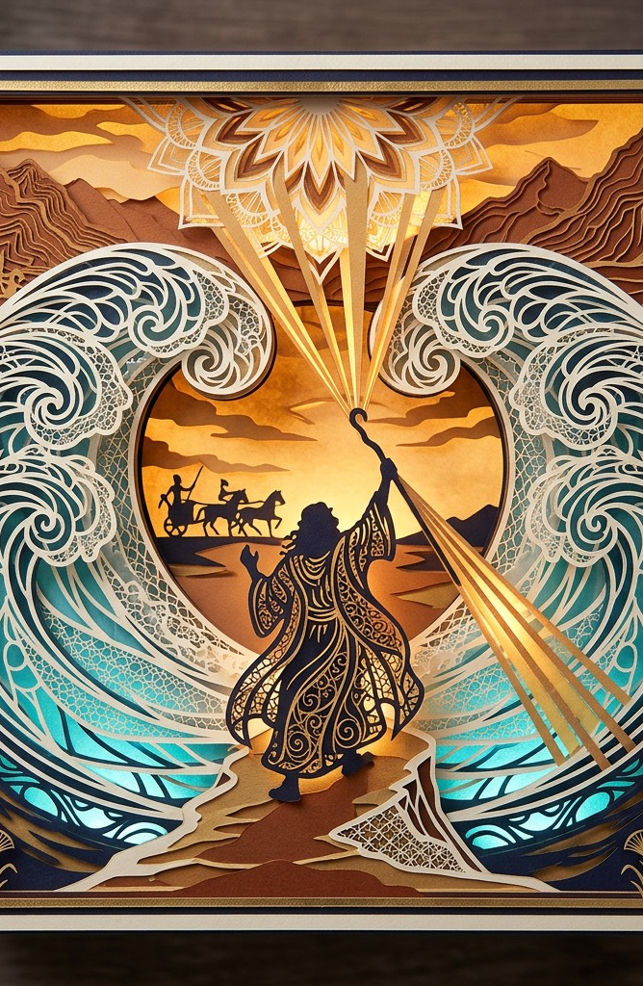
Deuteronomy 34: 1 – 12
NRSVUE

Slide 18
Then Moses went up from the plains of Moab to Mount Nebo, to the top of Pisgah, which is opposite Jericho, and the Lord showed him the whole land: Gilead as far as Dan,
² all Naphtali, the land of Ephraim and Manasseh, all the land of Judah as far as the Western Sea,

Slide 19
³ the Negeb, and the Plain—that is, the valley of Jericho, the city of palm trees—as far as Zoar.
⁴ The Lord said to him, “This is the land of which I swore to Abraham, to Isaac, and to Jacob, saying, ‘I will give it to your descendants.’ I have let you see it with your eyes, but you shall not cross over there.”

Slide 20
⁵ Then Moses, the servant of the Lord, died there in the land of Moab, at the Lord’s command.
⁶ He buried him in a valley in the land of Moab, opposite Beth-peor, but no one knows his burial place to this day.

Slide 21
⁷ Moses was one hundred twenty years old when he died; his sight was unimpaired, and his vigor had not abated.
⁸ The Israelites wept for Moses in the plains of Moab thirty days; then the period of mourning for Moses was ended.

Slide 22
⁹ Joshua son of Nun was full of the spirit of wisdom because Moses had laid his hands on him, and the Israelites obeyed him, doing as the Lord had commanded Moses.
¹⁰ Never since has there arisen a prophet in Israel like Moses, whom the Lord knew face to face.

Slide 23
¹¹ He was unequaled for all the signs and wonders that the Lord sent him to perform in the land of Egypt, against Pharaoh and all his servants and his entire land,
¹² and for all the mighty deeds and all the terrifying displays of power that Moses performed in the sight of all Israel.

Slide 24

Matthew 22:
34 – 46
NRSVUE

Slide 25
³⁴ When the Pharisees heard that he had silenced the Sadducees, they gathered together,
³⁵ and one of them, an expert in the law, asked him a question to test him.
³⁶ “Teacher, which commandment in the law is the greatest?”

Slide 26
³⁷ He said to him, “ ‘You shall love the Lord your God with all your heart and with all your soul and with all your mind.’
³⁸ This is the greatest and first commandment.
³⁹ And a second is like it: ‘You shall love your neighbor as yourself.’

Slide 27
⁴⁰ On these two commandments hang all the Law and the Prophets.”
⁴¹ Now while the Pharisees were gathered together, Jesus asked them this question:
⁴² “What do you think of the Messiah? Whose son is he?” They said to him, “The son of David.”

Slide 28
⁴³ He said to them, “How is it then that David by the Spirit calls him Lord, saying,
⁴⁴ ‘The Lord said to my Lord, “Sit at my right hand, until I put your enemies under your feet” ’?

Slide 29
⁴⁵ “If David thus calls him Lord, how can he be his son?”
⁴⁶ No one was able to give him an answer, nor from that day did anyone dare to ask him any more questions.

Slide 30
The Word of God for the people of God
Thanks be to God

Slide 31
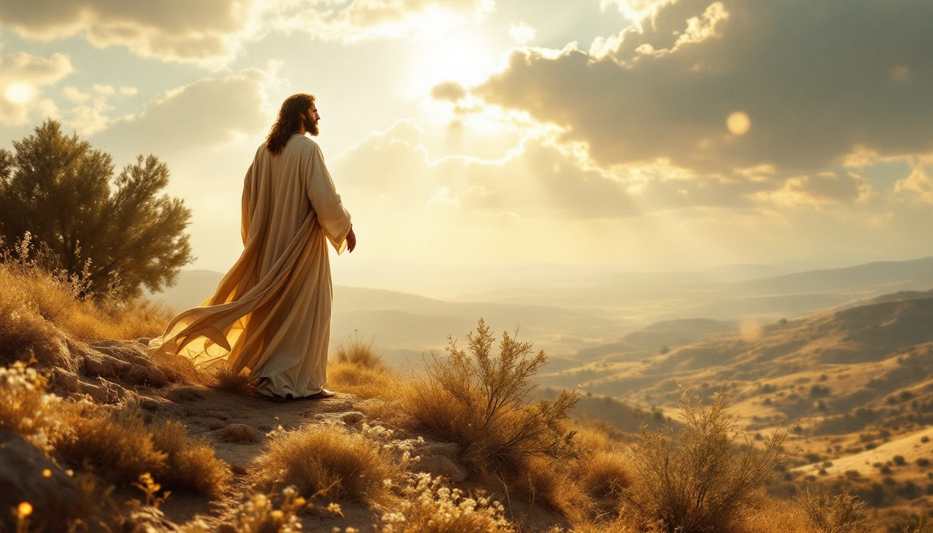
Sermon
Looking at Canaan, Loving the Lord

Slide 32

“O God, Our Help in Ages Past” UMH #117
WORDS: R. Deane Postlethwaite MUSIC: Jesse Seymour Irvine
Please stand as you are able and comfortable.
O God, our help in ages past,
our hope for years to come,
our shelter from the stormy blast,
and our eternal home!

Slide 33
“O God, Our Help in Ages Past” UMH #117
WORDS: R. Deane Postlethwaite MUSIC: Jesse Seymour Irvine
Please stand as you are able and comfortable.
Under the shadow of thy throne,
still may we dwell secure;
sufficient is thine arm alone,
and our defense is sure.

Slide 34
“O God, Our Help in Ages Past” UMH #117
WORDS: R. Deane Postlethwaite MUSIC: Jesse Seymour Irvine
Please stand as you are able and comfortable.
Before the hills in order stood,
or earth received her frame,
from everlasting, thou art God,
to endless years the same.

Slide 35
“O God, Our Help in Ages Past” UMH #117
WORDS: R. Deane Postlethwaite MUSIC: Jesse Seymour Irvine
Please stand as you are able and comfortable.
A thousand ages in thy sight,
are like an evening gone;
short as the watch that ends the night, before the rising sun.

Slide 36
“O God, Our Help in Ages Past” UMH #117
WORDS: R. Deane Postlethwaite MUSIC: Jesse Seymour Irvine
Please stand as you are able and comfortable.
Time, like an ever rolling stream,
bears all who breathe away;
they fly forgotten, as a dream
dies at the opening day.

Slide 37
“O God, Our Help in Ages Past” UMH #117
WORDS: R. Deane Postlethwaite MUSIC: Jesse Seymour Irvine
Please stand as you are able and comfortable.
O God, our help in ages past,
our hope for years to come;
be thou our guide while life shall last,
and our eternal home.

Slide 43
Tithes and Offerings
Worship through giving
Notes:
https://www.goodfon.com/flowers/wallpaper-blue-wood-blossom-spring-flowers-vesna-iablonia-tsvety.html

Slide 44

“Praise God, from Whom All Blessings Flow” UMH 94
WORDS: Thomas Ken, 1674; adapted by Gilbert H. Viera, 1978
MUSIC: Geistliche Kirchengesange, 1623; harmonized by Ralph Vaughn Williams, 1906
Please stand as you are able and comfortable.
Praise God from whom all blessings flow;
Praise God, all creatures here below:
Alleluia! Alleluia!
Praise God, the source of all our gifts!
Praise Jesus Christ, whose power uplifts!
Praise the Spirit, Holy Spirit!
Alleluia! Alleluia! Alleluia!

Slide 45
Offertory Prayer

Slide 52
Postlude
This service has ended, and now
your service in the world begins!

Slide 53
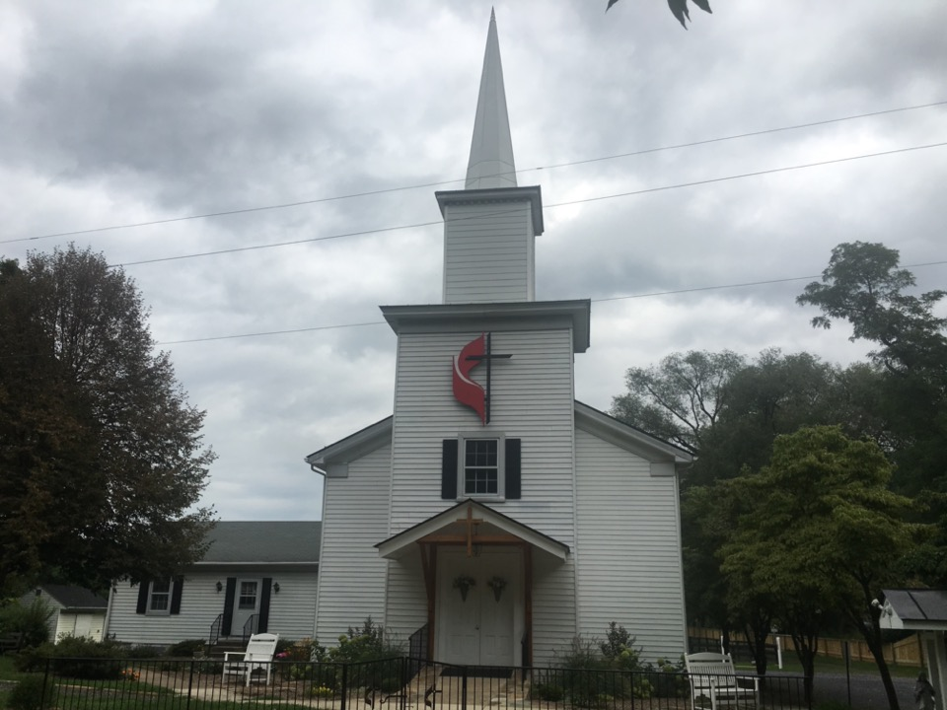
Rectortown United Methodist Church
serving God with
Prayer, Action, and Love
through Service.

