Slide 2
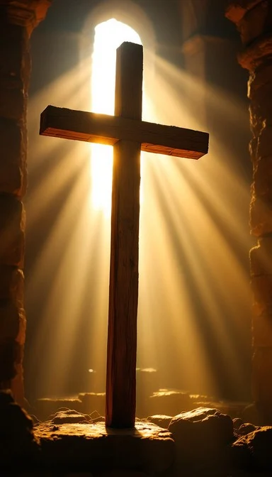
Prelude
Pastor Eduardo Carrillo
2nd Sunday after Easter
April 12th, 2026
CCLI License:
3430384-01-1829
Livestream Notice: Our worship service is live-streamed and recorded. By attending, you consent to being included in the broadcast. Thank you for joining us!

Slide 3
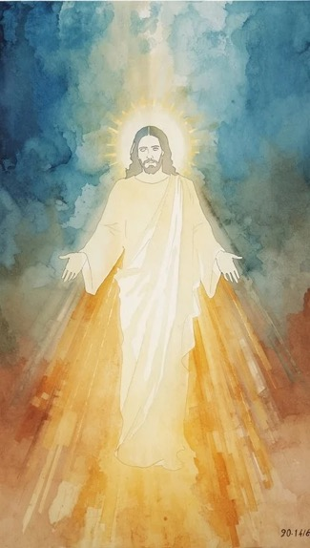
WELCOME,
ANNOUNCEMENTS,
and
CELEBRATIONS
Livestream Notice: Our worship service is live-streamed and recorded. By attending, you consent to being included in the broadcast. Thank you for joining us!

Slide 4
We gather today as people who have wrestled with questions and walked through darkness.
We come boldly, for God meets us even in our doubt!

Slide 5
Like Thomas, we have longed for proof. Like David, we have cried out in uncertainty.
Yet God did not abandon us to the grave, He rose, and He is here!

Slide 6
Christ stands among us today and says, "Peace be with you!"
We declare with Thomas: "My Lord and my God!”
All: Let us believe and worship the living God.

Slide 7
Risen Lord, we come before You as we are, with faith and with doubt, with questions and with hope. You did not turn Thomas away, and You do not turn us away.

Slide 8
Meet us here in this place. Breathe Your peace over our uncertainty. Open our eyes to see You clearly, and open our hearts to believe boldly.

Slide 9
Transform every doubt into deeper faith and every fear into confident trust. We worship You, our Lord, our God, our risen King. Amen.

Slide 10
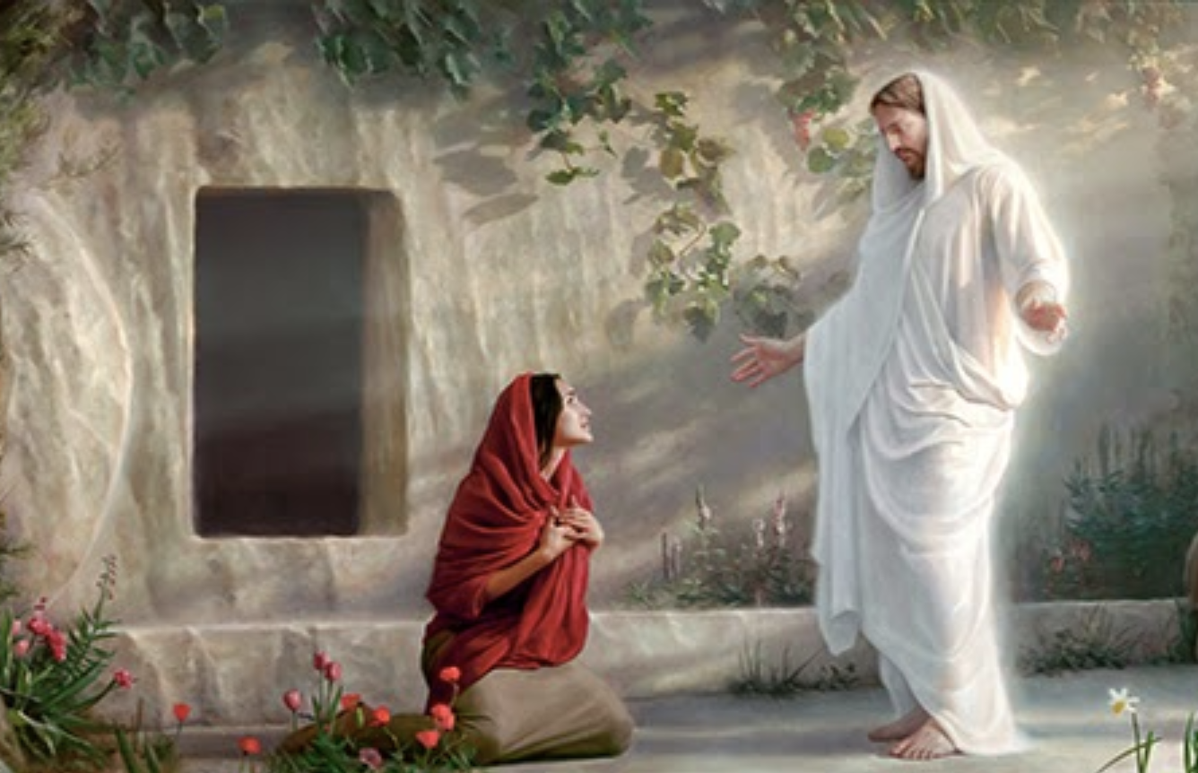
“The Day of Resurrection” UMH 303
WORDS: John of Damascus; translated by John Mason Neale, 1862
MUSIC: Henry T. Smart, 1835
Please stand as you are able and comfortable.
The day of resurrection!
Earth, tell it out abroad;
the passover gladness,
the passover of God.
From death to life eternal,
from earth unto the sky,
our Christ hath brought us over,
with hymns of victory.

Slide 11
“The Day of Resurrection” UMH 303
WORDS: John of Damascus; translated by John Mason Neale, 1862
MUSIC: Henry T. Smart, 1835
Please stand as you are able and comfortable.
Our hearts be pure from evil,
that we may see aright
the Lord in rays eternal
of resurrection light;
and listening to his accents,
may hear, so calm and plain,
his own “All hail!” and, hearing,
may raise the victor strain.

Slide 12
“The Day of Resurrection” UMH 303
WORDS: John of Damascus; translated by John Mason Neale, 1862
MUSIC: Henry T. Smart, 1835
Please stand as you are able and comfortable.
Now let the heavens joyful!
Let earth the song begin!
Let the round world keep triumph,
and all that is therein!
Let all things seen and unseen
their notes in gladness blend,
for Christ the Lord hath risen,
our joy that hath no end.

Slide 14
Prayer For Illumination
Spirit of the living God, fall afresh on me.
Spirit of the living God, fall afresh on me.
Melt me, mold me, fill me, use me.
Spirit of the living God, fall afresh on me.
UMH 393

Slide 15
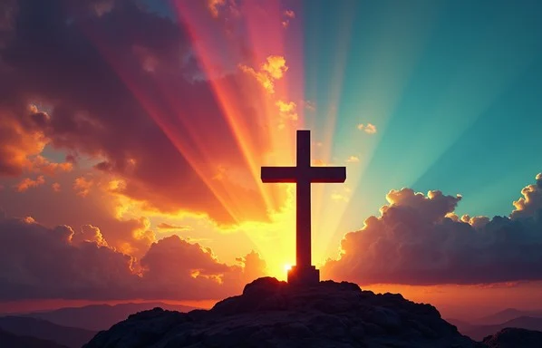
Psalm 16
NRSVUE

Slide 16
¹ Protect me, O God, for in you I take refuge.
² I say to the Lord, “You are my Lord; I have no good apart from you.”
³ As for the holy ones in the land, they are the noble ones in whom is all my delight.

Slide 17
⁴ Those who choose another god multiply their sorrows; their drink offerings of blood I will not pour out or take their names upon my lips.
⁵ The Lord is my chosen portion and my cup; you hold my lot.

Slide 18
⁶ The boundary lines have fallen for me in pleasant places; I have a goodly heritage.
⁷ I bless the Lord, who gives me counsel; in the night also my heart instructs me.
⁸ I keep the Lord always before me; because he is at my right hand, I shall not be moved.

Slide 19
⁹ Therefore my heart is glad, and my soul rejoices; my body also rests secure.
¹⁰ For you do not give me up to Sheol or let your faithful one see the Pit.
¹¹ You show me the path of life. In your presence there is fullness of joy; in your right hand are pleasures forevermore.

Slide 20
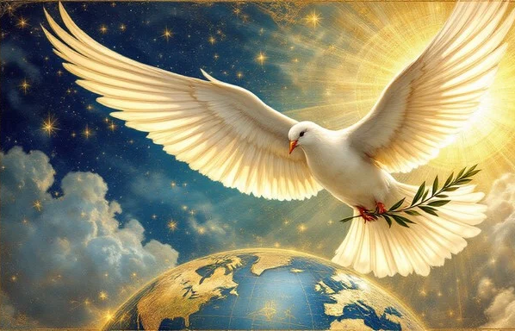
John 20: 19 – 31
NRSVUE

Slide 21
¹⁹When it was evening on that day, the first day of the week, and the doors were locked where the disciples were, for fear of the Jews, Jesus came and stood among them and said, “Peace be with you.”
John 20:19-31

Slide 22
²⁰ After he said this, he showed them his hands and side. The disciples rejoiced when they saw the Lord.
John 20:19-31

Slide 23
²¹ Jesus said to them again, “Peace be with you. As the Father has sent me, so I send you.”
²² When he had said this, he breathed on them and said to them, “Receive the Holy Spirit.
John 20:19-31

Slide 24
²³ If you forgive the sins of any, they are forgiven them; if you retain the sins of any, they are retained.”
John 20:19-31

Slide 25
²⁴ But Thomas (who was called the Twin), one of the twelve, was not with them when Jesus came.
John 20:19-31

Slide 26
²⁵ So the other disciples told him, “We have seen the Lord.” But he said to them, “Unless I see the mark of the nails in his hands and put my finger in the mark of the nails and my hand in his side, I will not believe.”
John 20:19-31

Slide 27
²⁶ A week later his disciples were again in the house, and Thomas was with them. Although the doors were shut, Jesus came and stood among them and said, “Peace be with you.”
John 20:19-31

Slide 28
²⁷ Then he said to Thomas, “Put your finger here and see my hands. Reach out your hand and put it in my side. Do not doubt but believe.”
John 20:19-31

Slide 29
²⁸ Thomas answered him, “My Lord and my God!”
John 20:19-31

Slide 30
²⁹ Jesus said to him, “Have you believed because you have seen me? Blessed are those who have not seen and yet have come to believe.”
John 20:19-31

Slide 31
³⁰ Now Jesus did many other signs in the presence of his disciples that are not written in this book.
John 20:19-31

Slide 32
³¹ But these are written so that you may continue to believe that Jesus is the Messiah, the Son of God, and that through believing you may have life in his name.
John 20:19-31

Slide 33
The Word of God for the people of God
Thanks be to God

Slide 34
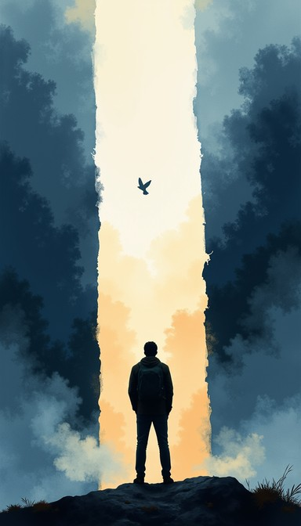
Sermon
“Meeting Your Doubt”

Slide 35
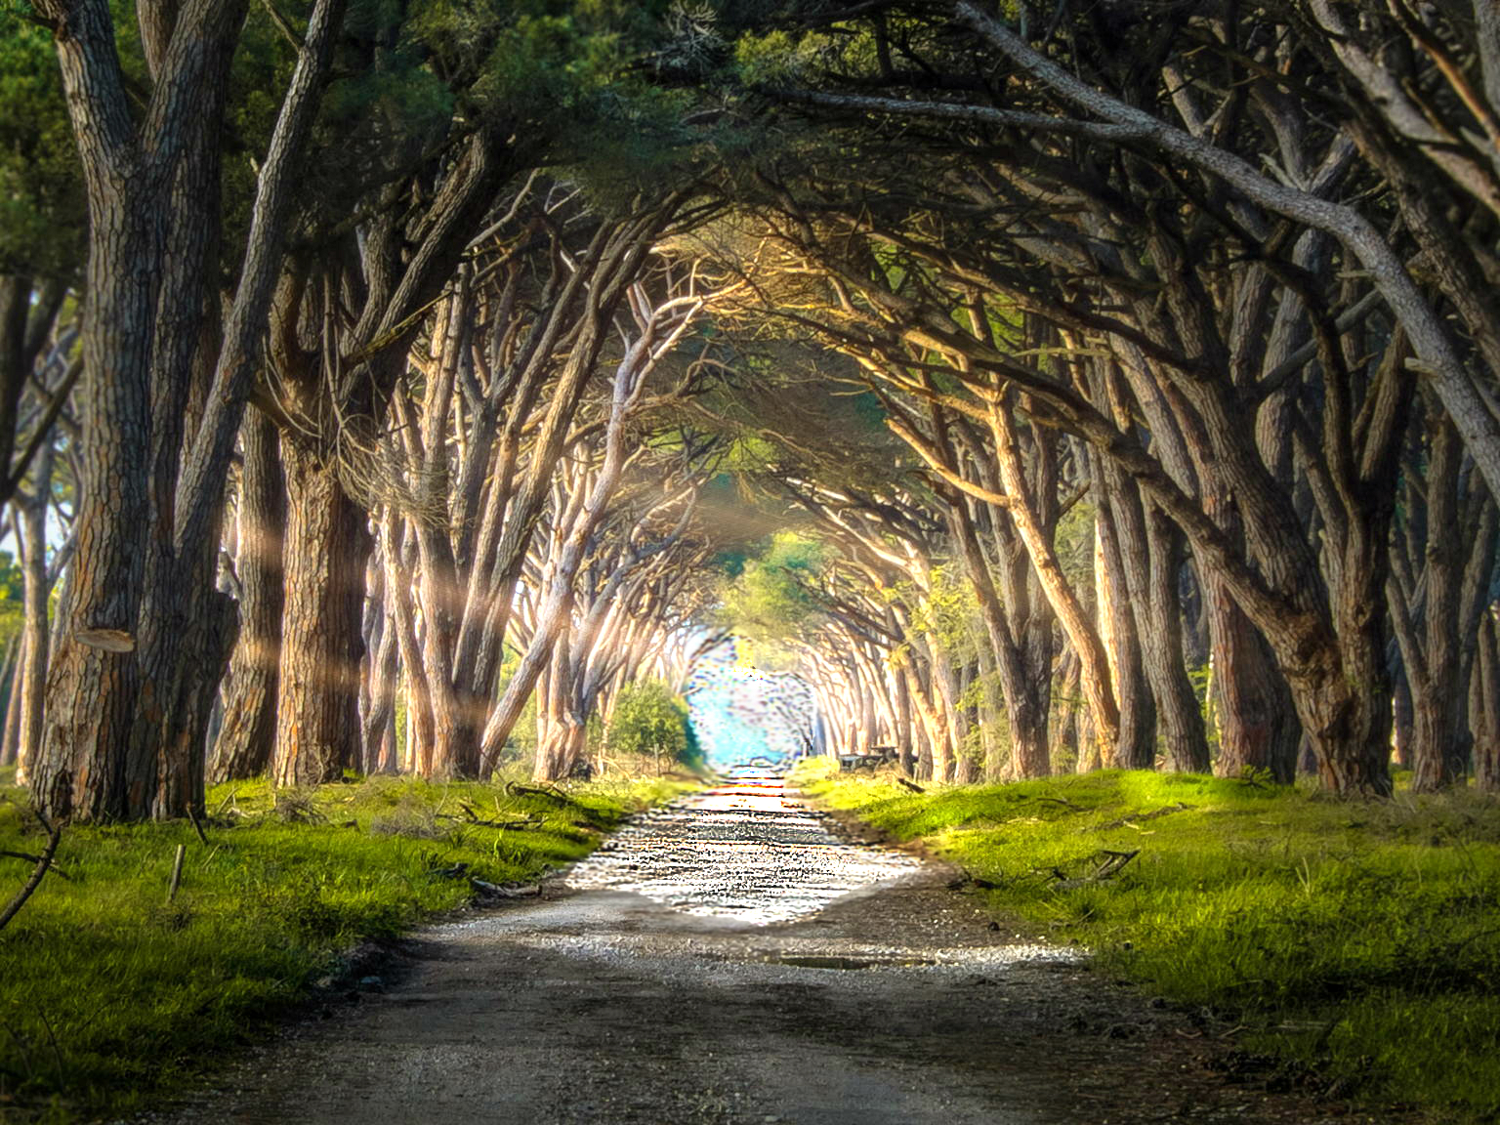
“We Walk by Faith” TFWS 2196 Words: Henry Alford; Music: Attr. to Hugh Wilson
We walk by faith, and not by sight, no gracious words we hear of him who spoke as none e’er spoke, but we believe him near.
We may not touch his hands and side, nor follow where he trod; yet in his promise we rejoice and cry, “My Lord and God!”

Slide 36
“We Walk by Faith” TFWS 2196 Words: Henry Alford; Music: Attr. to Hugh Wilson
Help then, O Lord, our unbelief; and may our faith abound to call on you when you are near, and seek where you are found.
That when our life of faith is done in realms of clearer light we may behold you as you are in full and endless sight.

Slide 37
“We Walk by Faith” TFWS 2196 Words: Henry Alford; Music: Attr. to Hugh Wilson
We walk by faith, and not by sight, no gracious words we hear of him who spoke as none e’er spoke, but we believe him near.

Slide 47
Tithes and Offerings
Worship through giving
Notes:
https://www.goodfon.com/flowers/wallpaper-blue-wood-blossom-spring-flowers-vesna-iablonia-tsvety.html

Slide 48

“Praise God, from Whom All Blessings Flow” UMH 94
WORDS: Thomas Ken, 1674; adapted by Gilbert H. Viera, 1978
MUSIC: Geistliche Kirchengesange, 1623; harmonized by Ralph Vaughn Williams, 1906
Please stand as you are able and comfortable.
Praise God from whom all blessings flow;
Praise God, all creatures here below:
Alleluia! Alleluia!
Praise God, the source of all our gifts!
Praise Jesus Christ, whose power uplifts!
Praise the Spirit, Holy Spirit!
Alleluia! Alleluia! Alleluia!

Slide 49
Offertory Prayer

Slide 50
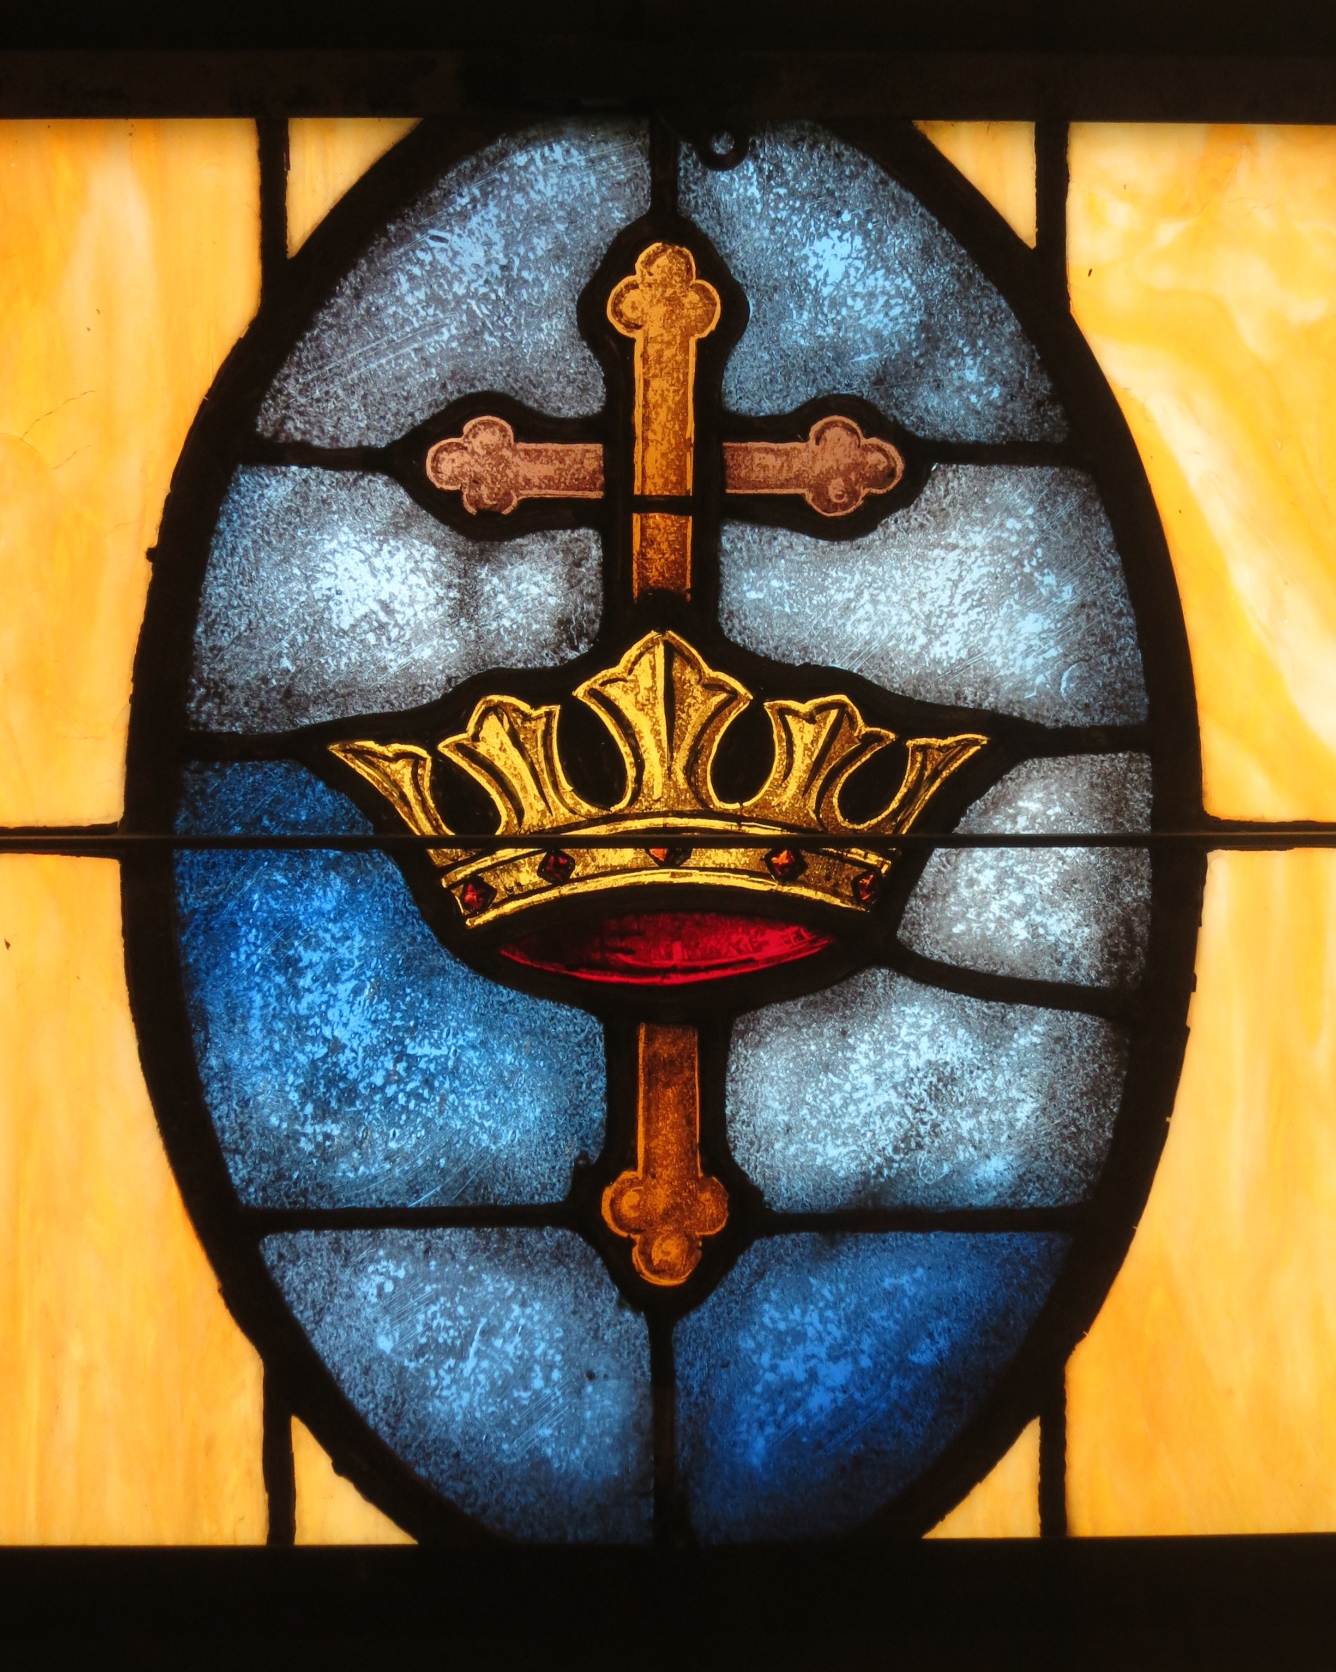
“Crown Him with Many Crowns” UMH 327
WORDS: Matthew Bridges, 1851 MUSIC: George J. Elvey, 1868
Please stand as you are able and comfortable.
Crown him with many crowns,
the Lamb upon his throne.
Hark! how the heavenly anthem drowns all music but its own.
Awake, my soul, and sing
of him who died for thee,
and hail him as thy matchless King through all eternity.

Slide 51
“Crown Him with Many Crowns” UMH 327
WORDS: Matthew Bridges, 1851 MUSIC: George J. Elvey, 1868
Please stand as you are able and comfortable.
Crown him the Lord of life,
who triumphed o’er the grave,
and rose victorious in the strife
for those he came to save.
His glories now we sing,
who died, and rose on high,
who died, eternal life to bring,
and lives that death may die.

Slide 52
“Crown Him with Many Crowns” UMH 327
WORDS: Matthew Bridges, 1851 MUSIC: George J. Elvey, 1868
Please stand as you are able and comfortable.
Crown him the Lord of peace,
whose power a scepter sways
from pole to pole, that wars may cease,
and all be prayer and praise.
His reign shall know no end,
and round his pierced feet,
fair flowers of paradise extend
their fragrance ever sweet.

Slide 53
“Crown Him with Many Crowns” UMH 327
WORDS: Matthew Bridges, 1851 MUSIC: George J. Elvey, 1868
Please stand as you are able and comfortable.
Crown him the Lord of love;
behold his hands and side,
those wounds, yet visible above,
in beauty glorified.
All hail, Redeemer, hail!
For thou hast died for me;
thy praise and glory shall not fail
throughout eternity.

Slide 55
BLESSING AND BENEDICTION
This service has ended, and now
your service in the world begins!

Slide 56
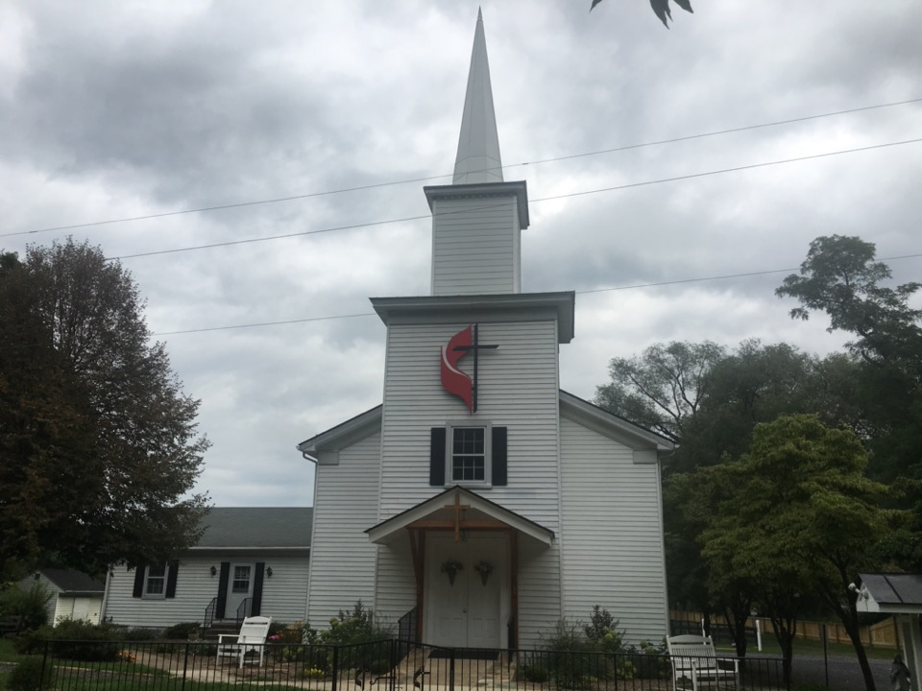
Rectortown United Methodist Church
serving God with
Prayer, Action, and Love
through Service.

