Slide 2
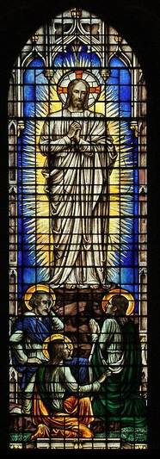
Prelude
Pastor TaeWon Kang
6th Sunday of Epiphany
February 16th, 2025
CCLI License:
3430384-01-1829
Livestream Notice: Our worship service is live-streamed and recorded. By attending, you consent to being included in the broadcast. Thank you for joining us!
Notes:
https://www.deviantart.com/digitalart-ai/art/Hail-Mary-5-1005127838

Slide 3
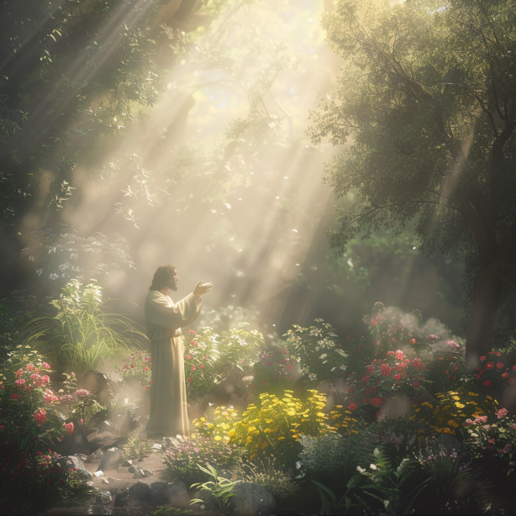
Bringing In The Light of Christ

Slide 4
WELCOME,
ANNOUNCEMENTS,
and
CELEBRATIONS
Livestream Notice: Our worship service is live-streamed and recorded. By attending, you consent to being included in the broadcast. Thank you for joining us!

Slide 5
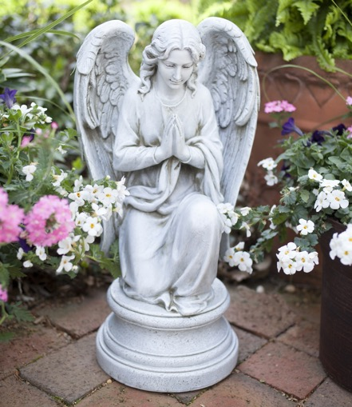
Give Thanks
Let us quiet our minds, hearts, and spirits as we begin to focus on the presence of God as we bring the Light of Christ into our midst.

Slide 6
Lord, you have called us to the mountaintop.
Help us to look forward to where you would have us go.

Slide 7
Help us to listen carefully to the words of your healing love.
Open our hearts and spirits to receive your glorious directions.

Slide 8
Place your trust in the Lord in all your ways.
Lord, we have come here to give our lives to you. AMEN.

Slide 9
Lord God, it seems so long ago that we heard your words at Jesus’ baptism. You reminded us that he is your beloved Son with whom you are well pleased.

Slide 10
Again today we hear your words that we are to listen to him, to pay attention. Open our hearts this day, Lord, to hear the words of Jesus, to follow in his footsteps, and to serve You. For we ask this in Christ’s Name. AMEN.

Slide 11

O Wondrous Sight!
O Vision Fair
258
WORDS: Sarum Breviary, 1495; trans. by John Mason Neale, 1851
(Mt. 17:1-8; Mk. 9:2-8; Lk. 9:28-36)
2. From age to age
the tale declares
how with the
three disciples there

Slide 12
O Wondrous Sight!
O Vision Fair
258
WORDS: Sarum Breviary, 1495; trans. by John Mason Neale, 1851
(Mt. 17:1-8; Mk. 9:2-8; Lk. 9:28-36)
where Moses and
Elijah meet,
the Lord holds converse
high and sweet.

Slide 13
O Wondrous Sight!
O Vision Fair
258
WORDS: Sarum Breviary, 1495; trans. by John Mason Neale, 1851
(Mt. 17:1-8; Mk. 9:2-8; Lk. 9:28-36)
4. With shining face
and bright array,
Christ deigns to
manifest that day

Slide 14
O Wondrous Sight!
O Vision Fair
258
WORDS: Sarum Breviary, 1495; trans. by John Mason Neale, 1851
(Mt. 17:1-8; Mk. 9:2-8; Lk. 9:28-36)
what glory shall
be theirs above
who joy in God
with perfect love.

Slide 15

Young Disciples’ Message

Slide 16
Spirit of the living God, fall afresh on me.
Spirit of the living God, fall afresh on me.
Melt me, mold me, fill me, use me.
Spirit of the living God, fall afresh on me.

Slide 17
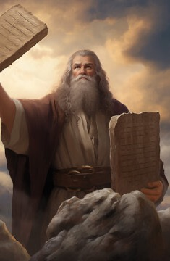
Exodus 34: 29 -35
NRSVUE

Slide 18
²⁹ Moses came down from Mount Sinai. As he came down from the mountain with the two tablets of the covenant in his hand, Moses did not know that the skin of his face shone because he had been talking with God.
³⁰ When Aaron and all the Israelites saw Moses, the skin of his face was shining, and they were afraid to come near him.

Slide 19
³¹ But Moses called to them, and Aaron and all the leaders of the congregation returned to him, and Moses spoke with them.
³² Afterward all the Israelites came near, and he gave them in commandment all that the Lord had spoken with him on Mount Sinai.

Slide 20
³³ When Moses had finished speaking with them, he put a veil on his face,
³⁴ but whenever Moses went in before the Lord to speak with him, he would take the veil off until he came out, and when he came out and told the Israelites what he had been commanded,

Slide 21
³⁵ the Israelites would see the face of Moses, that the skin of his face was shining, and Moses would put the veil on his face again until he went in to speak with him.

Slide 22
PSALM READING
Psalm 99 UMH 819

Slide 23
PSALM READING
Psalm 99 UMH 819
Leader: ¹The Lord reigns; let the peoples tremble! the Lord sits enthroned upon the cherubim, let the earth quake!
People: ²The Lord is great in Zion,
and is exalted over all the peoples.

Slide 24
PSALM READING
Psalm 99 UMH 819
Leader: ³Let them praise your great
and wondrous name!
People: Holy is the Lord!

Slide 25
PSALM READING
Psalm 99 UMH 819
Leader: ⁴Mighty Ruler, lover of justice,
you have established equity;
People: you have executed justice
and righteousness in Jacob.

Slide 26
PSALM READING
Psalm 99 UMH 819
Leader: ⁵Extol the Lord our God.
Worship at the Lord’s footstool!
People: Holy is the Lord!

Slide 27
PSALM READING
Psalm 99 UMH 819
Leader: ⁶Moses and Aaron were among
God’s priests, Samuel also was among
those who called on God’s name.
People: They cried to the Lord,
who answered them, who spoke to
them in the pillar of cloud.

Slide 28
PSALM READING
Psalm 99 UMH 819
Leader: ⁷They kept God’s testimonies,
and the statutes God gave them.
People: ⁸O Lord, our God, you answered them; you were a forgiving God to them,
but an avenger of their wrongdoings.

Slide 29
PSALM READING
Psalm 99 UMH 819
Leader: ⁹Extol the Lord our God,
and worship at his holy mountain.
People: Surely the Lord our God is holy!

Slide 30
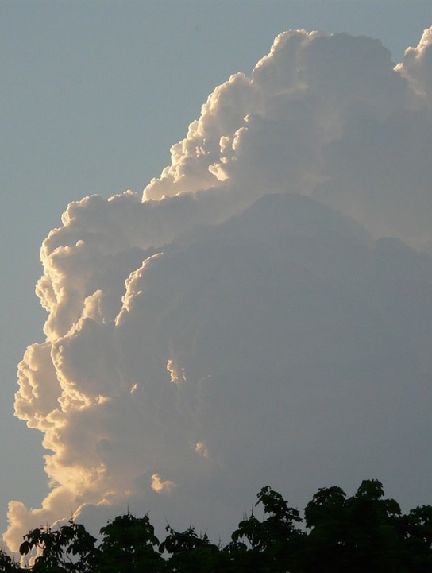
Luke 9 : 28 - 36
NRSVUE

Slide 31
²⁸ Now about eight days after these sayings Jesus took with him Peter and John and James and went up on the mountain to pray.
²⁹ And while he was praying, the appearance of his face changed, and his clothes became as bright as a flash of lightning.
³⁰ Suddenly they saw two men, Moses and Elijah, talking to him.

Slide 32
³¹ They appeared in glory and were speaking about his exodus, which he was about to fulfill in Jerusalem.
³² Now Peter and his companions were weighed down with sleep, but as they awoke they saw his glory and the two men who stood with him.

Slide 33
³³ Just as they were leaving him, Peter said to Jesus, “Master, it is good for us to be here; let us set up three tents: one for you, one for Moses, and one for Elijah,” not realizing what he was saying.
³⁴ While he was saying this, a cloud came and overshadowed them, and they were terrified as they entered the cloud.

Slide 34
³⁵ Then from the cloud came a voice that said, “This is my Son, my Chosen; listen to him!”
³⁶ When the voice had spoken, Jesus was found alone. And they kept silent and in those days told no one any of the things they had seen.

Slide 35

Glory Be to the Father
Glory Be to the Father
WORDS: Lesser Doxology, 3rd-4th cent.
70
Glory be to the Father
and to the Son
and to the Holy Ghost;

Slide 36
as it was in the beginning,
is now, and ever shall be,
world without end.
Amen. Amen.

Slide 37
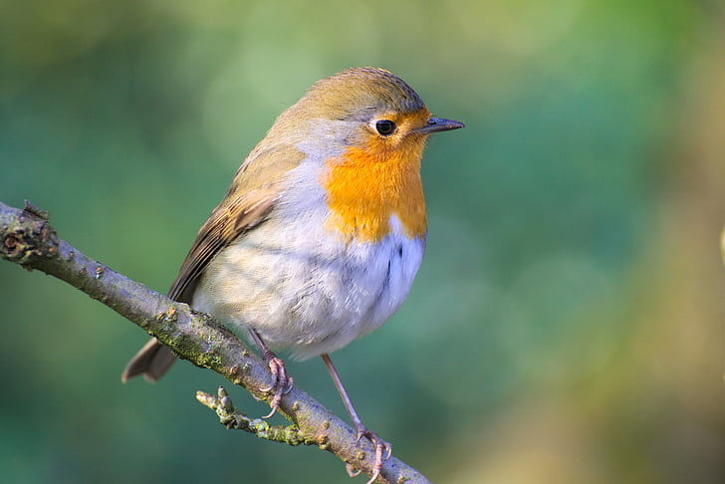
Sermon
“Listen to Jesus”
Notes:
https://vectorportal.com/vector/package-delivery-with-parachutes/25613

Slide 38
“Holy Ground” TFWS 2272
WORDS and MUSIC: Geron Davis, 1983
Please stand as you are able and comfortable.
We are standing
on holy ground,
and I know that there
are angels all around;
let us praise
Jesus now;
we are standing in his presence
on holy ground.

Slide 39
“Holy Ground” TFWS 2272
WORDS and MUSIC: Geron Davis, 1983
Please stand as you are able and comfortable.
We are standing
on holy ground,
and I know that there
are angels all around;
let us praise
Jesus now;
we are standing in his presence
on holy ground.

Slide 48
PRAYERS of the PEOPLE
as we lift up to you our joys and our concerns.

Slide 49

Pastoral Prayer
Notes:
https://www.bible-people.info/is-the-word-sunflower-in-the-bible/

Slide 50

Tithes and Offerings
Worship through giving
Notes:
https://www.goodfon.com/flowers/wallpaper-blue-wood-blossom-spring-flowers-vesna-iablonia-tsvety.html

Slide 51
“Praise God, from Whom All Blessings Flow” UMH 94
WORDS: Thomas Ken, 1674; adapted by Gilbert H. Viera, 1978
MUSIC: Geistliche Kirchengesange, 1623; harmonized by Ralph Vaughn Williams, 1906
Please stand as you are able and comfortable.
Praise God from whom all blessings flow;
Praise God, all creatures here below:
Alleluia! Alleluia!
Praise God, the source of all our gifts!
Praise Jesus Christ, whose power uplifts!
Praise the Spirit, Holy Spirit!
Alleluia! Alleluia! Alleluia!

Slide 52
Offertory Prayer

Slide 67
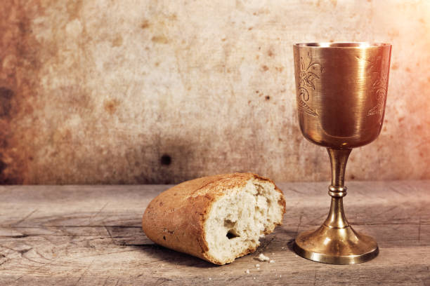
Breaking the Bread
&
Giving the Bread and Cup
The body of Christ, given for you.
Amen.
The blood of Christ, given for you.
Amen.

Slide 68
Eternal God, we give you thanks for this holy mystery in which you have given yourself to us. Grant that we may go into the world in the strength of your Spirit, to give ourselves for others, in the name of Jesus Christ our Lord, Amen.

Slide 69
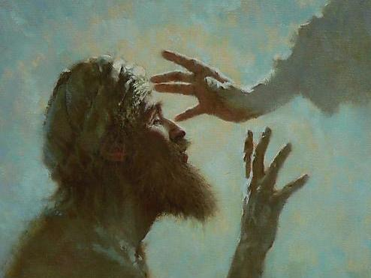
“Be Thou My Vision” UMH #451
WORDS: ancient Irish, translated by Mary E. Byrne, 1905;
MUSIC: traditional Irish melody; harmony by Carlton R. Young, 1963
Please stand as you are able and comfortable.
Be thou my vision,
O Lord of my heart;
naught be all else to me,
save that thou art.
Thou my best thought,
by day or night,
waking or sleeping,
thy presence my light.

Slide 70
“Be Thou My Vision” UMH #451
WORDS: ancient Irish, translated by Mary E. Byrne, 1905;
MUSIC: traditional Irish melody; harmony by Carlton R. Young, 1963
Please stand as you are able and comfortable.
Be thou my wisdom,
and thou my true word;
I ever with thee
and thou with me, Lord;
thou and thou only,
first in my heart,
great God of heaven,
my treasure thou art.

Slide 71
“Be Thou My Vision” UMH #451
WORDS: ancient Irish, translated by Mary E. Byrne, 1905;
MUSIC: traditional Irish melody; harmony by Carlton R. Young, 1963
Please stand as you are able and comfortable.
Great God of heaven,
my victory won,
may I reach heaven’s joys,
O bright heaven’s Sun!
Heart of my own heart,
whatever befall,
still be my vision,
O Ruler of all.

Slide 72

Benediction

Slide 73

POSTLUDE

Slide 74
BLESSING AND BENEDICTION
This service has ended, and now
your service in the world begins!

Slide 75
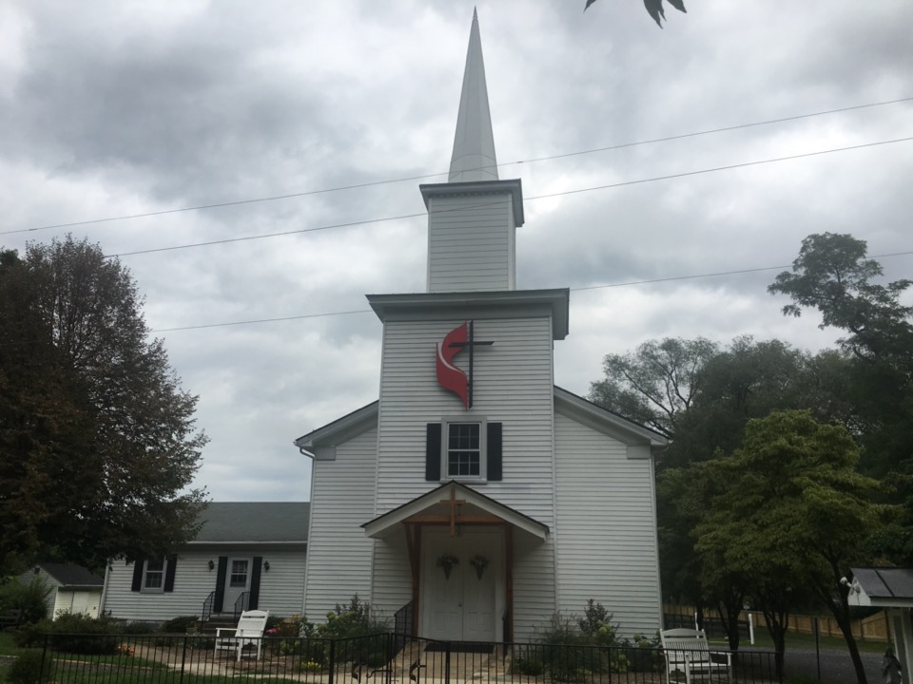
Rectortown United Methodist Church
serving God with
Prayer, Action, and Love
through Service.

