Slide 2
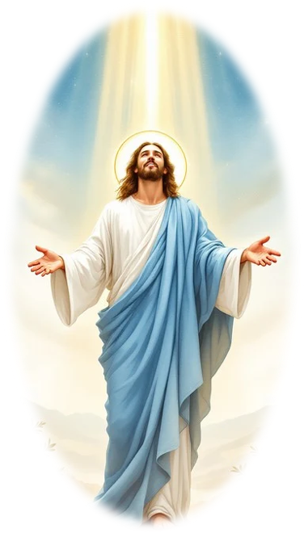
Prelude
Pastor Eduardo Carrillo
Transfiguration Sunday
February 15th , 2026
CCLI License:
3430384-01-1829
Livestream Notice: Our worship service is live-streamed and recorded. By attending, you consent to being included in the broadcast. Thank you for joining us!

Slide 3
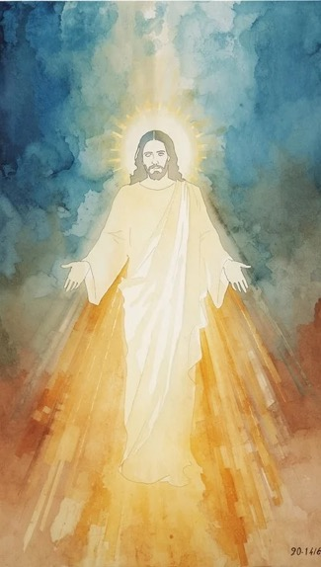
WELCOME,
ANNOUNCEMENTS,
and
CELEBRATIONS
Livestream Notice: Our worship service is live-streamed and recorded. By attending, you consent to being included in the broadcast. Thank you for joining us!

Slide 4
We leave the valley floor. We ascend the holy mountain.
The glory of the Lord awaits us in the cloud.

Slide 5
On Mount Sinai, God’s presence was a consuming fire.
On the Mount of Transfiguration, the face of Jesus shines like the sun.

Slide 6
Moses and Elijah stood as witnesses to Christ’s power.
We have come to see the fulfillment of all the prophets.

Slide 7
Hear the voice of the Father, ringing
from the light: "This is my Son, the Beloved."
We listen to Him. We follow His Light.

Slide 8
Almighty God, we stand before you, having left the low places of the week to climb the sacred mountain of Your presence. Forgive us for the times we have been spiritually drowsy,

Slide 9
tempted to build a comfortable tent in the valley of the ordinary, forgetting the radiant power we have witnessed on the mountain.

Slide 10
Focus our hearts on Jesus, that we may follow his teaching and, in our own lives, reflect the glory we have seen, Amen.

Slide 11
“O Worship the King” UMH #73
WORDS: Robert Grant, 1833 MUSIC: Johann Michael Hayden, arrgd by William Gardiner, 1815
Please stand as you are able and comfortable.
O worship the King,
all glorious above,
O gratefully sing
God’s power and God’s love;
our Shield and Defender,
the Ancient of Days,
pavilioned in splendor,
and girded with praise.

Slide 12
“O Worship the King” UMH #73
WORDS: Robert Grant, 1833 MUSIC: Johann Michael Hayden, arrgd by William Gardiner, 1815
Please stand as you are able and comfortable.
O tell of God’s might,
O sing of God’s grace,
whose robe is the light,
whose canopy space,
whose chariots of wrath
the deep thunderclouds form,
and dark is God’s path
on the wings of the storm.

Slide 13
“O Worship the King” UMH #73
WORDS: Robert Grant, 1833 MUSIC: Johann Michael Hayden, arrgd by William Gardiner, 1815
Please stand as you are able and comfortable.
The earth with its store
of wonders untold,
Almighty, thy power
hath founded of old;
hath stablished it fast
by a changeless decree,
and round it hath cast,
like a mantle, the sea.

Slide 14
“O Worship the King” UMH #73
WORDS: Robert Grant, 1833 MUSIC: Johann Michael Hayden, arrgd by William Gardiner, 1815
Please stand as you are able and comfortable.
Thy bountiful care,
what tongue can recite?
It breathes in the air,
it shines in the light;
it streams from the hills,
it descends to the plain,
and sweetly distills
in the dew and the rain.

Slide 15
“O Worship the King” UMH #73
WORDS: Robert Grant, 1833 MUSIC: Johann Michael Hayden, arrgd by William Gardiner, 1815
Please stand as you are able and comfortable.
Frail children of dust,
and feeble as frail,
in thee do we trust,
nor find thee to fail;
thy mercies how tender,
how firm to the end,
our Maker, Defender,
Redeemer and Friend.

Slide 17
Prayer For Illumination
Spirit of the living God, fall afresh on me.
Spirit of the living God, fall afresh on me.
Melt me, mold me, fill me, use me.
Spirit of the living God, fall afresh on me.
UMH 393

Slide 18
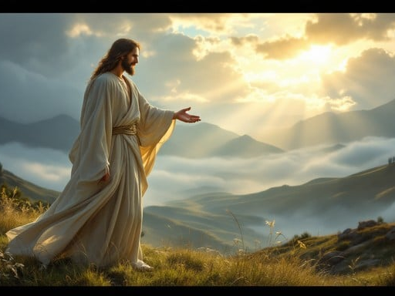
Exodus 24: 12 – 18
NRSVUE

Slide 19
¹² The Lord said to Moses, “Come up to me on the mountain and wait there; I will give you the tablets of stone, with the law and the commandment, which I have written for their instruction.”

Slide 20
¹³ So Moses set out with his assistant Joshua, and Moses went up onto the mountain of God.
¹⁴ To the elders he had said, “Wait here for us, until we come back to you. Look, Aaron and Hur are with you; whoever has a dispute may go to them.”

Slide 21
¹⁵ Then Moses went up on the mountain, and the cloud covered the mountain.
¹⁶ The glory of the Lord settled on Mount Sinai, and the cloud covered it for six days; on the seventh day he called to Moses out of the cloud.

Slide 22
¹⁷ Now the appearance of the glory of the Lord was like a devouring fire on the top of the mountain in the sight of the Israelites.
¹⁸ Moses entered the cloud and went up on the mountain. Moses was on the mountain for forty days and forty nights.

Slide 23
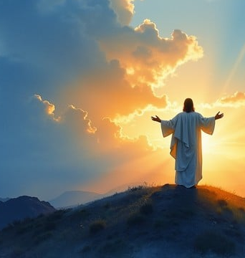
Matthew 17: 1 – 9
NRSVUE

Slide 24
Six days later, Jesus took with him Peter and James and his brother John and led them up a high mountain, by themselves.
² And he was transfigured before them, and his face shone like the sun, and his clothes became bright as light.

Slide 25
³ Suddenly there appeared to them Moses and Elijah, talking with him.
⁴ Then Peter said to Jesus, “Lord, it is good for us to be here; if you wish, I will set up three tents here, one for you, one for Moses, and one for Elijah.”

Slide 26
⁵ While he was still speaking, suddenly a bright cloud overshadowed them, and a voice from the cloud said, “This is my Son, the Beloved; with him I am well pleased; listen to him!”
⁶ When the disciples heard this, they fell to the ground and were overcome by fear.

Slide 27
⁷ But Jesus came and touched them, saying, “Get up and do not be afraid.”
⁸ And when they raised their eyes, they saw no one except Jesus himself alone.

Slide 28
⁹ As they were coming down the mountain, Jesus ordered them, “Tell no one about the vision until after the Son of Man has been raised from the dead.”

Slide 29
The Word of God for the people of God
Thanks be to God

Slide 30

Sermon
“Transfiguration”

Slide 31
“Lord of All Hopefulness” TFWS 2197
WORDS: Jan Struther MUSIC: Irish folk melody; harmony by Carlton R. Young
Please stand as you are able and comfortable.
Lord of all hopefulness,
Lord of all joy,
whose trust, ever child-like,
no cares could destroy:
Be there at our waking,
and give us, we pray,
your bliss in our hearts, Lord,
at the break of the day.

Slide 32
“Lord of All Hopefulness” TFWS 2197
WORDS: Jan Struther MUSIC: Irish folk melody; harmony by Carlton R. Young
Please stand as you are able and comfortable.
Lord of all eagerness,
Lord of all faith,
whose strong hands were skilled
at the plane and the lathe:
Be there at our labors,
and give us, we pray,
your strength in our hearts, Lord,
at the noon of the day.

Slide 33
“Lord of All Hopefulness” TFWS 2197
WORDS: Jan Struther MUSIC: Irish folk melody; harmony by Carlton R. Young
Please stand as you are able and comfortable.
Lord of all kindliness,
Lord of all grace,
your hands swift to welcome,
your arms to embrace:
Be there at our homing,
and give us, we pray,
your love in our hearts, Lord,
at the eve of the day.

Slide 34
“Lord of All Hopefulness” TFWS 2197
WORDS: Jan Struther MUSIC: Irish folk melody; harmony by Carlton R. Young
Please stand as you are able and comfortable.
Lord of all gentleness,
Lord of all calm,
whose voice is contentment,
whose presence is balm:
Be there at our sleeping,
and give us, we pray,
your peace in our hearts, Lord,
at the end of the day.

Slide 44
Tithes and Offerings
Worship through giving
Notes:
https://www.goodfon.com/flowers/wallpaper-blue-wood-blossom-spring-flowers-vesna-iablonia-tsvety.html

Slide 45

“Praise God, from Whom All Blessings Flow” UMH 94
WORDS: Thomas Ken, 1674; adapted by Gilbert H. Viera, 1978
MUSIC: Geistliche Kirchengesange, 1623; harmonized by Ralph Vaughn Williams, 1906
Please stand as you are able and comfortable.
Praise God from whom all blessings flow;
Praise God, all creatures here below:
Alleluia! Alleluia!
Praise God, the source of all our gifts!
Praise Jesus Christ, whose power uplifts!
Praise the Spirit, Holy Spirit!
Alleluia! Alleluia! Alleluia!

Slide 46
Offertory Prayer

Slide 47
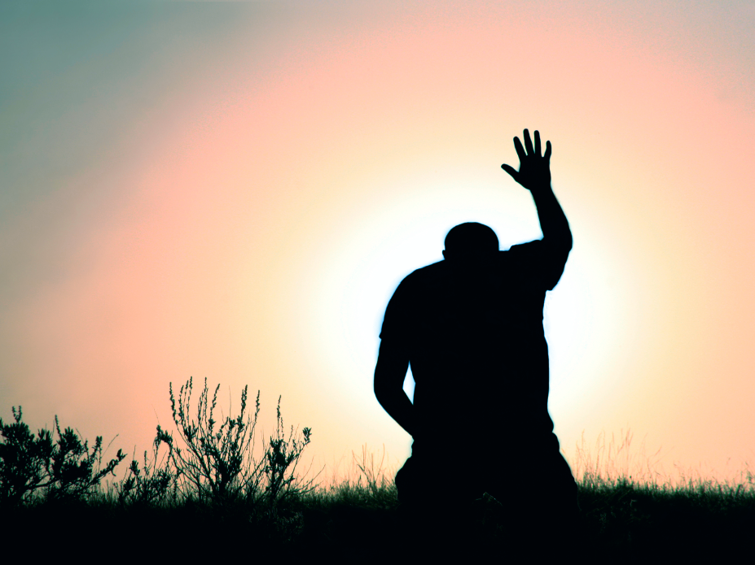
“Every Time I Feel the Spirit” UMH 404
WORDS and MUSIC: Afro-American spiritual.
Adapted and arranged by William Farley Smith, 1986
Please stand as you are able and comfortable.
Every time I feel the Spirit
moving in my heart, I will pray.
Yes, every time I feel the Spirit
moving in my heart, I will pray.

Slide 48
“Every Time I Feel the Spirit” UMH 404
WORDS and MUSIC: Afro-American spiritual.
Adapted and arranged by William Farley Smith, 1986
Please stand as you are able and comfortable.
Upon the mountain, my Lord spoke,
out his mouth came fire and smoke.
All around me looks to shine,
ask my Lord if all was mine.

Slide 49
“Every Time I Feel the Spirit” UMH 404
WORDS and MUSIC: Afro-American spiritual.
Adapted and arranged by William Farley Smith, 1986
Please stand as you are able and comfortable.
Every time I feel the Spirit
moving in my heart, I will pray.
Yes, every time I feel the Spirit
moving in my heart, I will pray.

Slide 50
“Every Time I Feel the Spirit” UMH 404
WORDS and MUSIC: Afro-American spiritual.
Adapted and arranged by William Farley Smith, 1986
Please stand as you are able and comfortable.
Jordan river runs right cold,
chills the body, not the soul.
Ain’t but one train on this track,
runs to heaven and right back.

Slide 51
“Every Time I Feel the Spirit” UMH 404
WORDS and MUSIC: Afro-American spiritual.
Adapted and arranged by William Farley Smith, 1986
Please stand as you are able and comfortable.
Every time I feel the Spirit
moving in my heart, I will pray.
Yes, every time I feel the Spirit
moving in my heart, I will pray.

Slide 53
BLESSING AND BENEDICTION
This service has ended, and now
your service in the world begins!

Slide 54
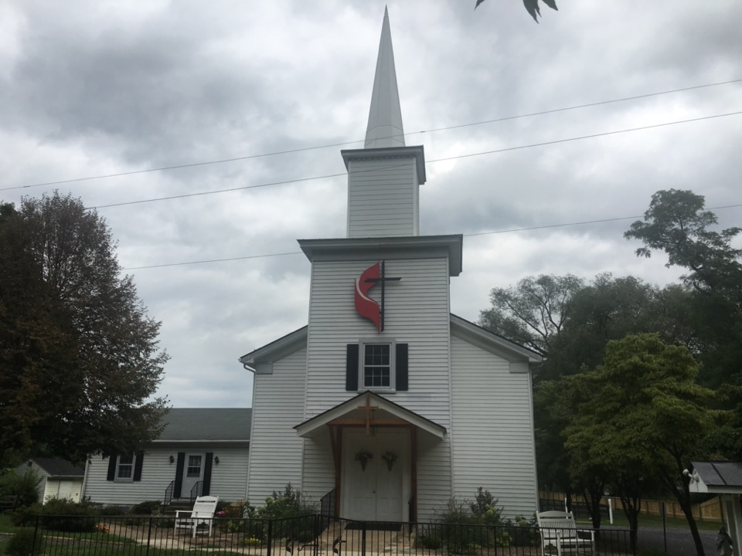
Rectortown United Methodist Church
serving God with
Prayer, Action, and Love
through Service.

