Slide 2
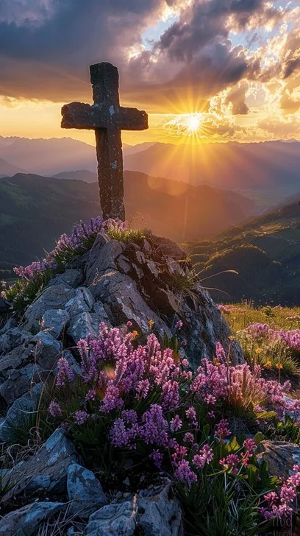
Prelude
Pastor Eduardo Carrillo
1st Sunday of Lent
February 22nd, 2026
CCLI License:
3430384-01-1829
Livestream Notice: Our worship service is live-streamed and recorded. By attending, you consent to being included in the broadcast. Thank you for joining us!

Slide 3
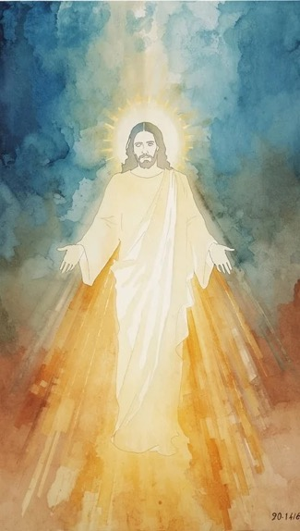
WELCOME,
ANNOUNCEMENTS,
and
CELEBRATIONS
Livestream Notice: Our worship service is live-streamed and recorded. By attending, you consent to being included in the broadcast. Thank you for joining us!

Slide 4
Wilderness-wanderers, holiness-seekers, listen for God’s voice today.
The Spirit whispers, “Turn around and come back home.”

Slide 5
It’s not too late for me, for you, for this world.
It’s not too late to take God up on God’s promises.

Slide 6
We claim God’s promises in each choice we make—
Each moment is a new chance to
choose what gives life.

Slide 7
May our worship help us see those
choices and turn back to God.
May our worship today say, “God, we choose you.”

Slide 8
God of life, sometimes the struggles we face make us feel like it’s too late for change; within us, our relationships, or the world. We despair or resign ourselves. We might even join in wrongdoing.

Slide 9
But you put a different choice before us in each new moment—a choice for life and love in Jesus. Forgive us for the times we have chosen death and disdain.

Slide 10
Forgive us for failing to see our choices clearly. Forgive us for passing up the hope you offer. We are turning around now. Grab hold of our hand and lead us in the way of Jesus. Amen.

Slide 11
“Lord, Who Throughout These 40 Days” UMH 269
WORDS: Claudia F. Hernaman, 1873 MUSIC: USA folk melody
Please stand as you are able and comfortable.
Lord, who throughout
these forty days
for us didst fast and pray,
teach us with thee
to mourn our sins
and close by thee to stay.

Slide 12
“Lord, Who Throughout These 40 Days” UMH 269
WORDS: Claudia F. Hernaman, 1873 MUSIC: USA folk melody
Please stand as you are able and comfortable.
As thou with Satan
didst contend,
and didst the victory win,
O give us strength
in thee to fight,
in thee to conquer sin.

Slide 13
“Lord, Who Throughout These 40 Days” UMH 269
WORDS: Claudia F. Hernaman, 1873 MUSIC: USA folk melody
Please stand as you are able and comfortable.
As thou didst hunger
bear, and thirst,
so teach us, gracious Lord,
to die to self,
and chiefly live
by thy most holy word.

Slide 14
“Lord, Who Throughout These 40 Days” UMH 269
WORDS: Claudia F. Hernaman, 1873 MUSIC: USA folk melody
Please stand as you are able and comfortable.
And through these
days of penitence,
and through thy passiontide,
yea, evermore
in life and death,
Jesus, with us abide.

Slide 15
“Lord, Who Throughout These 40 Days” UMH 269
WORDS: Claudia F. Hernaman, 1873 MUSIC: USA folk melody
Please stand as you are able and comfortable.
Abide with us,
that so, this life
of suffering over past,
an Easter of
unending joy
we may attain at last.

Slide 17
Prayer For Illumination
Spirit of the living God, fall afresh on me.
Spirit of the living God, fall afresh on me.
Melt me, mold me, fill me, use me.
Spirit of the living God, fall afresh on me.
UMH 393

Slide 18
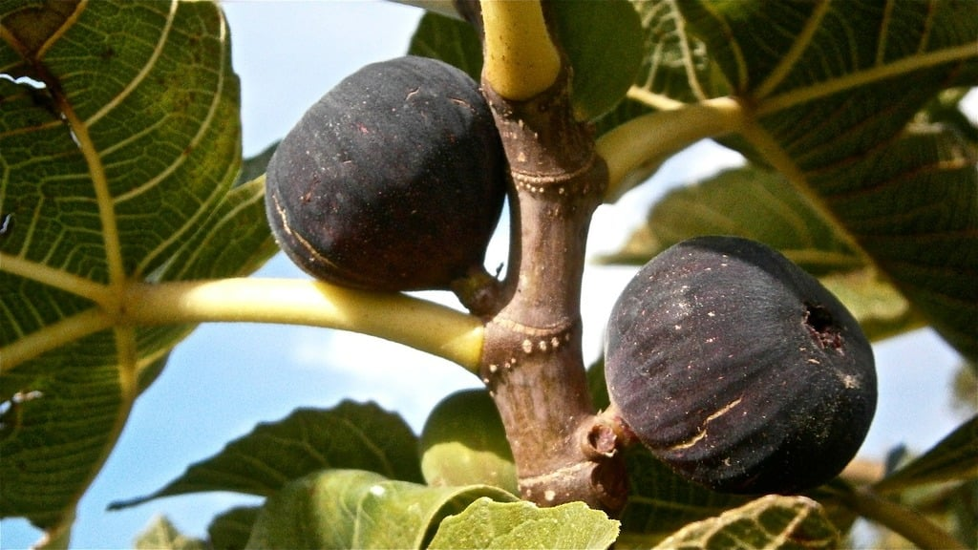
Luke 13: 6 - 9
NRSVUE

Slide 19
⁶ Then he told this parable: “A man had a fig tree planted in his vineyard, and he came looking for fruit on it and found none.

Slide 20
⁷ So he said to the man working the vineyard, ‘See here! For three years I have come looking for fruit on this fig tree, and still I find none. Cut it down! Why should it be wasting the soil?’

Slide 21
⁸ He replied, ‘Sir, let it alone for one more year, until I dig around it and put manure on it.
⁹ If it bears fruit next year, well and good, but if not, you can cut it down.’ ”

Slide 22
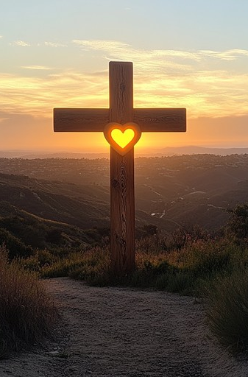
Deuteronomy 30: 11 – 20
NRSVUE

Slide 23
¹¹ “Surely, this commandment that I am commanding you today is not too hard for you, nor is it too far away.
¹² It is not in heaven, that you should say, ‘Who will go up to heaven for us and get it for us so that we may hear it and observe it?’

Slide 24
¹³ Neither is it beyond the sea, that you should say, ‘Who will cross to the other side of the sea for us and get it for us so that we may hear it and observe it?’
¹⁴ No, the word is very near to you; it is in your mouth and in your heart for you to observe.

Slide 25
¹⁵ “See, I have set before you today life and prosperity, death and adversity.

Slide 26
¹⁶ If you obey the commandments of the Lord your God that I am commanding you today, by loving the Lord your God, walking in his ways, and observing his commandments, decrees, and ordinances, then you shall live and become numerous, and the Lord your God will bless you in the land that you are entering to possess.

Slide 27
¹⁷ But if your heart turns away and you do not hear but are led astray to bow down to other gods and serve them,
¹⁸ I declare to you today that you shall certainly perish; you shall not live long in the land that you are crossing the Jordan to enter and possess.

Slide 28
¹⁹ I call heaven and earth to witness against you today that I have set before you life and death, blessings and curses. Choose life so that you and your descendants may live,

Slide 29
²⁰ loving the Lord your God, obeying him, and holding fast to him, for that means life to you and length of days, so that you may live in the land that the Lord swore to give to your ancestors, to Abraham, to Isaac, and to Jacob.”

Slide 30
The Word of God for the people of God
Thanks be to God

Slide 31
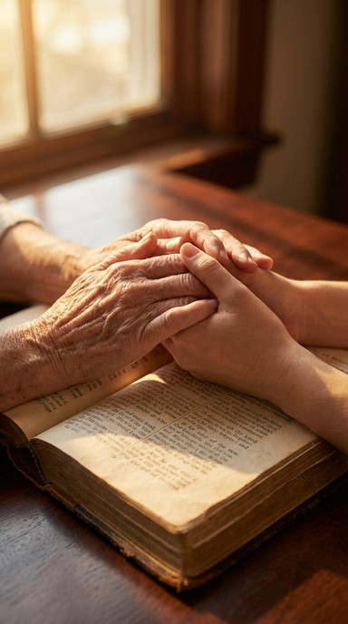
Sermon
“It’s Not Too Late to Choose Life”

Slide 32
“Grace Greater than Our Sin” UMH 365
WORDS: Julia H. Johnston, 1911 MUSIC: Daniel B. Towner, 1910
Please stand as you are able and comfortable.
Marvelous grace of our loving Lord,
grace that exceeds
our sin and our guilt!
Yonder on Calvary’s mount outpoured, there where the blood of
the Lamb was spilt.

Slide 33
“Grace Greater than Our Sin” UMH 365
WORDS: Julia H. Johnston, 1911 MUSIC: Daniel B. Towner, 1910
Please stand as you are able and comfortable.
Grace, grace, God’s grace,
grace that will pardon and cleanse within;
grace, grace, God’s grace,
grace that is greater than all our sin!

Slide 34
“Grace Greater than Our Sin” UMH 365
WORDS: Julia H. Johnston, 1911 MUSIC: Daniel B. Towner, 1910
Please stand as you are able and comfortable.
Sin and despair, like the sea waves cold, threaten the soul
with infinite loss;
grace that is greater, yes, grace untold, points to the refuge,
the mighty cross.

Slide 35
“Grace Greater than Our Sin” UMH 365
WORDS: Julia H. Johnston, 1911 MUSIC: Daniel B. Towner, 1910
Please stand as you are able and comfortable.
Grace, grace, God’s grace,
grace that will pardon and cleanse within;
grace, grace, God’s grace,
grace that is greater than all our sin!

Slide 36
“Grace Greater than Our Sin” UMH 365
WORDS: Julia H. Johnston, 1911 MUSIC: Daniel B. Towner, 1910
Please stand as you are able and comfortable.
Dark is the stain that we cannot hide.
What can avail
to wash it away?
Look! There is flowing a crimson tide, brighter than snow you
may be today.

Slide 37
“Grace Greater than Our Sin” UMH 365
WORDS: Julia H. Johnston, 1911 MUSIC: Daniel B. Towner, 1910
Please stand as you are able and comfortable.
Grace, grace, God’s grace,
grace that will pardon and cleanse within;
grace, grace, God’s grace,
grace that is greater than all our sin!

Slide 38
“Grace Greater than Our Sin” UMH 365
WORDS: Julia H. Johnston, 1911 MUSIC: Daniel B. Towner, 1910
Please stand as you are able and comfortable.
Marvelous, infinite, matchless grace,
freely bestowed
on all who believe!
You that are longing to see his face,
will you this moment
his grace receive?

Slide 39
“Grace Greater than Our Sin” UMH 365
WORDS: Julia H. Johnston, 1911 MUSIC: Daniel B. Towner, 1910
Please stand as you are able and comfortable.
Grace, grace, God’s grace,
grace that will pardon and cleanse within;
grace, grace, God’s grace,
grace that is greater than all our sin!

Slide 49
Tithes and Offerings
Worship through giving
Notes:
https://www.goodfon.com/flowers/wallpaper-blue-wood-blossom-spring-flowers-vesna-iablonia-tsvety.html

Slide 50

“Praise God, from Whom All Blessings Flow” UMH 94
WORDS: Thomas Ken, 1674; adapted by Gilbert H. Viera, 1978
MUSIC: Geistliche Kirchengesange, 1623; harmonized by Ralph Vaughn Williams, 1906
Please stand as you are able and comfortable.
Praise God from whom all blessings flow;
Praise God, all creatures here below:
Alleluia! Alleluia!
Praise God, the source of all our gifts!
Praise Jesus Christ, whose power uplifts!
Praise the Spirit, Holy Spirit!
Alleluia! Alleluia! Alleluia!

Slide 51
Offertory Prayer

Slide 52
“It’s Me, It’s Me, O Lord” UMH 352
WORDS: Afro-American Spiritual
MUSIC: Afro-American Spiritual; harmonized by William Farley Smith, 1986
Please stand as you are able and comfortable.
It’s me, it’s me, O Lord,
standing in the need of prayer.
It’s me, it’s me, O Lord,
standing in the need of prayer.

Slide 53
“It’s Me, It’s Me, O Lord” UMH 352
WORDS: Afro-American Spiritual
MUSIC: Afro-American Spiritual; harmonized by William Farley Smith, 1986
Please stand as you are able and comfortable.
Not my brother, not my sister,
but it’s me, O Lord,
standing in the need of prayer.
Not my brother, not my sister,
but it’s me, O Lord,
standing in the need of prayer.

Slide 54
“It’s Me, It’s Me, O Lord” UMH 352
WORDS: Afro-American Spiritual
MUSIC: Afro-American Spiritual; harmonized by William Farley Smith, 1986
Please stand as you are able and comfortable.
It’s me, it’s me, O Lord,
standing in the need of prayer.
It’s me, it’s me, O Lord,
standing in the need of prayer.

Slide 55
“It’s Me, It’s Me, O Lord” UMH 352
WORDS: Afro-American Spiritual
MUSIC: Afro-American Spiritual; harmonized by William Farley Smith, 1986
Please stand as you are able and comfortable.
Not the preacher, not the deacon,
but it’s me, O Lord,
standing in the need of prayer.
Not the preacher, not the deacon,
but it’s me, O Lord,
standing in the need of prayer.

Slide 56
“It’s Me, It’s Me, O Lord” UMH 352
WORDS: Afro-American Spiritual
MUSIC: Afro-American Spiritual; harmonized by William Farley Smith, 1986
Please stand as you are able and comfortable.
It’s me, it’s me, O Lord,
standing in the need of prayer.
It’s me, it’s me, O Lord,
standing in the need of prayer.

Slide 57
“It’s Me, It’s Me, O Lord” UMH 352
WORDS: Afro-American Spiritual
MUSIC: Afro-American Spiritual; harmonized by William Farley Smith, 1986
Please stand as you are able and comfortable.
Not my father, not my mother,
but it’s me, O Lord,
standing in the need of prayer.
Not my father, not my mother,
but it’s me, O Lord,
standing in the need of prayer.

Slide 58
“It’s Me, It’s Me, O Lord” UMH 352
WORDS: Afro-American Spiritual
MUSIC: Afro-American Spiritual; harmonized by William Farley Smith, 1986
Please stand as you are able and comfortable.
It’s me, it’s me, O Lord,
standing in the need of prayer.
It’s me, it’s me, O Lord,
standing in the need of prayer.

Slide 60
BLESSING AND BENEDICTION
This service has ended, and now
your service in the world begins!

Slide 61
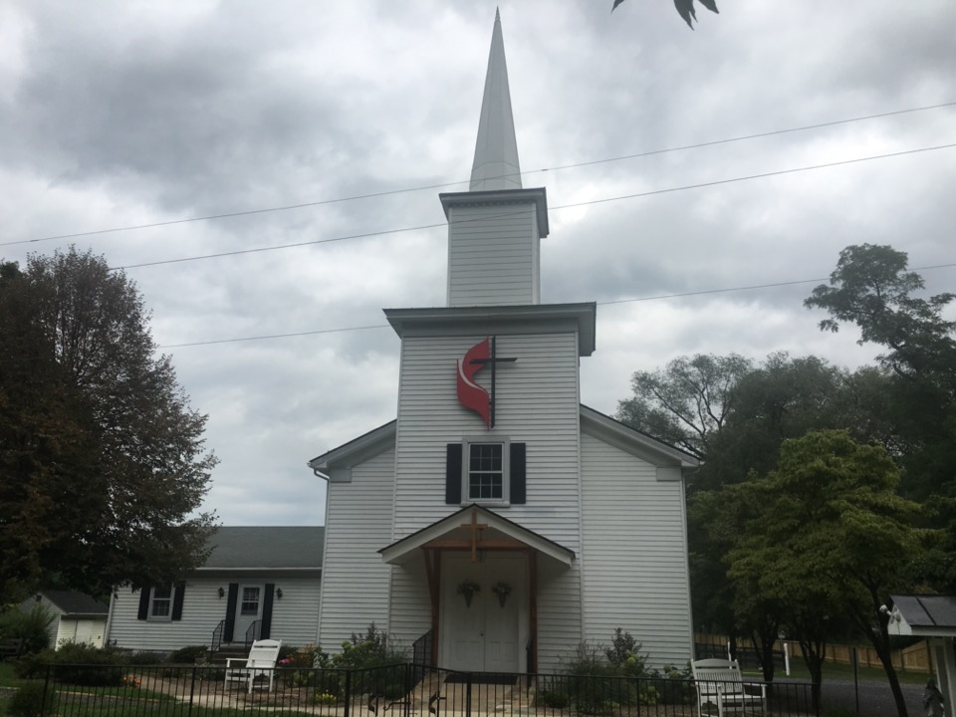
Rectortown United Methodist Church
serving God with
Prayer, Action, and Love
through Service.

