Slide 2
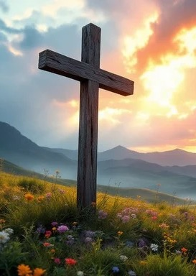
Prelude
Pastor Eduardo Carrillo
Fourteenth Sunday after Pentecost
August 30th, 2026
CCLI License:
3430384-01-1829
Livestream Notice: Our worship service is live-streamed and recorded. By attending, you consent to being included in the broadcast. Thank you for joining us!

Slide 3
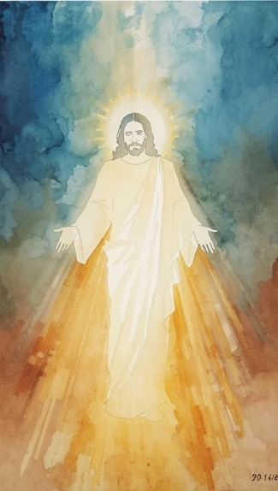
WELCOME,
ANNOUNCEMENTS,
and
CELEBRATIONS
Livestream Notice: Our worship service is live-streamed and recorded. By attending, you consent to being included in the broadcast. Thank you for joining us!

Slide 4
We gather together not as strangers, but as one family in Christ.
Bound together in love, united in praise.

Slide 5
Let us bring our whole lives to God.
Our joys, our needs, and our shared purpose.

Slide 6
We are here seeking, searching, answering.
With glad and sincere hearts, let us worship the Lord!

Slide 7
Gracious and Loving God, we draw near to You today, giving thanks for the gift of community. Thank You for gathering us into one body,

Slide 8
calling us to walk alongside one another in joy, generosity, and peace. Open our hearts during this time together. Melt away any division,

Slide 9
quiet our distractions, and unite our spirits in Your presence. May our worship reflect the beauty of Your love,

Slide 10
and may our fellowship shine as a light of hope to the world around us.
We ask for Your Holy Spirit to move freely among us today. In Jesus' name, Amen.

Slide 13

Song Choice
of the
Church

Slide 14
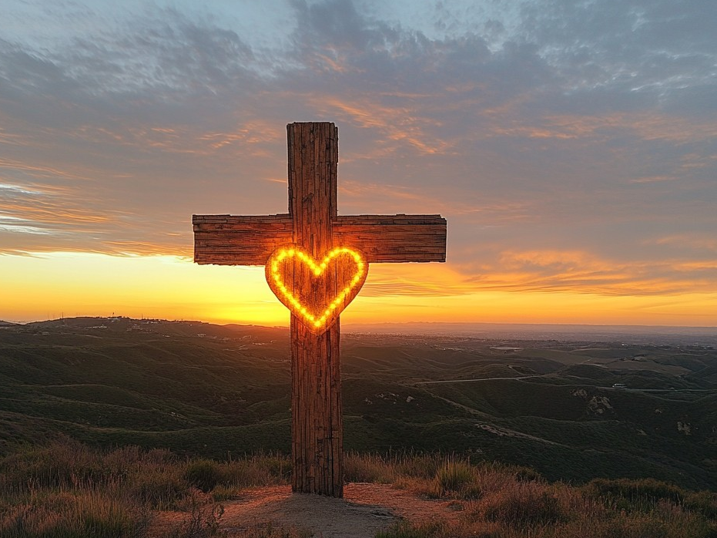
Acts 2: 44 - 47
NRSVUE

Slide 15
⁴⁴ All who believed were together and had all things in common;
⁴⁵ they would sell their possessions and goods and distribute the proceeds to all, as any had need.

Slide 16
⁴⁶ Day by day, as they spent much time together in the temple, they broke bread at home and ate their food with glad and generous hearts,
⁴⁷ praising God and having the goodwill of all the people. And day by day the Lord added to their number those who were being saved.

Slide 17
The Word of God for the people of God
Thanks be to God

Slide 18
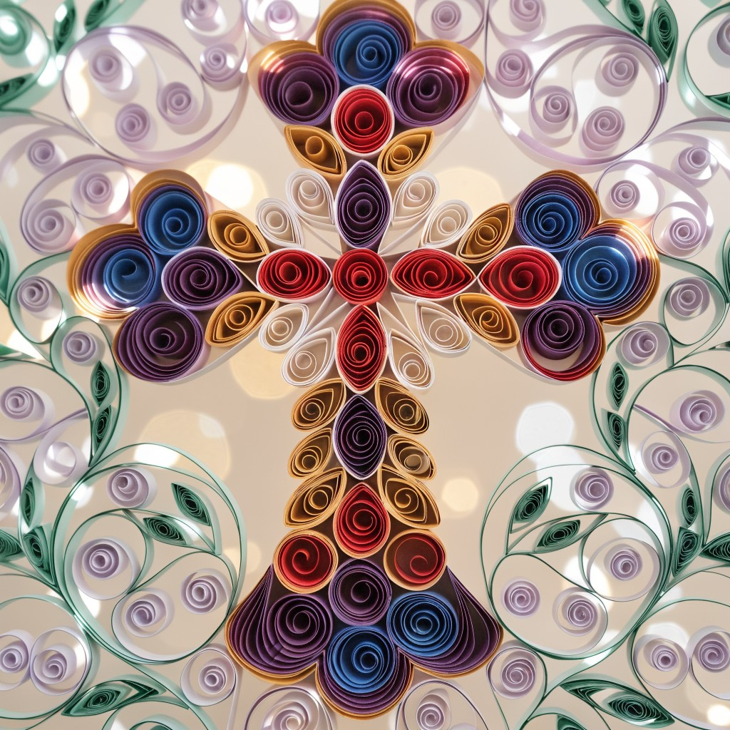
Sermon
Guest Speaker:
Wayne Frick

Slide 19
Song Choice
of the
Church

Slide 24
Tithes and Offerings
Worship through giving
Notes:
https://www.goodfon.com/flowers/wallpaper-blue-wood-blossom-spring-flowers-vesna-iablonia-tsvety.html

Slide 25

“Praise God, from Whom All Blessings Flow” UMH 94
WORDS: Thomas Ken, 1674; adapted by Gilbert H. Viera, 1978
MUSIC: Geistliche Kirchengesange, 1623; harmonized by Ralph Vaughn Williams, 1906
Please stand as you are able and comfortable.
Praise God from whom all blessings flow;
Praise God, all creatures here below:
Alleluia! Alleluia!
Praise God, the source of all our gifts!
Praise Jesus Christ, whose power uplifts!
Praise the Spirit, Holy Spirit!
Alleluia! Alleluia! Alleluia!

Slide 26
Offertory Prayer

Slide 27
Song Choice
of the
Church

Slide 34
Postlude
This service has ended, and now
your service in the world begins!

Slide 35
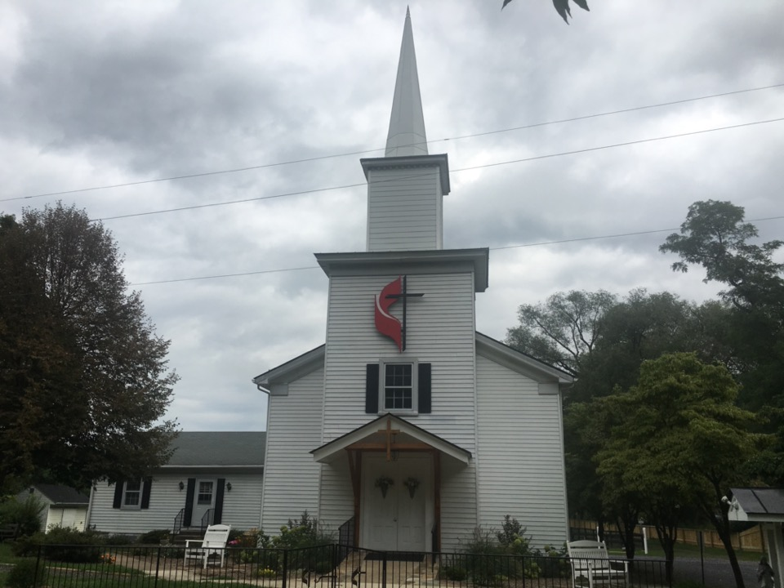
Rectortown United Methodist Church
serving God with
Prayer, Action, and Love
through Service.

