Slide 2
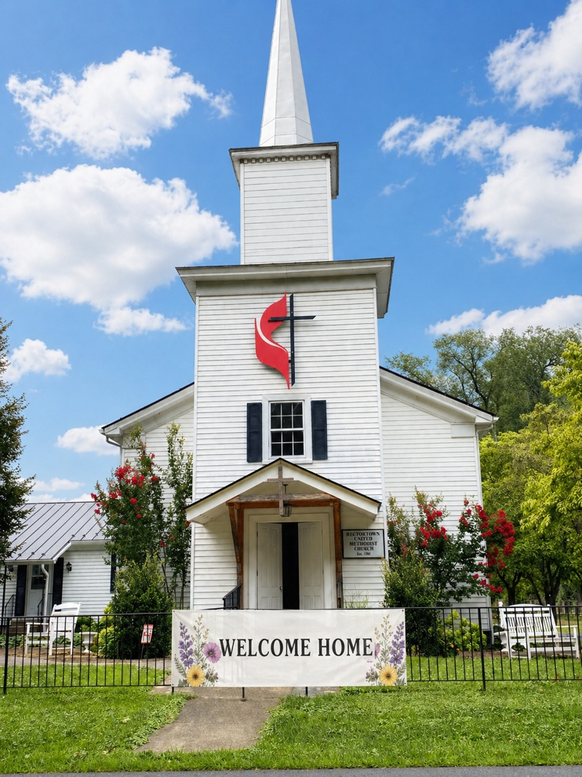
Prelude
Pastor Eduardo Carrillo
245TH Homecoming
May 17th, 2026
CCLI License:
3430384-01-1829
Livestream Notice: Our worship service is live-streamed and recorded. By attending, you consent to being included in the broadcast. Thank you for joining us!

Slide 3

WELCOME
Livestream Notice: Our worship service is live-streamed and recorded. By attending, you consent to being included in the broadcast. Thank you for joining us!

Slide 4
We come today from many places, some from just down the road, and others from years and miles away.
We come to remember where we have been and the Grace that carried us through.

Slide 5
We gather in this present moment, in this sacred space, to stand together as one family.
We are here to celebrate where we are, grounded in Faith and held by Love.

Slide 6
But our journey does not end at these doors. God is speaking a new word; the Spirit is breathing a new life into this season.
We look forward with hope to where God is calling us to go.

Slide 7
Whether this is your first time in these pews or your fifty-second year, welcome home. Not just to a building, but to the heart of the Father who has been waiting for your arrival.

Slide 8
Let us worship the God of our past, our present, and our future. Let us worship the God who brings us home!

Slide 9
Gracious and Eternal God, We come before You today, acknowledging the journeys we have taken. We thank You for where we have been, for the strength

Slide 10
You gave us in the valleys and the light You provided when the path was dim. We thank You for where we are, for this moment, this breath, and this family gathered in Your Name.

Slide 11
We confess that we have sometimes wandered in spirit, yet we rejoice in the homecoming You offer us daily. Thank You for welcoming us back into Your presence with open arms.

Slide 12
As we look toward where You are calling us, grant us the courage to step into this new season. Help us to be a people of vision, a people of grace, and a people who always find our true home in You. Amen.

Slide 13
“Victory in Jesus” UMH 370
WORDS and MUSIC: Eugene M. Bartlett, 1939
Please stand as you are able and comfortable.
I heard and old, old story,
how a Savior came from glory,
how he gave his life on Calvary
to save a wretch like me;
I heard about his groaning,
of his precious blood’s atoning,
then I repented of my sins
and won the victory.

Slide 14
“Victory in Jesus” UMH 370
WORDS and MUSIC: Eugene M. Bartlett, 1939
Please stand as you are able and comfortable.
O victory in Jesus, my Savior forever!
He sought me and bought me
with his redeeming blood;
he loved me ere I knew him,
and all my love is due him;
he plunged me to victory
beneath the cleansing flood.

Slide 15
“Victory in Jesus” UMH 370
WORDS and MUSIC: Eugene M. Bartlett, 1939
Please stand as you are able and comfortable.
I heard about his healing,
of his cleansing power revealing,
how he made the lame to walk again
and caused the blind to see;
and then I cried, “Dear Jesus,
come and heal my broken spirit,”
and somehow Jesus came and brought
to me the victory.

Slide 16
“Victory in Jesus” UMH 370
WORDS and MUSIC: Eugene M. Bartlett, 1939
Please stand as you are able and comfortable.
O victory in Jesus, my Savior forever!
He sought me and bought me
with his redeeming blood;
he loved me ere I knew him,
and all my love is due him;
he plunged me to victory
beneath the cleansing flood.

Slide 17
“Victory in Jesus” UMH 370
WORDS and MUSIC: Eugene M. Bartlett, 1939
Please stand as you are able and comfortable.
I heard about a mansion
he has built for me in glory,
and I heard about the streets of gold
beyond the crystal sea;
about the angels singing
and the old redemption story,
and some sweet day I’ll sing up there
the song of victory.

Slide 18
“Victory in Jesus” UMH 370
WORDS and MUSIC: Eugene M. Bartlett, 1939
Please stand as you are able and comfortable.
O victory in Jesus, my Savior forever!
He sought me and bought me
with his redeeming blood;
he loved me ere I knew him,
and all my love is due him;
he plunged me to victory
beneath the cleansing flood.

Slide 19
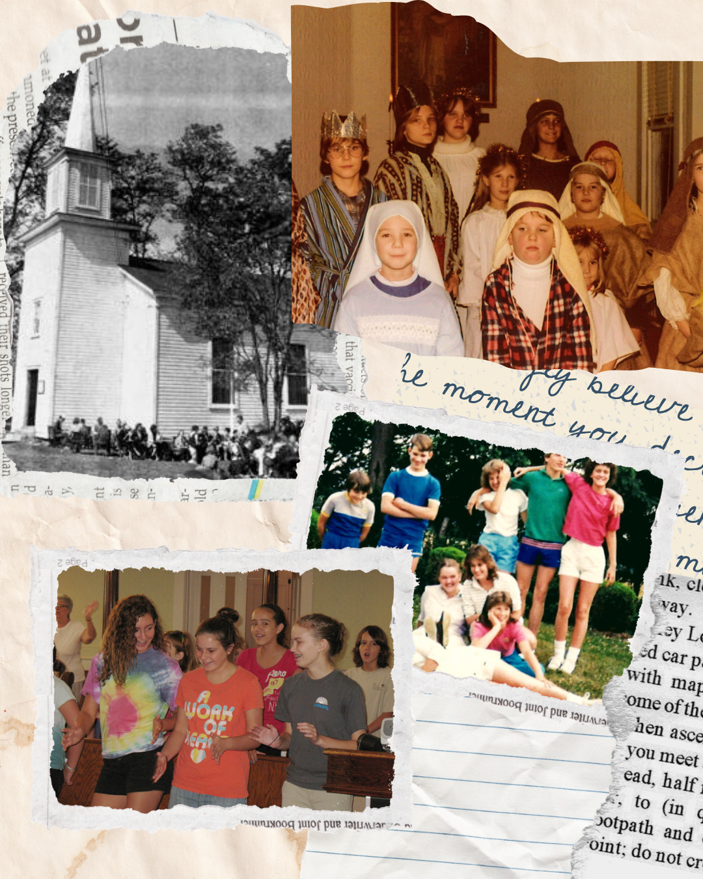
History of RUMC
Larry Scheuble

Slide 20
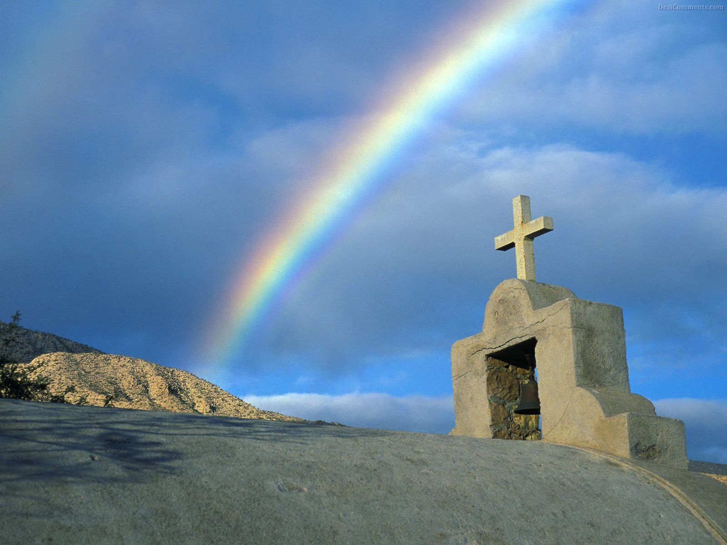
“Hymn of Promise” UMH 707
WORDS and MUSIC: Natalie Sleeth, 1986
Please stand as you are able and comfortable.
In the bulb there is a flower;
in the seed, an apple tree;
in cocoons, a hidden promise:
butterflies will soon be free!
In the cold and snow of winter
there’s a spring that waits to be,
unrevealed until its season,
something God alone can see.

Slide 21
“Hymn of Promise” UMH 707
WORDS and MUSIC: Natalie Sleeth, 1986
Please stand as you are able and comfortable.
There’s a song in every silence,
seeking word and melody;
there’s a dawn in every darkness,
bringing hope to you and me.
From the past will come the future;
what it holds, a mystery,
unrevealed until its season,
something God alone can see.

Slide 22
“Hymn of Promise” UMH 707
WORDS and MUSIC: Natalie Sleeth, 1986
Please stand as you are able and comfortable.
In our end is our beginning;
in our time, infinity;
in our doubt there is believing;
in our life, eternity.
In our death, a resurrection;
at the last, a victory,
unrevealed until its season,
something God alone can see.

Slide 23
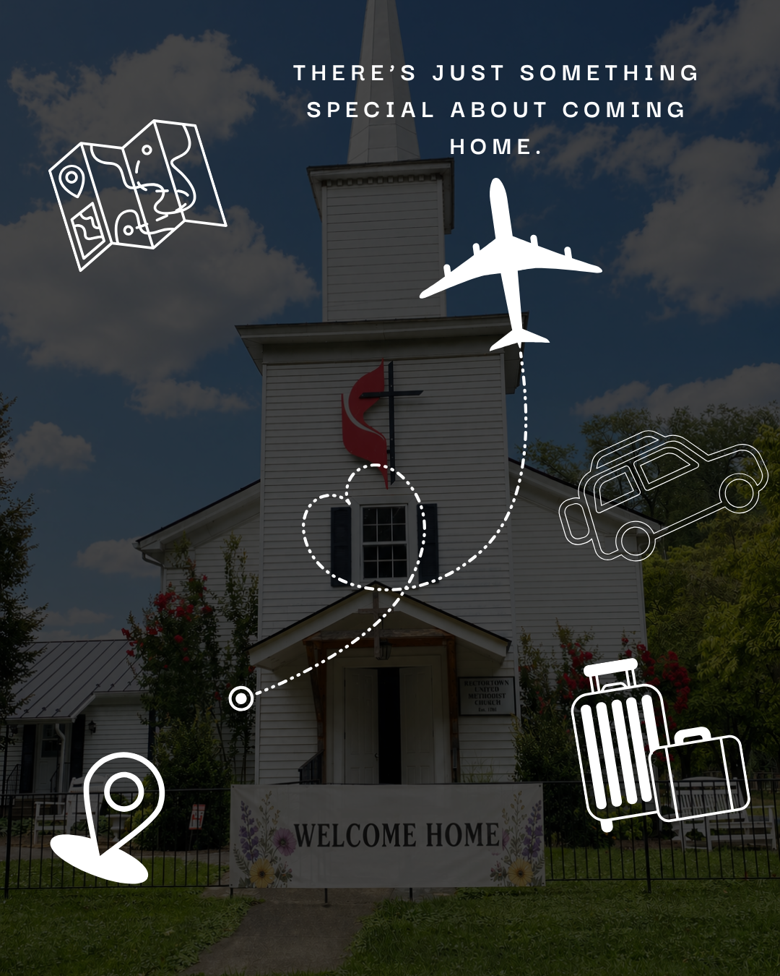
Guest Recognition

Slide 25
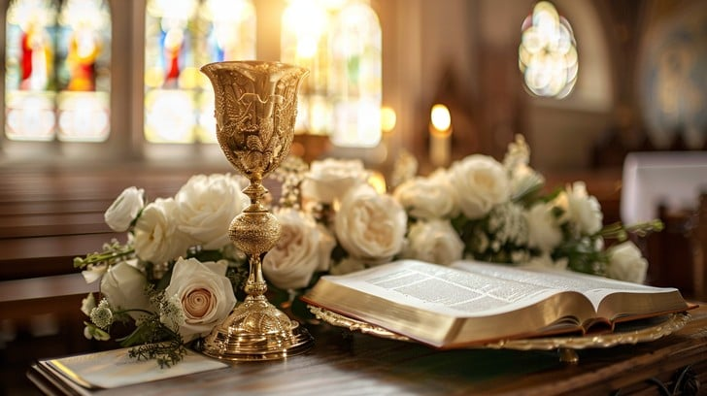
Communion

Slide 26
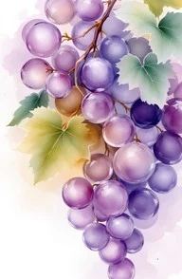
John 15: 1 – 11
NRSVUE

Slide 27
¹ “I am the true vine, and my Father is the vinegrower.
² He removes every branch in me that bears no fruit. Every branch that bears fruit he prunes to make it bear more fruit.
³ You have already been cleansed by the word that I have spoken to you.

Slide 28
⁴ Abide in me as I abide in you. Just as the branch cannot bear fruit by itself unless it abides in the vine, neither can you unless you abide in me.
⁵ I am the vine; you are the branches. Those who abide in me and I in them bear much fruit, because apart from me you can do nothing.

Slide 29
⁶ Whoever does not abide in me is thrown away like a branch and withers; such branches are gathered, thrown into the fire, and burned.
⁷ If you abide in me and my words abide in you, ask for whatever you wish, and it will be done for you.

Slide 30
⁸ My Father is glorified by this, that you bear much fruit and become my disciples.
⁹ As the Father has loved me, so I have loved you; abide in my love.

Slide 31
¹⁰ If you keep my commandments, you will abide in my love, just as I have kept my Father’s commandments and abide in his love.
¹¹ I have said these things to you so that my joy may be in you and that your joy may be complete.

Slide 32

Sermon
“Deep Roots Makes For Great Fruit”

Slide 33

“Blest Be the Tie That Binds” UMH 557
WORDS: John Fawcett, 1782 MUSIC: Johann G. Nageli; arr. by Lowell Mason, 1845
Please stand as you are able and comfortable.
Blest be the tie that binds
our hearts in Christian love;
the fellowship of kindred minds
is like to that above.

Slide 34
“Blest Be the Tie That Binds” UMH 557
WORDS: John Fawcett, 1782 MUSIC: Johann G. Nageli; arr. by Lowell Mason, 1845
Please stand as you are able and comfortable.
Before our Father’s throne
we pour our ardent prayers;
our fears, our hopes, our aims are one,
our comforts and our cares.

Slide 35
“Blest Be the Tie That Binds” UMH 557
WORDS: John Fawcett, 1782 MUSIC: Johann G. Nageli; arr. by Lowell Mason, 1845
Please stand as you are able and comfortable.
We share each other’s woes,
our mutual burdens bear;
and often for each other flows
the sympathizing tear.

Slide 36
“Blest Be the Tie That Binds” UMH 557
WORDS: John Fawcett, 1782 MUSIC: Johann G. Nageli; arr. by Lowell Mason, 1845
Please stand as you are able and comfortable.
When we asunder part,
it gives us inward pain;
but we shall still be joined in heart,
and hope to meet again.

Slide 37

Benediction
&
Meal Blessing

Slide 38
BLESSING AND BENEDICTION
This service has ended, and now
your service in the world begins!

Slide 39
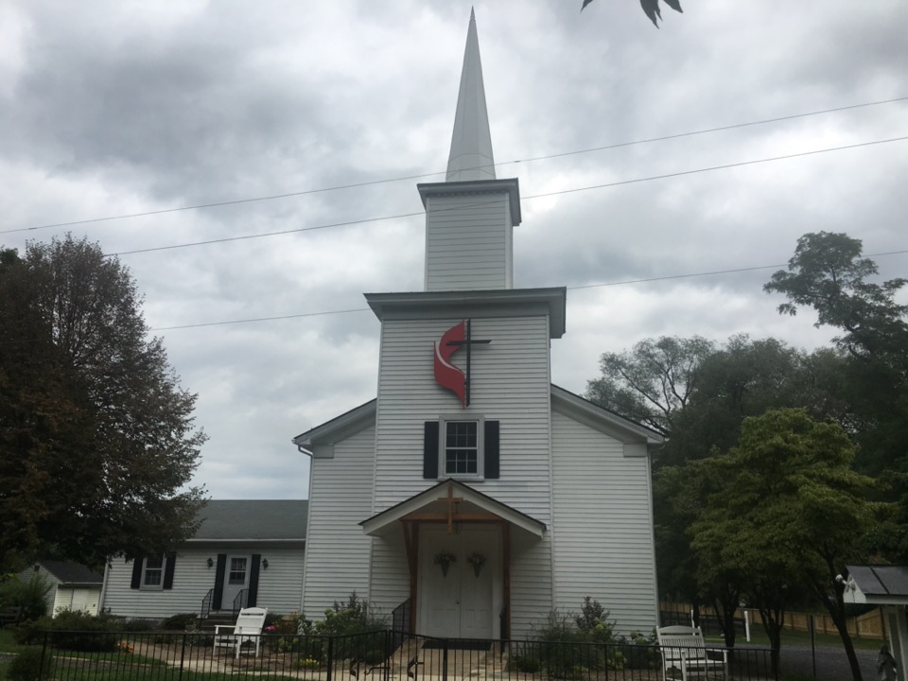
Rectortown United Methodist Church
serving God with
Prayer, Action, and Love
through Service.

