Slide 2
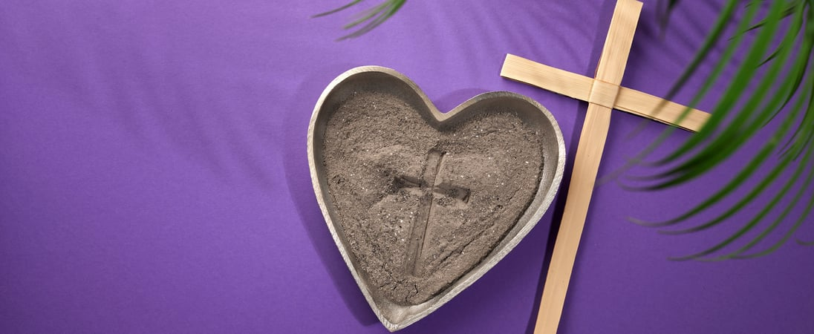
Prelude
Pastor Eduardo Carrillo
Ash Wednesday
February 18th , 2026
CCLI License:
3430384-01-1829
Livestream Notice: Our worship service is live-streamed and recorded. By attending, you consent to being included in the broadcast. Thank you for joining us!

Slide 3
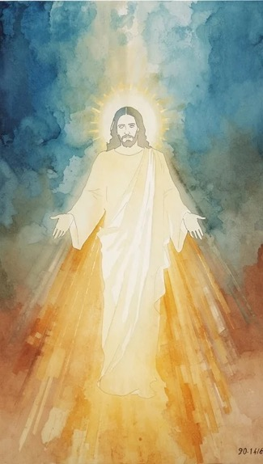
WELCOME,
ANNOUNCEMENTS,
and
CELEBRATIONS
Livestream Notice: Our worship service is live-streamed and recorded. By attending, you consent to being included in the broadcast. Thank you for joining us!

Slide 4
We come to the ashes
to remember we are dust, and to dust we shall return.

Slide 5
We come to the ashes
to confess our sins and seek God’s mercy.

Slide 6
We come to the ashes
to hear again that God is gracious, slow to anger, and abounding in steadfast love.

Slide 7
We come to the ashes
to open our hearts, to be renewed, and to change.

Slide 8
Holy and merciful God, we come to you aware of our failings. We confess our sins, lay down our pride, and open our hearts to your mercy.

Slide 9
Create in us clean hearts and renew a right spirit within us. Meet us in these ashes, remind us of your steadfast love, and guide us toward a true change of heart.

Slide 10
In this holy season, teach us to turn to you, to repent, and to live in hope, trusting that it is never too late for your grace to transform us. Amen.

Slide 11

Joel 2: 12 – 17
NRSVUE

Slide 12
¹² Yet even now, says the Lord, return to me with all your heart, with fasting, with weeping, and with mourning;
¹³ rend your hearts and not your clothing. Return to the Lord your God, for he is gracious and merciful, slow to anger, abounding in steadfast love, and relenting from punishment.

Slide 13
¹⁴ Who knows whether he will not turn and relent and leave a blessing behind him, a grain offering and a drink offering for the Lord your God?
¹⁵ Blow the trumpet in Zion; consecrate a fast;
call a solemn assembly;

Slide 14
¹⁶ gather the people. Consecrate the congregation; assemble the aged; gather the children, even infants at the breast. Let the bridegroom leave his room and the bride her canopy.

Slide 15
¹⁷ Between the vestibule and the altar, let the priests, the ministers of the Lord, weep. Let them say, “Spare your people, O Lord, and do not make your heritage a mockery, a byword among the nations. Why should it be said among the peoples, ‘Where is their God?’ ”

Slide 16
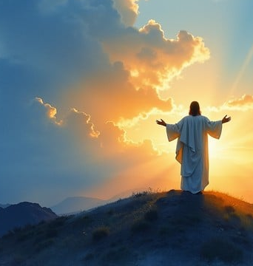
Matthew 17: 1 – 9
NRSVUE

Slide 17
Six days later, Jesus took with him Peter and James and his brother John and led them up a high mountain, by themselves.
² And he was transfigured before them, and his face shone like the sun, and his clothes became bright as light.

Slide 18
³ Suddenly there appeared to them Moses and Elijah, talking with him.
⁴ Then Peter said to Jesus, “Lord, it is good for us to be here; if you wish, I will set up three tents here, one for you, one for Moses, and one for Elijah.”

Slide 19
⁵ While he was still speaking, suddenly a bright cloud overshadowed them, and a voice from the cloud said, “This is my Son, the Beloved; with him I am well pleased; listen to him!”
⁶ When the disciples heard this, they fell to the ground and were overcome by fear.

Slide 20
⁷ But Jesus came and touched them, saying, “Get up and do not be afraid.”
⁸ And when they raised their eyes, they saw no one except Jesus himself alone.

Slide 21
⁹ As they were coming down the mountain, Jesus ordered them, “Tell no one about the vision until after the Son of Man has been raised from the dead.”

Slide 22
The Word of God for the people of God
Thanks be to God

Slide 23
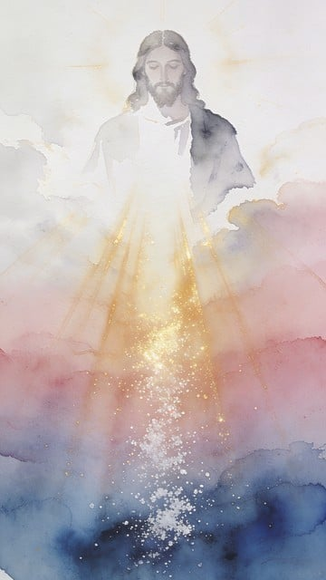
Sermon
“It’s Not Too Late for a Change of Heart”

Slide 24
BLESSING AND BENEDICTION
This service has ended, and now
your service in the world begins!

Slide 25
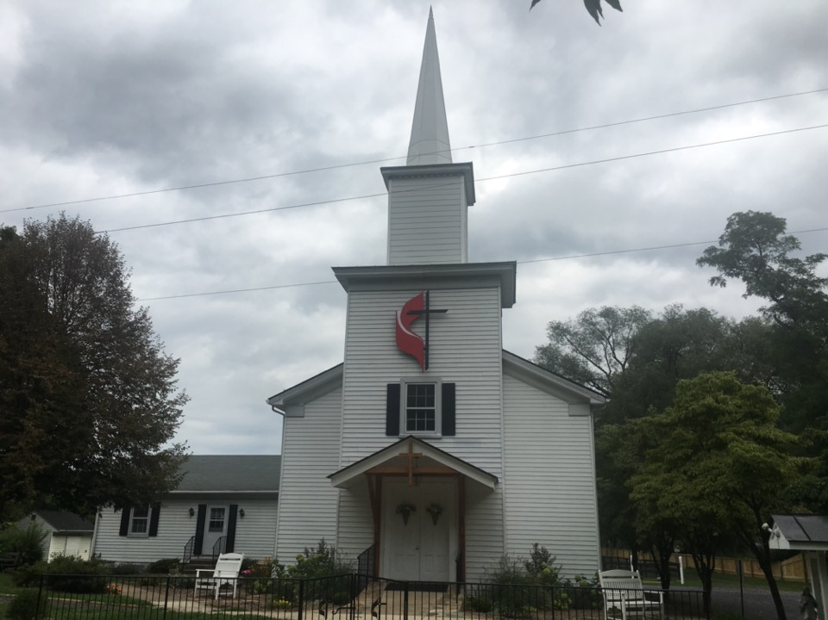
Rectortown United Methodist Church
serving God with
Prayer, Action, and Love
through Service.

