Slide 2

Prelude
Pastor Eduardo Carrillo
Twenty-first Sunday after Pentecost
October 18th, 2026
CCLI License:
3430384-01-1829
Livestream Notice: Our worship service is live-streamed and recorded. By attending, you consent to being included in the broadcast. Thank you for joining us!

Slide 3
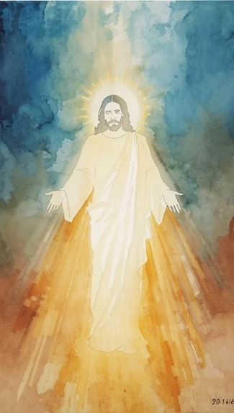
WELCOME,
ANNOUNCEMENTS,
and
CELEBRATIONS
Livestream Notice: Our worship service is live-streamed and recorded. By attending, you consent to being included in the broadcast. Thank you for joining us!

Slide 4
Caesar demands his coin, and the world claims its share of our allegiance.
But we bear the image of the God whose glory passes before us.

Slide 5
No one can see God's face and live, yet He hides us in the cleft of the rock.
He covers us with His hand and reveals His goodness in our midst.

Slide 6
Render to the world what belongs to the world, but give your soul to God.
We give ourselves entirely to the One who knows us by name.

Slide 7
Sovereign Lord, You hold the nations in Your hands, and earthly powers are but a drop in the bucket before You. We confess how easily we divide our loyalty,

Slide 8
giving our passions to worldly kingdoms while offering You only leftover devotion. Hide us today in the cleft of the rock, Christ Jesus, and let Your divine goodness pass before us.

Slide 9
Remind us that we bear Your image, not the world’s. Take our hearts, our lives, and our worship, and anchor us in Your glory. Amen.

Slide 10

“Immortal, Invisible, God Only Wise” UMH 103
WORDS: Walter Chalmers Smith, 1867
MUSIC: Welsh melody, 1839; harmonized by John Roberts
Please stand as you are able and comfortable.
Immortal, invisible,
God only wise,
in light inaccessible
hid from our eyes,
most blessed, most glorious,
the Ancient of Days,
almighty , victorious,
thy great name we praise.

Slide 11
“Immortal, Invisible, God Only Wise” UMH 103
WORDS: Walter Chalmers Smith, 1867
MUSIC: Welsh melody, 1839; harmonized by John Roberts
Please stand as you are able and comfortable.
Unresting, unhasting,
and silent as light,
nor wanting, nor wasting,
thou rulest in might;
thy justice like mountains
high soaring above
thy clouds which are fountains
of goodness and love.

Slide 12
“Immortal, Invisible, God Only Wise” UMH 103
WORDS: Walter Chalmers Smith, 1867
MUSIC: Welsh melody, 1839; harmonized by John Roberts
Please stand as you are able and comfortable.
To all, life thou givest,
to both great and small;
in all life thou livest,
the true life of all;
we blossom and flourish
as leaves on the tree,
and wither and perish,
but naught changeth thee.

Slide 13
“Immortal, Invisible, God Only Wise” UMH 103
WORDS: Walter Chalmers Smith, 1867
MUSIC: Welsh melody, 1839; harmonized by John Roberts
Please stand as you are able and comfortable.
Thou reignest in glory;
thou dwellest in light;
thine angels adore thee,
all veiling their sight;
all laud we would render:
O help us to see
’tis only the splendor
of light hideth thee.

Slide 15
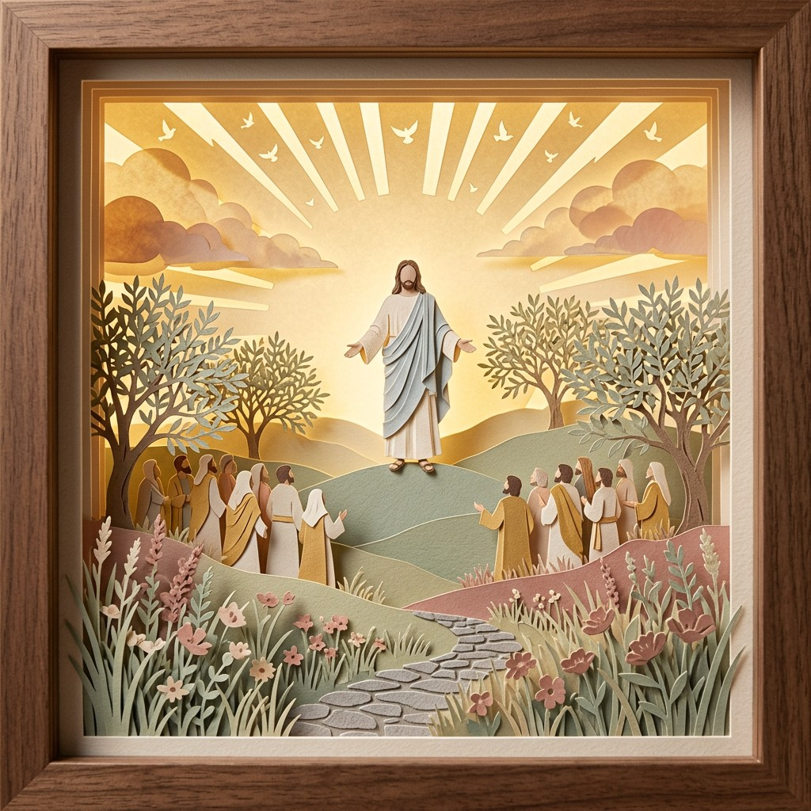
Exodus 33: 12 – 23
NRSVUE

Slide 16
¹² Moses said to the Lord, “See, you have said to me, ‘Bring up this people,’ but you have not let me know whom you will send with me. Yet you have said, ‘I know you by name, and you have also found favor in my sight.’
¹³ Now if I have found favor in your sight, please show me your ways, so that I may know you and find favor in your sight. Consider, too, that this nation is your people.”

Slide 17
¹⁴ He said, “My presence will go with you, and I will give you rest.”
¹⁵ And he said to him, “If your presence will not go, do not bring us up from here.

Slide 18
¹⁶ For how shall it be known that I have found favor in your sight, I and your people, unless you go with us? In this way, we shall be distinct, I and your people, from every people on the face of the earth.”
¹⁷ The Lord said to Moses, “I will also do this thing that you have asked, for you have found favor in my sight, and I know you by name.”

Slide 19
¹⁸ Moses said, “Please show me your glory.”
¹⁹ And he said, “I will make all my goodness pass before you and will proclaim before you the name, ‘The Lord,’ and I will be gracious to whom I will be gracious and will show mercy on whom I will show mercy.

Slide 20
²⁰ But,” he said, “you cannot see my face, for no one shall see me and live.”
²¹ And the Lord continued, “See, there is a place by me where you shall stand on the rock,

Slide 21
²² and while my glory passes by I will put you in a cleft of the rock, and I will cover you with my hand until I have passed by;
²³ then I will take away my hand, and you shall see my back, but my face shall not be seen.”

Slide 22
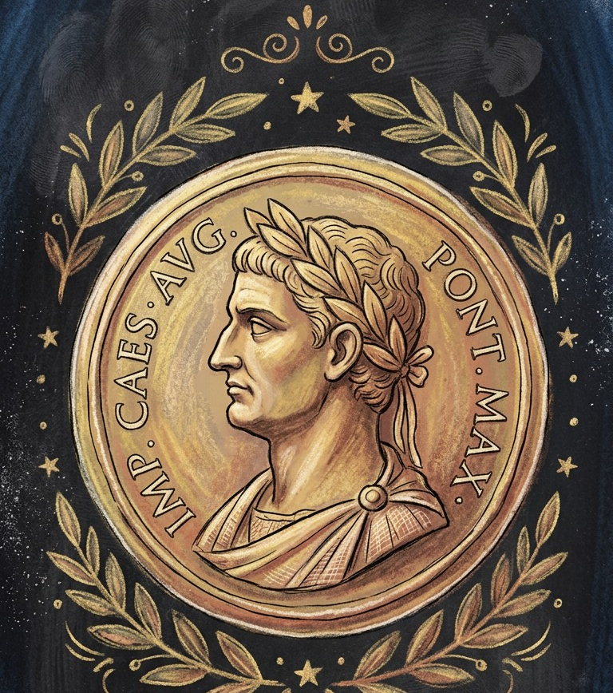
Matthew 22: 15 – 22
NRSVUE

Slide 23
¹⁵ Then the Pharisees went and plotted to entrap him in what he said.
¹⁶ So they sent their disciples to him, along with the Herodians, saying, “Teacher, we know that you are sincere, and teach the way of God in accordance with truth, and show deference to no one, for you do not regard people with partiality.

Slide 24
¹⁷ Tell us, then, what you think. Is it lawful to pay taxes to Caesar or not?”
¹⁸ But Jesus, aware of their malice, said, “Why are you putting me to the test, you hypocrites?

Slide 25
¹⁹ Show me the coin used for the tax.” And they brought him a denarius.
²⁰ Then he said to them, “Whose head is this and whose title?”

Slide 26
²¹ They answered, “Caesar’s.” Then he said to them, “Give therefore to Caesar the things that are Caesar’s and to God the things that are God’s.”
²² When they heard this, they were amazed, and they left him and went away.

Slide 27
The Word of God for the people of God
Thanks be to God

Slide 28

Sermon
Stamped with God’s Image

Slide 29

“O Jesus, I Have Promised” UMH 396
WORDS: John E. Bode, ca. 1866 MUSIC: Arthur H. Mann, 1881
Please stand as you are able and comfortable.
O Jesus, I have promised
to serve thee to the end;
be thou forever near me,
my Master and my friend.
I shall not fear the battle
if thou art by my side,
nor wander from the pathway
if thou wilt be my guide.

Slide 30
“O Jesus, I Have Promised” UMH 396
WORDS: John E. Bode, ca. 1866 MUSIC: Arthur H. Mann, 1881
Please stand as you are able and comfortable.
O let me feel thee near me!
The world is ever near;
I see the sights that dazzle,
the tempting sounds I hear;
my foes are ever near me,
around me and within;
but Jesus, draw thou nearer,
and shield my soul from sin.

Slide 31
“O Jesus, I Have Promised” UMH 396
WORDS: John E. Bode, ca. 1866 MUSIC: Arthur H. Mann, 1881
Please stand as you are able and comfortable.
O let me hear thee speaking
in accents clear and still,
above the storms of passion,
the murmurs of self-will.
O speak to reassure me,
to hasten or control;
O speak, and make me listen,
thou guardian of my soul.

Slide 32
“O Jesus, I Have Promised” UMH 396
WORDS: John E. Bode, ca. 1866 MUSIC: Arthur H. Mann, 1881
Please stand as you are able and comfortable.
O Jesus, thou hast promised
to all who follow thee
that where thou art in glory
there shall thy servant be.
And Jesus, I have promised
to serve thee to the end;
O give me grace to follow,
my Master and my friend.

Slide 37
Tithes and Offerings
Worship through giving
Notes:
https://www.goodfon.com/flowers/wallpaper-blue-wood-blossom-spring-flowers-vesna-iablonia-tsvety.html

Slide 38

“Praise God, from Whom All Blessings Flow” UMH 94
WORDS: Thomas Ken, 1674; adapted by Gilbert H. Viera, 1978
MUSIC: Geistliche Kirchengesange, 1623; harmonized by Ralph Vaughn Williams, 1906
Please stand as you are able and comfortable.
Praise God from whom all blessings flow;
Praise God, all creatures here below:
Alleluia! Alleluia!
Praise God, the source of all our gifts!
Praise Jesus Christ, whose power uplifts!
Praise the Spirit, Holy Spirit!
Alleluia! Alleluia! Alleluia!

Slide 39
Offertory Prayer

Slide 46

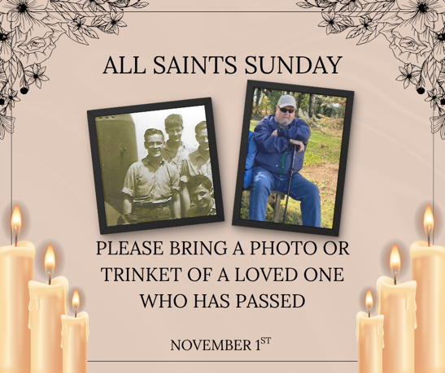
Upcoming Event Reminders

Slide 47
Postlude
This service has ended, and now
your service in the world begins!

Slide 48
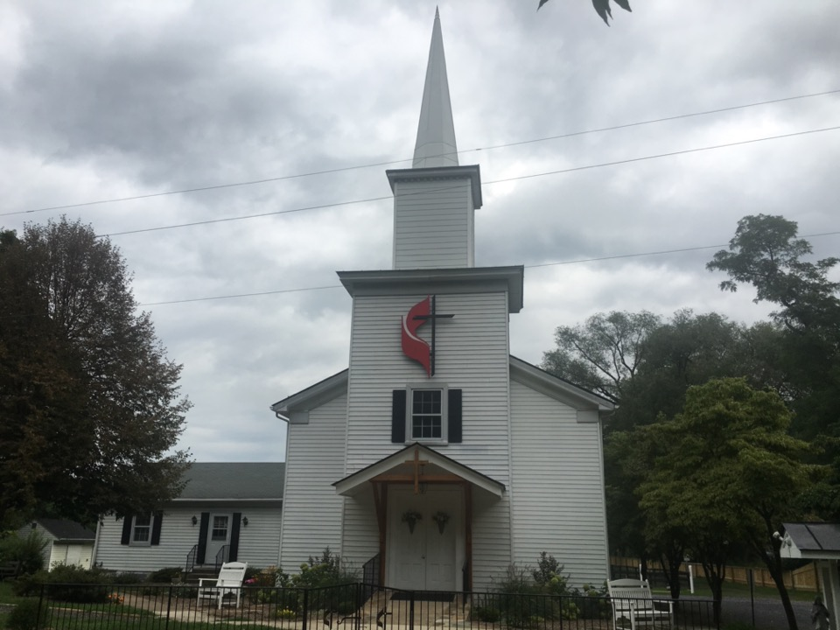
Rectortown United Methodist Church
serving God with
Prayer, Action, and Love
through Service.

