Slide 2

Prelude
Pastor Eduardo Carrillo
4th Sunday of Lent
March 15th, 2026
CCLI License:
3430384-01-1829
Livestream Notice: Our worship service is live-streamed and recorded. By attending, you consent to being included in the broadcast. Thank you for joining us!

Slide 3
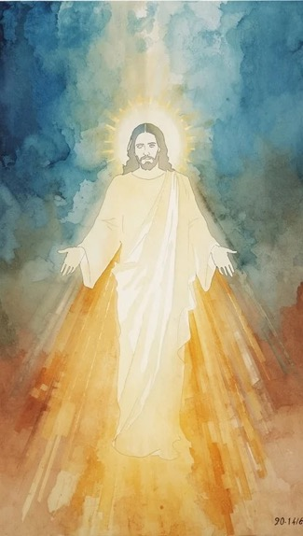
WELCOME,
ANNOUNCEMENTS,
and
CELEBRATIONS
Livestream Notice: Our worship service is live-streamed and recorded. By attending, you consent to being included in the broadcast. Thank you for joining us!

Slide 4
Wilderness-wanderers, holiness-seekers, listen for God’s voice today.
A voice of holy righteousness, not human rightness.

Slide 5
What does God say as God looks at your life?
Lord, give us strength to listen with honesty.

Slide 6
Where does God affirm, and where does God challenge?
Lord, give us strength to listen with humility.

Slide 7
Where does God call us to take
responsibility? What is ours to do?
Lord, give us courage to accept and to act on what we hear.

Slide 8
Holy One, source of all that is good and right, we confess that at times we find safety in our own sense of rightness. We confuse our own thoughts and beliefs with yours.

Slide 9
We don’t leave room for you to challenge or change us. And when we sense you nudging us to a change or shift, we fear what might happen. Forgive us.

Slide 10
Give us the courage to speak and act where you call us to speak and act, and the humility not to where you don’t. We trust you to be God,

Slide 11
so that we can simply be the human beings we are, flawed, faithful, and figuring it out. In Jesus’ name we pray. Amen.

Slide 12
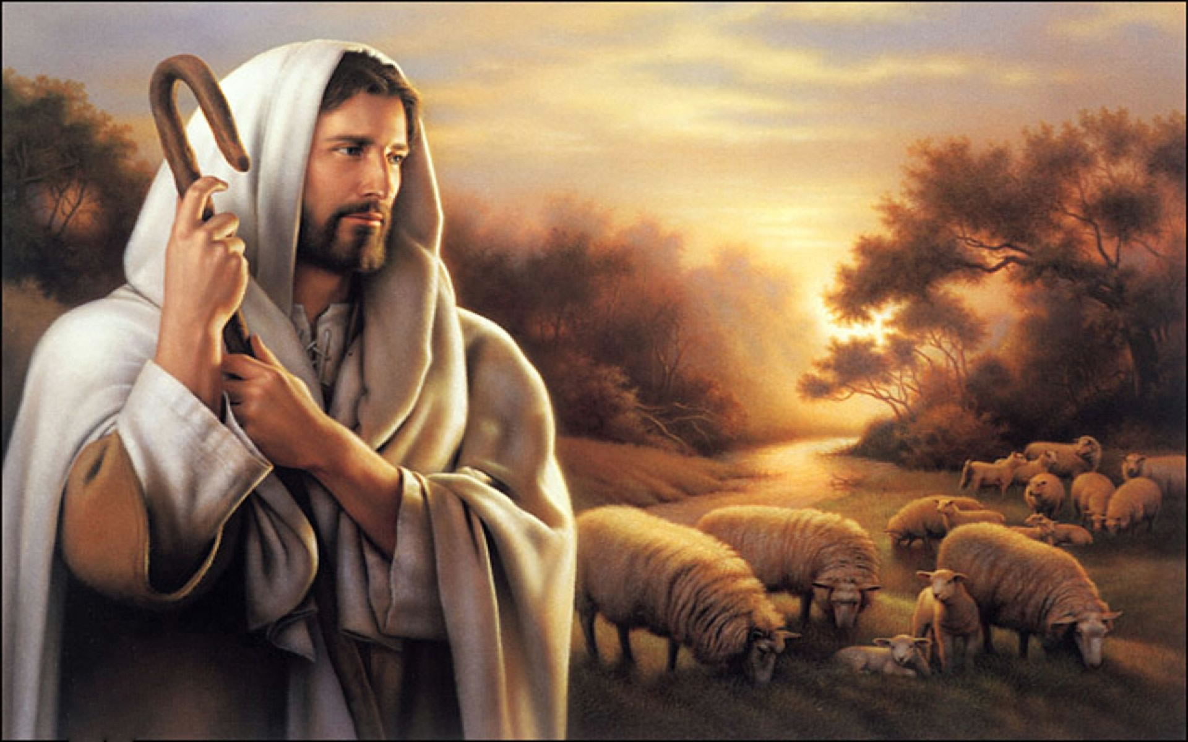
“Savior, Like a Shepherd Lead Us” UMH 381
WORDS: Attributed to Dorothy A. Thrupp, 1836
MUSIC: William B. Bradbury, 1859
Please stand as you are able and comfortable.
Savior, like a shepherd lead us,
much we need thy tender care;
in thy pleasant pastures feed us,
for our use thy folds prepare.

Slide 13
“Savior, Like a Shepherd Lead Us” UMH 381
WORDS: Attributed to Dorothy A. Thrupp, 1836
MUSIC: William B. Bradbury, 1859
Please stand as you are able and comfortable.
Blessed Jesus, blessed Jesus!
Thou hast bought us, thine we are.
Blessed Jesus, blessed Jesus!
Thou hast bought us, thine we are.

Slide 14
“Savior, Like a Shepherd Lead Us” UMH 381
WORDS: Attributed to Dorothy A. Thrupp, 1836
MUSIC: William B. Bradbury, 1859
Please stand as you are able and comfortable.
We are thine, thou dost befriend us,
be the guardian of our way;
keep thy flock, from sin defend us,
seek us when we go astray.

Slide 15
“Savior, Like a Shepherd Lead Us” UMH 381
WORDS: Attributed to Dorothy A. Thrupp, 1836
MUSIC: William B. Bradbury, 1859
Please stand as you are able and comfortable.
Blessed Jesus, blessed Jesus!
Thou hast bought us, thine we are.
Blessed Jesus, blessed Jesus!
Thou hast bought us, thine we are.

Slide 16
“Savior, Like a Shepherd Lead Us” UMH 381
WORDS: Attributed to Dorothy A. Thrupp, 1836
MUSIC: William B. Bradbury, 1859
Please stand as you are able and comfortable.
Thou hast promised to receive us,
poor and sinful though we be;
thou hast mercy to relieve us,
grace to cleanse and power to free.

Slide 17
“Savior, Like a Shepherd Lead Us” UMH 381
WORDS: Attributed to Dorothy A. Thrupp, 1836
MUSIC: William B. Bradbury, 1859
Please stand as you are able and comfortable.
Blessed Jesus, blessed Jesus!
Thou hast bought us, thine we are.
Blessed Jesus, blessed Jesus!
Thou hast bought us, thine we are.

Slide 18
“Savior, Like a Shepherd Lead Us” UMH 381
WORDS: Attributed to Dorothy A. Thrupp, 1836
MUSIC: William B. Bradbury, 1859
Please stand as you are able and comfortable.
Early let us seek thy favor,
early let us do thy will;
blessed Lord and only Savior,
with thy love our bossoms fill.

Slide 19
“Savior, Like a Shepherd Lead Us” UMH 381
WORDS: Attributed to Dorothy A. Thrupp, 1836
MUSIC: William B. Bradbury, 1859
Please stand as you are able and comfortable.
Blessed Jesus, blessed Jesus!
Thou hast bought us, thine we are.
Blessed Jesus, blessed Jesus!
Thou hast bought us, thine we are.

Slide 21
Prayer For Illumination
Spirit of the living God, fall afresh on me.
Spirit of the living God, fall afresh on me.
Melt me, mold me, fill me, use me.
Spirit of the living God, fall afresh on me.
UMH 393

Slide 22

Psalm 32: 1 – 7
NRSVUE

Slide 23
¹ Happy are those whose transgression is forgiven, whose sin is covered.
² Happy are those to whom the Lord imputes no iniquity and in whose spirit there is no deceit.
³ While I kept silent, my body wasted away through my groaning all day long.

Slide 24
⁴ For day and night your hand was heavy upon me; my strength was dried up as by the heat of summer. Selah
⁵ Then I acknowledged my sin to you, and I did not hide my iniquity; I said, “I will confess my transgressions to the Lord,” and you forgave the guilt of my sin. Selah

Slide 25
⁶ Therefore let all who are faithful offer prayer to you; at a time of distress,[the rush of mighty waters shall not reach them.
⁷ You are a hiding place for me; you preserve me from trouble; you surround me with glad cries of deliverance. Selah

Slide 26

Acts 9: 1 – 22
NRSVUE

Slide 27
Meanwhile Saul, still breathing threats and murder against the disciples of the Lord, went to the high priest
² and asked him for letters to the synagogues at Damascus, so that if he found any who belonged to the Way, men or women, he might bring them bound to Jerusalem.

Slide 28
³ Now as he was going along and approaching Damascus, suddenly a light from heaven flashed around him.
⁴ He fell to the ground and heard a voice saying to him, “Saul, Saul, why do you persecute me?”

Slide 29
⁵ He asked, “Who are you, Lord?” The reply came, “I am Jesus, whom you are persecuting.
⁶ But get up and enter the city, and you will be told what you are to do.”
⁷ The men who were traveling with him stood speechless because they heard the voice but saw no one.

Slide 30
⁸ Saul got up from the ground, and though his eyes were open, he could see nothing; so they led him by the hand and brought him into Damascus.
⁹ For three days he was without sight and neither ate nor drank.

Slide 31
¹⁰ Now there was a disciple in Damascus named Ananias. The Lord said to him in a vision, “Ananias.” He answered, “Here I am, Lord.”
¹¹ The Lord said to him, “Get up and go to the street called Straight, and at the house of Judas look for a man of Tarsus named Saul. At this moment he is praying,

Slide 32
¹² and he has seen in a vision^{[b]} a man named Ananias come in and lay his hands on him so that he might regain his sight.”
¹³ But Ananias answered, “Lord, I have heard from many about this man, how much evil he has done to your saints in Jerusalem,
¹⁴ and here he has authority from the chief priests to bind all who invoke your name.”

Slide 33
¹⁵ But the Lord said to him, “Go, for he is an instrument whom I have chosen to bring my name before gentiles and kings and before the people of Israel;
¹⁶ I myself will show him how much he must suffer for the sake of my name.”

Slide 34
¹⁷ So Ananias went and entered the house. He laid his hands on Saul and said, “Brother Saul, the Lord Jesus, who appeared to you on your way here, has sent me so that you may regain your sight and be filled with the Holy Spirit.”
¹⁸ And immediately something like scales fell from his eyes, and his sight was restored. Then he got up and was baptized,

Slide 35
¹⁹ and after taking some food, he regained his strength. For several days he was with the disciples in Damascus,
²⁰ and immediately he began to proclaim Jesus in the synagogues, saying, “He is the Son of God.”

Slide 36
²¹ All who heard him were amazed and said, “Is not this the man who made havoc in Jerusalem among those who invoked this name? And has he not come here for the purpose of bringing them bound before the chief priests?”

Slide 37
²² Saul became increasingly more powerful and confounded the Jews who lived in Damascus by proving that Jesus was the Messiah.

Slide 38
The Word of God for the people of God
Thanks be to God

Slide 39

Sermon
“It’s Not Too Late to Take Ownership”

Slide 40
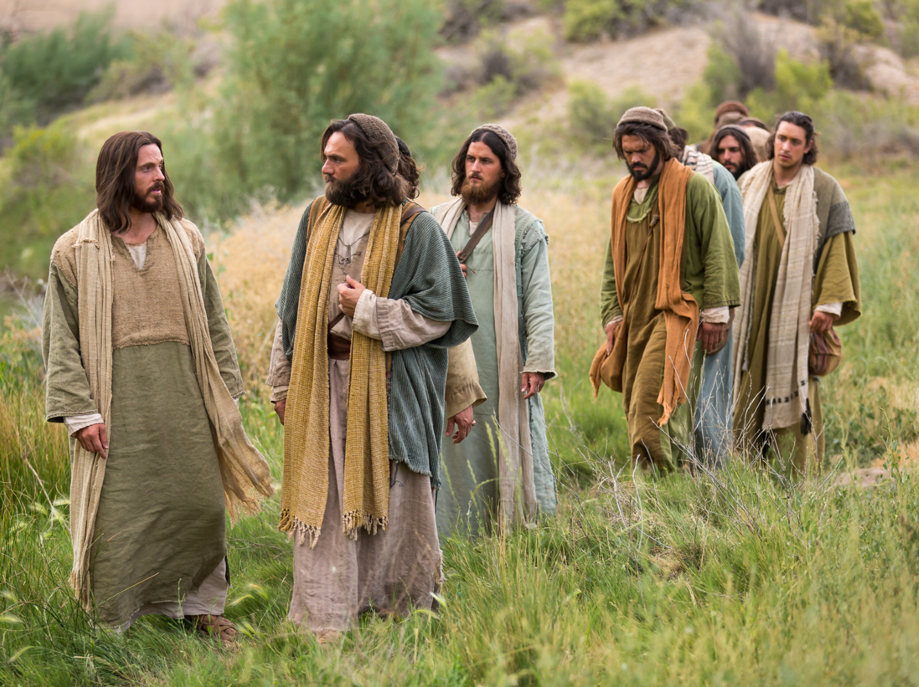
“Close to Thee” UMH 407
WORDS: Fanny J. Crosby, 1874 MUSIC: Silas J. Vail, 1874
Please stand as you are able and comfortable.
Thou my everlasting portion,
more than friend or life to me,
all along my pilgrim journey,
Savior, let me walk with thee.
Close to thee, close to thee,
close to thee, close to thee,
all along my pilgrim journey,
Savior, let me walk with thee.

Slide 41
“Close to Thee” UMH 407
WORDS: Fanny J. Crosby, 1874 MUSIC: Silas J. Vail, 1874
Please stand as you are able and comfortable.
Not for ease or worldly pleasure,
nor for fame my prayer shall be;
gladly will I toil and suffer,
only let me walk with thee.
Close to thee, close to thee,
close to thee, close to thee,
gladly will I toil and suffer,
only let me walk with thee.

Slide 42
“Close to Thee” UMH 407
WORDS: Fanny J. Crosby, 1874 MUSIC: Silas J. Vail, 1874
Please stand as you are able and comfortable.
Lead me through the vale of shadows,
bear me o’er life’s fitful sea;
then the gate of life eternal
may I enter, Lord, with thee.
Close to thee, close to thee,
close to thee, close to thee,
then the gate of life eternal
may I enter, Lord, with thee.

Slide 52
Tithes and Offerings
Worship through giving
Notes:
https://www.goodfon.com/flowers/wallpaper-blue-wood-blossom-spring-flowers-vesna-iablonia-tsvety.html

Slide 53

“Praise God, from Whom All Blessings Flow” UMH 94
WORDS: Thomas Ken, 1674; adapted by Gilbert H. Viera, 1978
MUSIC: Geistliche Kirchengesange, 1623; harmonized by Ralph Vaughn Williams, 1906
Please stand as you are able and comfortable.
Praise God from whom all blessings flow;
Praise God, all creatures here below:
Alleluia! Alleluia!
Praise God, the source of all our gifts!
Praise Jesus Christ, whose power uplifts!
Praise the Spirit, Holy Spirit!
Alleluia! Alleluia! Alleluia!

Slide 54
Offertory Prayer

Slide 55
“Open My Eyes, That I May See” UMH 454
WORDS and MUSIC: Clara H. Scott, 1895
Please stand as you are able and comfortable.
Open my eyes
that I may see
glimpses of truth
thou hast for me;
place in my hands
the wonderful key
that shall unclasp
and set me free.

Slide 56
“Open My Eyes, That I May See” UMH 454
WORDS and MUSIC: Clara H. Scott, 1895
Please stand as you are able and comfortable.
Silently now
I wait for thee,
ready, my God,
thy will to see.
Open my eyes,
illumine me,
Spirit Divine!

Slide 57
“Open My Eyes, That I May See” UMH 454
WORDS and MUSIC: Clara H. Scott, 1895
Please stand as you are able and comfortable.
Open my ears,
that I may hear
voices of truth
thou sendest clear;
and while the wavenotes
fall on my ear,
everything false
will disappear.

Slide 58
“Open My Eyes, That I May See” UMH 454
WORDS and MUSIC: Clara H. Scott, 1895
Please stand as you are able and comfortable.
Silently now
I wait for thee,
ready, my God,
thy will to see.
Open my ears,
illumine me,
Spirit Divine!

Slide 59
“Open My Eyes, That I May See” UMH 454
WORDS and MUSIC: Clara H. Scott, 1895
Please stand as you are able and comfortable.
Open my mouth,
and let me bear
gladly the warm
truth everywhere;
open my heart
and let me prepare
love with thy children
thus to share.

Slide 60
“Open My Eyes, That I May See” UMH 454
WORDS and MUSIC: Clara H. Scott, 1895
Please stand as you are able and comfortable.
Silently now
I wait for thee,
ready, my God,
thy will to see.
Open my heart,
illumine me,
Spirit Divine!

Slide 62
BLESSING AND BENEDICTION
This service has ended, and now
your service in the world begins!

Slide 63
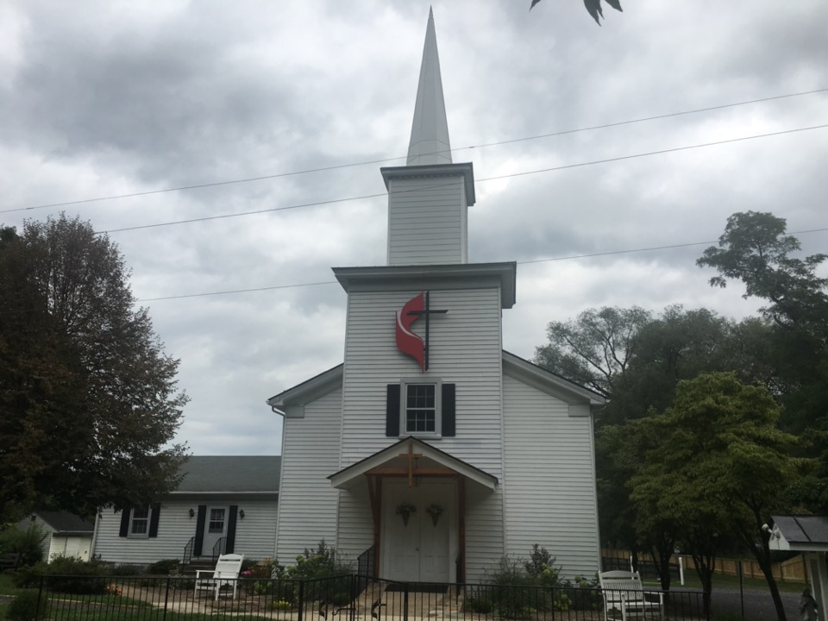
Rectortown United Methodist Church
serving God with
Prayer, Action, and Love
through Service.

