Slide 2

Prelude
Pastor Eduardo Carrillo
6th Sunday after Easter/ Mother’s Day
May 10th, 2026
CCLI License:
3430384-01-1829
Livestream Notice: Our worship service is live-streamed and recorded. By attending, you consent to being included in the broadcast. Thank you for joining us!

Slide 3
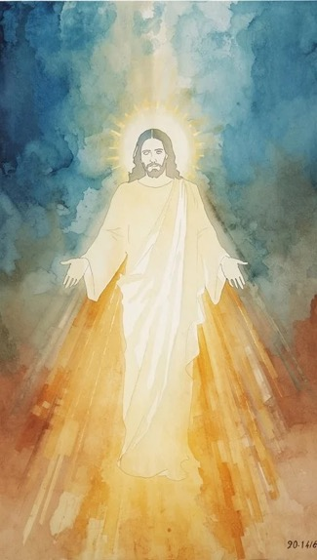
WELCOME,
ANNOUNCEMENTS,
and
CELEBRATIONS
Livestream Notice: Our worship service is live-streamed and recorded. By attending, you consent to being included in the broadcast. Thank you for joining us!

Slide 4
The world searches for a God it cannot name, but we have been found by Him!
Praise our God, all peoples! Let the sound of His praise be heard!

Slide 5
He is not far from any one of us, He is here, He is near, He is alive!
God brought us through, and we are still here to praise Him!

Slide 6
He did not ignore our cry! He did not turn away! He is the God who is known!
We shout with joy, the Unknown God has made Himself known to us in Christ!

Slide 7
God of every nation and every searching soul, we celebrate You today! You are not a God who hides, You are a God who comes. You walked among us, You died for us,

Slide 8
You rose for us, and You live in us. Like the Psalmist, we come with our testimony, You have heard us, You have held us, You have never let us go. Forgive us when we stop listening,

Slide 9
holding on, and trusting you. Fill us afresh with Your Spirit today. Let this worship ring out boldly, You are ours and we are Yours. Amen!

Slide 10
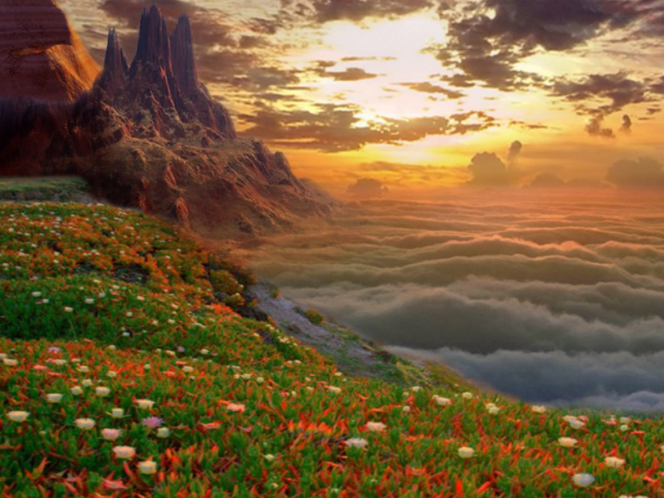
“For the Beauty of the Earth” UMH 92
WORDS: Folliot S. Pierpoint, 1864
MUSIC: Conrad Kocher, 1383; arranged by W. H. Monk, 1861
Please stand as you are able and comfortable.
For the beauty of the earth,
for the glory of the skies,
for the love which from our birth
over and around us lies;
Lord of all, to thee we raise
this our hymn of grateful praise.

Slide 11
“For the Beauty of the Earth” UMH 92
WORDS: Folliot S. Pierpoint, 1864
MUSIC: Conrad Kocher, 1383; arranged by W. H. Monk, 1861
Please stand as you are able and comfortable.
For the beauty of each hour,
of the day and of the night,
hill and vale, and tree and flower
sun and moon, and stars of light;
Lord of all, to thee we raise
this our hymn of grateful praise.

Slide 12
“For the Beauty of the Earth” UMH 92
WORDS: Folliot S. Pierpoint, 1864
MUSIC: Conrad Kocher, 1383; arranged by W. H. Monk, 1861
Please stand as you are able and comfortable.
For the joy of ear and eye,
for the heart and mind’s delight,
for the mystic harmony
linking sense to sound and sight;
Lord of all, to thee we raise
this our hymn of grateful praise.

Slide 13
“For the Beauty of the Earth” UMH 92
WORDS: Folliot S. Pierpoint, 1864
MUSIC: Conrad Kocher, 1383; arranged by W. H. Monk, 1861
Please stand as you are able and comfortable.
For the joy of human love,
brother, sister, parent, child,
friends on earth and friends above,
for all gentle thoughts and mild;
Lord of all, to thee we raise
this our hymn of grateful praise.

Slide 14
“For the Beauty of the Earth” UMH 92
WORDS: Folliot S. Pierpoint, 1864
MUSIC: Conrad Kocher, 1383; arranged by W. H. Monk, 1861
Please stand as you are able and comfortable.
For thy church, that evermore,
lifteth holy hands above,
offering up on every shore
her pure sacrifice of love;
Lord of all, to thee we raise
this our hymn of grateful praise.

Slide 15
“For the Beauty of the Earth” UMH 92
WORDS: Folliot S. Pierpoint, 1864
MUSIC: Conrad Kocher, 1383; arranged by W. H. Monk, 1861
Please stand as you are able and comfortable.
For thyself, best Gift Divine,
to the world so freely given,
for that great, great love of thine,
peace on earth, and joy in heaven;
Lord of all, to thee we raise
this our hymn of grateful praise.

Slide 17
Prayer For Illumination
Spirit of the living God, fall afresh on me.
Spirit of the living God, fall afresh on me.
Melt me, mold me, fill me, use me.
Spirit of the living God, fall afresh on me.
UMH 393

Slide 18
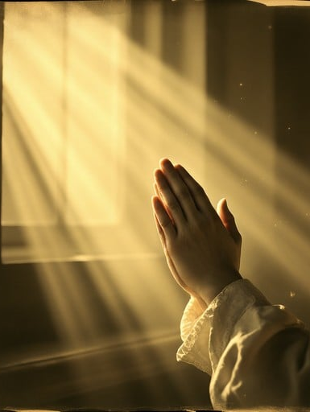
Psalm 66: 8 – 20
NRSVUE

Slide 19
⁸ Bless our God, O peoples; let the sound of his praise be heard,
⁹ who has kept us among the living and has not let our feet slip.
¹⁰ For you, O God, have tested us; you have tried us as silver is tried.

Slide 20
¹¹ You brought us into the net; you laid burdens on our backs;
¹² you let people ride over our heads; we went through fire and through water; yet you have brought us out to a spacious place.

Slide 21
¹³ I will come into your house with burnt offerings; I will pay you my vows,
¹⁴ those that my lips uttered and my mouth promised when I was in trouble.
¹⁵ I will offer to you burnt offerings of fatted calves, with the smoke of the sacrifice of rams; I will make an offering of bulls and goats. Selah

Slide 22
¹⁶ Come and hear, all you who fear God, and I will tell what he has done for me.
¹⁷ I cried aloud to him, and he was extolled with my tongue.
¹⁸ If I had cherished iniquity in my heart, the Lord would not have listened.

Slide 23
¹⁹ But truly God has listened; he has heard the words of my prayer.
²⁰ Blessed be God, who has not rejected my prayer or removed his steadfast love from me.

Slide 24
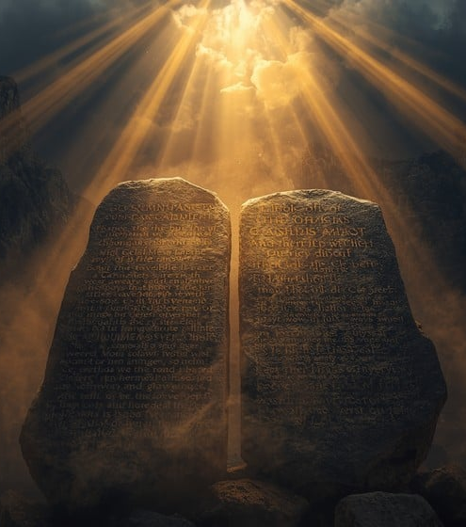
John 14: 15 -21
NRSVUE

Slide 25
¹⁵ “If you love me, you will keep my commandments.
¹⁶ And I will ask the Father, and he will give you another Advocate, to be with you forever.

Slide 26
¹⁷ This is the Spirit of truth, whom the world cannot receive because it neither sees him nor knows him. You know him because he abides with you, and he will be in you.
¹⁸ “I will not leave you orphaned; I am coming to you.

Slide 27
¹⁹ In a little while the world will no longer see me, but you will see me; because I live, you also will live.
²⁰ On that day you will know that I am in my Father, and you in me, and I in you.

Slide 28
²¹ They who have my commandments and keep them are those who love me, and those who love me will be loved by my Father, and I will love them and reveal myself to them.”

Slide 29
The Word of God for the people of God
Thanks be to God

Slide 30

Sermon
“Love That Never Quits”

Slide 31
“Swing Low, Sweet Chariot” UMH 703
WORDS and MUSIC: Afro-American spiritual; adapted and arranged by William Farley Smith, 1987
Please stand as you are able and comfortable.
Swing low, sweet chariot,
coming for to carry me home;
swing low, sweet chariot,
coming for to carry me home.

Slide 32
“Swing Low, Sweet Chariot” UMH 703
WORDS and MUSIC: Afro-American spiritual; adapted and arranged by William Farley Smith, 1987
Please stand as you are able and comfortable.
I looked over Jordan,
and what did I see,
coming for to carry me home?
A band of angels
coming after me,
coming for to carry me home.

Slide 33
“Swing Low, Sweet Chariot” UMH 703
WORDS and MUSIC: Afro-American spiritual; adapted and arranged by William Farley Smith, 1987
Please stand as you are able and comfortable.
Swing low, sweet chariot,
coming for to carry me home;
swing low, sweet chariot,
coming for to carry me home.

Slide 34
“Swing Low, Sweet Chariot” UMH 703
WORDS and MUSIC: Afro-American spiritual; adapted and arranged by William Farley Smith, 1987
Please stand as you are able and comfortable.
If you get there
before I do,
coming for to carry me home;
tell all my friends
I’m coming too,
coming for to carry me home.

Slide 35
“Swing Low, Sweet Chariot” UMH 703
WORDS and MUSIC: Afro-American spiritual; adapted and arranged by William Farley Smith, 1987
Please stand as you are able and comfortable.
Swing low, sweet chariot,
coming for to carry me home;
swing low, sweet chariot,
coming for to carry me home.

Slide 36
“Swing Low, Sweet Chariot” UMH 703
WORDS and MUSIC: Afro-American spiritual; adapted and arranged by William Farley Smith, 1987
Please stand as you are able and comfortable.
I’m sometimes up,
I’m sometimes down,
coming for to carry me home;
but still my soul
feels heavenly bound,
coming for to carry me home.

Slide 37
“Swing Low, Sweet Chariot” UMH 703
WORDS and MUSIC: Afro-American spiritual; adapted and arranged by William Farley Smith, 1987
Please stand as you are able and comfortable.
Swing low, sweet chariot,
coming for to carry me home;
swing low, sweet chariot,
coming for to carry me home.

Slide 38
“Swing Low, Sweet Chariot” UMH 703
WORDS and MUSIC: Afro-American spiritual; adapted and arranged by William Farley Smith, 1987
Please stand as you are able and comfortable.
The brightest day
that I can say,
coming for to carry me home;
when Jesus washed
my sins away,
coming for to carry me home.

Slide 39
“Swing Low, Sweet Chariot” UMH 703
WORDS and MUSIC: Afro-American spiritual; adapted and arranged by William Farley Smith, 1987
Please stand as you are able and comfortable.
Swing low, sweet chariot,
coming for to carry me home;
swing low, sweet chariot,
coming for to carry me home.

Slide 49
Tithes and Offerings
Worship through giving
Notes:
https://www.goodfon.com/flowers/wallpaper-blue-wood-blossom-spring-flowers-vesna-iablonia-tsvety.html

Slide 50

“Praise God, from Whom All Blessings Flow” UMH 94
WORDS: Thomas Ken, 1674; adapted by Gilbert H. Viera, 1978
MUSIC: Geistliche Kirchengesange, 1623; harmonized by Ralph Vaughn Williams, 1906
Please stand as you are able and comfortable.
Praise God from whom all blessings flow;
Praise God, all creatures here below:
Alleluia! Alleluia!
Praise God, the source of all our gifts!
Praise Jesus Christ, whose power uplifts!
Praise the Spirit, Holy Spirit!
Alleluia! Alleluia! Alleluia!

Slide 51
Offertory Prayer

Slide 52
“Because He Lives” UMH 364
WORDS: Gloria and William J. Gaither, 1971 MUSIC: William J. Gaither, 1971
Please stand as you are able and comfortable.
God sent his Son, they called him Jesus;
he came to love, heal, and forgive;
he lived and died to buy my pardon,
an empty grave is there to prove my Savior lives.

Slide 53
“Because He Lives” UMH 364
WORDS: Gloria and William J. Gaither, 1971 MUSIC: William J. Gaither, 1971
Please stand as you are able and comfortable.
Because he lives, I can face tomorrow;
because he lives, all fear is gone;
because I know he holds the future,
and life is worth the living just because he lives.

Slide 54
“Because He Lives” UMH 364
WORDS: Gloria and William J. Gaither, 1971 MUSIC: William J. Gaither, 1971
Please stand as you are able and comfortable.
How sweet to hold a newborn baby,
and feel the pride and joy he gives;
but greater still the calm assurance,
this child can face uncertain days because he lives.

Slide 55
“Because He Lives” UMH 364
WORDS: Gloria and William J. Gaither, 1971 MUSIC: William J. Gaither, 1971
Please stand as you are able and comfortable.
Because he lives, I can face tomorrow;
because he lives, all fear is gone;
because I know he holds the future,
and life is worth the living just because he lives.

Slide 56
“Because He Lives” UMH 364
WORDS: Gloria and William J. Gaither, 1971 MUSIC: William J. Gaither, 1971
Please stand as you are able and comfortable.
And then one day I’ll cross the river;
I’ll fight life’s final war with pain;
and then as death gives way to victory,
I’ll see the lights of glory and I’ll know he reigns.

Slide 57
“Because He Lives” UMH 364
WORDS: Gloria and William J. Gaither, 1971 MUSIC: William J. Gaither, 1971
Please stand as you are able and comfortable.
Because he lives, I can face tomorrow;
because he lives, all fear is gone;
because I know he holds the future,
and life is worth the living just because he lives.

Slide 59
BLESSING AND BENEDICTION
This service has ended, and now
your service in the world begins!

Slide 60
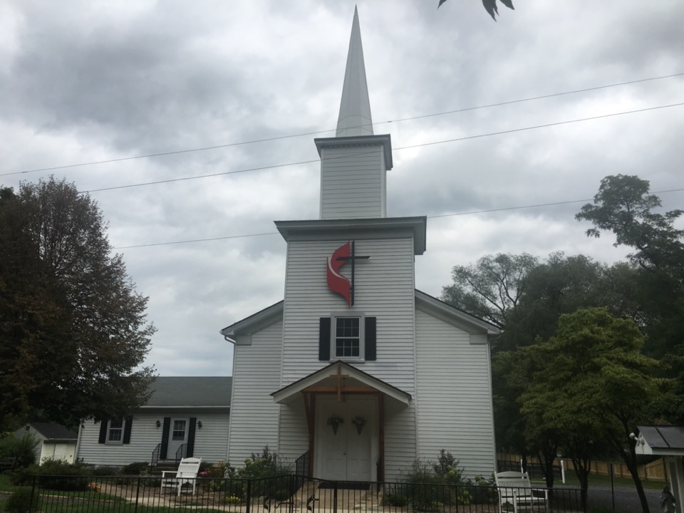
Rectortown United Methodist Church
serving God with
Prayer, Action, and Love
through Service.

