Slide 1
Introducing:
Victrato Seed Treatment
CLASSIFICATION: PUBLIC
All photos are either the property of Syngenta or are used with permission.
© 2025 Syngenta. Important: Always read and follow label instructions. Some products may not be registered for sale or use in all states or counties. Please check with your local extension service to ensure registration status. TYMIRIUM®, Victrato®, the Alliance Frame, the Purpose Icon and the Syngenta logo are trademarks of a Syngenta Group Company. All other trademarks are the property of their respective third-party owners.

Slide 2
Soybean Label
Protection From the Following Pests:
Sudden Death Syndrome (Fusarium virguliforme)
Plant parasitic nematodes
  Soybean Cyst
  Root Knot
  Reniform
  Lesion
  Lance
Suppression of Red Crown Rot (Calonectria ilicicola)
Early-Season Suppression of Foliar Diseases
  Septoria Brown Spot (Septoria glycines)
  Frogeye Leaf Spot (Cercospora sojina)
  Target Spot (Corynespora cassiicola)
Rate:
0.075 mg ai/seed
50g ai/100kg soybean seed
0.714 fl oz/140K
Assumes 3,000 seeds/pound
CLASSIFICATION: PUBLIC
© 2025 Syngenta. Important: Always read and follow label instructions. Some products may not be registered for sale or use in all states or counties. Please check with your local extension service to ensure registration status. TYMIRIUM®, Victrato®, the Alliance Frame and the Syngenta logo are trademarks of a Syngenta Group Company. All other trademarks are the property of their respective third-party owners.

Slide 3



Choose Your Protection
Old SDHI Chemistry
Notes:
Could add a video with no sound here doing the molecular demonstration and have these photos by them and work them in?

Slide 4

SCN Cysts/Gram of Root (30 DAP)
Soybean Greenhouse Trial (4 Reps)
SCN Cysts/Gram of Root
88% Reduction
Compared to ILEVO
Base
ILEVO® 50g
+ Base
Victrato® 50g
+ Base
Saltro® 50g
+ Base
Vero Beach Research Center, 2021
Replicated greenhouse study; pots inoculated with 3,000 SCN eggs/pot
CLASSIFICATION: PUBLIC
All photos are either the property of Syngenta or are used with permission.
Product performance assumes disease presence. Trials reflect treatment rates and mixing partners commonly recommended in the marketplace.
Performance assessments are based upon results or analysis of public information, field observations and/or internal Syngenta evaluations.
© 2025 Syngenta. Important: Always read and follow label instructions. Some products may not be registered for sale or use in all states or counties. Please check with your local extension service to ensure registration status. Saltro®, TYMIRIUM®, Victrato®, the Alliance Frame and the Syngenta logo are trademarks of a Syngenta Group Company. ILEVO® is a registered trademark of BASF.
Notes:
DAP = Days After Planting
Base treatment = Vibrance Trio
Pots inoculated 3,000 SCN eggs/pot
Vero Beach Research Center
Trial conducted in 2021; greenhouse pots inoculated with 3,000 SCN eggs/pot

Slide 5
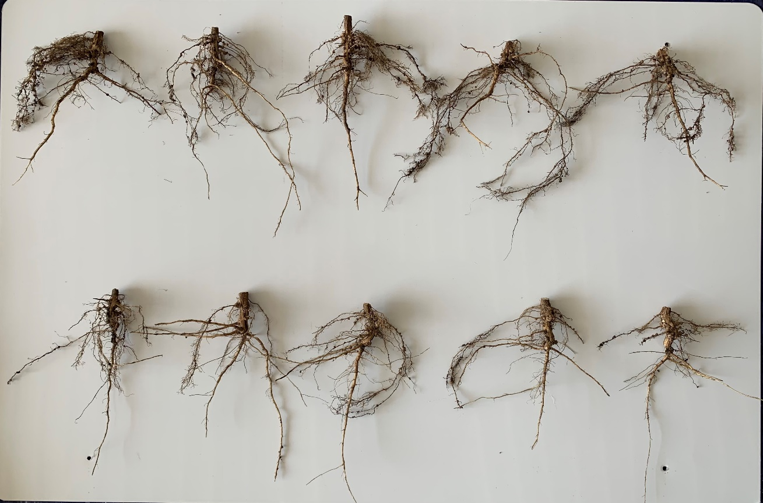
2024: Seed Treatment Protection of Soybean Fresh Root Mass
Representative sample of 5 root masses of 21 total measured per treatment
Victrato® seed treatment protected 33% greater root mass 56 days after planting
Victrato® (50g) + CruiserMaxx® APX
CruiserMaxx® APX
Abasola Simon, PhD; Syngenta Illinois Innovation Center; 2024
Replicated Field Trial – 56 DAP; 1,420 SCN eggs/100 CCs soil
CLASSIFICATION: PUBLIC
All photos are either the property of Syngenta or are used with permission.
Product performance assumes disease presence. Trials reflect treatment rates and mixing partners commonly recommended in the marketplace.
Performance assessments are based upon results or analysis of public information, field observations and/or internal Syngenta evaluations.
© 2025 Syngenta. Important: Always read and follow label instructions. Some products may not be registered for sale or use in all states or counties. Please check with your local extension service to ensure registration status. CruiserMaxx®, TYMIRIUM®, Victrato®, the Alliance Frame and the Syngenta logo are trademarks of a Syngenta Group Company.
CLASSIFICATION: PUBLIC – PRESENTATION ONLY – NOT FOR DISTRIBUTION
All photos are either the property of Syngenta or are used with permission.
Performance assessments are based upon results or analysis of public information, field observations and/or internal Syngenta evaluations.
© 2024 Syngenta. Important: Always read and follow label instructions. Some products may not be registered for sale or use in all states or counties. Please check with your local extension service to ensure registration status. TYMIRIUM technology is not yet registered for sale or use in the United States and is not being offered for sale. Saltro®, TYMIRIUM®, the Alliance Frame and the Syngenta logo are trademarks of a Syngenta Group Company. All other trademarks are the property of their respective third-party owners.

Slide 6
2021 Soybean Cyst Nematode Protection (9 locs x 6 reps/loc)
Cross-Location Summary (IA, SD, NE, MN, IL (4), and MI)
Yield (bu/A)
CruiserMaxx®
Vibrance®
0.0945 mg ai/seed
Saltro®
0.075 mg ai/seed
Victrato®
0.075 mg ai/seed
ILEVO®
0.075 mg ai/seed
ILEVO®
0.15 mg ai/seed
Levels not connected by same letter are significantly different. α = 0.1
All locations >500 SCN eggs/100 ccs soil
CLASSIFICATION: PUBLIC
Product performance assumes disease presence. Trials reflect treatment rates and mixing partners commonly recommended in the marketplace.
Performance assessments are based upon results or analysis of public information, field observations and/or internal Syngenta evaluations.
© 2025 Syngenta. Important: Always read and follow label instructions. Some products may not be registered for sale or use in all states or counties. Please check with your local extension service to ensure registration status. CruiserMaxx®, Saltro®, TYMIRIUM®, Vibrance®, Victrato®, the Alliance Frame and the Syngenta logo are trademarks of a Syngenta Group Company. ILEVO® is a registered trademark of BASF.
Notes:
Summary of 9 locations (6 reps per location); all locations >500 SCN eggs/100 ccs soil
Randomized custom block design
TMGC10Y3-2021US
LSD, α=0.1
There is NOT significant evidence of a location by treatment interaction, pooled analysis
Trt 1 = Base across all treatments

Slide 7

Yield Increase Across Trials with SDS Pressure
Victrato® (50g) vs. Saltro® (50g) Under Moderate-Heavy SDS Pressure
Positive Yield Increase = 87%
Mean Difference = 2.8 bu/A
Yield Increase (bu/A)
Disease pressure = Significant difference between the CruiserMaxx® Vibrance® check & Saltro® fungicide seed treatments in one disease assessment or more.
Field trials (n=23); IA, IL, KS, KY, MI, MN, TN and WI 2018-2021
CLASSIFICATION: PUBLIC
All photos are either the property of Syngenta or are used with permission.
Product performance assumes disease presence. Trials reflect treatment rates and mixing partners commonly recommended in the marketplace.
Performance assessments are based upon results or analysis of public information, field observations and/or internal Syngenta evaluations.
© 2025 Syngenta. Important: Always read and follow label instructions. Some products may not be registered for sale or use in all states or counties. Please check with your local extension service to ensure registration status. CruiserMaxx®, Saltro®, TYMIRIUM®, Vibrance®, Victrato® and the Syngenta logo are trademarks of a Syngenta Group Company. All other trademarks are the property of their respective third-party owners.

