Slide 1
2025 Growing season Year in Review

Slide 2
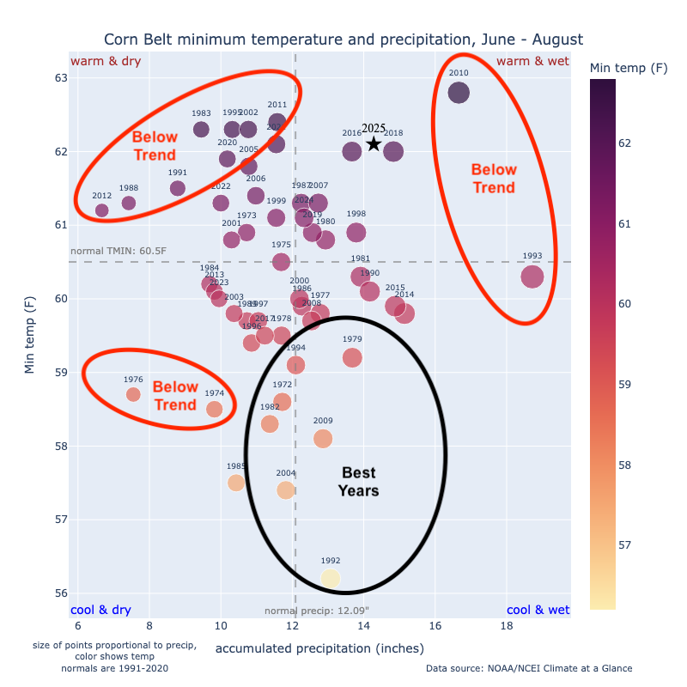
Lower yield for corn in 2025: Why?

Slide 3
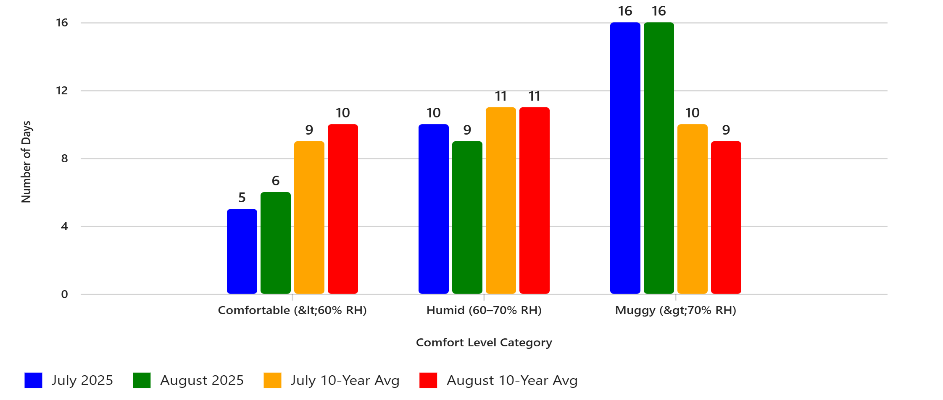
July & August Weather- Iowa
Research indicates that nights over 70 degrees F are likely to be detrimental to yield
  Increased cellular respiration
  Accelerated phenology
  Increased water loss
Yield loss can be severe as 2% but generally is about 1% (per day)

Slide 4
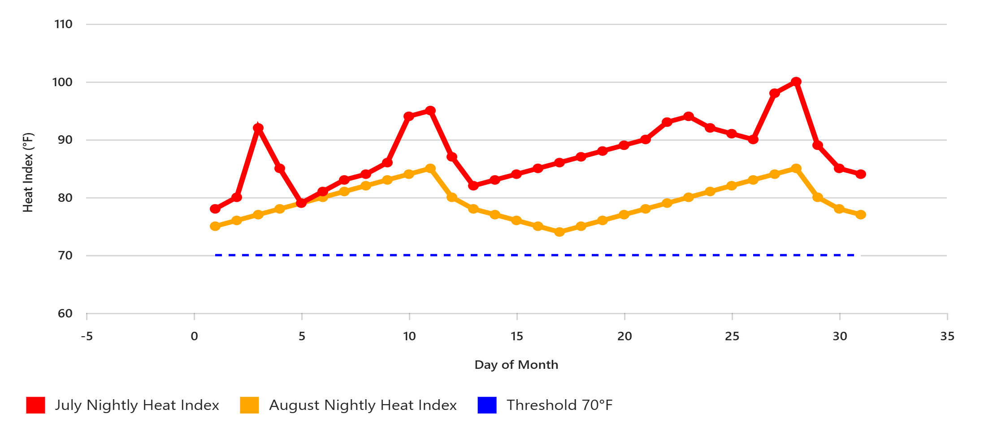
July and August nighttime Heat Index, Carroll, IA

Slide 5
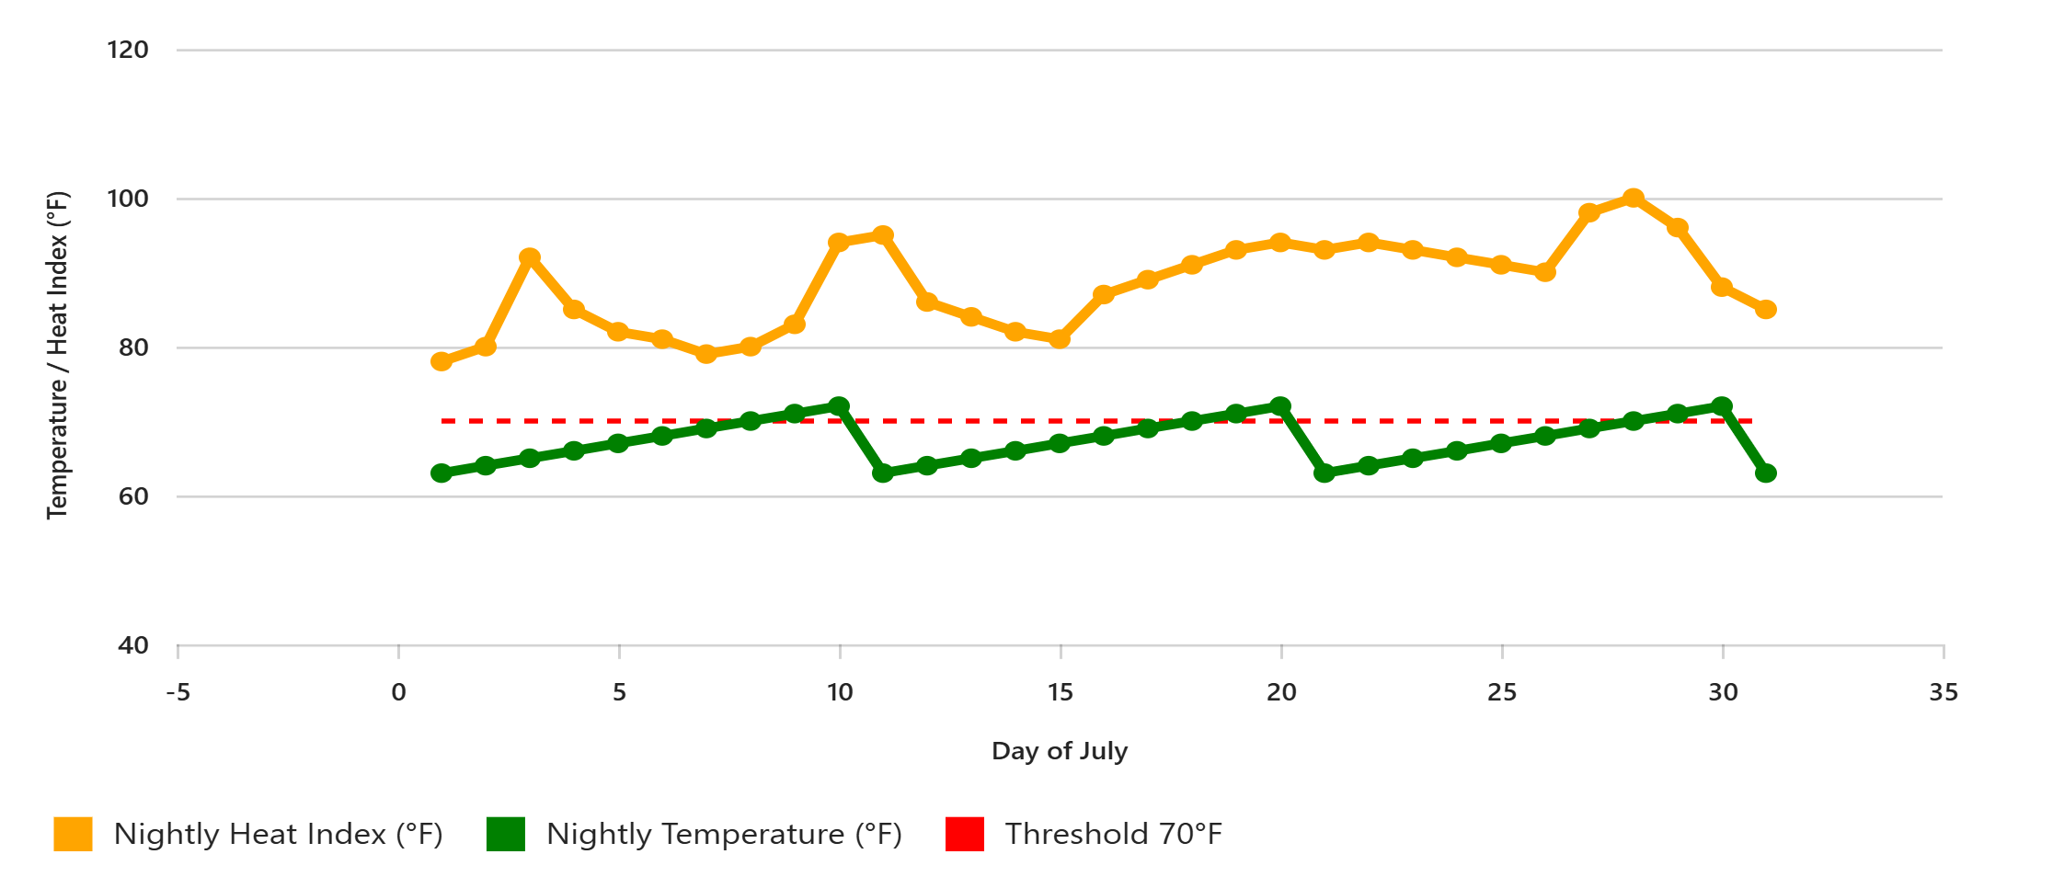
July & August Nightly Heat Index & Temp Carroll, IA
Nightly Heat Index: Stayed above 70 degrees every night, with peaks during the heat wave (July 27-28)
Nightly Temps: Varied between 63 and 73 degrees, showing how humidity drove the heat index much higher than actual temperature.

Slide 6
Lower yield for corn in 2025: Why?
Weather
Disease
Southern Rust
Tar Spot
Ear Mold
Some Goss’ Wilt
Bacterial Leaf Streak
Warmer, wetter year
Warm and humid nights during grain fill
Lack of solar radiation during grain fill

Slide 7
Late fungicide applications for southern rust

Slide 8
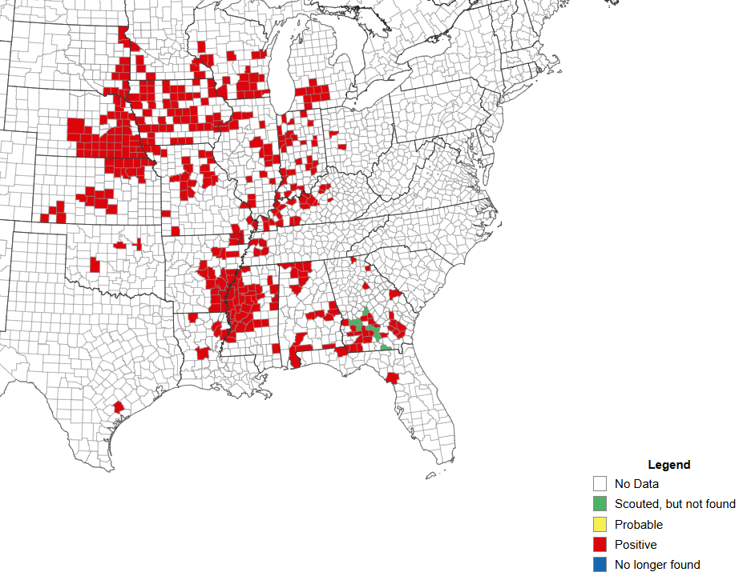
Current Distribution in US (August 17)

Slide 9
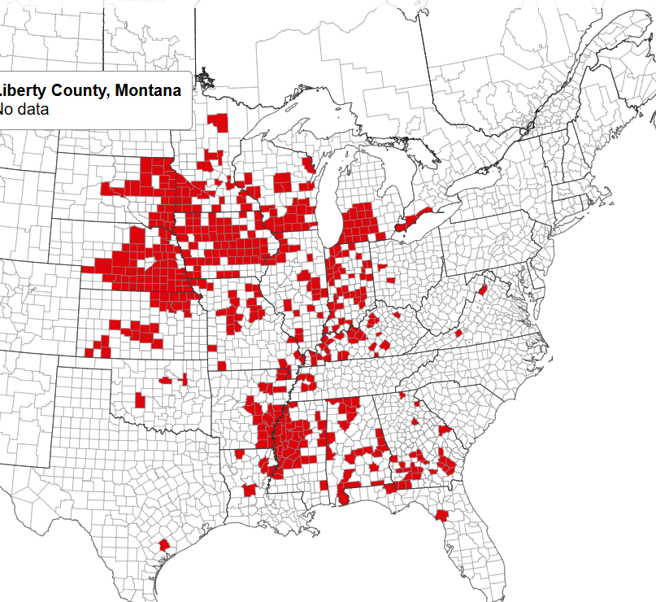
Southern Rust October 14

Slide 10
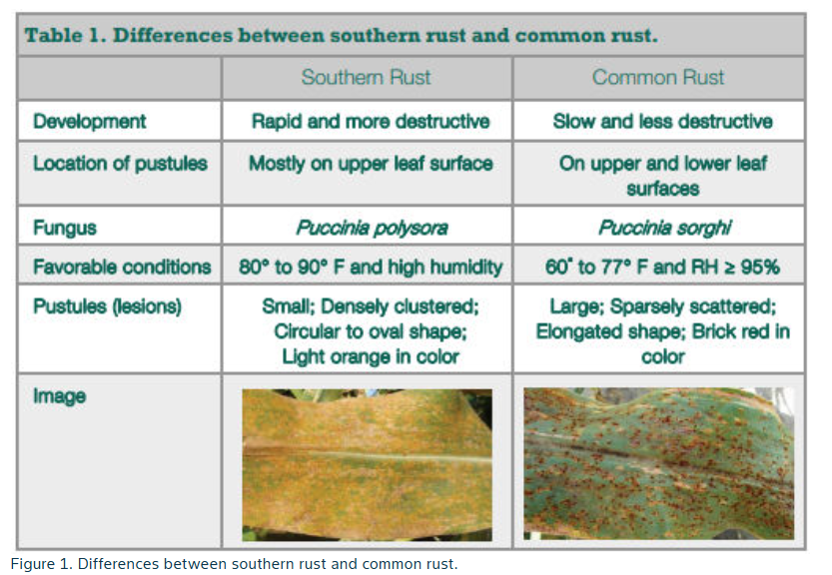
Southern Rust vs Common Rust

Slide 11
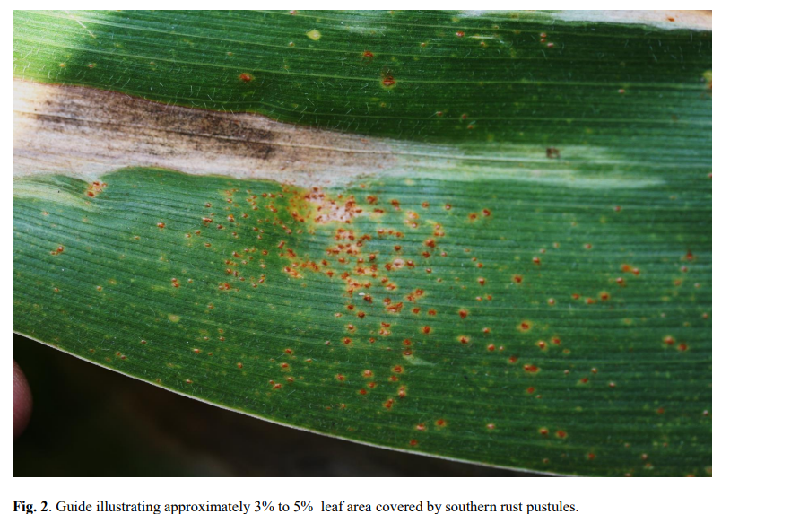
Southern Rust

Slide 12
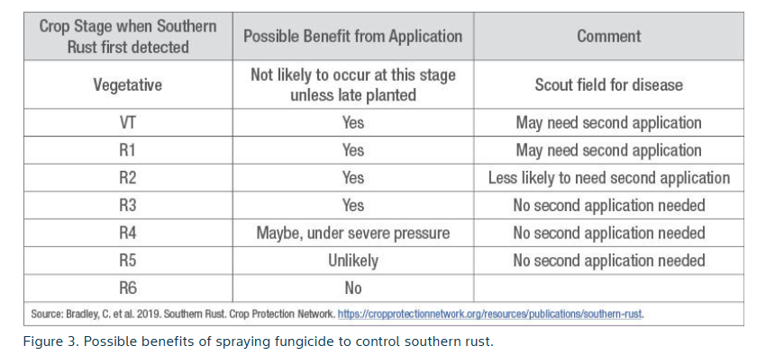
Southern Rust

Slide 13
Southern rust vs. competition
Depends on geography but rust was more severe in the, but had impacts throughout the region
Reports anywhere from 30 bushels to 110 bushel yield loss when no fungicide was used
  Name brand fungicides showed better performance
  Two applications showed 15-20 bu advantage in most areas
So far Corteva held up better than Bayer in most geographies I service
Take what we learned this year and help our growers yield more
Spraying can benefit up to R3 (milk) but not much beyond

Slide 14
Corn East Region Data
Fall 2025

Slide 15
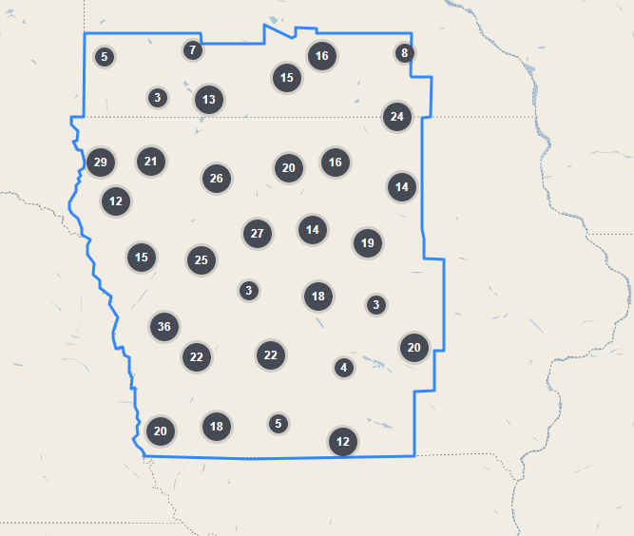
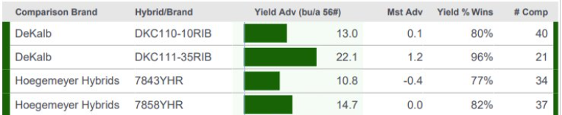
Understanding the Data
Source of Data presented today
  Multi Year Data - 2023, 2024 & 2025
  IMPACT/Research
  Hoegemeyer strip trials and 3rd Party trials
Maps
  Performance against ALL Hoegemeyer and Competitor products +/- 2 CRM
  Ex. 110 CRM product compares to 108,109,110,111,112 CRM’s
  All data comes from the Blue outlined region
Bar Charts
  Head to Head vs Selected Hoegemeyer and Competitive Checks
  Green bar means the Featured hybrid won
  Red bar means the Comparison hybrid won

Slide 16
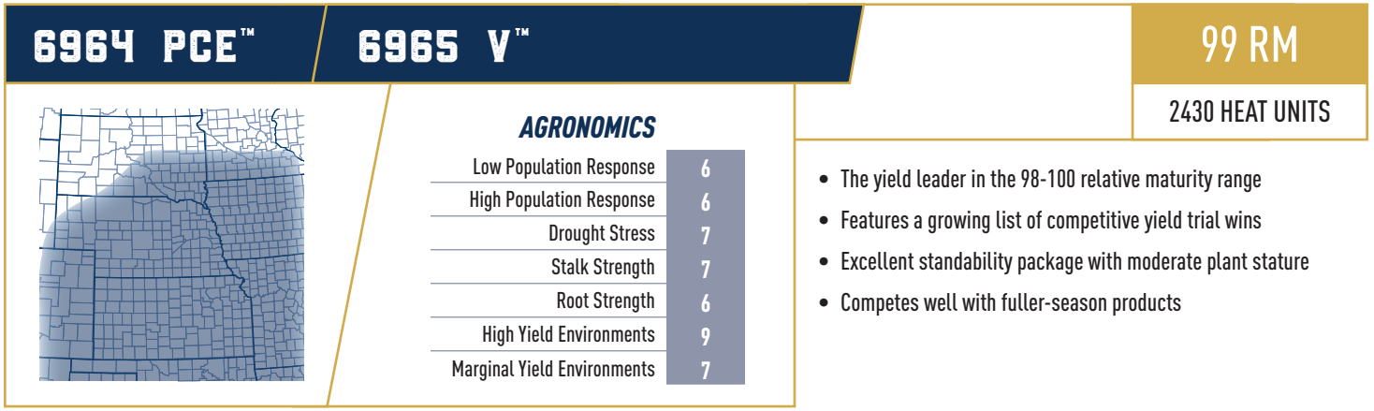
Availability: Good
Availability: Good

Slide 17
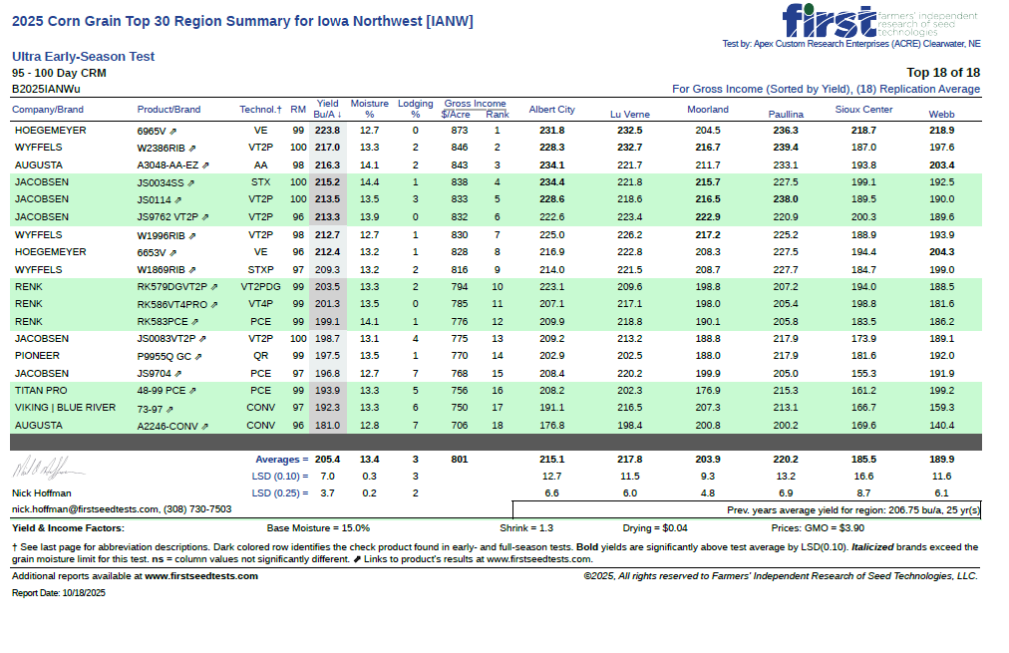

Slide 18
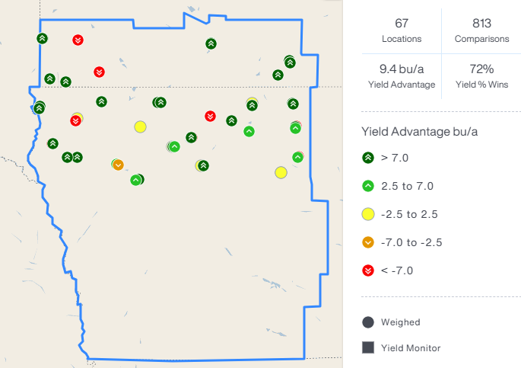
6964 PCE vs All Products (+/- 2 RM)

Slide 19
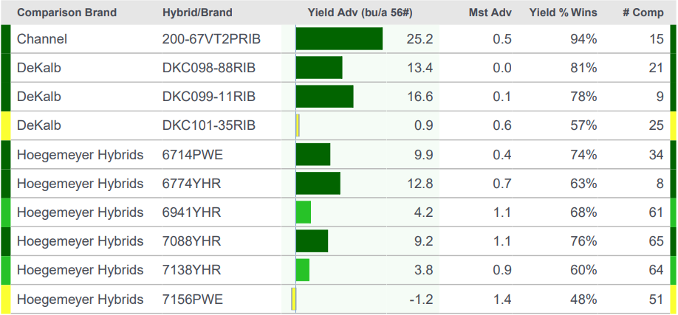
6964 PCE Head to Head

Slide 20
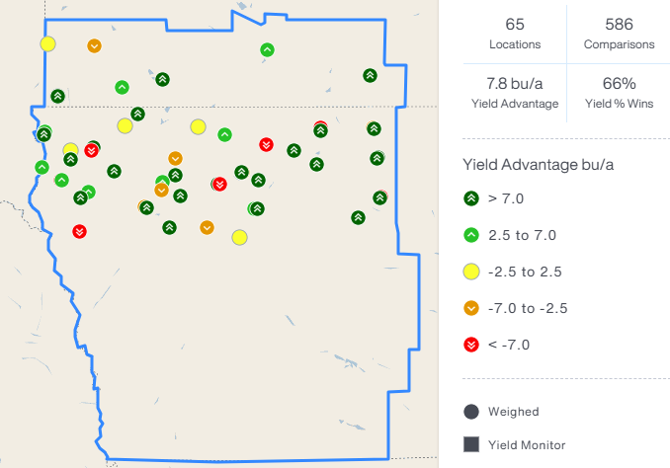
6965 V vs All Products (+/- 2 RM)

Slide 21
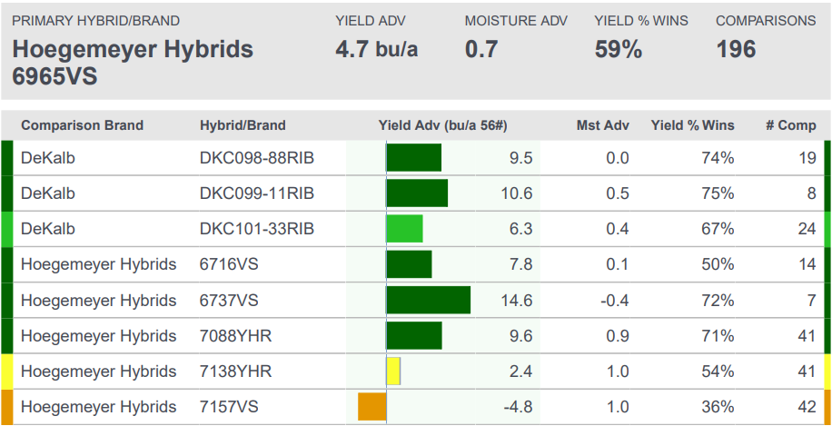
6965 V Head to Head

Slide 22
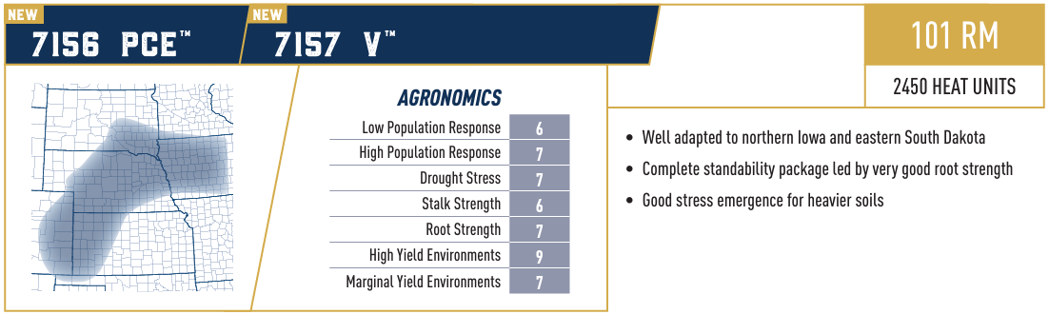
Availability: Limited
Availability: Good

Slide 23
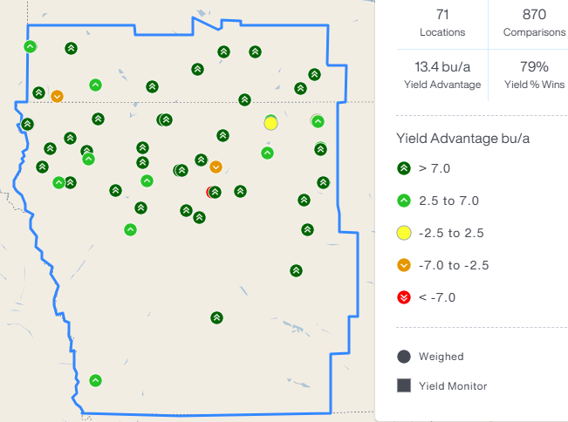
7156 PCE vs All Products (+/- 2 RM)

Slide 24
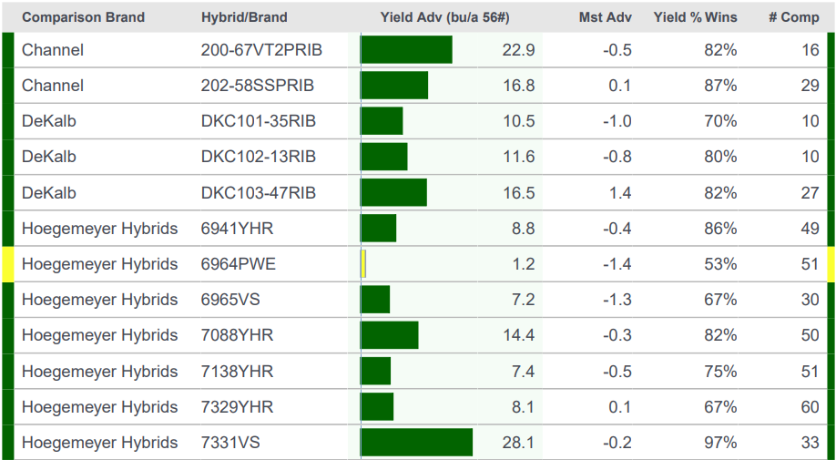
7156 PCE Head to Head

Slide 25
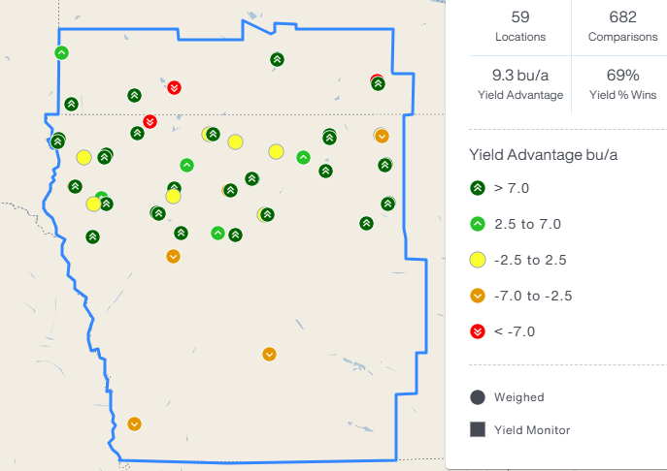
7157 V vs All Products (+/- 2 RM)

Slide 26
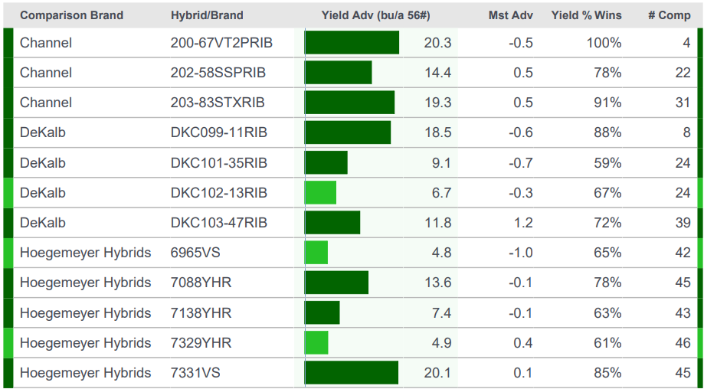
7157 V Head to Head

Slide 27
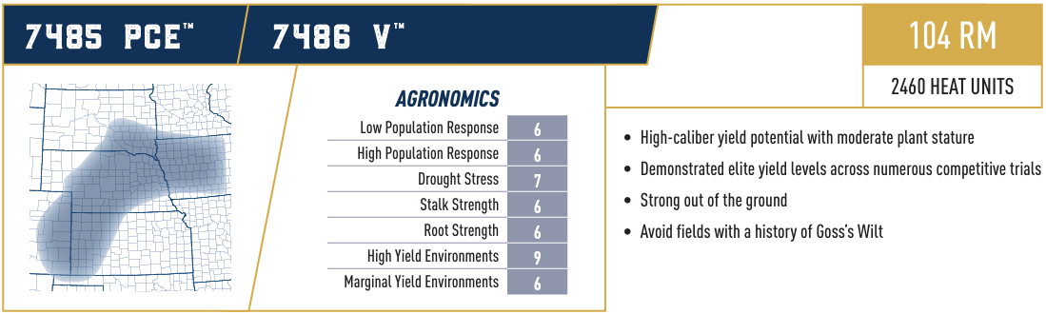
Availability: Good
Availability: Good

Slide 28
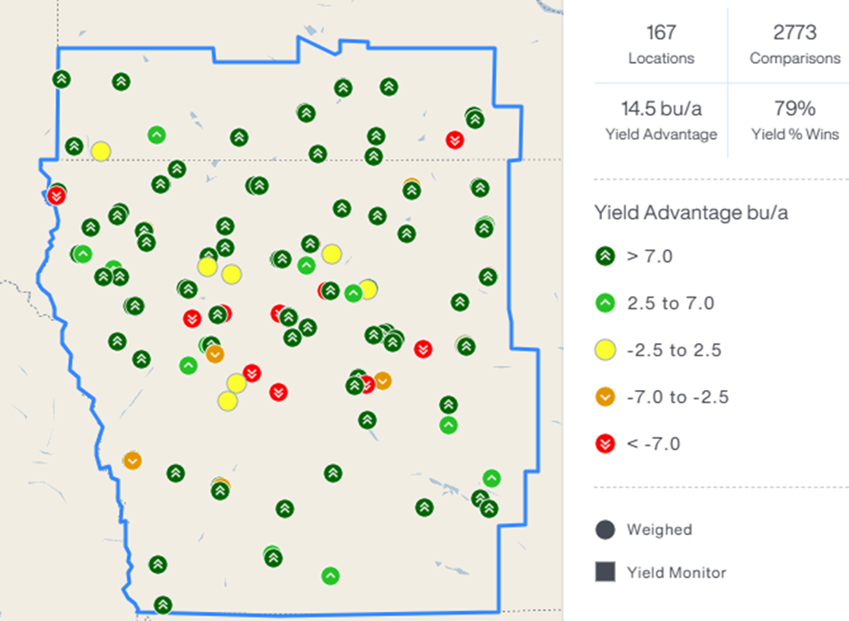
7485 PCE vs All Products (+/- 2 RM)

Slide 29
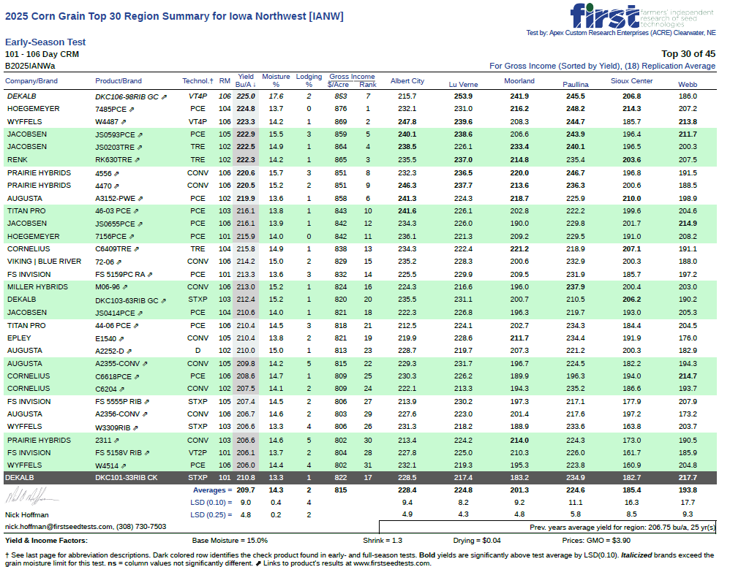

Slide 30
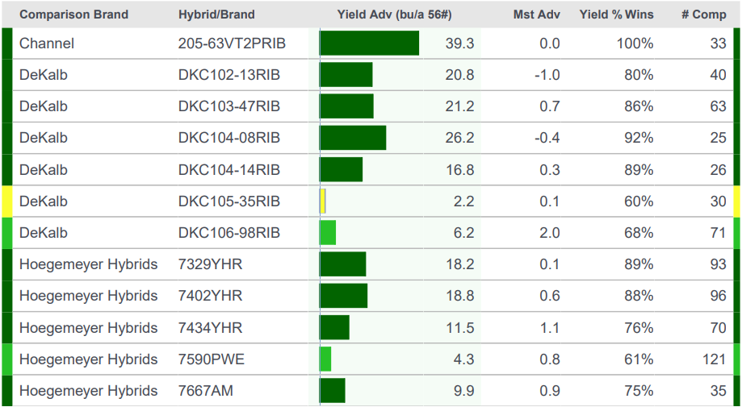
7485 PCE Head to Head

Slide 31
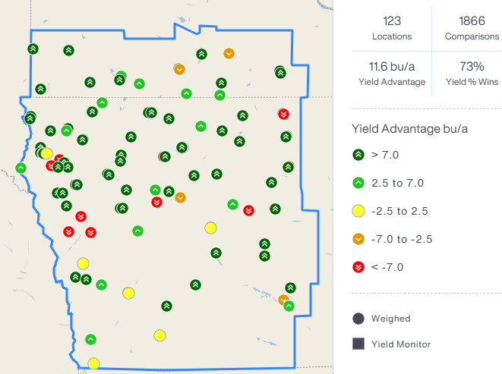
7486 V vs All Products (+/- 2 RM)

Slide 32
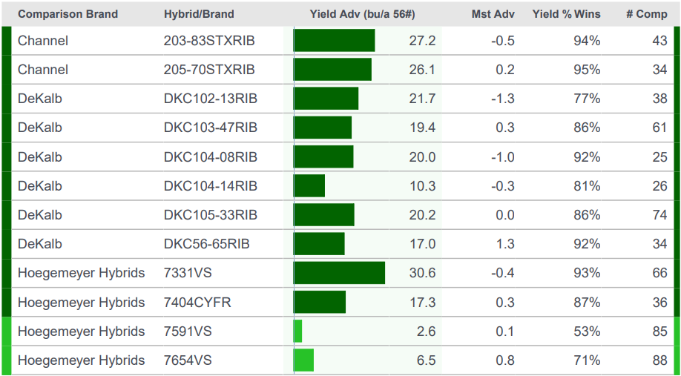
7486 V Head to Head

Slide 33
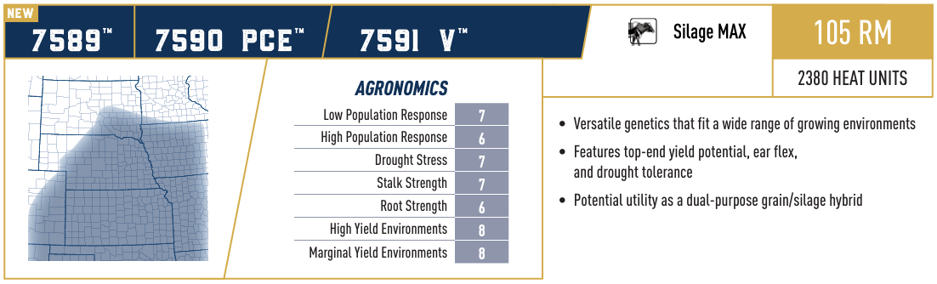
Availability: Good
Availability: Good
Availability: Good
Root Strength Score updated to 5

Slide 34
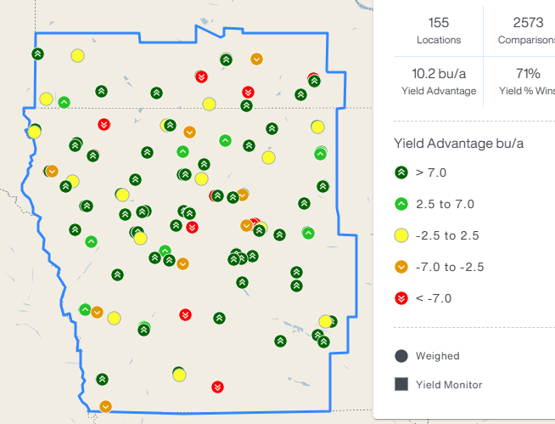
7590 PCE vs All Products (+/- 2 RM)

Slide 35
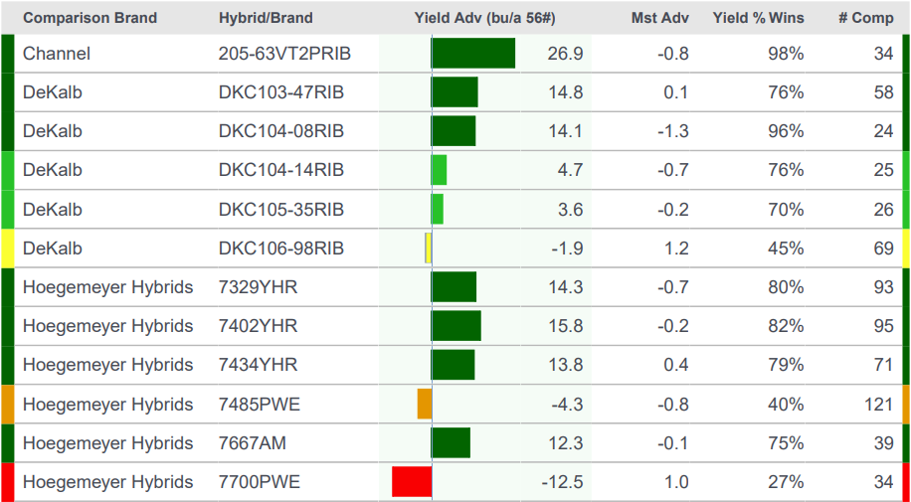
7590 PCE Head to Head

Slide 36
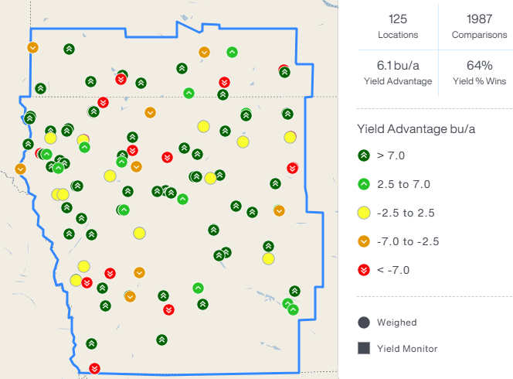
7591 V vs All Products (+/- 2 RM)

Slide 37
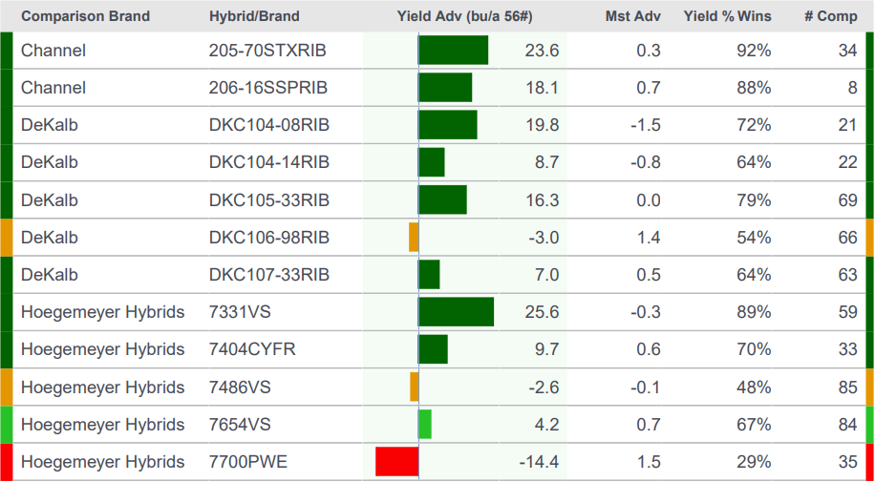
7591 V Head to Head

Slide 38
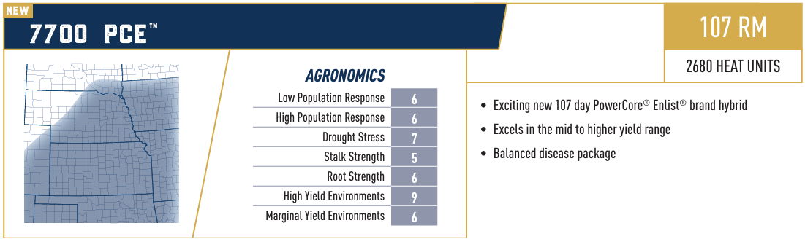
Availability: Good

Slide 39
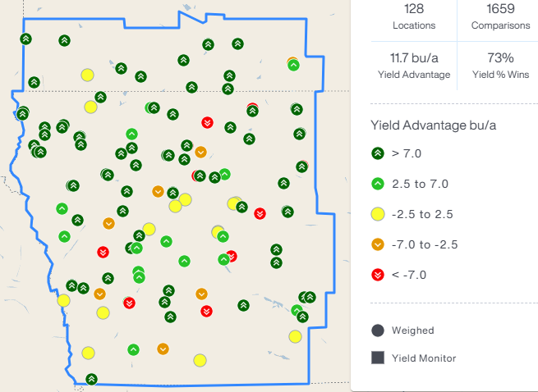
7700 PCE vs All Products (+/- 2 RM)

Slide 40
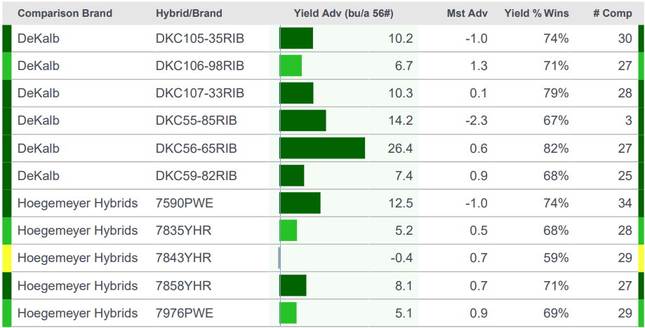
7700 PCE Head to Head

Slide 41
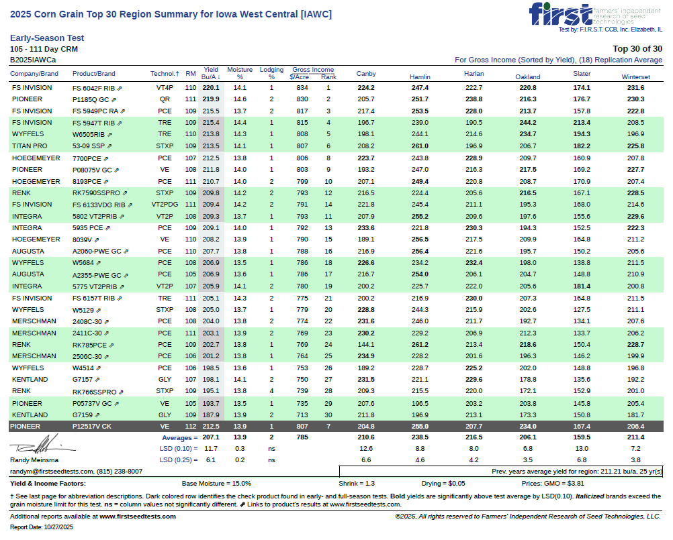

Slide 42
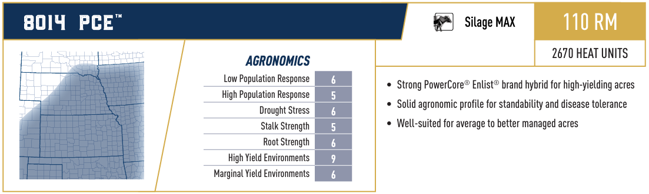
Availability: Limited

Slide 43
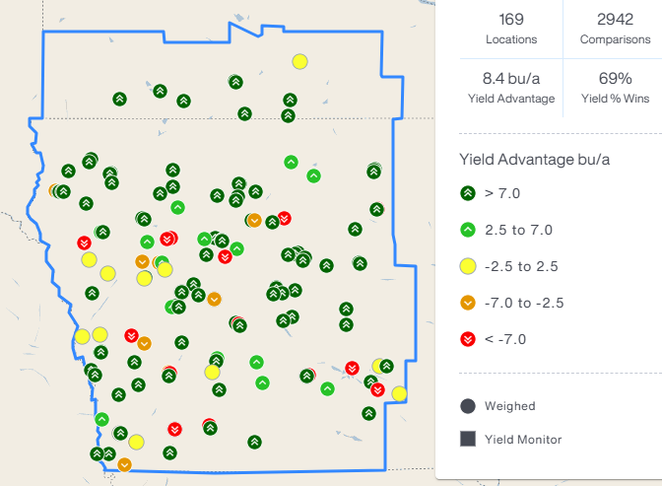
8014 PCE vs All Products (+/- 2 RM)

Slide 44
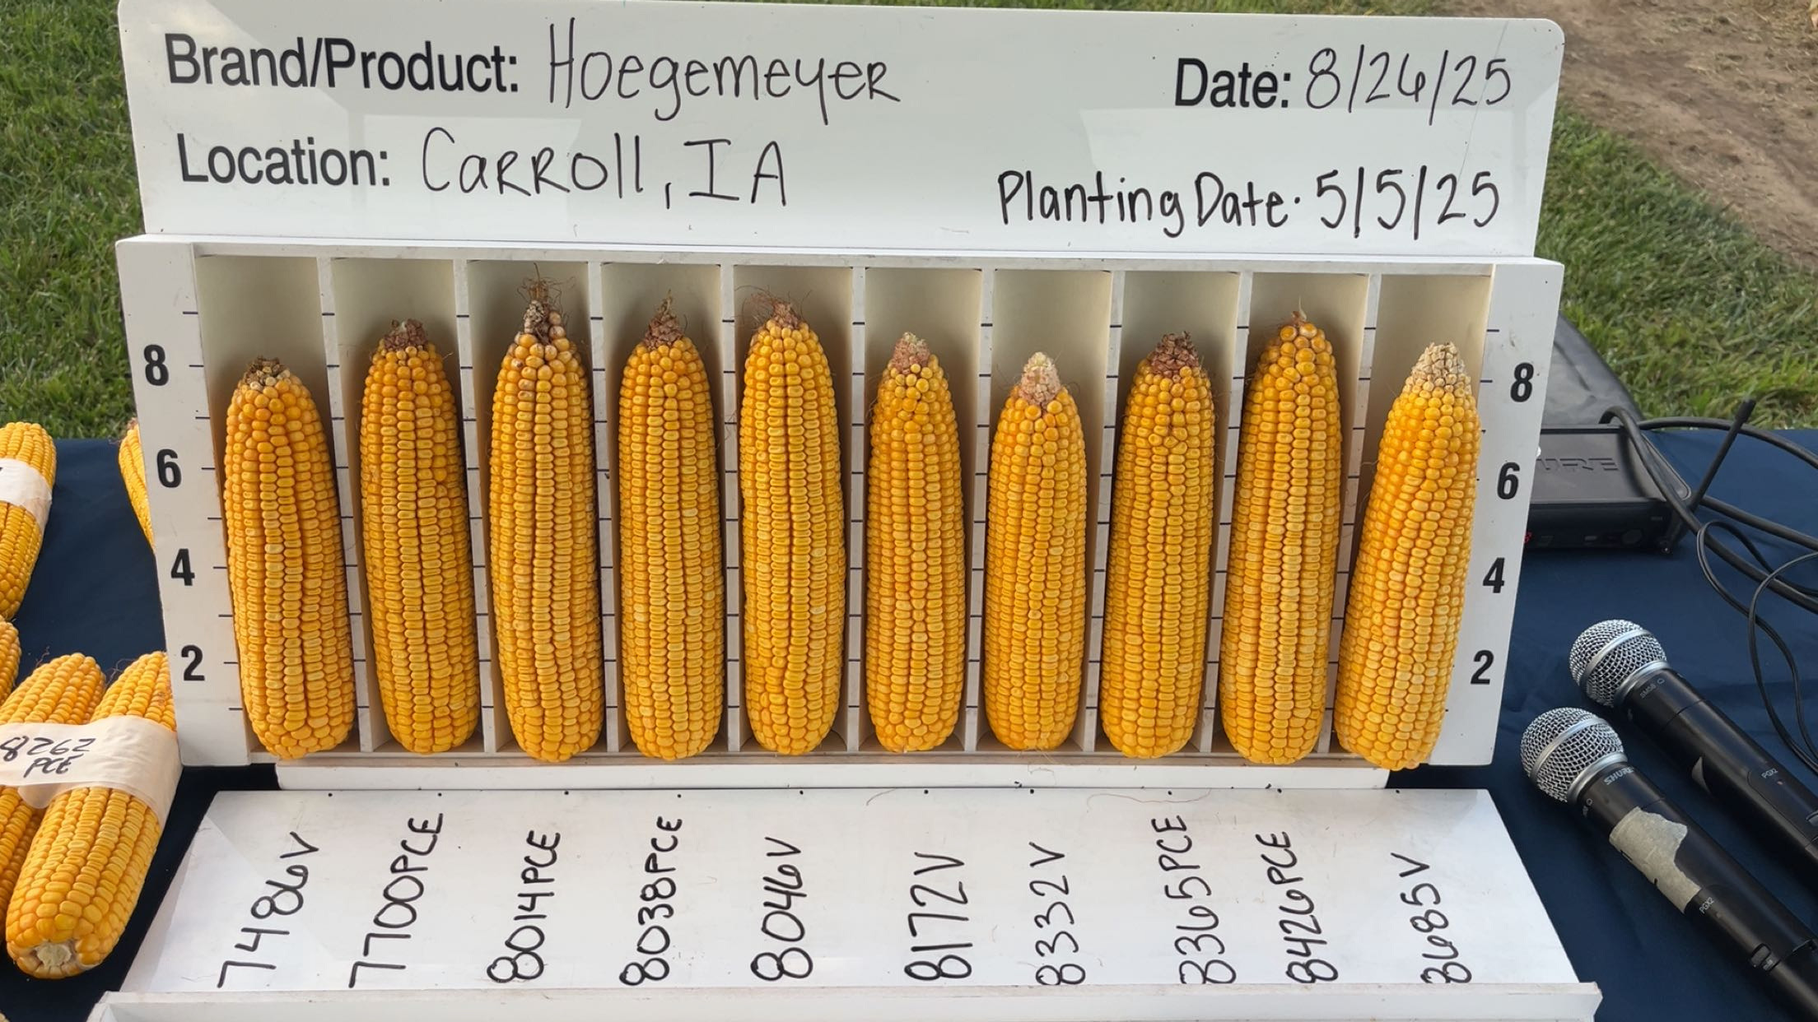
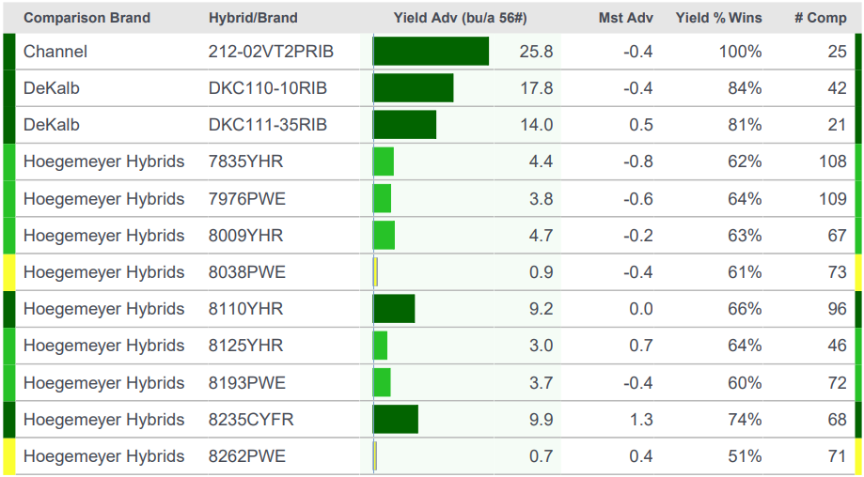
8014 PCE Head to Head

Slide 45
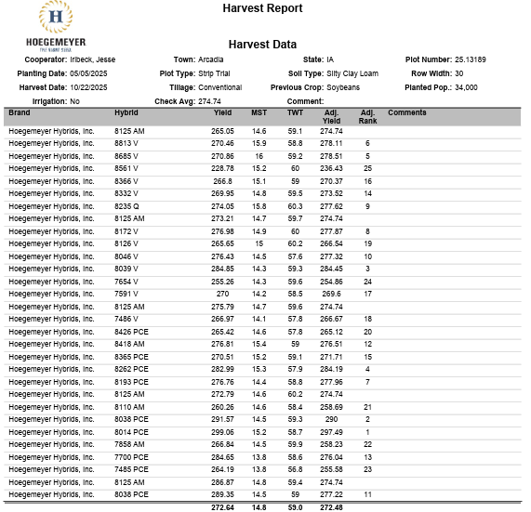
Carroll Master Plot
8014 PCE #1
8038 PCE #2
8039 V #3

Slide 46
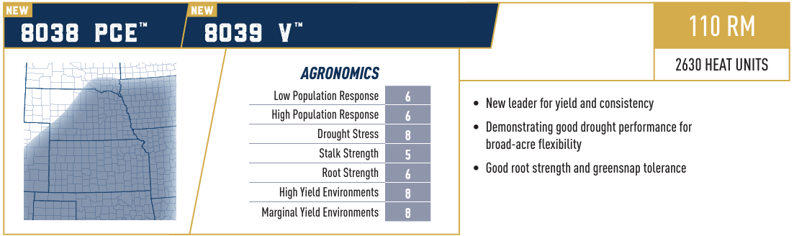
Availability: Good
Availability: Limited

Slide 47
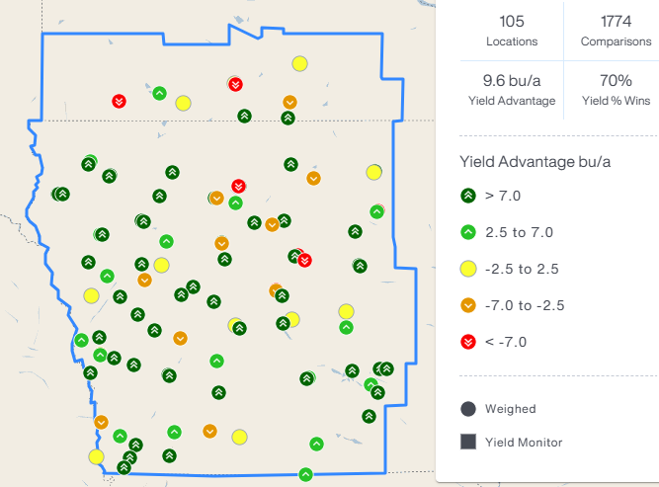
8038 PCE vs All Products (+/- 2 RM)

Slide 48
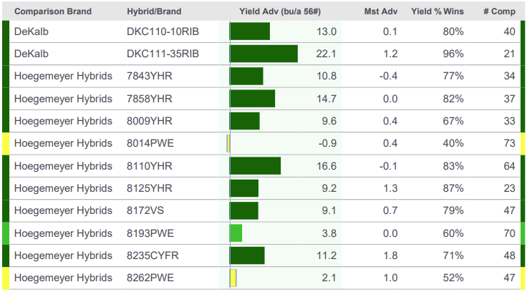
8038 PCE Head to Heads

Slide 49
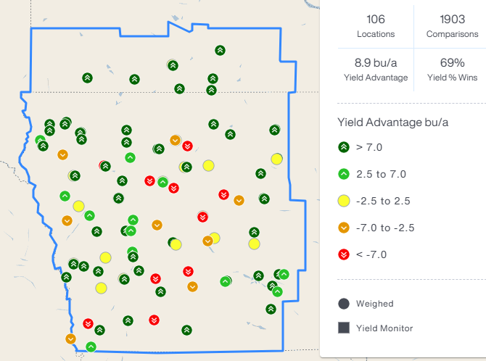
8039 V vs All Products (+/- 2 RM)

Slide 50
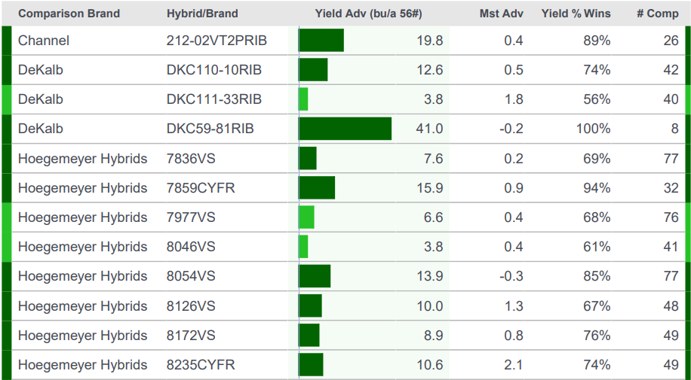
8039 V Head to Head

Slide 51
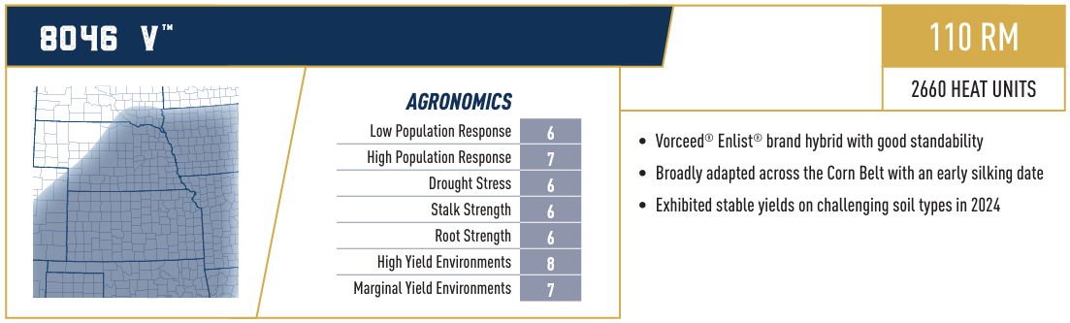
Availability: Limited

Slide 52
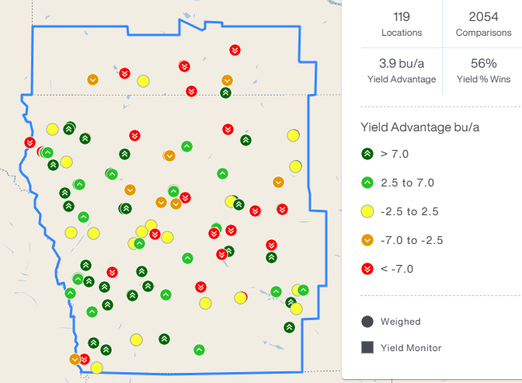
8046 V vs All Products (+/- 2 RM)

Slide 53
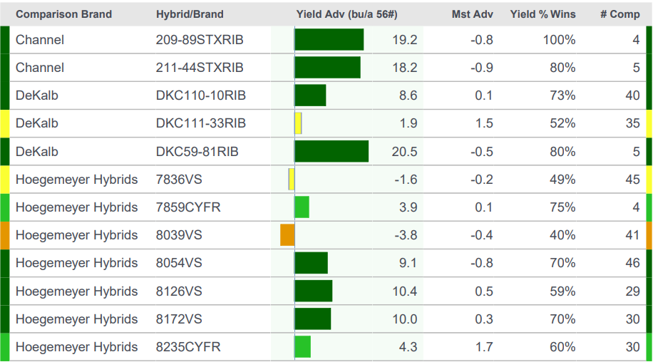
8046 V Head to Head

Slide 54

Availability: Good

Slide 55

8172 V vs All Products (+/- 2 RM)

Slide 56


Slide 57

8172 V Head to Head

Slide 58

Availability: Limited

Slide 59

8193 PCE vs All Products (+/- 2 RM)

Slide 60


Slide 61

8193 PCE Head to Head

Slide 62

Availability: Limited

Slide 63


Slide 64

Whittmuss Master
8262 PCE #1
8014 PCE #2
8418 AM #3

Slide 65

8262 PCE vs All Products (+/- 2 RM)

Slide 66

8262 PCE Head to Head

Slide 67





Multi-Disease Resistance trait (MDR)
Research Hybrid Efficacy Trial³
Regions:
NA, LA
Expected Launch:
NA – Late Decade
LA – Mid 2030s
Novel approach for breeding disease-resistant products
Traits
Delivers dominant disease resistance traits in elite hybrids
Targeting multi-disease corn solutions for Northern Leaf Blight, Southern Rust, Gray Leaf Spot, and Anthracnose Stalk Rot resistance
Proprietary technology developed by Corteva Agriscience
Key Benefits:
  Addresses farmers' top disease management concerns
  Potential sustainability benefits by reducing equipment use to spray fungicide
  Increased plant health, could result in increased yield
  Positive step change in resistance for Northern Leaf Blight, Southern Rust, and Gray Leaf Spot²
  Allows breeders to focus on increasing yield potential and select hybrids with other performance characteristics that are important to the farmer
  Annual US corn & soybean disease losses: >$7.5B1
  Leaf and stalk pathogens
Non-edited Hybrid
Hybrid with Gene Edit³
¹ Sources: USDA, Crop Protection Network.
² In early efficacy studies observed: NLB 5 – 7.5, GLS 5.5 to 7.7, SR 2 – 8 on a 1=very susceptible, 9= very resistant.
³ 2023 Union City, TN, Non-edited isogenic hybrid vs hybrid containing edits for Northern Leaf Blight and Southern Rust resistance, natural Southern Rust resistance inoculation.
Notes:
Updated March 26, 2025
We shared on the Nov 19, 2024, R&D Innovation Day that we could launch the MDR trait as early as 2028 in limited stewarded market introduction quantities with three disease resistant solutions. Pending regulatory approval, anticipate in early-mid-2030’s the concept will include anthracnose stalk rot resistance.

Slide 68


Introducing…
Supports cell wall development, protein synthesis and root growth (0.02%)
Essential component of key enzymes, including those that synthesize chlorophyll (1.0%)
Water and nutrient transport from soil. Photosynthesis and cell growth. (2.0%)
Essential for germination, root growth, chlorophyll function and nitrogen use. (0.05%)
Key for metabolism and enzyme function. Supports soil N-fixation. (0.01%)
Supports nitrogen use and early seedling growth. (0.01%)
5
B
Boron
16
S
Sulfur
19
K
Potassium
25
Mn
Manganese
27
Co
Cobalt
42
Mo
Molybdenum

Slide 69

Improves Stand, Increased Yield Potential
Significantly improves stand uniformity compared to current recipe
+2 bu/A advantage
70.8% win rate over current recipe
Data from 2022 – 2024
72 locations
What will be treated for 2026?
New launch products
Trial seed
Limited new crop batches...more detail available by mid-winter

Slide 70
2025 Soybean Year in Review

Slide 71

Sudden Death in Soybeans
Understanding impacts and management of SDS

Slide 72
Sudden Death Syndrome Overview
Disease Cause and Origin
  Sudden Death Syndrome is caused by Fusarium virguliforme fungus and was first identified in Arkansas in 1971.
Disease Phases
  SDS has two phases: root rot affects early growth, and foliar scorch appears during reproductive stages.
Spore Survival and Infection
  Fungal spores survive winter in soil and residue, germinating in spring to infect soybean roots early.
Economic Impact
  SDS significantly reduces soybean yield and causes major economic losses if unmanaged.

Slide 73
Combining Strategies for Effective Control
Integrated Disease Management
  Combining resistant varieties, seed treatments, and soil health practices effectively controls soybean SDS.
Monitoring and Detection
  Monitoring SCN populations and early detection through scouting enable timely SDS interventions.
Sustainable Farming Practices
  Cover cropping and reduced tillage improve soil structure and reduce disease pressure sustainably.

Slide 74
Soybean performance

Slide 75

Availability: Limited

Slide 76

Opheim SB Plot
Hoegemeyer took top 4 places in plot

Slide 77

Buresch SB
3 out of top 4 in plot

Slide 78

1586E vs All Products (+/- 2 RM)

Slide 79

1586E Head to Head

Slide 80

Availability: Good

Slide 81

Solberg Plot
Hoegemeyer took top 7 places

Slide 82

1865E vs All Products (+/- 2 RM)

Slide 83

1865E Head to Head

Slide 84

Availability: Good

Slide 85

2056E vs All Products (+/- 2 RM)

Slide 86

2056E Head to Head

Slide 87

Availability: Good

Slide 88

Kock SB Plot
Hoegemeyer took top 4 places in plot

Slide 89

2185E vs All Products (+/- 2 RM)

Slide 90

2185E Head to Head

Slide 91

Availability: Good

Slide 92

2395E vs All Products (+/- 2 RM)

Slide 93

2395E Head to Head

Slide 94

Availability: Good

Slide 95

2484E vs All Products (+/- 2 RM)

Slide 96

2484E Head to Head

Slide 97

Availability: Good

Slide 98

2645E vs All Products (+/- 2 RM)

Slide 99

2645E Head to Head

Slide 100

Availability: Good

Slide 101


Slide 102

2855E vs All Products (+/- 2 RM)

Slide 103

2855E Head to Head

Slide 104
Questions?

