Slide 1
What happened to our yields?!?
WHAT HAPPENED TO YIELDS IN 2025?!?

Slide 2
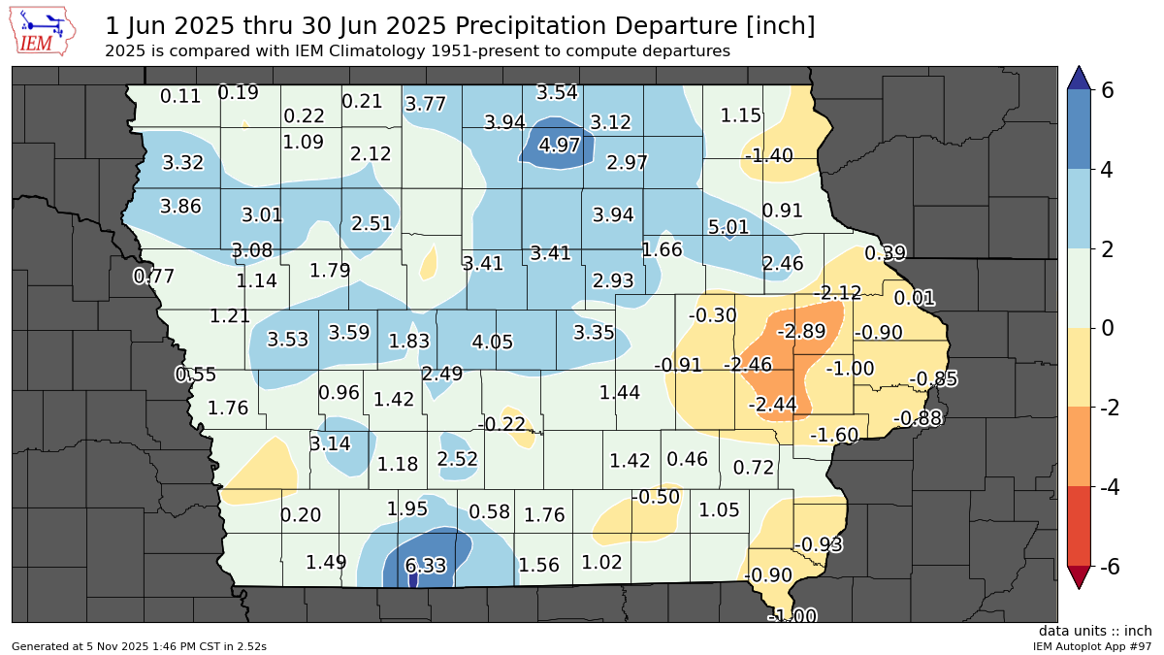
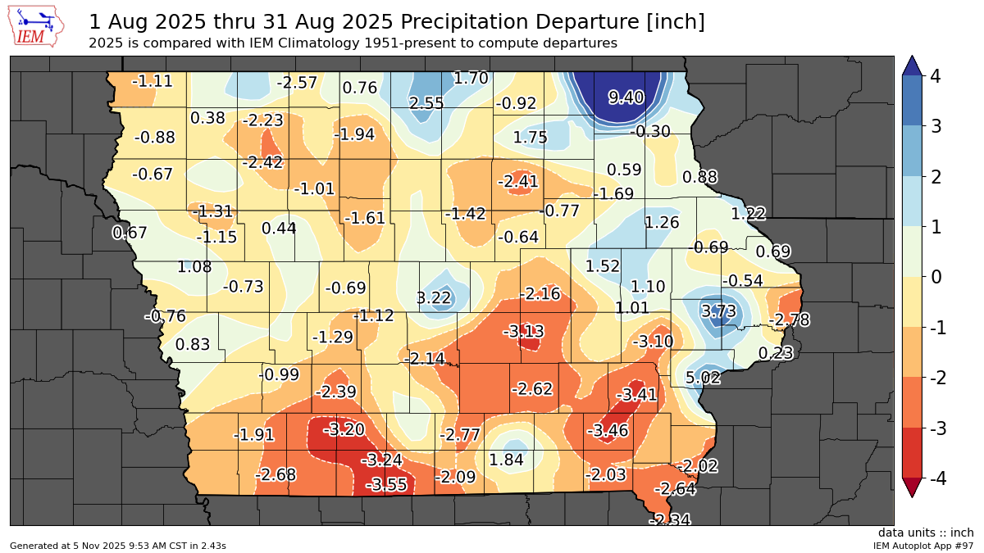
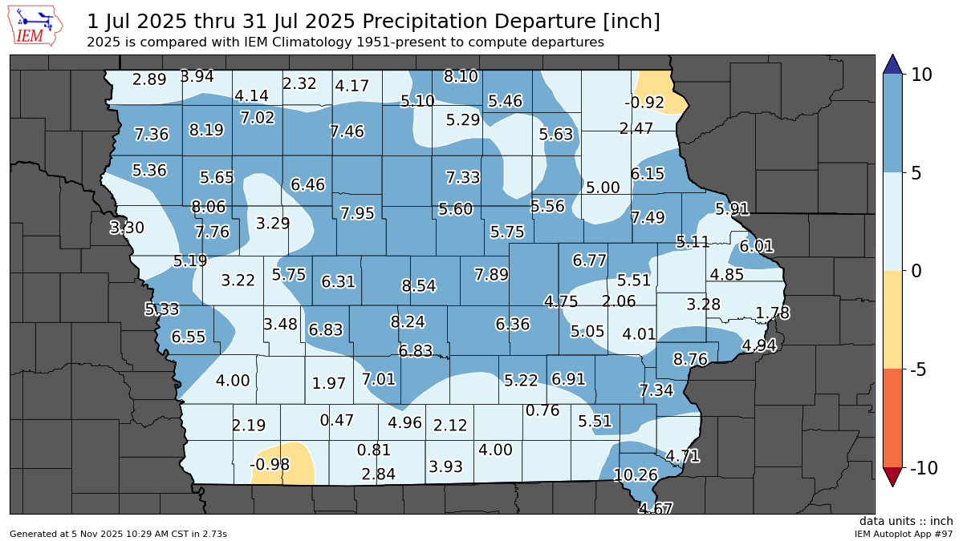
RAINFALL

Slide 3
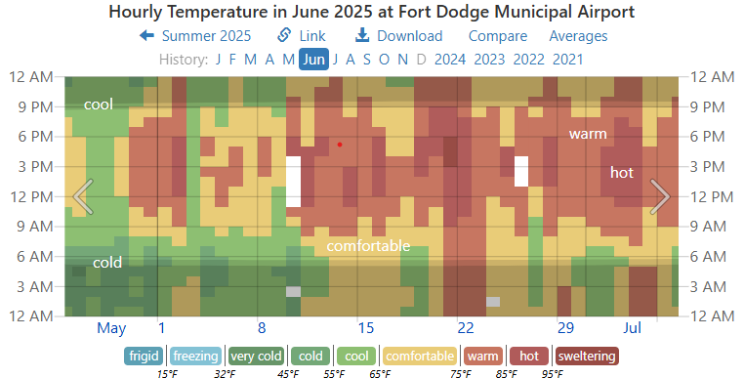
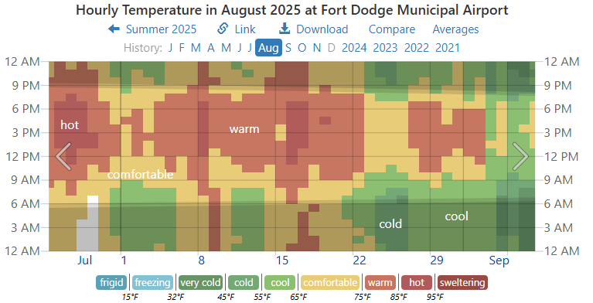
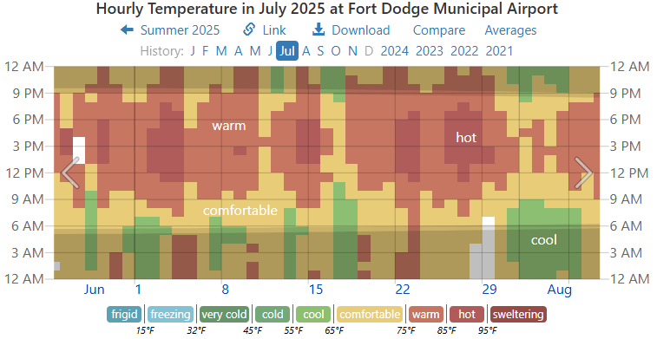
TEMPERATURE

Slide 4
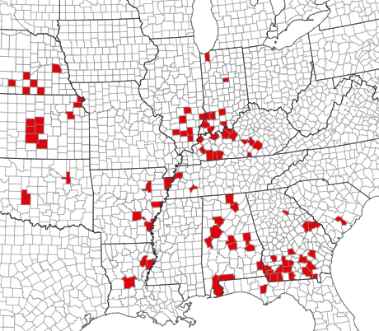
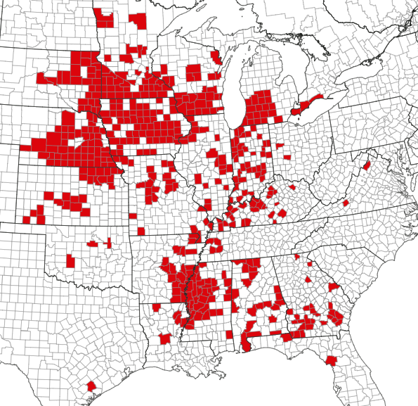
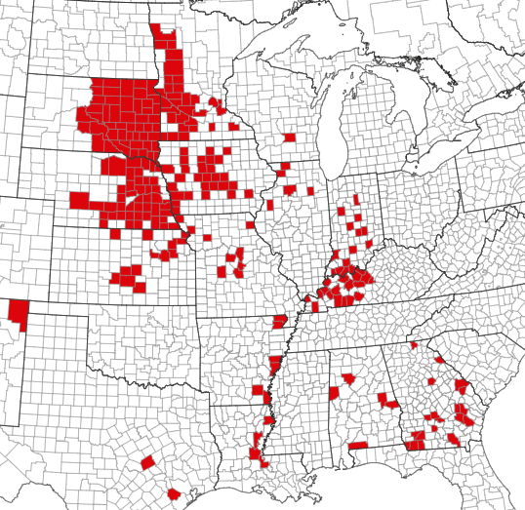
DISEASE
Southern Rust Map 2023
Southern Rust Map 2024
Southern Rust Map 2025

Slide 5
OPHEIM SEED & CHEMICAL
POST HARVEST MEETING
2026 Product Focus
Brian Rouse & Jeff Morey
11/13/25 – Thor, IA

Slide 6





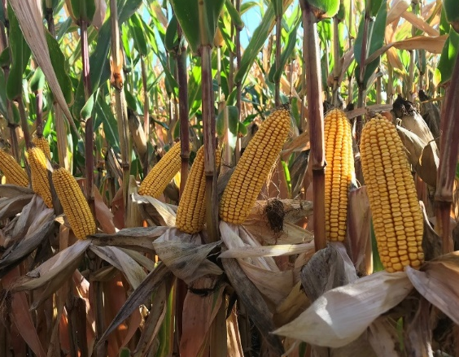
A630-04
BRAND RM 100
TRAITS
PLANT HEIGHT
Medium
Performs best in moderate to high-yield environments
Ear flex by ear length supports moderate to low planting populations
Responds favorably to fungicide and sidedress-nitrogen applications
STALK STRENGTH
Excellent
GREENSNAP VULNERABILITY
Low
EAR CHARACTERISTICS
Flex
Red coloring
Very good test weight
DISEASE YIELD CROP
SOIL
TOLERANCE ENVIRONMENT ROTATION
DRAINAGE
EMERGENCE
Very good
Gray leaf spot NCLB
Tar spot
High Average Low
Following soy Following corn
Well-drained Poorly-drained
ROOT STRENGTH
Average
KEY
Place
Place
Place with appropriate
confidently
reliably
management

Slide 7


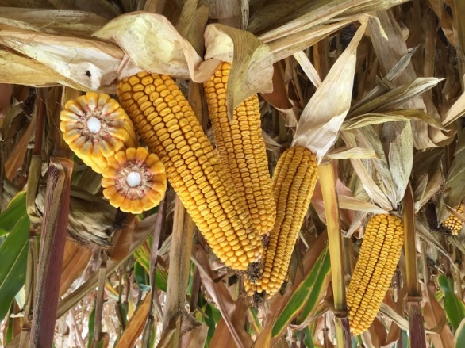
A631-08
BRAND RM 101
TRAITS
PLANT HEIGHT
Medium short
Broadly adapted product excels across various environments
Strong agronomics enable broad east to west movement
Benefits from a fungicide application to protect leaf tissue
STALK STRENGTH
Excellent
GREENSNAP VULNERABILITY
Low
EAR CHARACTERISTICS
Flex
Pink coloring
Good test weight
DISEASE YIELD CROP
SOIL
TOLERANCE ENVIRONMENT ROTATION
DRAINAGE
EMERGENCE
Excellent
Anthracnose NCLB
Tar spot
High Average Low
Following soy Following corn
Well-drained Poorly-drained
ROOT STRENGTH
Very good
KEY
Place
Place
Place with appropriate
confidently
reliably
management

Slide 8
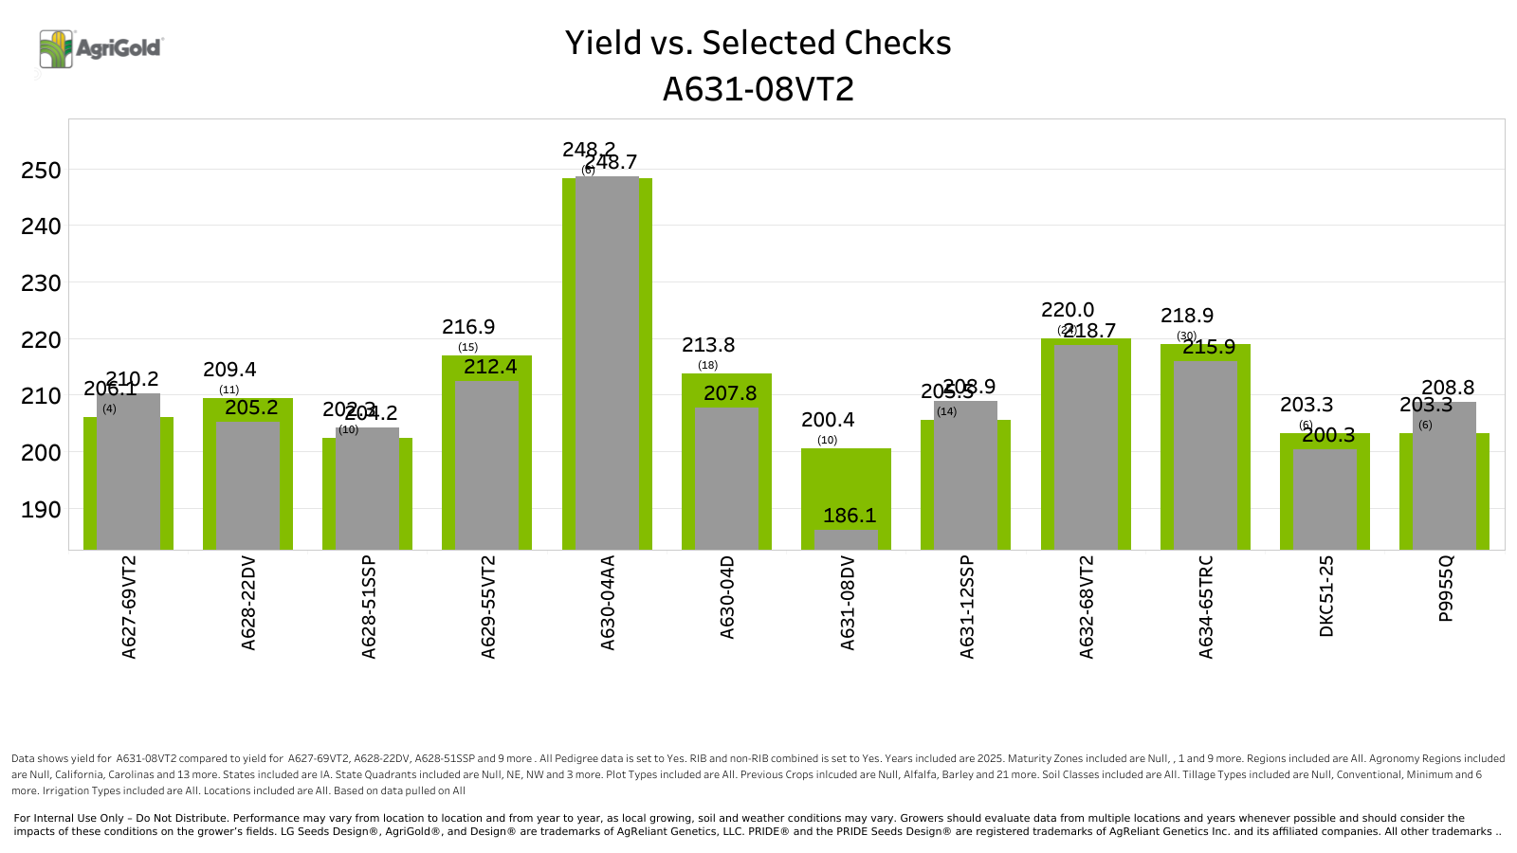
2025

Slide 9
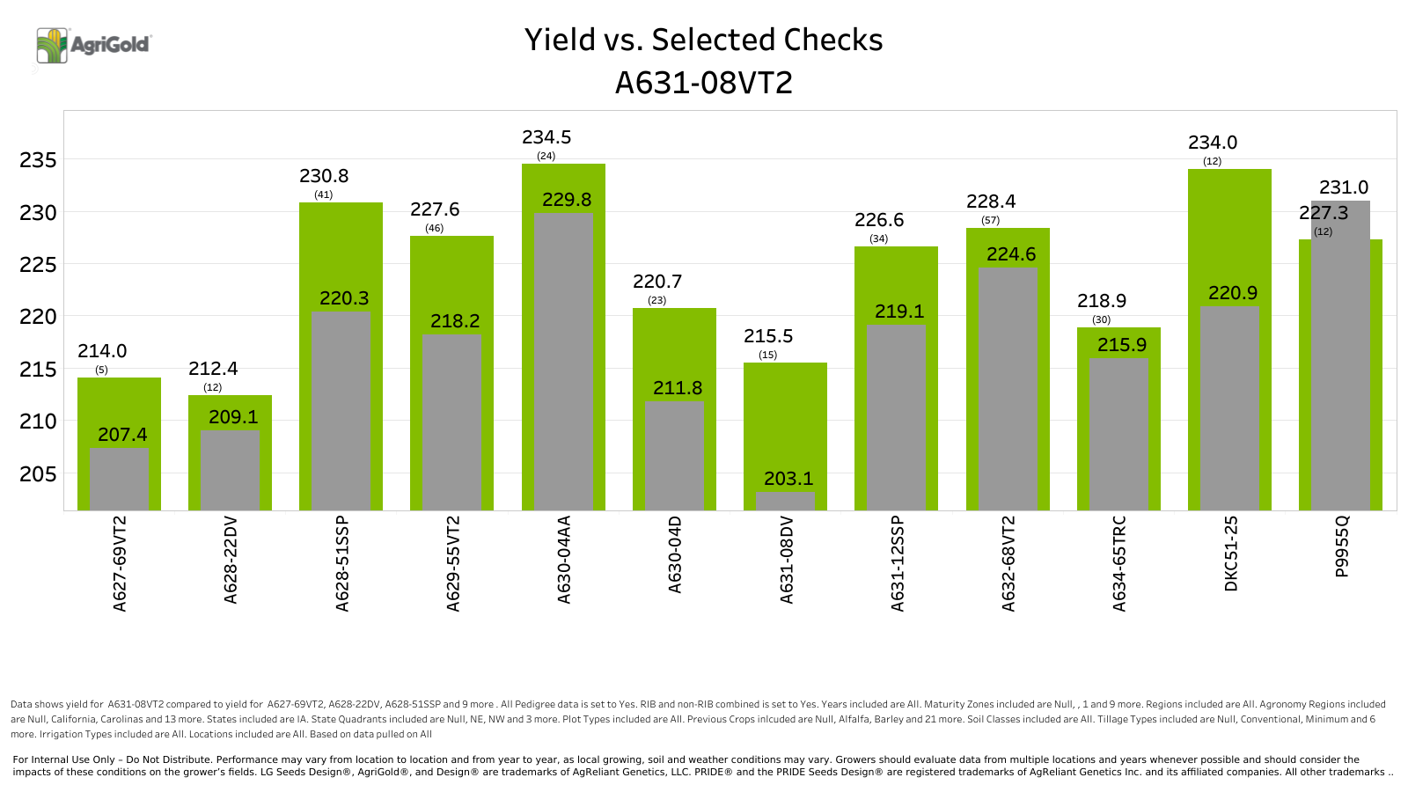
2022-2025

Slide 10

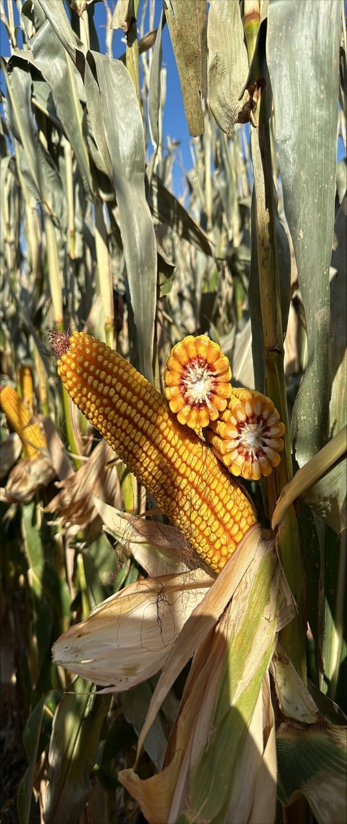
A632-68
BRAND RM 102
TRAITS
PLANT HEIGHT
Medium tall
Maintains consistent performance across multiple cropping systems and many environments
Responds favorably to fungicide and sidedress-nitrogen applications
Plant at medium to higher populations for optimal performance
STALK STRENGTH
Good
GREENSNAP VULNERABILITY
Low
EAR CHARACTERISTICS
Flex
Red coloring
Very good test weight
DISEASE TOLERANCE
Gray leaf spot
NCLB
Tar spot
YIELD CROP
SOIL
ENVIRONMENT ROTATION
DRAINAGE
EMERGENCE
Good
High Average Low
Following soy Following corn
Well-drained Poorly-drained
ROOT STRENGTH
Very good
KEY
Place
Place
Place with appropriate
confidently
reliably
management

Slide 11

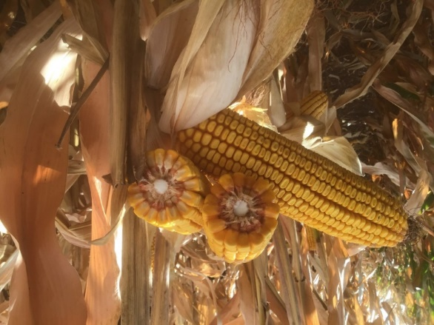
A634-11
BRAND RM 104
TRAITS
PLANT HEIGHT
Medium tall
Fits exceptionally well on highly productive soils under heavy CRW pressure
Maximize yield performance with a fungicide application
Excellent option for areas with a history of Goss’s wilt
STALK STRENGTH
Very good
GREENSNAP VULNERABILITY
Low
EAR CHARACTERISTICS
Semi-flex
Red coloring
Very good test weight
DISEASE YIELD CROP
SOIL
TOLERANCE ENVIRONMENT ROTATION
DRAINAGE
EMERGENCE
Excellent
Gray leaf spot NCLB
Goss’s wilt
High Average Low
Following soy Following corn
Well-drained Poorly-drained
ROOT STRENGTH
Very good
KEY
Place
Place
Place with appropriate
confidently
reliably
management

Slide 12
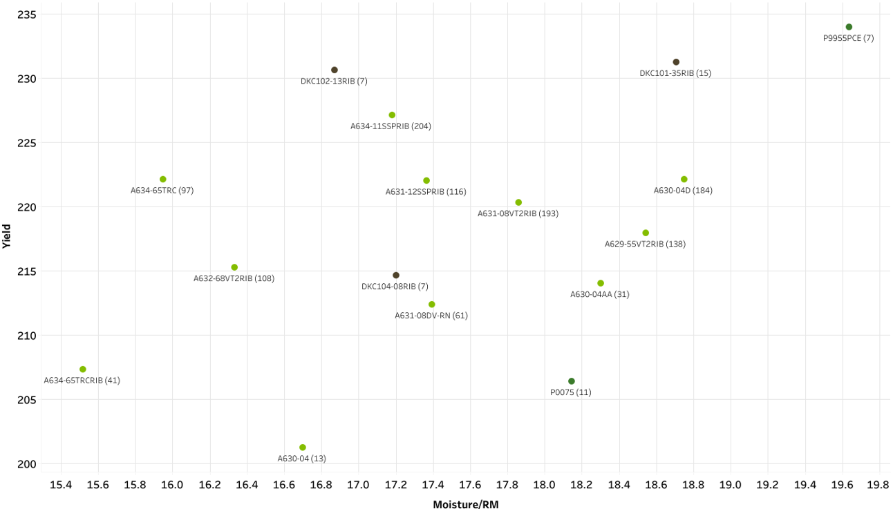
Scattergraph 100-104RM
2025 Central & West

Slide 13



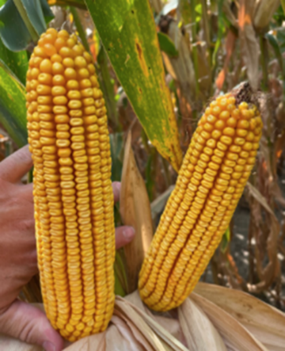
A634-65
BRAND RM 104
TRAITS
PLANT HEIGHT
Medium
Covers a broad footprint, while delivering agronomics suitable for western Corn Belt acres
Delivers exceptional grain quality and well- rounded disease resistance ratings
Excels compared to others when faced with high pH soil types
STALK STRENGTH
Excellent
GREENSNAP VULNERABILITY
Low
EAR CHARACTERISTICS
Flex
Red coloring
Excellent test weight
DISEASE YIELD CROP
SOIL
TOLERANCE ENVIRONMENT ROTATION
DRAINAGE
EMERGENCE
Good
Gray leaf spot NCLB
Tar spot
High Average Low
Following soy Following corn
Well-drained Poorly-drained
ROOT STRENGTH
Excellent
KEY
Place
Place
Place with appropriate
confidently
reliably
management

Slide 14
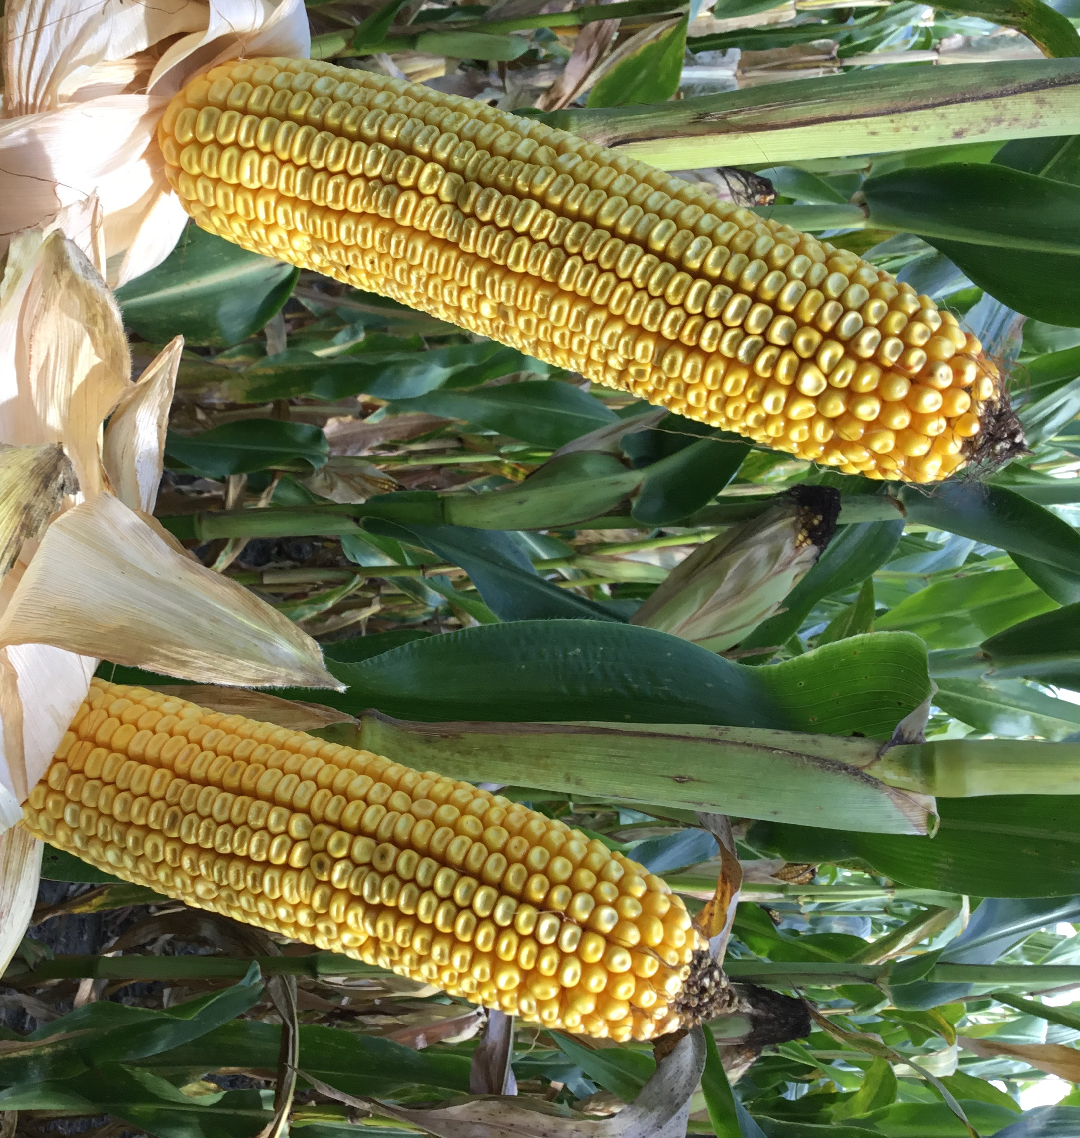
A636-11
BRAND RM 106
TRAITS
PLANT HEIGHT
Medium tall
Plant at medium to higher plant populations for optimal performance
Provides strong yield stability under variable conditions
Delivers strong emergence and vigor to allow for planting in cool conditions
STALK STRENGTH
Very good
GREENSNAP VULNERABILITY
Moderate
EAR CHARACTERISTICS
Semi-flex
Red coloring
Good test weight
DISEASE YIELD CROP
SOIL
TOLERANCE ENVIRONMENT ROTATION
DRAINAGE
EMERGENCE
Very good
Gray leaf spot NCLB
Tar spot
High Average Low
Following soy Following corn
Well-drained Poorly-drained
ROOT STRENGTH
Good
KEY
Place
Place
Place with appropriate
confidently
reliably
management

Slide 15

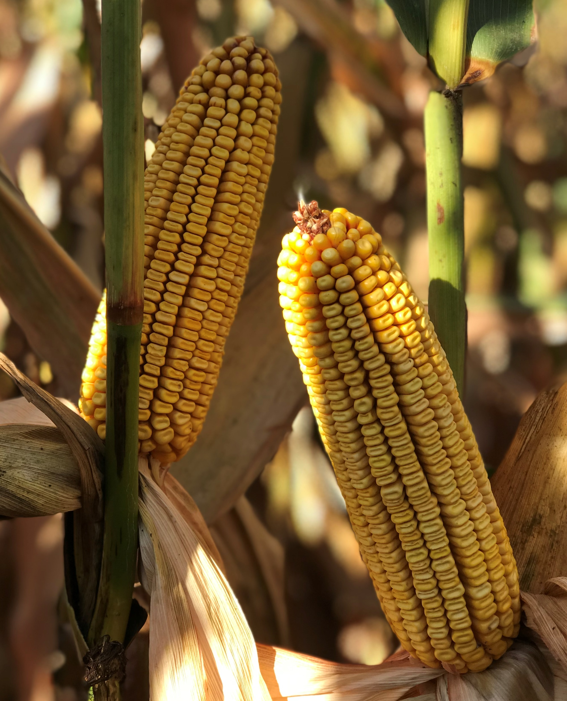
A636-16
BRAND RM 106
TRAITS
PLANT HEIGHT
Tall
Great option for areas impacted by high tar spot pressure
Plant early to take advantage of strong emergence and vigor
Performs well in any cropping or tillage system
STALK STRENGTH
Excellent
GREENSNAP VULNERABILITY
Low
EAR CHARACTERISTICS
Semi-flex
Red coloring
Good test weight
DISEASE TOLERANCE
Gray leaf spot
NCLB
Tar spot
YIELD ENVIRONMENT
High
Average Low
CROP ROTATION
Following soy
Following corn
SOIL
DRAINAGE
EMERGENCE
Very good
Well-drained Poorly-drained
ROOT STRENGTH
Good
KEY
Place
Place
Place with appropriate
confidently
reliably
management

Slide 16
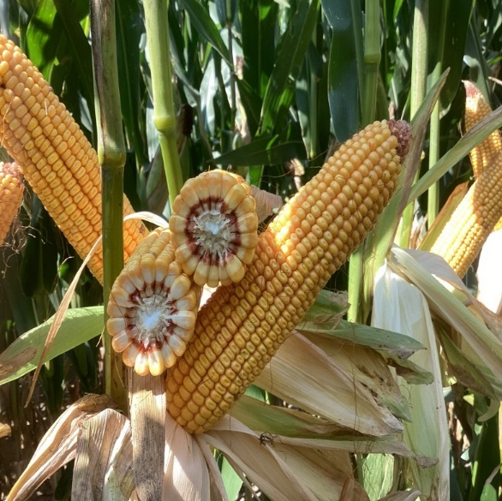
A638-91
BRAND RM 108
TRAITS
PLANT HEIGHT
Medium short
Features thoroughbred-like genetics with wide adaptability across vast acres
Offers excellent ear flex, pairing well for those seeking to maximize populations through VRT
Apply fungicide at VT/R1 to protect against heavy disease pressure
STALK STRENGTH
Good
GREENSNAP VULNERABILITY
Low
EAR CHARACTERISTICS
Semi-flex
Crimson coloring Excellent test weight
DISEASE TOLERANCE
YIELD CROP
SOIL
ENVIRONMENT ROTATION
DRAINAGE
EMERGENCE
Very good
Gray leaf spot NCLB
Southern rust
High Average Low
Following soy Following corn
Well-drained Poorly-drained
ROOT STRENGTH
Good
KEY
Place
Place
Place with appropriate
confidently
reliably
management

Slide 17
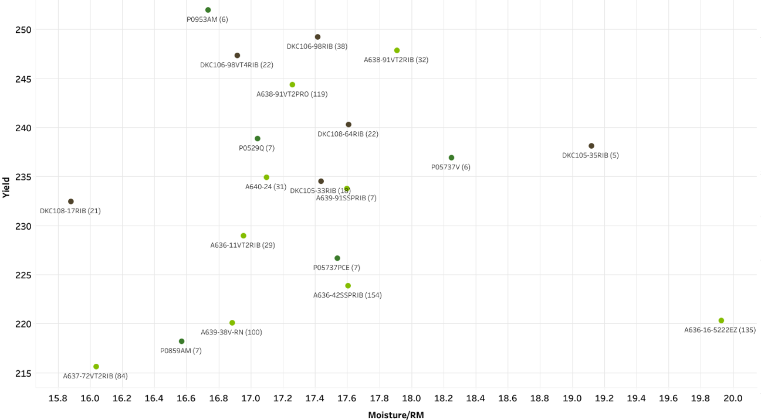
105-109 RM Scattergraph
2025 Central & West

Slide 18


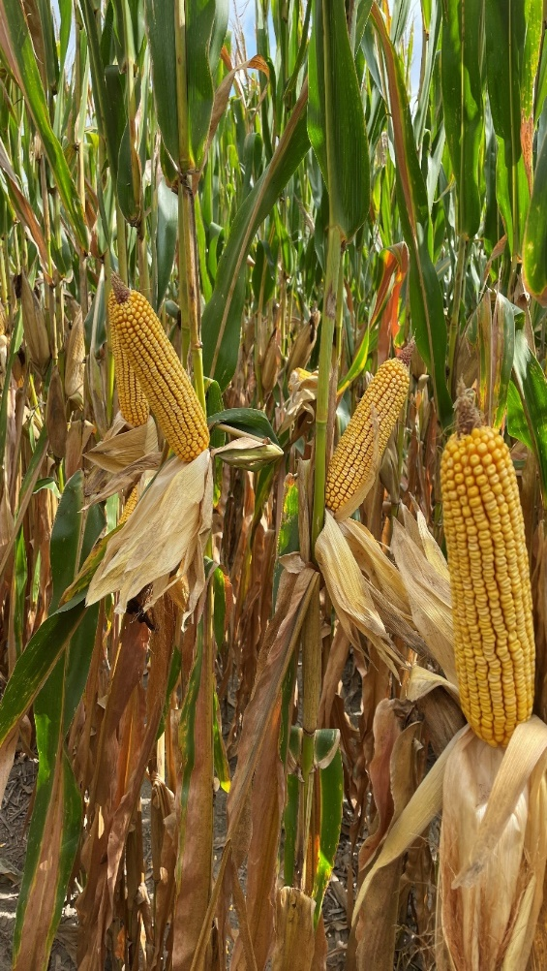
A640-16
BRAND RM 110
TRAITS
PLANT HEIGHT
Medium tall
Excels in high-yield environments and provides robust disease protection
Provides excellent tolerance to multiple foliar diseases, including tar spot
Thrives under high-management practices and strong soil fertility levels
STALK STRENGTH
Good
GREENSNAP VULNERABILITY
Low
EAR CHARACTERISTICS
Semi-flex
Red coloring
Very good test weight
DISEASE YIELD CROP
SOIL
TOLERANCE ENVIRONMENT ROTATION
DRAINAGE
EMERGENCE
Excellent
Gray leaf spot NCLB
Tar spot
High Average Low
Following soy Following corn
Well-drained Poorly-drained
ROOT STRENGTH
Excellent
KEY
Place
Place
Place with appropriate
confidently
reliably
management

Slide 19


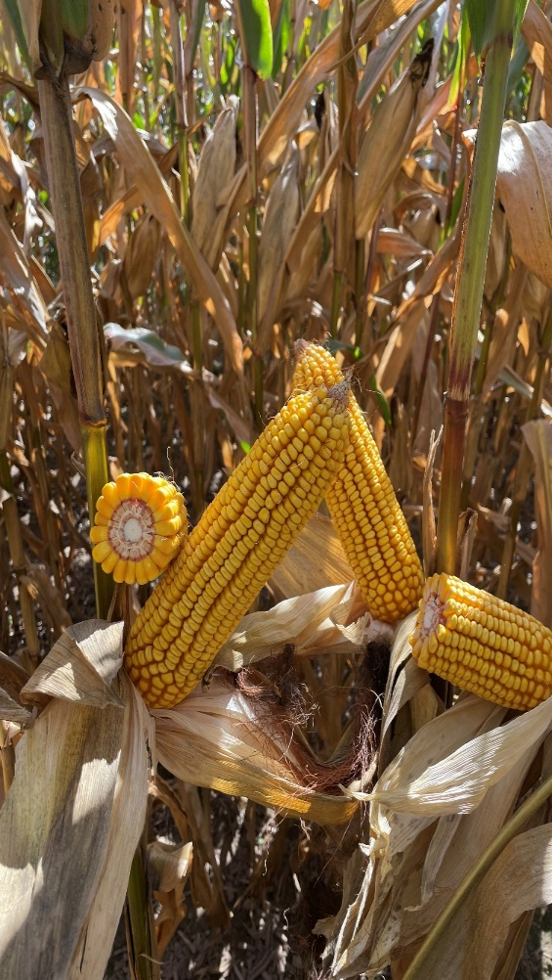
A642-18
BRAND RM 112
TRAITS
PLANT HEIGHT
Medium tall
Shows broad adaptability with excellent movement south of the normal maturity zone
Responds favorably to early-season starter or sidedressed nutrients
Thrives under an aggressive, highly- managed environment
STALK STRENGTH
Excellent
GREENSNAP VULNERABILITY
Moderate
EAR CHARACTERISTICS
Flex
Red coloring
Good test weight
DISEASE YIELD CROP
SOIL
TOLERANCE ENVIRONMENT ROTATION
DRAINAGE
EMERGENCE
Good
Gray leaf spot NCLB
Tar spot
High Average Low
Following soy Following corn
Well-drained Poorly-drained
ROOT STRENGTH
Very good
KEY
Place
Place
Place with appropriate
confidently
reliably
management

Slide 20
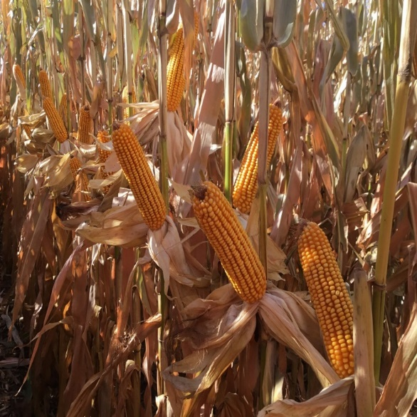
A642-32
BRAND RM 112
TRAITS
PLANT HEIGHT
Medium tall
Features a semi-flex ear that can adapt to multiple population zones and yield levels
Delivers consistent results in high-yield environments
Apply late-season nitrogen and fungicide to maximize yield
STALK STRENGTH
Very good
GREENSNAP VULNERABILITY
Low
EAR CHARACTERISTICS
Semi-flex
Crimson coloring Excellent test weight
DISEASE YIELD CROP
SOIL
TOLERANCE ENVIRONMENT ROTATION
DRAINAGE
EMERGENCE
Very good
Goss’s wilt NCLB
Tar spot
High Average Low
Following soy Following corn
Well-drained Poorly-drained
ROOT STRENGTH
Excellent
KEY
Place
Place
Place with appropriate
confidently
reliably
management

Slide 21
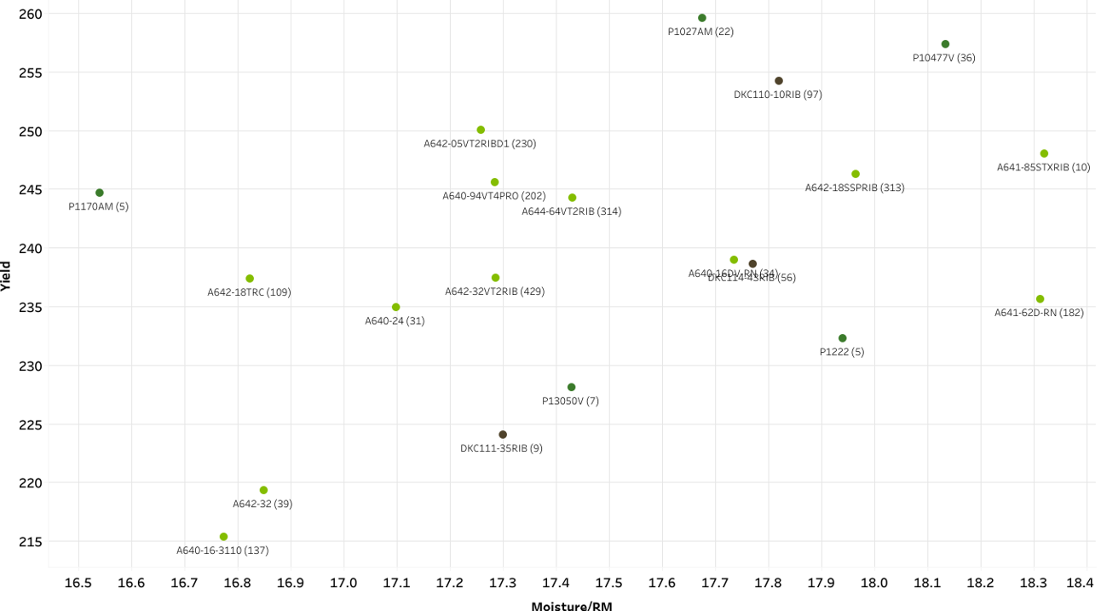
110-114RM Scattergraph
2025 Central & West

Slide 22
SOYBEANS

Slide 23



Conventional
7 Products – 2 NEW
24 Products – 5 NEW
23 Products – 6 NEW
Early | Mid | Full
G1755 | G2802 | G3702
G2025 | G3104 | -
G2304 | G3402 | -
Early | Mid | Full
G0500XF | G2450XF | G4184XF
G0854XF | G2755XF | G4430XF
G1394XF | G2950XF | G4615XF
G1515XF | G3114XF | G4650XF
G1704XF | G3334XF | G4755XF
G2000XF | G3552XF | G4910XF
G2306XF | G3725XF | G5104XF
G2573XF | G3955XF | G5364XF
- | - | -
Early | Mid | Full
G0431E3 | G2265E3 | G3635E3
G0894E3 | G2425E3 | G3854E3
G1055E3 | G2601E3 | G4051E3
G1244E3 | G2893E3 | G4204E3
G1493E3 | G3051E3 | G4459E3
G1645E3 | G3255E3 | G4695E3
G1823E3 | G3404E3 | G4884E3
G2003E3 | G3577E3 | -
COMPANY CONFIDENTIAL

Slide 24
THANK YOU FOR YOUR SUPPORT & BUSINESS!!

