Slide 1
Winter meeting Dec 3rd
Topics of discussion
-Yield data/placement, plots, University of Illinois data, AIP 3rd party trials
-What’s new in the pails?
-The System’s Approach-Take Cost Out
-Q&A

Slide 2
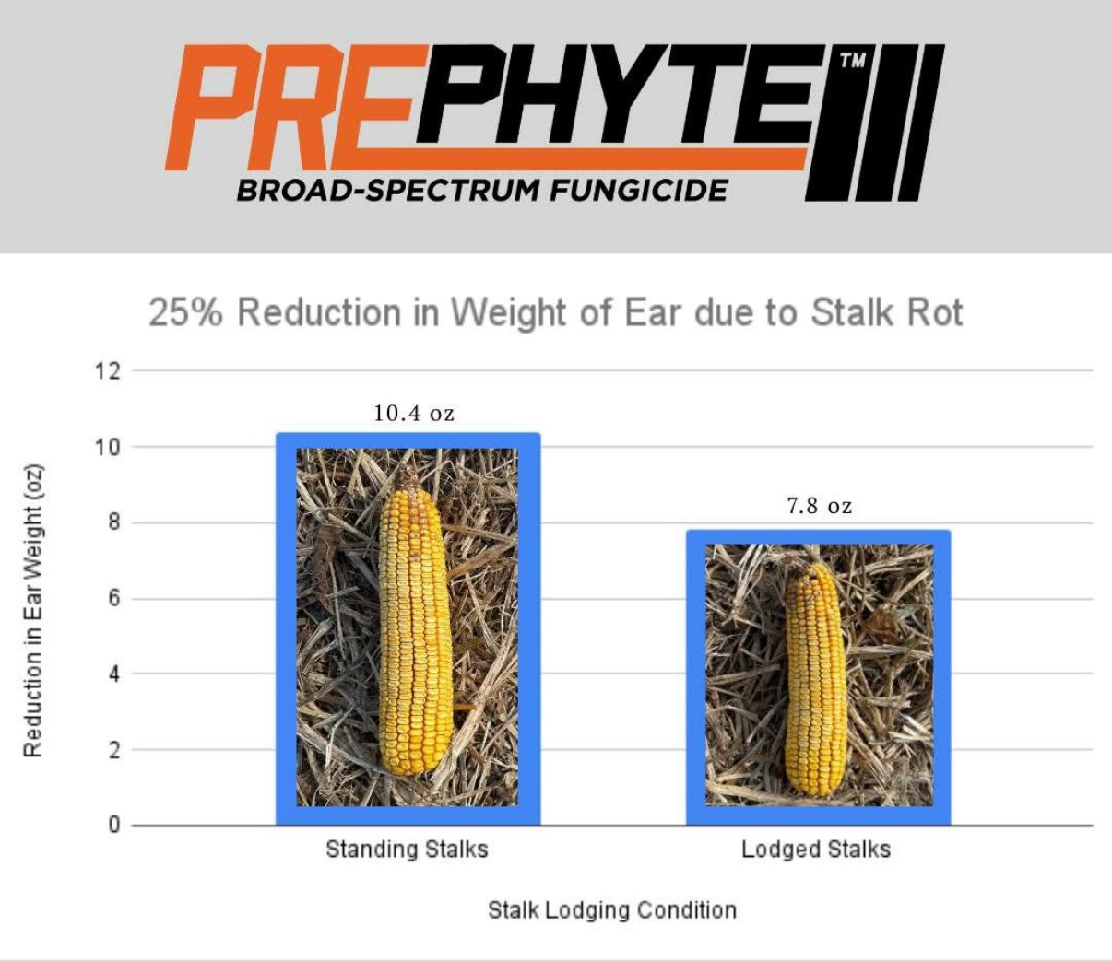
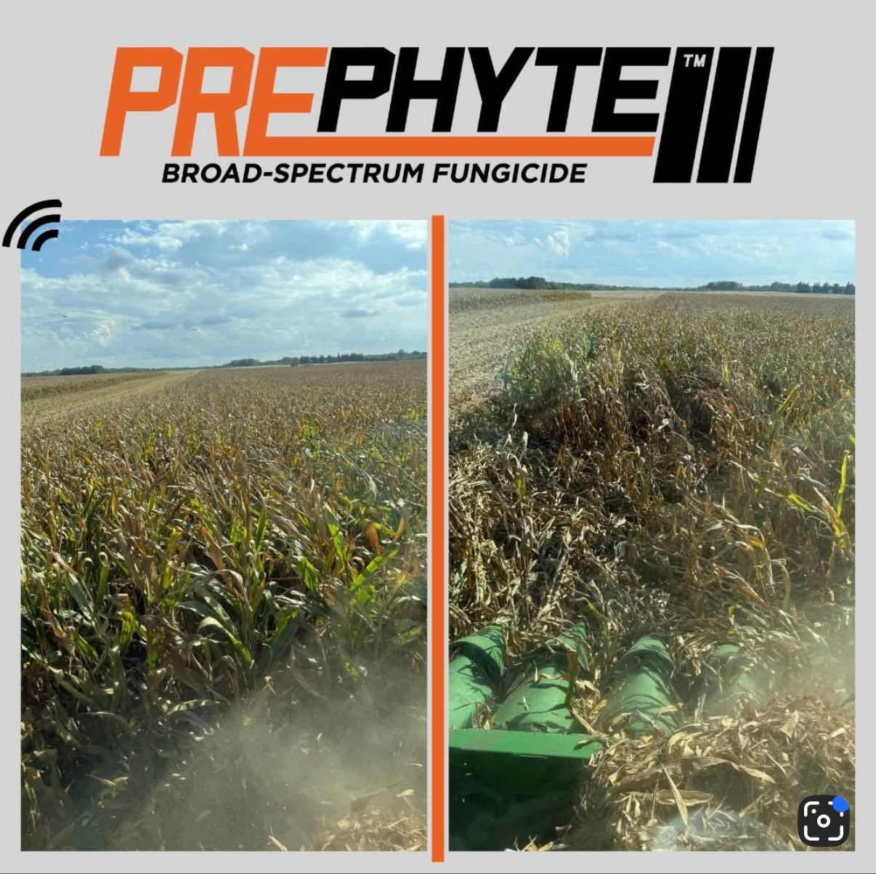
Hopper Throttle Ace Pail-Prephyte

Slide 3

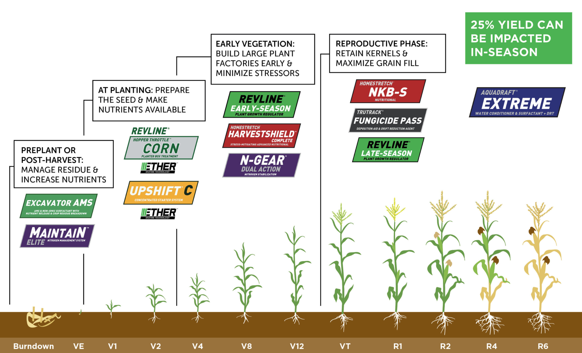
The System Approach – Take Costs Out
@ Planter Applications:
NONE
Standard Spend per Acre
(No Land/Equip/Insurance)
Seed $130
Dry Fert (80-80) $120
Nitrogen $115
Chemical /Adj $70
Fungicide $25
Total: $460
Meristem Spend per Acre
(No Land/Equip/Insurance)
Seed $130
Excavator AMS $15
Hopper Throttle $20
Nitrogen $100
N Stabilizer $10
Chemical /Adj $65
Fungicide $40
Foliar Protection $40
Total: $420
$40/ac Less
More Yield
Bray P1 > 20ppm K > 200ppm

