Slide 1


Xitavo Soybeans
2026 Key Varieties
Opheim Seed and Chemical | November 2025

Slide 2
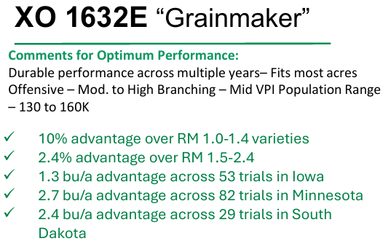
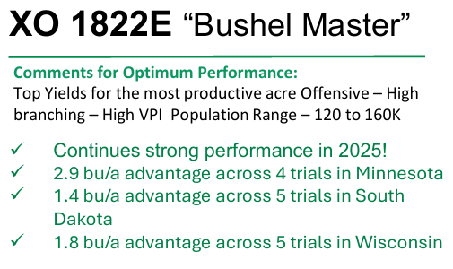
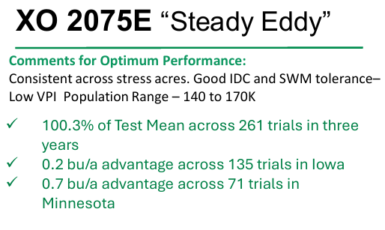
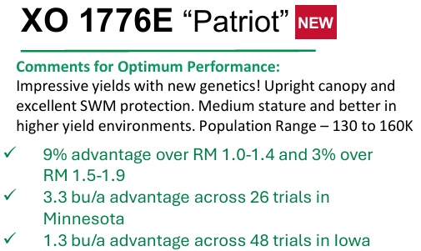
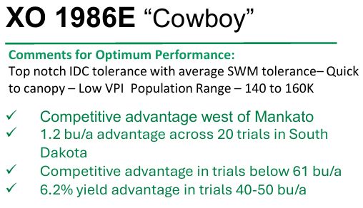
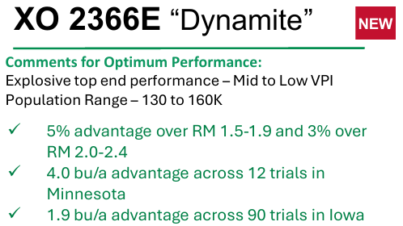
Key Varieties for 2026

Slide 3

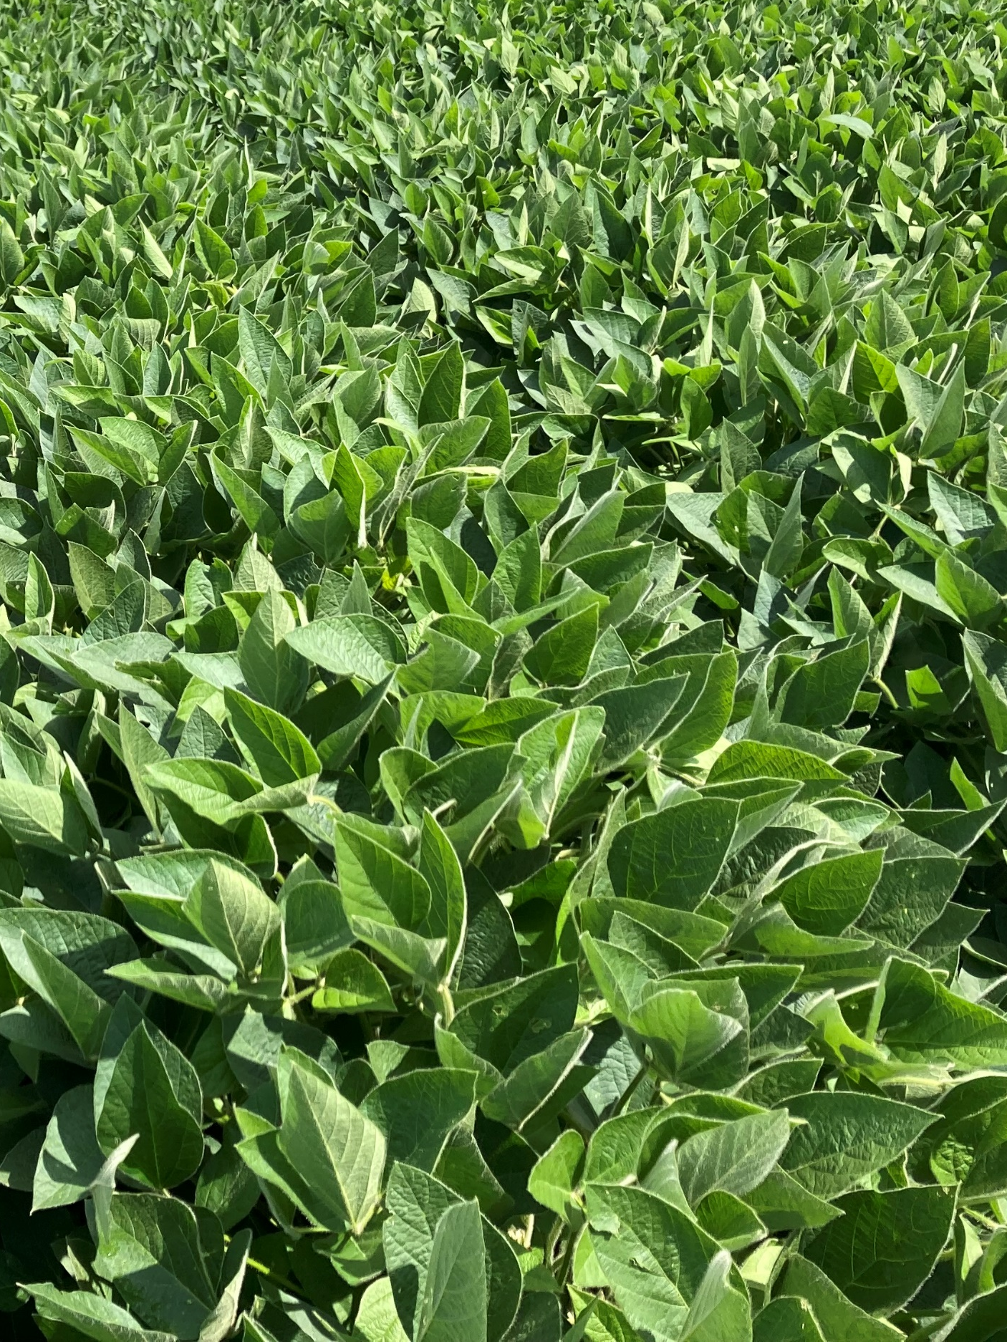
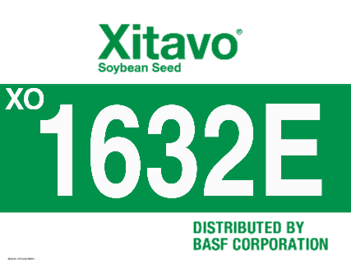

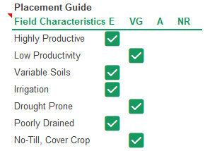
Xitavo® Soybean Seed Variety
XO 1632E
Local Agronomic Recommendations
Solid disease package including Rps3a gene. Good early season emergence and vigor. Solid agronomic package including IDC, SDS, BSR, and 3a PRR gene and tolerance. Mid VPI. Excellent top end yield potential for highly productive acre. Good standability with moderate height and bushiness. Excluder for Chloride.
Product Ratings | 1 = Excellent / 9 = Poor
Height/Canopy Type | Medium; Med-Bush
Standability | 3
Phytophthora | Rps3a; 2
White Mold | 5
Brown Stem Rot | 1
Soybean Cyst Nematode | PI88788
The transgenic soybean event in Enlist E3 soybeans is jointly developed and owned by Corteva Agriscience and M.S. Technologies, L.L.C.
Always read and follow label directions. XITAVO is a registered trademark of M.S. Technologies, L.L.C., West Point, IA, and is distributed exclusively by BASF. Enlist E3 is a registered trademark of Corteva Agriscience and its affiliated companies. ©2024 BASF Corporation. All Rights Reserved.

Slide 4

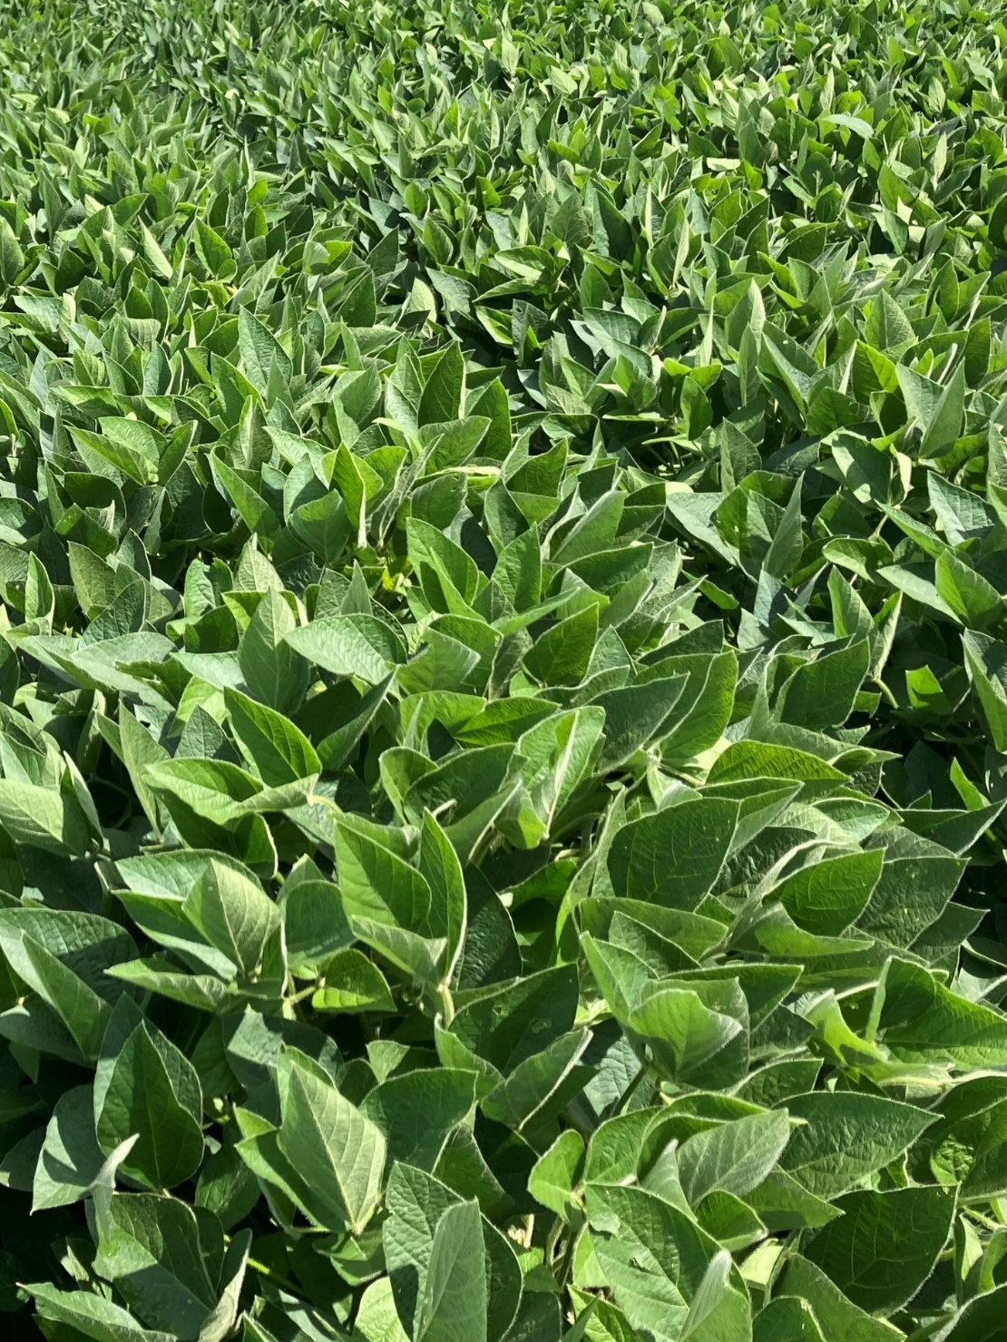

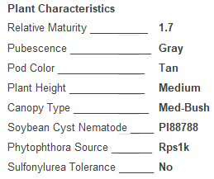
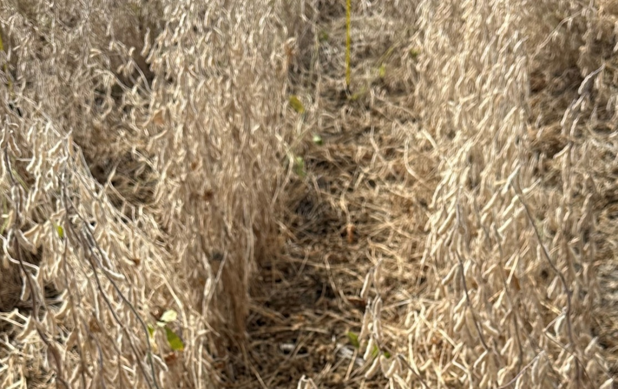
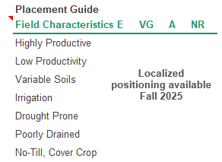
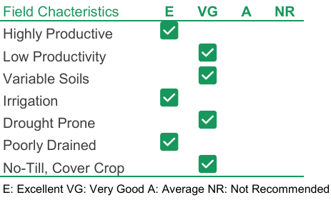
Xitavo® Soybean Seed Variety
XO 1776E
NEW!
Local Agronomic Recommendations
Disease package that moves East (Rps1k for PRR & BSR resistance), and with SWM protection. Medium stature and better in higher yielding environments. Updated version of XO 1761E.
1776E
XO
Product Ratings | 1 = Excellent / 9 = Poor
Height/Canopy Type | Medium; Med-Bush
Standability | 3
Phytophthora | Rps1k; 3
White Mold | 3
Iron Deficiency Chlorosis | 4
Soybean Cyst Nematode | PI88788
The transgenic soybean event in Enlist E3 soybeans is jointly developed and owned by Corteva Agriscience and M.S. Technologies, L.L.C.
Always read and follow label directions. XITAVO is a registered trademark of M.S. Technologies, L.L.C., West Point, IA, and is distributed exclusively by BASF. Enlist E3 is a registered trademark of Corteva Agriscience and its affiliated companies. ©2025 BASF Corporation. All Rights Reserved.

Slide 5


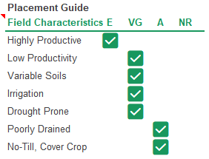
Xitavo® Soybean Seed Variety
XO 1822E
Local Agronomic Recommendations
Solid disease package including Rps3a gene. Good early season emergence and vigor. Solid agronomic package including IDC, SDS, BSR, and 3a PRR gene and tolerance. Mid VPI. Excellent top end yield potential for highly productive acre. Good standability with moderate height and bushiness. Excluder for Chloride.
Product Ratings | 1 = Excellent / 9 = Poor
Height/Canopy Type | Med/Avg; Bushy
Standability | 4
Phytophthora | Rps3a; 2
White Mold | 6
Iron Deficiency Chlorosis | 5
Soybean Cyst Nematode | PI88788
The transgenic soybean event in Enlist E3 soybeans is jointly developed and owned by Corteva Agriscience and M.S. Technologies, L.L.C.
Always read and follow label directions. XITAVO is a registered trademark of M.S. Technologies, L.L.C., West Point, IA, and is distributed exclusively by BASF. Enlist E3 is a registered trademark of Corteva Agriscience and its affiliated companies. ©2024 BASF Corporation. All Rights Reserved.

Slide 6
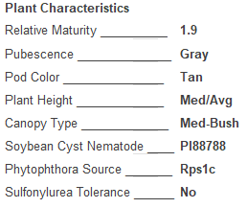
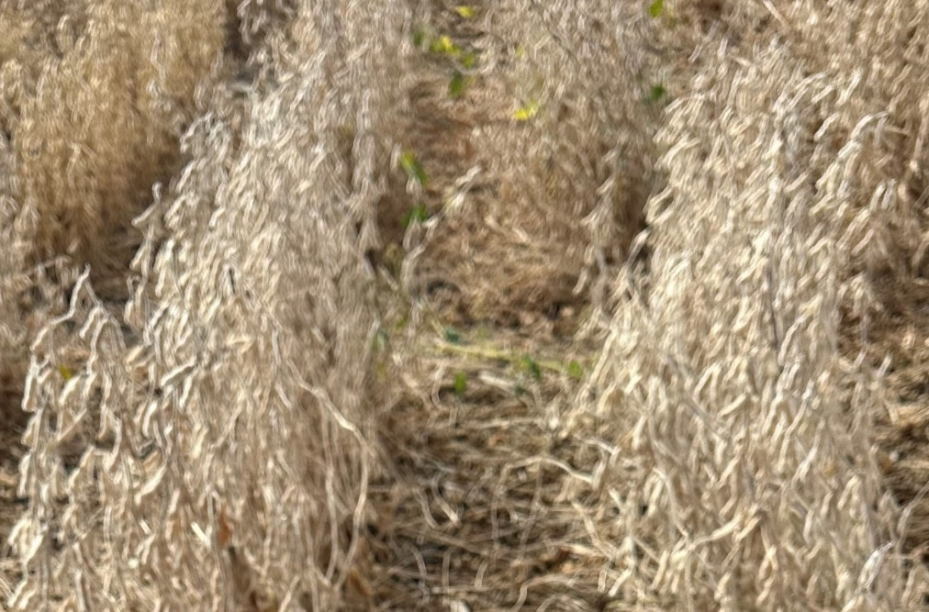
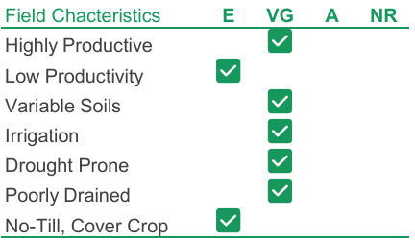
Xitavo® Soybean Seed Variety
XO 1986E
NEW!
Local Agronomic Recommendations
Strong performer on IDC acres with very good SWM tolerance. Medium plant type with a big-time yield punch over products like XO 1822E and XO 1971E. Consistent across all yield environments.
1986E
XO
Product Ratings | 1 = Excellent / 9 = Poor
Height/Canopy Type | Medium/Avg; Med-Bush
Standability | 3
Phytophthora | Rps1c; 3
White Mold | 4
Iron Deficiency Chlorosis | 3
Soybean Cyst Nematode | PI88788
The transgenic soybean event in Enlist E3 soybeans is jointly developed and owned by Corteva Agriscience and M.S. Technologies, L.L.C.
Always read and follow label directions. XITAVO is a registered trademark of M.S. Technologies, L.L.C., West Point, IA, and is distributed exclusively by BASF. Enlist E3 is a registered trademark of Corteva Agriscience and its affiliated companies. ©2025 BASF Corporation. All Rights Reserved.

Slide 7



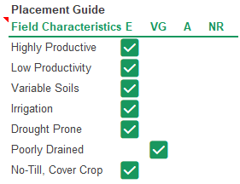
Xitavo® Soybean Seed Variety
XO 2075E
Local Agronomic Recommendations
Good IDC and SWM tolerance with Peking SCN source. Good standability in a Med-Tall plant type. Low VPI rating. SEG for Chloride. Stable across yield environments. Excellent choice for placement on any acre.
Product Ratings | 1 = Excellent / 9 = Poor
Height/Canopy Type | Med/Tall; Med-Bush
Standability | 3
Phytophthora | Rps3a; 2
White Mold | 3
Iron Deficiency Chlorosis | 3
Sudden Death Syndrome | 4
Soybean Cyst Nematode | Peking
The transgenic soybean event in Enlist E3 soybeans is jointly developed and owned by Corteva Agriscience and M.S. Technologies, L.L.C.
Always read and follow label directions. XITAVO is a registered trademark of M.S. Technologies, L.L.C., West Point, IA, and is distributed exclusively by BASF. Enlist E3 is a registered trademark of Corteva Agriscience and its affiliated companies. ©2024 BASF Corporation. All Rights Reserved.

Slide 8

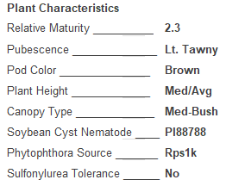
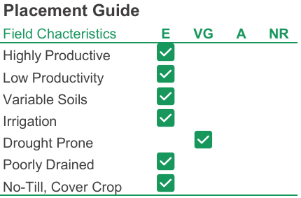
Xitavo® Soybean Seed Variety
XO 2366E
NEW!
Local Agronomic Recommendations
Standout performer besting XO 2444E by 3.4 bushels in 2024 data. Attractive light tawny/brown appearance with solid SDS, IDC, PRR, SWM tolerance. Step change yield you’ve been waiting for in this RM across multiple yield environments! Includer for Chloride.
2366E
XO
Product Ratings | 1 = Excellent / 9 = Poor
Height/Canopy Type | Medium/Avg; Med-Bush
Standability | 3
Phytophthora | Rps1k; 3
White Mold | 4
Iron Deficiency Chlorosis | 5
Soybean Cyst Nematode | PI88788
The transgenic soybean event in Enlist E3 soybeans is jointly developed and owned by Corteva Agriscience and M.S. Technologies, L.L.C.
Always read and follow label directions. XITAVO is a registered trademark of M.S. Technologies, L.L.C., West Point, IA, and is distributed exclusively by BASF. Enlist E3 is a registered trademark of Corteva Agriscience and its affiliated companies. ©2025 BASF Corporation. All Rights Reserved.

Slide 9
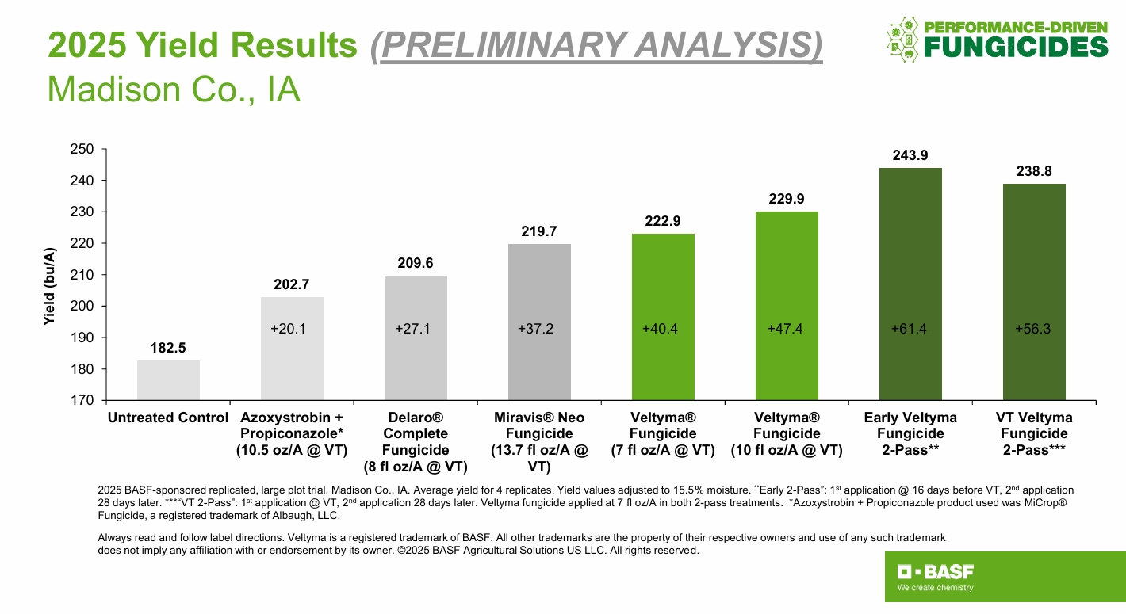

Slide 10
2025 Veltyma® Fungicide Performance
Story City, IA
2025 BASF internal, small-plot replicated trial. Story City, IA. Corn planted 4/19/2025. Veltyma Fungicide applied at 7.0 fl oz/A and 10 fl oz/A. All fungicides applied at labeled rates to VT/R1 corn on 7/9/2025. Always read and follow label directions. Veltyma is a registered trademark of BASF. All other trademarks are the property of their respective owners and use of any such trademark does not imply any affiliation with or endorsement by its owner. ©2025 BASF Corporation. All Rights Reserved.
Notes:
C41

Slide 11
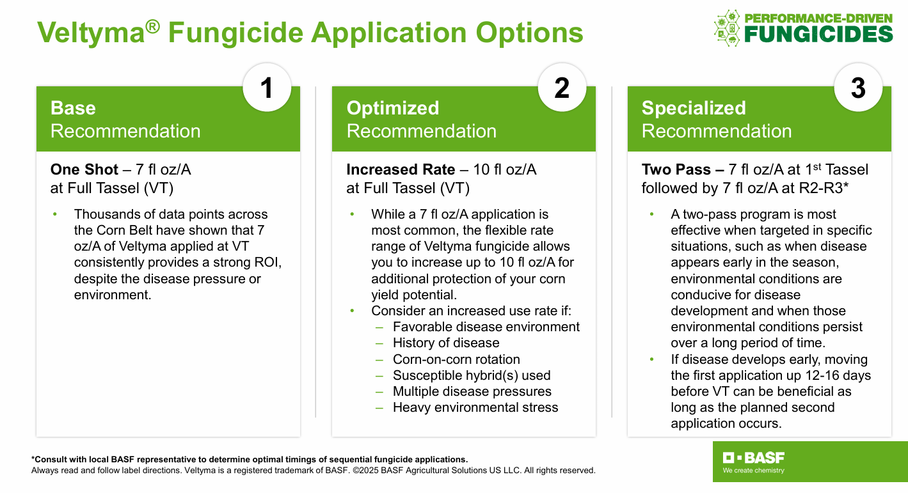

Slide 12
